Slide 1
CoNDERC
White paper & status
Dr.-Eng. Jean-Christophe Sublet
Nuclear Data Services Unit Head
Nuclear Data Section
NAPC, IAEA

Slide 2
The CoNDERC project 2018 - 2024
The purpose of the project entitled Compilation of Nuclear Data Experiments for Radiation Characterisation is to provide and transfer into technology the experimental integral radiation information that can be used as part of the Validation and Verification processes of nuclear model and code systems, and to provide various schema to perform the V&V processes
The aim is to provide all experimental methods, protocols, know how and calculational information in such computational ways that it can easily, seamlessly and rapidly be deployed in support of the many scientific systems that need them: model, inventory, transport, material sciences, Multiphysics code systems,…

Slide 3
Key elements
Identify and compile a set of radiation characterization benchmarks (both computational and experimental) that includes spectral indices, reaction rates, decay heat, resonance integral, particle emissions, radiations source terms
Assess and review the data, including quantification of uncertainties, then compile the data into computer format for dissemination
Perform simulations of each benchmark cases with a suitable code system and nuclear libraries and produce a database/repository of the necessary input files to repeat those simulations for other settings

Slide 4
Lexical semantics: R&V&V
Regression, Unit test: with save outputs and results files, the current execution is compared to the above templates
Verification: analytical and semi-analytical solutions to an equation (Boltzmann, Bateman, Schrödinger, Dirac, etc.) may exist, to ensure that the simulation tool is solving the correct equation
Validation: combination of code, schema and processed nuclear data to produce results comparable to observables

Slide 5
Lexical semantics: characterization metrics
Prompt, delayed, decay heat
Integral power, power density, power deposition,..
Reaction rates, emitted particles rates and spectra
Dose, particle fluence, dpa, activity, gas production, activation,
depletion, breeding, radiation,..
Fission yields: cumulative and spontaneous, radionuclides yields
Fission products, residual nuclei, transmutation,..

Slide 6
Benchmarks experiments
1. JAEA time dependent Fusion Neutron Source decay heat experiments (73 materials, 2/3 irradiation campaigns)
2. UCB DT-source NIF concrete (gamma dose rate)
3. Li(p,n) (up to 150 MeV) angular neutron yields
4. Fission pulse decay heat experiments ✯
5. Fission delayed neutron experiments
6. Selected criticality experiment with reaction rates from ICSBEP, IRPhEP, REAL-IAEA, … ✯
7. Experimental MACS from ASTRAL & KADoNiS ✯
black to be done
blue done, work in progress
✯ in this talk

Slide 7
Benchmarks experiments
8. Spectrum-averaged xs in reference spectra (e.g. Cf-252,ACCR,LR-0, etc.)
9. Resonance integrals (based on the Atlas, other experiments, compilation)
10. Resonance integrals and thermal xs based on kayzero database for NAA
11. Time dependent gamma measurements from PNNL (fission) and UK (fusion)
12. (γ,n) experimental data (Laser-Compton scattering from TUNL and New Subaru)
13. Integro-differential benchmark (from EXFOR or otherwise)
14. Shielding and leakage benchmarks from SINBAD (including models) ✯
15. Reference spectra for computational analysis: 122 ✯
black to be done
blue done, work in progress
✯ in this talk

Slide 8
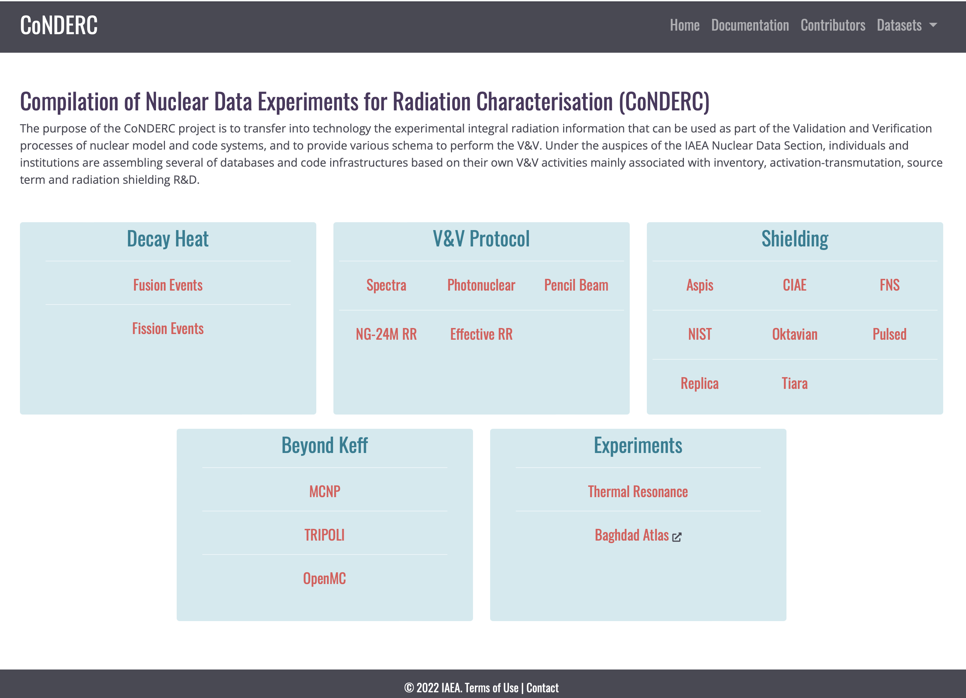
Portal https://www-nds.iaea.org/conderc/

Slide 9
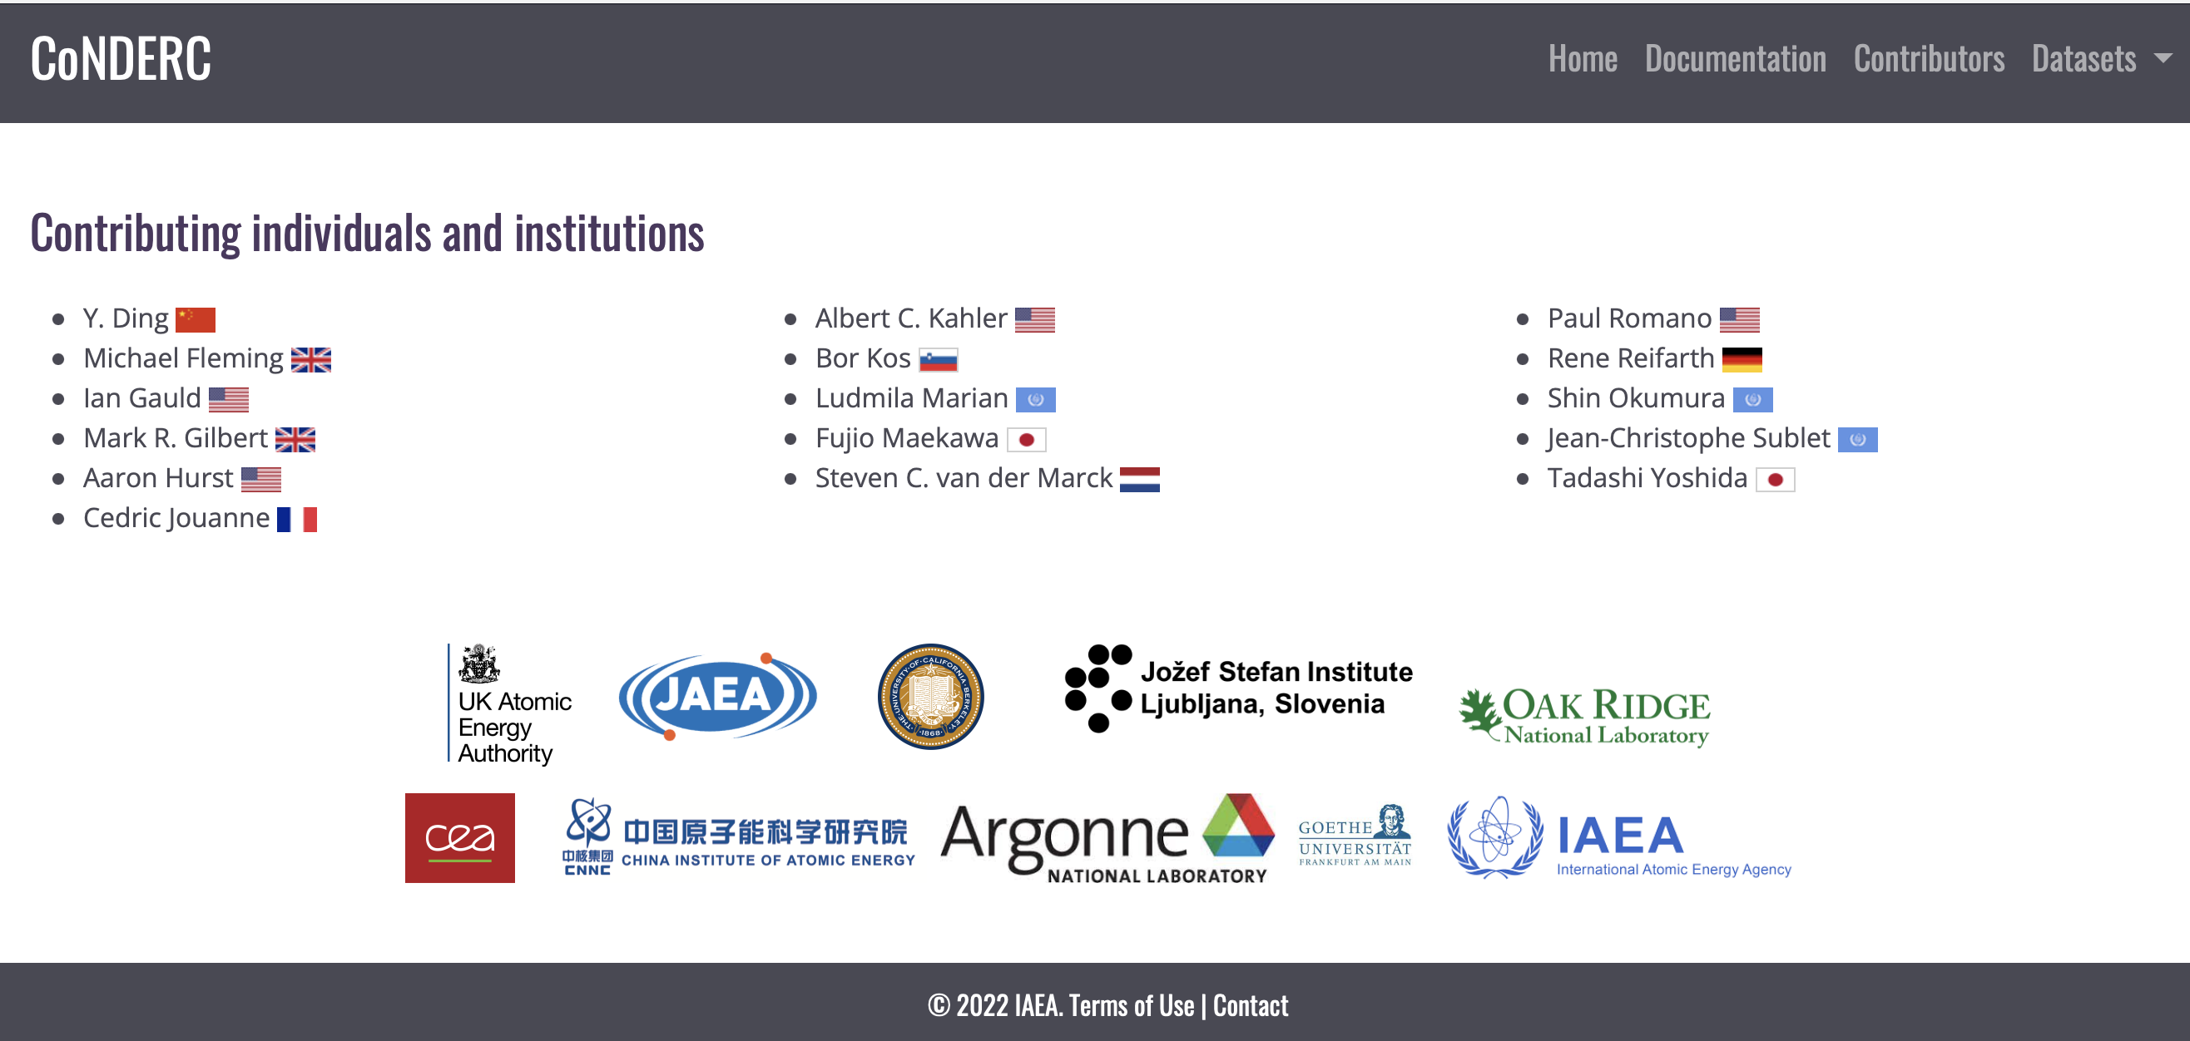
CoNDERC contributors
A handfull of experts and national laboratory generous contributions

Slide 10
Spectra
The majority of neutron-application spectra stem from light-water assemblies, mock-ups, piles or reactors where the integral responses are strongly, if not solely, influenced by the energy ranges of the fission spectra, resonance range and thermal Maxwellian
Fusion spectra that have been obtained from magnetic confinement (MCF) or inertial confinement fusion (ICF) simulation and present typical D-D 2.5 MeV, or D-T 14 MeV peaks sometimes accompanied by a higher-energy tail, but also showing rather different slowing-down profiles
Accelerator-driven beam secondary spectra are important in their role in nuclear sciences, nuclear observables, materials research and medical applications

Slide 11
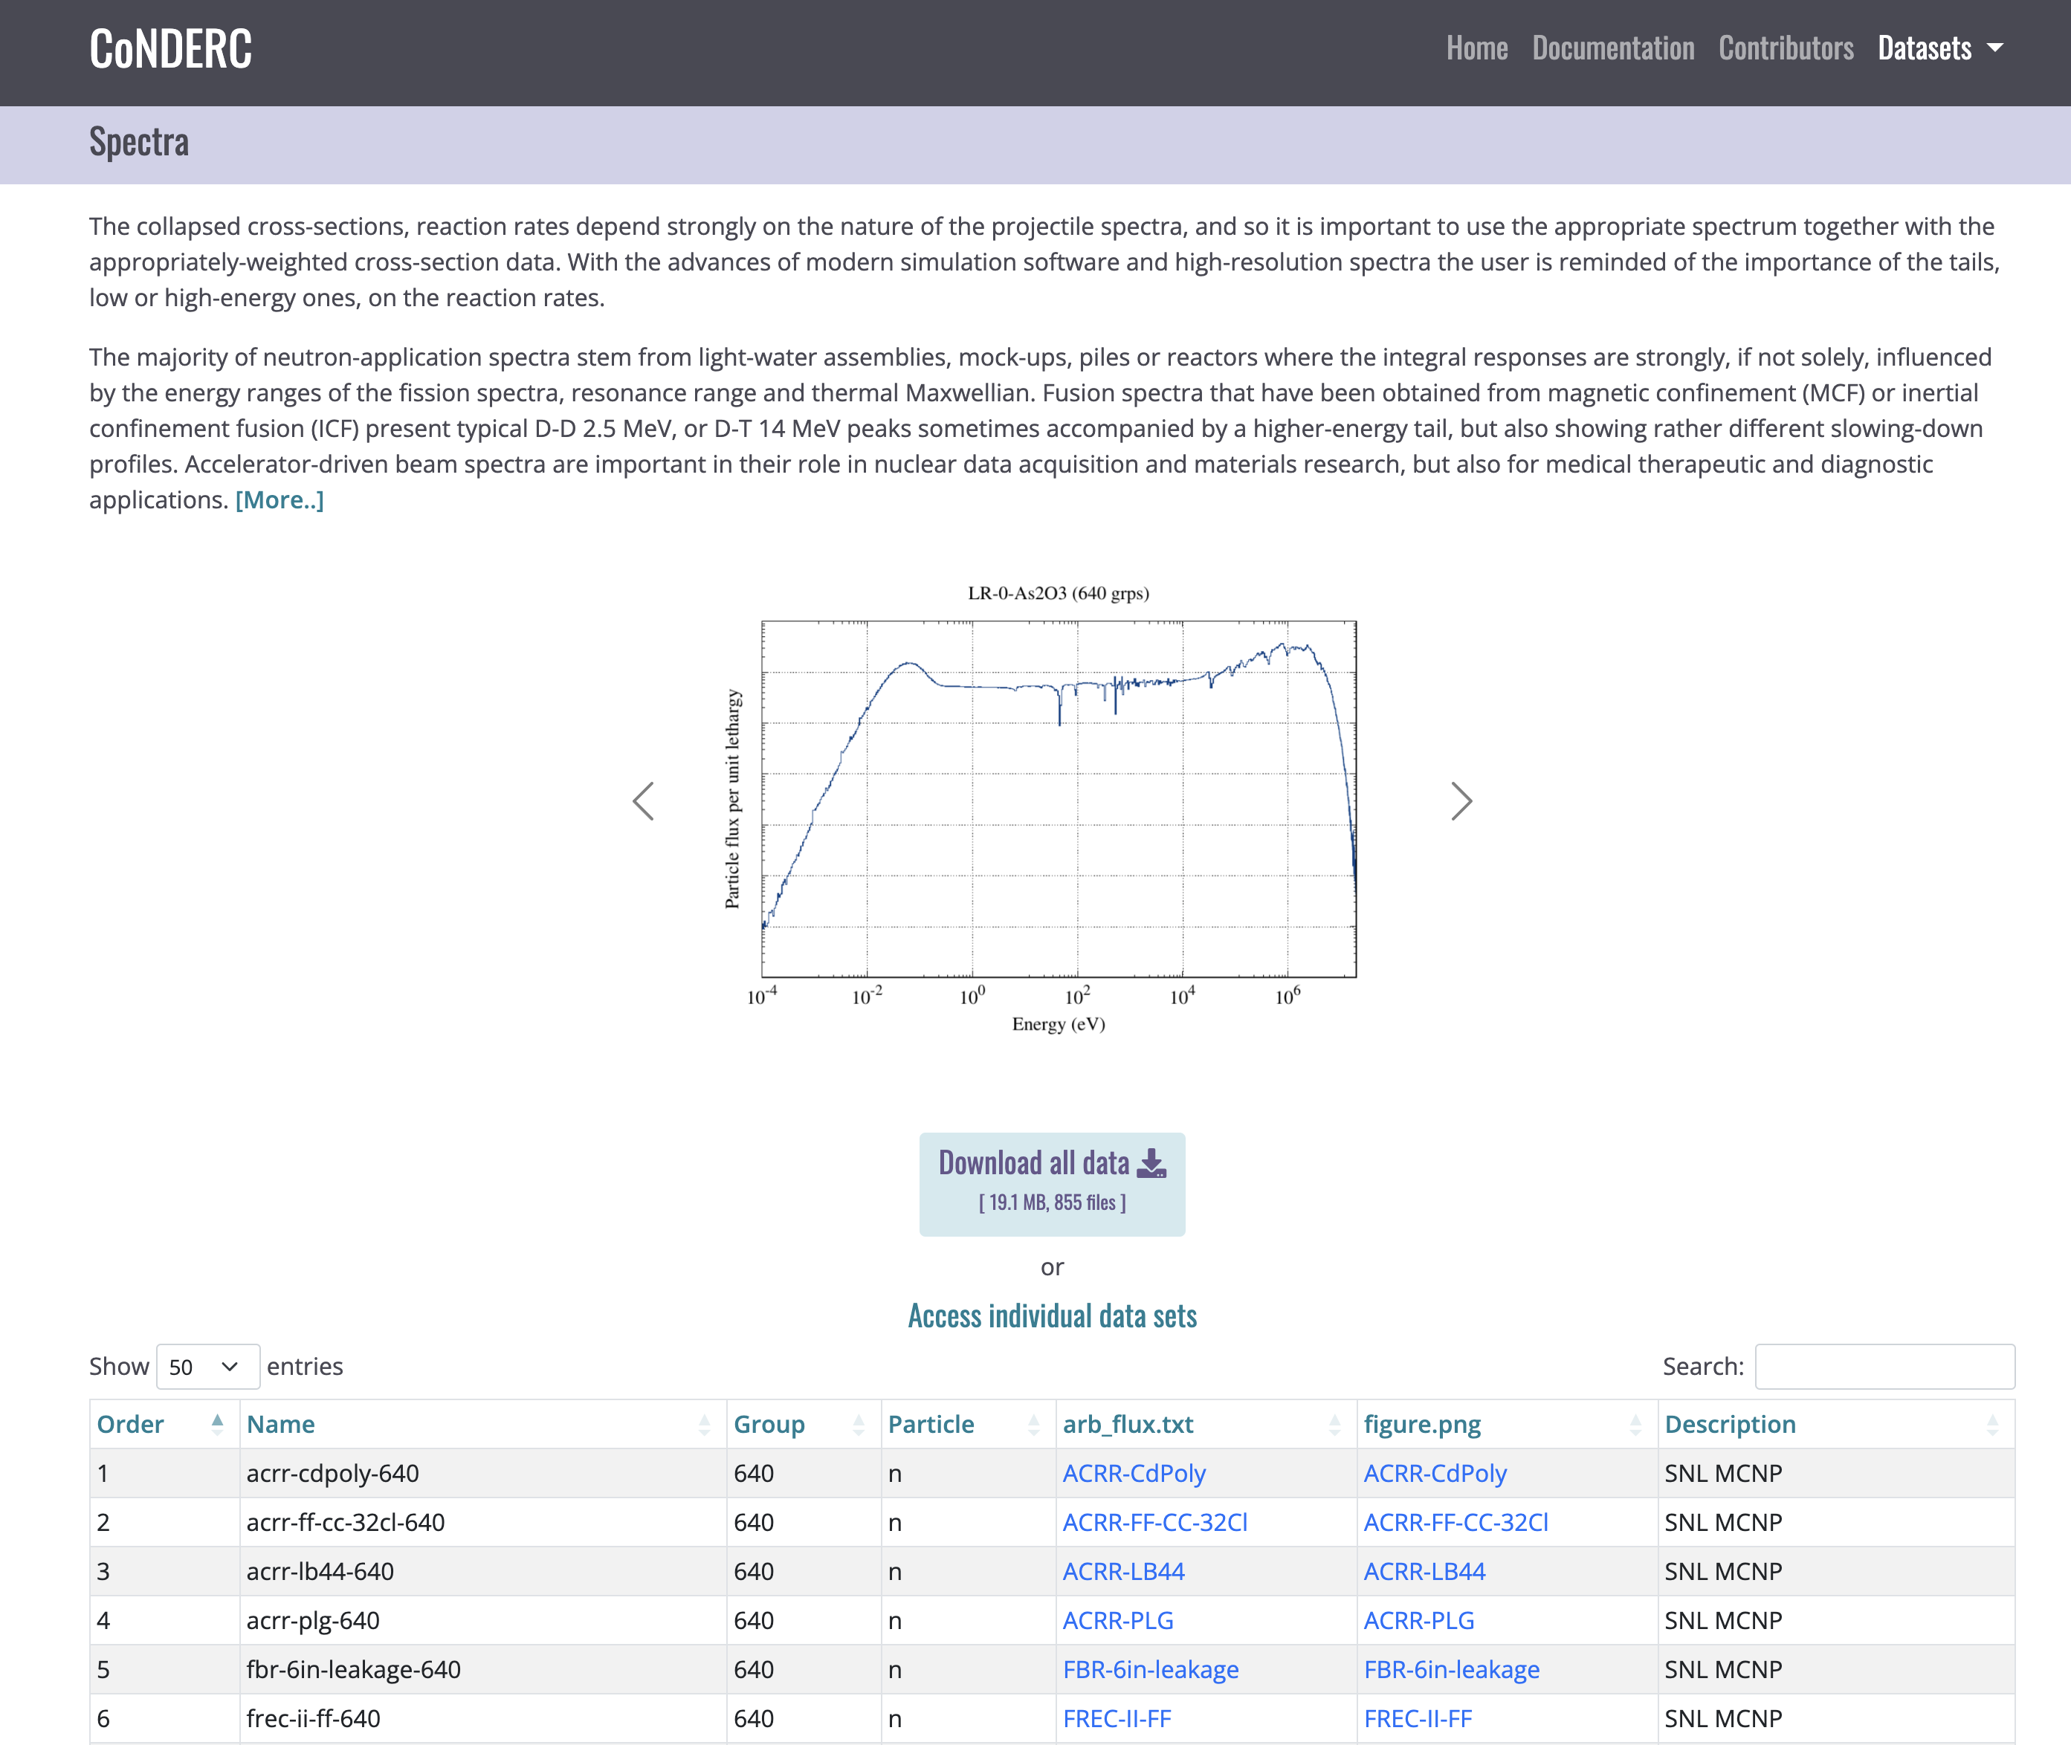
Spectra
122 spectra from all over the World, all types, piles,NPPs, research reactor, spallation, FBRs, Maxwellian, Am-Be, at temperatures,
one gamma from LMJ flash
plots and mumerical data

Slide 12
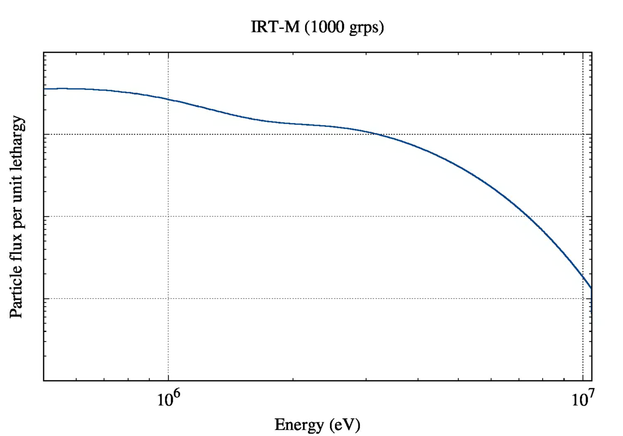
Spectra shape shifting

Slide 13
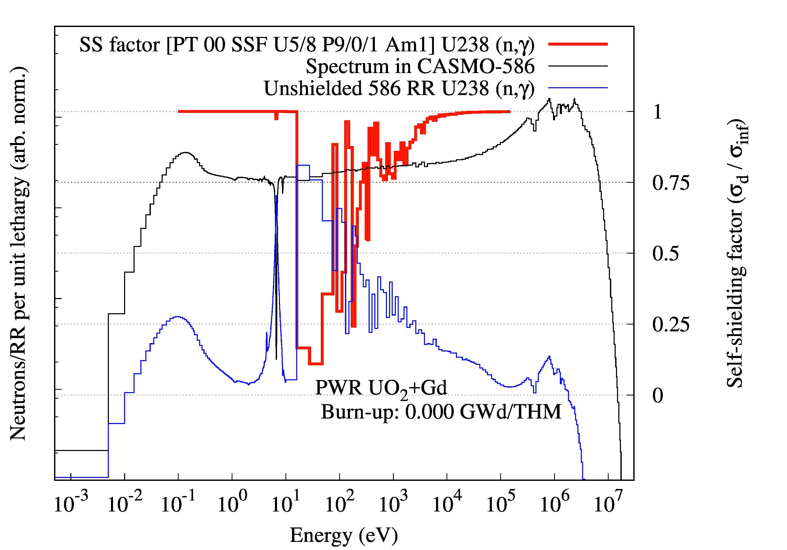
Spectra shape shifting
Reaction Rates
below the
Unresolved and Resolved Resonance Range
are strongly impacted !!

Slide 14
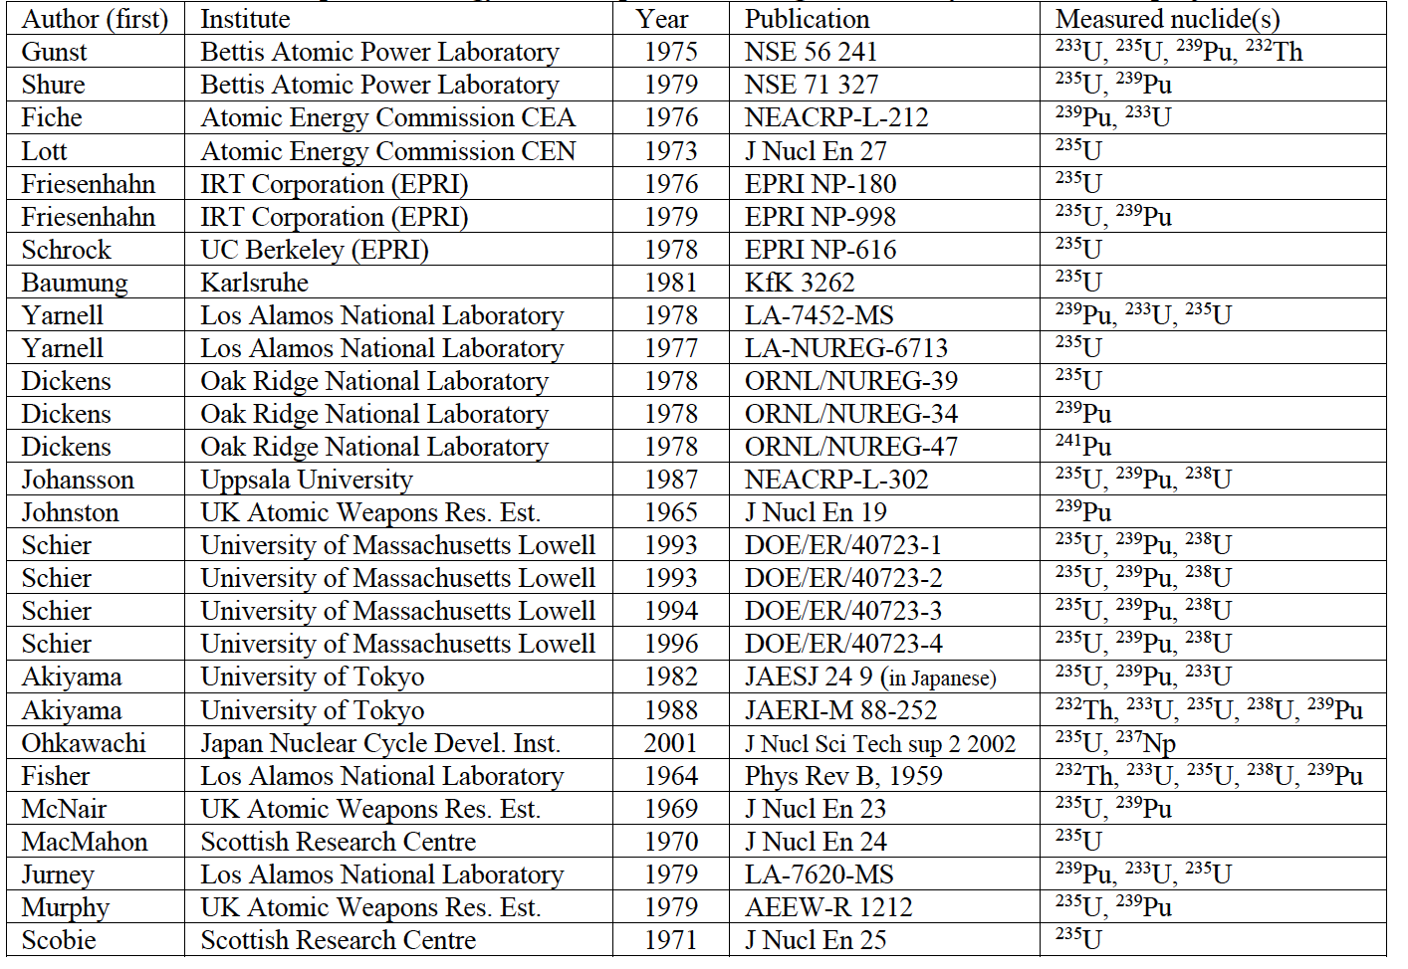
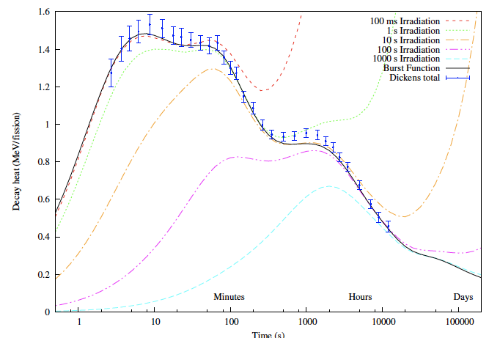
Fission pulsed events
29 complete experimental datasets from the World over in one place
Scobie 1971
…30 years
Ohkawashi 2001
29
1

Slide 15
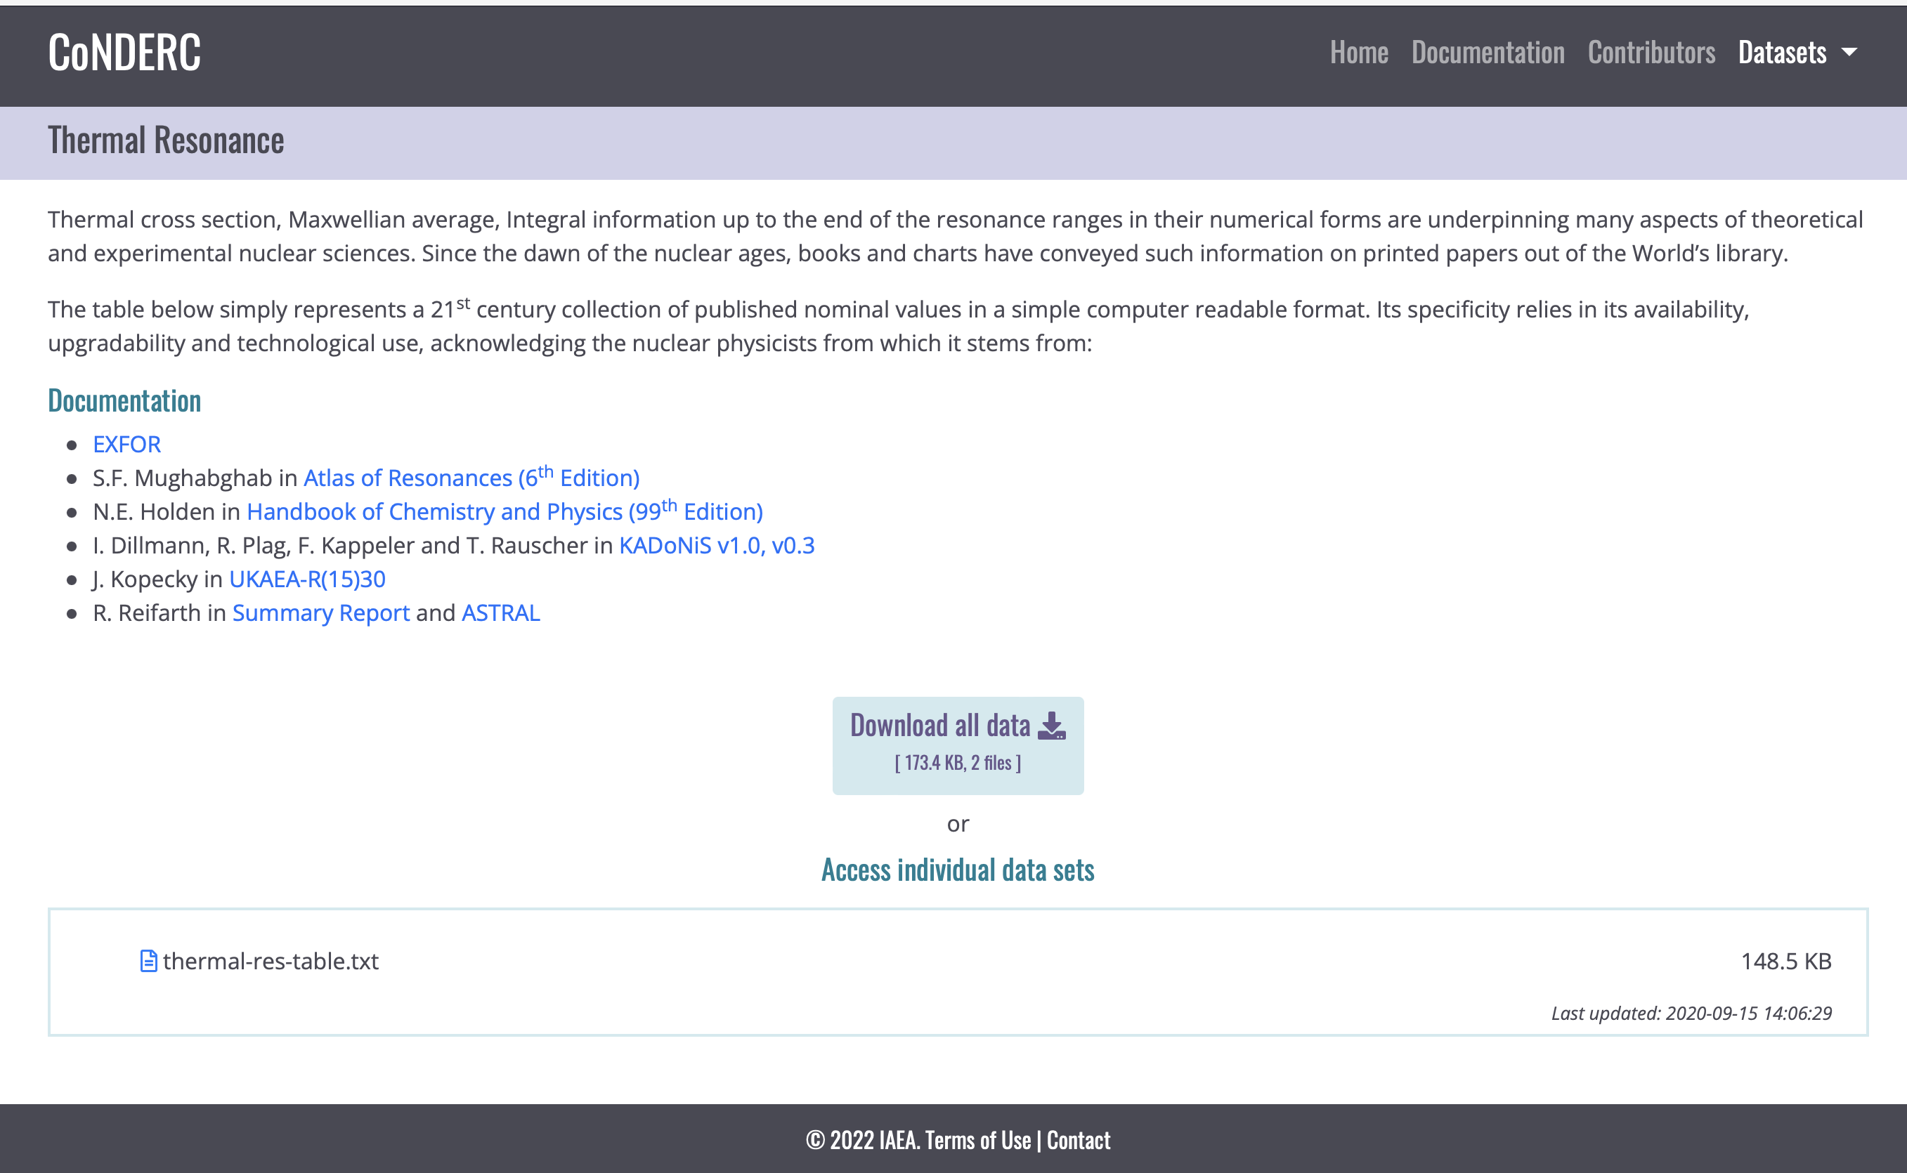
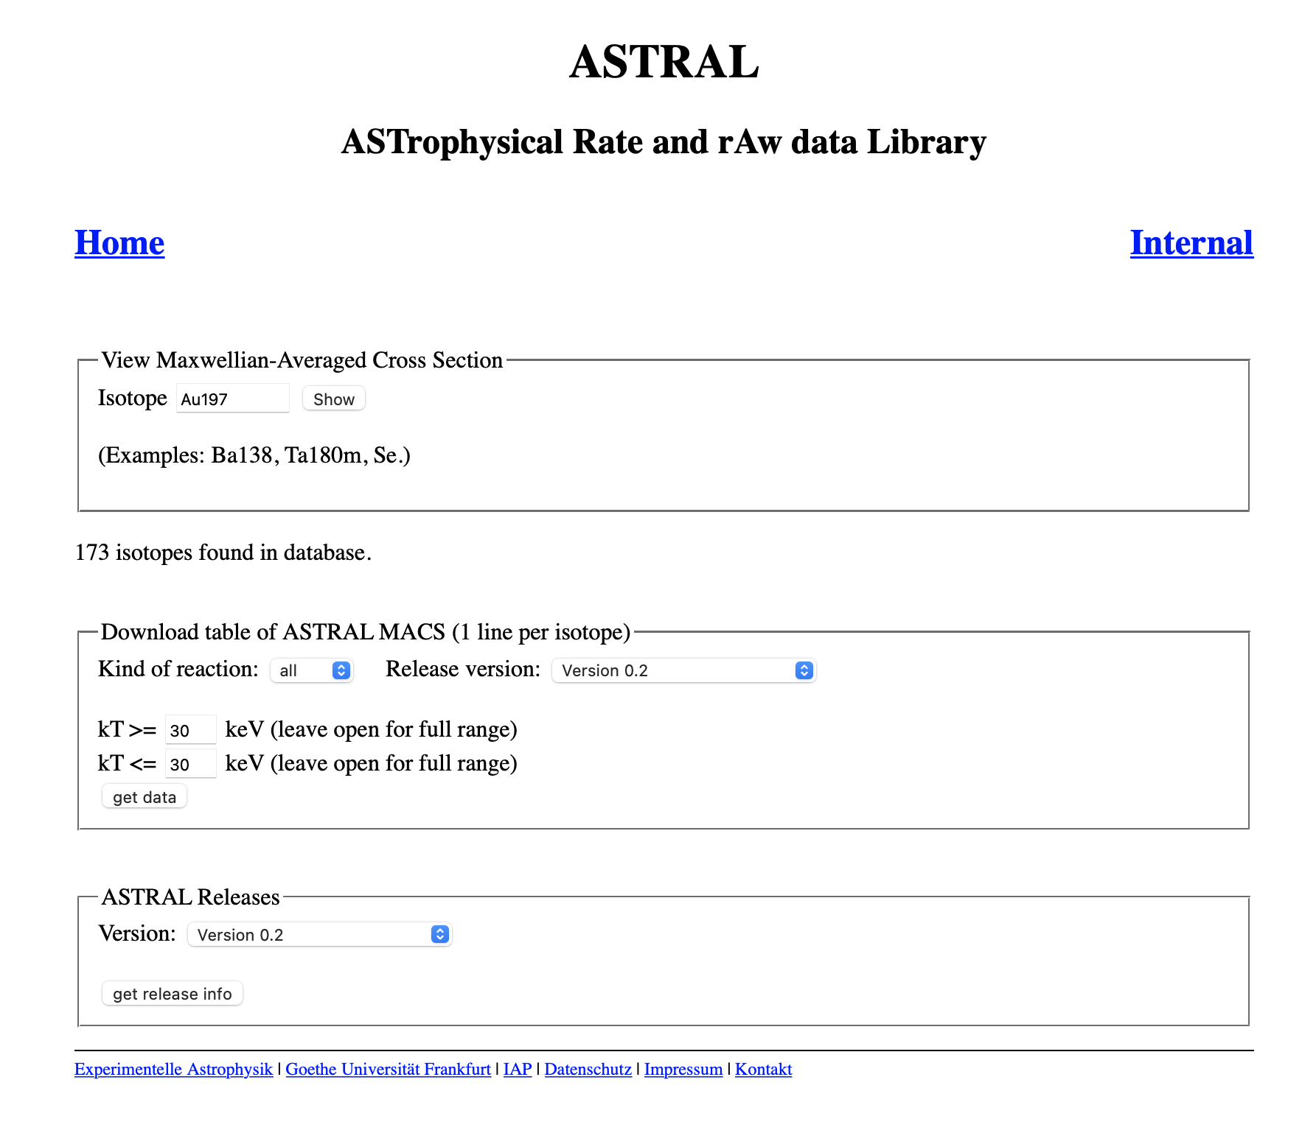
Experimental MACS from ASTRAL # KADONIS
Second stage of KADONIS upgrade, 78 traditional + 58 activations (136)
The ¹⁹⁷Au(n,γ) standard!! @kT=30 keV changed from 582±9 mb (Kadonis 0.3 and earlier) to 612±6 mb
https://exp-astro.de/astral/

Slide 16
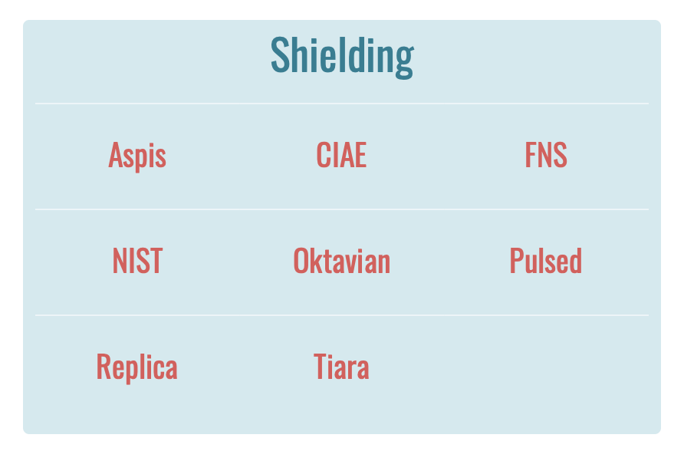
Shielding
Upon specific request of member states, beyond Keff and radiation shielding benchmark are now also considered in CoNDERC
Building from the existent: IAEA consultancy achievements, generous contributors and moving forward ensemble
MCNP6®, TRIPOLI-4® and OpenMC input decks have been developed for:

Slide 17
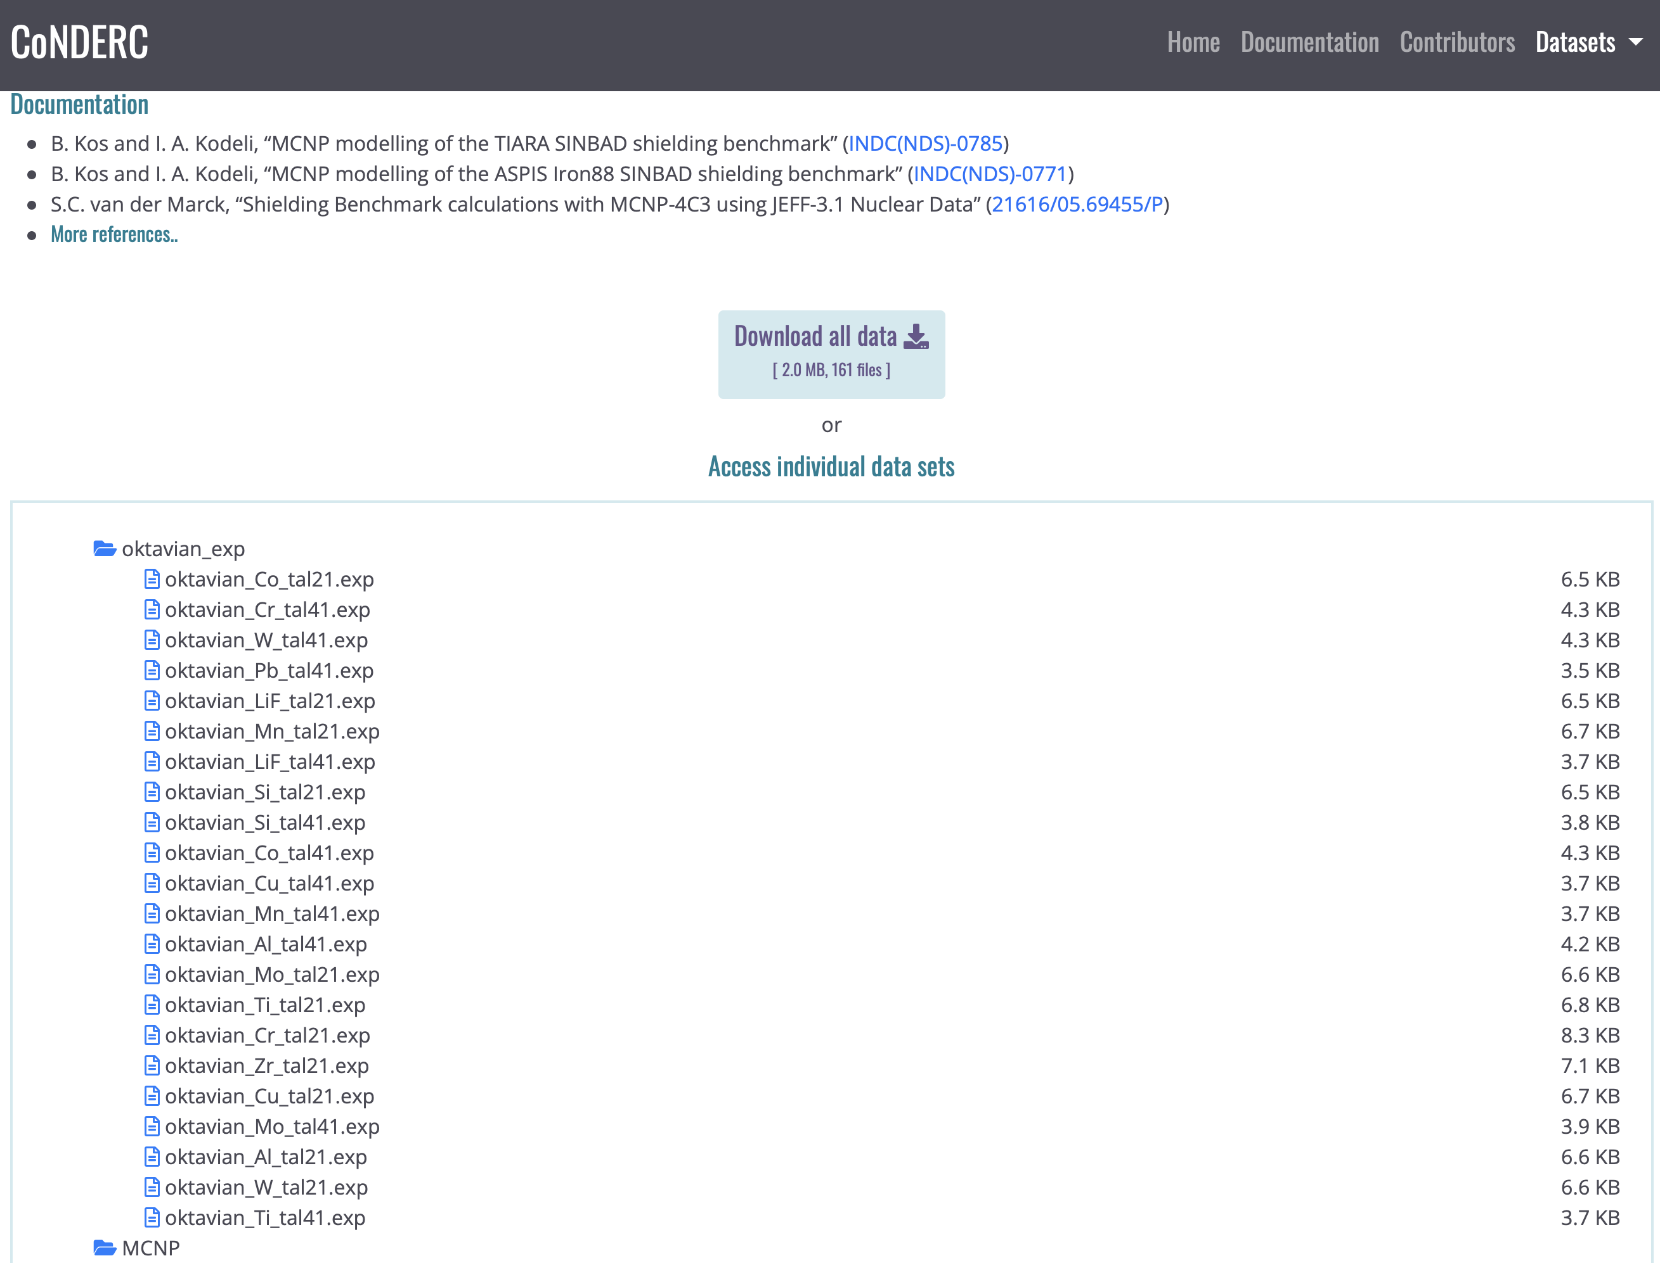
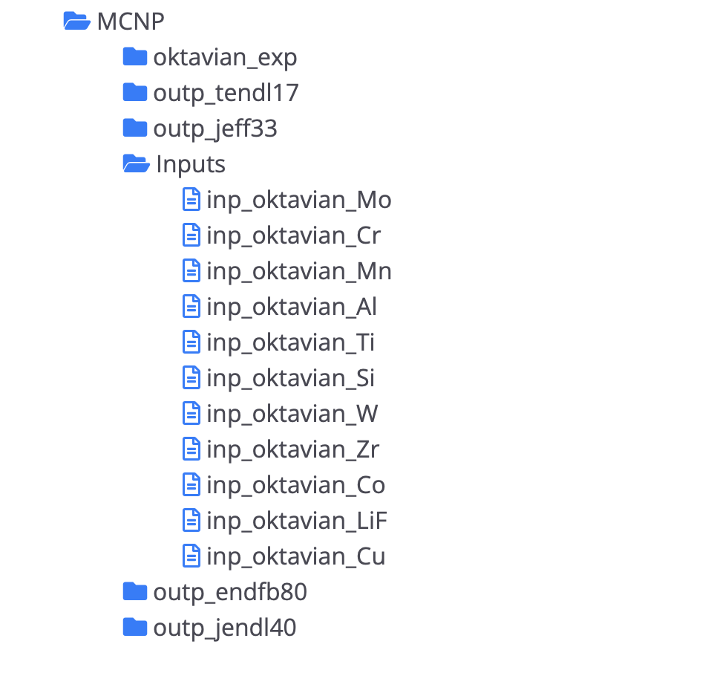
Shielding: e.g. Oktavian
Computational
  experimental data
  expert crafted Monte Carlo input decks
  validation Monte Carlo outputs
  for different libraries
Documentation
  open litterature
  open declassified report
  figures

Slide 18
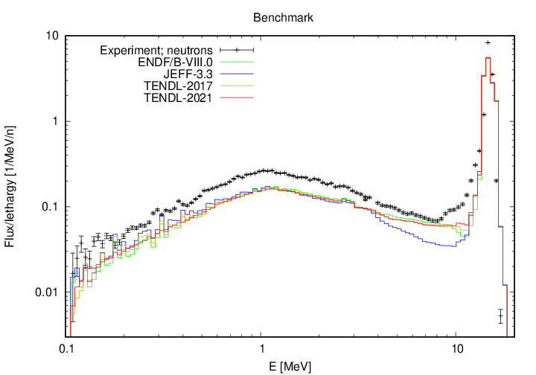
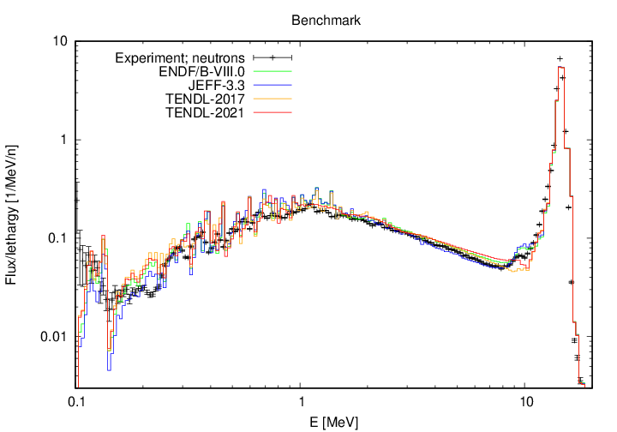
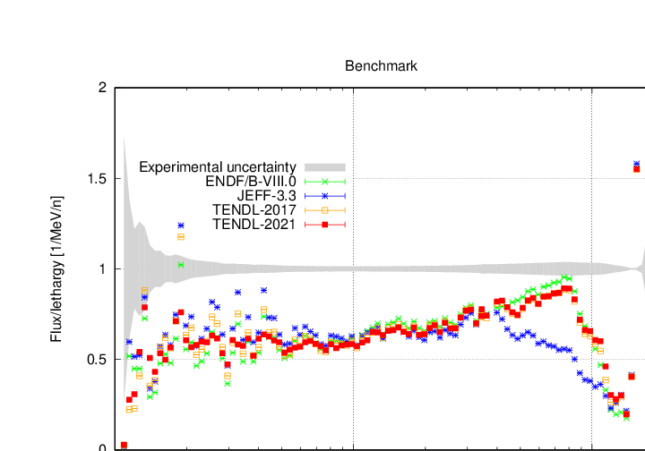
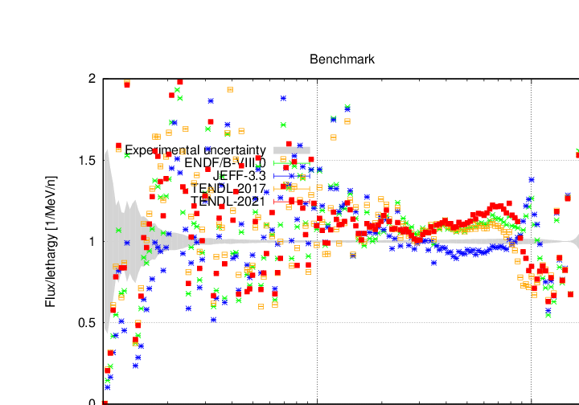
Shielding
Oktavian Co ✘ Zr ~
Log-Log could be deceptive
- 10 to 50% !!

Slide 19
ICSBEP & reaction rates: beyond K_{eff}
International Criticality Safety Benchmark Evaluation Project (ICSBEP)
International Reactor Physics Experiment Evaluation Project (IRPhEP)
Compile critical and subcritical benchmark experiment data into a standardized format to validate simulation tools and cross-section libraries
In addition to criticality some benchmark evaluations also contain spectral indices and measured reaction rate data
Another class of experimental data that can provide additional qualification of the underlying nuclear data and simulation tools

Slide 20
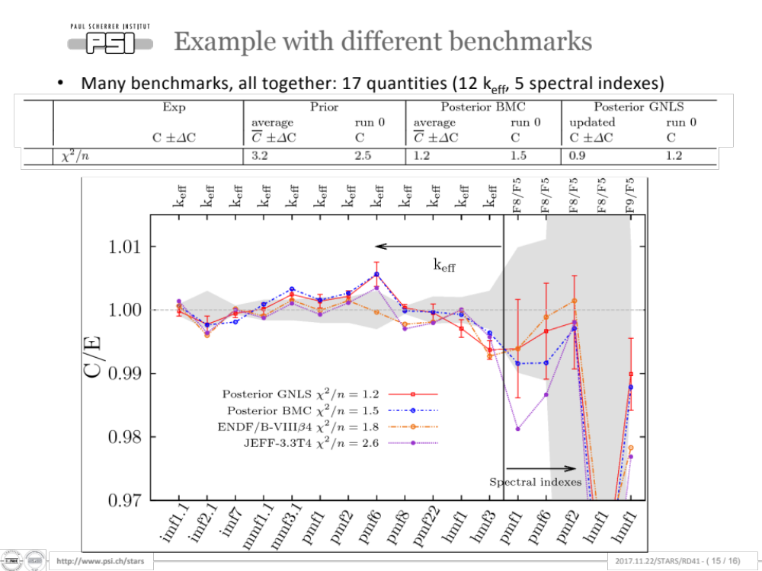
ICSBEP & reaction rates: beyond K_{eff}
Good Keff C/E with small uncertainty
More troubled spectral indices C/E
Right for the wrong reasons?
Courtesy D. Rochman (PSI)

Slide 21
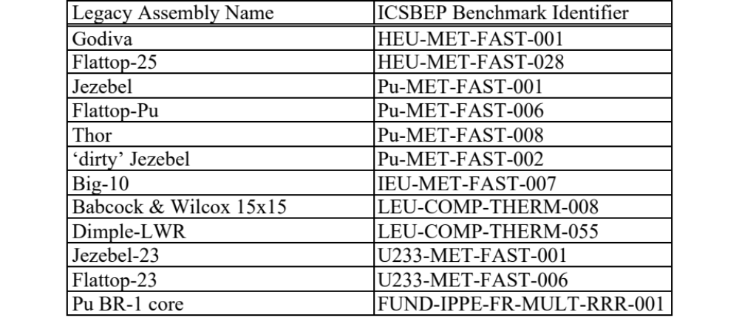
ICSBEP and IRPhEP Handbooks
MCNP6® , TRIPOLI-4® and OpenMC input decks with reaction rate (spectral index) or pin power data

Slide 22
Running strategy
up to six MCNP6® “kcode”
50 million (50M) and 250 million (250M) active neutron histories
  5100 cycles (100 warmup cycles and 5000 active cycles) with either 10,000 or 50,000 neutrons per cycle
  remaining jobs were run with 50 warmup cycles and 2,500,000 neutrons per cycle
These jobs were stopped/continued after 450, 2050, 4050 and 10050 cycles, for a total of 1 billion (1B), 5 billion (5B), 10 billion (10B) and 25 billion (25B) active histories, respectively
For a given f4 tally we also specify an identical *f4 tally. Division of the *f4 tally result by the f4 tally result yields the average energy for that reaction <E>

Slide 23
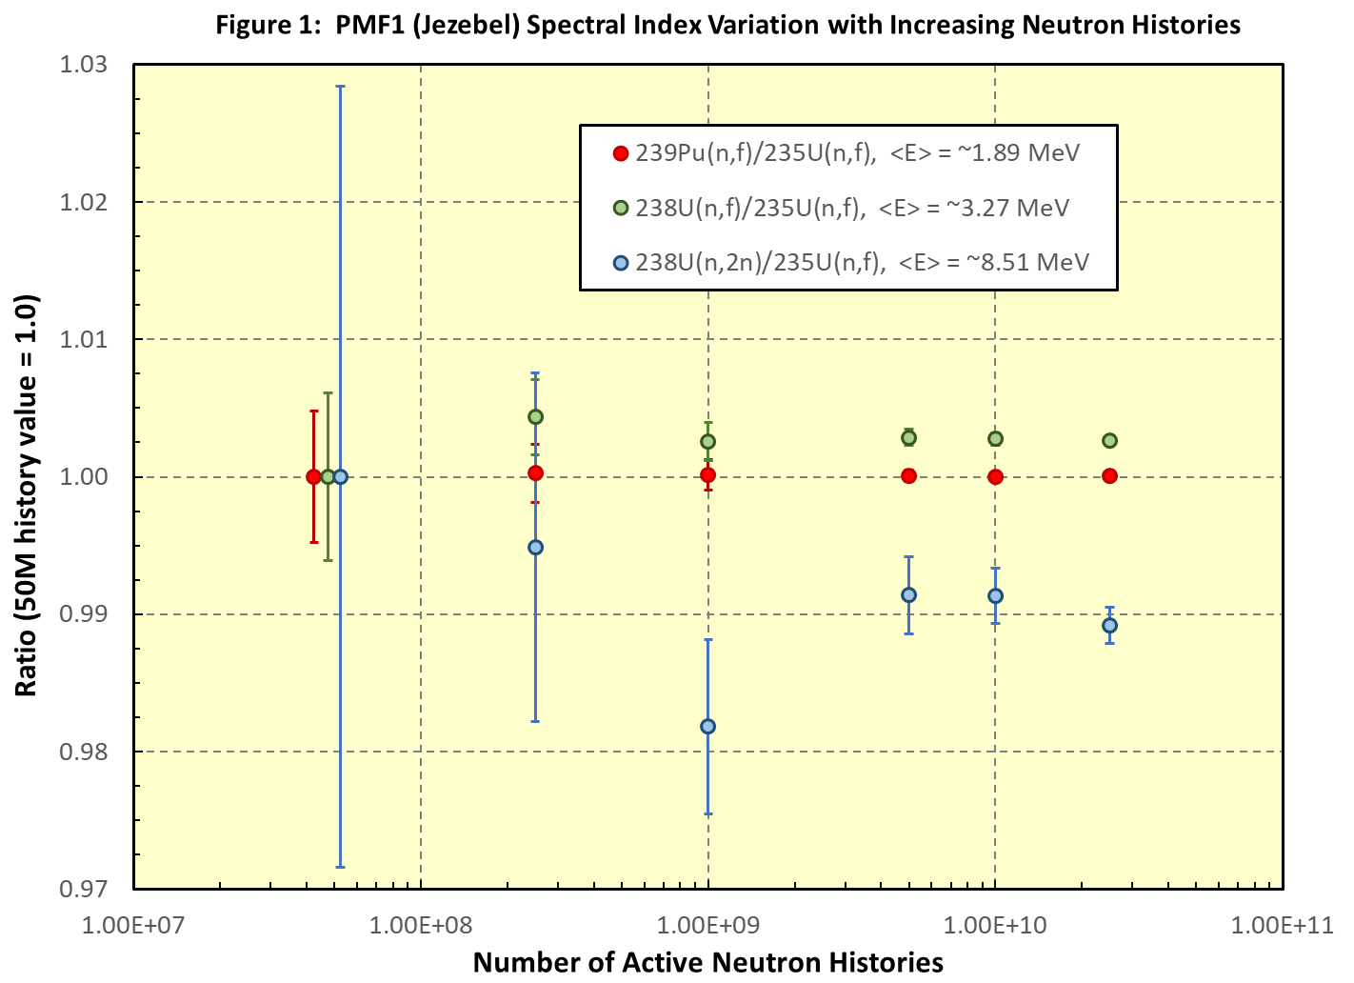
PMF1 (Jezebel Rev 4) - MCNP6® & ENDF/B-VIII.0
Spectral index variation with increasing neutron histories
50 million to 25 billion, 25x10⁹
<E> 8,5 MeV – 2%
deemed acceptable

Slide 24
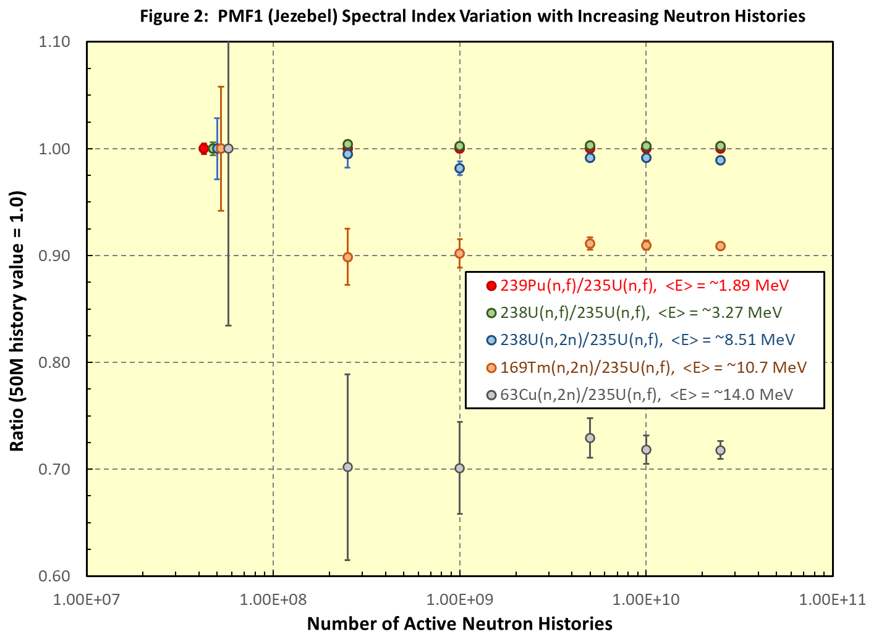
PMF1 (Jezebel) - MCNP6® & ENDF/B-VIII.0
Zoom out
50 million to 25 billion 25x10⁹
<E> 8.5 MeV – 2%
<E> 10.7 MeV - 10%
<E> 14 MeV - 30%

Slide 25
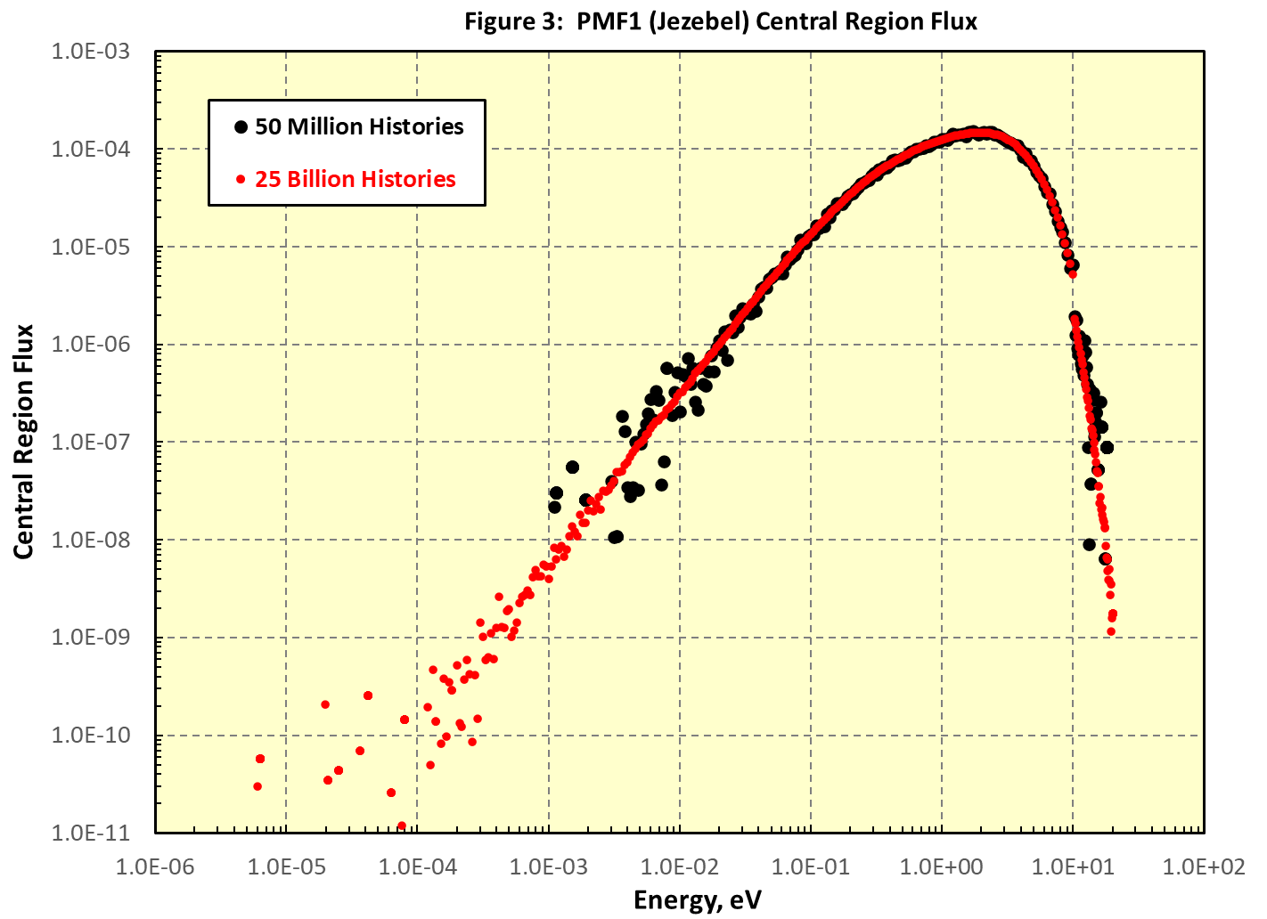
Jezebel PMF1 central region flux
Histories x 500
High tail – sharp decrease
Low tail – more scattered but has the potential to notably impact capture, fission
Span 5 decades

Slide 26
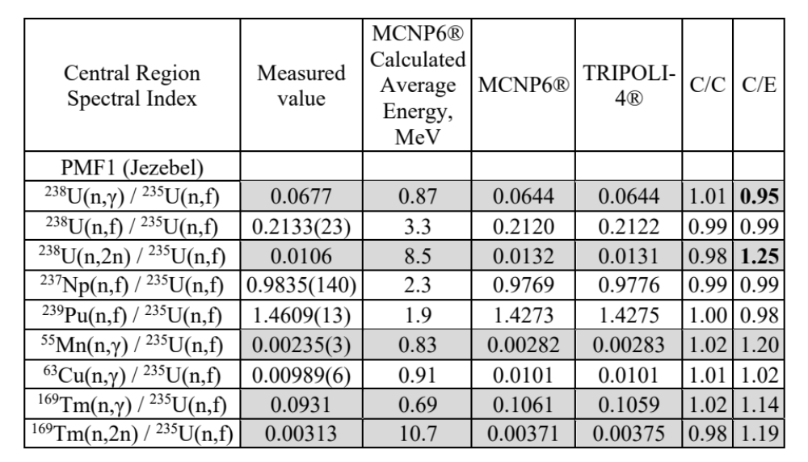
Spectral Indices: Jezebel PMF1
Shaded area
Good C/C +/-2%
C/E divergence -5% to 25% increase with energy

Slide 27
Conclusions
Live web portal, explicit with graphics, tables, datasets
Deployable data streams, full download
V&V codes inputs & outputs
Experimental information in computer forms
Safe repository
Partly accessible through GitHub
Priority next ?

Slide 28
CoNDERC
White paper & status
Thank you for your attention!

