Slide 1
Update of R-matrix evaluations with EDAf90
Consultancy Meeting on International Nuclear Data Evaluation Network-Light Elements
G. Hale & M. Paris (LANL/T-2)
2022-06-22
LA-UR-22-25773

Slide 2
Outline
Review of R-matrix theory
  Theoretical overview
    R-matrix theory; resonance parameters
  Evaluation pipeline
New code implementation:
  resonance parameters
    par2ENDFtk.py
¹⁷O evaluation

Slide 3
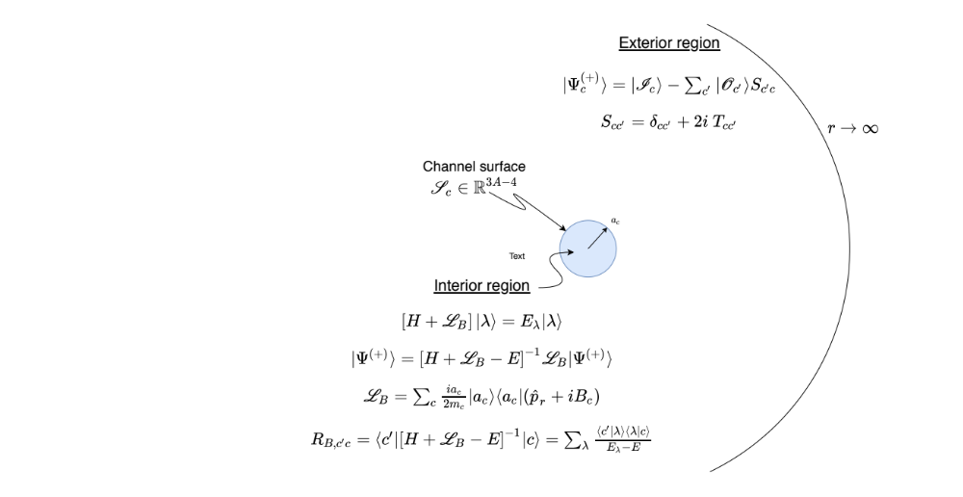
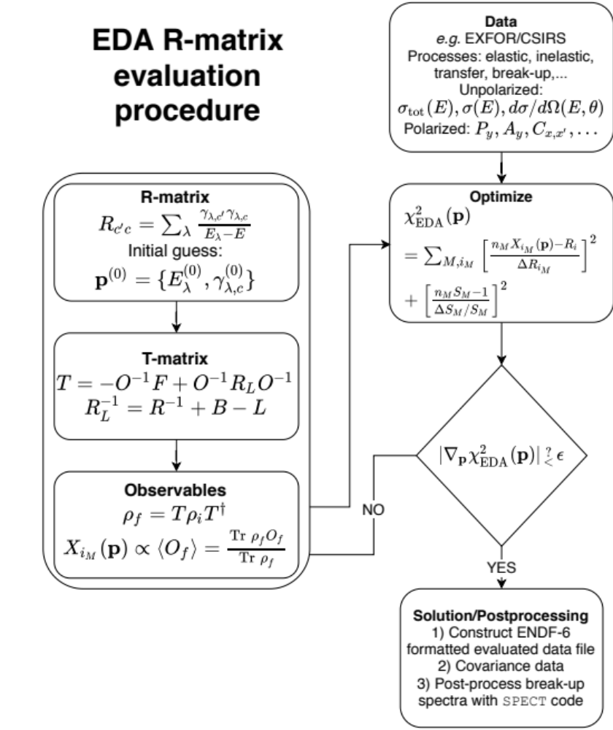
Light-element R-matrix evaluation
R-matrix formalism

Slide 4
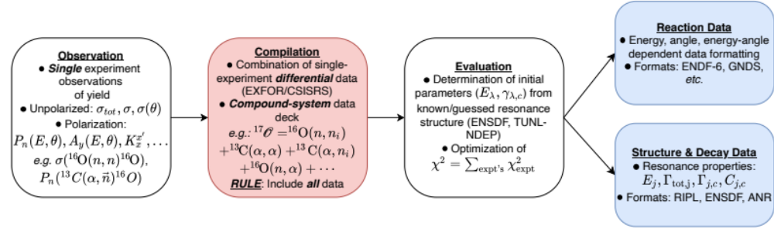
Evaluation pipeline
EDAf90 code handles all types of data [EXFOR/CSISRS; publications; priv. comm.]
  total, integrated, diff’l, polarized, unpolarized; neutron- and CP-induced: (n,X), (p,X), (d,X), (t,X),...
EDAf90 handles all the compound system (here: ¹⁷O) data simultaneously
Optimization over parameters simultaneously fits all the data with the same parameters
EDAf90 → ENDF-6 formatted ENDF/B libraries for processing to CE & MG libraries
Testing & evaluation by hand; future: automate

Slide 5


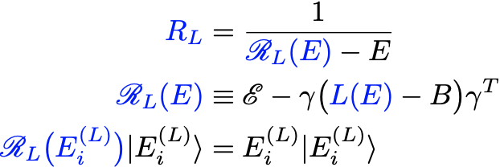

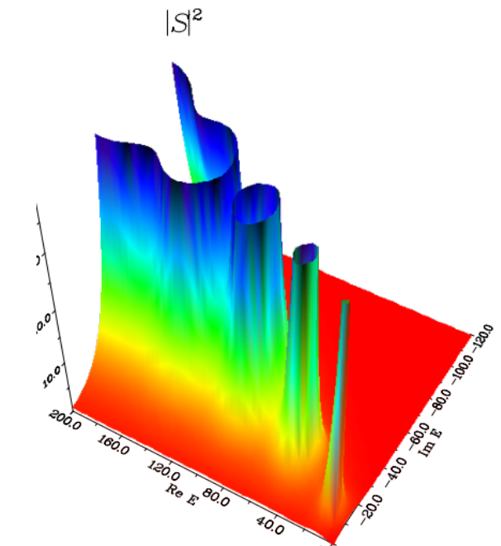

Resonance parameters
Wigner-Eisenbud parameters
Resolvents
  S-matrix/T-matrix/R_{L}-matrix poles
  R_{S}-matrix (AKA “Brune alternative”) poles
Toy model

Slide 6
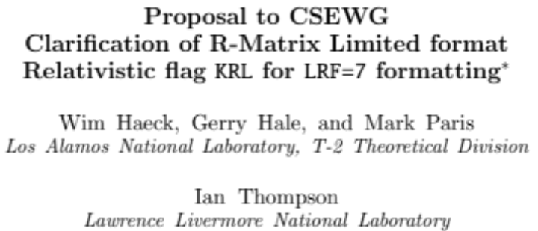
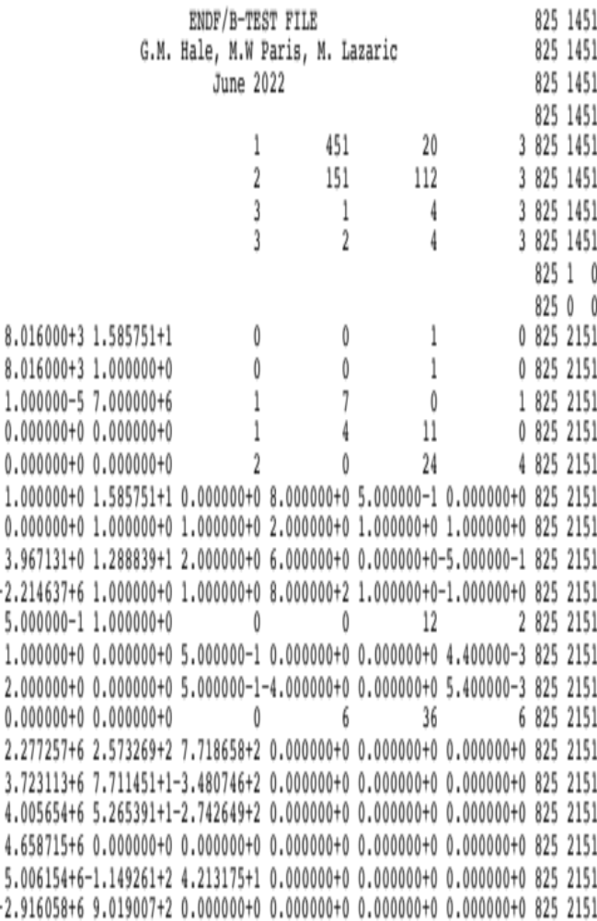
New ENDF/B MF=2 formatting
LRF=7 (R-matrix [un]Limited)
CSEWG formats proposal
  provisionally approved
  R-Matrix Limited section
    MF=2, MT=151, LRU=1, LRF=7, KRM=4, KRL=1
par2ENDFtk.py
  working with M. Lazaric (UNM, Perfetti group)
  enabled by Ian Thompson’s eda_parfile.py
  ENDFtk by LANL dev’s

Slide 7
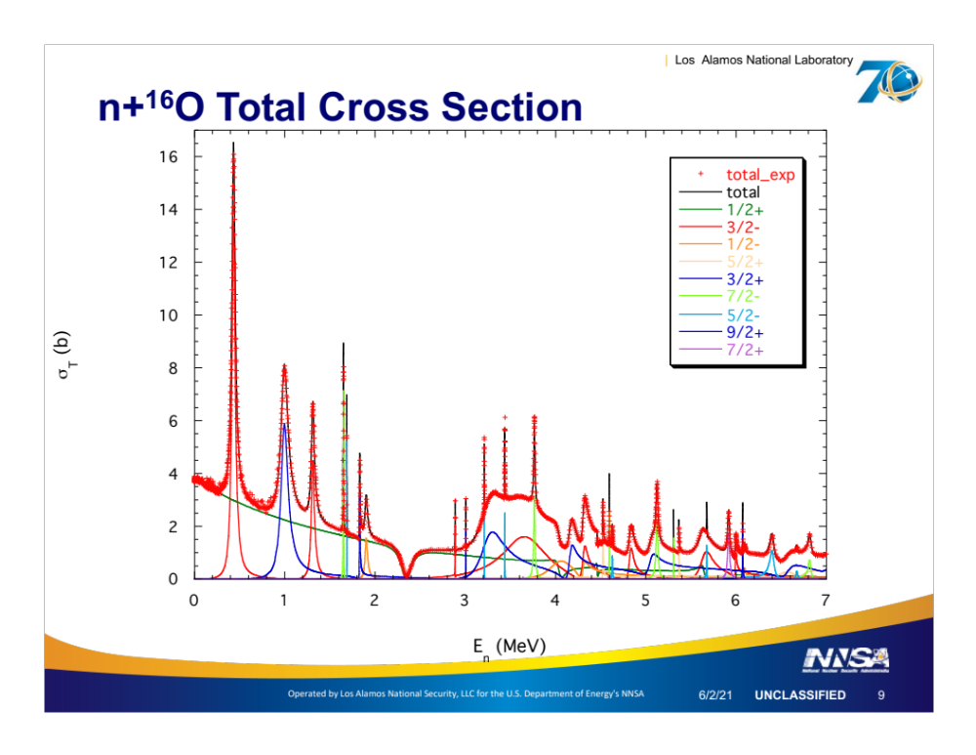


Total cross section
Partial cross section decomposition: highlight ½⁺ background wave
½⁺ “hardly” resonant
“Windows”
  Destructive interference b/w hard-sphere and pole terms
R-matrix pole is sensitive to channel radius
But phase shift/Xsec is not

Slide 8
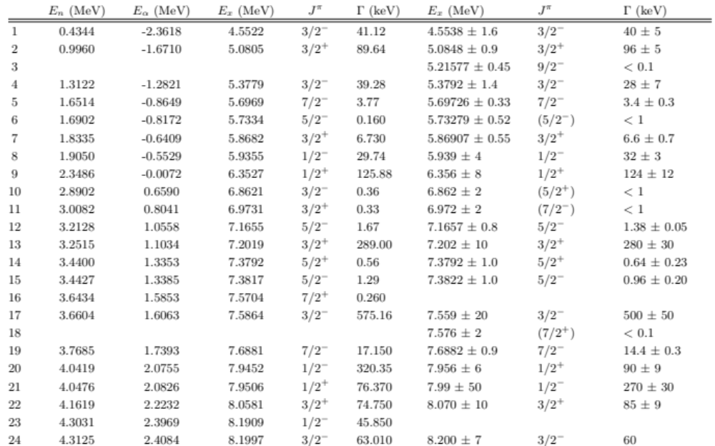
R_{L} resonance parameters

Slide 9
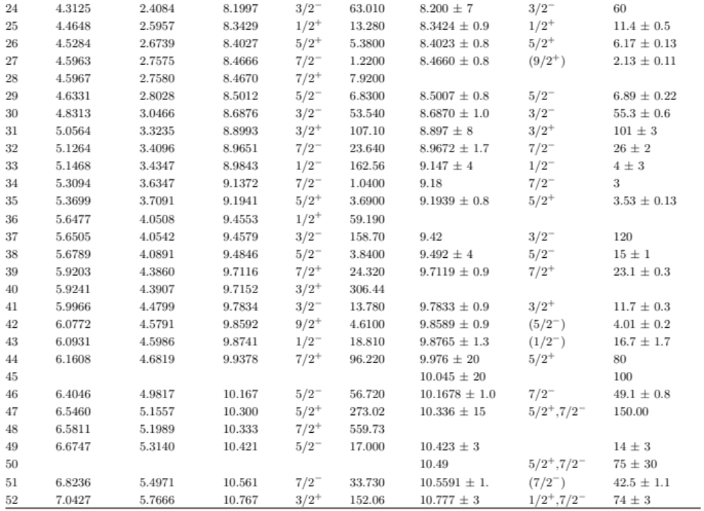
R_{L} resonance parameters

Slide 10
ENDF/B history
6.8, 7.1, 8.0
ENDF/B-VI.8 (2001 April): LANL(Chadwick, Hale, Young), KAPL(Caro, Lubitz)
  Below 3.4 MeV*: R-function + optical model (OPTIC code; Caro)
  3.4 < E_{n} < 6.25 MeV: LANL R-matrix (multichannel; EDA)
    Data: n+¹⁶O (total) [Johnson75, Larson80], ¹⁶O(n,el) ang.[Lane60,…],
    ¹⁶O(n,𝛼₀) [inverse Walton et al.], ¹³C(𝛼,n), ¹³C(𝛼,el) excit. fn
  E_{n} > 6.25
    6.25 → 20: subtraction of non-elastic (MT=3) from total
    Inelastic (MT51, …, 57)
      ¹⁶O(n,x𝛾) Nelson, Chadwick, Michaudon & Young NSE99
  MT800: Bair&Haas73 without renormalization
    6.2→20: factor of 1.5 “bring into rough agreement” (n,𝛼₀) of Davis ‘63
  MT801-803: inferred from (n,𝛼𝛾) [Nelson99]
ENDF/B-VII.1 (2005 Dec.): VI.8+Page+Kawano+Young
  MT=800: 32% reduction (n,𝛼₀) 2.4→8.9 MeV
    “assuming Harissopulos05 are definitive”; “Ha05 is 100% correct, BH73 100% wrong norm”
ENDF/B-VIII.0 (2016 Dec.): VII.1+Hale+Kawano+MWP
  Re-evaluation of Ha05 by Giorginis et al. (CIELO)
JENDL-4.0 (2010)
  ¹⁶O(n,𝛼_{tot}) < 6.5 MeV ~ ENDF/B-VII.0
*all incident neutron lab energies [MeV]

Slide 11
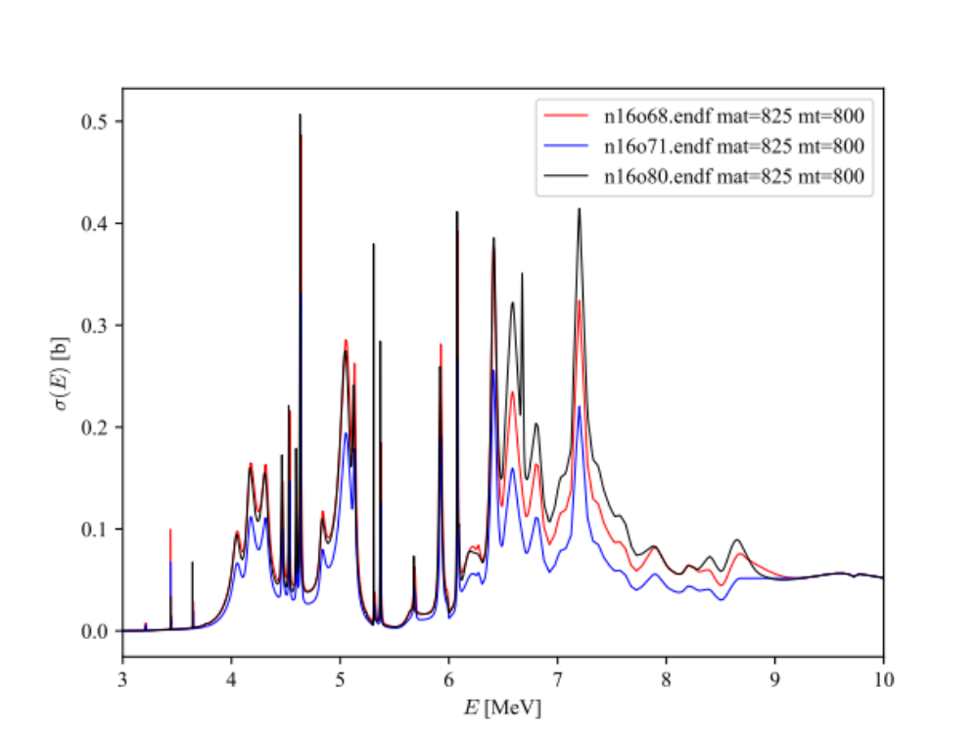
ENDF/B comparisons ¹⁶O(n,𝛼₀)¹³C [MT=800]
6.8, 7.1, 8.0
Three regions
  < 5.2 MeV
  5.2 → 6 MeV
  > 6 MeV
Trends
  7.1 < 6.8/8.0
  ~Equivalent
  7.1 < 6.8 < 8.0

Slide 12
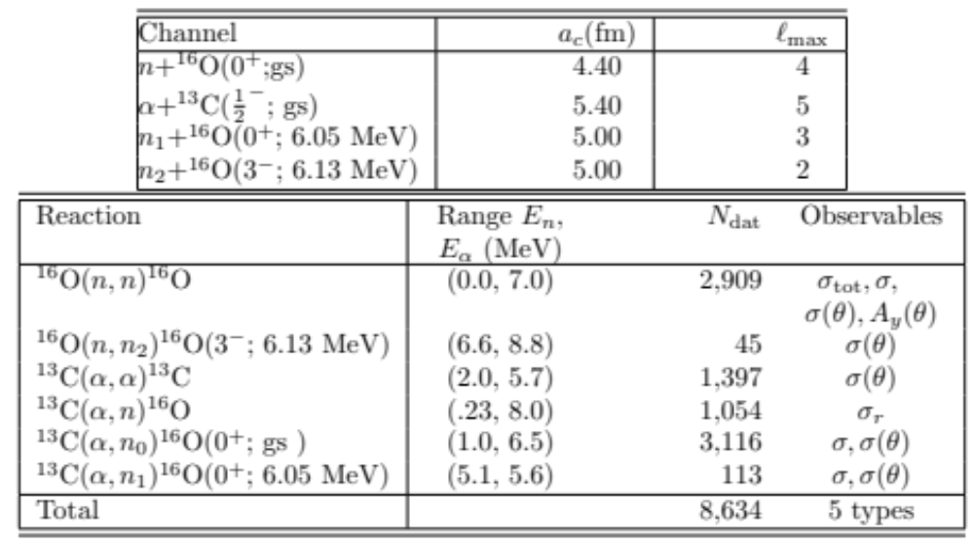
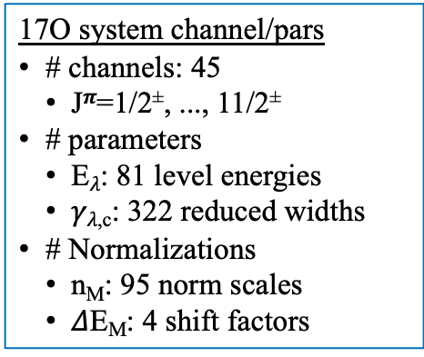
¹⁷O Preliminary evaluation
Preliminary results
Configuration: channels, R-matrix parameters
Observed data in data deck
  Channels: (n,n₀), (n,n₂), (𝜶,n₀), (𝜶,n₁), (𝜶,n)
  Types: total, integrated, differential, polarization [A_{y}, P_{n}]
New data
  Ciani et al. (2021) (𝜶,n₀)
  Brandenburg & Meisel (2021) (𝜶,n)
  Febbraro, DeBoer et al. (2020) (𝜶,n₀), (𝜶,n₁)
17O system channel/pars
# channels: 45
  J^{𝝅}=1/2±, ..., 11/2±
# parameters
  E_{𝜆}: 81 level energies
  𝛾_{𝜆,c}: 322 reduced widths
# Normalizations
  n_{M}: 95 norm scales
  $Δ$E_{M}: 4 shift factors

Slide 13
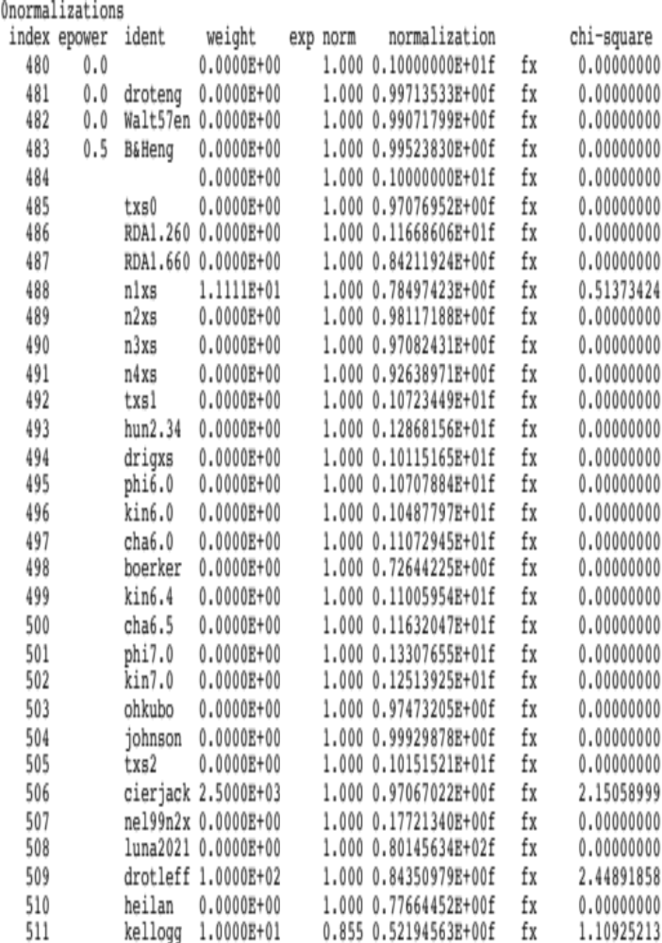
¹⁷O Preliminary evaluation
Normalizations

Slide 14
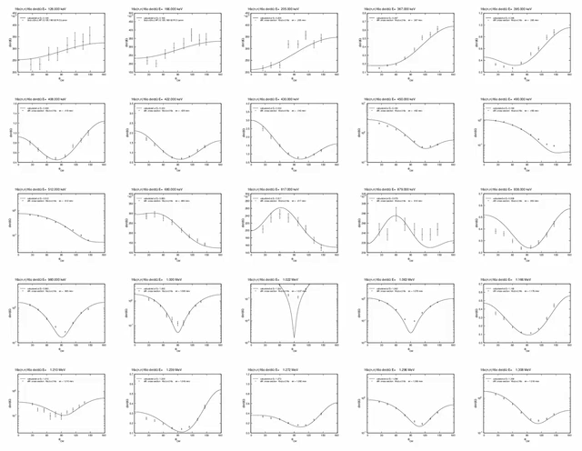
¹⁷O Preliminary evaluation scope
Preliminary results

Slide 15
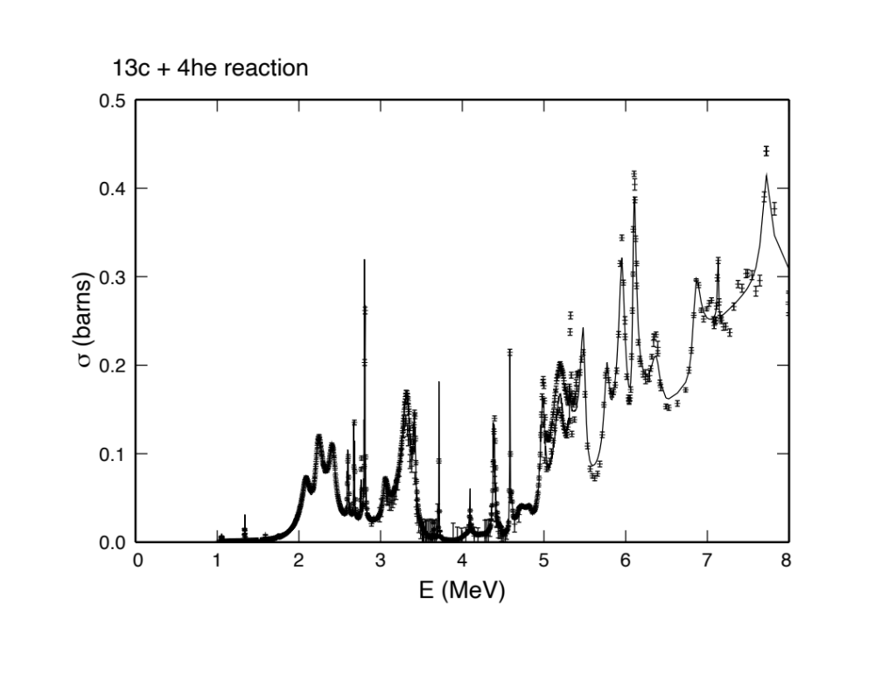
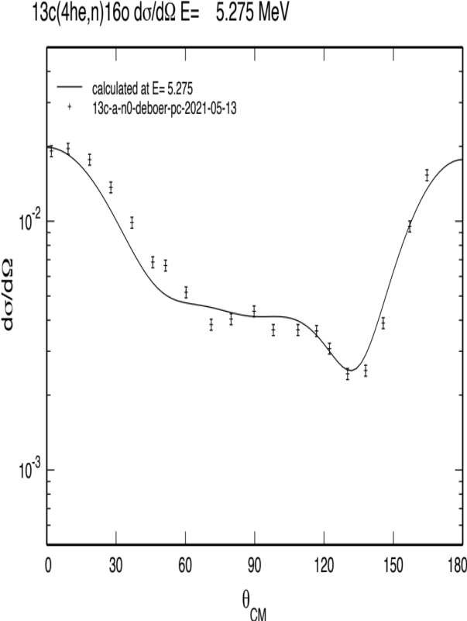
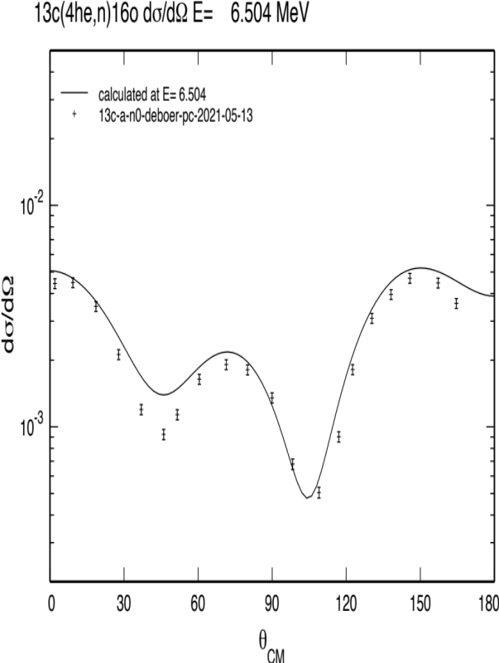
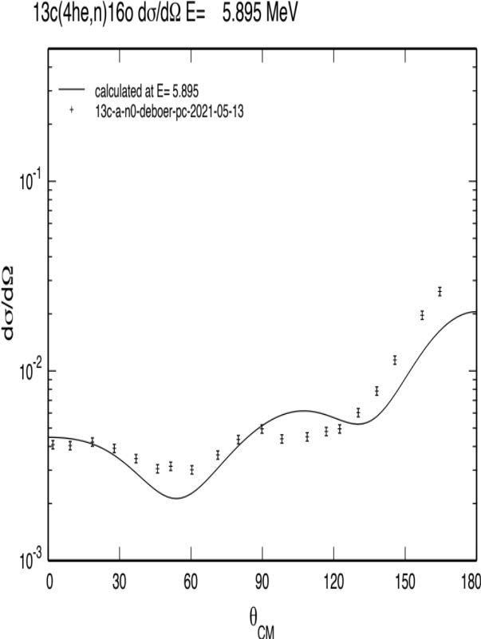
¹⁷O Preliminary evaluation
Preliminary results: (𝜶,n₀)
preliminary
preliminary
preliminary
preliminary

Slide 16
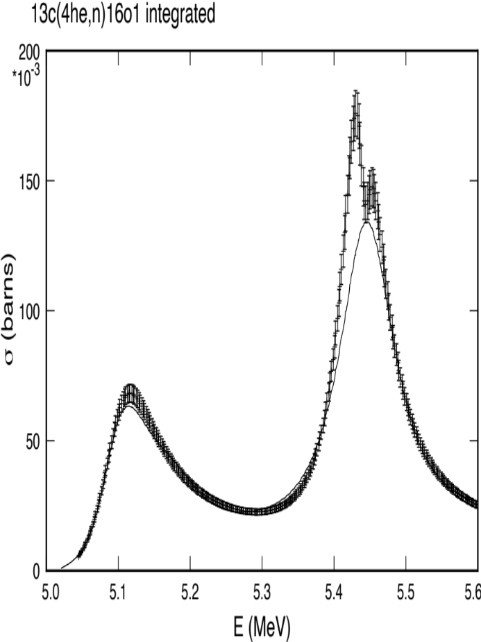
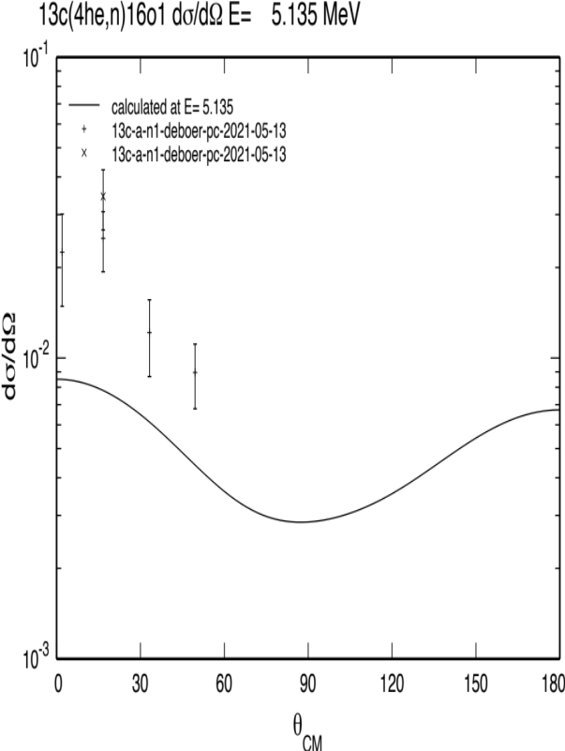
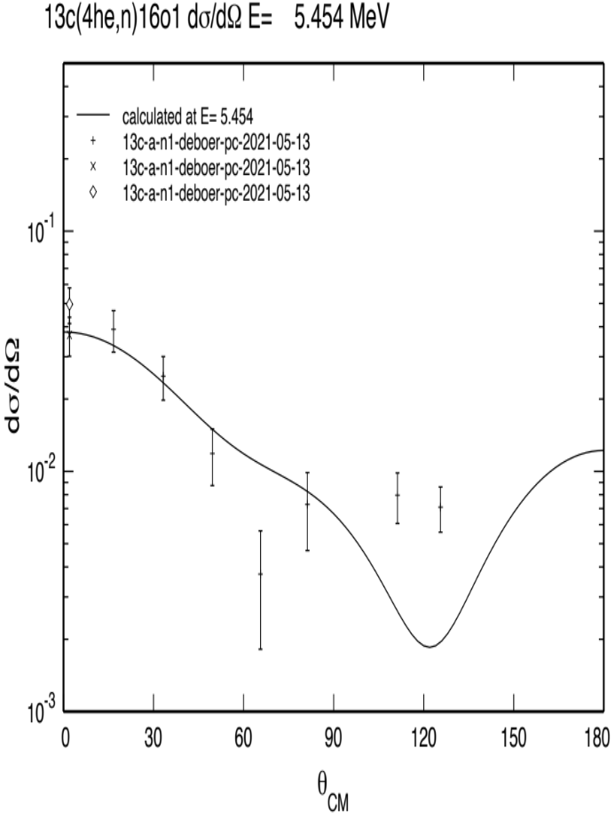
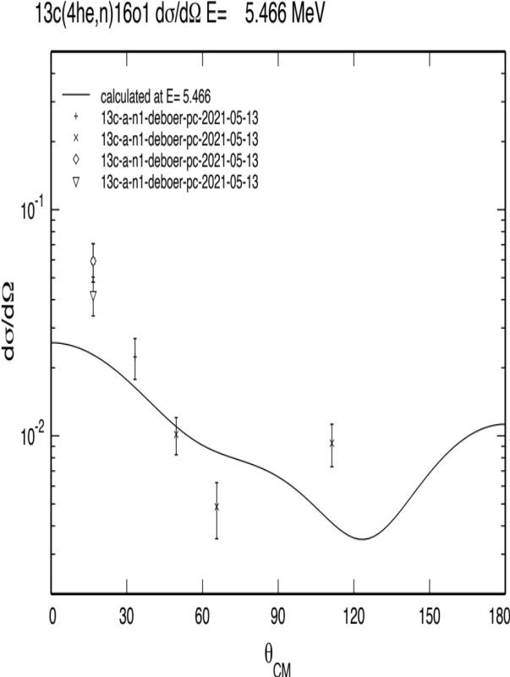
¹⁷O Preliminary evaluation
Preliminary results: (𝜶,n₁)
preliminary
preliminary
preliminary
preliminary

Slide 17
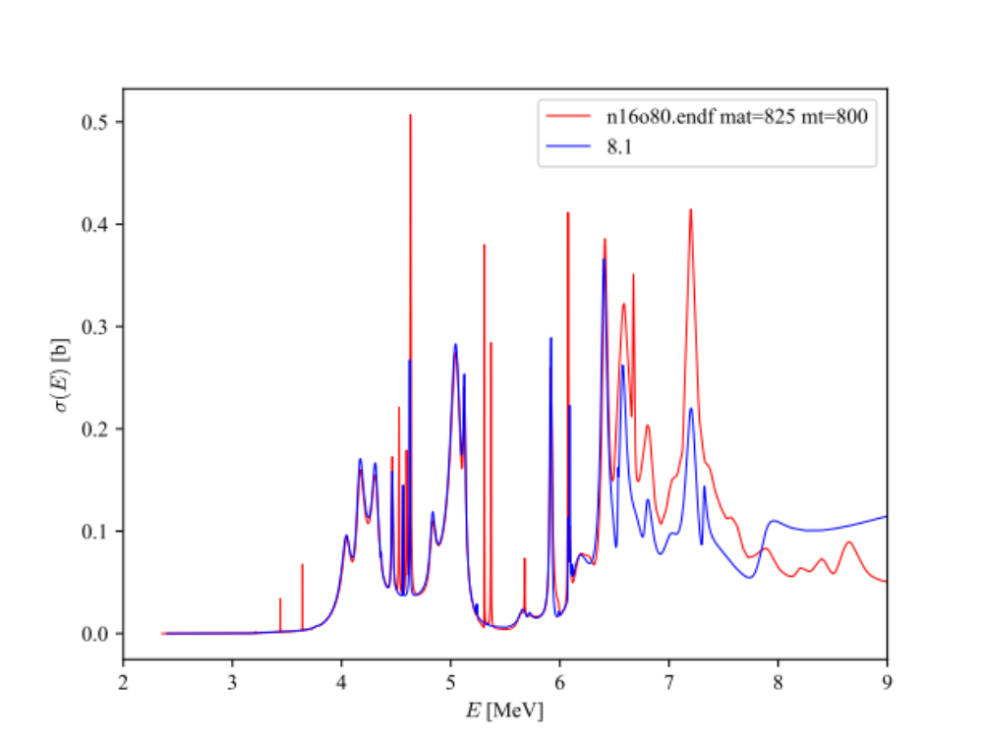
ENDF/B-VIII.0 ¹⁶O(n,𝛼₀)¹³C [MT=800]
Comparison with New Evaluation “8.1”
preliminary

Slide 18
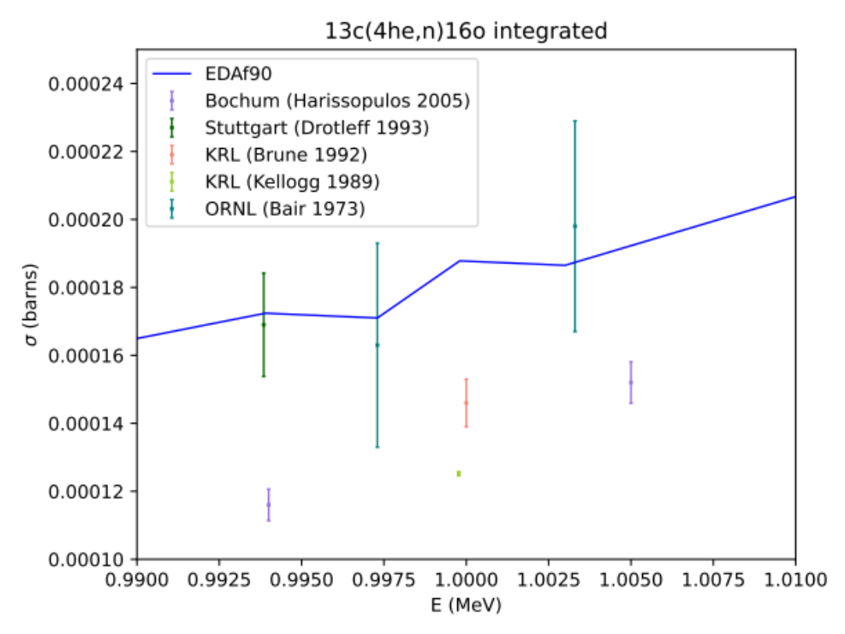
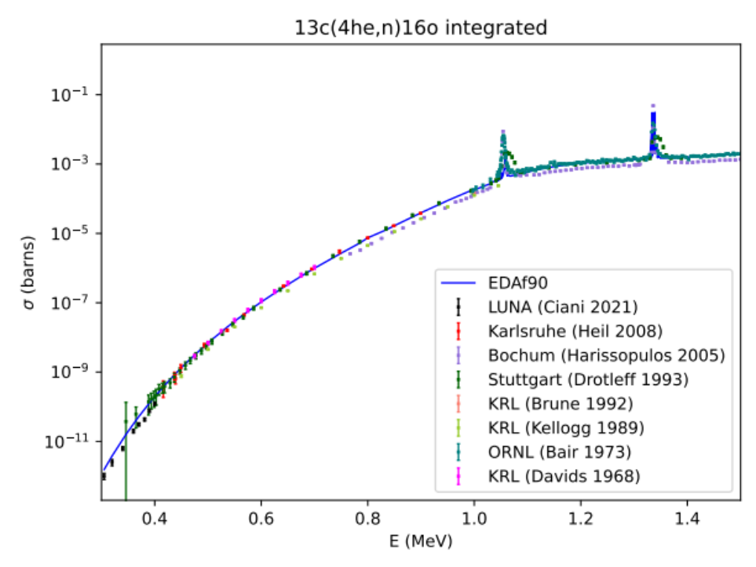
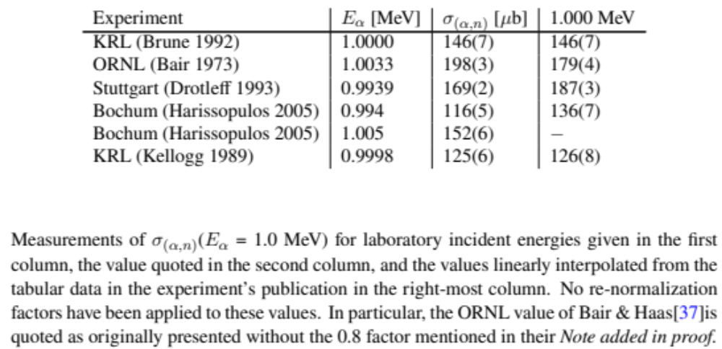
¹⁷O Preliminary evaluation
Preliminary results: low energy

Slide 19
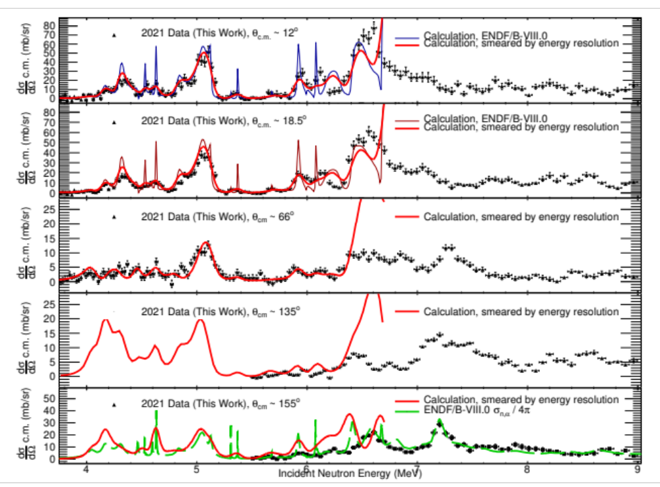
Comparison LENZ(2017) data vs. ENDF/B-VIII.0
¹⁶O(n,𝛼₀)¹³C excitation functions
S. Kuvin & H.Y. Lee (LANL)

Slide 20
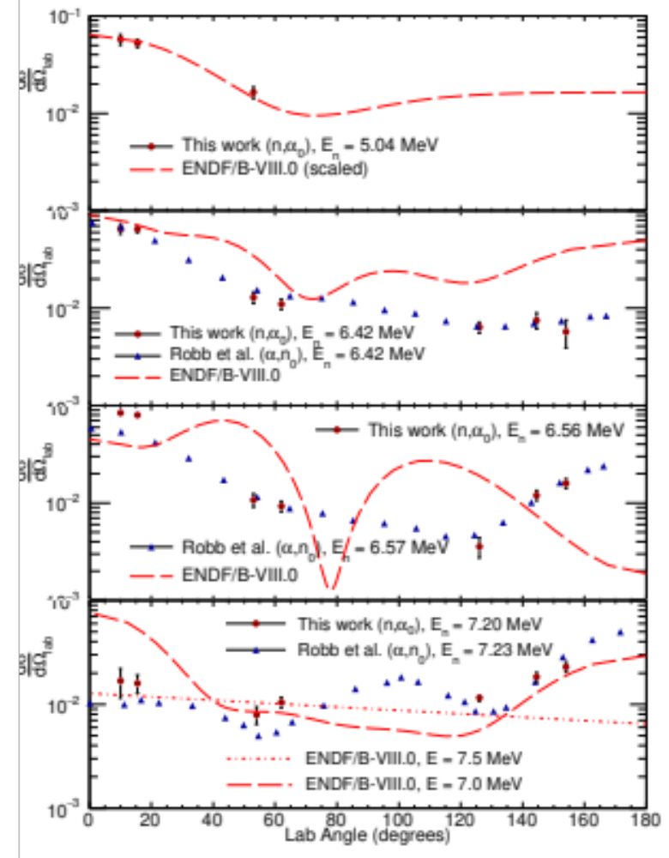
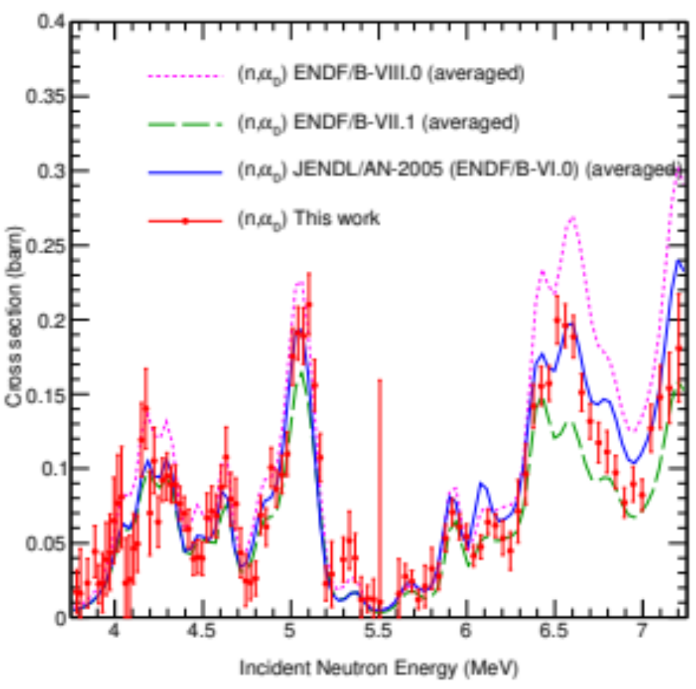
Comparison LENZ(2017) data vs. ENDF/B-VIII.0
¹⁶O(n,𝛼₀)¹³C excitation functions
S. Kuvin & H.Y. Lee (LANL)

Slide 21
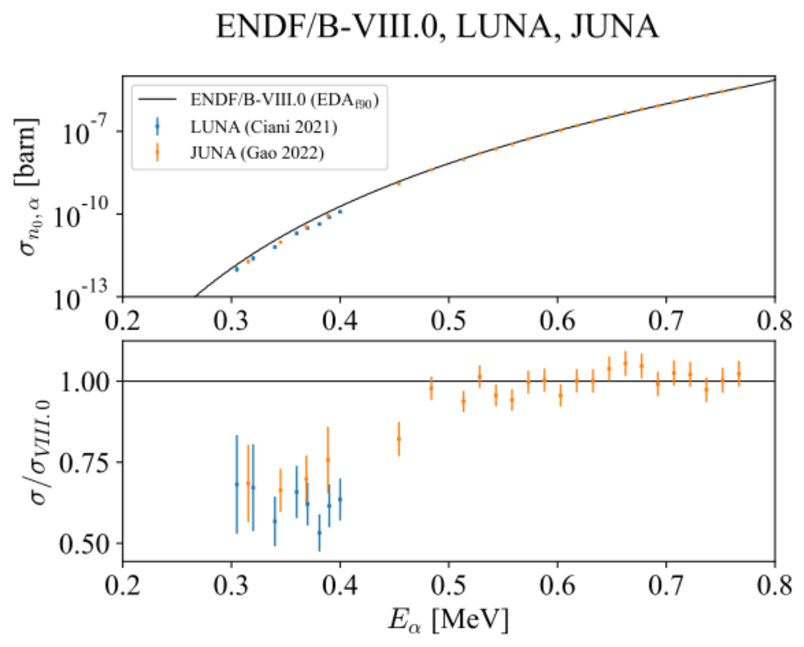
ENDF/B-VIII.0
vs. new data
Data from JUNA collaboration, courtesy of James deBoer

Slide 22
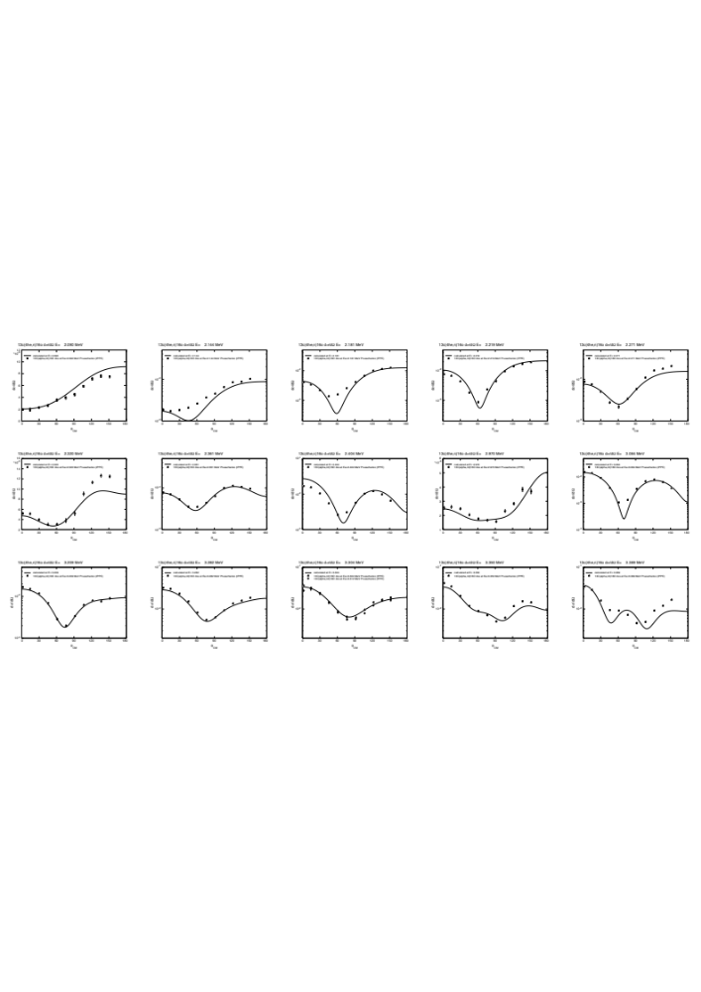
¹³C(𝛼,n₀)¹⁶O Angular distributions
IPPE Prusachenko et al. PRC105, 024612 (2022)
Energies measured: 2.1 MeV < E_{𝛼} < 6.2 MeV
Energies shown here: 2.1 MeV < E_{𝛼} < 3.4 MeV
ENDF/B-VIII.0 was fit with data from Roddy Walton
  reversed from (𝛼,n₀) to (n,𝛼₀) by Graham Foster

Slide 23
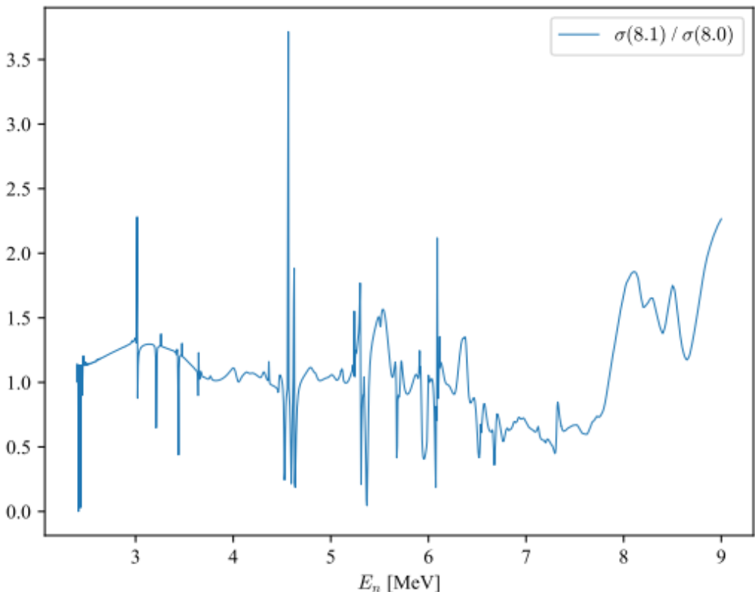
ENDF/B-VIII.0 ¹⁶O(n,𝛼₀)¹³C [MT=800]
Ratio of New Evaluation to ENDF/B-VIII.0

Slide 24
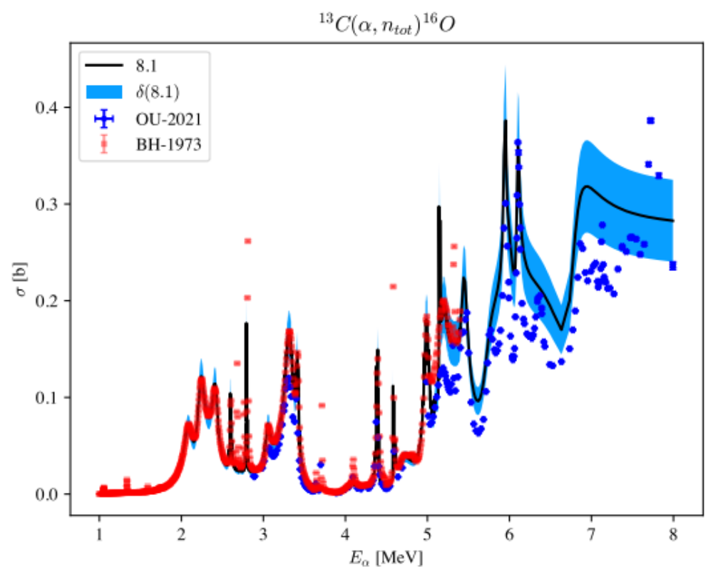
Preliminary new evaluation with fit errors
vs. OU(2021) & Bair & Haas(1973)

Slide 25
Outlook
n+¹⁶O
  Complete the evaluation to E_{n} ~ 9 MeV (optimistically to 10 MeV)
    add missing data
    Investigate normalization of the (n,n_{tot}) Cierjacks’ ‘68 & ‘83 datasets
  ¹³C(𝛼,n₀)¹⁶O is currently too high everywhere
    Note that (n,n_{tot}) and (n,𝛼_{x}) are tightly correlated by unitarity
  Perform a complete normalization/covariance study

