Slide 1
Extending the Be7 evaluation to include
Li6 exited states and also capture to Be7 excited state
Review for INDEN-LE
Ian Thompson
Nuclear Data and Theory Group
Aug 30, 2023

Slide 2
R-matrix Framework
Contribution of He3+He4 to ENDF/B-VIII.1 :
  The calculations should be made using B_{c} = −L_{c}
  Background levels at 20 MeV (in this basis), 1 per spin group
  Maximum orbital angular momentum L_{ah}^{max} = 4, L_{pLi}^{max} = 1,
  and all the spin groups up to J^{π} = 9/2±.
  R-matrix channel radii determined as a = 1.4 [fm] (A₁^{1/3}+A₂^{1/3})
  and the same for all channels within a particle pair.
  No capture channels yet
  Most emphasis on h+α cross sections up to about 12 MeV: the data.
Present Strategy:
  Include Li6_e1 excited state (3+ resonance)
  Include capture channels (either by Reich-Moore, or as primary channels)
  Consider further data up to 20 MeV.
  Consider for p+Li6 evaluation ?

Slide 3
Previous Experiment Data for the Be7 system
Use *.dat files from de Boer to make ‘Test3’ calculation
Still need to specify properties of these files:
projectile | ejectile | residual | file | sys-error | stat-error | norm | group | splitnorms | lab | abserr | scale | filedir | eshift | ecalib | splitshifts
h | h | 0 | Barnard_aa.dat | 5 | 3 | 1 | E | FALSE | TRUE | TRUE | b | Expt5/ | 0 | 0 | FALSE
p | h | 0 | Elwyn_pa.dat | 9 | -1 | 1 | A | FALSE | TRUE | TRUE | b | Expt5/ | 0 | 0 | FALSE
p | p | 0 | Fasoli_pp.dat | -1 | 1.5 | 1 | E | TRUE | TRUE | TRUE | b | Expt5/ | 0 | 0 | FALSE
p | p | 0 | Harrison_pp0.dat | -1 | 2 | 2.2 | A | FALSE | TRUE | TRUE | b | Expt5/ | 0 | 0 | FALSE
p | p | 1 | Harrison_pp1.dat | -1 | -1 | 0.2 | A | FALSE | TRUE | TRUE | b | Expt5/ | 0 | 0 | FALSE
p | h | 0 | Lin_pa.dat | 10 | -1 | 1 | A | TRUE | TRUE | TRUE | b | Expt5/ | 0 | 0 | FALSE
p | p | 0 | McCray_pp.dat | 5 | -1 | 1 | E | TRUE | TRUE | TRUE | b | Expt5/ | 0 | 0 | FALSE
h | h | 0 | Mohr_aa.dat | -1 | 5 | 1 | A | TRUE | TRUE | TRUE | b | Expt5/ | 0 | 0 | FALSE
h | h | 0 | Spiger-A1094004-lab_aa.dat | 1.5 | -1 | 1 | E | TRUE | TRUE | TRUE | b | Expt5/ | 0 | 0.02 | TRUE
h | p | 0 | Spiger-cm_ap0.dat | 1.5 | -1 | 1 | A | TRUE | FALSE | TRUE | mb | Expt5/ | 0 | 0 | FALSE
h | h | 0 | Tombrello_aa.dat | 5 | -1 | 1 | E | FALSE | TRUE | TRUE | b | Expt5/ | 0 | 0.02 | TRUE
a | h | 15 | LIMIT | 4.001506 | 3.01550116
p | Li6 | 2.79 | LIMIT | 1.008665 | 6.01347726
Correct some data:
The 9.106 MeV point at 36.999 deg in the Spiger_aa data is not extracted from the plots properly.
The Tombrello_aa data (not A1039 but A1295) should have a constant discretization error of 0.5 mb/sr added in quadrature to the per-cent errors for the A1295002 data.
The points in Elwyn_pa at Ep = 2.277, 2.377, and 2.476 MeV were not plotted correctly, if checked by Legendre data.

Slide 4
Include also excited state Li6_e1 (3⁺ resonance)
projectile | ejectile | residual | file | sys-error | stat-error | norm | splitnorms | lab | abserr | scale | Npoints | EXFOR
H1 | H1 | 1 | Gould-A1417005_e1.dat | 5 | 5 | 1 | FALSE | FALSE | TRUE | mb | 35 | A1417005
H1 | H1 | 1 | Harrison-A1397002_e1.dat | 5 | 5 | 1 | FALSE | FALSE | TRUE | mb | 41 | A1397002
H1 | H1 | 1 | Laurat-A1508006_e1.dat | 5 | 5 | 1 | FALSE | TRUE | TRUE | mb | 18 | A1508006
H1 | H1 | 1 | Laurat-A1508007_e1.dat | 5 | 5 | 1 | FALSE | FALSE | TRUE | mb | 50 | A1508007
H1 | H1 | 1 | Merchez-A1415002_e1.dat | 5 | 5 | 1 | FALSE | FALSE | TRUE | mb | 54 | A1415002
He3 | H1 | 1 | Spiger-A1094008_e1.dat | 5 | 5 | 1 | FALSE | TRUE | TRUE | mb | 58 | A1094008
He3 | H1 | 1 | Spiger-A1094009_e1.dat | 5 | 5 | 1 | FALSE | TRUE | TRUE | mb | 44 | A1094009
He3 | H1 | 1 | Spiger-A1094010_e1.dat | 5 | 5 | 1 | FALSE | TRUE | TRUE | mb | 58 | A1094010
Combine with ‘test3’ data
Refit
Ferdinand: https://github.com/LLNL/ferdinand
Rflow: https://github.com/LLNL/Rflow
(uses tensorflow with cpus or gpus)

Slide 5
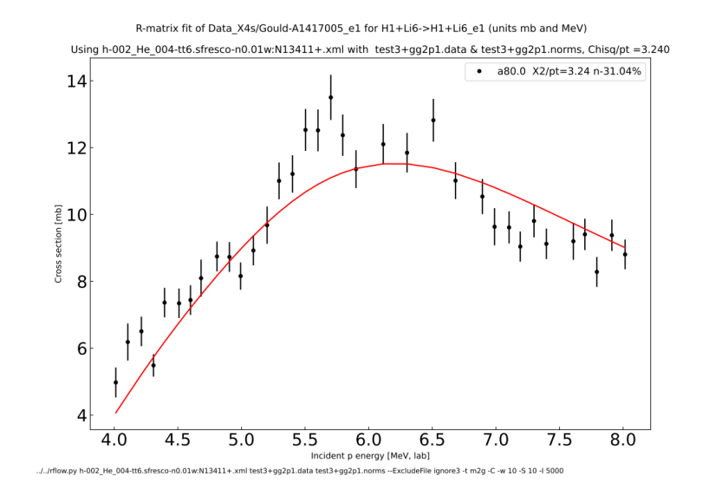
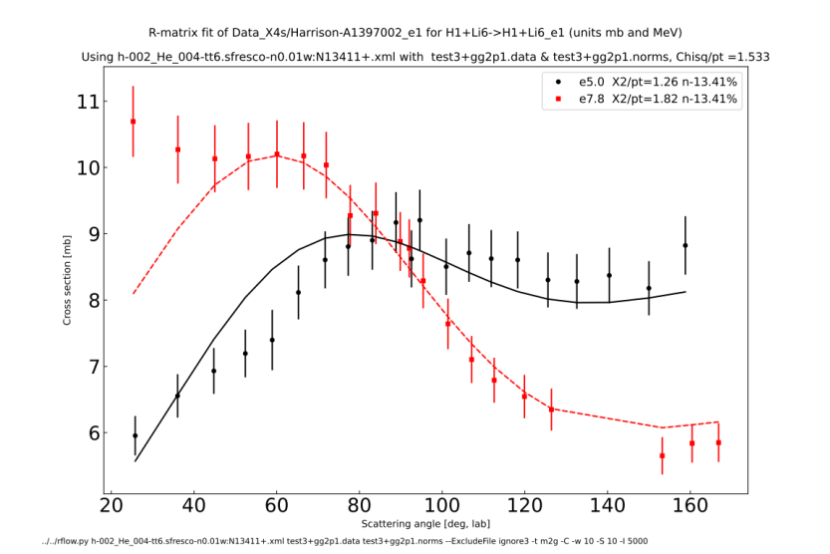
Fitting excited state Li6_e1 (slide 1)
Gould-A1417005_e1
Harrison-A1397002_e1

Slide 6
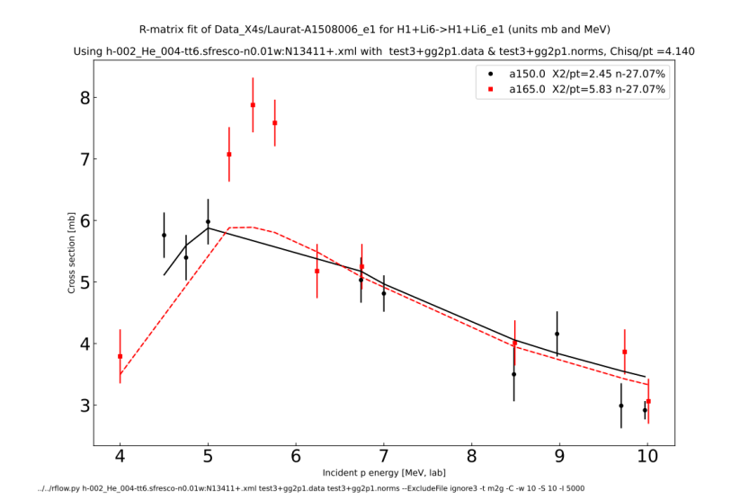
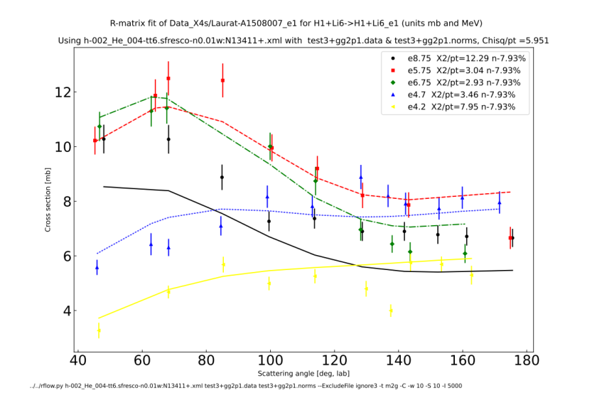
Fitting excited state Li6_e1 (slide 2)
Laurat-A1508006_e1
Laurat-A1508007_e1

Slide 7
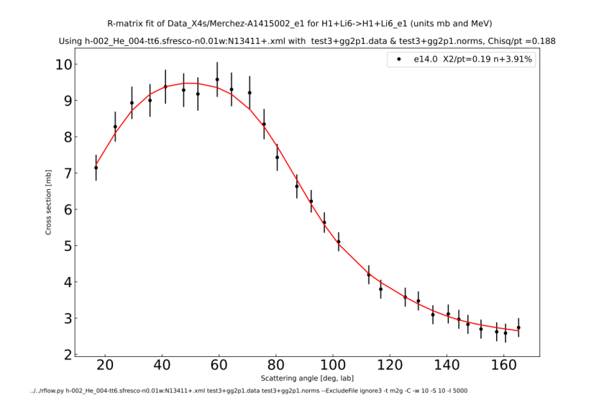
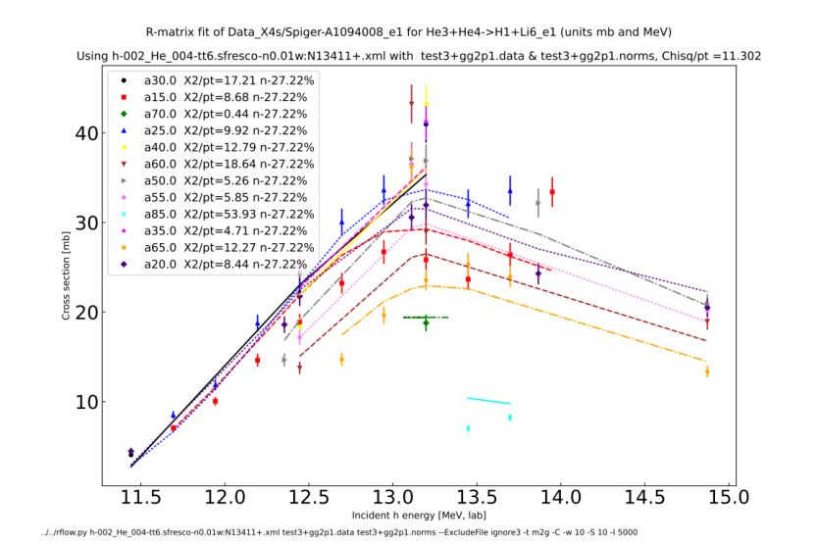
Fitting excited state Li6_e1 (slide 3)
Merchez-A1415002_e1
Spiger-A1094008_e1

Slide 8
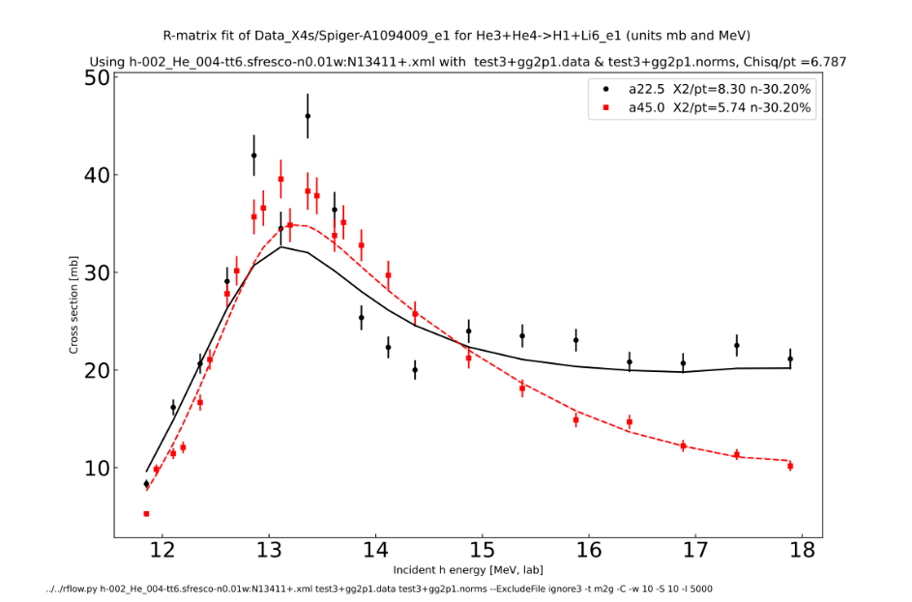
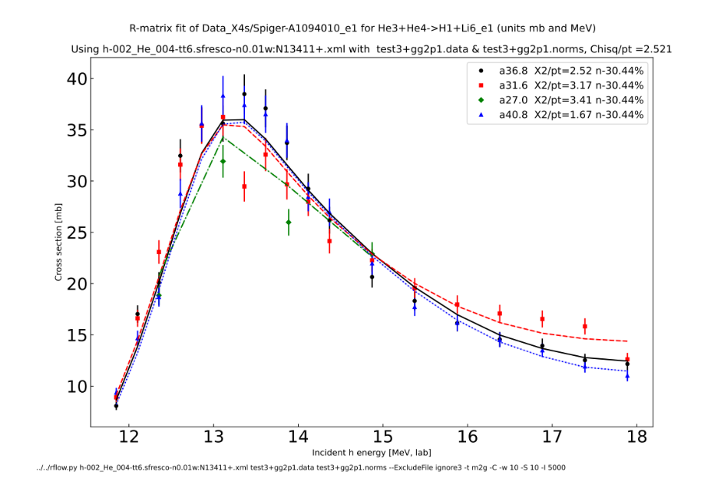
Fitting excited state Li6_e1 (slide 4)
Spiger-A1094009_e1
Spiger-A1094010_e1

Slide 9
Discussion
Should be included
Add to candidate for ENDF/B-VIII.1-beta3 ?

Slide 10
Include capture channels
(a) primary gammas as two-body channels
Two channels:
  Production of Be7 ground state
  Production of Be7_e1 excited state
    (Decay of excited state given by branching ratios. Here: 100% to gs)
Easier in GNDS format:
  <reaction label="Be7 + photon” >
  <reaction label="Be7_e1 + photon” >
Harder in ENDF:
  need to use MT=900 and 901
  I proposed this at Mini-CSEWG in April 2023.

Slide 11
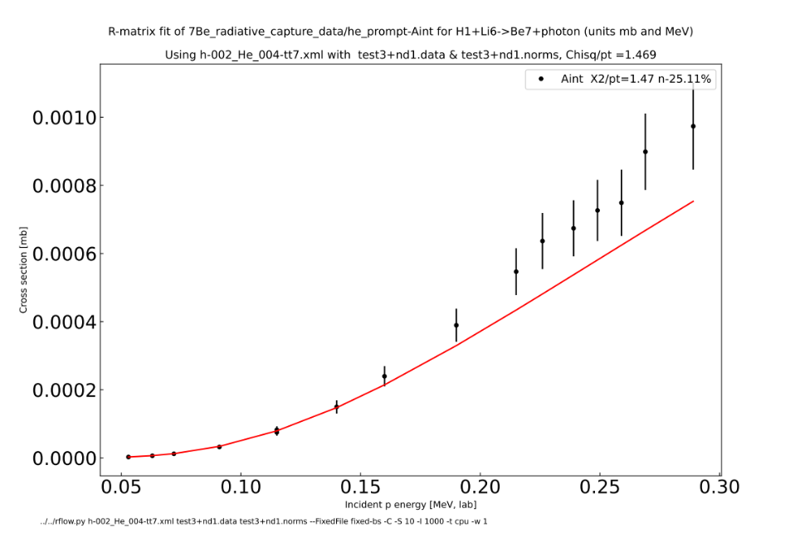
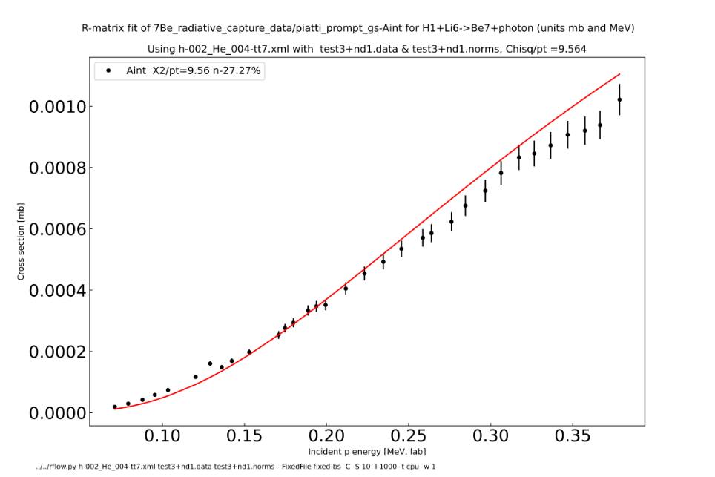
Fitted primary gammas: (p,γ)Be7 (gs)
Angle-integrated

Slide 12
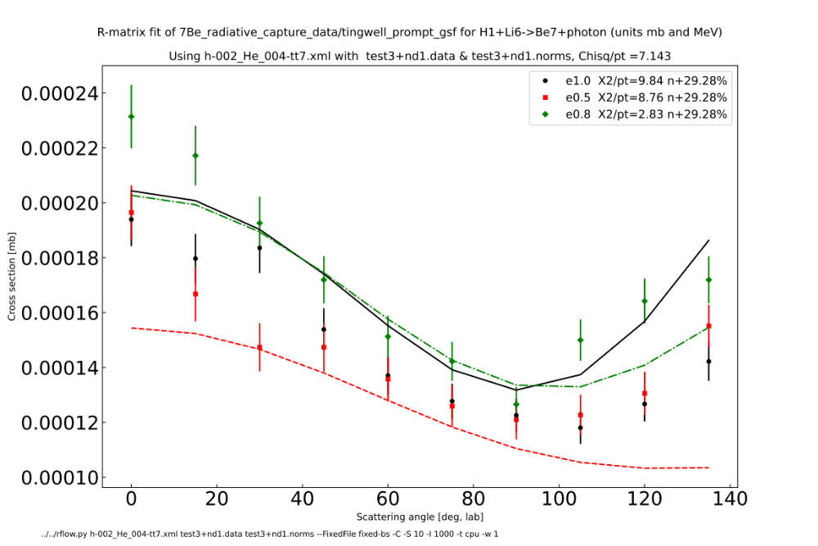
Fitted primary gammas: (p,γ)Be7 (gs) angular distributions

Slide 13
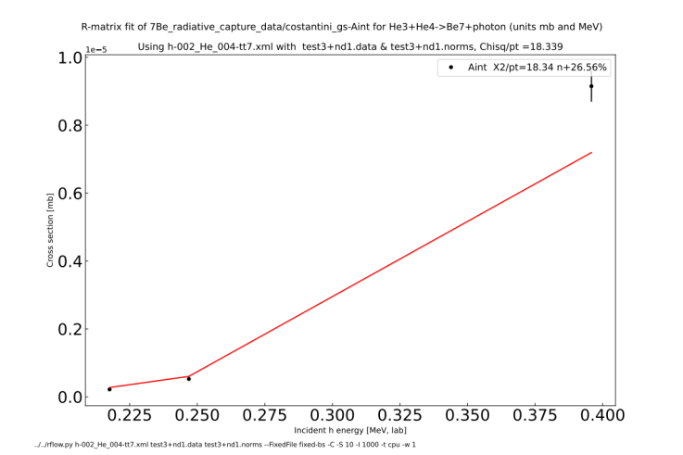
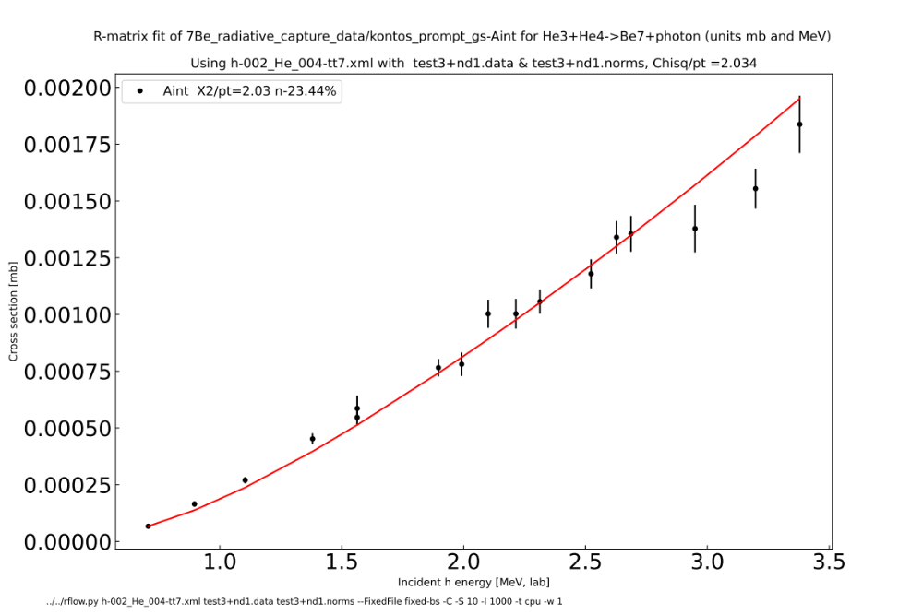
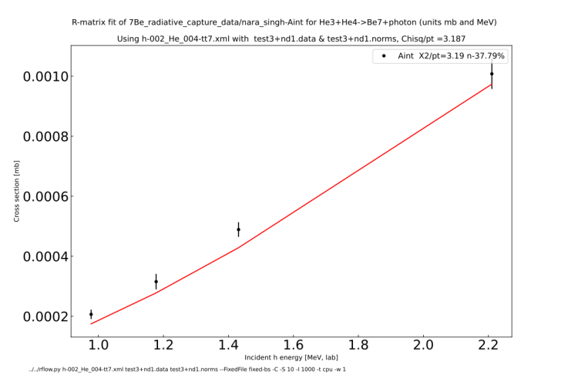
Fitted primary gammas: (h,γ)Be7 (gs)

Slide 14

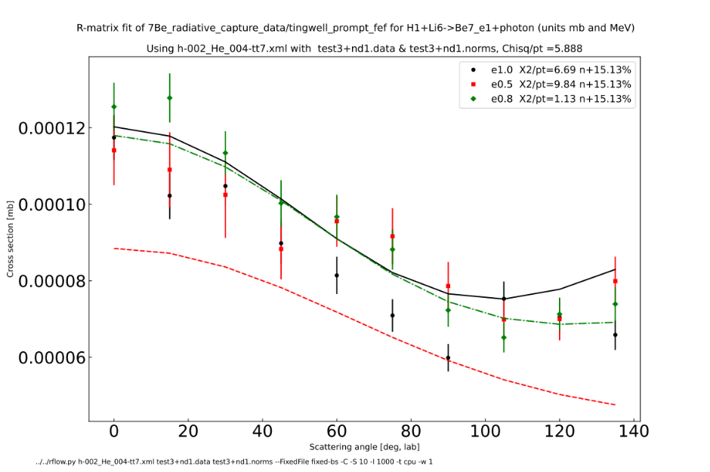
Fitted primary gammas: (p,γ)Be7_e1 (fe)
Piatti (angle-integrated)
Tingwell (angular distributions)

Slide 15
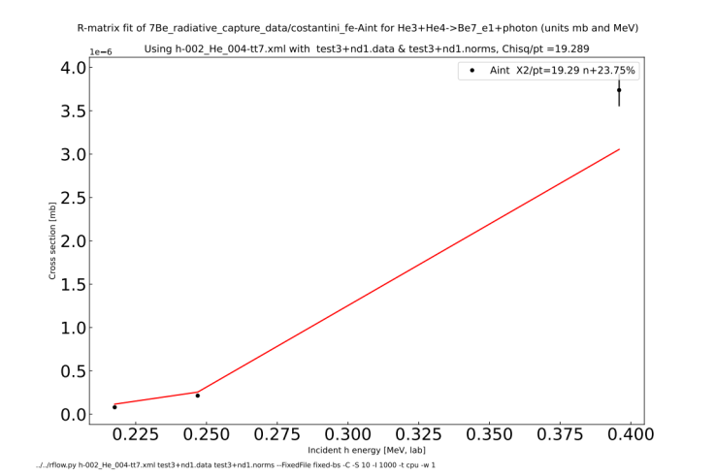
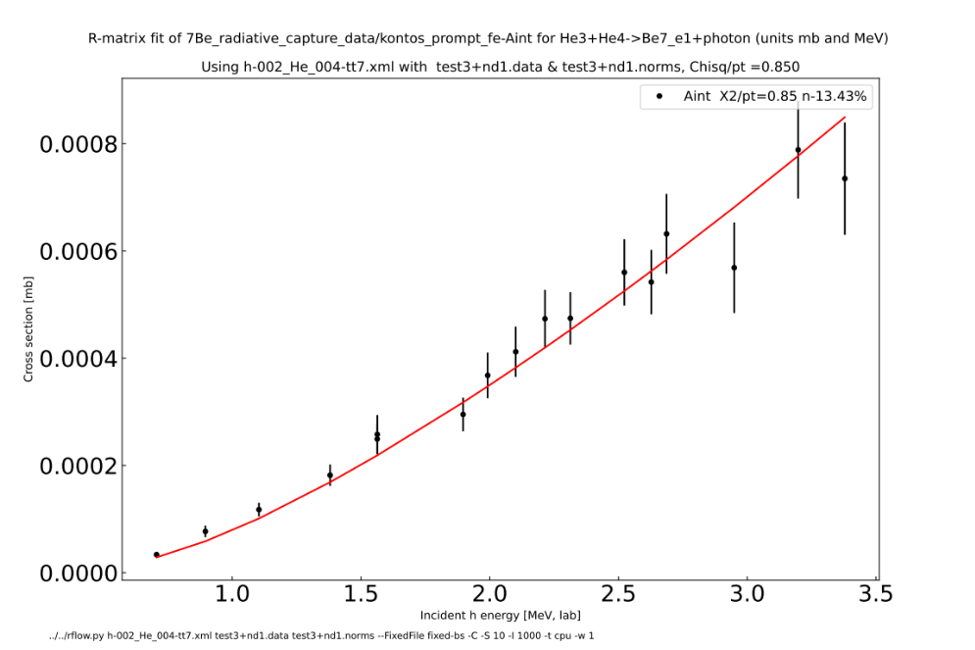
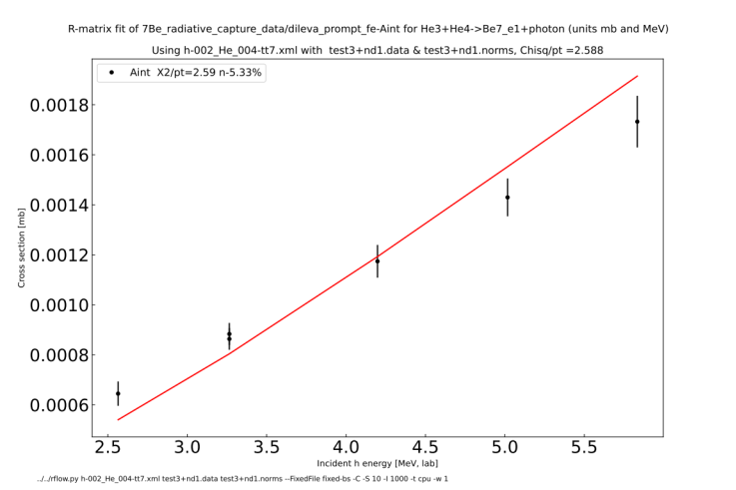
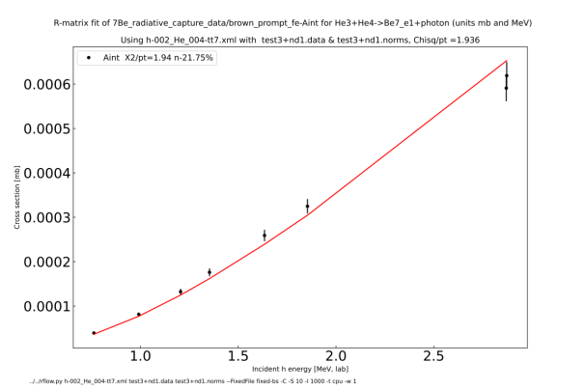
Fitted primary gammas: (h,γ)Be7_e1 (fe)

Slide 16
Data renormalization factors from fit
  h-g/costantini_gs: +26.6 %
  h-g/kontos_prompt_gs -23.4 %
  h-g/nara_singh -37.8 %
  p-g/he_prompt -25.1 %
  p-g/piatti_prompt_gs -27.3 %
  p-g/tingwell_prompt_gs : +29.1 %
  h-g1/brown_prompt_fe -21.8 %
  h-g1/costantini_fe +23.8 %
  h-g1/dileva_prompt_fe -5.3 %
  h-g1/kontos_prompt_fe -13.4 %
  p-g1/piatti_prompt_fe -33.8 %
  p-g1/tingwell_prompt_fe +15.1 %
nd1

Slide 17
Data renormalization factors from fit
Then with Rg = 50 fm, 100 fm
  h-g/costantini_gs: +26.6 % +14.4% +25.2 %
  h-g/kontos_prompt_gs -23.4 % -5% -23.6 %
  h-g/nara_singh -37.8 % -23.7% -39.5 %
  p-g/he_prompt -25.1 % -19.4% -21.9 %
  p-g/piatti_prompt_gs -27.3 % -18.9 % -25.5 %
  p-g/tingwell_prompt_gs : +29.1 % +25.5% +32.2 %
  h-g1/brown_prompt_fe -21.8 % -6.94 % -9.4 %
  h-g1/costantini_fe +23.8 % +12.6 % +18.4 %
  h-g1/dileva_prompt_fe -5.3 % -0.6 % -0.62 %
  h-g1/kontos_prompt_fe -13.4 % +2.4 % -1.71%
  p-g1/piatti_prompt_fe -33.8 % -24.4 % -27.5%
  p-g1/tingwell_prompt_fe +15.1 % -10.7 % +11.4 %
nd2

Slide 18
Data renormalization factors from fit (no He)
Then with Rg = 50 fm, 100 fm
  h-g/costantini_gs: +26.6 % +14.8% +30.6 %
  h-g/kontos_prompt_gs -23.4 % -2.2% -5.42 %
  h-g/nara_singh -37.8 % -21.6% -23.3 %
  p-g/piatti_prompt_gs -27.3 % -23.8 % -25.5 %
  p-g/tingwell_prompt_gs : +29.1 % +17.5% +32.2 %
  h-g1/brown_prompt_fe -21.8 % -9.4 % -9.4 %
  h-g1/costantini_fe +23.8 % +9.5 % +18.4 %
  h-g1/dileva_prompt_fe -5.3 % -2.5 % -0.62 %
  h-g1/kontos_prompt_fe -13.4 % +0.2 % -1.71%
  p-g1/piatti_prompt_fe -33.8 % -23.2 % -27.5%
  p-g1/tingwell_prompt_fe +15.1 % -13.5 % +11.4 %
nd3 (but not Rg=100 fm

Slide 19
Data renormalization factors from fit (no He, Piatti, Tingwell). Then with Rg = 50 fm, 100 fm
  h-g/costantini_gs: +26.6 % +18.2% +30.6 %
  h-g/kontos_prompt_gs -23.4 % -9.03% -5.42 %
  h-g/nara_singh -37.8 % -29.4% -23.3 %
  p-g/piatti_prompt_gs -27.3 % -23.8 % -25.5 %
  p-g/tingwell_prompt_gs : +29.1 % +17.5% +32.2 %
  h-g1/brown_prompt_fe -21.8 % -12.2 % -9.4 %
  h-g1/costantini_fe +23.8 % +12.8 % +18.4 %
  h-g1/dileva_prompt_fe -5.3 % -8.1% -0.62 %
  h-g1/kontos_prompt_fe -13.4 % +3.2 % -1.71%
  p-g1/piatti_prompt_fe -33.8 % -23.2 % -27.5%
  p-g1/tingwell_prompt_fe +15.1 % -13.5 % +11.4 %
nd4 (but not Rg=100 fm)

Slide 20
Include capture channels
(b) inclusive gammas by Reich-Moore approx.
Cannot distinguish these two channels in reaction model
  Production of Be7 ground state and Be7_e1 excited state
  Can split by hand afterwards
Easy in GNDS format:
  <reaction label="Be7 + photon [inclusive]” ENDF_MT=“102” >
Traditional in ENDF:
  Use MT=102
Fit damping width for each R-matrix pole above threshold

Slide 21
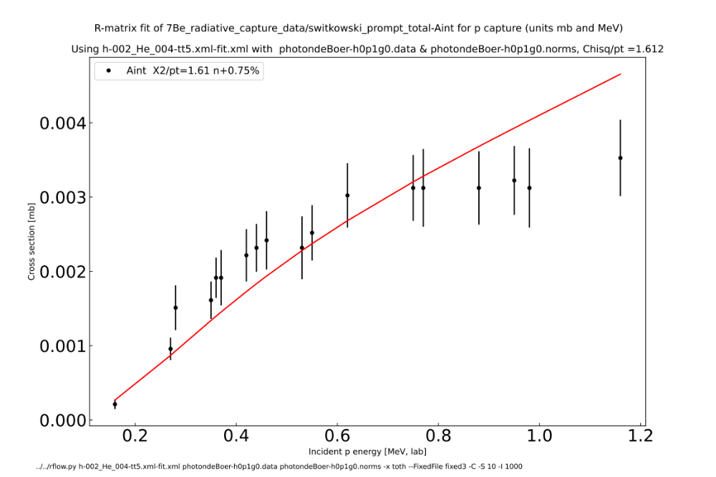
Reich-Moore gammas: (p,γ)Be7 (total=absorption)
All angle-integrated

Slide 22
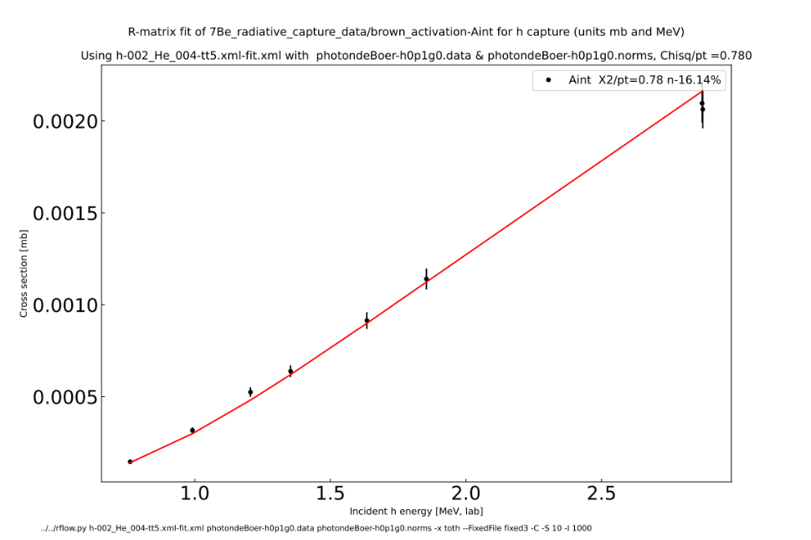
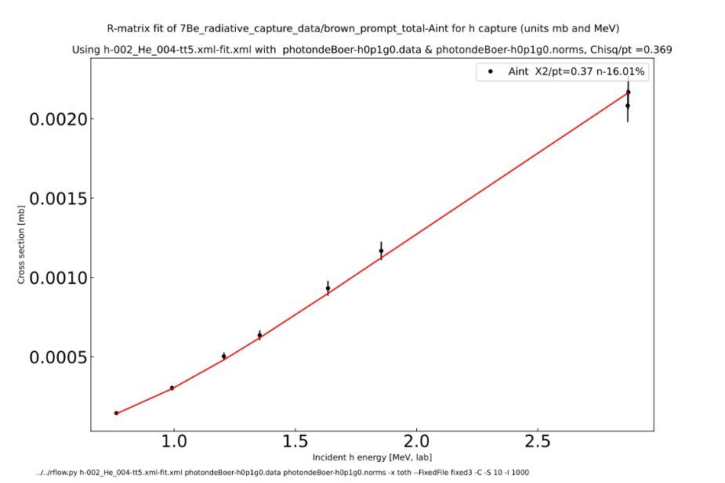
Reich-Moore gammas: (h,γ)Be7 (total=absorption)
All angle-integrated

Slide 23
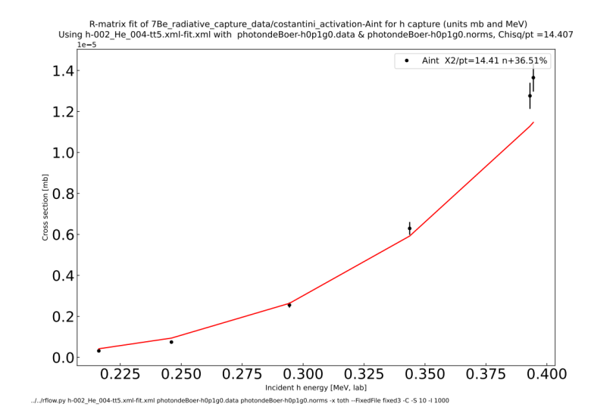
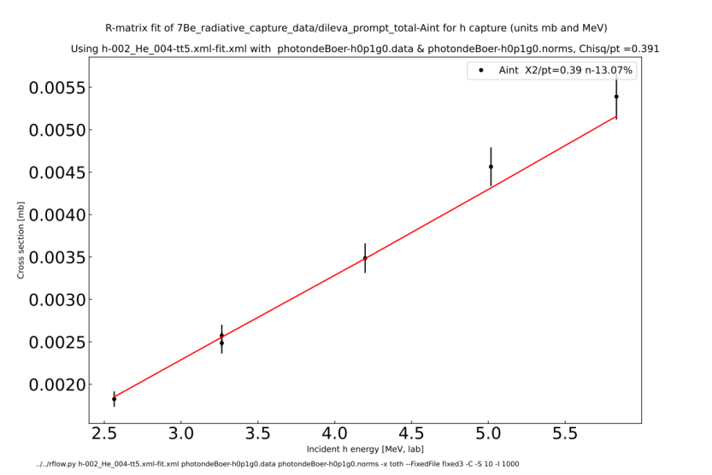
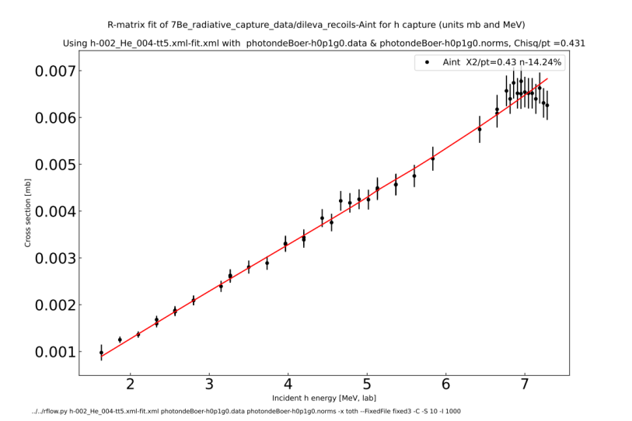
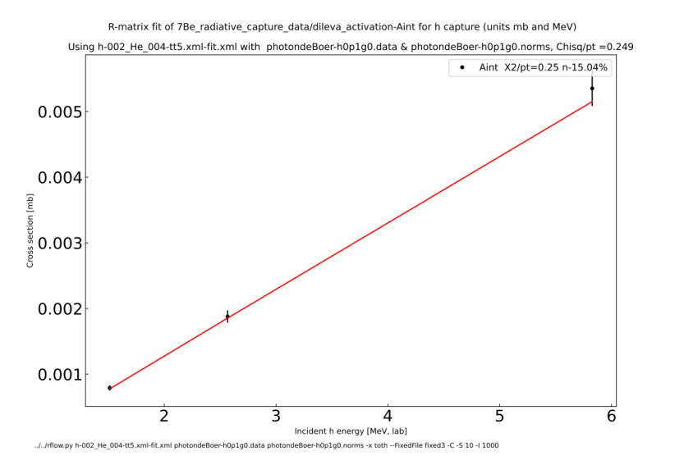
Reich-Moore gammas: (h,γ)Be7 (total=absorption)
All angle-integrated

Slide 24
Data renormalization factors from fit
h-g
  brown_activation -16.2 %
  brown_prompt_total -16.0 %
  costantini_activation +36.5 %
  dileva_activation -15.0 %s
  dileva_prompt_total -13.0 %
  dileva_recoils -14.3 %
  parker_and_kavanagh_prompt -1.5 %
  szucs_activation +2.6 %
p-g
  switkowski_prompt_total: +0.7 %

Slide 25
Discussion of gamma fits
Which to choose: primary channels, or Reich-Moore ?
  Which can be put in ENDF-6 format?
Why large data renormalizations (up and down by 40%) ?

Slide 26
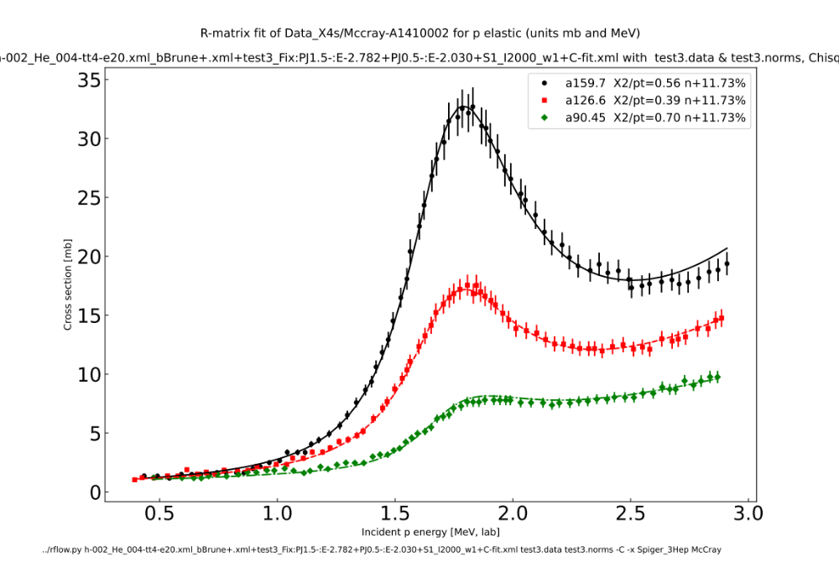
Further particle data up to 20 MeV: refit all data
Now: Mccray-A1410002 (p,p), Spiger-A1094007 (h,p), Tombrello-A1295005 (h,p)
Replacing
Mccray-pp.dat

Slide 27
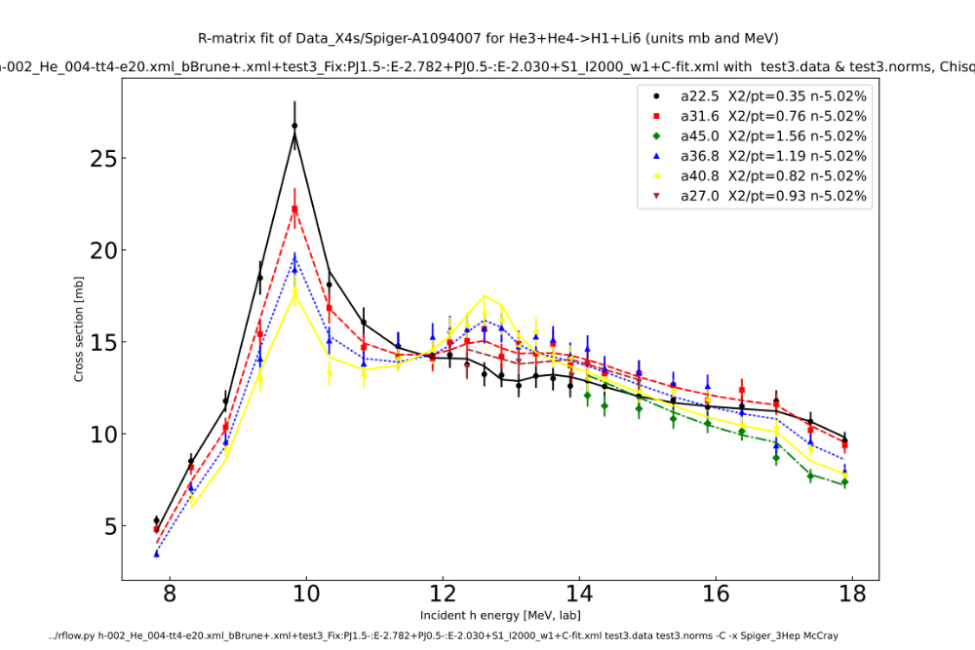
Further proton data up to 20 MeV
Now: Mccray-A1410002 (p,p), Spiger-A1094007 (h,p), Tombrello-A1295005 (h,p)
Replacing
Spiger-cm_ap0.dat

Slide 28
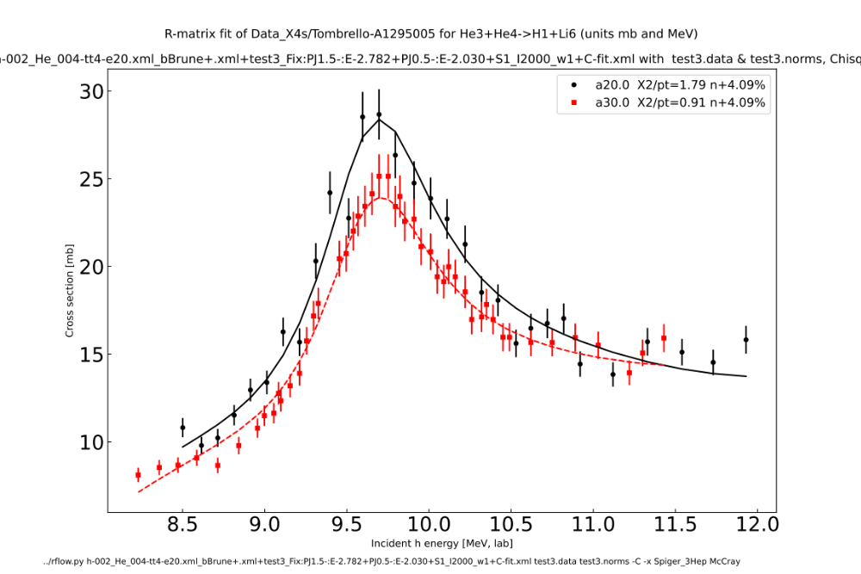
Further particle data up to 20 MeV
Now: Mccray-A1410002 (p,p), Spiger-A1094007 (h,p), Tombrello-A1295005 (h,p)
New
data

Slide 29
Discussion
Are these improved enough to submit to ENDF/B-VIII.1 ?
Submit a p+Li6 evaluation ?

