Slide 1
Current status of LANL ⁷Be evaluation
M. Paris, G. Hale (LANL/T-2)
IAEA Consultancy Meeting of the International Nuclear Data Evaluation Network – Light Elements
2023-08-30
LA-UR-23-29895

Slide 2
Outline
Overview of R-matrix evalution procedure
Evaluation & testing work
  ⁷Be
Conclusion

Slide 3
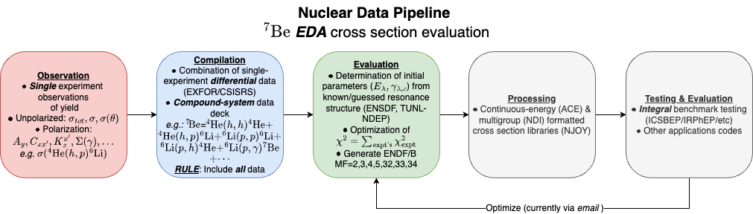
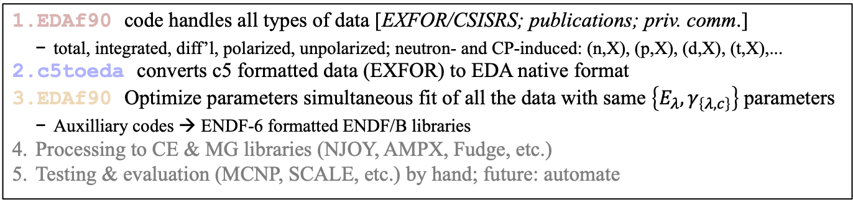
Evaluation pipeline
EDA R-matrix procedure
EDAf90 code handles all types of data [EXFOR/CSISRS; publications; priv. comm.]
  total, integrated, diff’l, polarized, unpolarized; neutron- and CP-induced: (n,X), (p,X), (d,X), (t,X),...
c5toeda converts c5 formatted data (EXFOR) to EDA native format
EDAf90 Optimize parameters simultaneous fit of all the data with same $\left\{E_{λ}, γ_{\left\{λ,c\right\}}\right\}$parameters
  Auxilliary codes → ENDF-6 formatted ENDF/B libraries
Processing to CE & MG libraries (NJOY, AMPX, Fudge, etc.)
Testing & evaluation (MCNP, SCALE, etc.) by hand; future: automate

Slide 4
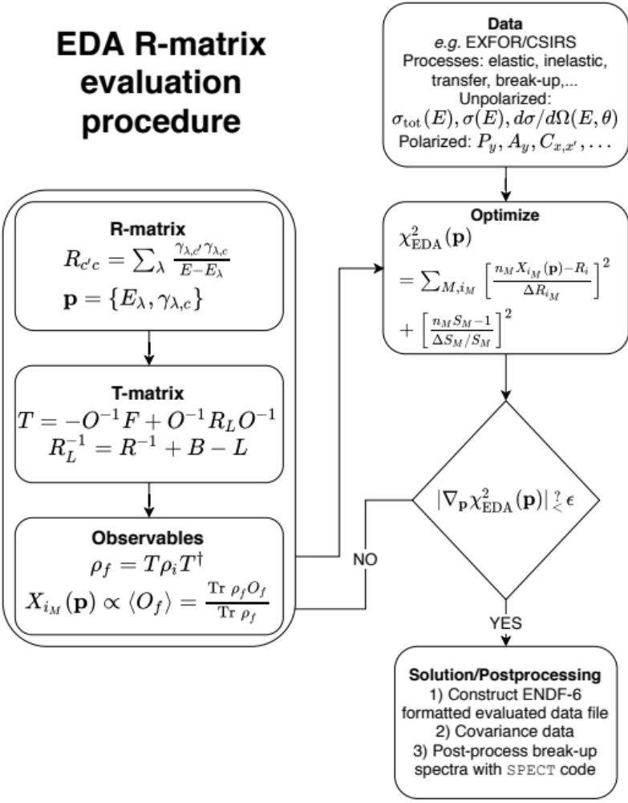
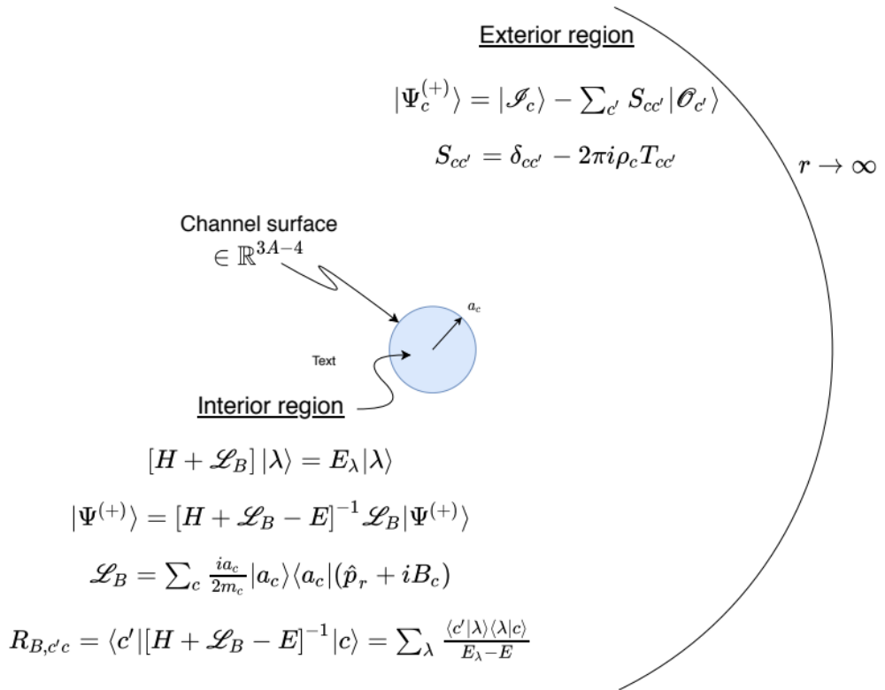
R-matrix
Overview of evaluation framework

Slide 5
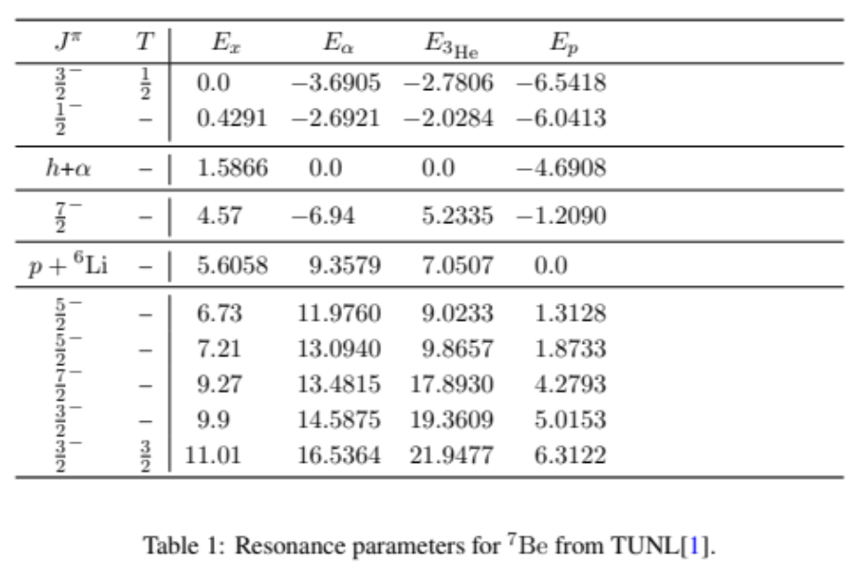
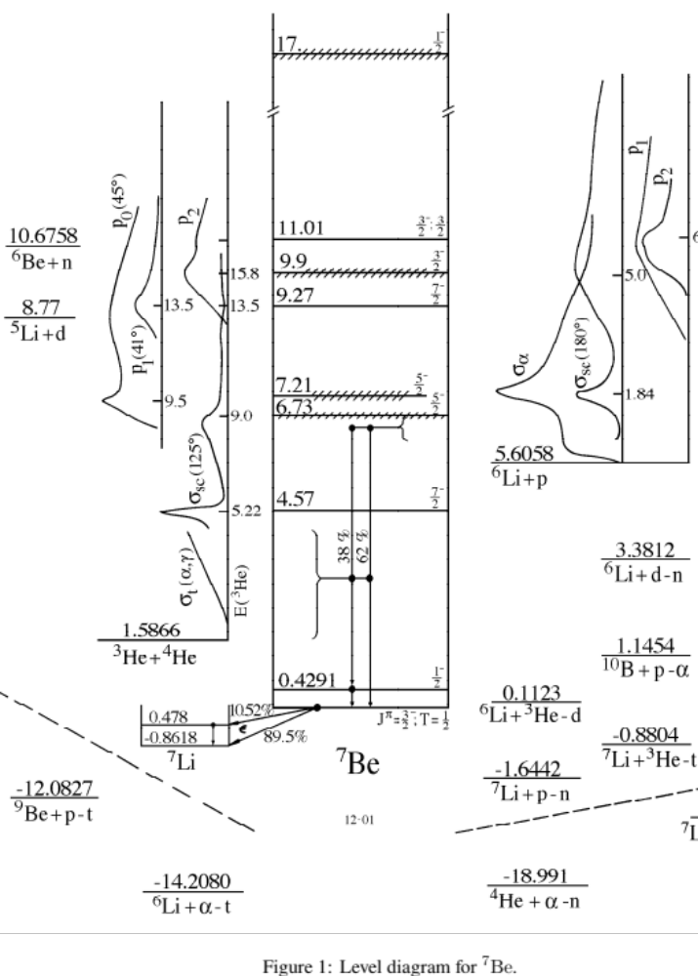
⁷Be
Level diagram

Slide 6
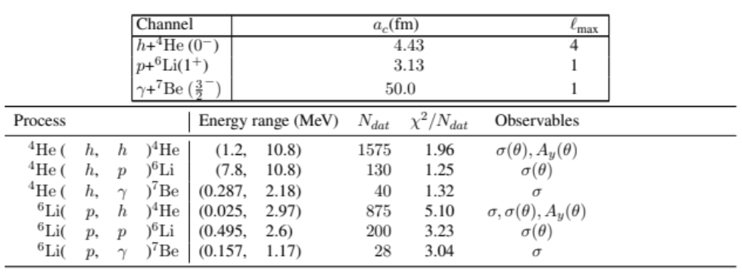
⁷Be
R-matrix configuration

Slide 7
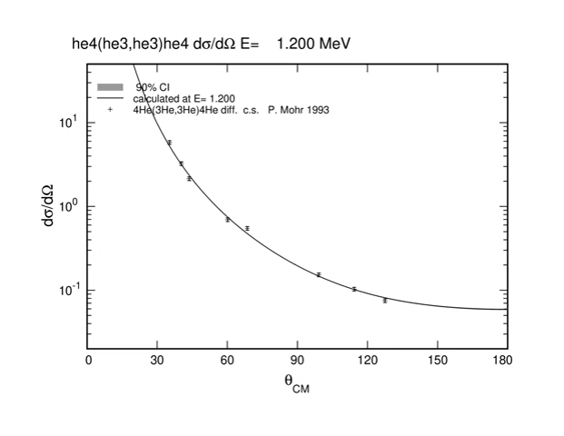
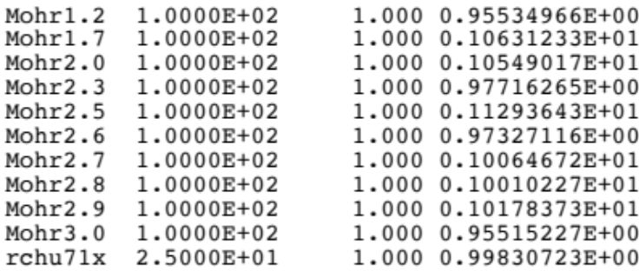
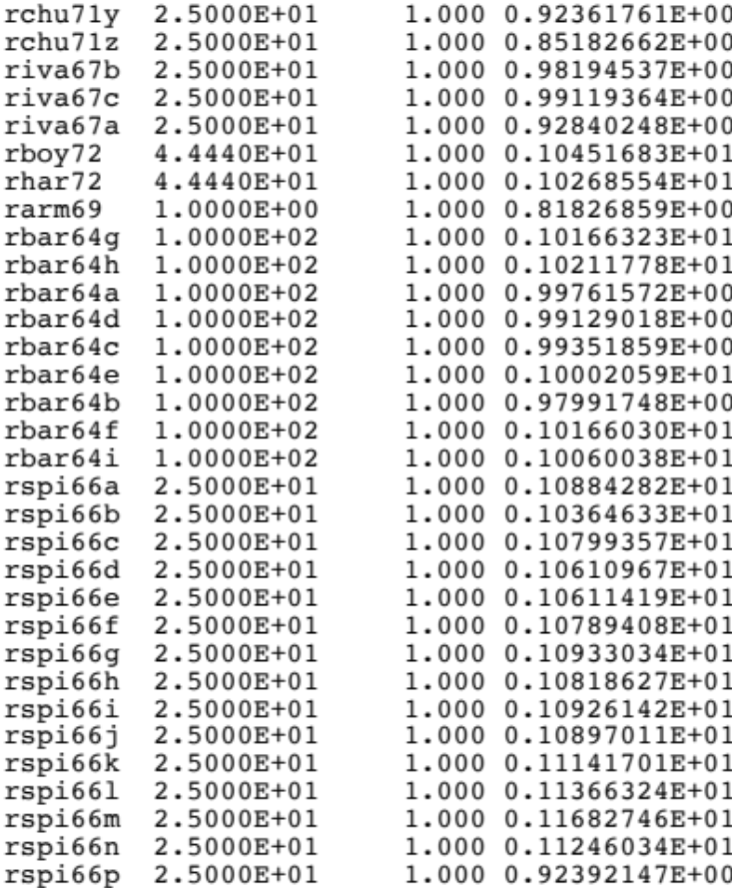
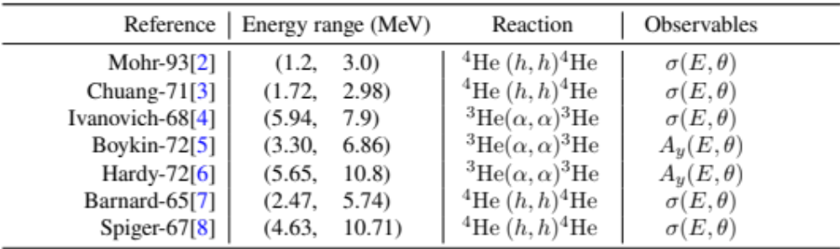
⁷Be
⁴He(h,h)⁴He

Slide 8
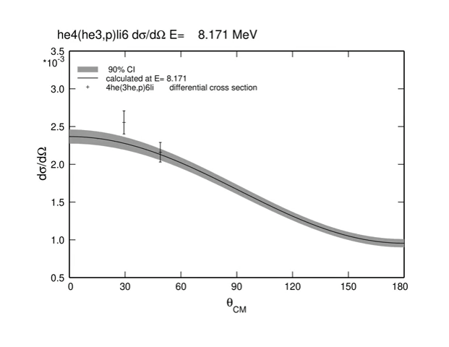
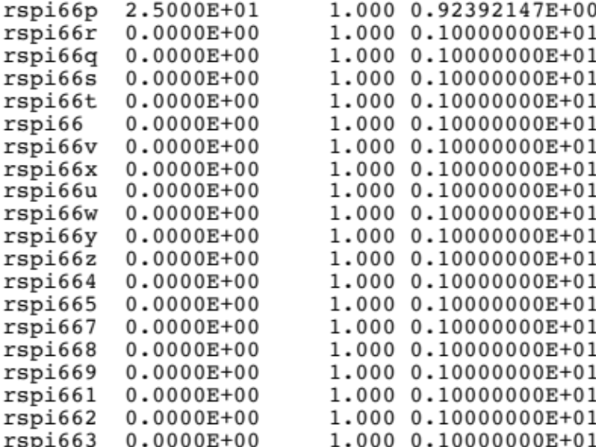
⁷Be
⁴He(h,p)⁴He

Slide 9
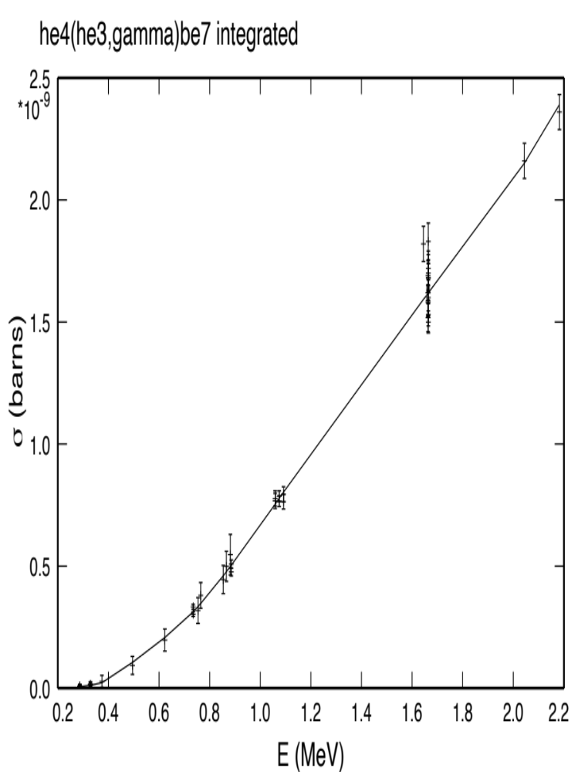
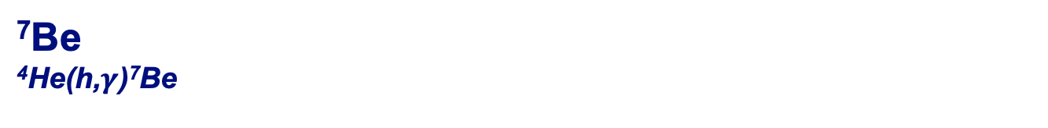
⁷Be
⁴He(h,$γ$)⁷Be

Slide 10
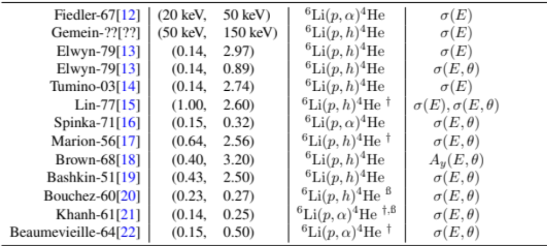
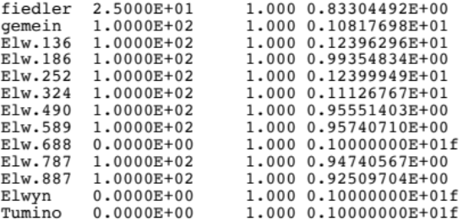
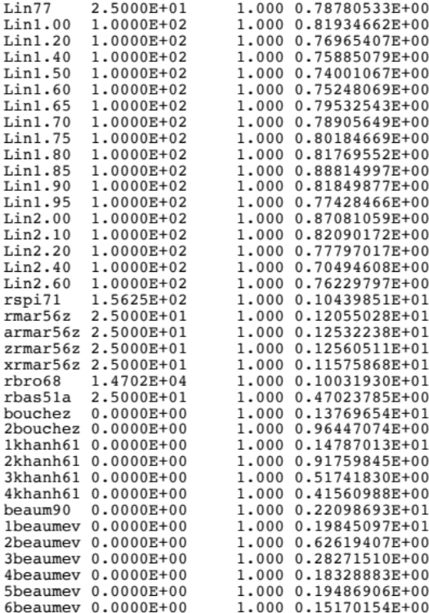
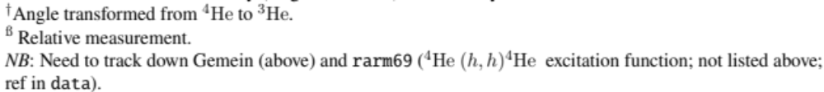
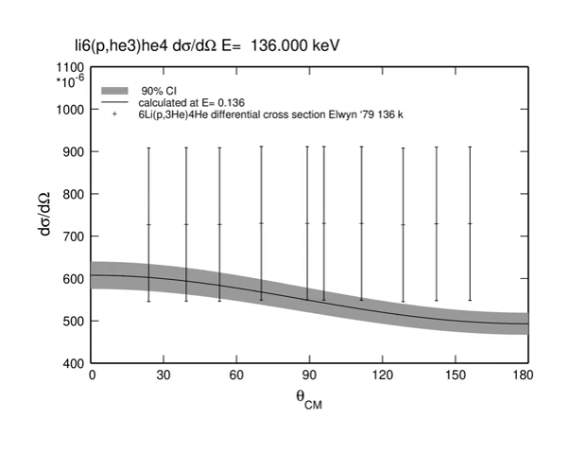
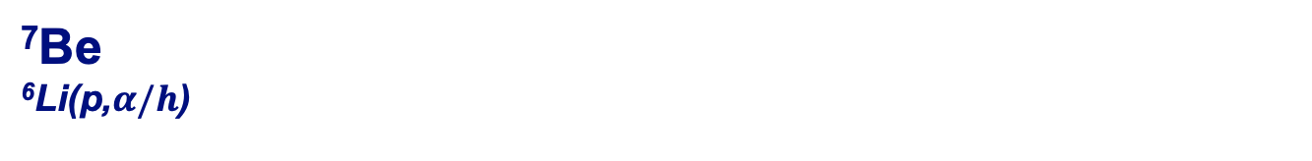
⁷Be
⁶Li(p,$α/h$)

Slide 11
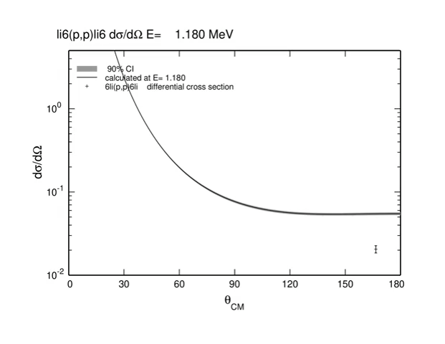
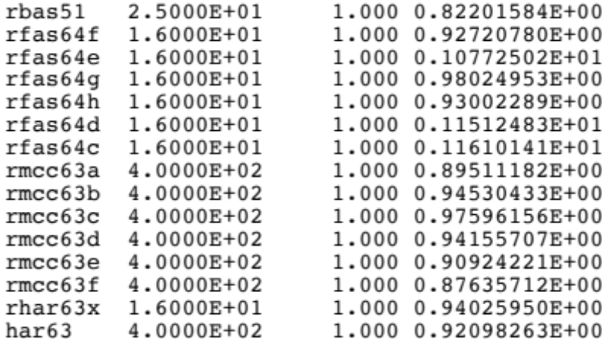
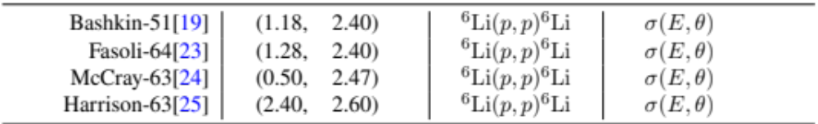
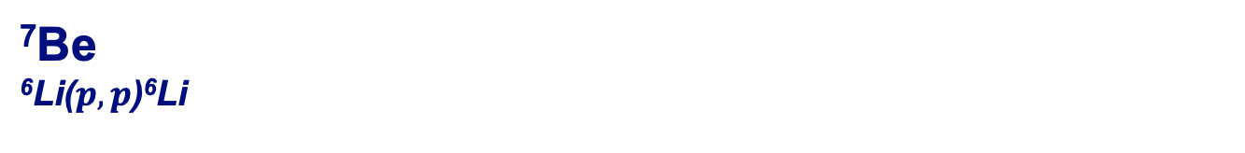
⁷Be
⁶Li($p,p$)⁶Li

Slide 12
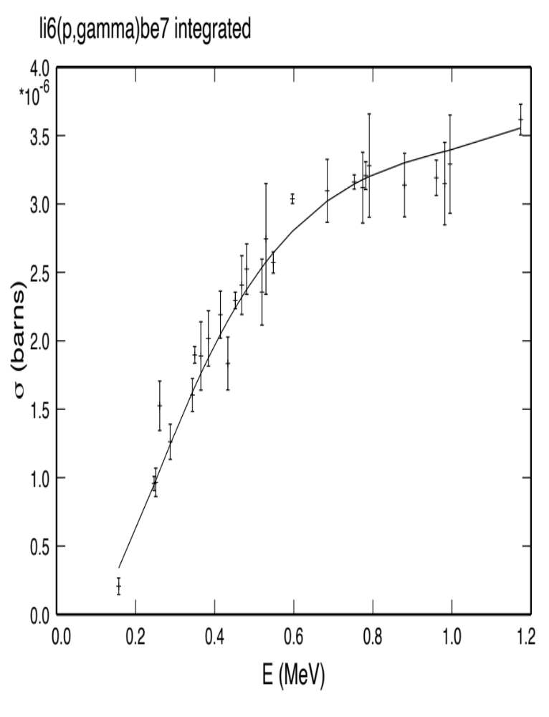
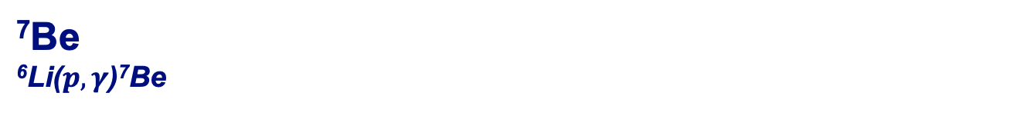
⁷Be
⁶Li($p,γ$)⁷Be

Slide 13
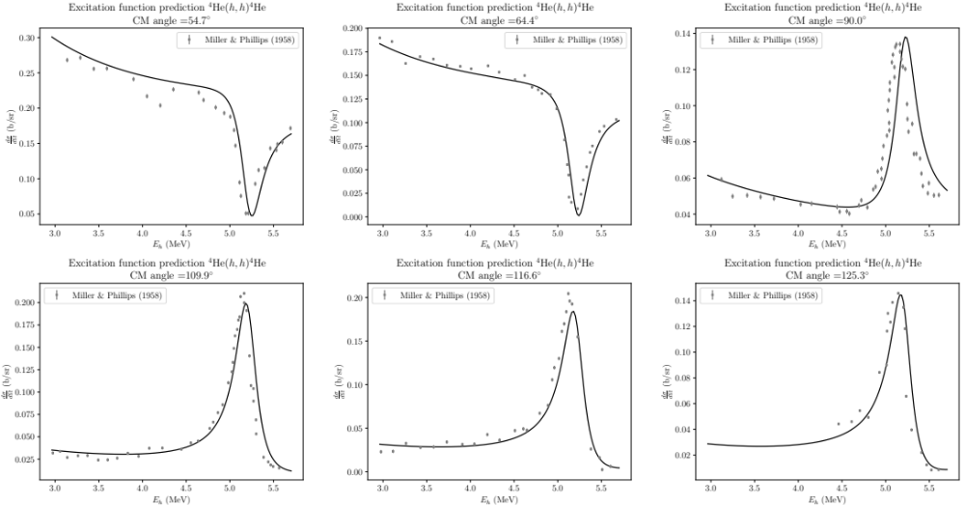
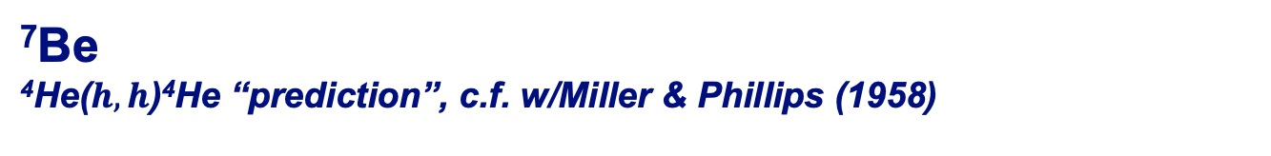
⁷Be
⁴He($h,h$)⁴He “prediction”, c.f. w/Miller & Phillips (1958)

Slide 14
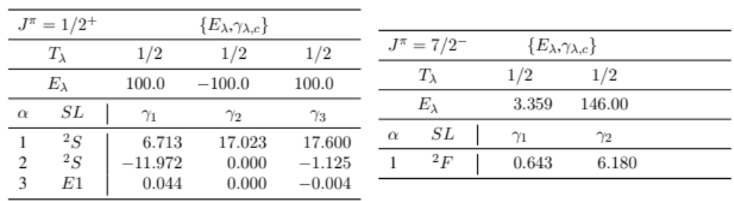
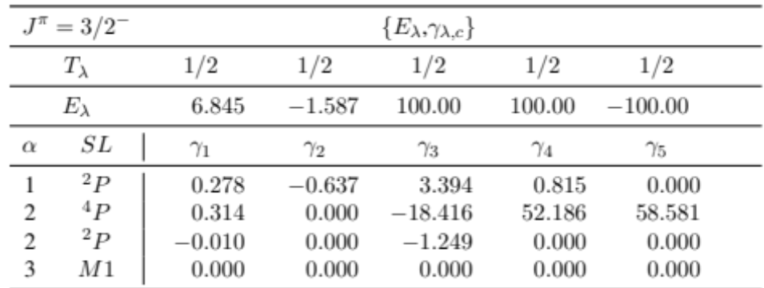
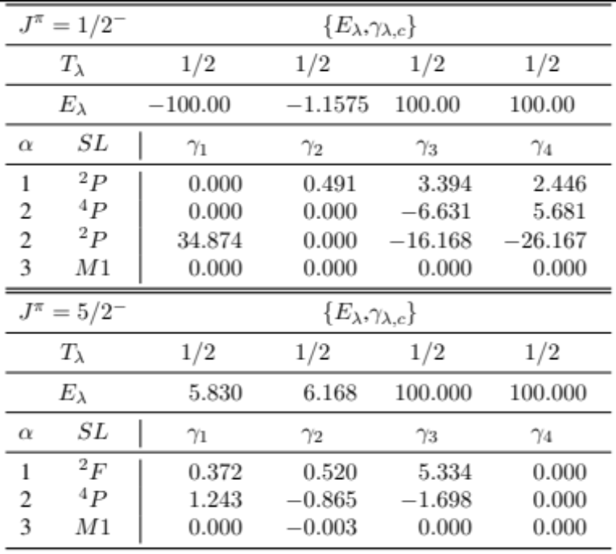
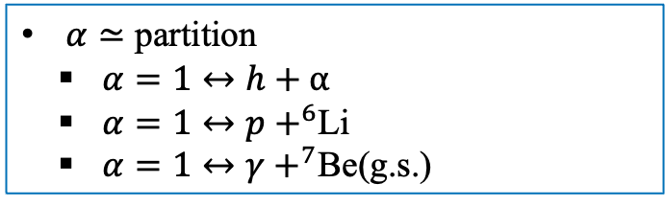
⁷Be
^{R-matrix parameters}
^{(partial set)}
$α≃$ partition
  $α=1↔h+α$
  $α=1↔p+^{6}$Li
  $α=1↔γ+^{7}$Be(g.s.)

Slide 15
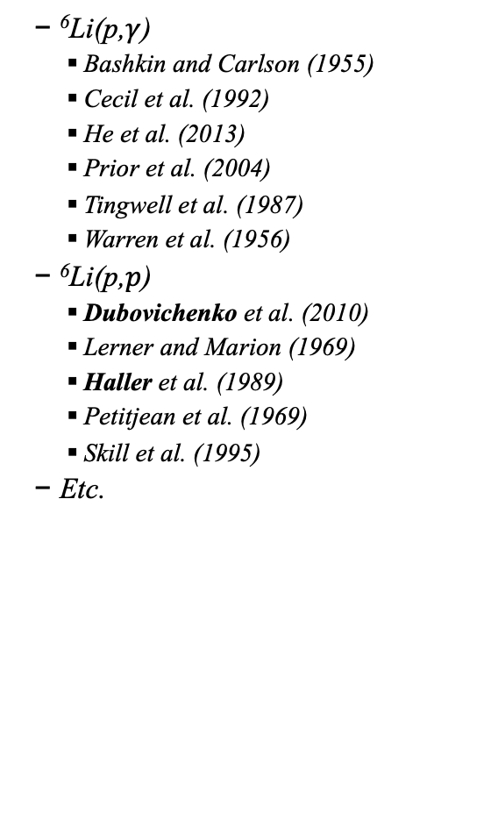
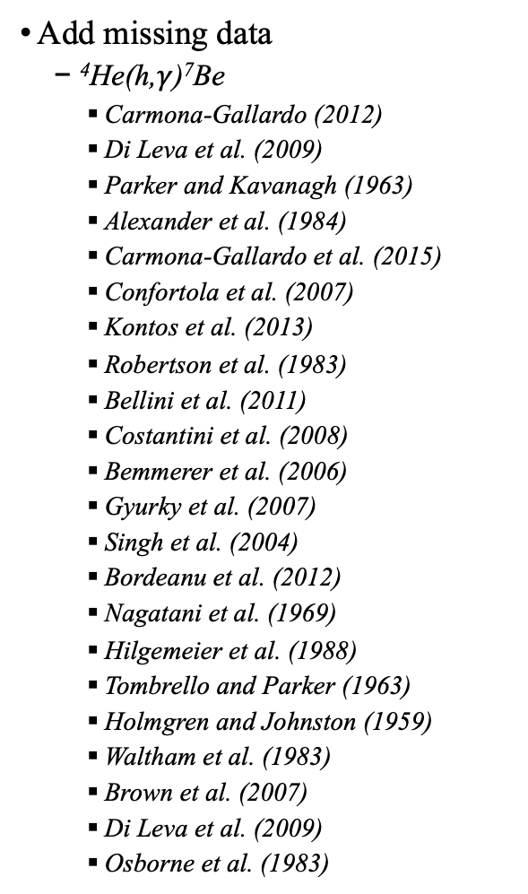
⁷Be: What is to be done.
Add missing data
  ⁴He(h,$γ$)⁷Be
    Carmona-Gallardo (2012)
    Di Leva et al. (2009)
    Parker and Kavanagh (1963)
    Alexander et al. (1984)
    Carmona-Gallardo et al. (2015)
    Confortola et al. (2007)
    Kontos et al. (2013)
    Robertson et al. (1983)
    Bellini et al. (2011)
    Costantini et al. (2008)
    Bemmerer et al. (2006)
    Gyurky et al. (2007)
    Singh et al. (2004)
    Bordeanu et al. (2012)
    Nagatani et al. (1969)
    Hilgemeier et al. (1988)
    Tombrello and Parker (1963)
    Holmgren and Johnston (1959)
    Waltham et al. (1983)
    Brown et al. (2007)
    Di Leva et al. (2009)
    Osborne et al. (1983)
  ⁶Li(p,$γ$)
    Bashkin and Carlson (1955)
    Cecil et al. (1992)
    He et al. (2013)
    Prior et al. (2004)
    Tingwell et al. (1987)
    Warren et al. (1956)
  ⁶Li(p,$p$)
    Dubovichenko et al. (2010)
    Lerner and Marion (1969)
    Haller et al. (1989)
    Petitjean et al. (1969)
    Skill et al. (1995)
  Etc.

Slide 16
⁷Be: What is to be done.
Add missing data
Inelastic (p + ⁶Li*)
⁷Li + ⁷Be

