Slide 1
New fission-product decay data measurements to improve decay heat calculations
Lydie.Giot@subatech.in2p3.fr
SUBATECH,
CNRS-IN2P3, France
In collaboration with the TAS Collaboration (IFIC-Valencia, Univ. of Surrey, Subatech)
Part of this work is also included in an IAEA coordinated paper in preparation, submission foreseen this year
Exchanges with P. Dimitriou and T. Yoshida are acknowledged

Slide 2
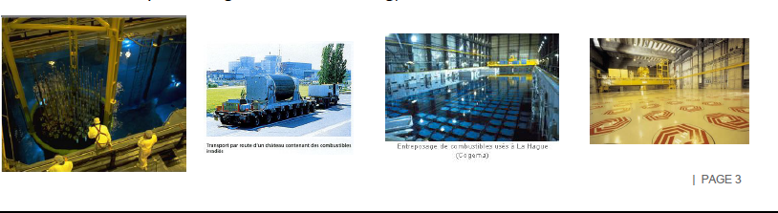
Motivations on Decay Heat
Safety/Radiation protection
Economic interests for the complete cycle (Gen II, Gen III)
Key issue for new concepts: Gen IV, innovative reactor design, innovative fuels, most of the concepts with fast neutrons => not so many data, limited reactor operation feedback
Important design parameter for a spent fuel repository
Nuclear stage impacted | Time of cooling
Safety systems of cooling | 0.1s to 8 days
Unloading of assemblies from core | 5 to 25 days
Fuel transport | 1 to 10 years
Reprocessing, vitrification, storage | 4 to 3000 years
Storage | 50 to 300 000 years and more

Slide 3
Decay Heat calculations
Summation Formula
N_{i} : Number of nuclei i at the cooling time t_{c}
n
λ_{i} : Decay constant of the nucleus i
Σ
DH(t) = f(t) = N_{i}(t_{c}) λ_{i} E_{i}
E_{i} : Total decay energy of the nucleus i
i
- Large time range: 10⁻¹ to 10⁶ years
- Important quantity to design the size/capacity of safety systems
- Complex calculation (reactor modeling + depletion): quality of the code but also of the data !
- ~ 40 000 nuclear data: σ, E, Branching Ratio, λ, Fission Yields, ν
- Increasing will of safety authorities to ask for a precise calculation & detailed uncertainty quantification
- Interest of industry to reduce the uncertainty for economic reasons, with keeping the same level of safety
- For Gen IV reactors, most of codes developed/benchmarked for/on LWR reactors
Rigorous calculation with evaluated codes associated to experimental validation
but also identification of biases in the calculation/data to improve them ….

Slide 4
Available Decay Heat Measurements for U/Pu cycle
Available decay heat measurements = Possible to get/use them ☺
GE Morris/ HEDL UO₂, 80 PWR/BWR assemblies
Fission Pulses ²³⁵U_{th}, ²³⁹Pu_{th}, ²⁴¹Pu_{th}
CLAB UO₂, 74 PWR/BWR assemblies
0.3 s
1 day
2 years
11 years
27 years
Cooling time
Available in AIEA CONDERC database
Foreseen to be included in the SFCOMPO NEA database
- 2022 new Data@CLAB : DH of 5 assemblies PWR/BWR UO₂ cooling 4-21 years
Calculations performed in a blind way with same inputs: geometry, materials, reactor operation + cooling time, DH measurements given after the calculations..
Blind benchmark exercise for spent nuclear fuel decay heat, P. Jansson et al., Nucl. Sc. & Eng., 2022
- 60 new CLAB DH measurements foreseen (EPRI Report published soon)
Notes:
GE morris/HEDL : calorimetric measurements
GE morris BWR: 3.4->4 enrichment, burnup 15-47 MWd/kg, 2-11 years of cooling
GE morris PWR: 1.1-2.5 enrichment, burnup 27-39 MWd/kg, 3-8 years of cooling
HEDL 2.5 enrichment, 26-28 burnup, coolin 3-5 years
PWR measurements only till 8 years !!!!
Be careful, number of measurements higher than number of assmeblies (several measurements time to time for some assemblies at different cooling time)
Merci experiment @OSIRIS reactor UO₂ rod, cooling time:0.02-43 days, but cea/edf properties, no external access possible so far

Slide 5
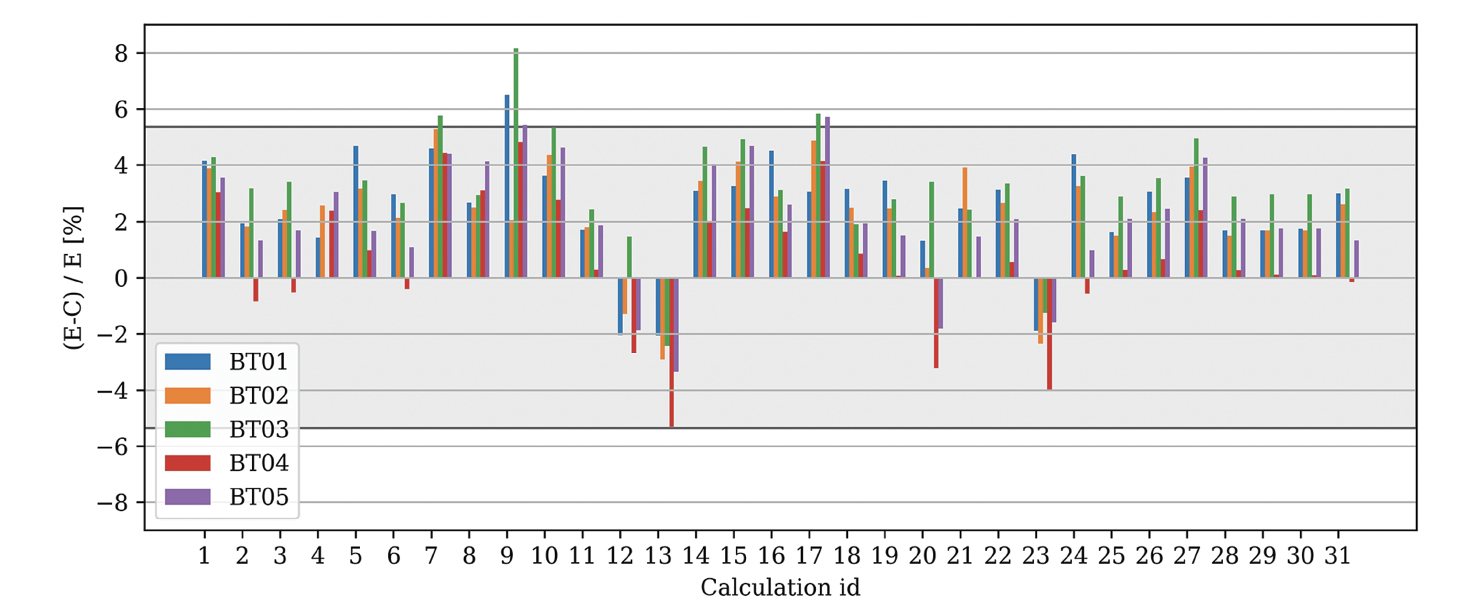
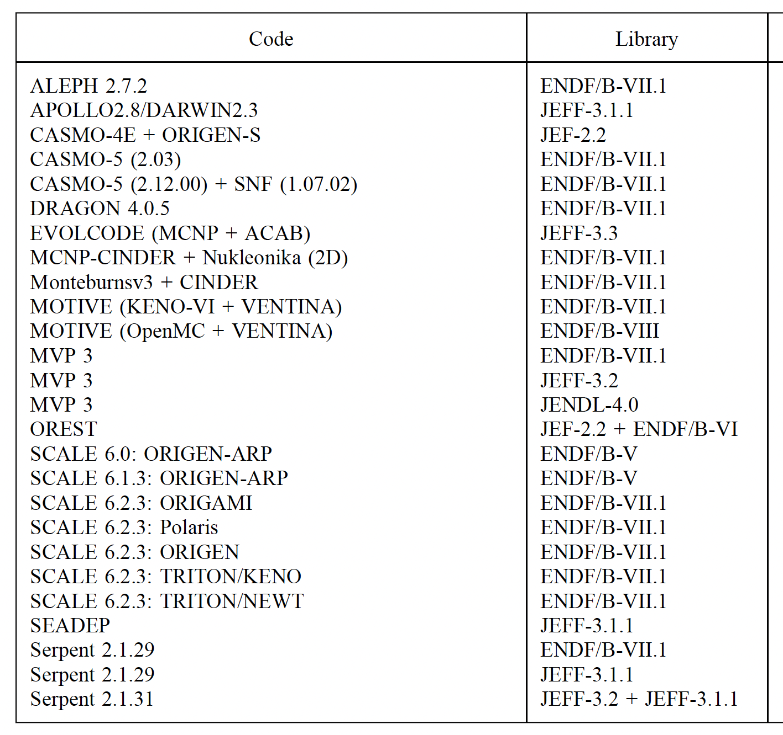
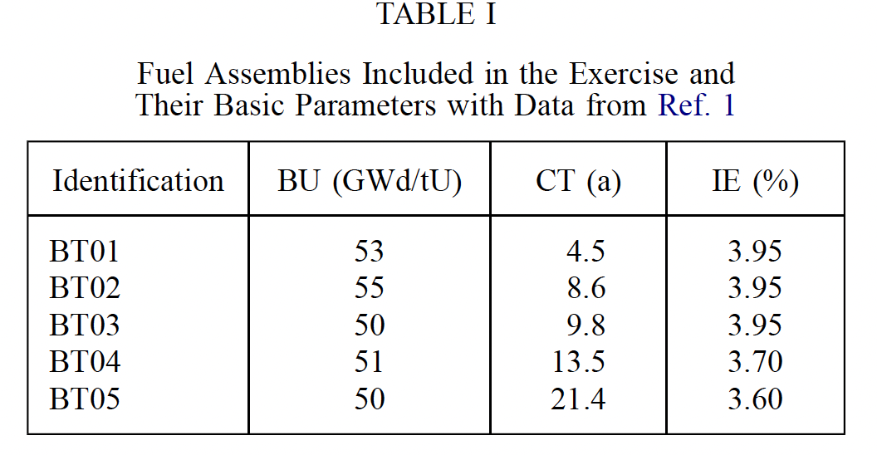
Available Decay Heat Measurements for U/Pu cycle
Blind benchmark exercise for spent nuclear fuel decay heat, P. Jansson et al., Nucl. Sc. & Eng., 2022

Slide 6
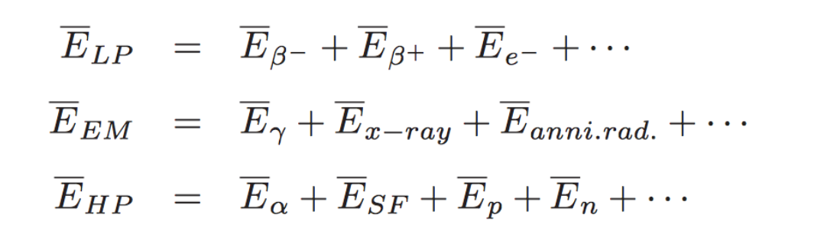
Decay Heat calculations
n
Σ
DH(t) = f(t) = N_{i}(t_{c}) λ_{i} E_{i}
i
Bateman equations solved to get Atomic Densities N_{i} at the cooling time
Depletion calculation within a reactor model + code (e.g with SERPENT)
dN_{i}(t)
Σ
=
( b_{j→i} λ_{j} + φ σ_{j→i} ) N_{j}(t)
b_{j→i}: branching ratio
dt
j
φ : neutron flux
- ( λ_{i} + φ σ_{i} ) N_{i}(t)
E_{i} is usually divided in evaluated librairies(e.g ENDF, JEFF, JENDL) in 3 parts :
Light particles component
Electromagnetic component
Heavy particles component

Slide 7
Decay Energy and Pandemonium effect
- Total Decay energy (E_{i}) measurements
Before the 90s, conventional detection techniques: high resolution γ-ray spectroscopy
Excellent resolution but efficiency which strongly decreases with increasing energy
Risk of overlooking the existence of β⁻ feeding into the high energy nuclear levels of daughter nuclei
Incomplete decay schemes: overestimate E_{beta}, underestimate E_{gamma}
Missing
Level 3
Gamma intensity entering the level 1
Level 3
Not all ΣI_{i} seen by the Ge detector
_{Z}A_{N}
Level 2
_{Z}A_{N}
Level 2
I_{β}
I_{γ-in-1} = I₂ + I₃
I_{β}
Σi_{i} = 0
I₂
I₃
Q_{β}
Level 1
Q_{β}
Level 1
Gamma intensity leaving the level 1
REAL FEEDING
I_{T}
APPARENT
FEEDING
I_{T}
Apparent beta intensity
Ground state
I_{T} = I_{γ-in-1} + I_{β}
Ground state
Beta intensity feeding the level 1
I_{T} = I_{γ-out-1} = I_{β}
_{Z+1}A_{N-1}
I_{β} = I_{T} - I_{γ-in-1}
_{Z+1}A_{N-1}
Bias in nuclear data bases for some key FP nuclei and all their applications (safeguards, DH, antineutrinos experiments)
=> Known as the « Pandemonium effect »
J. Hardy et al., PLB 71 (2) 307, 1977
Notes:
o John Milton's Paradise Lost.

Slide 8
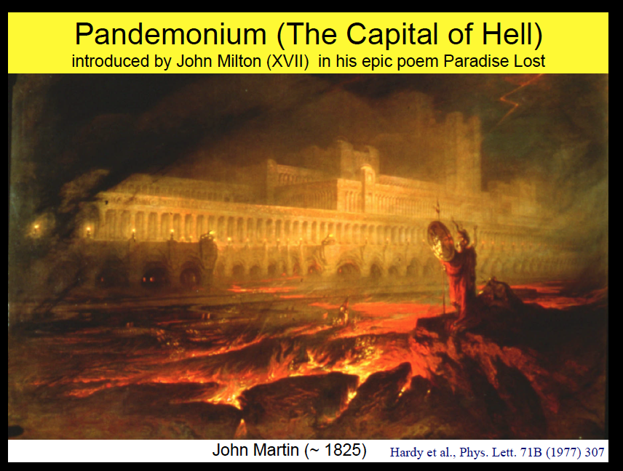
II. Total Decay Energy and Pandemonium effect
Decay Energy and Pandemonium effect
Courtesy of A. Algora

Slide 9
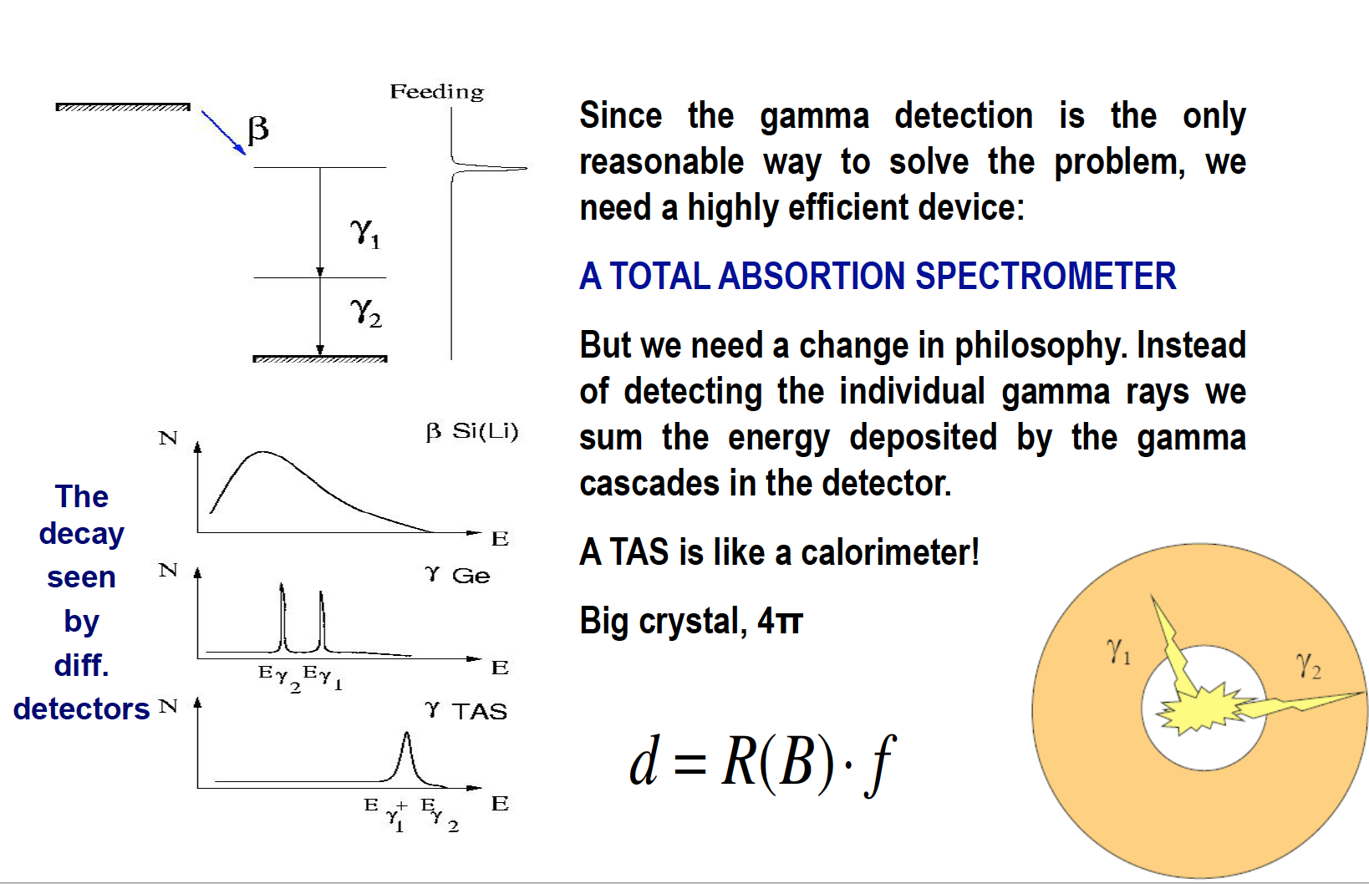
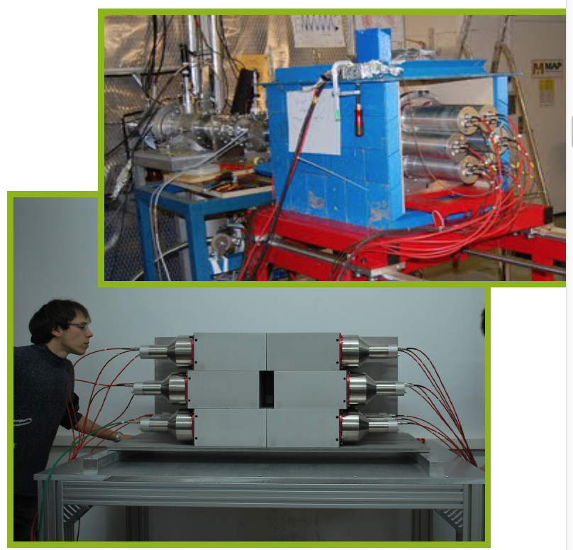
Total Absorption Gamma spectroscopy technique
Most suitable technique to re-measure key nuclei: Total Absorption Spectroscopy
IFIC Valencia/Subatech/Surrey TAGS collaboration
Experiments @ Jyväskylä, Finland to high precision penning trap (Pure beams)
TAGS Arrays, Valencia
From TAS collaboration: contacts A. Algora & J. L. Tain @Valencia, W. Gelletly@Surrey, M. Fallot@Subatech

Slide 10
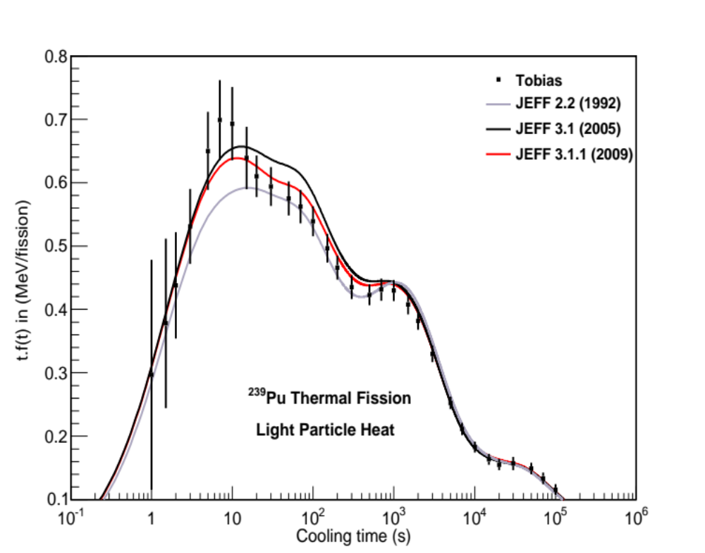
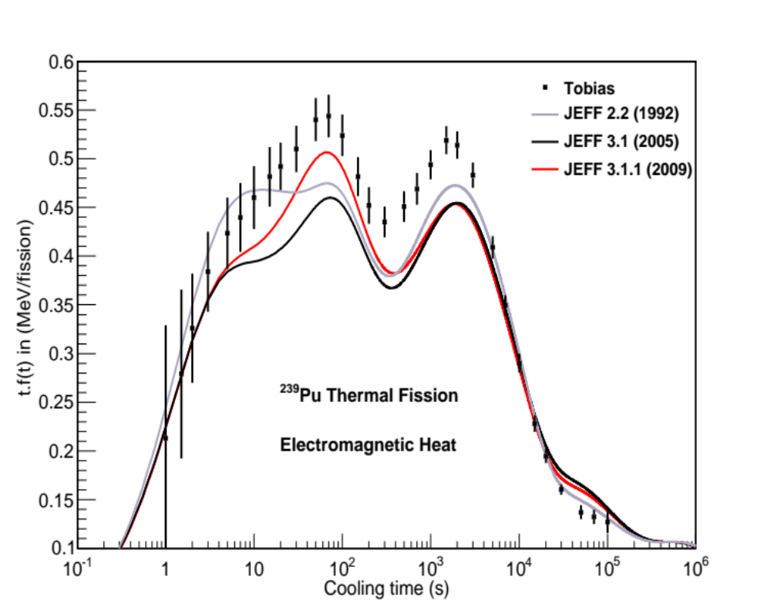
TAGS Measurements in decay libraries
- 1990s: 50 TAGS measurements per Greenwood et al @ IDAHO National Laboratory
R. Greenwood et al., NIM A 390, 95, 1997
First inclusion of 29 nuclei in JEFF-3.1.1, M. Kellett & O. Bersillon, EPJ Web Conf 146 0209 (2017)
Also taken into account in the release of ENDF/B-VII.1 (2011)

Slide 11
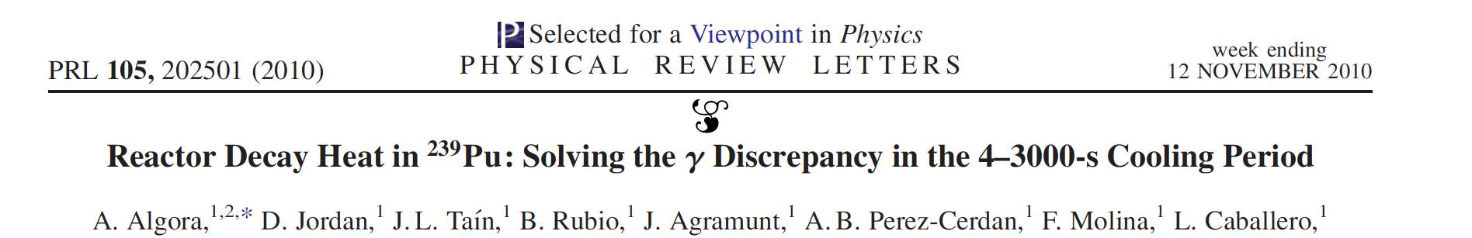
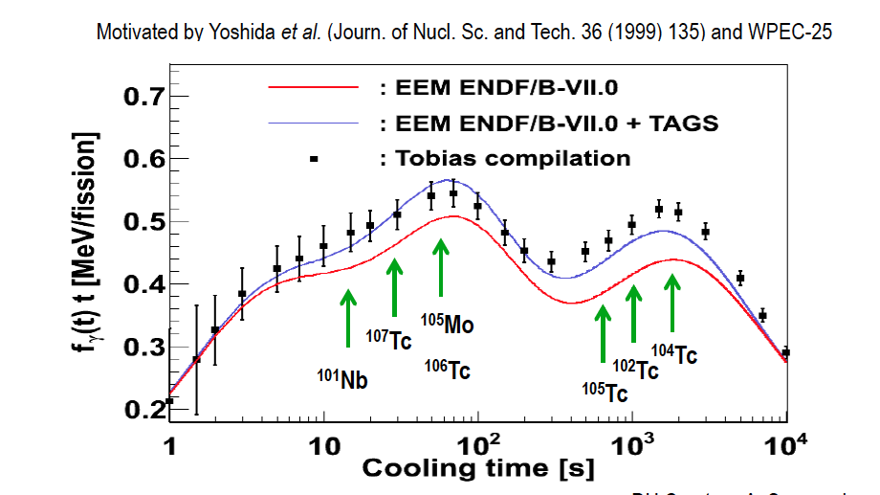
II. Decay Heat Calculation
TAGS Measurements in decay libraries
TAGS Measurements from the TAS collaboration
EEM DH (MeV/fission)
Strong impact on Electromagnetic component of Decay Heat for ²³⁹Pu thermal fission
¹⁰⁵Mo, ^{104,105,106,107}Tc
Suffered from Pandemonium
In JEFF 3.3 & ENDF/B-VII.1
Cooling time (s)
Same results obtained with SERPENT + JEFF 3.1.1

Slide 12
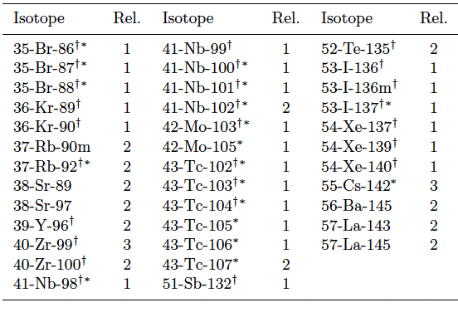

II. Decay Heat Calculation
Published TAGS Measurements so far …
TAS Collaboration : IFIC Valencia, Univ. of Surrey, Subatech
3 experimental campaigns (2007, 2009, 2014)
+ Experiment 09/2022 @Jyvaskyla
MTAS Collaboration : Univ. of Warsaw, ORNL, Univ of Tennessee
Experiments @ Argonne National Laboratory’s CARIBU facility
Parent nuclides identified per WPEC-25 for TAGS meas. for ²³⁵U/²³⁹Pu reactors, (NEA, T. Yoshida/ A. Nichols, 2007)
+ ^{91,94,95}Rb, ^{96m}Y
+ ^{89,90}Rb
In total, 29 published nuclei
: also relevant for ²³²Th/²³³U cycle
A. Algora et al., EPJ A 57, 2021

Slide 13
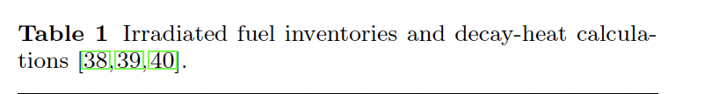
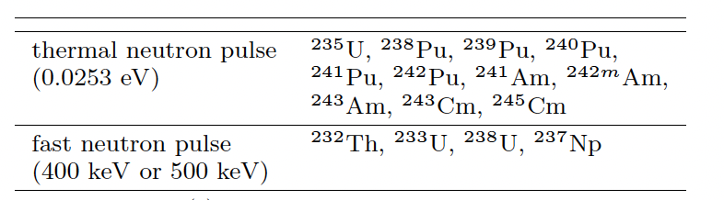
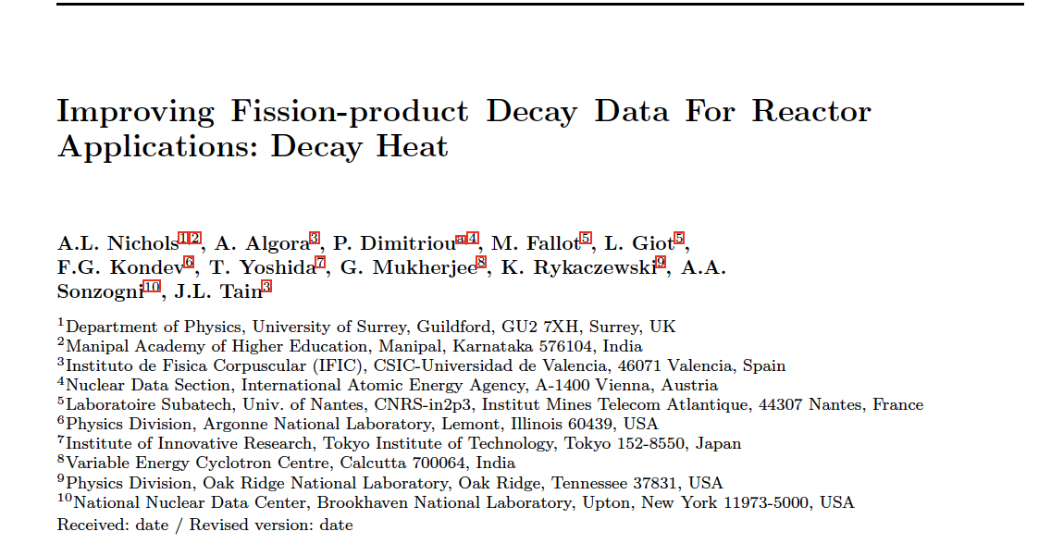
II. Decay Heat Calculation
Impact of TAGS data on Decay Heat calculations
- Impact of the 28 published TAGS (wo ^{96m}Y ) nuclei on Decay Heat calculations for 15 systems were studied
Systems chosen to compare to FISPACT-II DH calc. with classical libraries (ENDF/B-VII.1, JEFF3.1.1, JENDL4-0)
M. Fleming, J. C. Sublet, 2015, CCFE-R15-28
DH experimental meas. available
in IAEA CONDERC database
- Results presented here are part of a Review paper coordinated per IAEA (P. Dimitriou) on TAGS measurements, in completion phase
Serpent used for DH with JEFF libraries + TAGS data
But also used for cross-checks on DH with ENDF (FISPACT-II/P. Dimitriou) + TAGS data
or JENDL (OYAK98/ T. Yoshida & F. Minato) + TAGS data

Slide 14
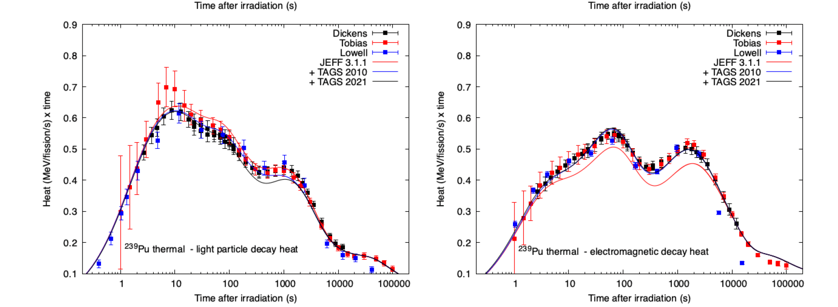
II. Decay Heat Calculation
Impact of TAGS data on Decay Heat calculations
- For each fissioning system:
3 sets of DH calculations combining the same FY library each time with :
- Decay Data without the Algora 2010 TAGS data: reference library or baseline
- Decay Data with the Algora 2010 TAGS data : + TAGS 2010
- Decay Data with the 2021 TAGS published data : + TAGS 2021
+ TAGS 2010 : improved agreement for ²³⁹Pu_{th}, ²⁴¹Pu_{th} & ²³⁸U_{fast}
small impact for ²³²Th_{fast} & ²³³U_{fast}
²³⁹Pu_{th}
²³⁹Pu_{th}
Same conclusions with ENDF library

Slide 15
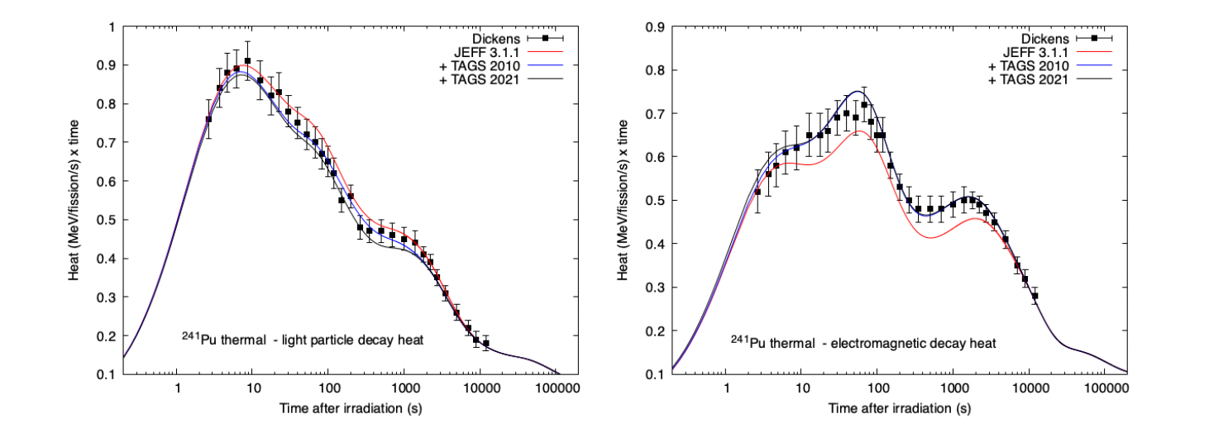
II. Decay Heat Calculation
Impact of TAGS data on Decay Heat calculations
- For each fissioning system:
3 sets of DH calculations combining the same FY library each time with :
- Decay Data without the Algora 2010 TAGS data: reference library or baseline
- Decay Data with the Algora 2010 TAGS data : + TAGS 2010
- Decay Data with the 2021 TAGS published data : + TAGS 2021
+ TAGS 2010 : improved agreement for ²³⁹Pu_{th}, ²⁴¹Pu_{th} & ²³⁸U_{fast}
small impact for ²³²Th_{fast} & ²³³U_{fast}
²⁴¹Pu_{th}
²⁴¹Pu_{th}
Same conclusions with ENDF library

Slide 16
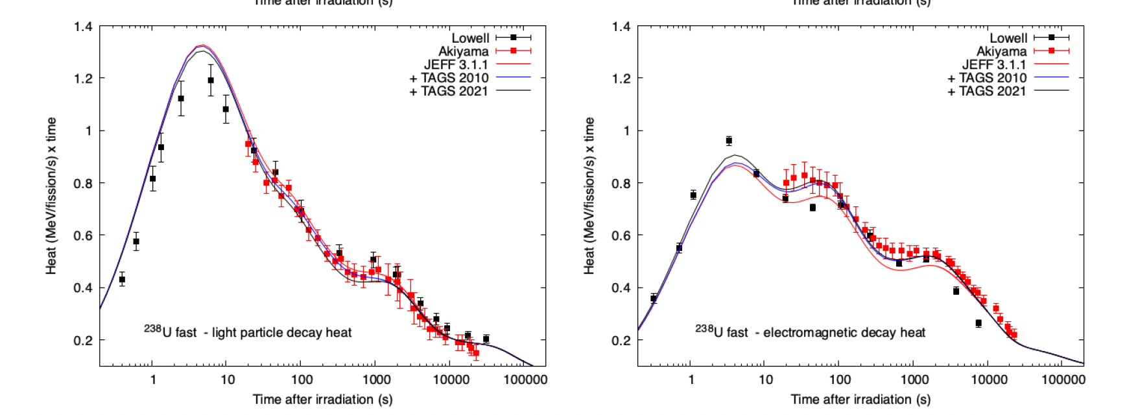
II. Decay Heat Calculation
Impact of TAGS data on Decay Heat calculations
- For each fissioning system:
3 sets of DH calculations combining the same FY library each time with :
- Decay Data without the Algora 2010 TAGS data: reference library or baseline
- Decay Data with the Algora 2010 TAGS data : + TAGS 2010
- Decay Data with the 2021 TAGS published data : + TAGS 2021
+ TAGS 2010 : improved agreement for ²³⁹Pu_{th}, ²⁴¹Pu_{th} & ²³⁸U_{fast}
small impact for ²³²Th_{fast} & ²³³U_{fast}
²³⁸U_{fast}
²³⁸U_{fast}
Same conclusions with ENDF library

Slide 17
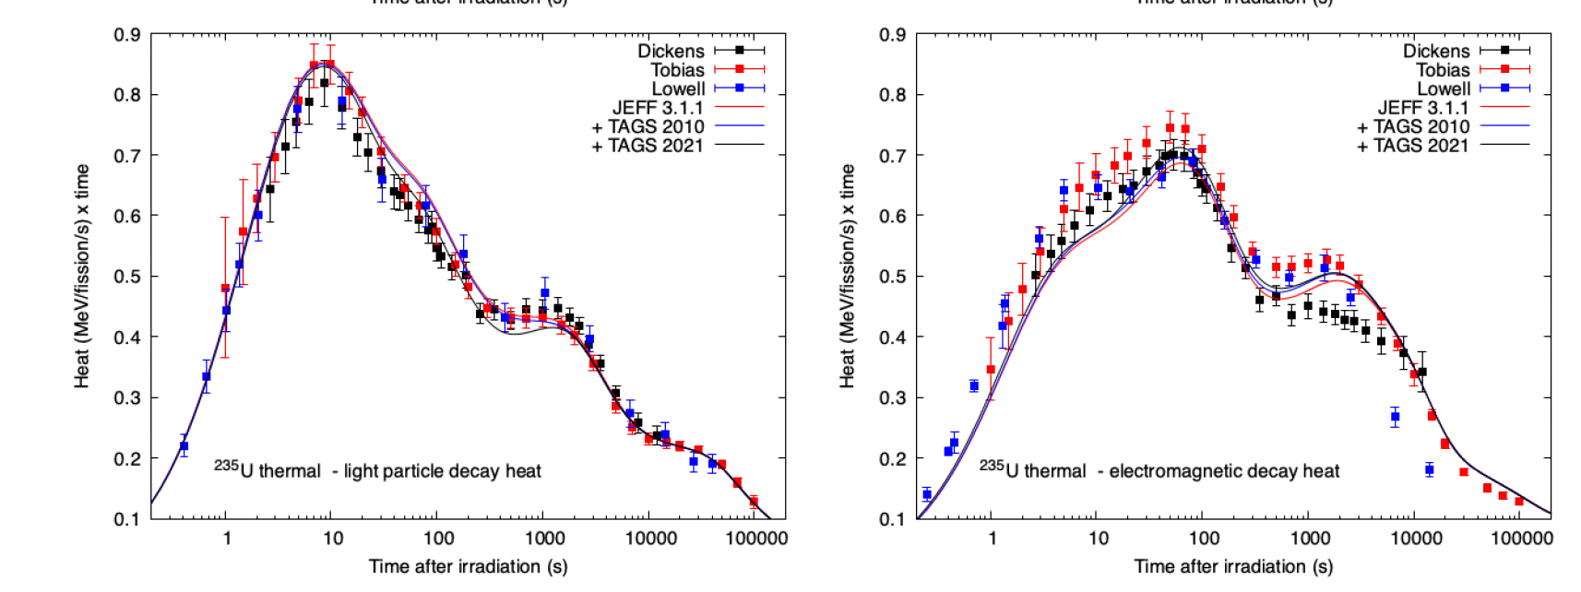
II. Decay Heat Calculation
Impact of TAGS data on Decay Heat calculations
²³⁵U_{th}
+ TAGS 2010 : no impact on ELP component
+ TAGS 2021 : ELP slightly improved in 10-400s but underestimation in 400-1000s
Hard to say on EEM wrt differences between the 3 experimental sets !
²³⁵U_{th}
²³⁵U_{th}
Need of new DH fission pulse experiments ☺
Same conclusions with ENDF library

Slide 18
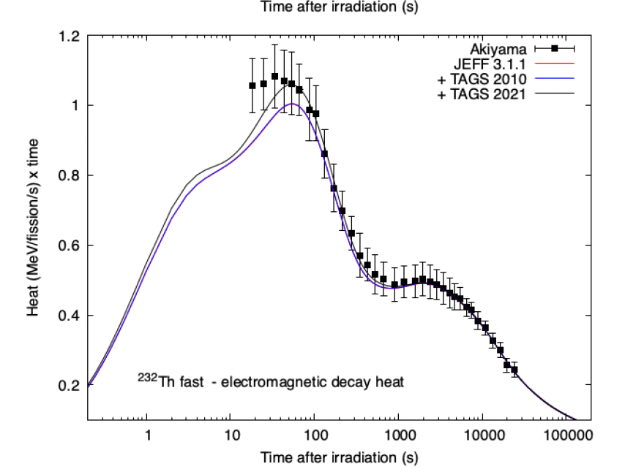
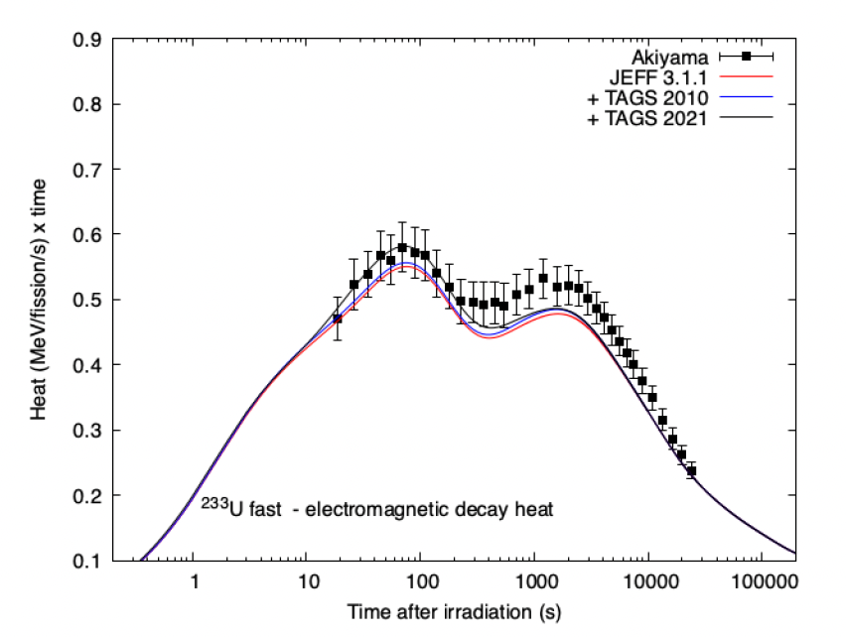
II. Decay Heat Calculation
Impact of TAGS data on Decay Heat calculations
+ TAGS 2021 : improved agreement of EEM component for ²³³U_{fast}, ²³⁸U_{fast}, ²³²Th_{fast}, for cooling time below 100s
²³²Th_{fast}
²³³U_{fast}
But also need of new DH fission pulse experiments ☺
Need to investigate key FPs for cooling range > 100s

Slide 19
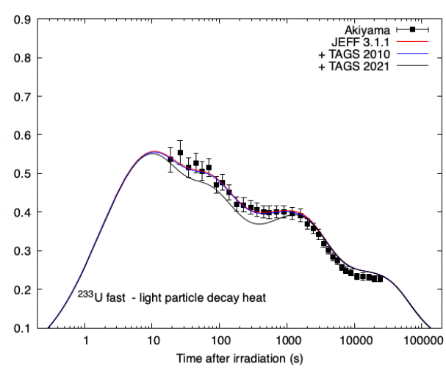
II. Decay Heat Calculation
Impact of TAGS data on Decay Heat calculations
+ TAGS 2021 : small under estimation of ELP component for ²³⁵U_{th}, ²³⁹Pu_{th}, ²⁴¹Pu_{th}, ²³³U_{fast} & ²³⁸U_{fast} at cooling times ranging from 30s to 1000s
²⁴¹Pu_{th}
²³³U_{fast}
=> Only one set of experimental data, till in the errors bars for ²⁴¹Pu_{th}
=> Needs for extra experimental data but also extra investigation on key FP suffering of Pandemonium effect
=> Also on going work to take into account FY and DD uncertainties through MC sampling
Same conclusions with ENDF library

Slide 20
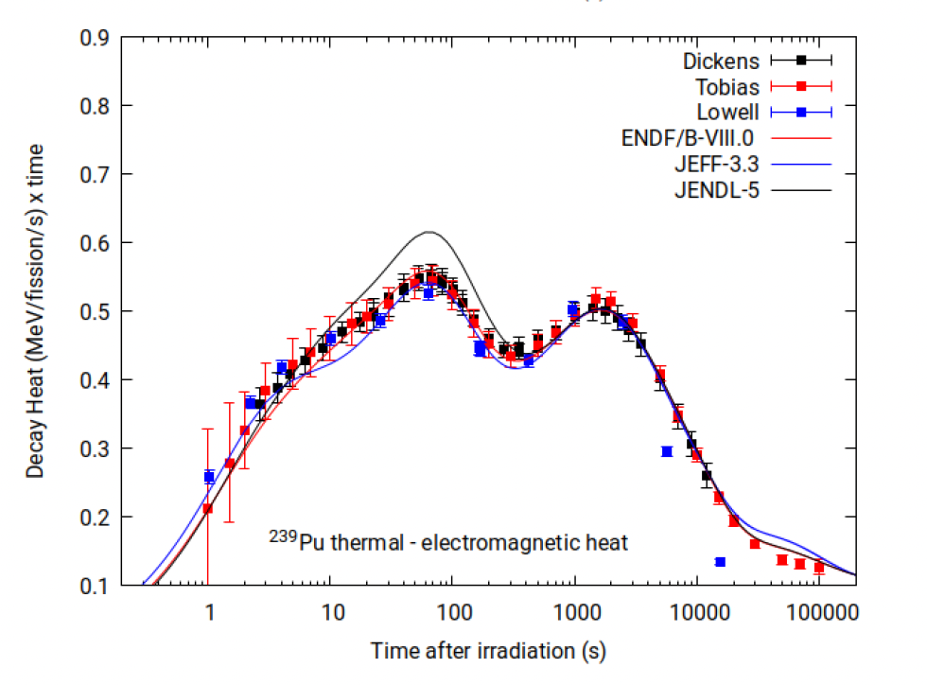
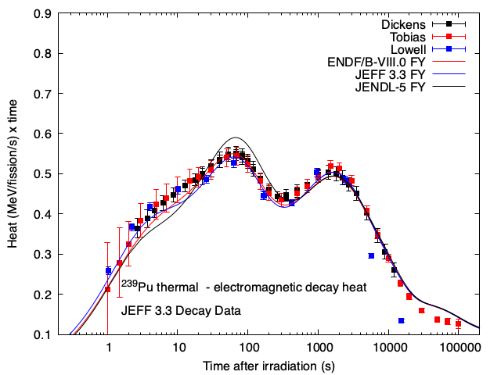
II. Decay Heat Calculation
Impact of TAGS data on DH calculations
Overestimation of EEM component for JENDL5 for ²³⁹Pu_{th}
Impact of Fission Yields ?
²³⁹Pu_{th}
²³⁹Pu_{th}

Slide 21
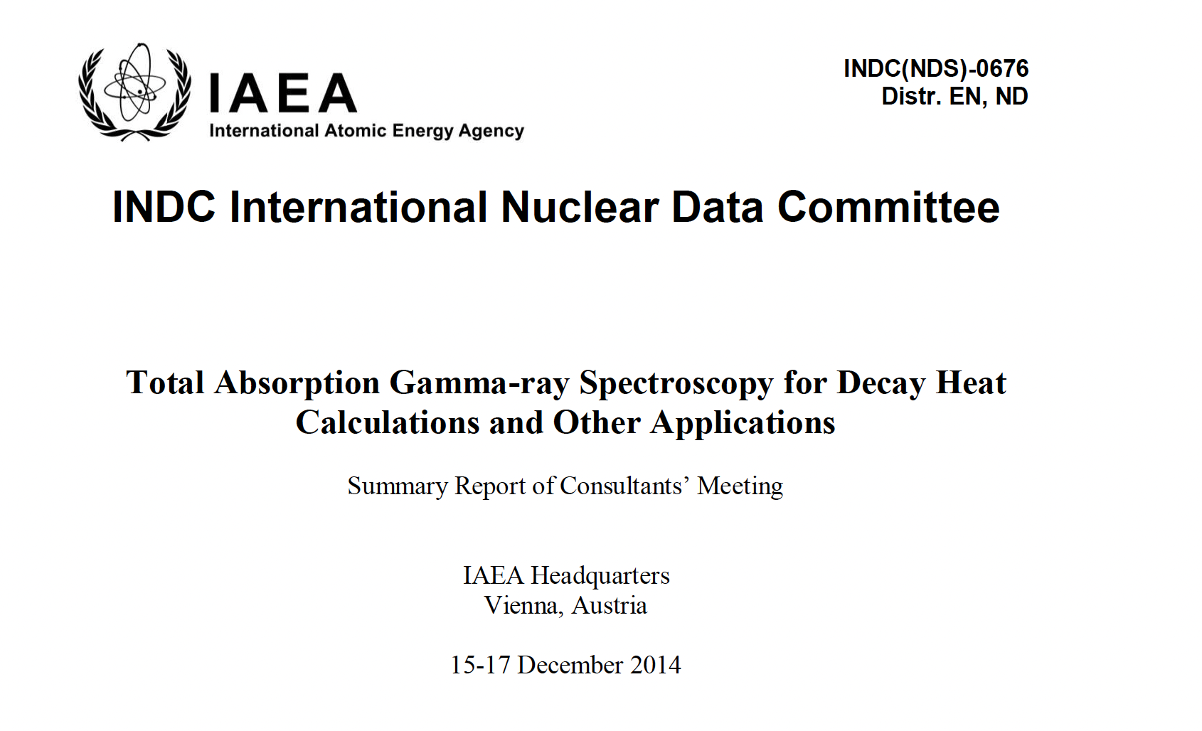
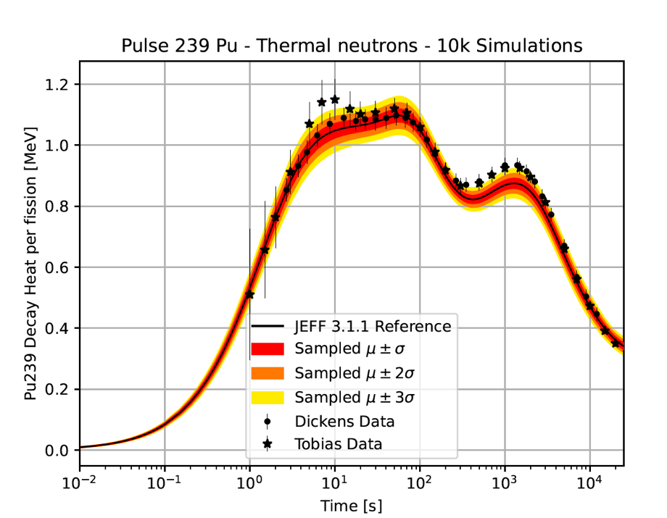

II. Decay Heat Calculation
Final remarks and Outlooks
- Further extensive assessments need to accomodate the impact of delayed neutrons on decay heat up 10s cooling time
- Further investigations are needed to improve DH exp data vs calculations :
- New Decay Heat fission pulse experiments …
- New TAGS measurements based on WPEC-25 list and IAEA consultants’ meetings
priority 1 nuclei : ^{99,100}Zr, ^{98,99}Nb,^{130m, 132}Sb,¹³⁸Cs, ¹⁴³La
priority 2 nuclei :
⁸⁴As, ⁸⁵Se, ^{84,89}Br, ⁹¹Kr, ⁹²⁻⁹⁵Sr, ⁹⁷Y, ¹⁰⁵Nb, ^{104,107}Mo, ¹⁰⁸Tc, ¹³³Sb,
^{136,137}Te, ^{139, 141, 143, 144}Ba, ¹⁴⁴⁻¹⁴⁷La, ¹⁴⁶Pr, ¹³⁹⁻¹⁴¹Cs, ^{136,136m}I, ¹⁴⁰Xe
- Extra investigations to identify key FP & Pandemonium candidates
-- on pulse calculations
taking also into account uncertainties on Decay Data
on-going PhD @Subatech Y. Molla, 2021-2024
-- on new fuels/ reactor concepts
ex: new PhD @Subatech&LPSC M. Tazreiter 2022-2025
on Molten Salt Reactors

Slide 22
Thank you

