Slide 1

TUNL Contributions in the Nuclear Structure and Decay Data network
Nuclear Structure Data Evaluation Program
J.H. Kelley - USNDP Structure Group Leader: (9 months FTE),
J. Purcell (emeritus 0.1 FTE), and open
We are responsible for nuclear structure evaluation in the A=2-20 mass region
  Energy Levels of Light Nuclei reviews published in Nuclear Physics A
  ENSDF files for A=2-20
  XUNDL from A=2-20
Web interface for A=3-20 Information
This material is based upon work supported by the U.S. Department of Energy, Office of Science, Office of Nuclear Physics.

Slide 2
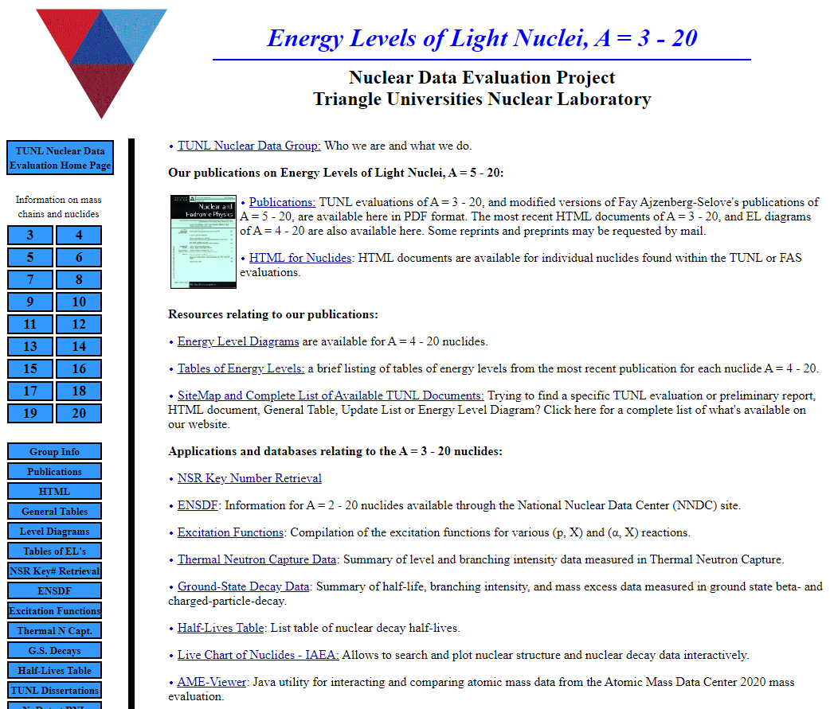

Slide 3

Evaluation Activities
A-Chains:
  Submitted A=13
  Preparing NDS articles A=14(Kelley), A=5(Purcell)
ENSDF datasets for
  Submitted ¹⁷O
  Preparing update on ⁴n, some work on ^{18,19}Ne
β-decay lifetimes A=3-20 (up-to-date)

Slide 4
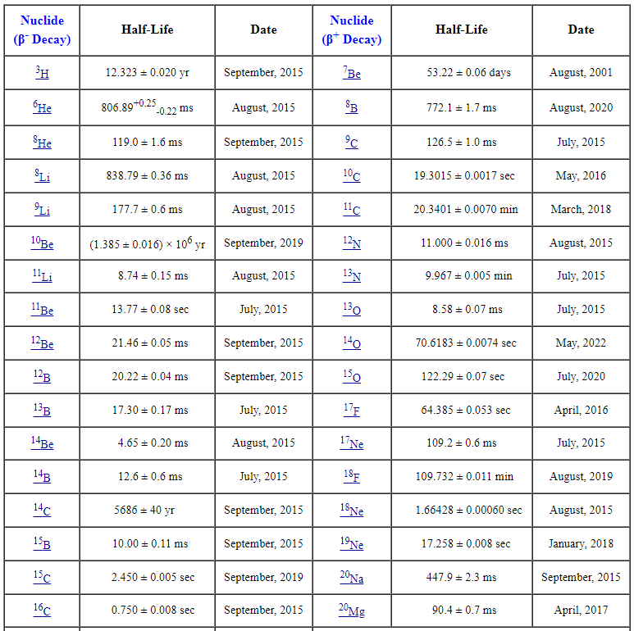
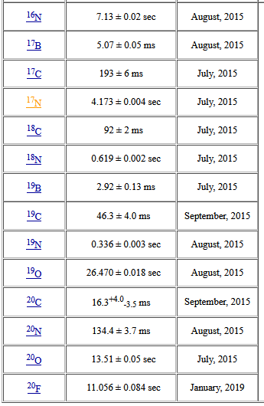
Comments on β-decay lifetimes
Research Experience for Undergraduate Project (Susan Olmstead) in 2015:
Compiled relevant articles
Use McMaster data group’s Java averaging program
Evaluated lifetimes using a variety of averaging methods
Produced a table of recommended values

Slide 5
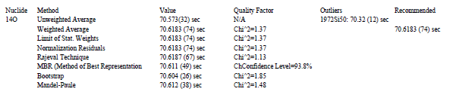
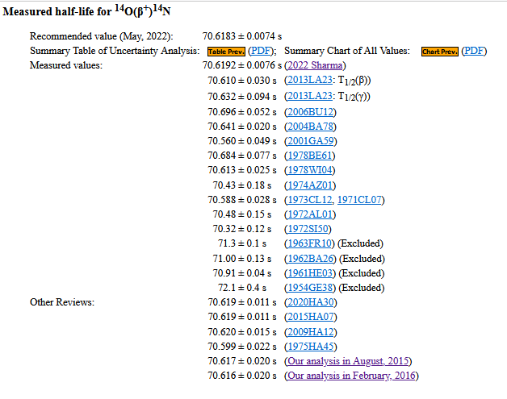
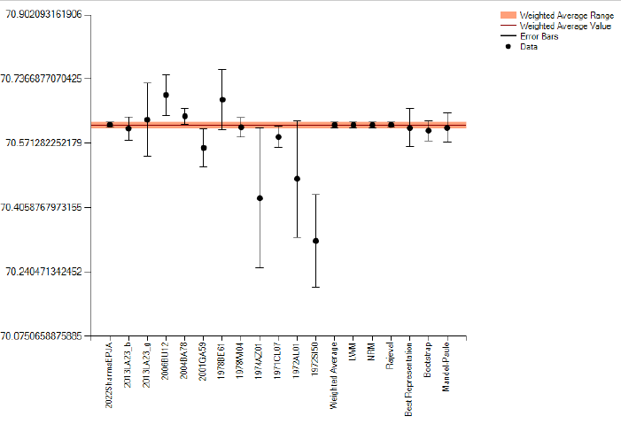
β-decay lifetimes -continued
Comments on β-decay lifetimes

Slide 6
Compilation Activities
Committed to XUNDL (A=2-20)
  FY22 40 articles/49 datasets
  FY21 41 articles/36 datasets
  FY20 47 articles/52 datasets
Compilation of ground state decay & β-decay references and data
Compilation of (p,X) and (α,X) excitation functions
Compilation of thermal neutron capture references and data
TUNL Dissertations-

Slide 7
FY 2022: Σ=57 k
Transition to Duke managed server & name change
Using Awstats

Slide 8
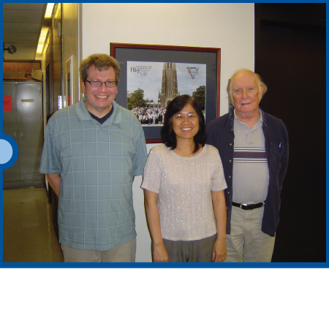

TUNL’s most important member
Grace Sheu

