Slide 1
A new V&V philosophy for fusion nuclear data libraries
D. Laghi^{1,2}, M. Fabbri³
¹NIER Ingegneria, Castel Maggiore, Italy
²University of Bologna, Bologna, Italy
³Fusion For Energy, Barcelona, Spain
11/10/2022

Slide 3
Index
JADE
Nuclear data libraries and their V&V
What is JADE?
The Sphere Leakage benchmark
JADE architecture and development
Looking ahead
Our wish list
Machine Learning
Summary

Slide 4
JADE

Slide 5
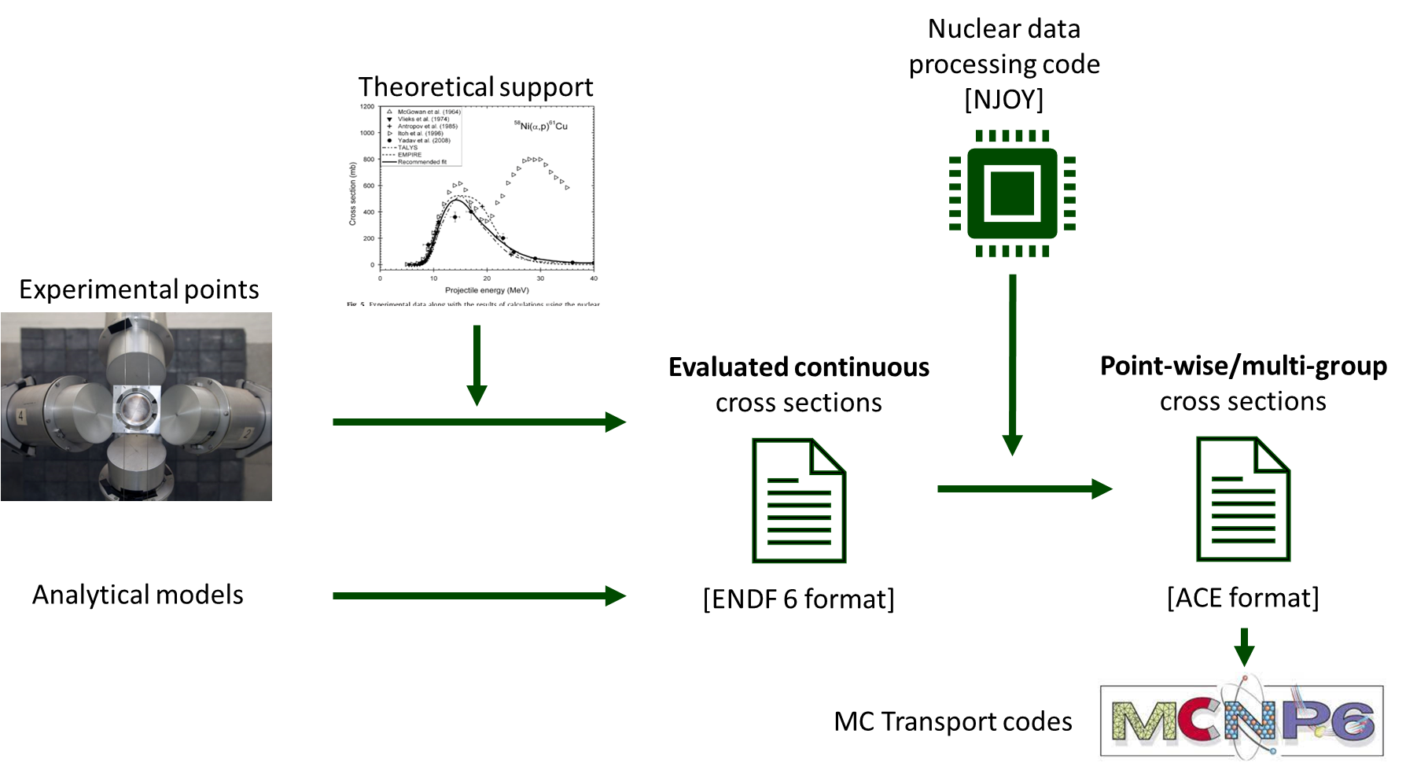
Nuclear data libraries and their V&V
The nuclear data libraries production chain
It is a complex procedure that require extensive Verification and Validation (V&V)

Slide 6





Nuclear data libraries and their V&V
The need for automation and standardization
10³ isotopes in a single library
1 .ACE file per isotope
10² reactions per .ACE file (MT numbers)
~ 10⁵ different cross sections to be verified!
Heavy automation is a necessity, which, at the same time, is an opportunity for standardization

Slide 7
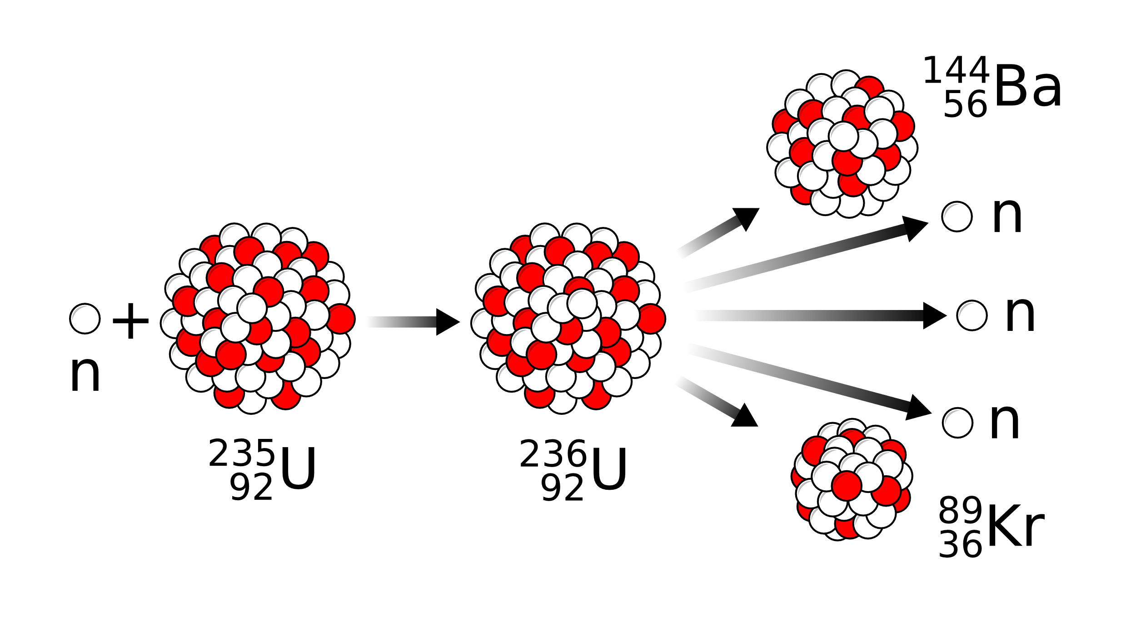
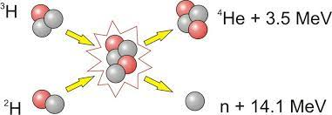
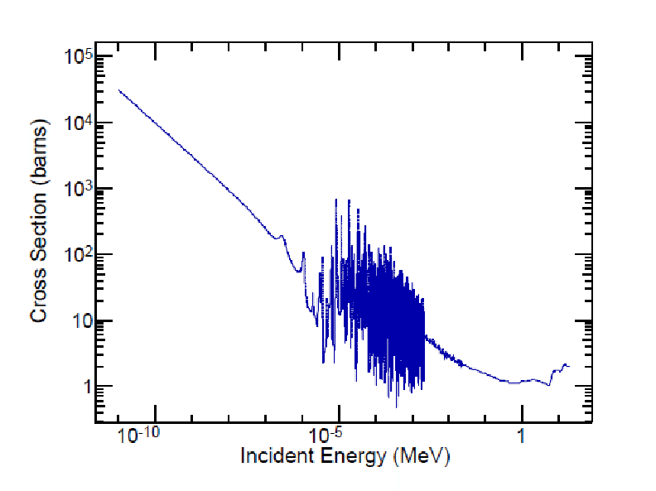
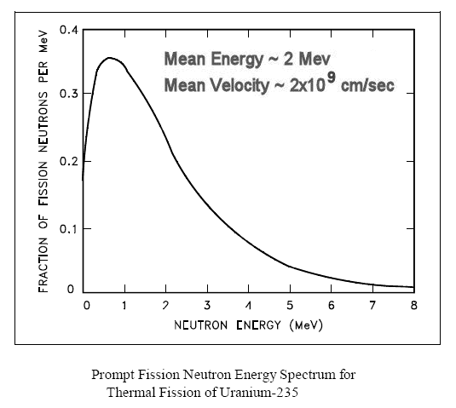
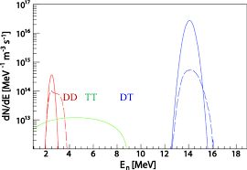
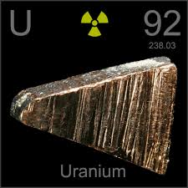
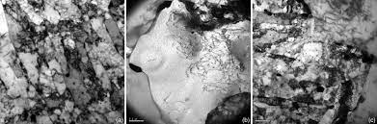
Nuclear data libraries and their V&V
The fission bias
Vs
Energy range
EUROFER 97
Fusion rate
Different materials and cross sections
Fission rate
Tritium production
Fission products
Heating on superconductive magnets
Activation issues

Slide 8
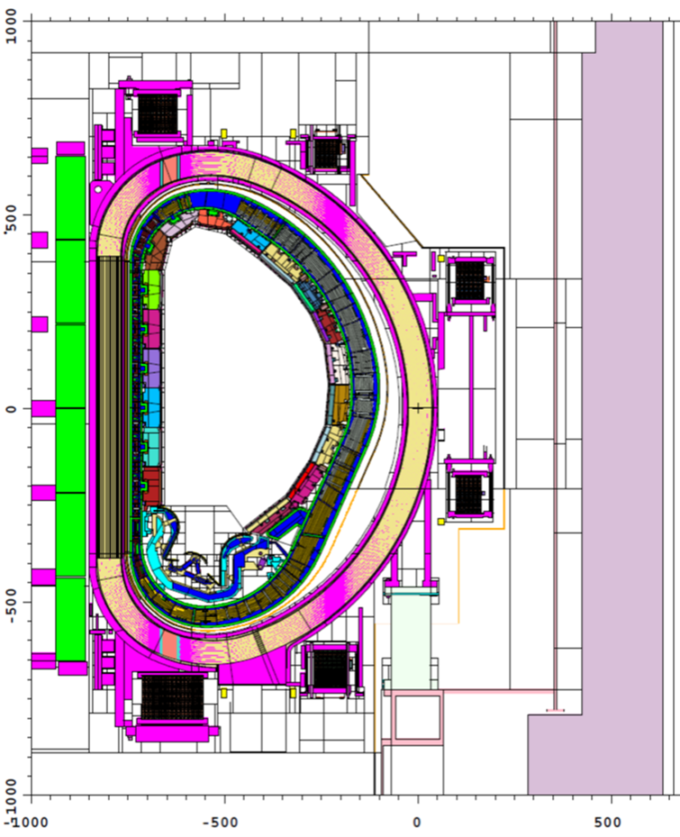
Nuclear data libraries and their V&V
The fission bias
Vs
complex geometries that need to be fully modelled
different regions with different needs
a detailed spatial distribution of tallies is needed
K_{eff}
β_{eff}
Nubar
Integral parameters representative of the entire system that simplifies the V&V process
Vast amount of tallies and energy/spatial discretization

Slide 9




What is JADE?
JADE
JADE is a python based software that aims to establish itself as a corner stone for a complete and extensive automated and standardized V&V procedure for nuclear data libraries, with a special focus towards fusion applications.
LACK OF AUTOMATION
EFFORT FRAGMENTATION
ISSUES
LACK OF STANDARDIZATION
FISSION BIAS

Slide 10
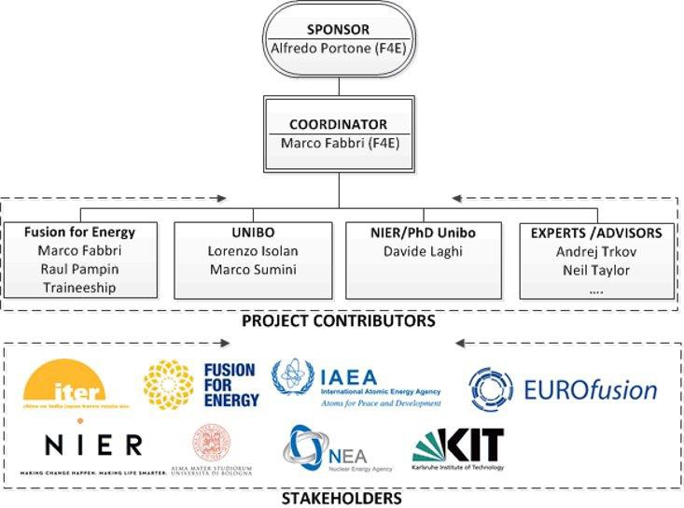
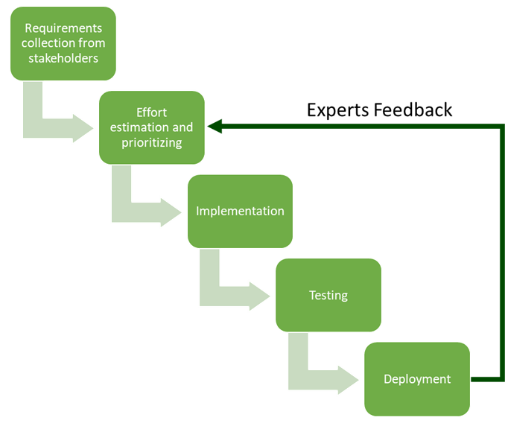
What is JADE?
The organization of the project
Waterfall approach
Implemented by means of a stage approach and > 1.5 ppy of total effort

Slide 11







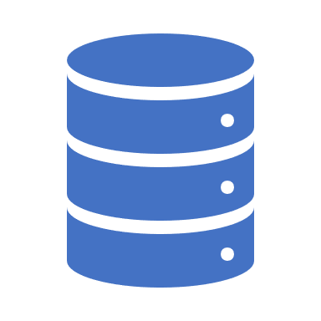

What is JADE?
JADE needs
MCNP as transport code
Vast amount of outputs
Meaningful automatic post-processing
Vast amount of benchmark to be automatically generated and run

Slide 12
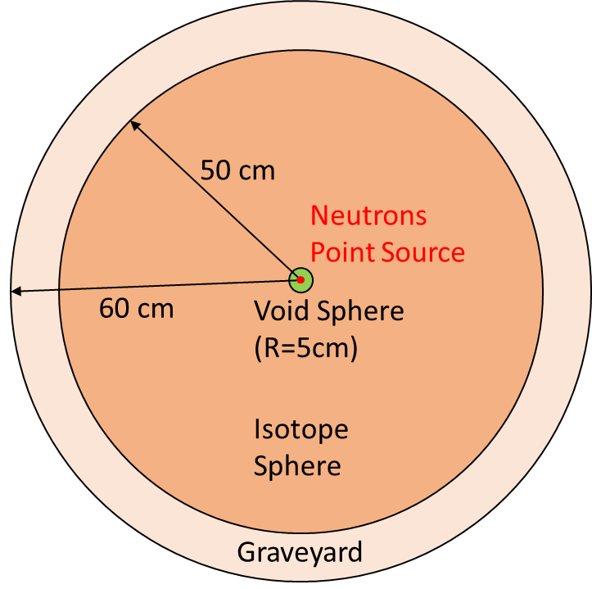

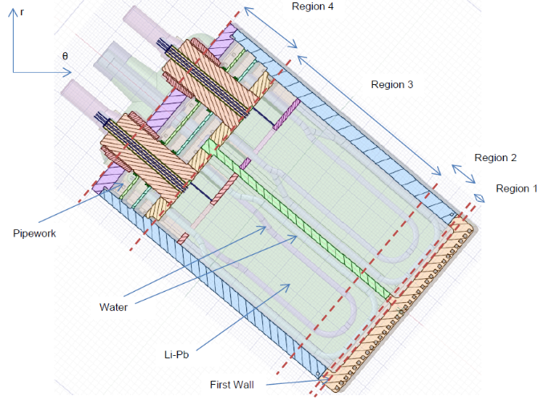
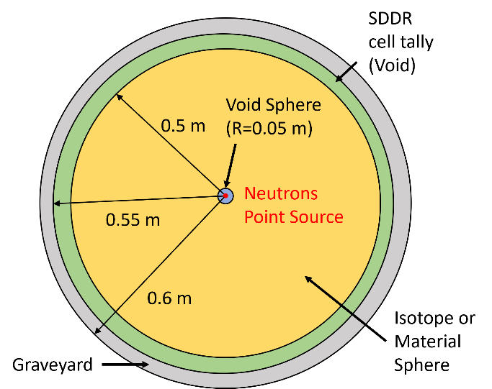
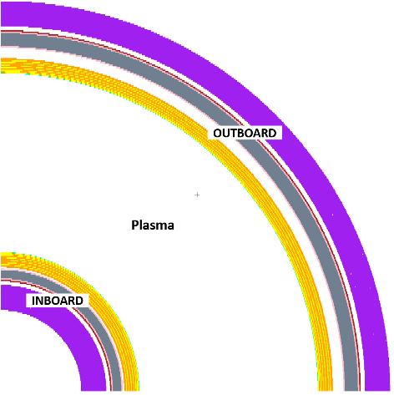
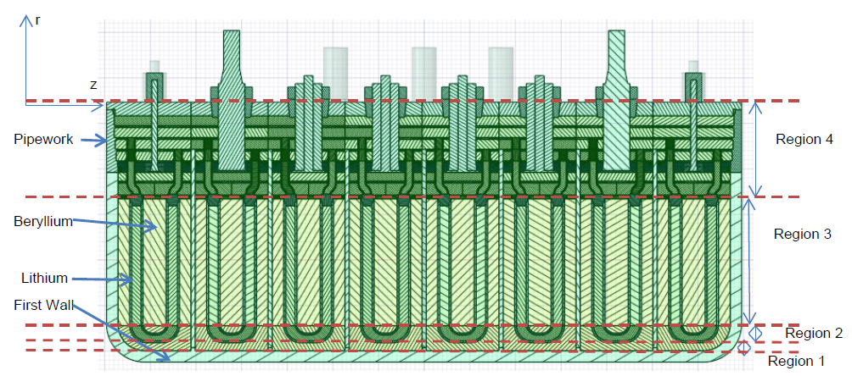
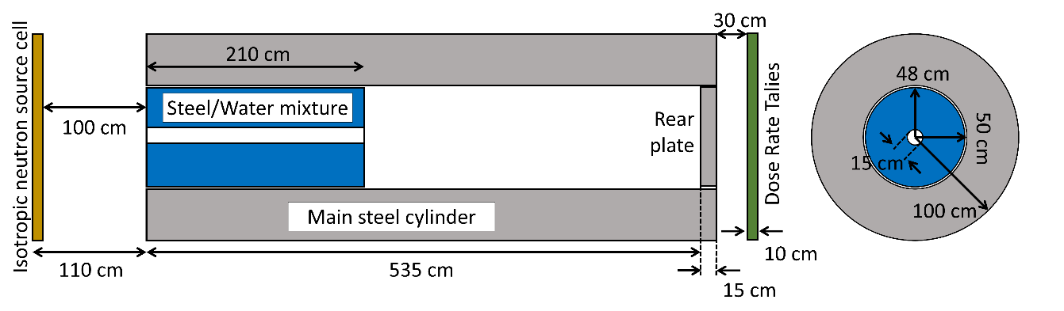
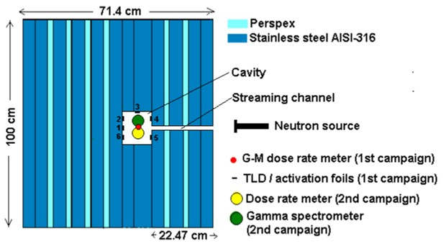
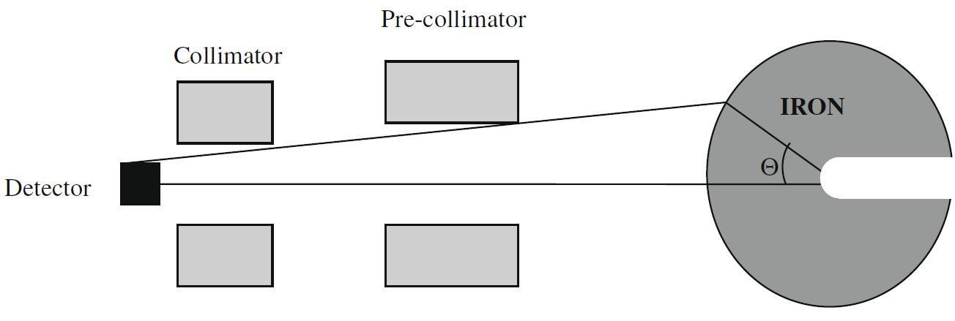
What is JADE?
Benchmarks suite
TRANSPORT
ACTIVATION
Sphere Leakage
C-model
WCLL TBM
SPHERE SDDR
ITER 1D
COMPUTATIONAL
HCPB TBM
ITER CYL SDDR
OKTAVIAN
FNG SDDR
EXPERIMENTAL

Slide 13
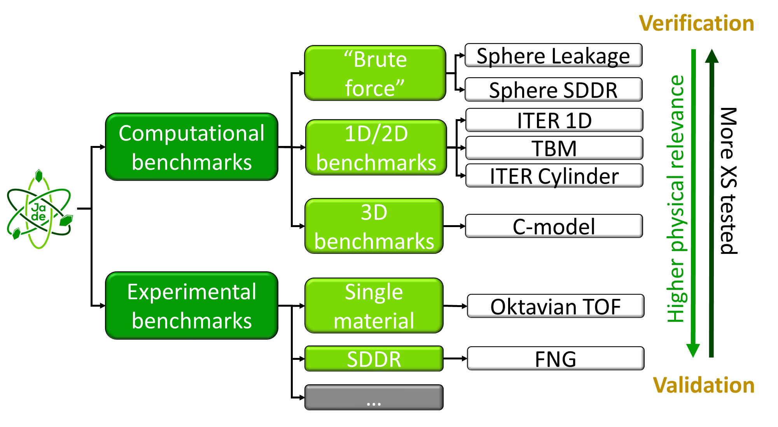
What is JADE
Benchmarks suite

Slide 14
The Sphere Leakage benchmark
Benchmark description
A uniform 0-14 MeV neutron point source is inserted at the center of a sphere composed entirely by a single isotope or a typical ITER material.
All isotopes provided by the nuclear data library under assessment are singularly tested.
Tallied quantities:
Neutron and photon leakage flux (energy binned);
Neutron and photon heating inside the sphere;
Tritium and Helium production inside the sphere;
DPA.

Slide 15
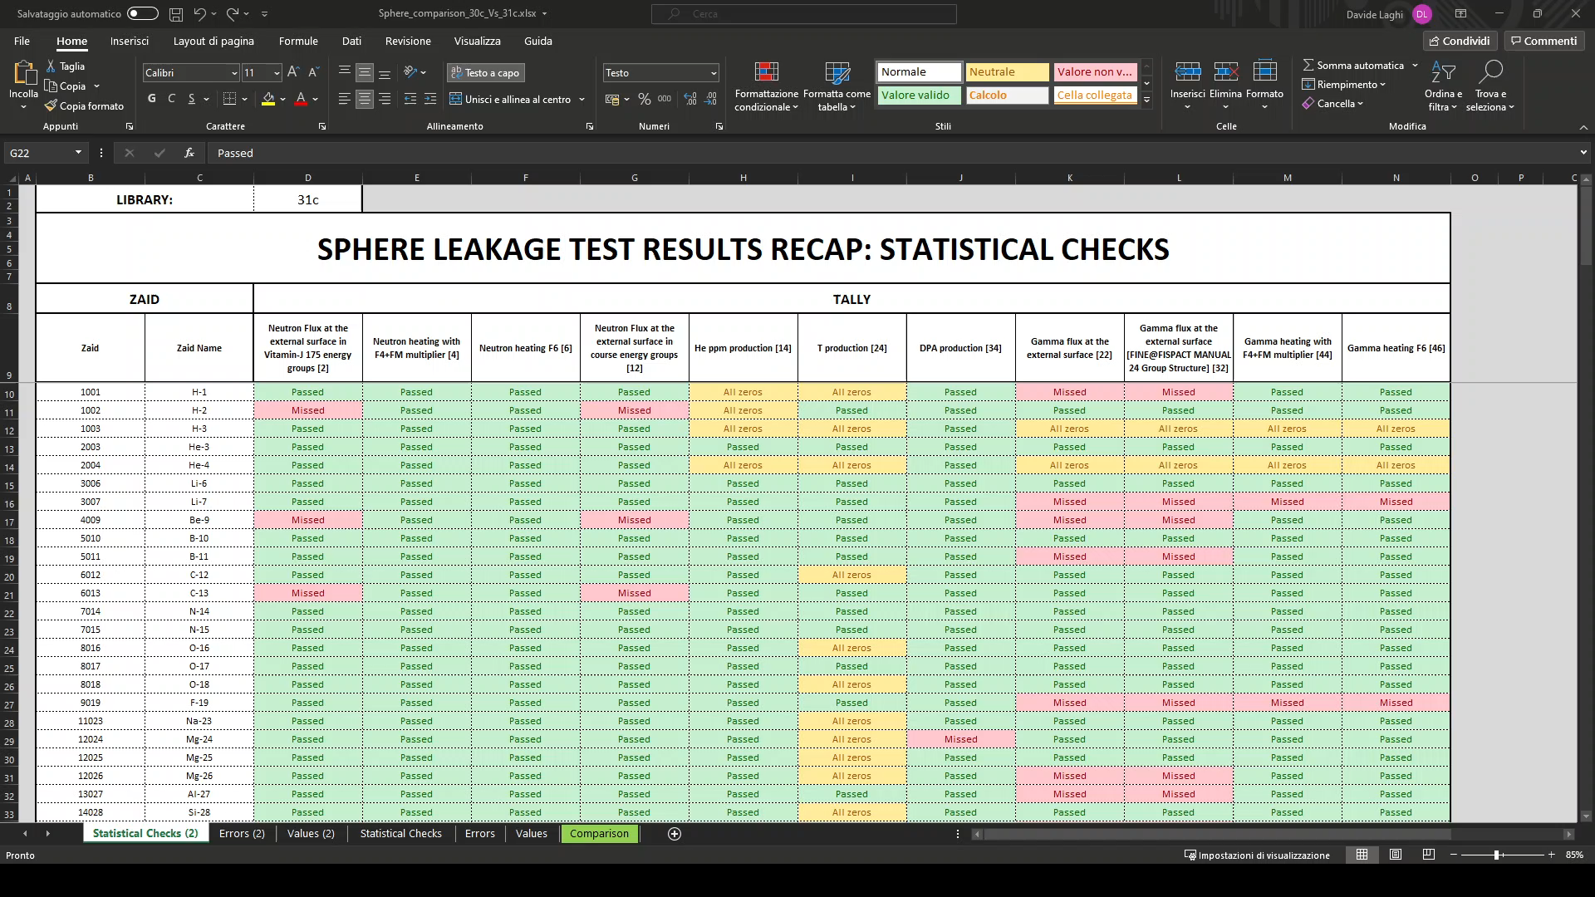
The Sphere Leakage benchmark
Excel formatted tables

Slide 16
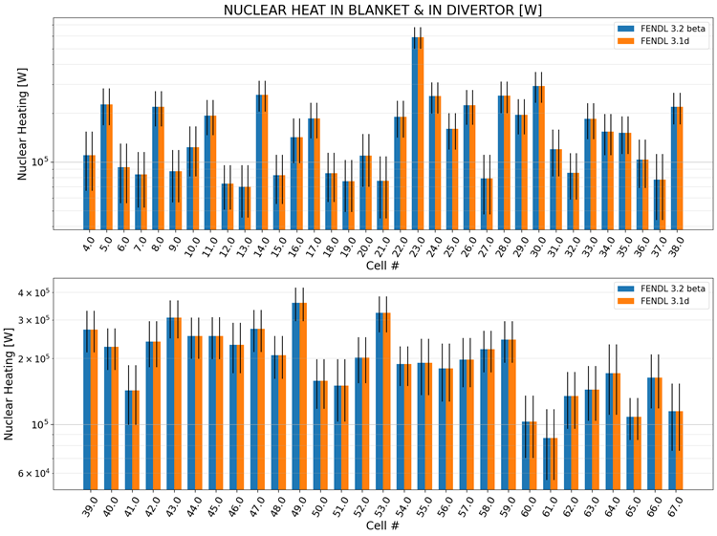
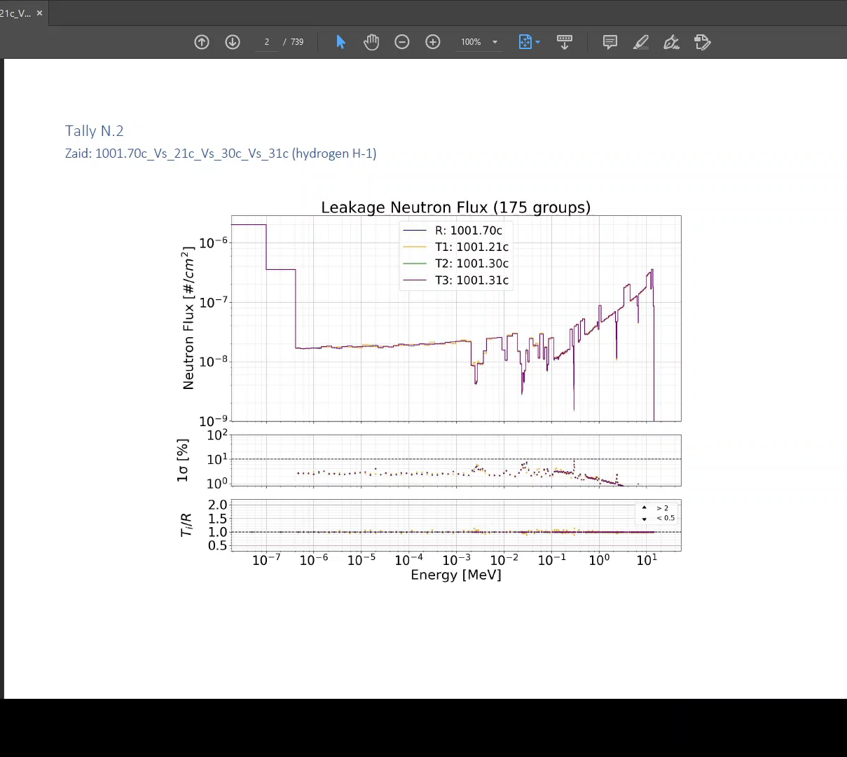
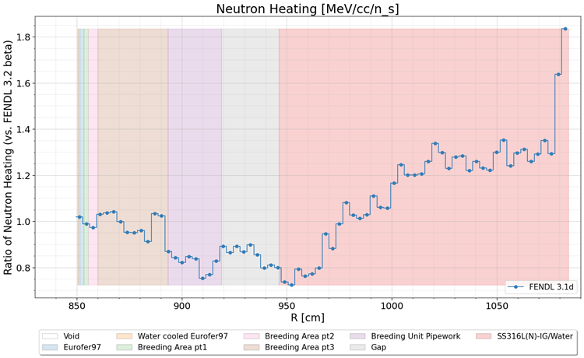
The Sphere Leakage benchmark
Plot atlas

Slide 17
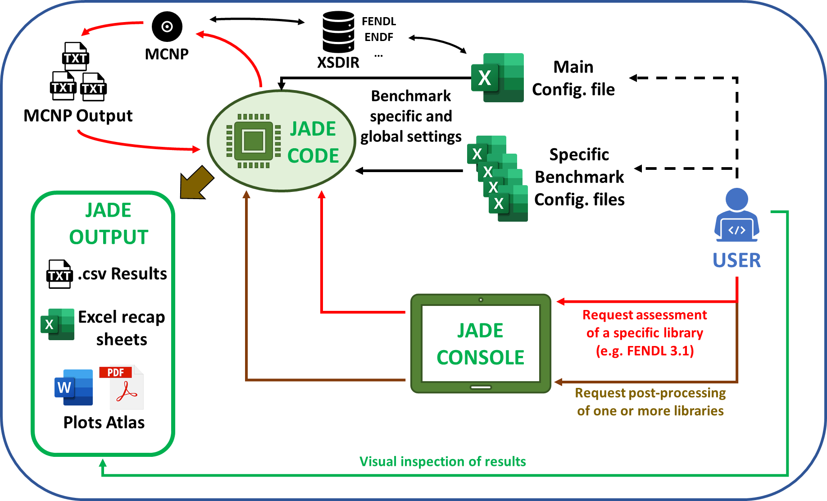
JADE architecture and development
General scheme

Slide 18
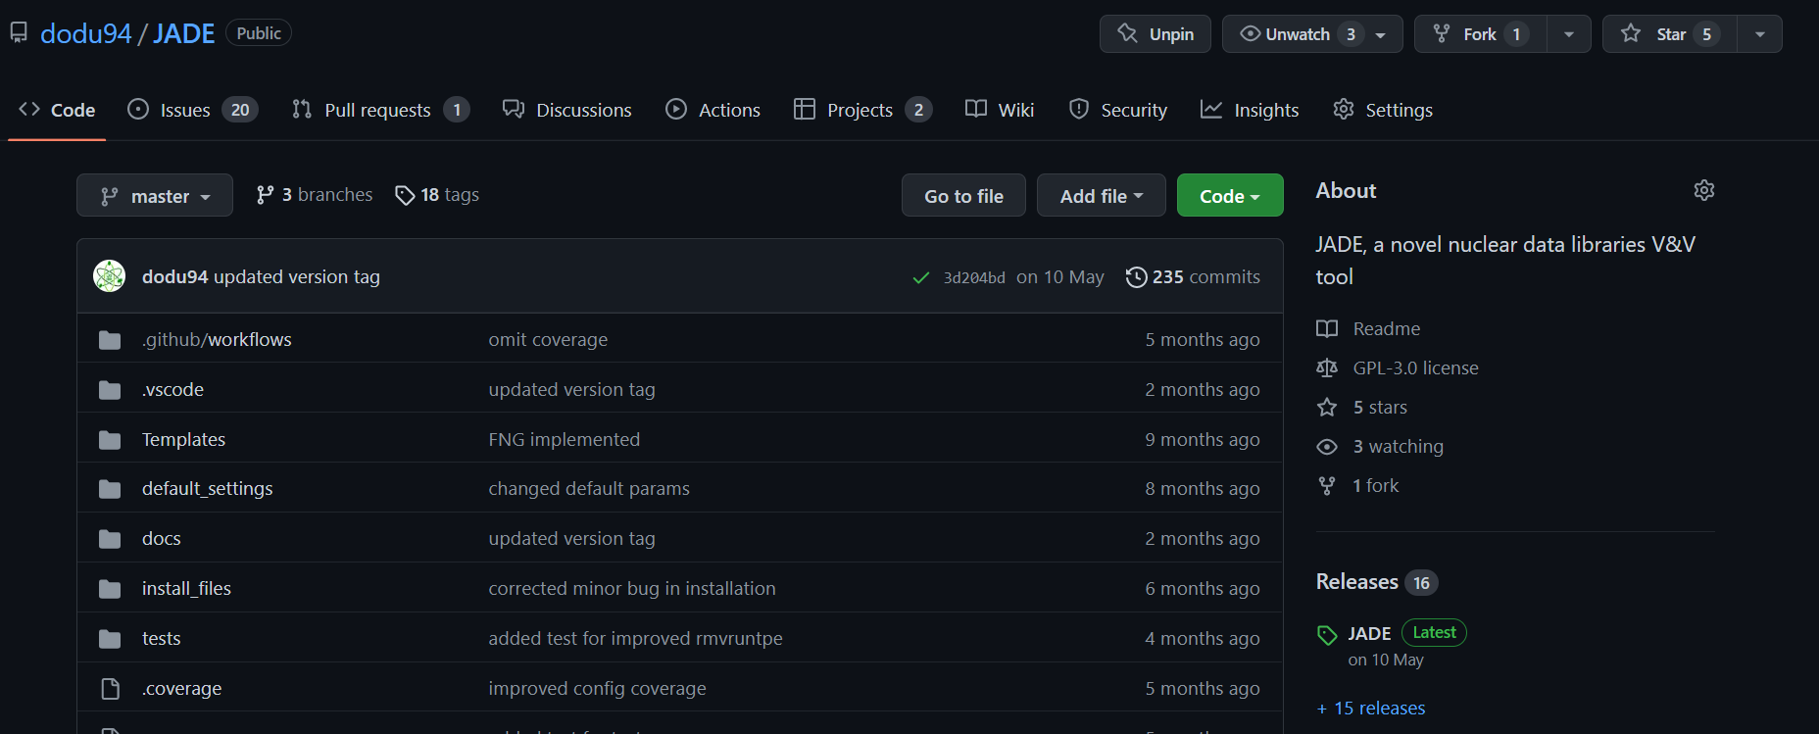
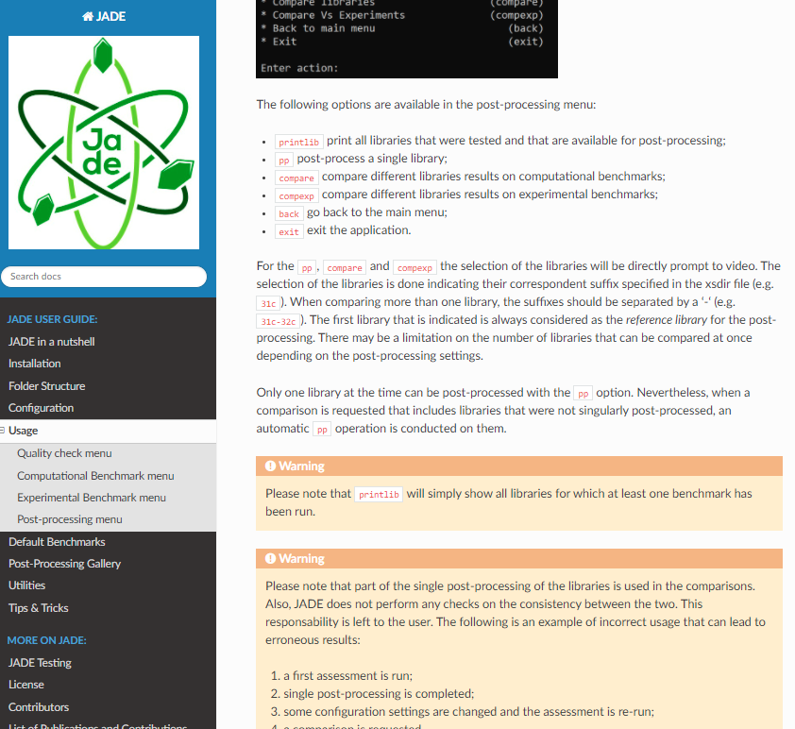
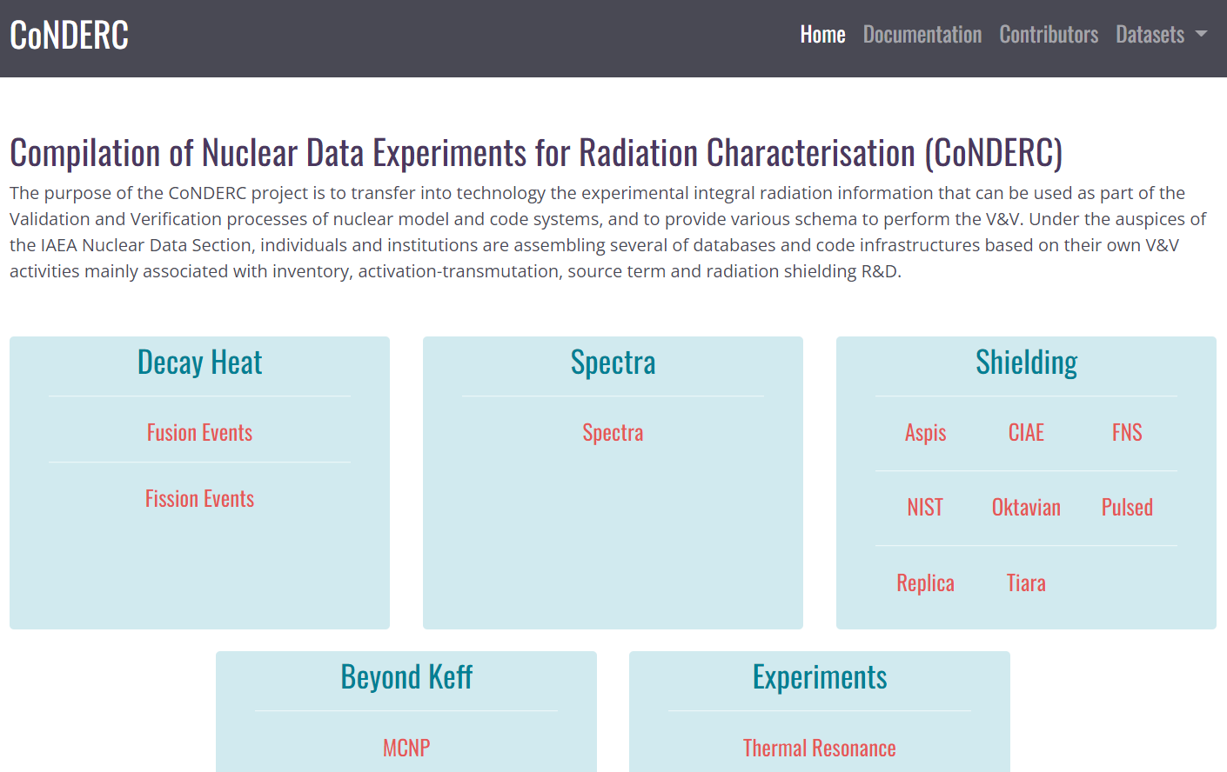
JADE Architecture and development
Open source
GitHub: https://github.com/dodu94/JADE
ReadTheDocs: https://jade-a-nuclear-data-libraries-vv-tool.readthedocs.io/en/latest/
CoNDERC: https://nds.iaea.org/conderc/

Slide 19
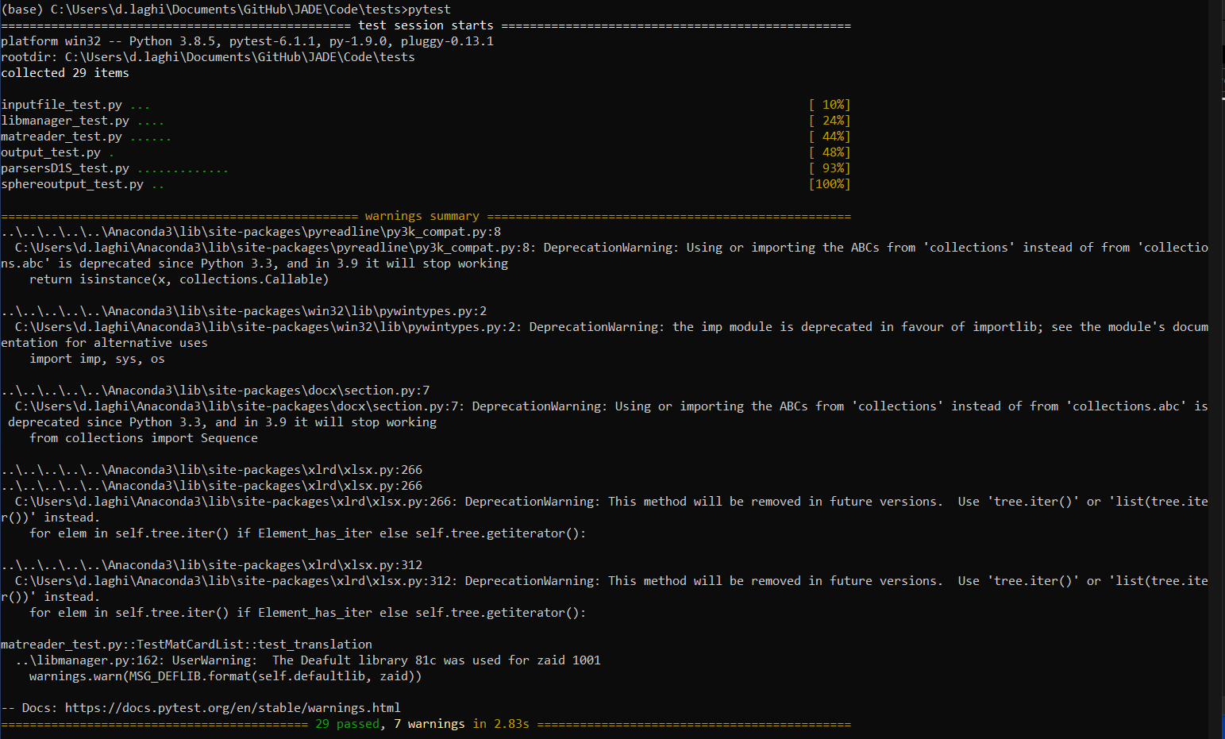
JADE architecture and development
Automatic testing with pytest and coverage
Help the stability of the code
Increase trust on JADE results
Sets a minimum quality standard for future contributors to the code
Speed up introduction of new features (faster verification)

Slide 20
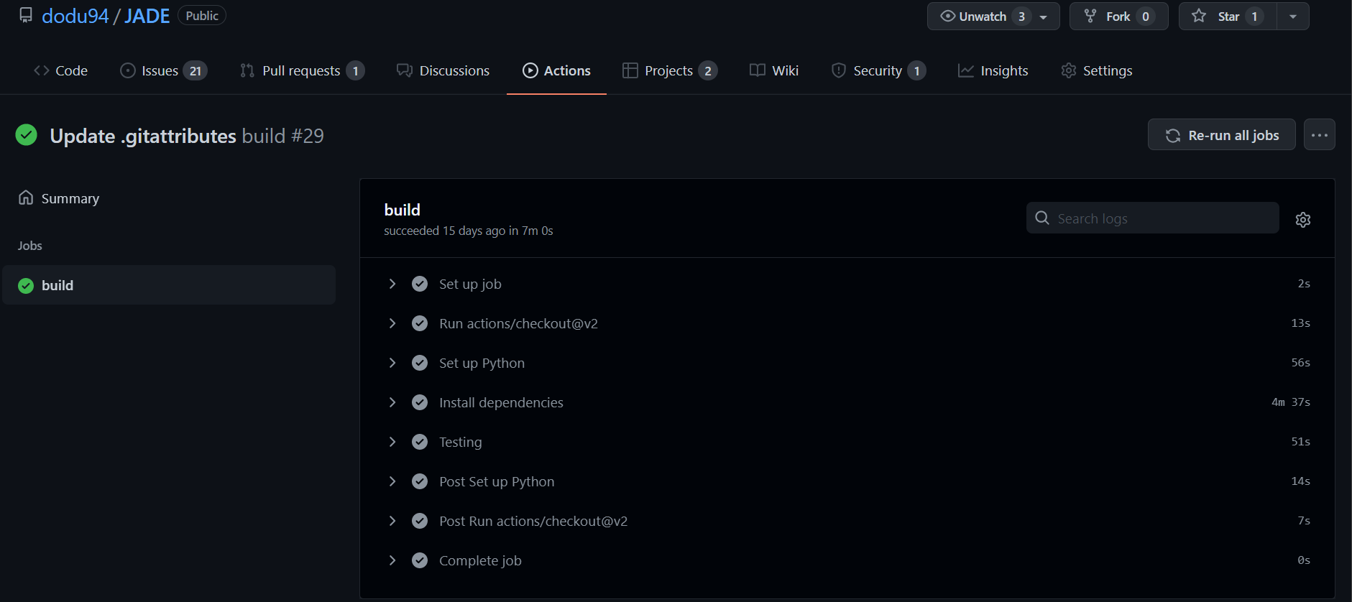
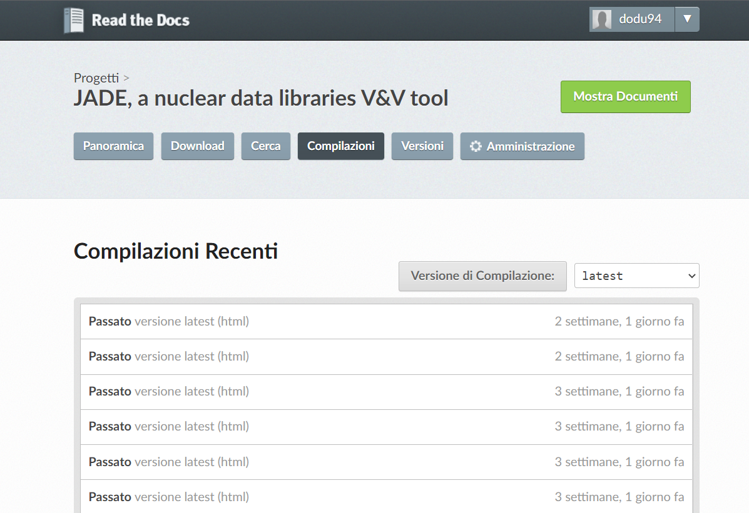
JADE architecture and development
Continuous Integration (CI)
At each push on the main JADE branch:
JADE is installed in a cloud Windows environment and the automatic testing is run (handled by GitHub)
The documentation is rebuilt by ReadTheDocs and adjourned

Slide 21
JADE in numbers
12k
Lines of code
9
Implemented benchmarks
2
Published papers
>10⁶
CPU simulation hours worth of data that has been post-processed
D. Laghi et al, 2020, “JADE, a new software tool for nuclear fusion data libraries Verification & Validation”, Fusion Engineering and Design, 161 112075. DOI: https://doi.org/10.1016/j.fusengdes.2020.112075
D. Laghi et al, “Application of JADE V&V capabilities to the new FENDL v3.2 Beta release”, Nuclear Fusion, 61 11.DOI: http://iopscience.iop.org/article/10.1088/1741-4326/ac121a

Slide 22
Looking ahead

Slide 23



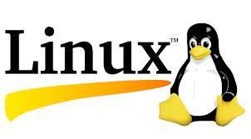
Next foreseeable steps
CoNDERC &
Expansion of the benchmarks suite
SINBAD

Slide 24
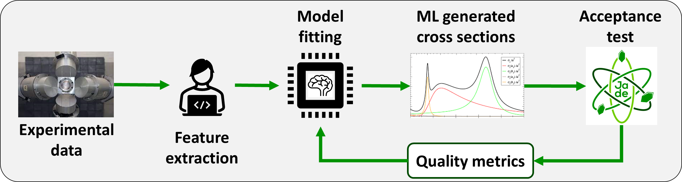
Machine learning: a possible mid-term future
Leveraging the open source automation of benchmarks running and definition of acceptance test, ML algorithm could be introduced to support the libraries evaluation process
Monte Carlo codes like OpenMC are currently porting their code to GPU solvers
Simulation time could decrease by a few order of magnitudes!
An example of application is NucML¹: https://pedrojrv.github.io/nucml/index.html
¹Pedro Jr. Vicente-Valdez, Massimiliano Fratoni (UC Berkely, USA)

Slide 25
What it will be great to have
A comprehensive, unified, user-friendly, open-source, ready to be used database of experiment (e.g., Conderc+SINBAD GitHub).
A platform to provide feedback and record exchanges (e.g., GitHub).
A collection of computational benchmark to use (e.g., 1D ITER).
A standardized way to share and collect the different executed benchmarks in a common database (e.g., CONDERC) trying to avoid duplication.
A closer collaboration with the different parties with periodic exchange (i.e., CCFE).
Guidelines for the V&V of (fusion) libraries with clear acceptance criteria (e.g., C/E TBR : [0.95, 1.05]).

Slide 26
Summary
JADE improves the standardization and the automation level in the field of nuclear data V&V (especially regarding fusion application).
JADE is a consolidated open-source tool built for the community by the community. If you are interested on collaborating do not hesitate to contact us. Let’s join forces.
V&V on many libraries has been already performed by JADE(i.e., FENDL3.1d, FENDL3.2, JEFF-3.3., JEFF-4.0T1). Few inconsistencies and discrepancies were spotted and reported. More work is planned.
We sincerely appreciate the effort put in place by NEA, IAEA, SINBAD to modernize the experimental database and the collaboration with the different parties to continue the development of JADE.

Slide 27
GitHub: https://github.com/dodu94/JADE
READ THE DOCS: https://readthedocs.org/

Slide 29
Backup slides

Slide 30
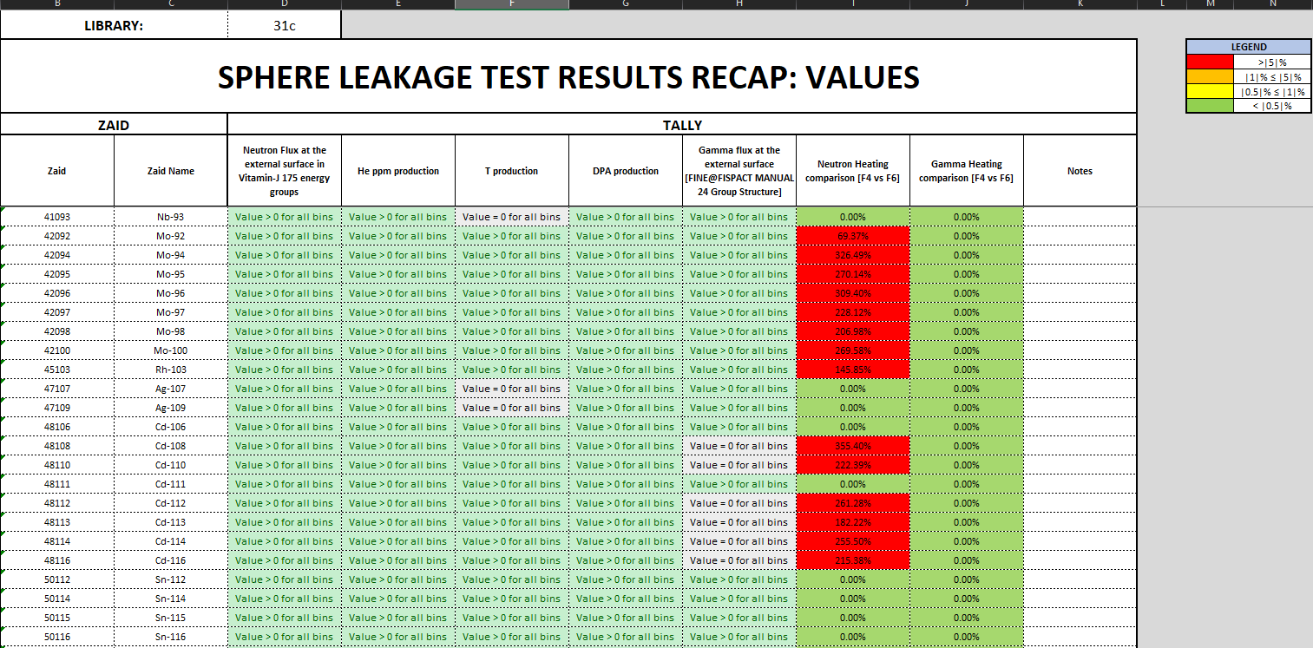
JADE application to production cases
Proof of concept
Tested libraries:
FENDL v2.1
FENDL v3.0
FENDL v3.1d
ENDF VII.1
Known errors in the FENDL v3.1d were re-spotted by JADE consistency checks
Paper:
D. Laghi, M. Fabbri, L. Isolan, R. Pampin, M. Sumini, A. Portone and A. Trkov, 2020, “JADE, a new software tool for nuclear fusion data libraries Verification & Validation”, Fusion Engineering and Design, 161 112075. DOI: https://doi.org/10.1016/j.fusengdes.2020.112075

Slide 31
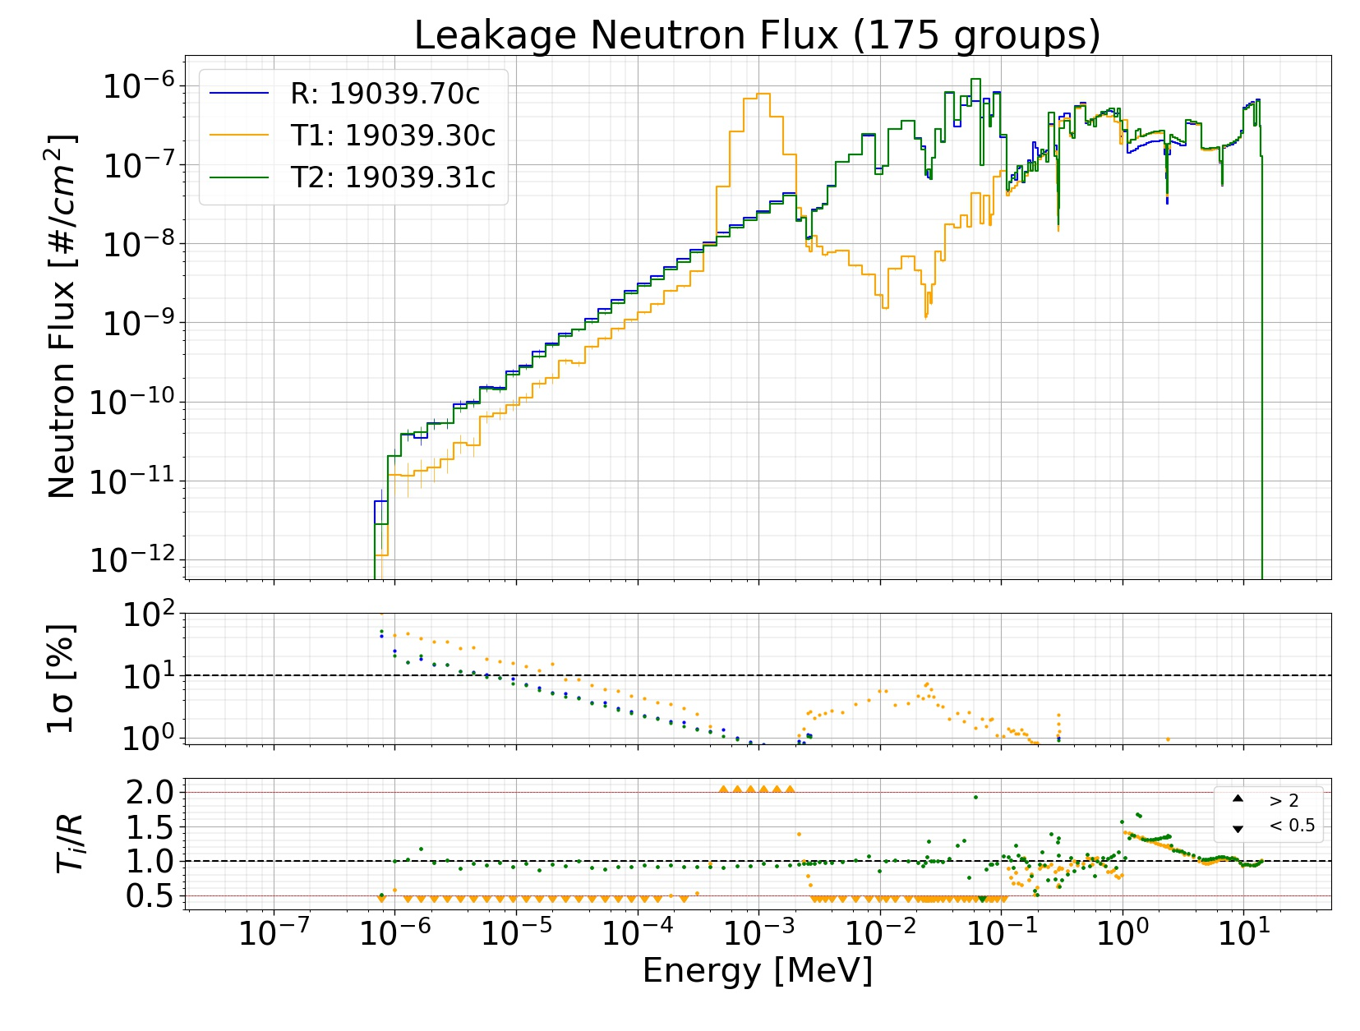
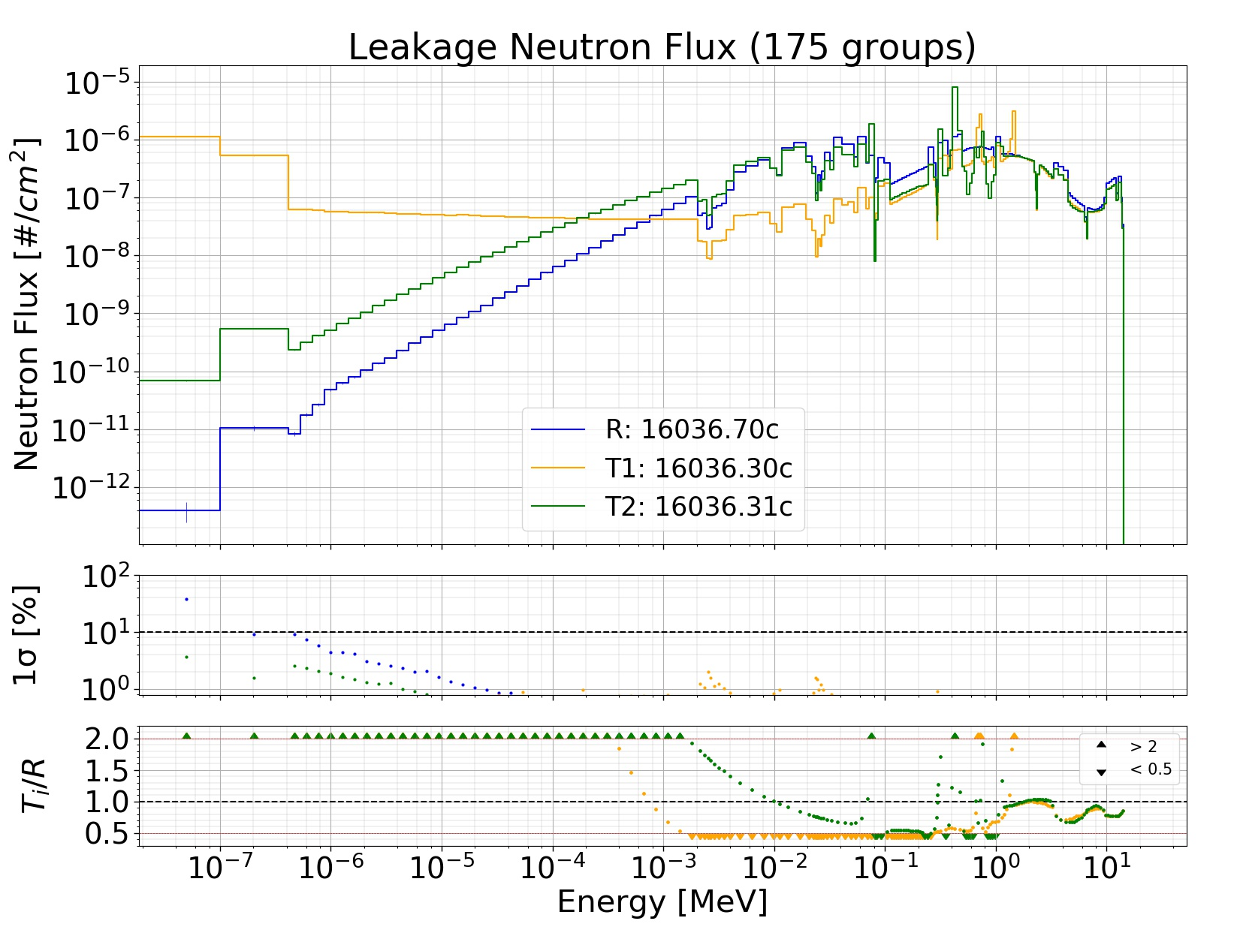
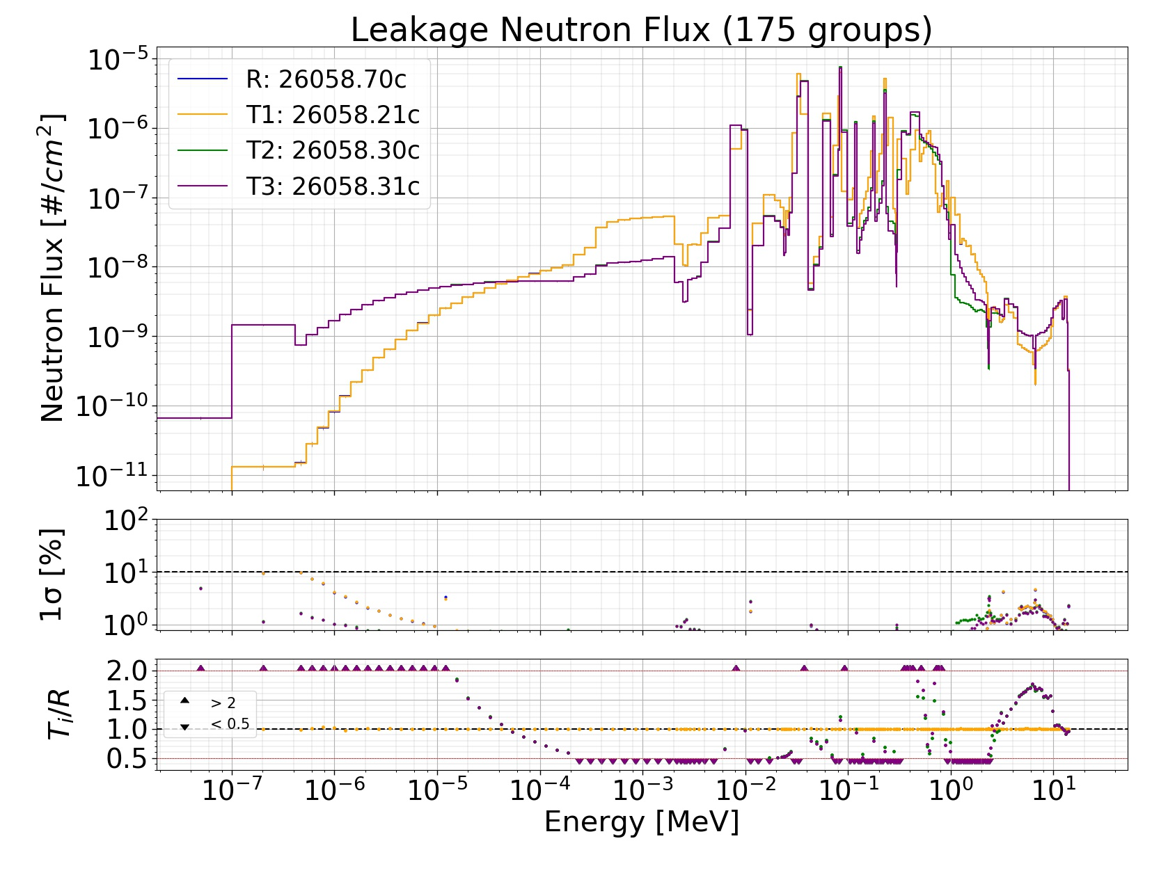
JADE application to production cases
Proof of concept
Some examples where the leakage neutron flux results differed significantly among the tested libraries.

Slide 32
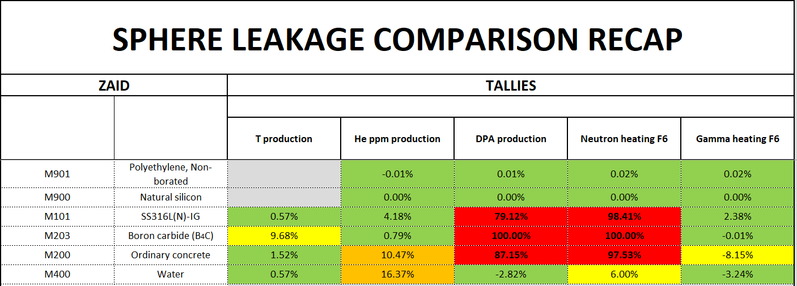
JADE application to production cases
FENDL v3.2 release (BETA)
Important differences in key neutron related quantities were spotted for typical ITER materials when comparing the old and new release of FENDL libraries
Paper:
D. Laghi, M. Fabbri, L. Isolan, M. Sumini, G. Schnabel and A. Trkov, 2021, “Application of JADE V&V capabilities to the new FENDL v3.2 Beta release”, Nuclear Fusion, 61 11.DOI: http://iopscience.iop.org/article/10.1088/1741-4326/ac121a

Slide 33
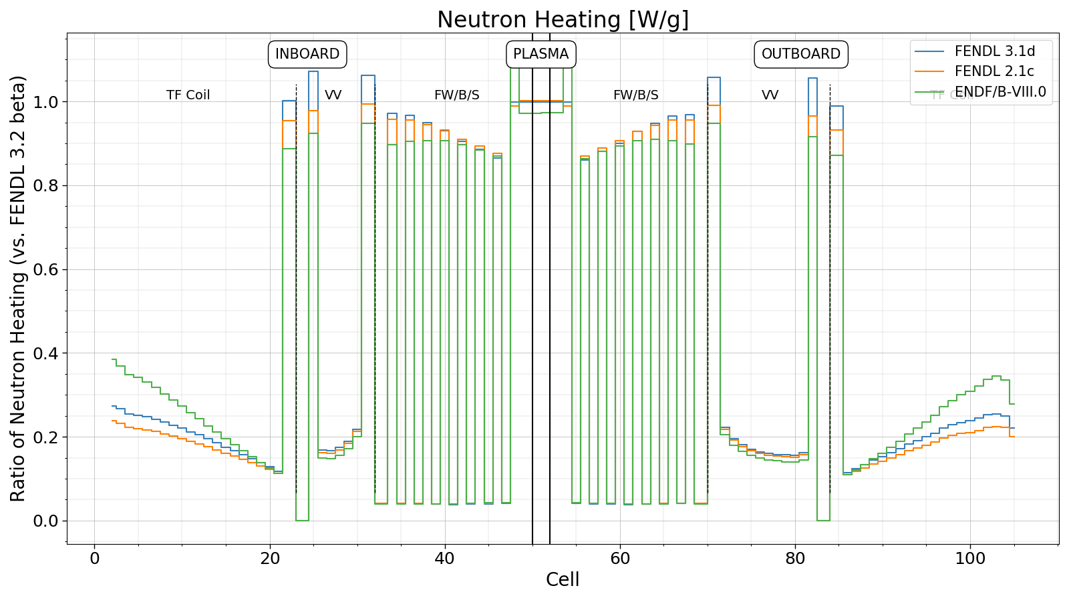

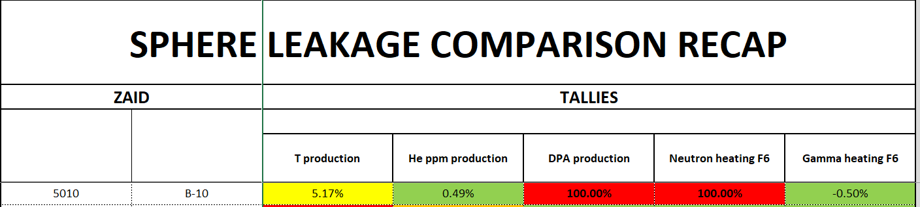
JADE application to production cases
FENDL v3.2 release (BETA)
Effect of the higher neutron heating in the steel layers of the ITER 1D model
B-10 accounts only for 0.00036 % (in mass) of SS316L(N)-IG and at the same time SS316L(N)-IG is composed by 45 different isotopes. Without systematic and automated testing it would have been more difficult to track the origin of the issue.

Slide 34
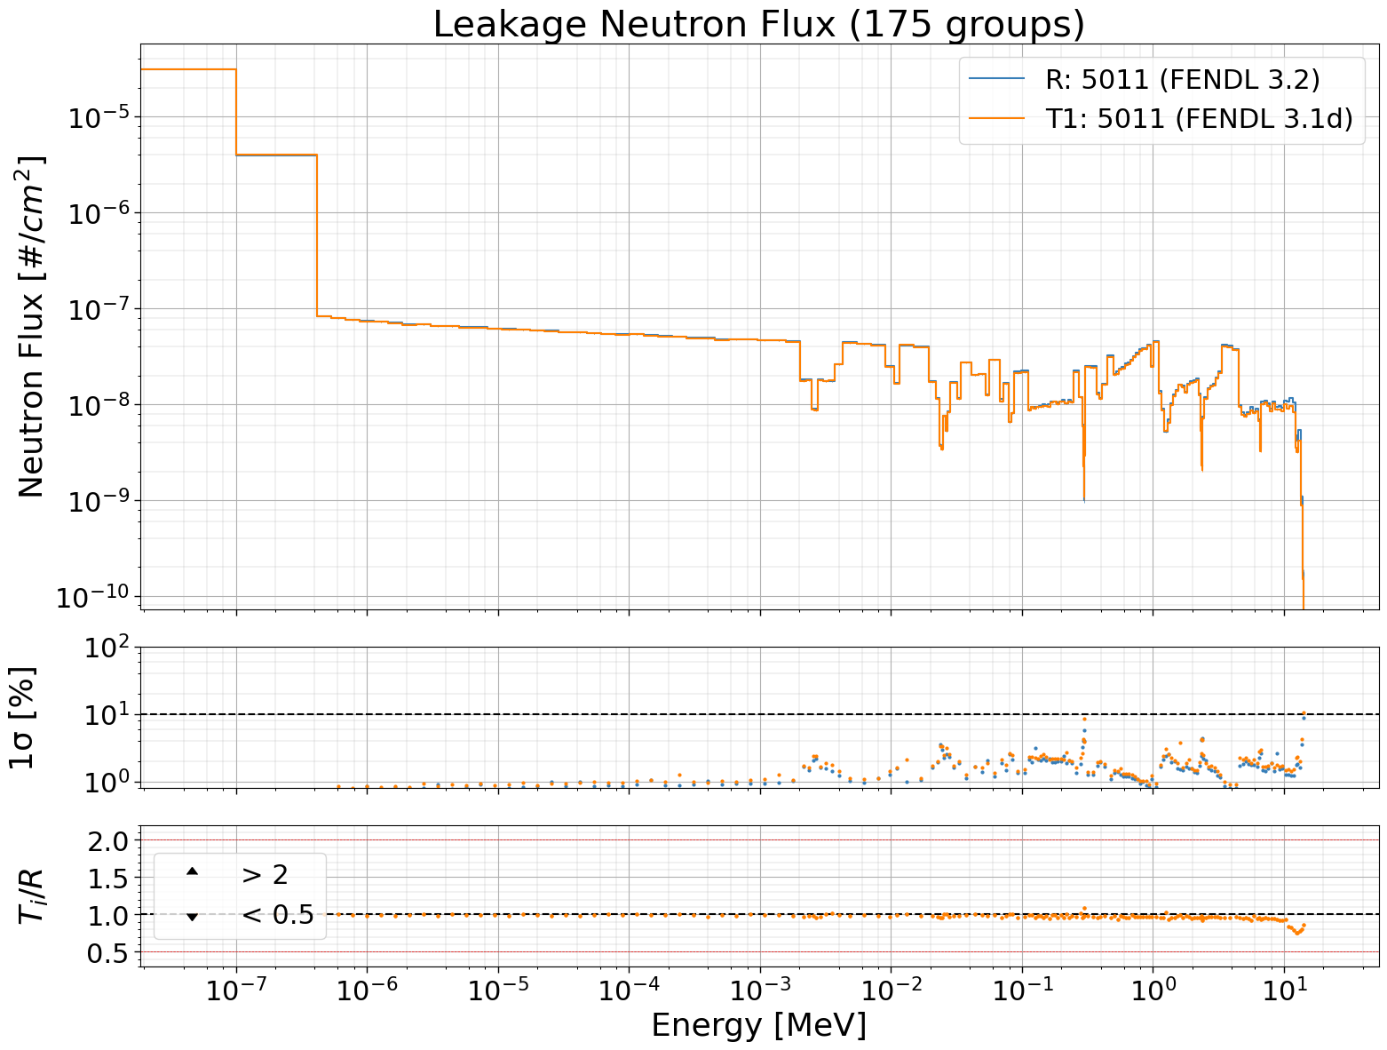
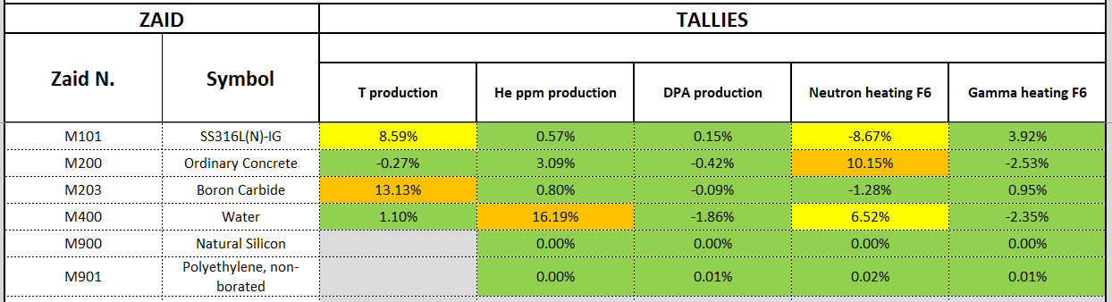
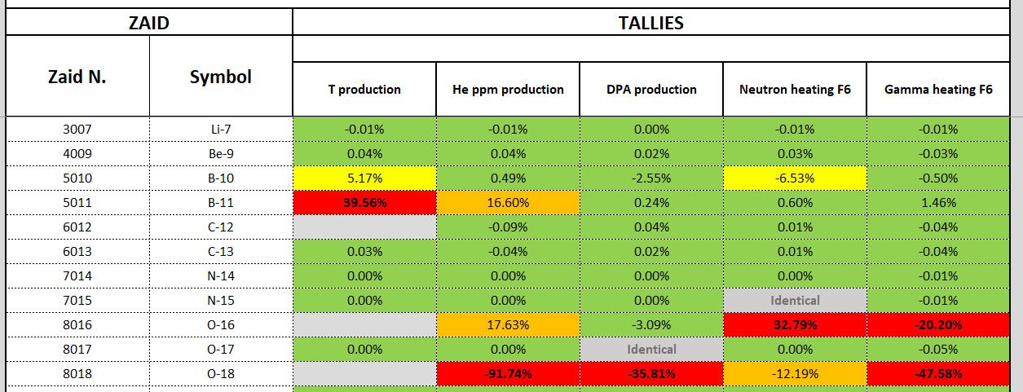
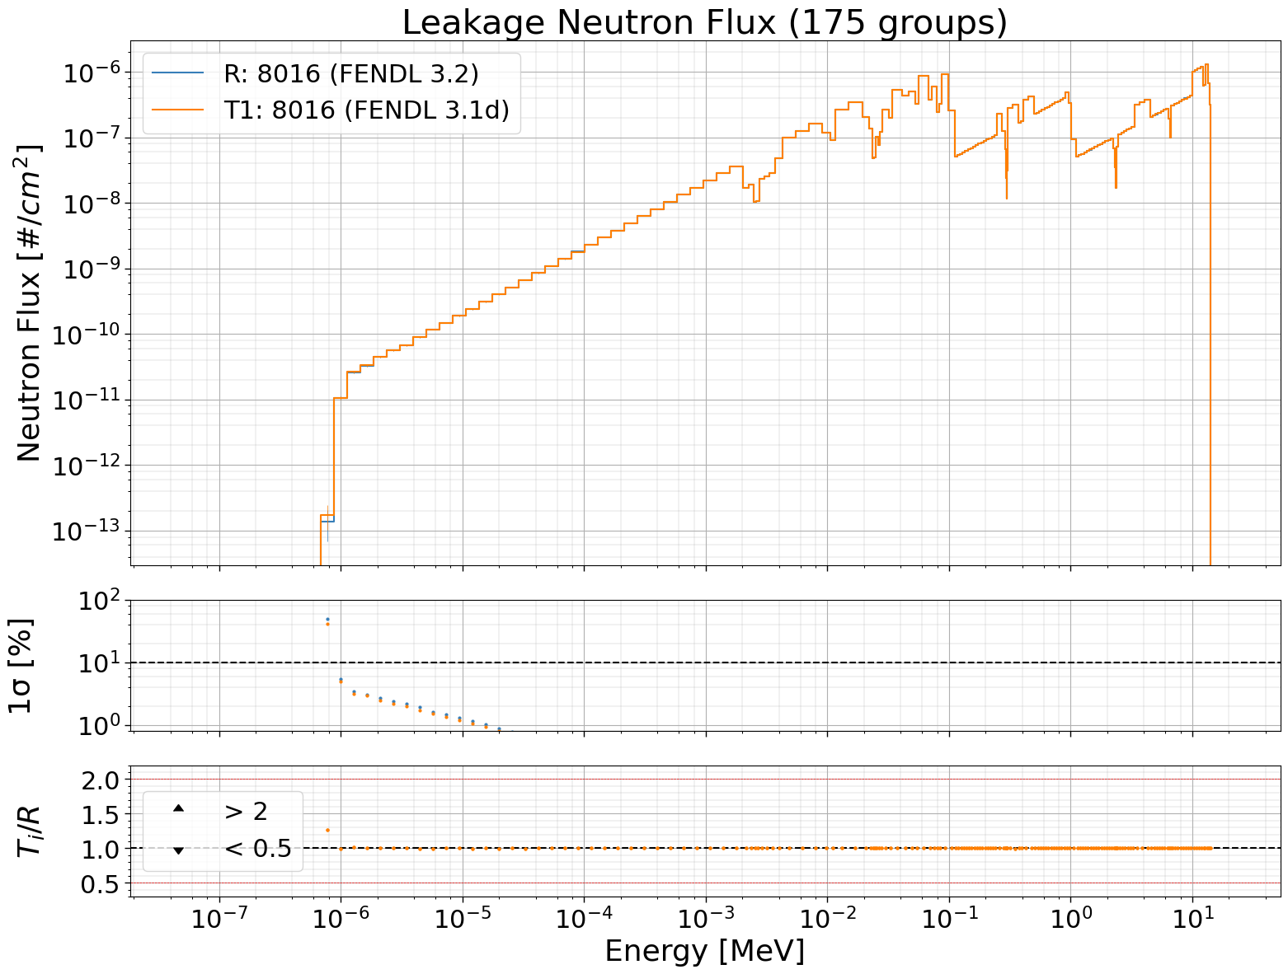
JADE application to production cases
FENDL v3.2 official release

Slide 35
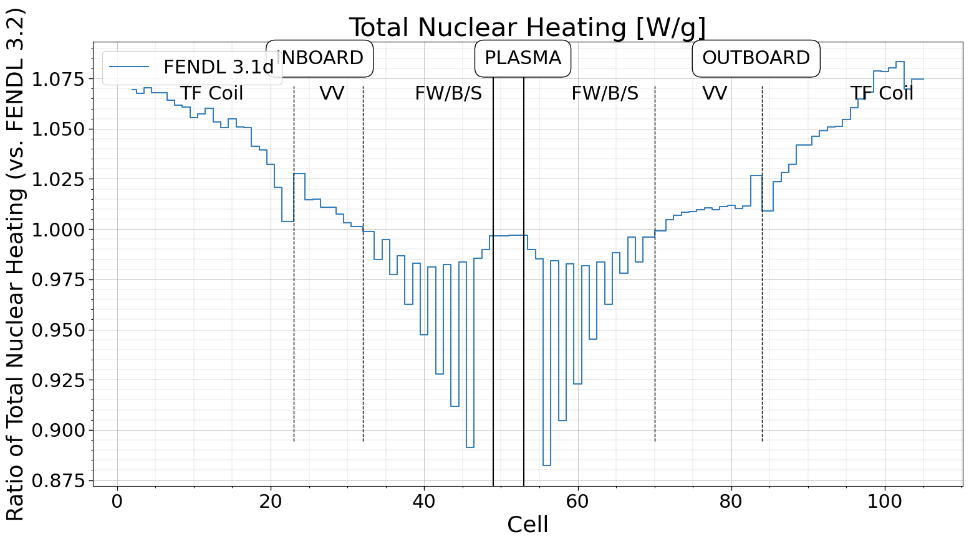
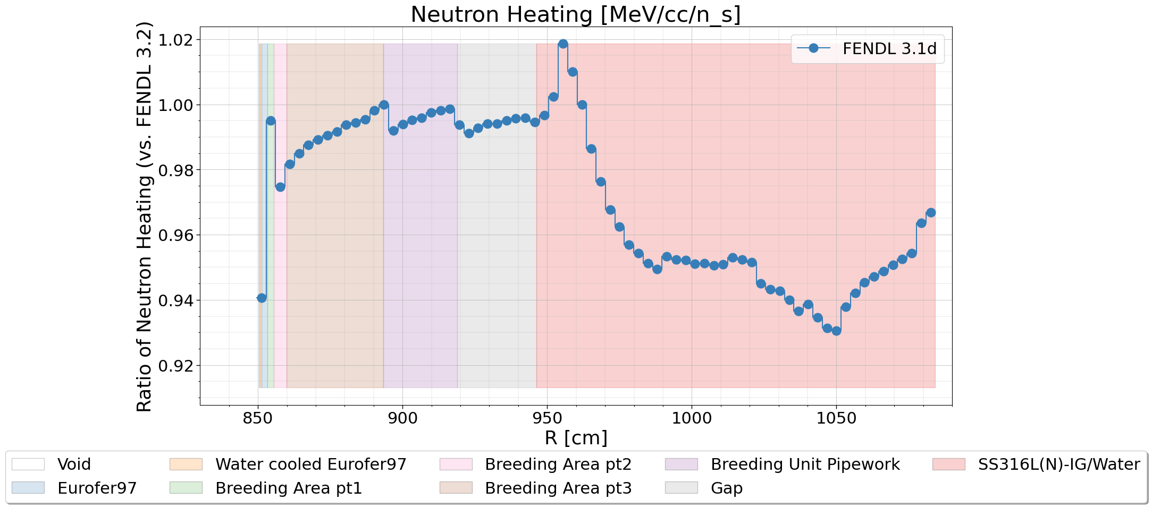
JADE application to production cases
FENDL v3.2 official release (Water/O-16)
Difference in neutron heating are clearly visible in water both in ITER1D and HCPB TBM benchmarks.
IAEA nuclear data section is considering for the O-16 cross section to either to:
Switch to ENDFVIII.0 evaluation;
Correct NJOY processing routine for KERMA data

