Slide 1


Determination of stopping power for α-particles in carbon by resonance scattering
IAEA Thechnical Meeting on (alpha,n) data, November 2023
T.L. Bobrovskiy, P.S. Prusachenko, A.F. Gurbich, M.V. Bokhovko
Institute for Physics and Power Engineering, Obninsk, Russia
timofeybobrovskiy@gmail.com

Slide 2
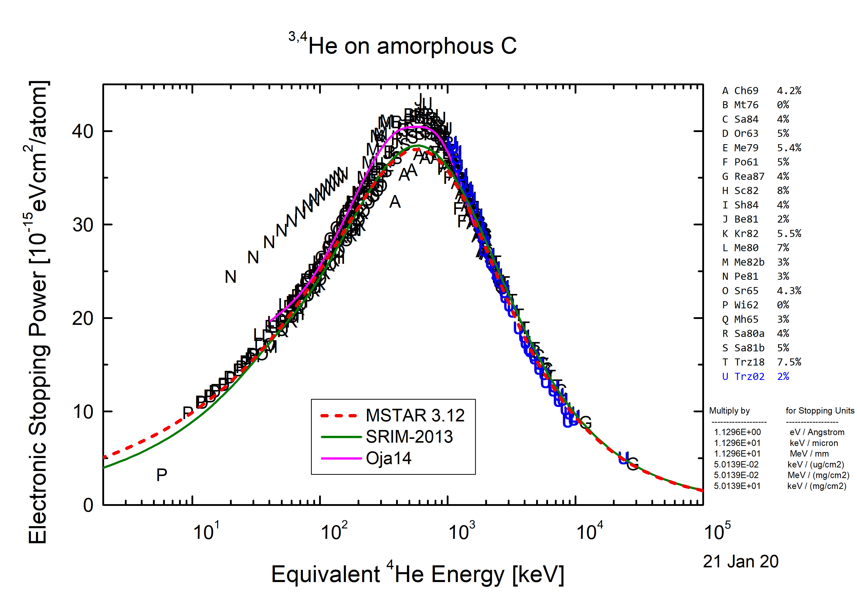
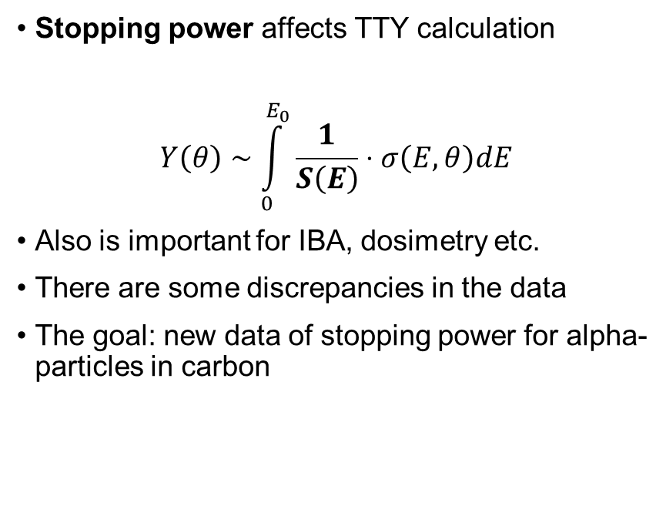
Motivation
Stopping power affects TTY calculation
$$Y\left(θ\right)∼\int_{0}^{E_{0}}{\frac{1}{S\left(E\right)}⋅σ\left(E, θ\right)dE}$$
Also is important for IBA, dosimetry etc.
There are some discrepancies in the data
The goal: new data of stopping power for alpha-particles in carbon
Data from H.Paul database*
*Claudia Montanari, P. Dimitriou. The IAEA stopping power database, following the trends in stiopping power of ions in matter // Nuclear Instruments and methods in physics research Section B. 408. 2017 p.50-55

Slide 3
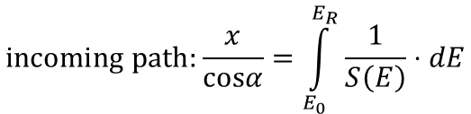
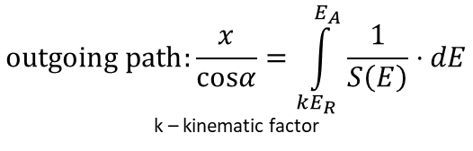
Single scattering model
Resonant scattering usually occurs on light nuclei
Method requires:
Thick target
Suitable resonances
Carbon target
$$incoming path:\frac{x}{cosα}=\int_{E_{0}}^{E_{R}}{\frac{1}{S\left(E\right)}⋅dE}$$
E0
ER
∠α
kER
∠β
$$outgoing path:\frac{x}{cosα}=\int_{{kE}_{R}}^{E_{A}}{\frac{1}{S\left(E\right)}⋅dE}$$
k – kinematic factor
E_{R}
E_{A}
EA
x
Detector
Resonances in the excitation function lead to anomalies of similar shape in the spectrum.

Slide 4
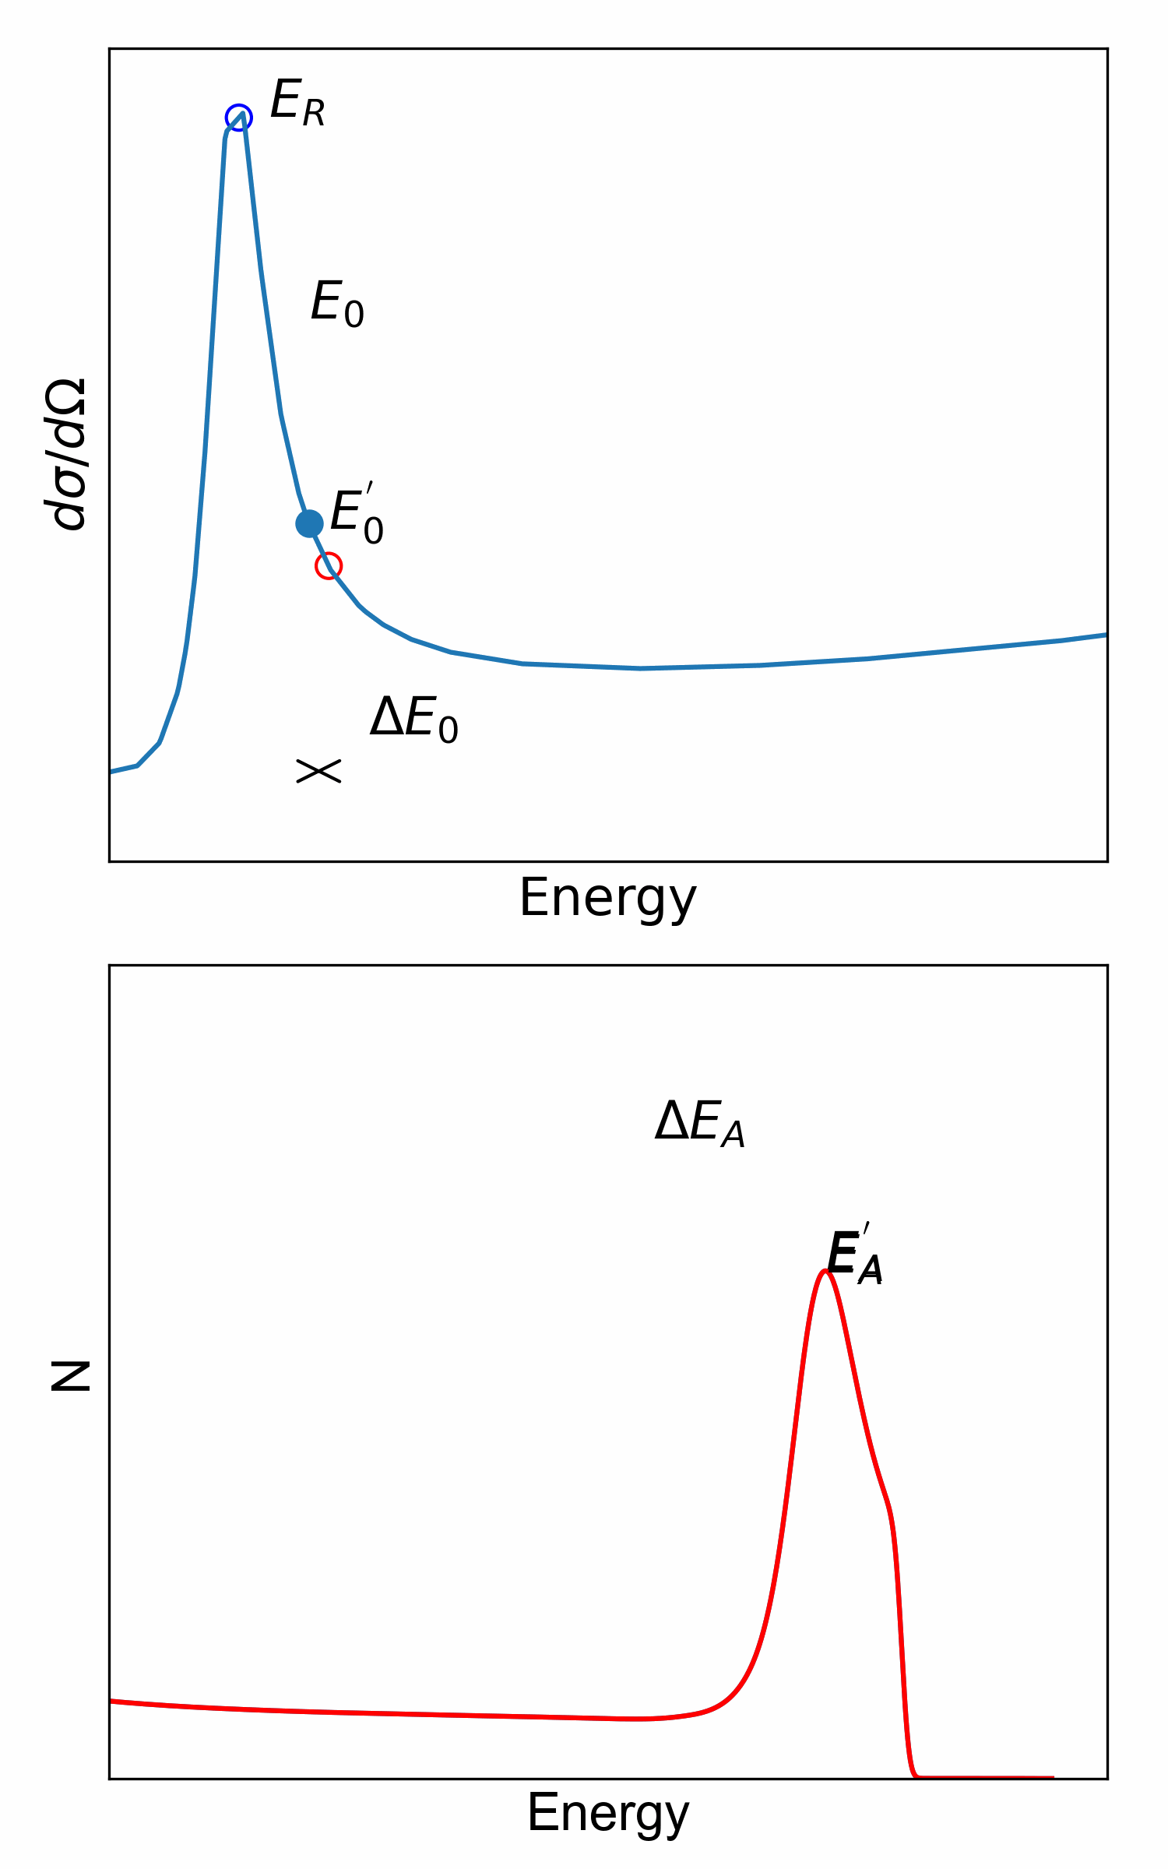
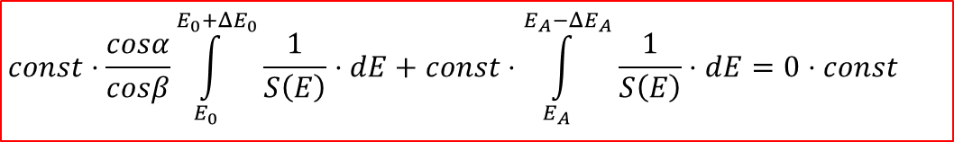
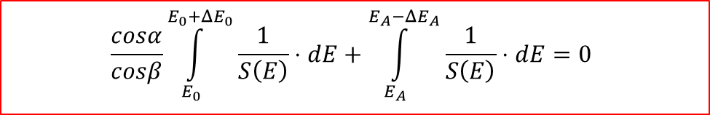
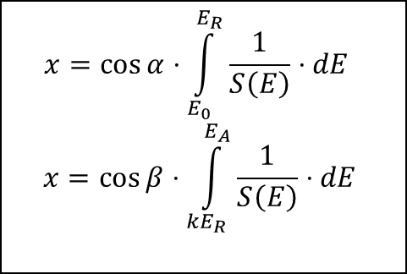
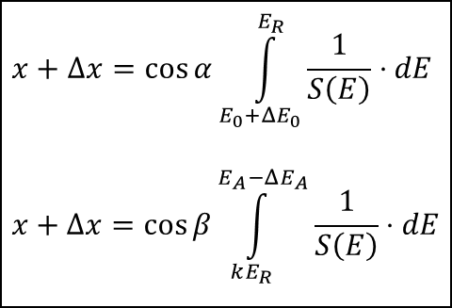
Method
Excitation function
$$x=\cos{α⋅\int_{E_{0}}^{E_{R}}{\frac{1}{S\left(E\right)}⋅dE}}$$
$$x=\cos{β⋅\int_{{kE}_{R}}^{E_{A}}{\frac{1}{S\left(E\right)}⋅dE}}$$
$$x+Δx=\cos{α\int_{E_{0}+ΔE_{0}}^{E_{R}}{\frac{1}{S\left(E\right)}⋅dE}}$$
$$x+Δx=\cos{β\int_{kE_{R}}^{E_{A}−ΔE_{A}}{\frac{1}{S\left(E\right)}⋅dE}}$$
Backscattering spectrum
$$const⋅\frac{cosα}{cosβ}\int_{E_{0}}^{E_{0}+ΔE_{0}}{\frac{1}{S\left(E\right)}⋅dE}+const⋅\int_{E_{A}}^{E_{A}−ΔE_{A}}{\frac{1}{S\left(E\right)}⋅dE}=0⋅const$$
$$\frac{cosα}{cosβ}\int_{E_{0}}^{E_{0}+ΔE_{0}}{\frac{1}{S\left(E\right)}⋅dE}+\int_{E_{A}}^{E_{A}−ΔE_{A}}{\frac{1}{S\left(E\right)}⋅dE}=0$$
Fitting a shape of stopping power
Normalization via RBS analysis

Slide 5
Experimental setup
4
5
6
7
3
4
5
3
1
4He++
Target (pyrolytic graphite)
Current integrator
PIPS detectors at 150° and 170°
Preamplifiers
Spectrometry amplifiers
Two channel ADC
Accelerator work station
-300V
Scattering chamber
2

Slide 6
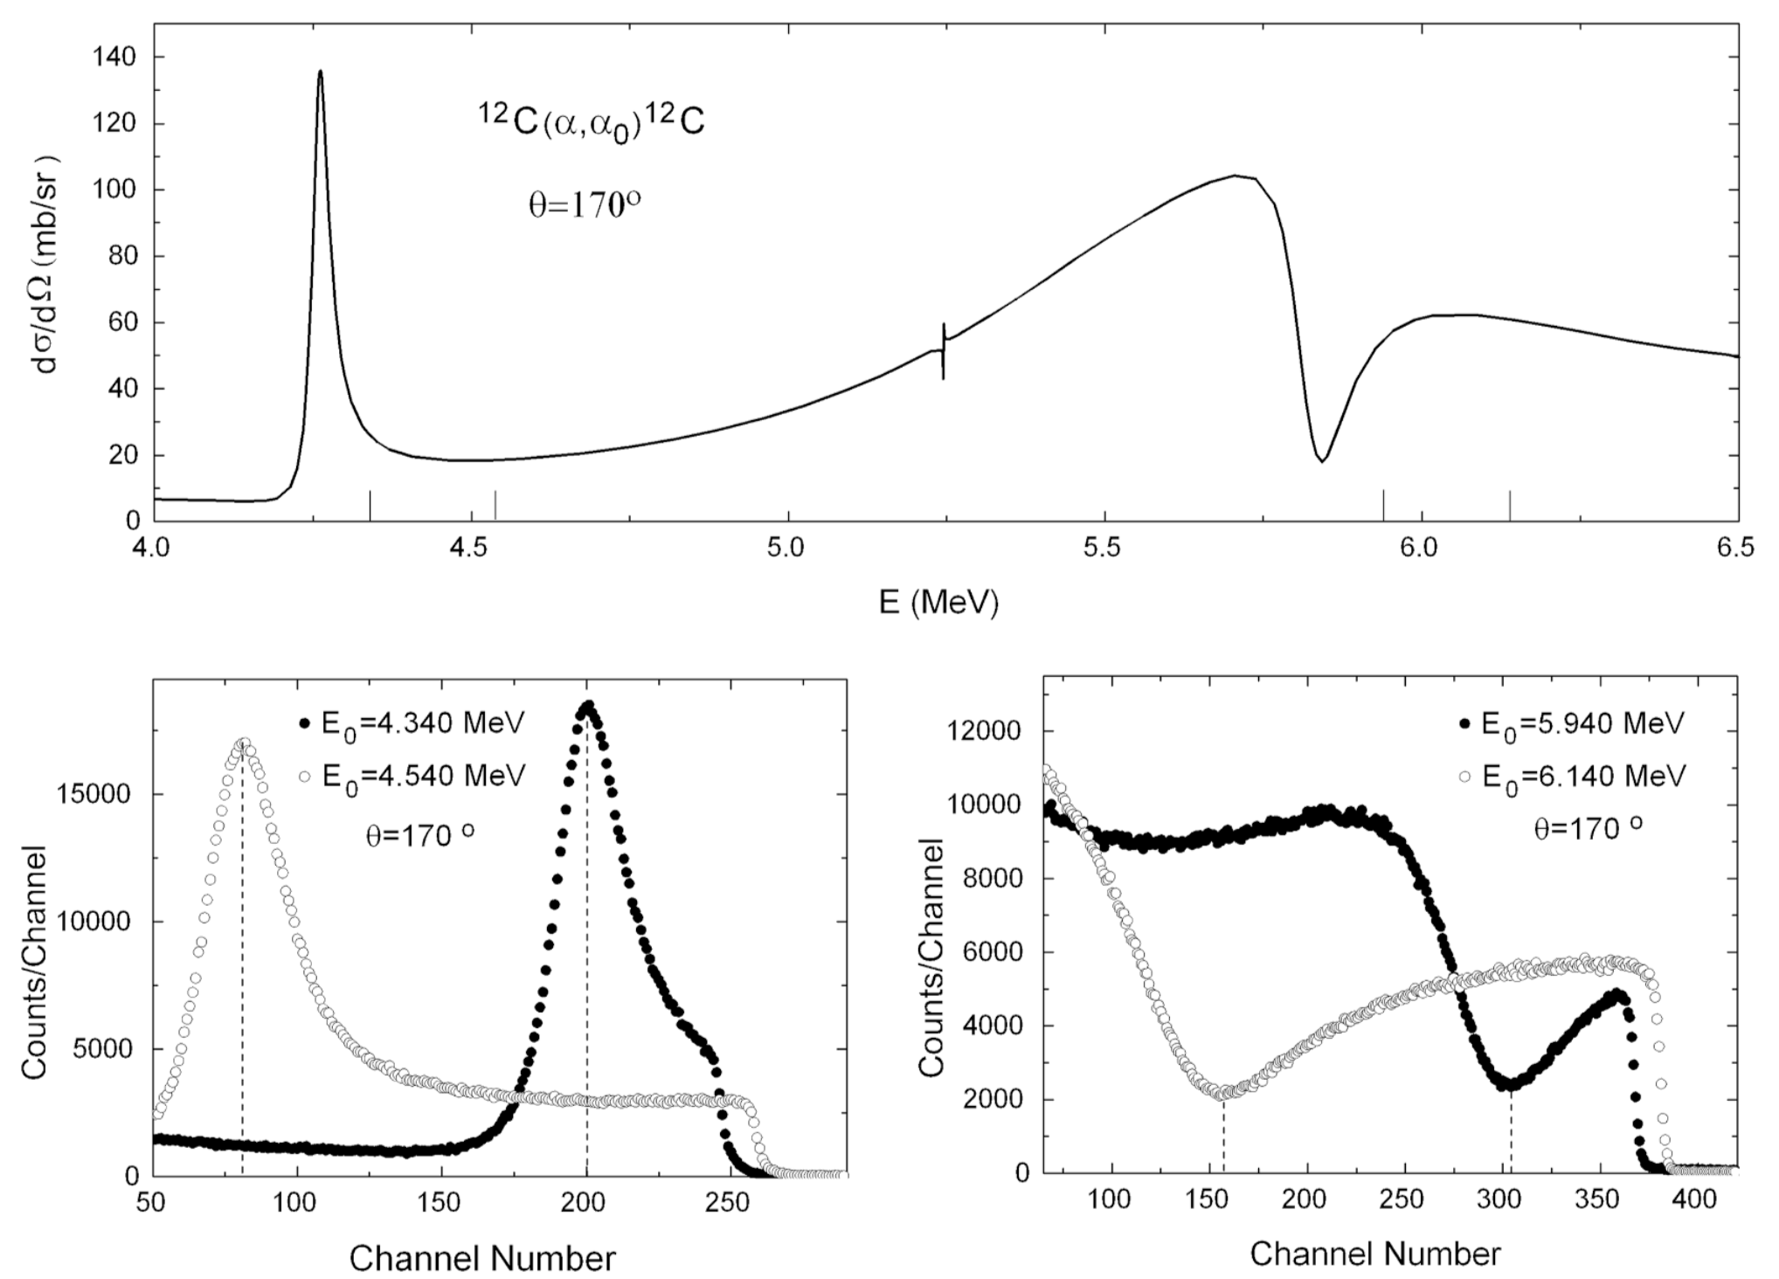
Acquired spectra
Excitation function
Resonance energy
Anomaly energy
The energy of anomaly was found as local extremum using 3-degree polynomial fitting
Spectra examples

Slide 7
Straggling correction
Energetic straggling affects anomaly position in spectra
Comparing of anomaly position with taking into account straggling and excluding
Energy shift due to straggling
The energy shift mainly depends on angle

Slide 8
Stopping power normalization
Fitting procedure
Optimization was carried out by simulated annealing → energy dependency
Additional spectrum for 1990 keV
Normalization was carried out using standard SIMNRA utilities → absolute value

Slide 9
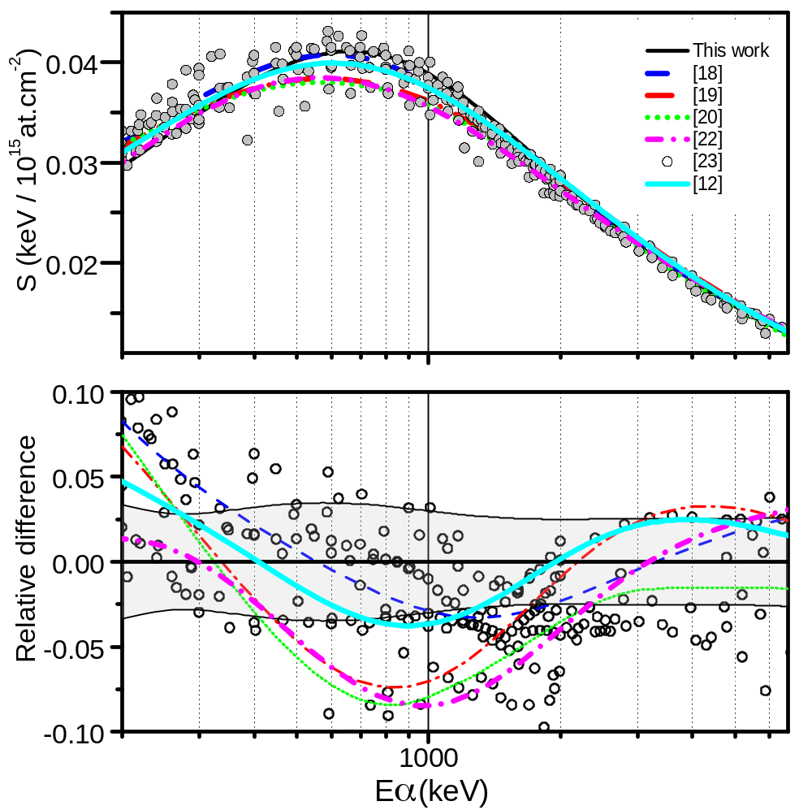
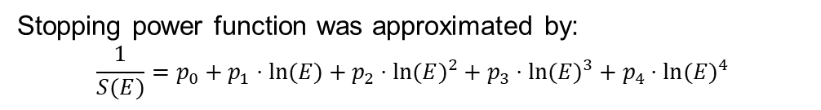
Results
Obtained stopping power
This work
ZBL
SRIM
ASTAR
KKK
H.Paul
Tosaki
Stopping power function was approximated by:
$$\frac{1}{S(E)}=p_{0}+p_{1}⋅ln(E)+p_{2}⋅ln(E)^{2}+p_{3}⋅ln(E)^{3}+p_{4}⋅ln(E)^{4}$$
P₀ | 2.88 E2
P₁ | -9.78 E1
P₂ | 1.52 E1
P₃ | -1.5 E0
P₄ | 9.17 E-2
Uncertainty | Relative value
Anomaly energy | 0.7 %
Initial energy | <<1%
Optimization | 2-3 %
Normalization | 2-3 %
Total | ~3 %

Slide 10
Validation
We tested stopping power using M. Mayer`s data *
SIMNRA-7 simulation reproduces spectra much better if our stoppings is taken into account **
These data were used in our ¹³C(α,n)¹⁶O experiment ***
*M. Mayer, Statistical analysis of cross-section data for 12C(4 He,4 He)12C backscattering, Nucl. Instr. Meth. Phys. Res. B 285 (2012) 116–124.
**T.L. Bobrovskiy et al. Determination of stopping power for light ions using resonance backscattering // Nuclear Instruments and methods in physics research Section B. Volume 543, October 2023, 165094
***P.S. Prusachenko et al. Experimental study of thick target yield from the ¹³C(α,n)¹⁶O reaction // Nuclear science and engineering. DOI: 10.1080/00295639.2023.2236477

Slide 11
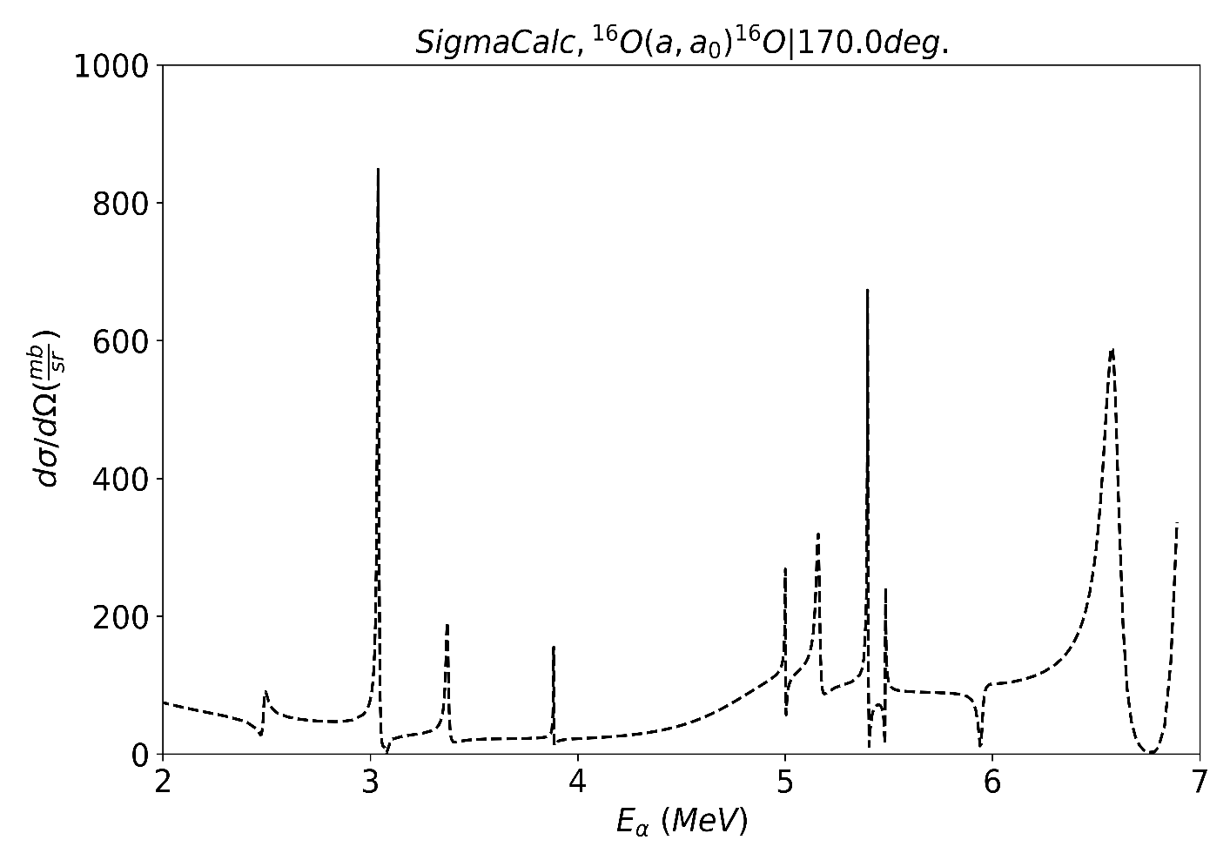
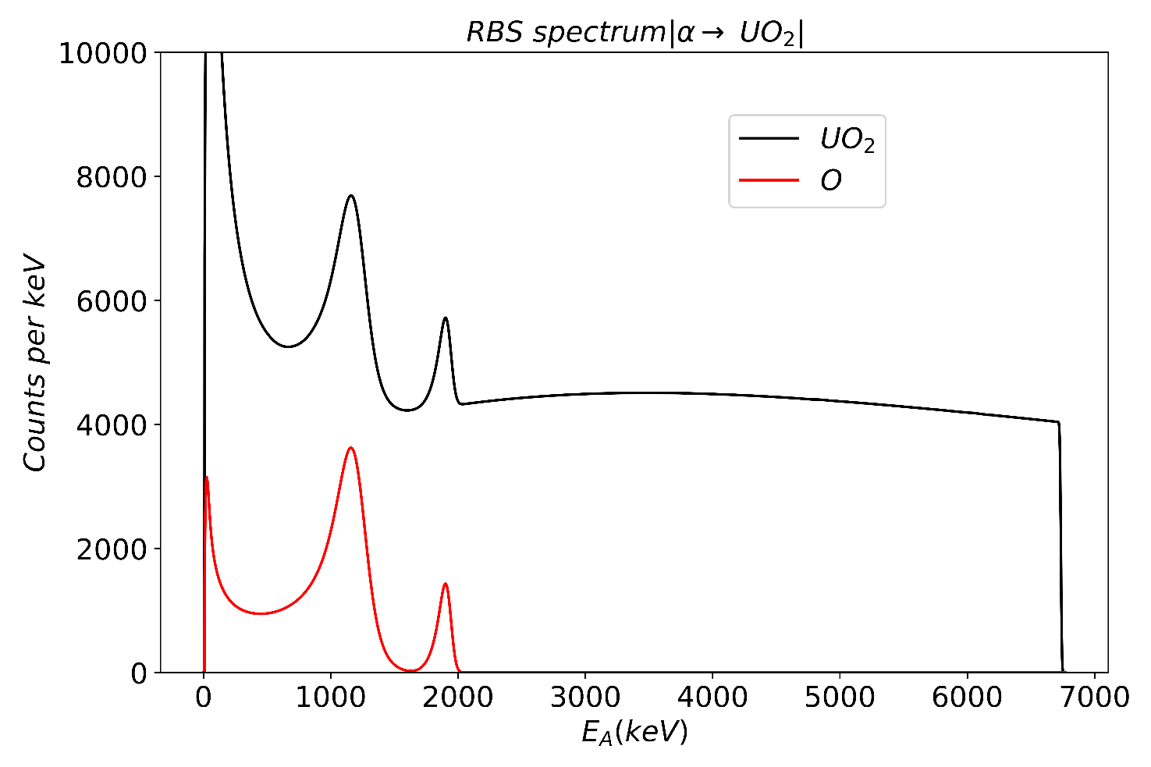
Future plans
Measuring the stopping power of actinide compounds
Checking Bragg-Kleeman rule
Target is prepared
Waiting for beam time

Slide 12
Summary
New data on stopping power for α-particles in carbon were obtained
A new approach was used
The accuracy of the data was estimated to be approximately 3%.

Slide 13
Thank you for attention!

