Slide 1
New developments for ENSDF evaluation tools
Jun Chen
2022 NSDD Spring Meeting

Slide 2

Summary of Modernized Codes
Old Code (Fortran) | New Code (Java)
ENSDAT | McMaster-MSU Java-NDS
RULER | Java-RULER (test phase)
GTOL | GLSC (Gamma to Level Scheme Computation)
GABS
PANDORA | ConsistencyCheck
RADLIST | RadiationReport* (test phase)
LOGFT*
--- | AME-NUBASE viewer
* See Xavier Mougeot’s BetaShape code for comprehensive calculations of beta decay and electron capture.

Slide 3
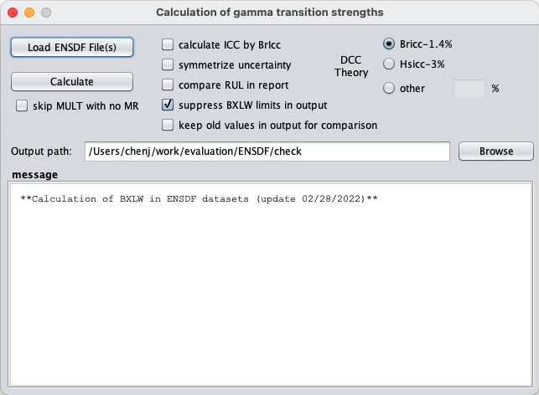
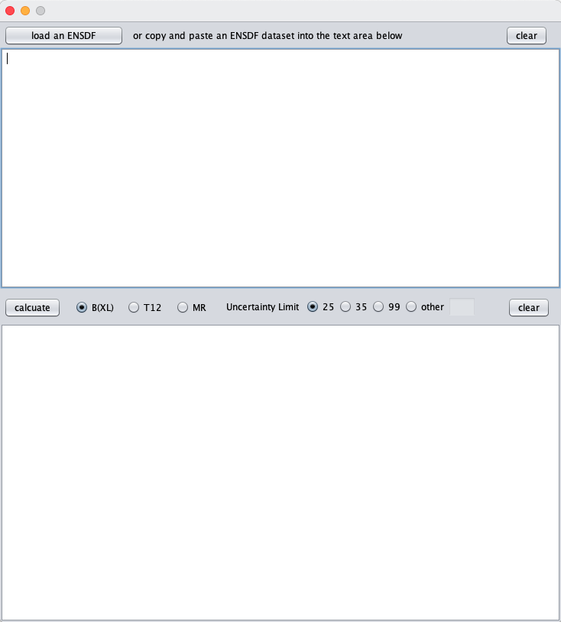
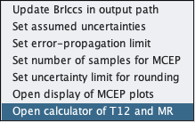
New feature in Java-RULER: calculator of B(XL), T1/2, MR for individual levels and gammas
This is an editor pane:
Copy&paste ENSDF lines of levels and gammas to be calculated for
Or load a whole dataset
And modify anything for re-calculation
right click
calculate B(XL)(W.u.) for gammas, T1/2 or mixing ratio if any of the other two and gamma intensities are given
results

Slide 4
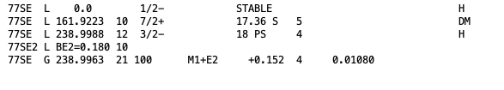
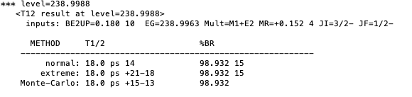
New feature in Java-RULER: example calculator of B(XL), T1/2, MR for individual levels and gammas
right click

Slide 5
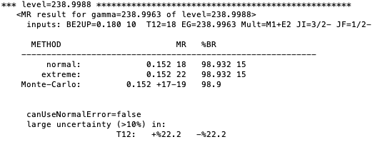
New feature in Java-RULER: example calculator of B(XL), T1/2, MR for individual levels and gammas
right click

Slide 6
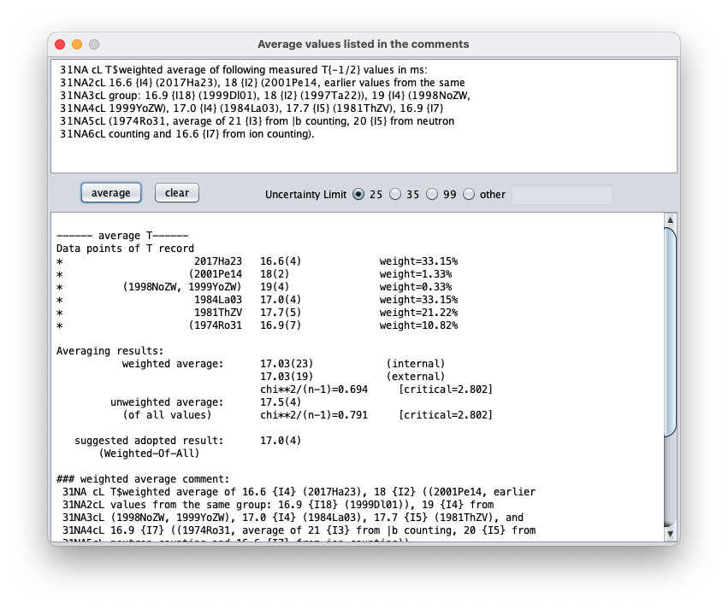
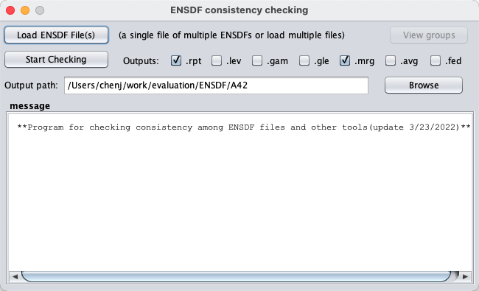
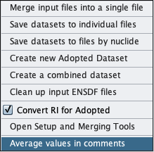
New feature in ConsistencyCheck: calculator of B(XL), T1/2, MR for individual levels and gammas
right click
Inputs are directly copied and
pasted from ENSDF comments
Inputs can be edited freely
Data points extracted from input comments
right-click: open an interactive
window for average
Results
New comments

Slide 7
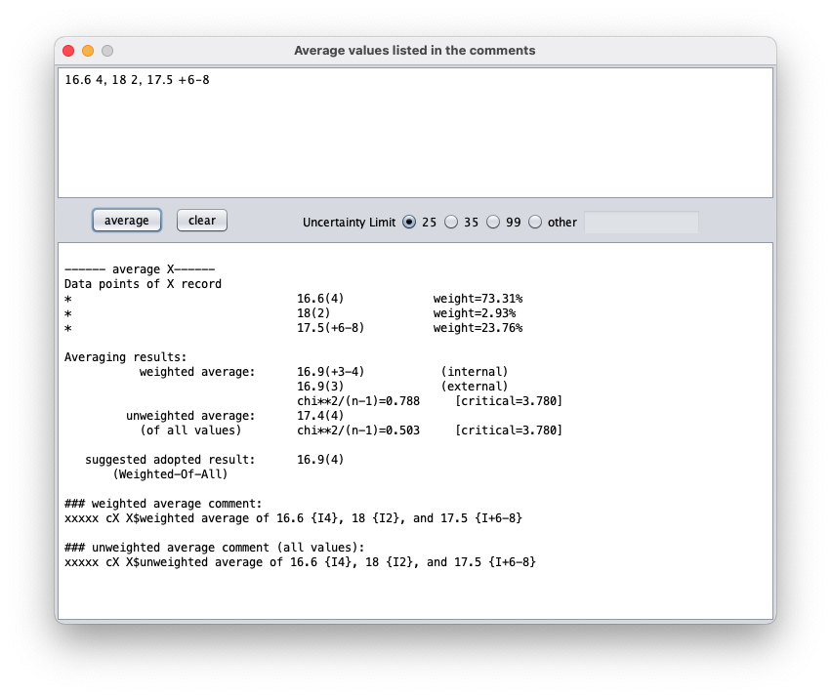
New feature in ConsistencyCheck: calculator of B(XL), T1/2, MR for individual levels and gammas
right click
inputs can be also from typing,
separated by “,”
uncertainty in ENSDF format
right-click: open an interactive
window for average

Slide 8
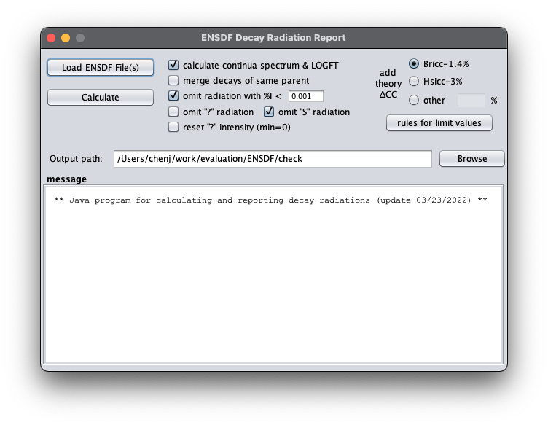
RadiationReport: a new alternative to RADLIST+LOGFT
Most recent atomic data (e.g.,
AME2020)
Improved uncertainty propagation
Added calculations for high-order (>2) forbidden unique decays
similar outputs as RADLIST and LOGFT
Constant maintenance
Thanks to Filip for his suggestions, inputs and help with testing

Slide 9
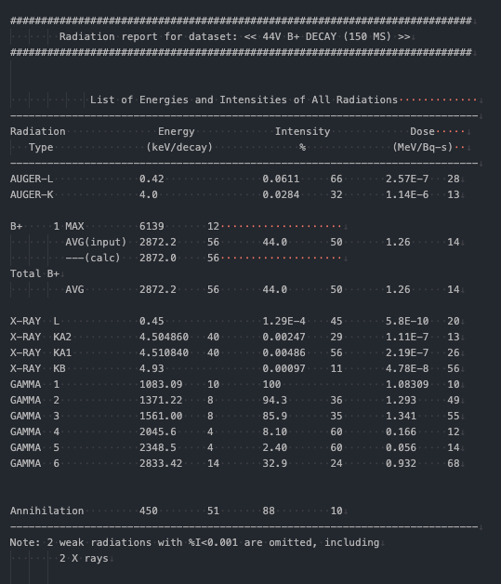
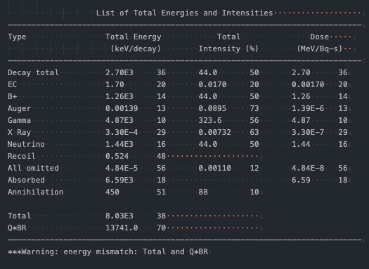
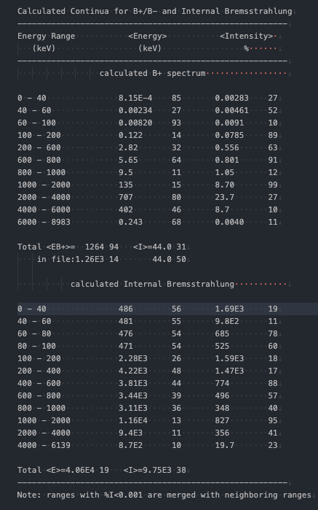
RadiationReport: example report (RADLIST type) a new alternative to RADLIST+LOGFT
List of Energies and Intensities of All Radiations
List of Total Energies and Intensities
Calculated Continua for B+/B- and Internal Bremsstrahlung
All lists are in a single .rpt file and made as clean and easy to read as possible.

Slide 10
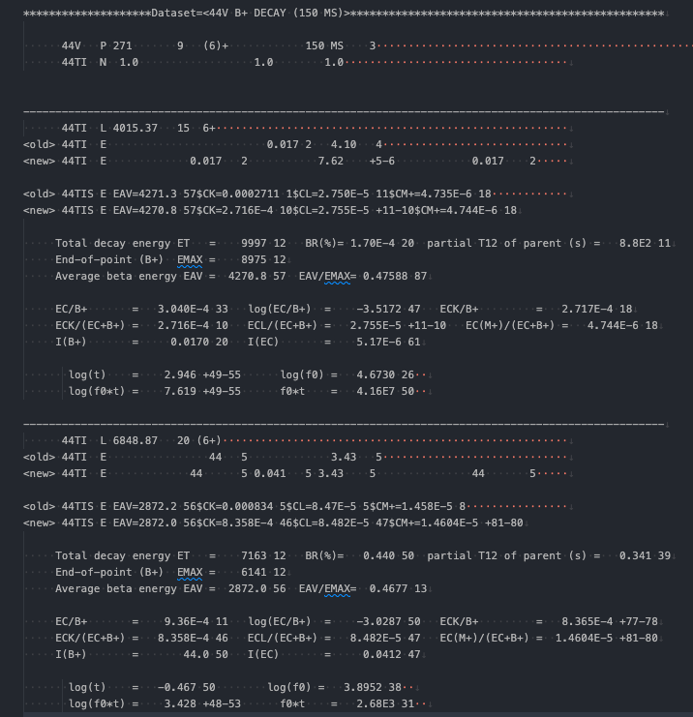
RadiationReport: example report (LOGFT type) a new alternative to RADLIST+LOGFT
Updated atomic data (e.g., AME2020)
Improved uncertainty propagation (e.g., correlations)
Improved precision for calculated energies (e.g., use exact mass instead of mass number for mass)
Allowing asymmetric uncertainty in logft value instead of symmetrization
Adding calculations for unique forbidden decays instead of assumption as allowed (non-unique still assumed as allowed*)
Free of bugs seen in the legacy LOGFT code
*NOTE: see Xavier Mougeot’s BetaShape code for comprehensive calculations of beta decay and electron capture, such as more accurate logft values for non-unique forbidden decays

Slide 11
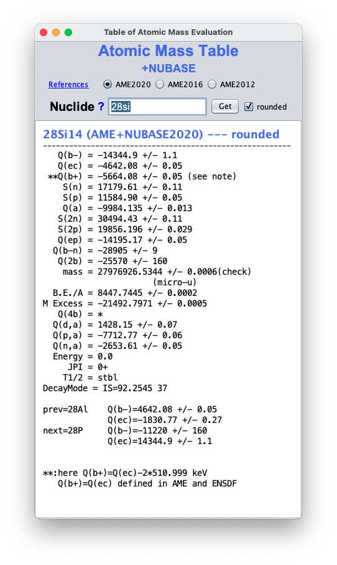
AME-NUBASE viewer: a fast and easy way to view and use AME and NUBASE
retrieve and display any data in AME2020 & NUBASE2020
automatically update Q record in an input ENSDF file
instruction
to get all AME entries for a single nuclide
type nuclide name, like, 28Si
to list all isotopes of an element
type element symbol or Z=##, like Si or Z=14
to list all isotones of the same mass
type A=## or ##, like A=28 or 28
to get specific data entries of a nuclide or nuclides, type any of inputs
above followed by the entry names, separated by :, like
A=28:QB:E:J:T:ME:SN for all A=28 isotones
or A=28,Z=14:QB:E:J:T:ME:SN for A=28 isotones plus Z=14 isotopes
to get data entries deduced from masses, like Q(B-3N) for A=77
type A=77: QB3N
to calculate mass differences, like calculating Q(B-2N) for ⁷⁷Co
type 77CO−75NI−2*n
usages
See instruction for detailed usages

Slide 12
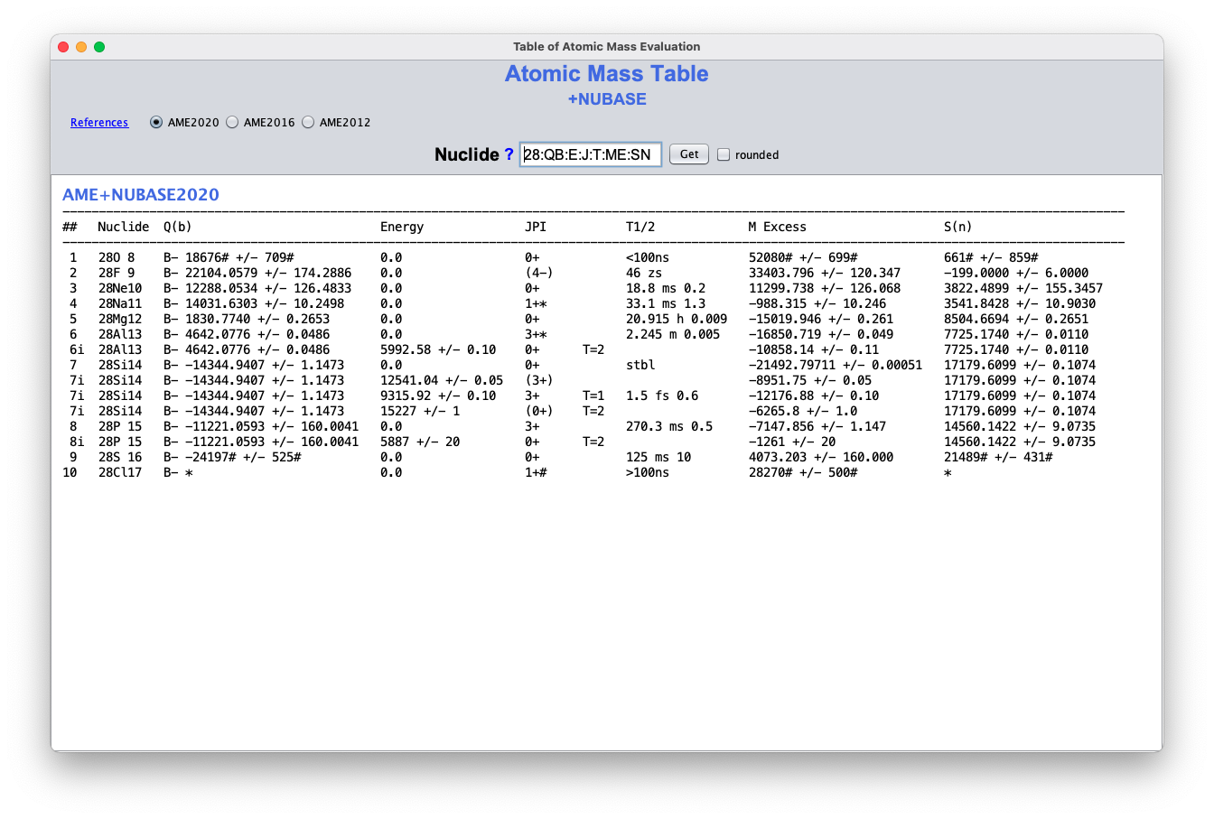
AME-NUBASE viewer: example a fast and easy way to view and use AME and NUBASE
example input: A=28:QB:E:J:T:ME:SN
to get data entries of Q(beta), Energy, JPI, T1/2, mass excess, S(n) for all A=28 nuclides from AME&NUBASE

Slide 13
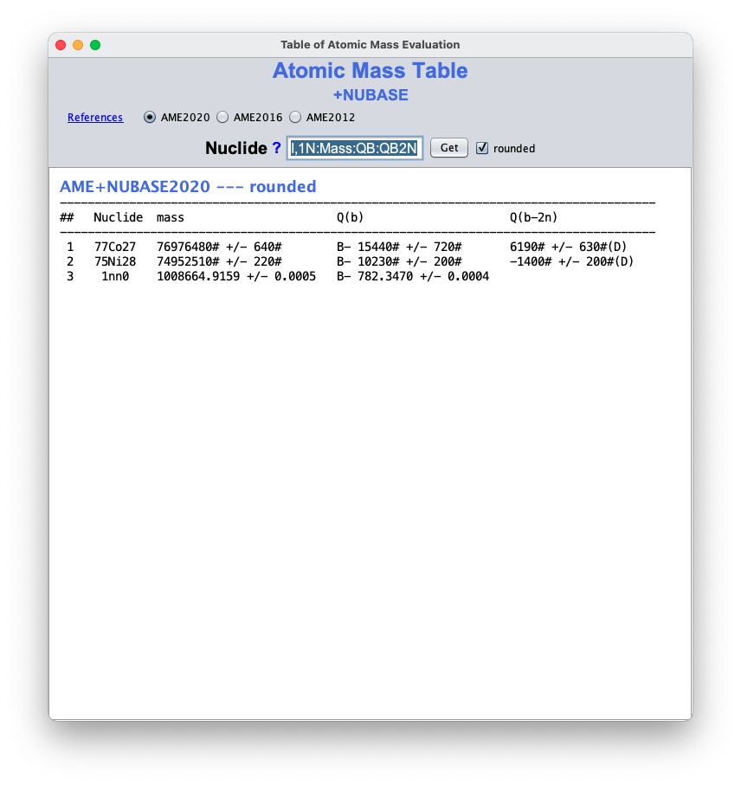
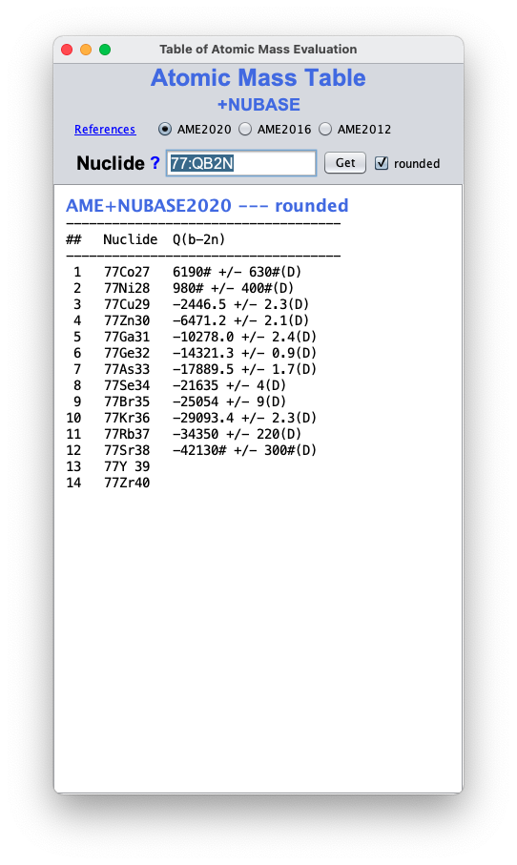
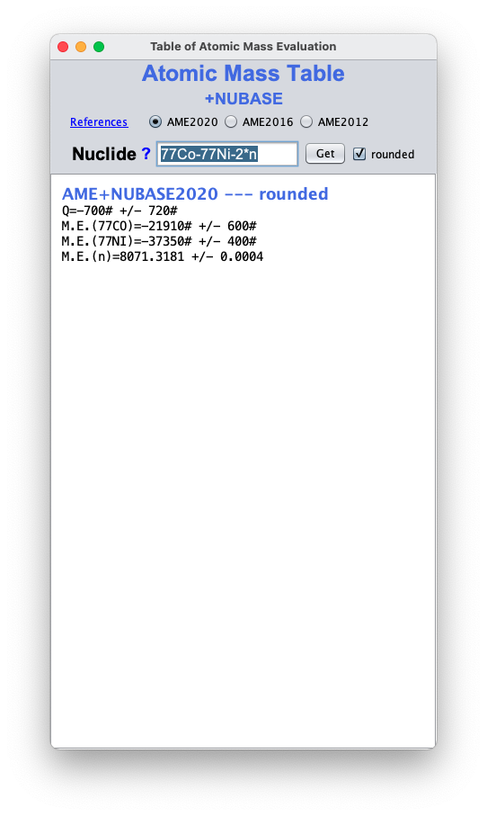
AME-NUBASE viewer: examples a fast and easy way to view and use AME and NUBASE
example input: 77CO,75NI,1N:Mass:QB:QB2N
to get data entries of atomic mass, Q(B-), Q(B-2n) for ⁷⁷Co, ⁷⁵Ni and neutron (1n)
example input: 77:QB2N
to get data entries of Q(B-2n) for all A=77 isotones
example input: 77Co-77Ni-2*n
to get mass difference as indicated.

Slide 14
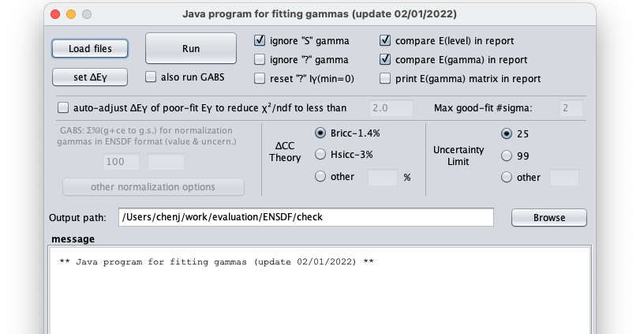
GLSC (Gamma to Level Scheme Computation):
%I𝛾 normalization tool
default normalization uses sum of 𝛾+ce intensities to ground state
Open a window for other normalization options
next slide

Slide 15
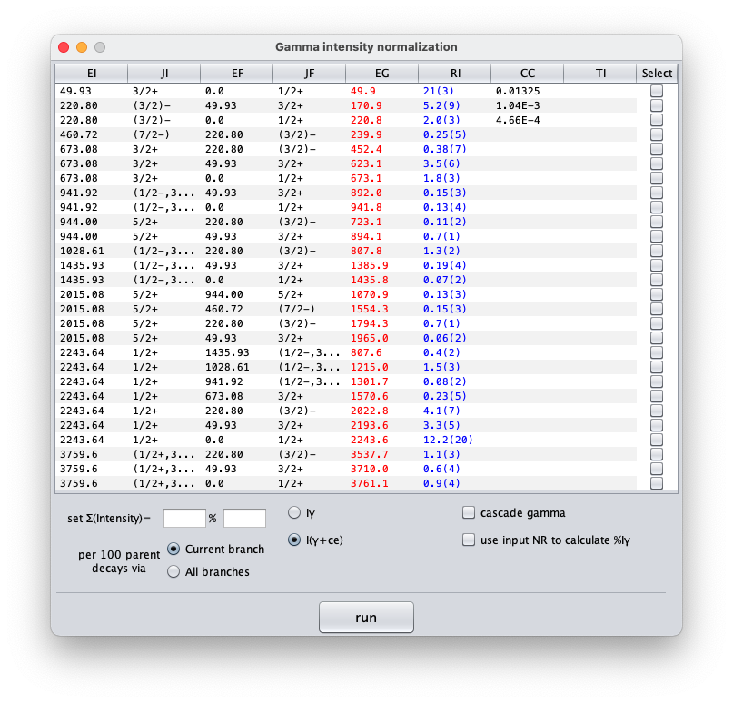
GLSC (Gamma to Level Scheme Computation):
%I𝛾 normalization tool
Select normalization
gammas
Set total absolute intensities of selected gammas
Other options

