Slide 1
What we’ve been up to beyond k-eff at LLNL
Presented at the Technical Meeting on the Compilation of Nuclear Data Experiments for Radiation Characterization (CoNDERC)
10-14 October 2022 at IAEA, Vienna, Austria
Dave Heinrichs
Tim Classen
Soon Kim
Ed Lent
Daniel Siefman
Lucas Snyder
October 1, 2022

Slide 2
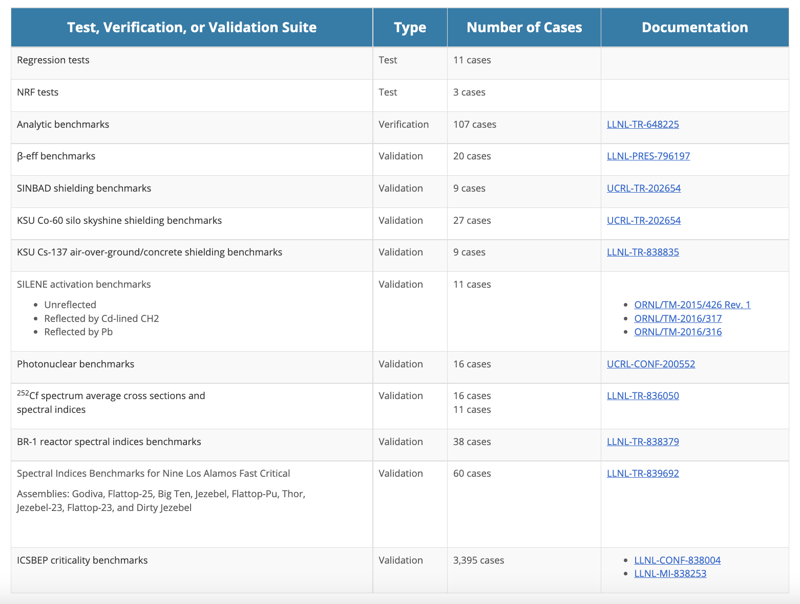
A significant effort is on-going at LLNL to document COG benchmark results with reports available at:
https://cog.llnl.gov
IAEA NDS is welcome to incorporate this work into CoNDERC.

Slide 3
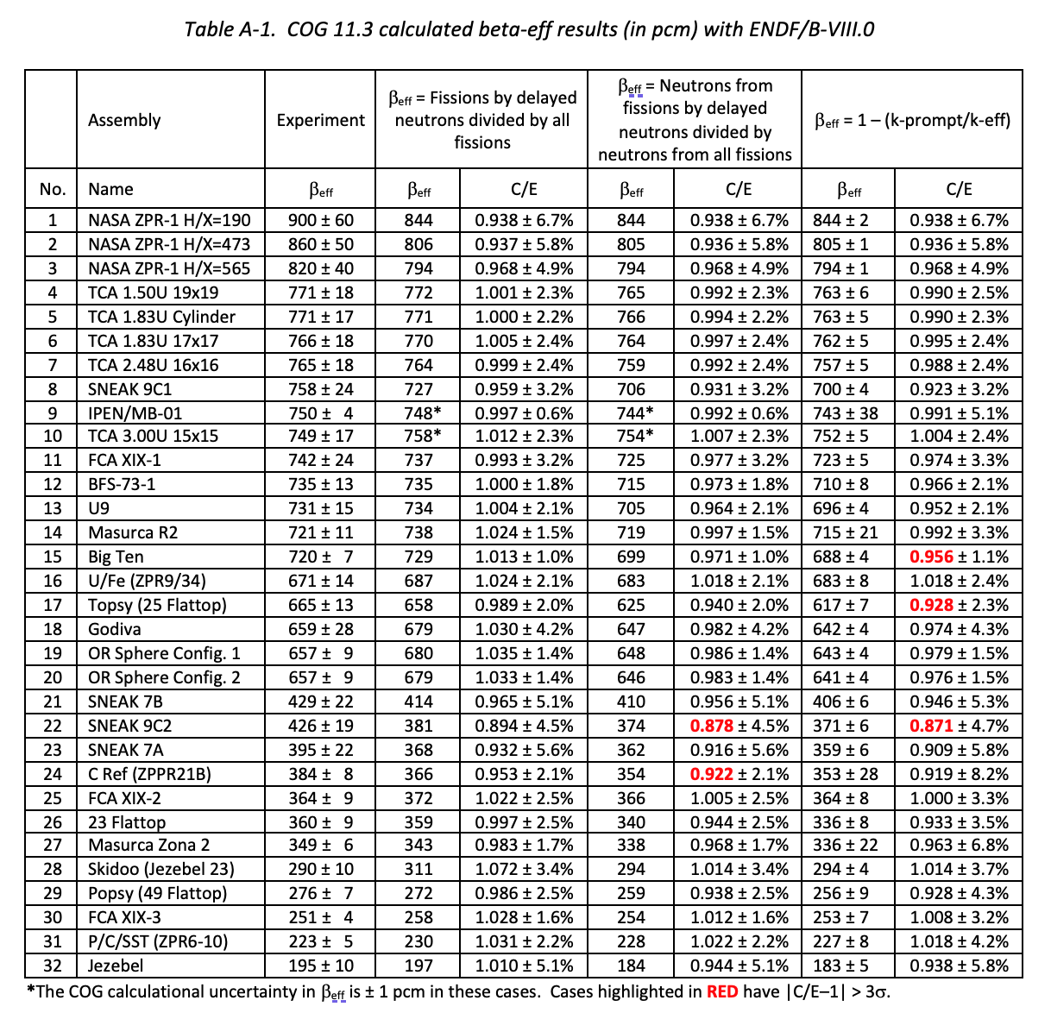
Three new β-eff estimators in COG are available in one run as prompt and delayed neutrons and gammas are treated as separate particles until the end.
Results using JEFF-3.3 are in progress.
https://cog.llnl.gov

Slide 4
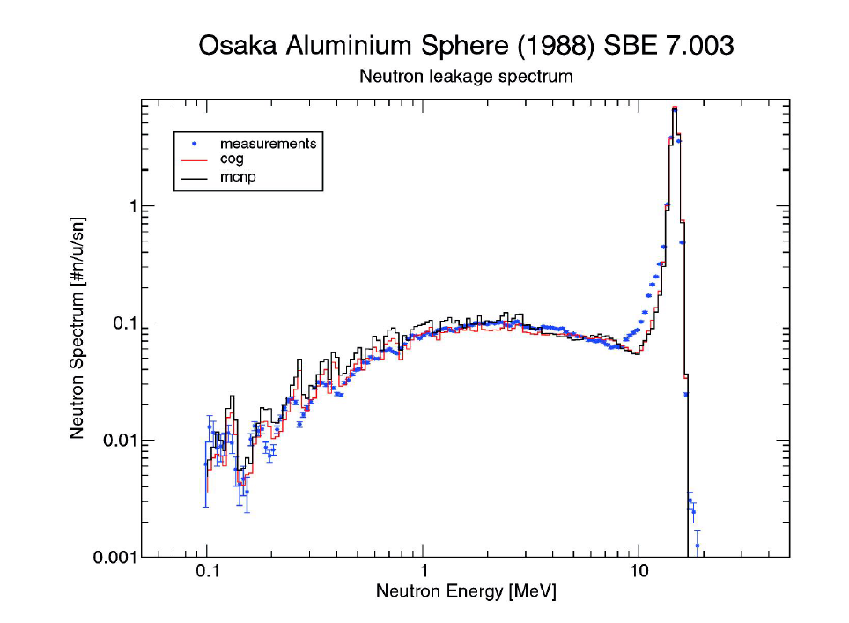
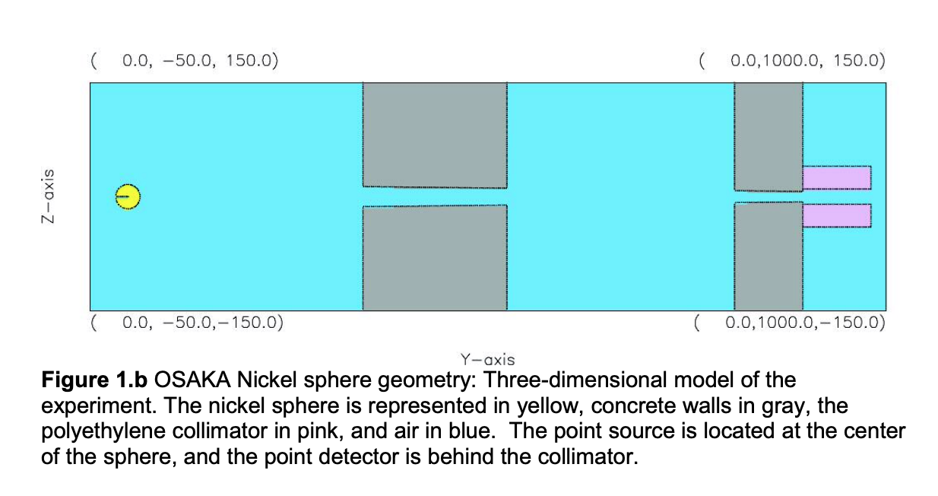
We are expanding our suite of SINBAD benchmarks beyond OKTAVIAN (M.-A. Descalle et al.)
https://cog.llnl.gov

Slide 5
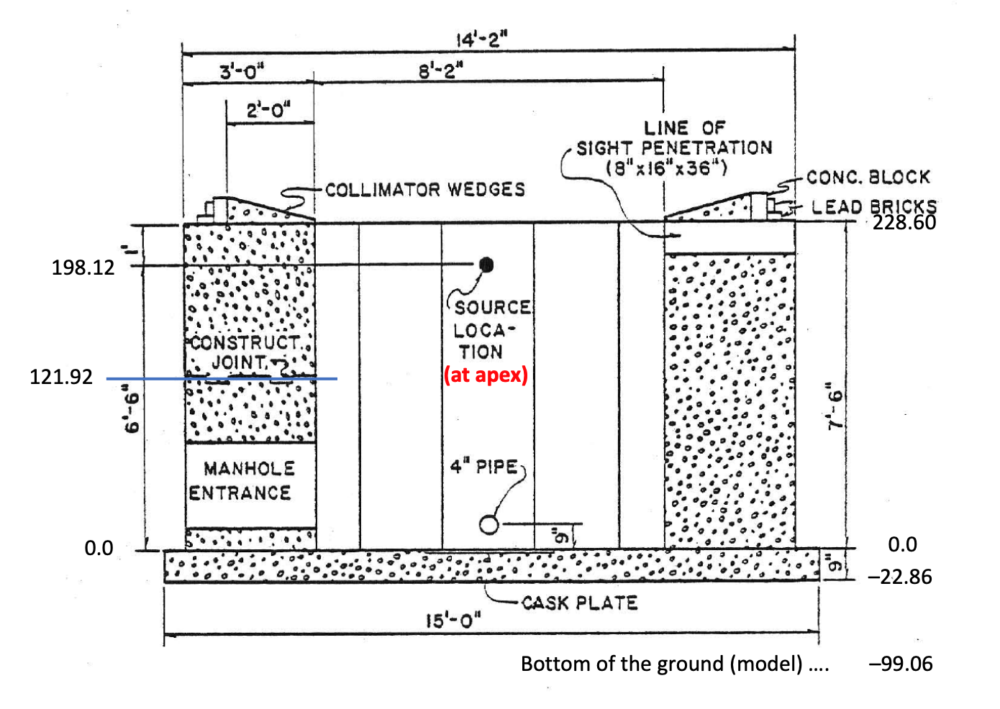
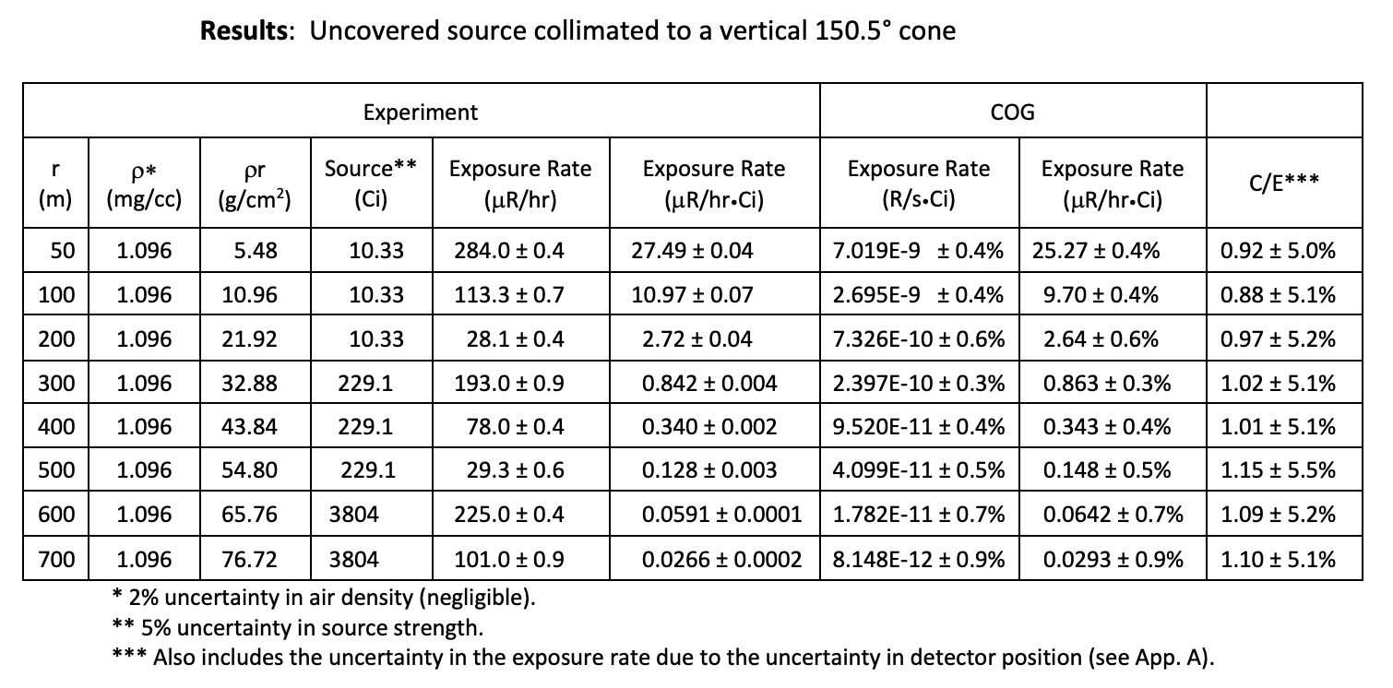
Many benchmarks are useful for specific applications rather than nuclear data evaluation.
KSU skyshine benchmark
https://cog.llnl.gov

Slide 6
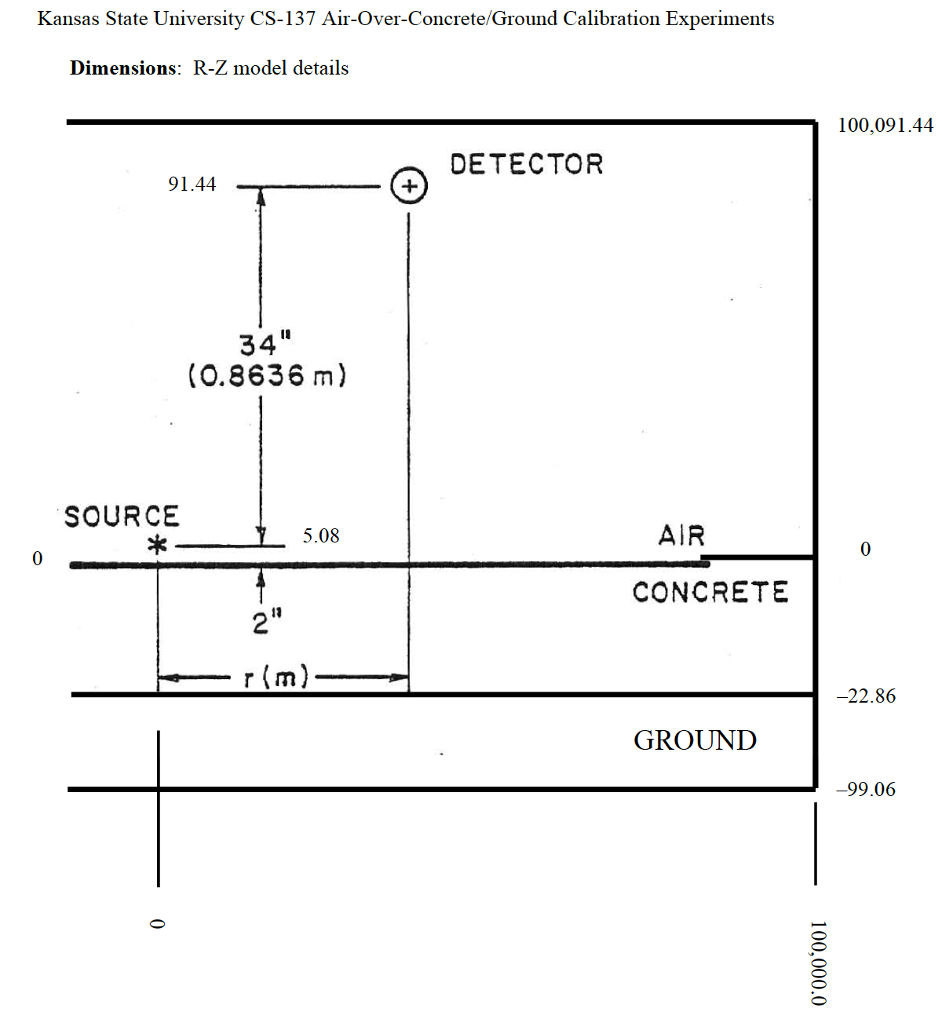
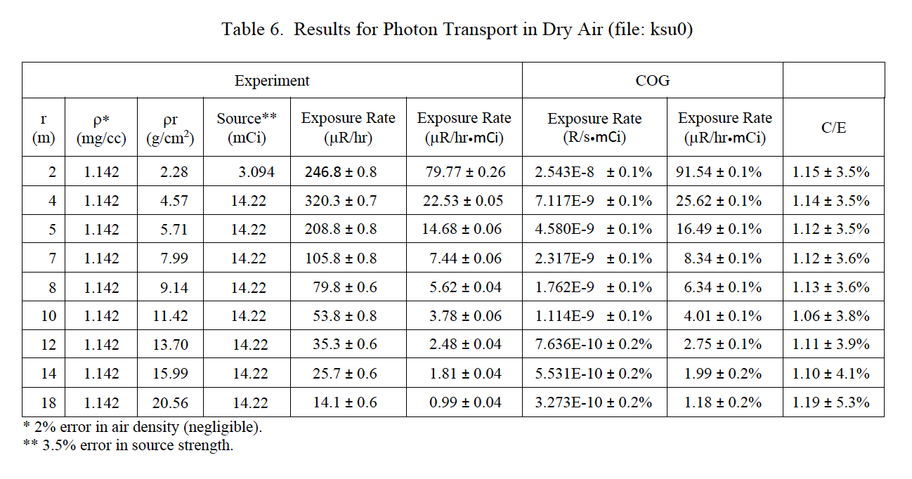
KSU Cs-137 detector calibration tests.
https://cog.llnl.gov

Slide 7
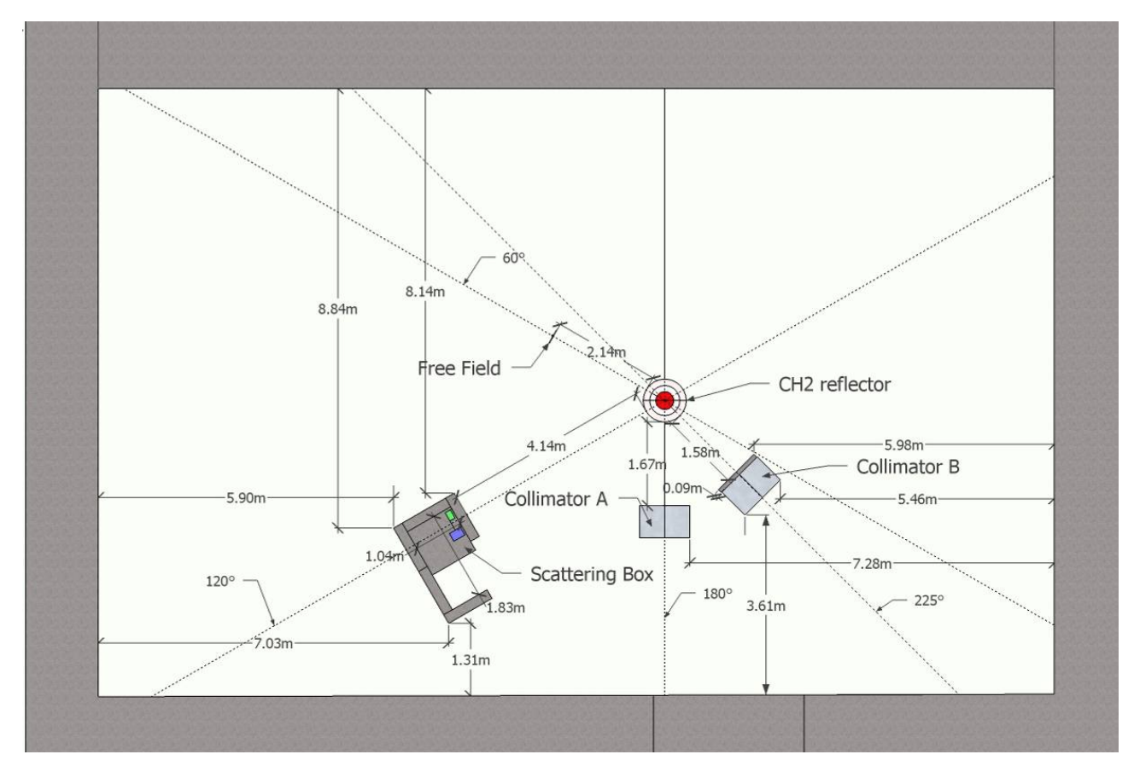
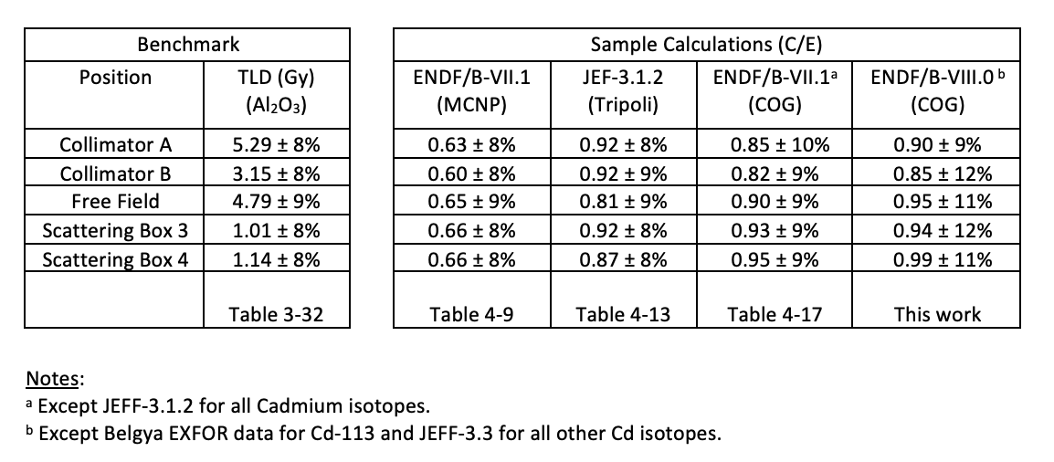
Cd-lined
This SILENE neutron activation foil and photon TLD benchmark revealed no radiative capture gamma production in ENDF/B-VIII.0 for Cd isotopes. #&@!
https://cog.llnl.gov

Slide 8
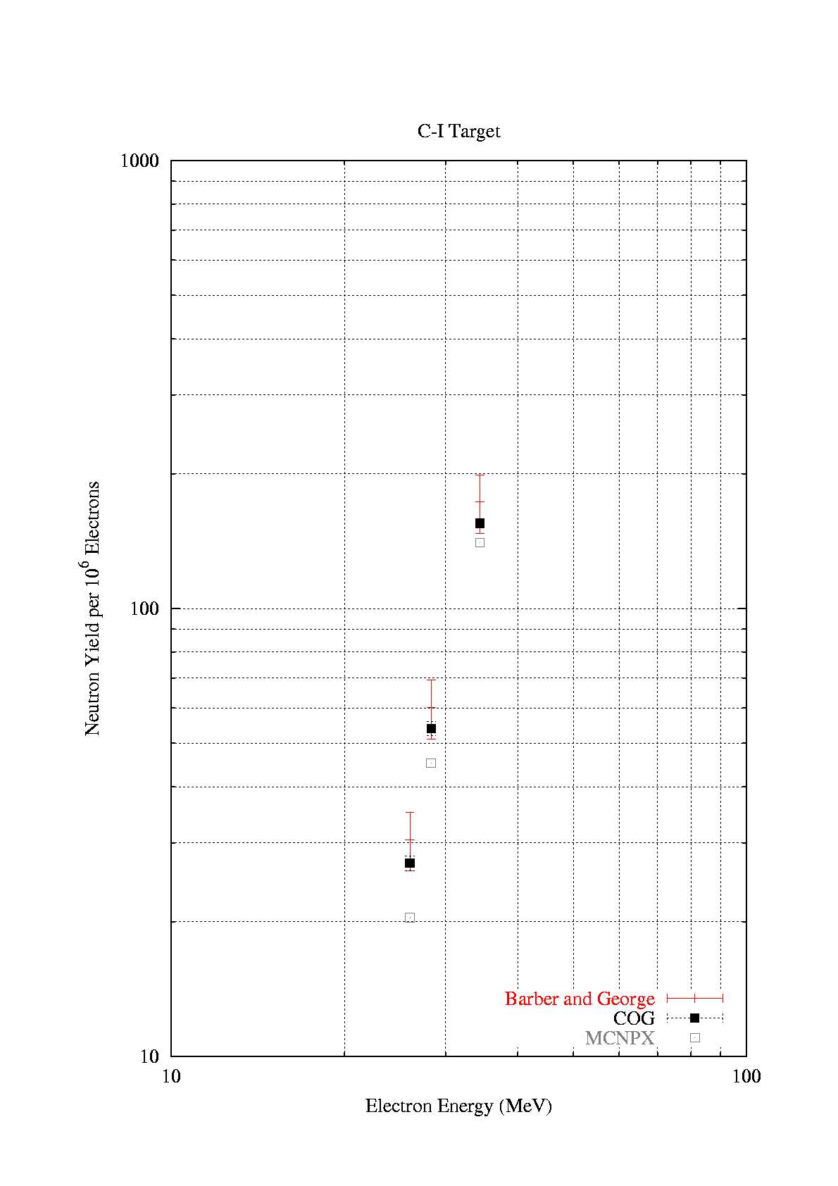
Barber and George (SLAC) photoneutron benchmarks
(coupled e-γ-n problems)
Plan to redo now that COG has EGS5 inside and in-line PEGS library creation.
https://cog.llnl.gov

Slide 9
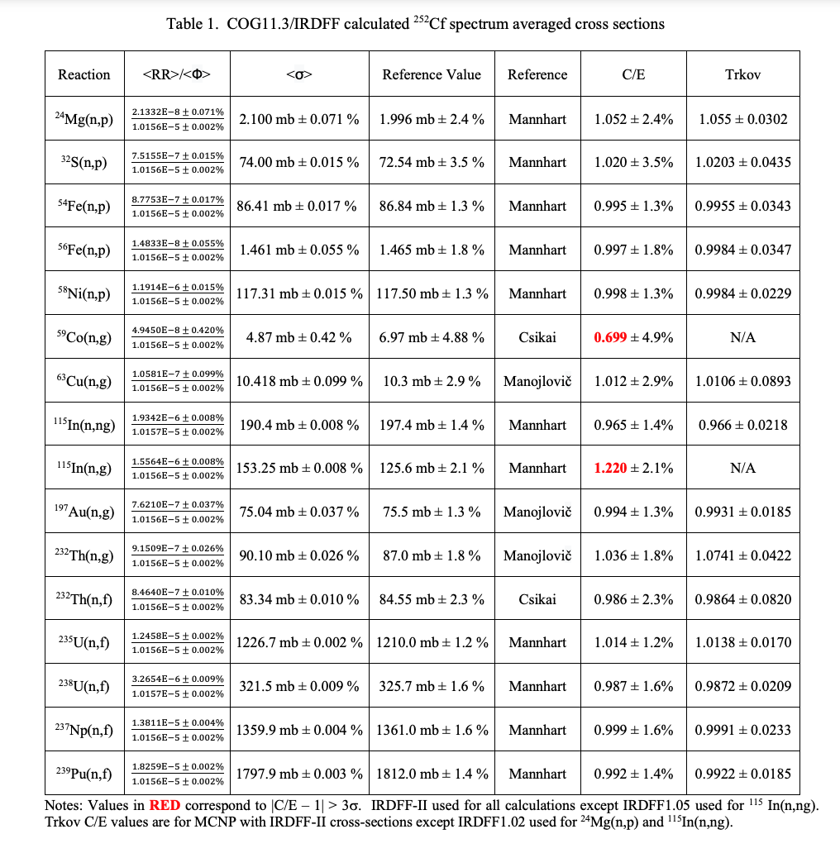
A. Trkov et al., “IRDFF-II: A New Neutron Metrology Library,” Nuclear Data Sheets: 163 (2020) 1-108.
Cf-252 spectrum averaged cross sections.
Some problems observed with all libraries.
https://cog.llnl.gov

Slide 10
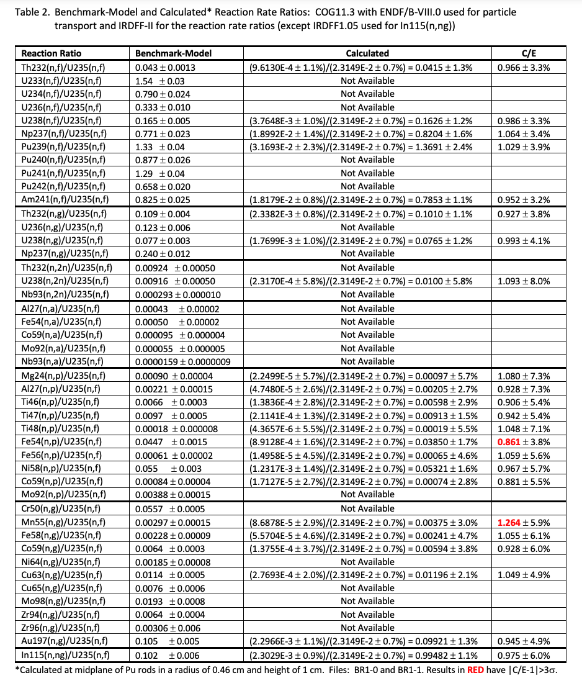
FUND-IPPE-FR-MULT-RRR-001
BR-1 reactor spectral indices
https://cog.llnl.gov

Slide 11
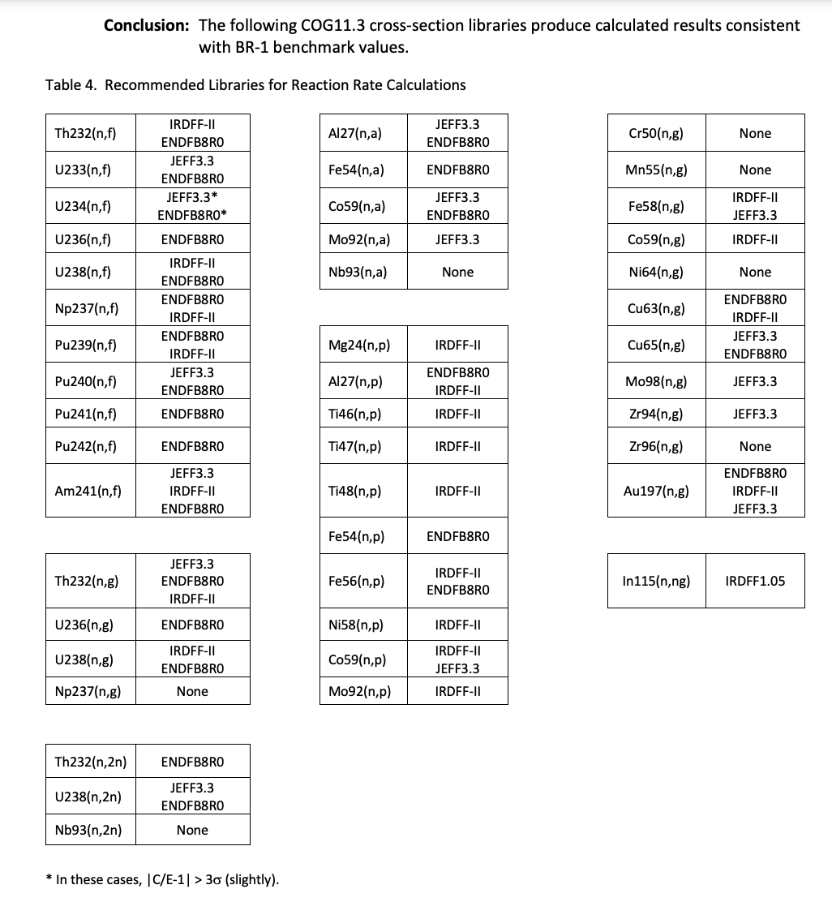
FUND-IPPE-FR-MULT-RRR-001
BR-1 reactor spectral indices are useful for nuclear data selection
https://cog.llnl.gov

Slide 12
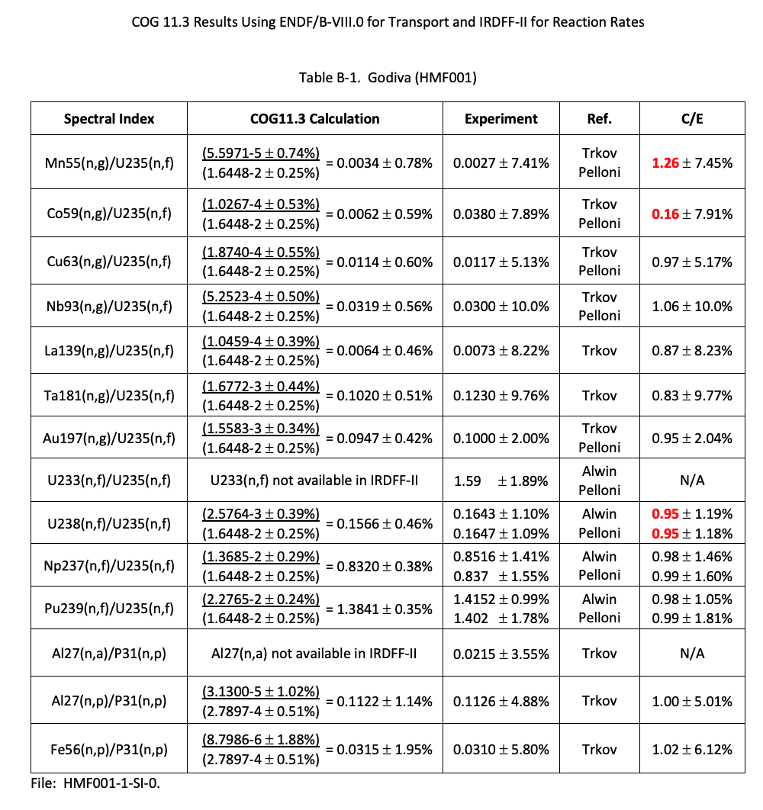
Spectral indices for 9 LANL fast critical assemblies:
- Godiva
- Flattop-25
- Big-Ten
- Jezebel
- Flattop-Pu
- Thor
- Jezebel-23
- Flattop-23
- Dirty Jezebel
https://cog.llnl.gov

Slide 13
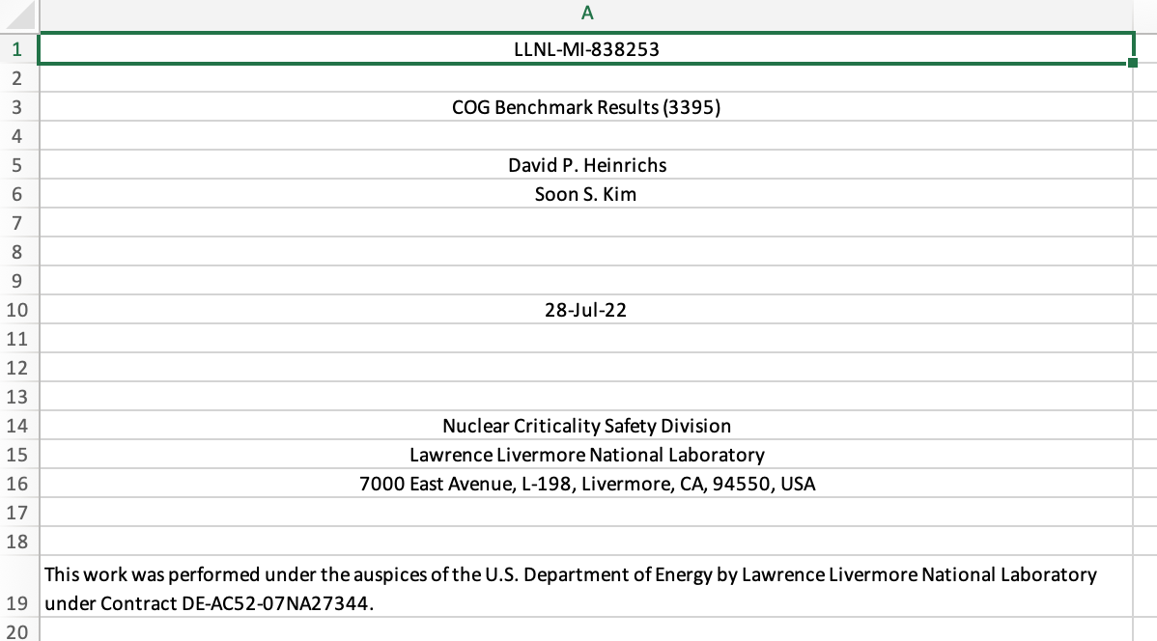
Work in progress – ICSBEP k-eff benchmark intercomparison project in progress
Spreadsheet with 3,395 ICSBEP benchmark k-eff’s
- ENDF/B-VII.1
- ENDF/B-VIII.0
- JEFF-3.3
Code intercomparison with COG, MCNP, MORET, SCALE (and MERCURY)
https://cog.llnl.gov

Slide 14
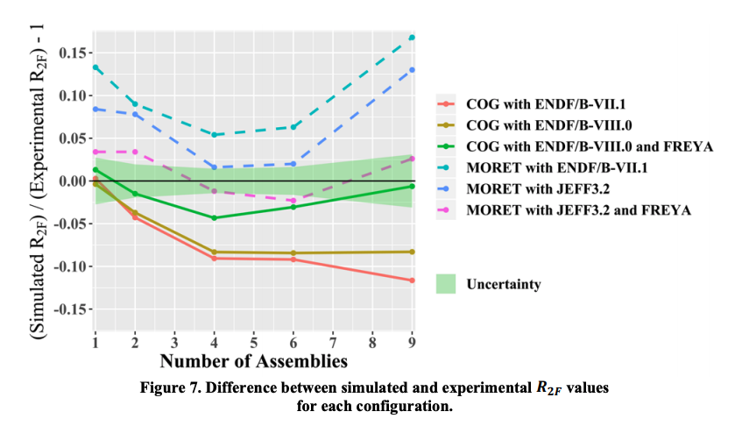
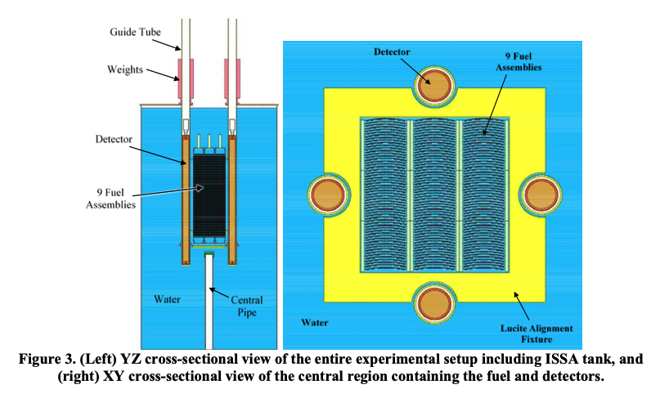
Work in progress – Subcritical benchmarks too!
  Implemented FREYA in COG to improve R2F simulation of the ISSA. Much higher additional subcritical multiplication experiments by IRSN, LANL and LLNL are in progress at SNL using 7uPCX.
  A. Nelson et al., “Fundamental Physics Subcritical Neutron Multiplicity Benchmark Experiments Using Water Moderated Highly Enriched Uranium Fuel” – ICNC 2019

Slide 15
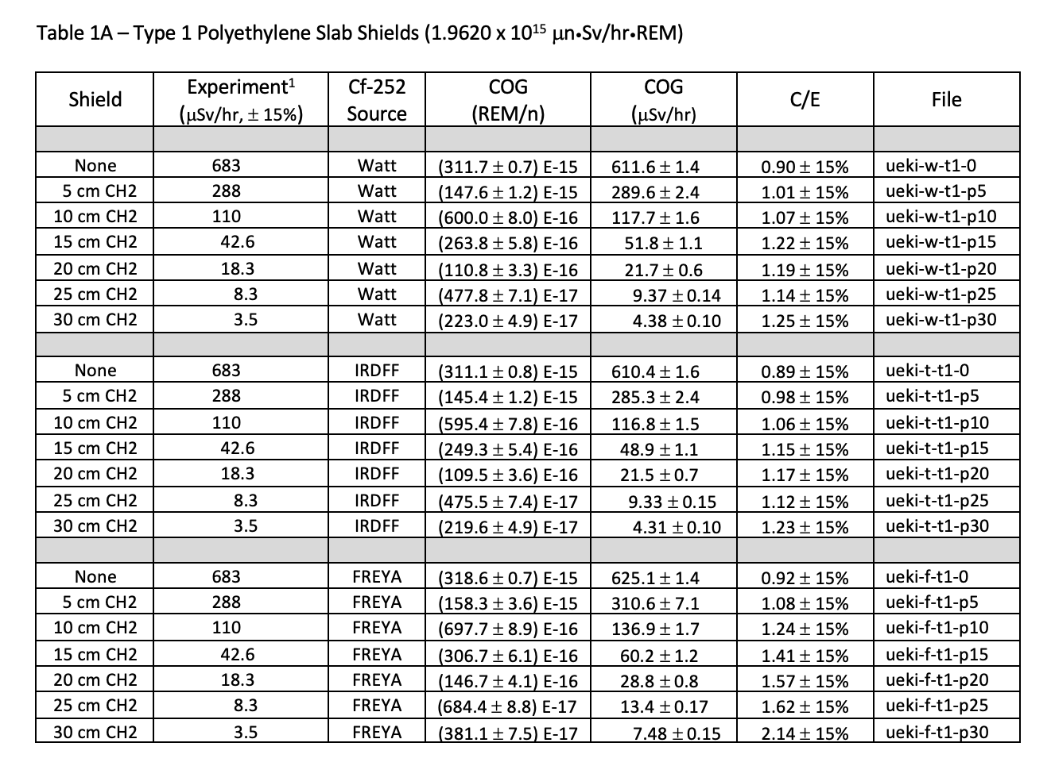
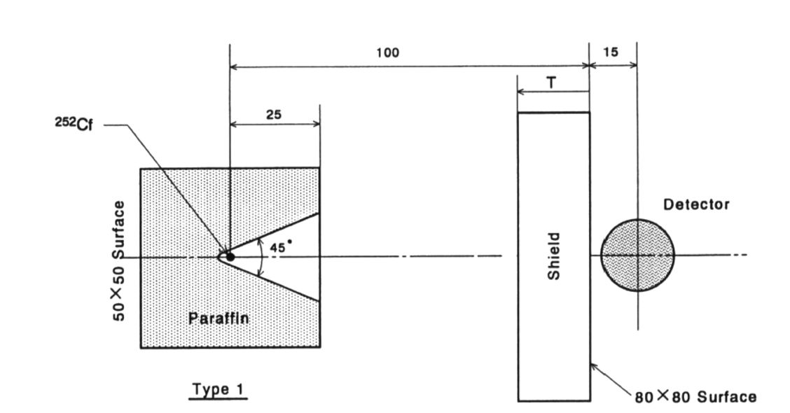
Work in progress – Ueki single slab and multi-slab shield benchmarks
Many excellent benchmarks have yet to be evaluated and published in international compendia like ICSBEP and SINBAD. One much used example is:
NSE: 124, 455-464 (1996), Systematic Evaluation of Neutron Shielding Effects for Materials, K. Ueki et al.

Slide 16
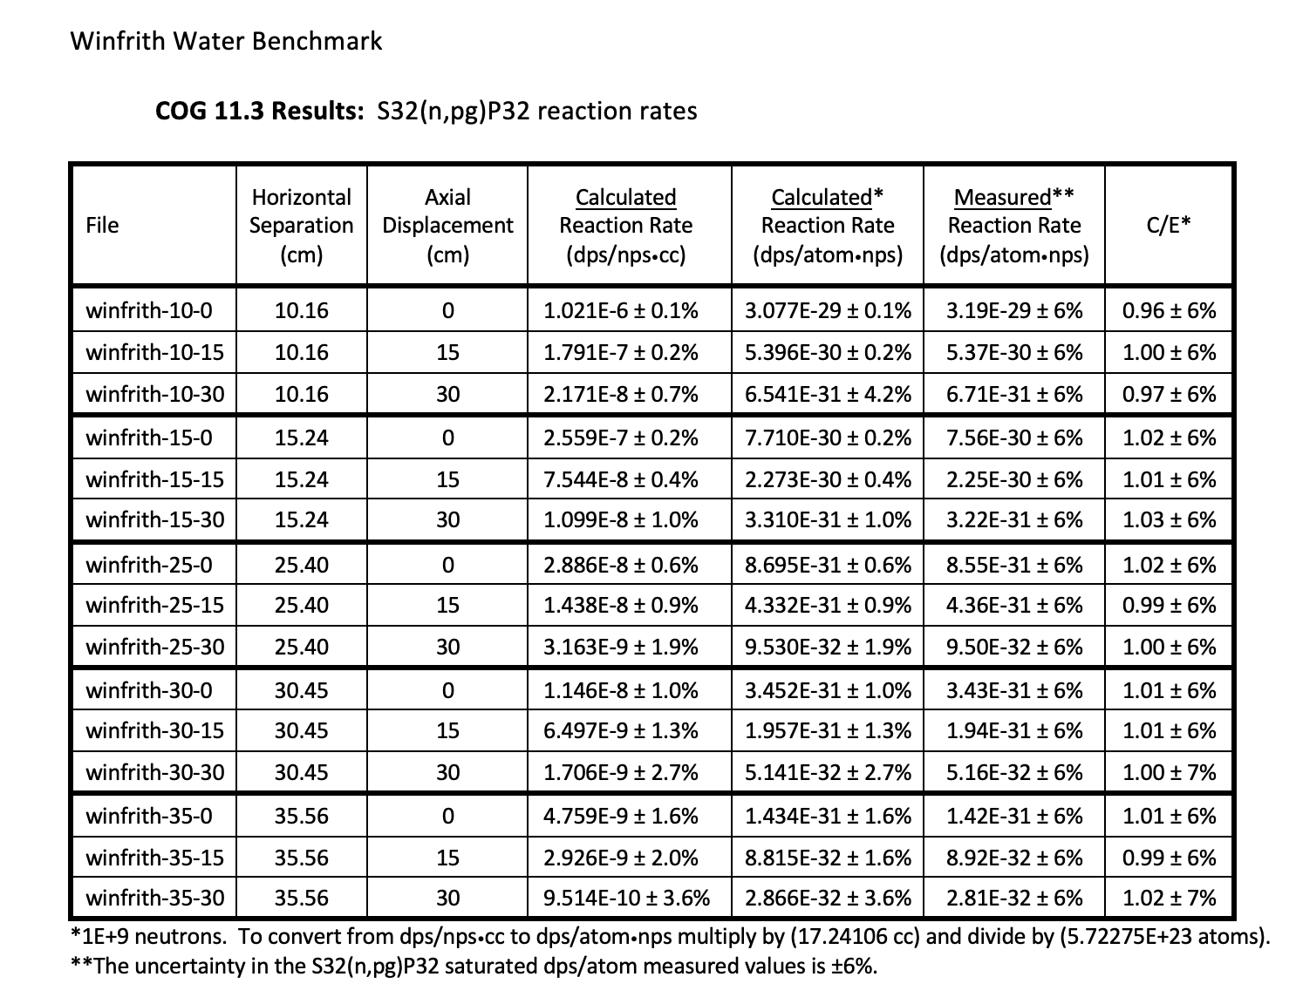
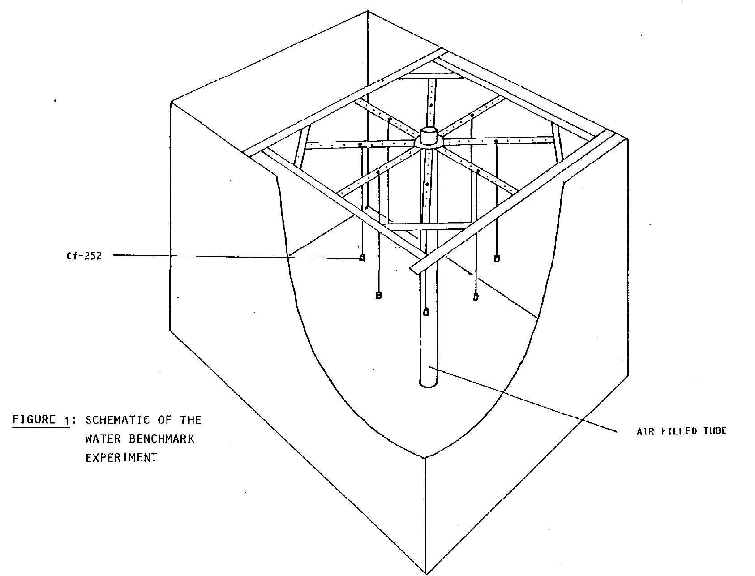
Work in progress – SINBAD Winfrith Water Benchmark

Slide 17
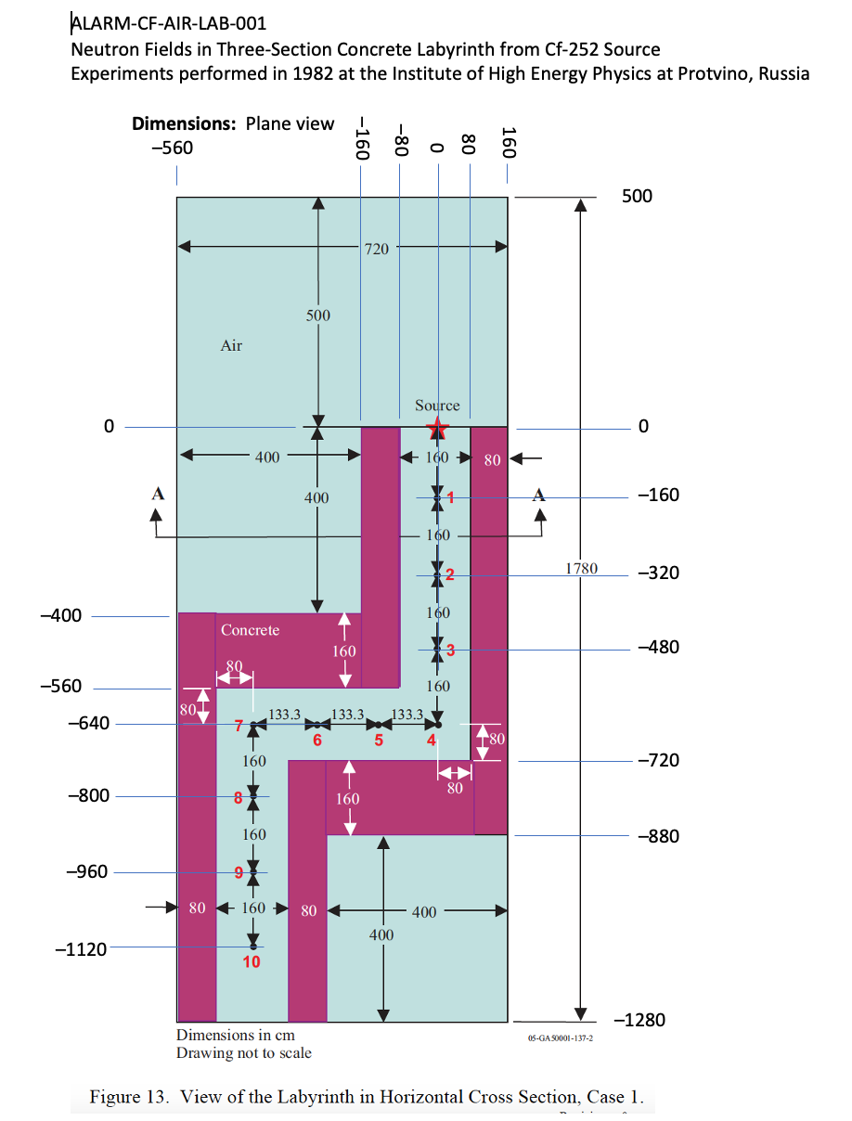
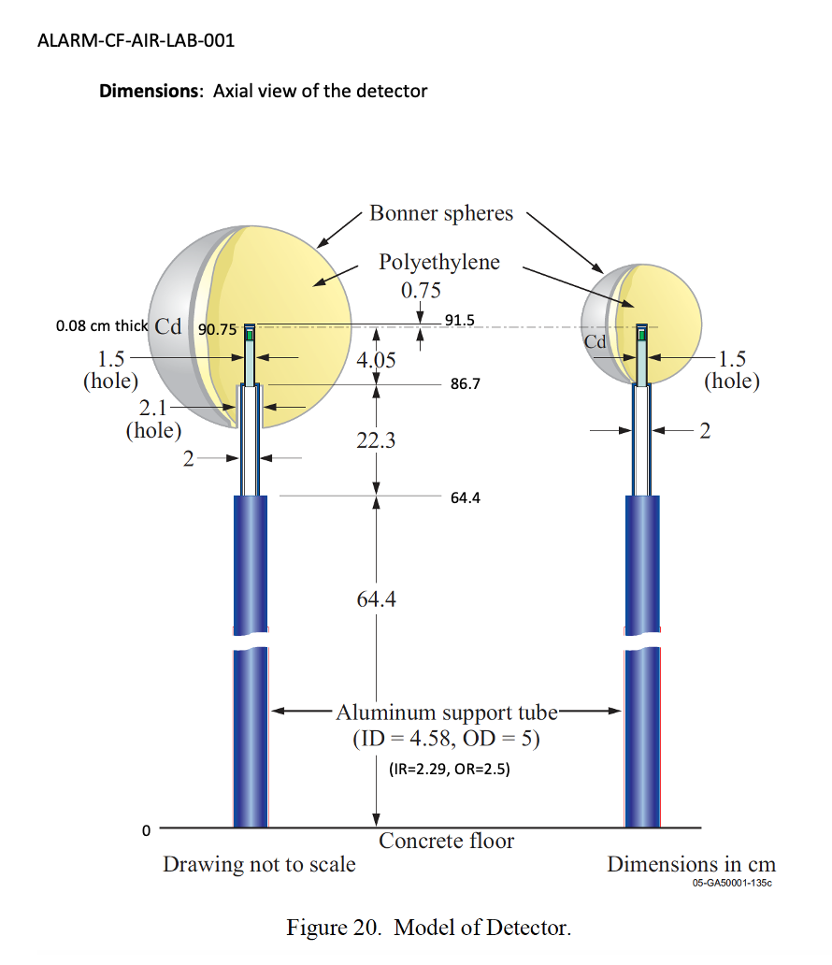
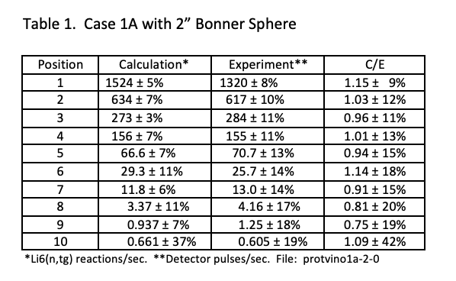
Lo-Fi results using evaluators’ detector response function:
Work in progress – ALARM-CF-AIR-LAB-001
Hi-Fi calculation with Bonner sphere explicitly modeled in progress. The far field will require 1E+12 neutron histories (or more)

Slide 18
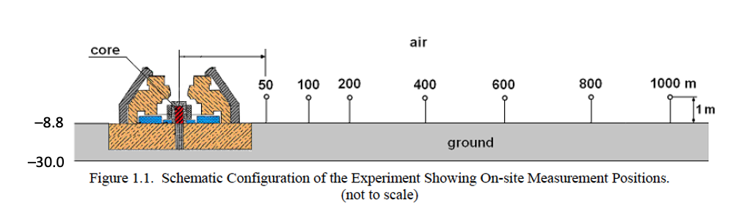
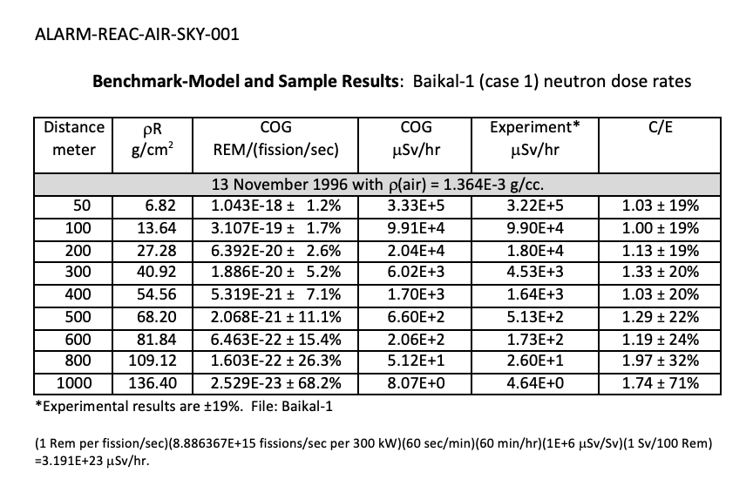
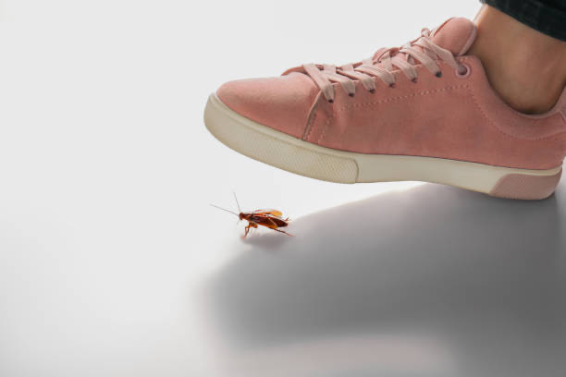
Work in progress – ALARM-REAC-AIR-SKY-001 – Baikal-1 Skyshine Benchmark
Lo-Fi neutron dose results shown.
Delayed fission gamma problem in COG 11.3 (waiting for bug fix)

Slide 19
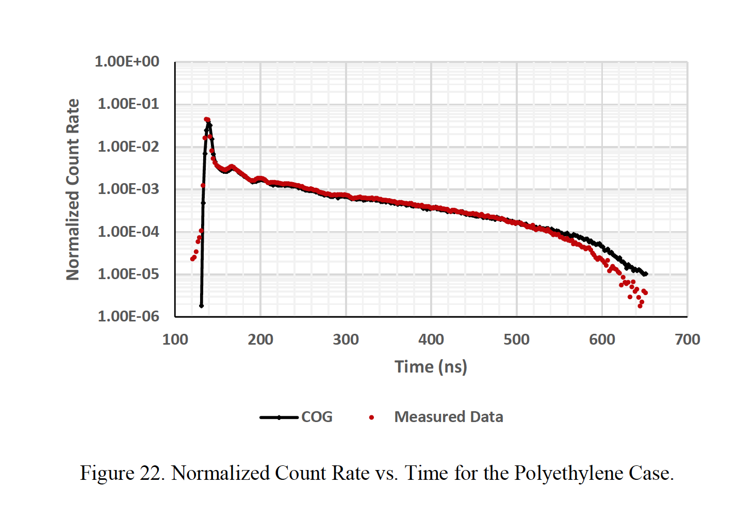
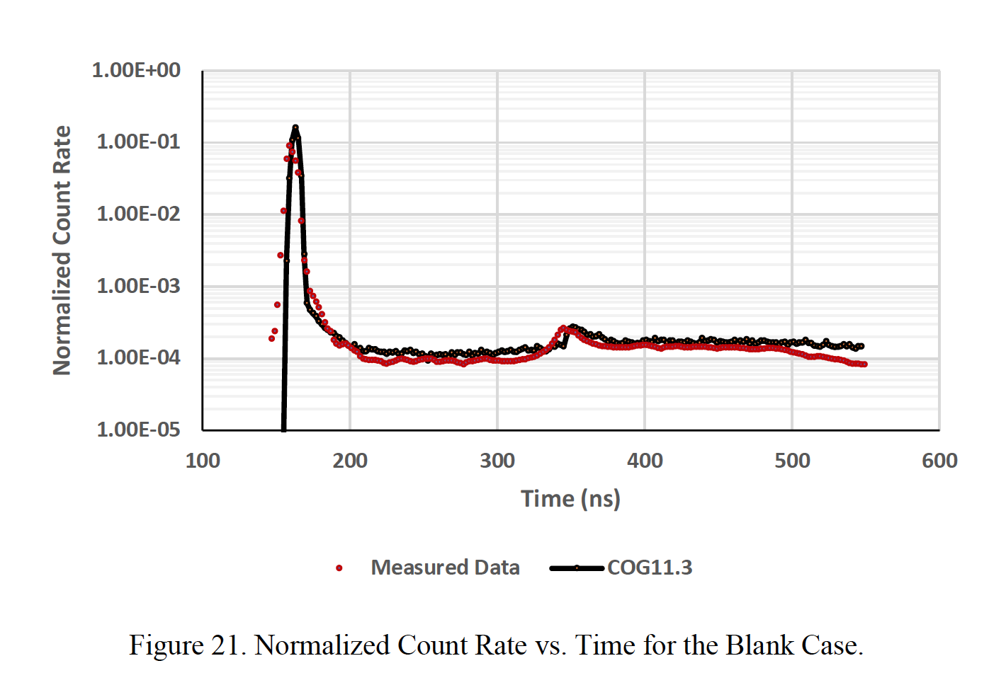
Work in progress – LLNL Pulsed Spheres – External review in progress by SINBAD TRG

Slide 20
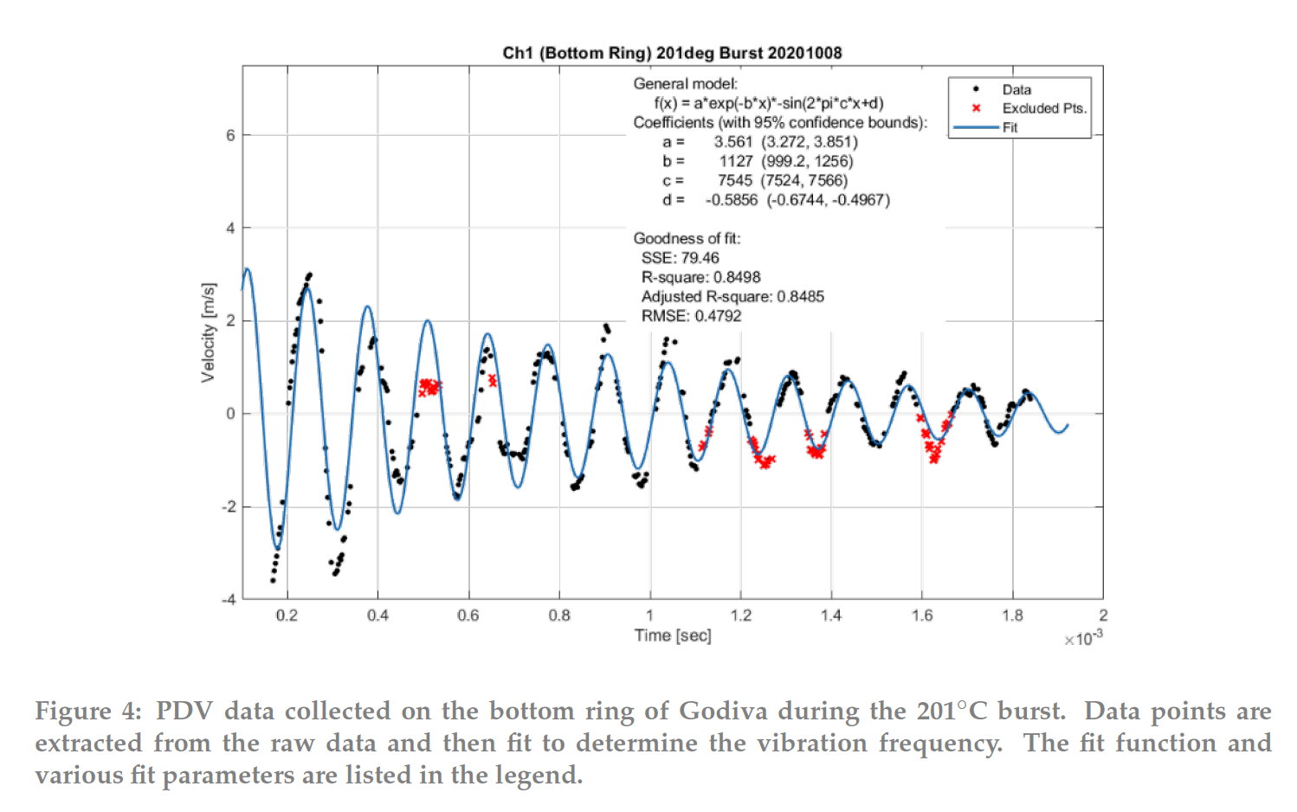
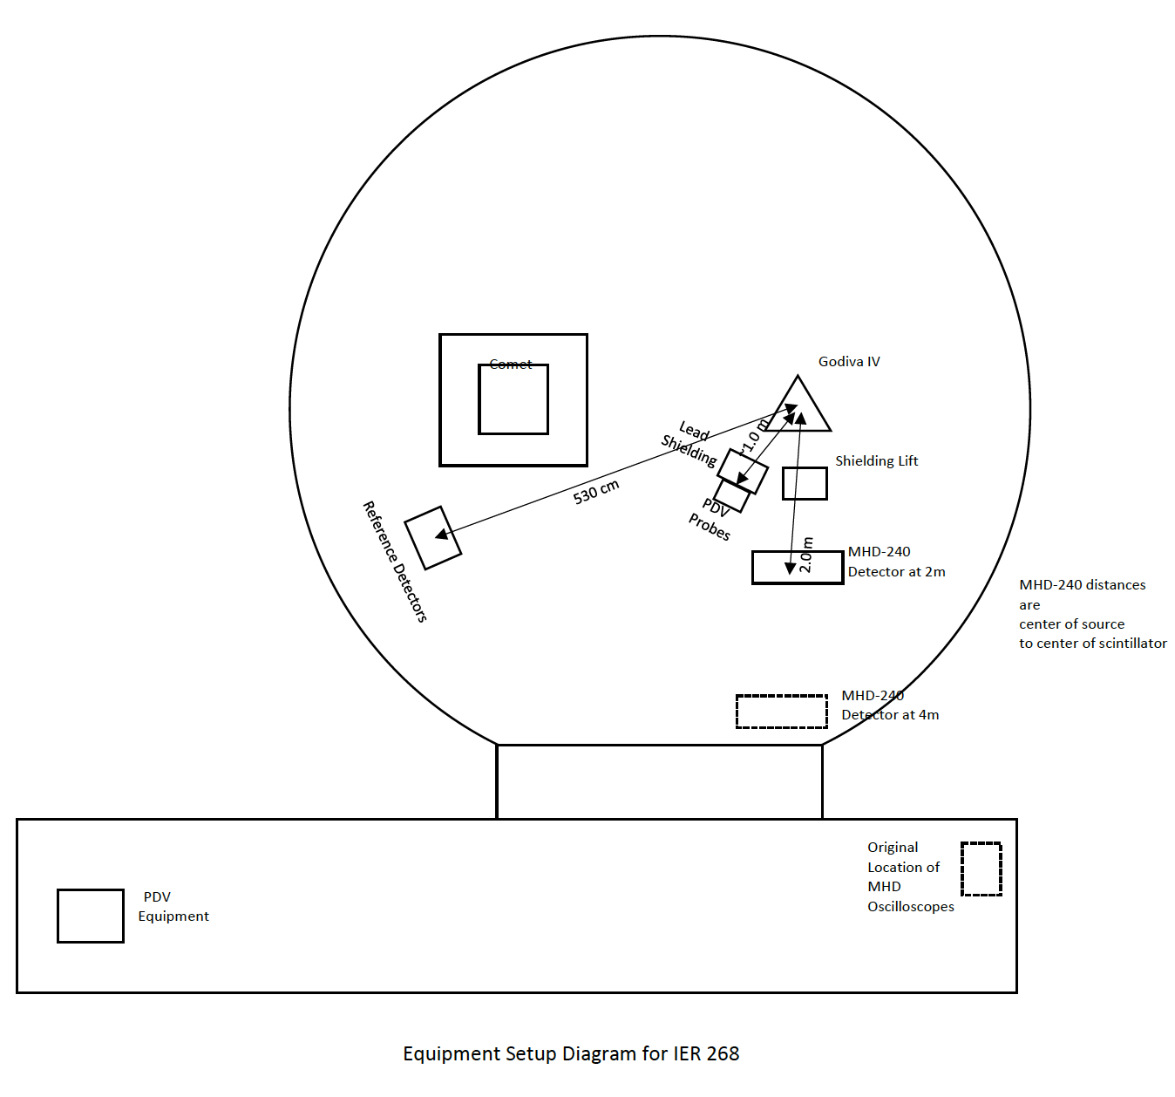
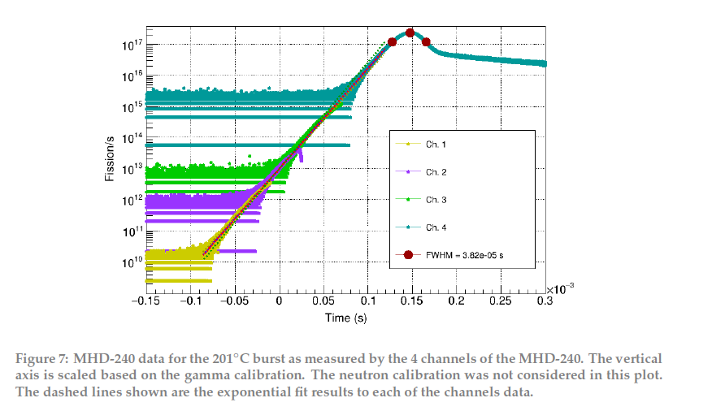
(LLNL-TR-826595)
Work in progress – Godiva-IV PDV dynamic benchmark
(LA-UR-21-21533)

Slide 21
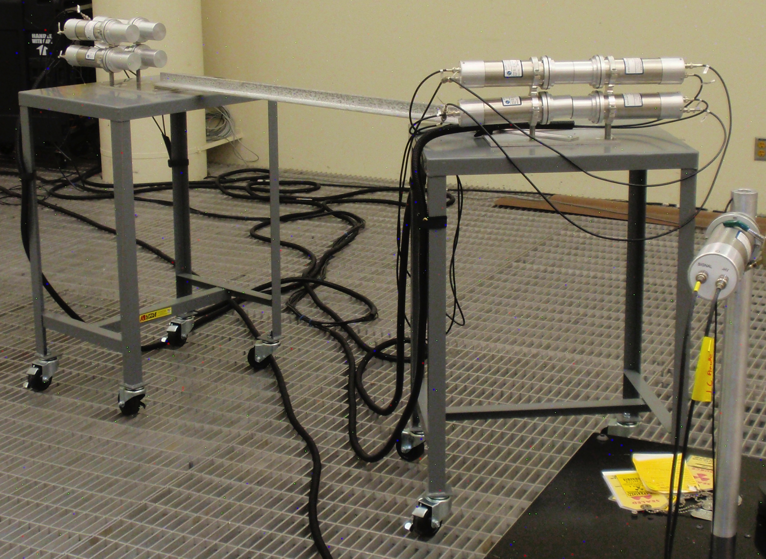
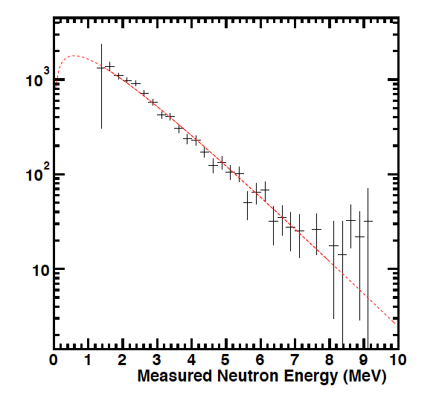
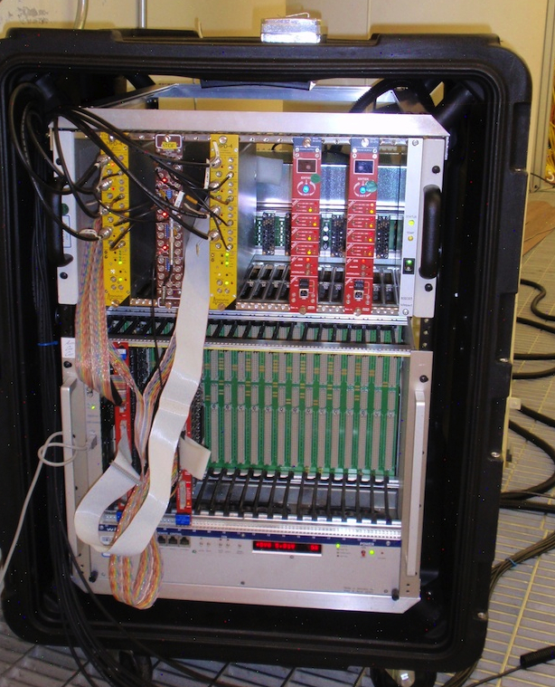
Work in progress – Neutron spectra measurements with a portable instrument
Initially developed in 2013.
Used for a test measurement of the GODIVA sub-critical assembly.
Un-reduceable correlated backgrounds resulted in inaccuracies in the result.

Slide 22
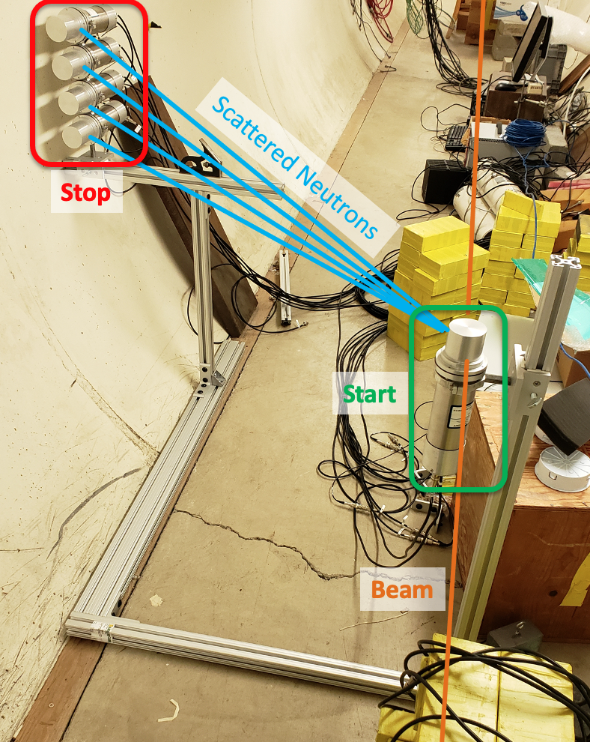
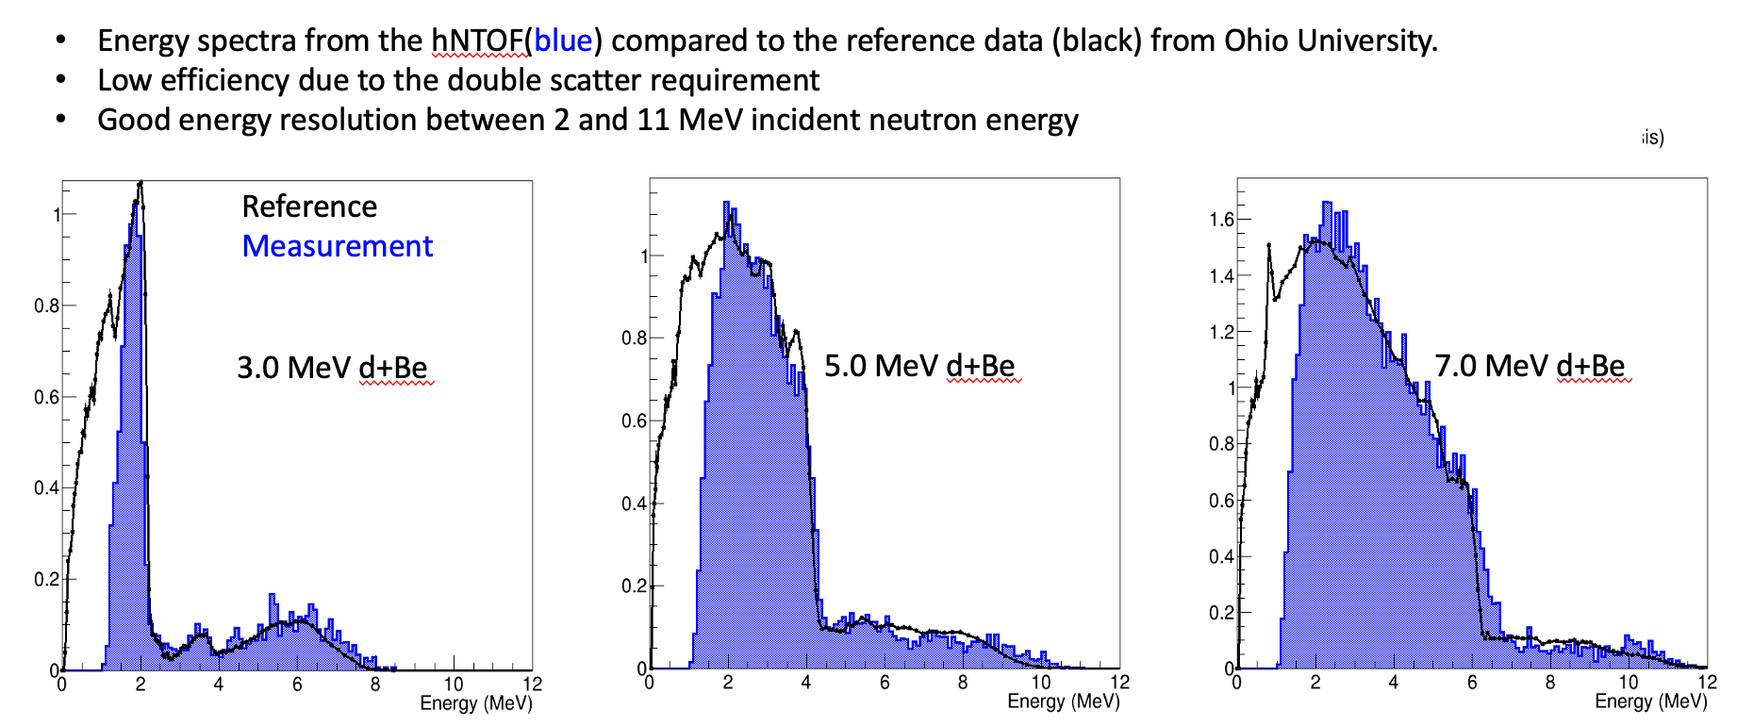
Work in progress – Neutron spectra measurement calibration at Ohio University

Slide 23
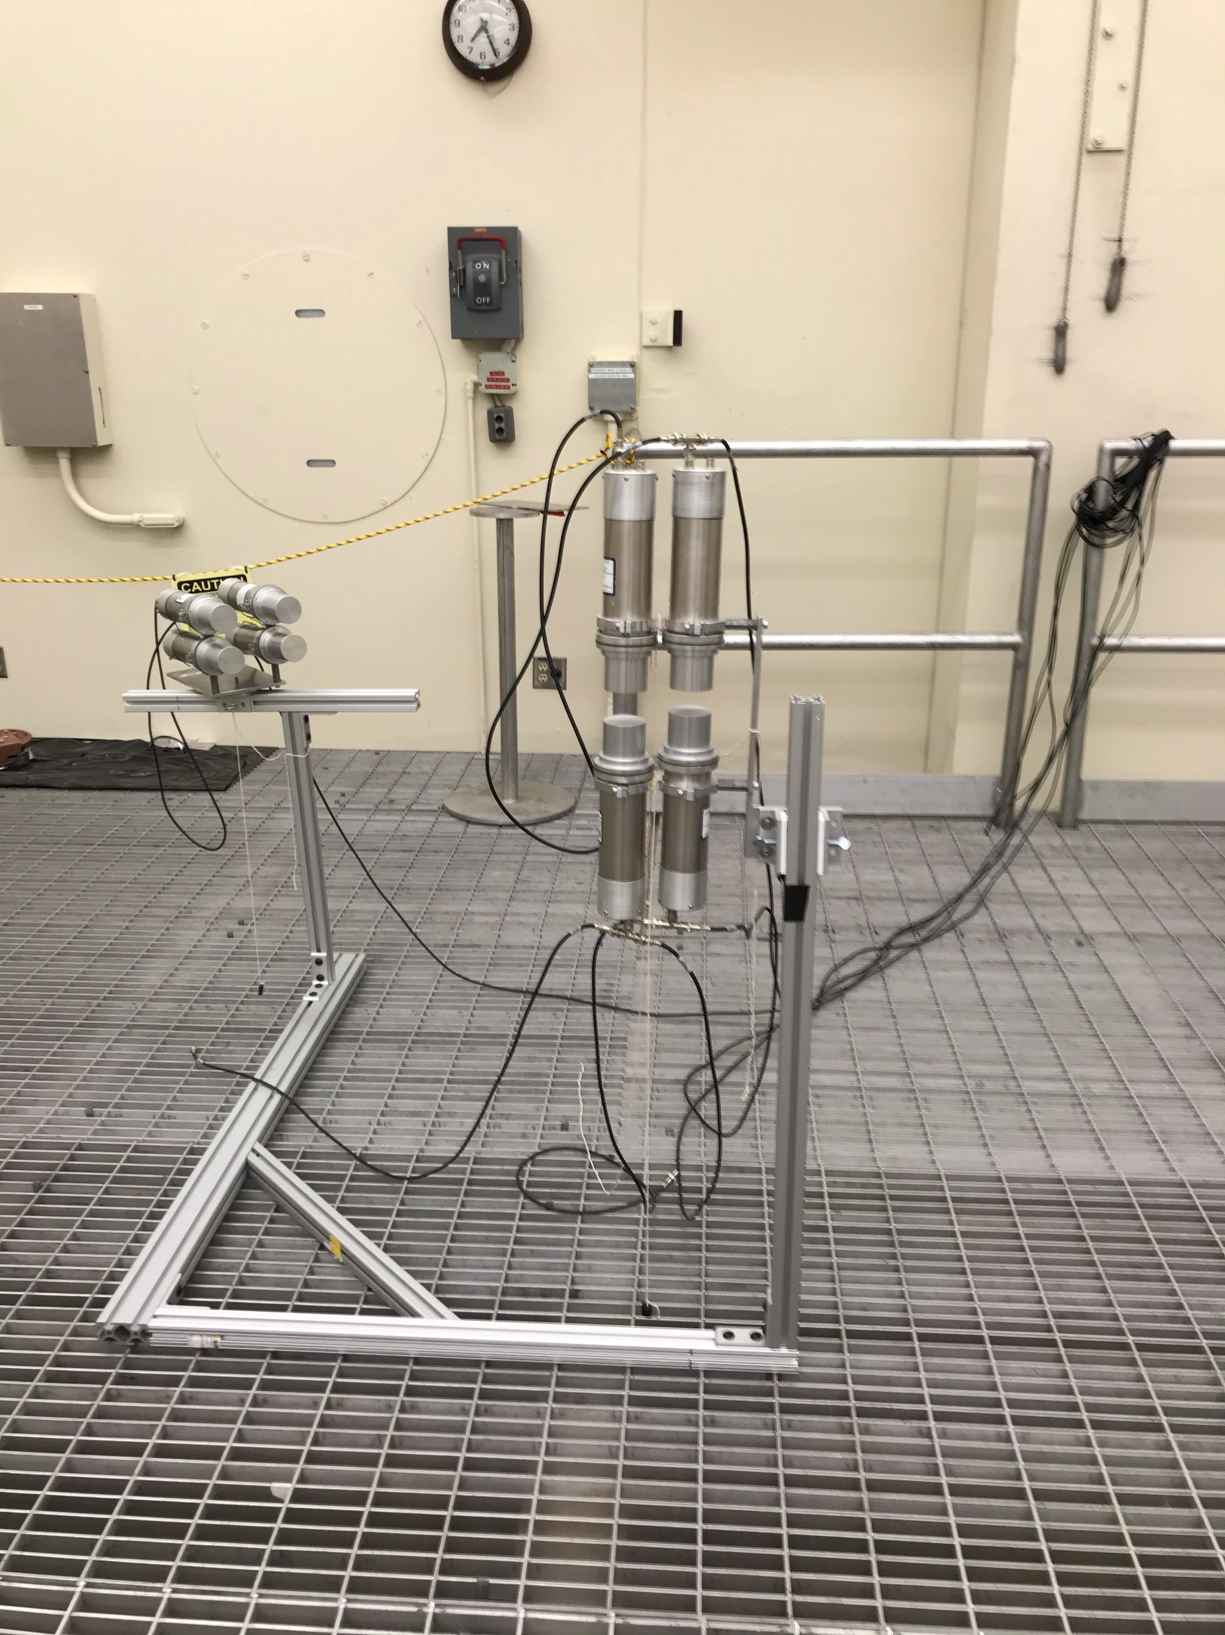
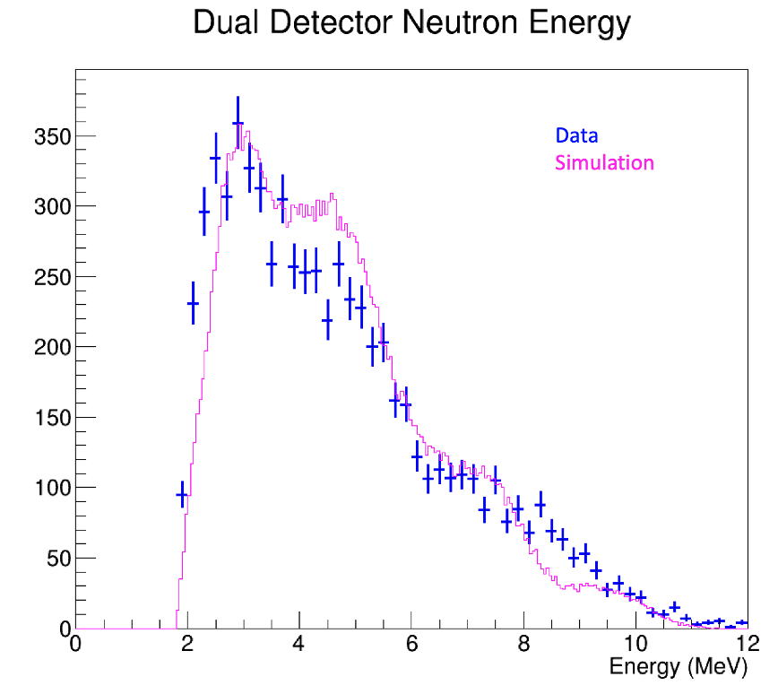
Work in progress – Neutron spectra measurements of AmBe in a low scatter LLNL facility
Simulation improvements to include source capsule construction and room details.
Doubling the number of detectors to quadruple efficiency.

Slide 24
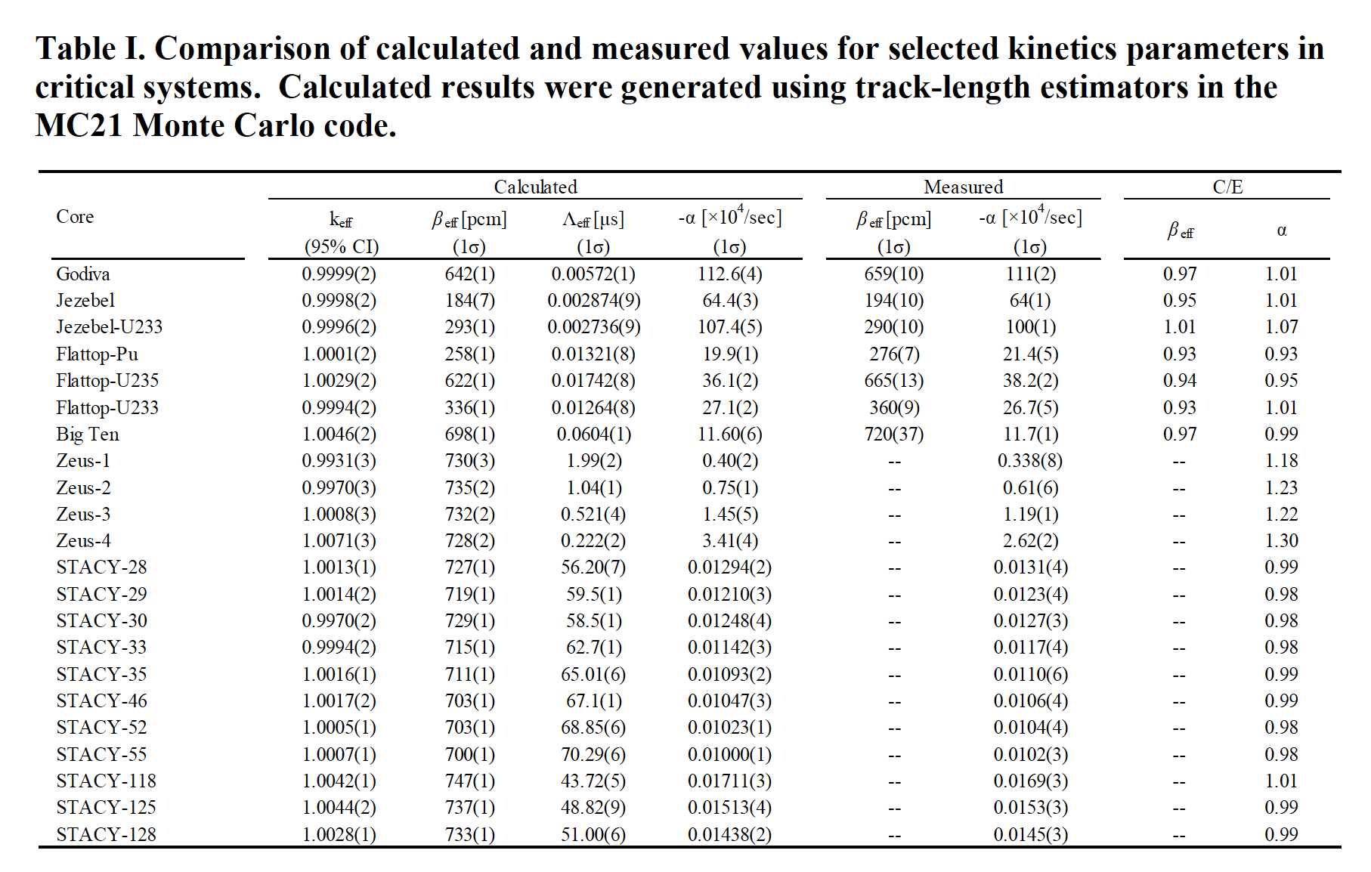
Work in progress – Delayed critical α_{DC} = –β/l = 1/Λ – 1/ l
… and many more (FCA, TCA, SHE)

Slide 25
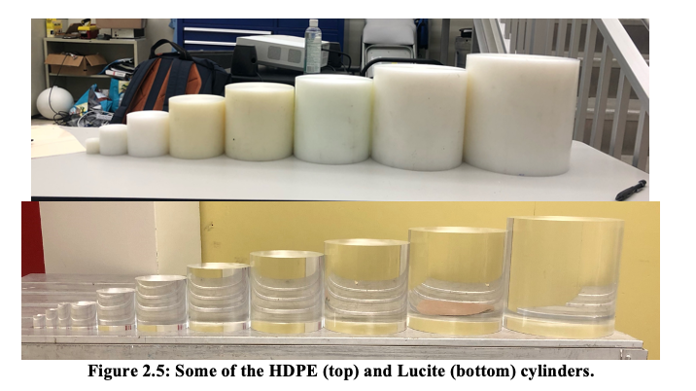
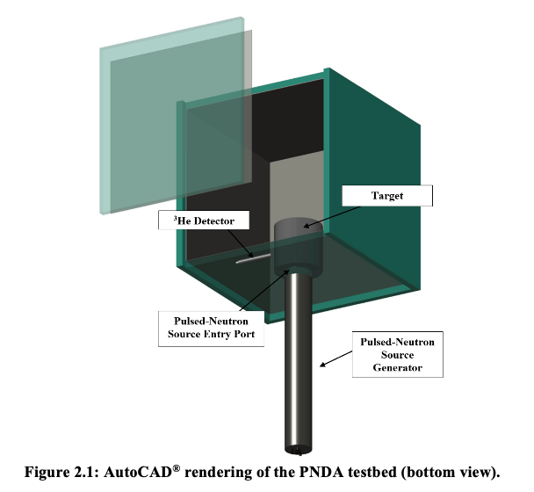
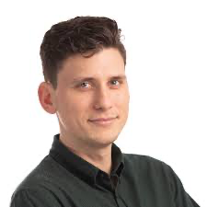
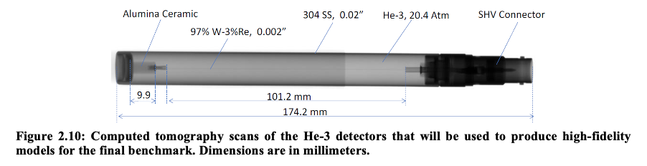
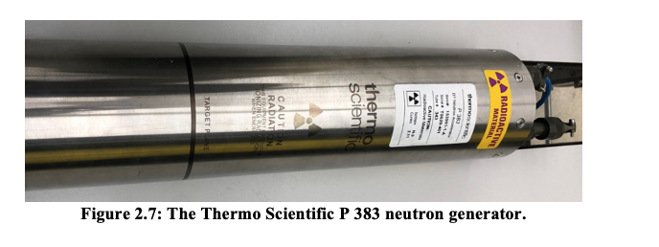
Work in progress – Pulse Neutron Die-Away (–α) in Moderators w/w/o Absorbers
Subject of a later presentation by Dr. Daniel Siefman.

Slide 26
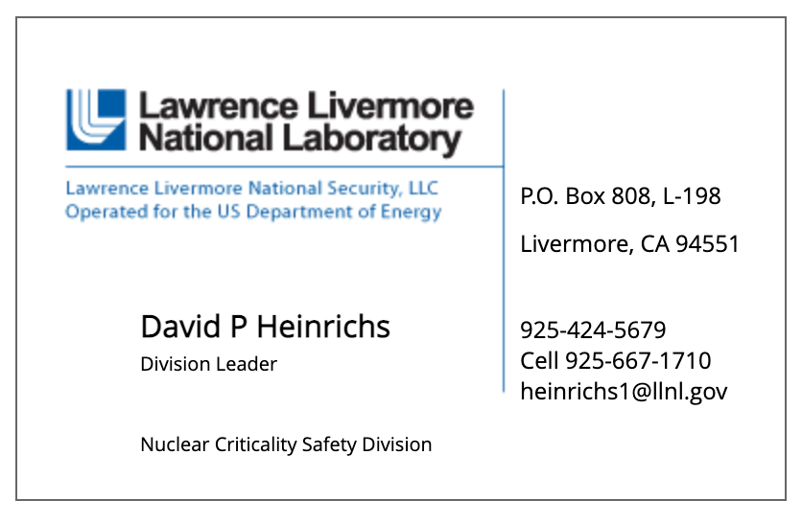
Questions? Comments?

