Slide 1
IAEA Dissemination Tools
Marco Verpelli, Nuclear Data Section
NSDD Spring Meeting
Consultancy Meeting on ENSDF Evaluations,
Policies and Procedures, Codes and Dissemination Tools
4-7 April 2022

Slide 2
Livechart: ν spectra, decay libraries comparison
Nubase chart viewer
Isotope browser in German, …
NSDD codes on GitHub
API for automatic data download
Medical Isotope Browser a collider on the Web

Slide 3
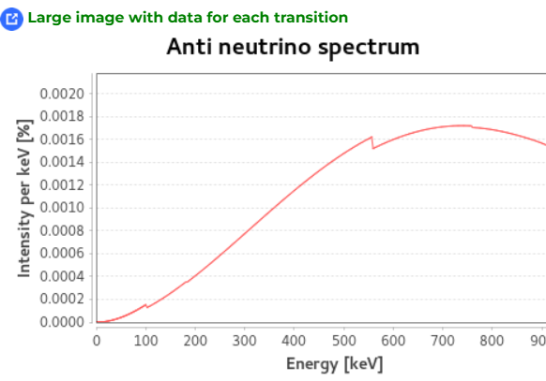
ν and ν spectra (Livechart decay tab)
Spectra are obtained using Betashape (X. Mugeot)
Access to each transition spectra and data
Plots are interactive, with data tables
Allowes a better energy balance estimate

Slide 4
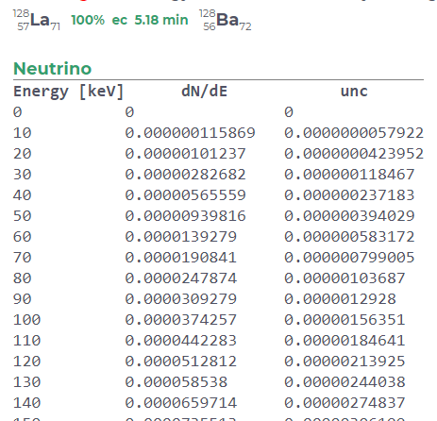
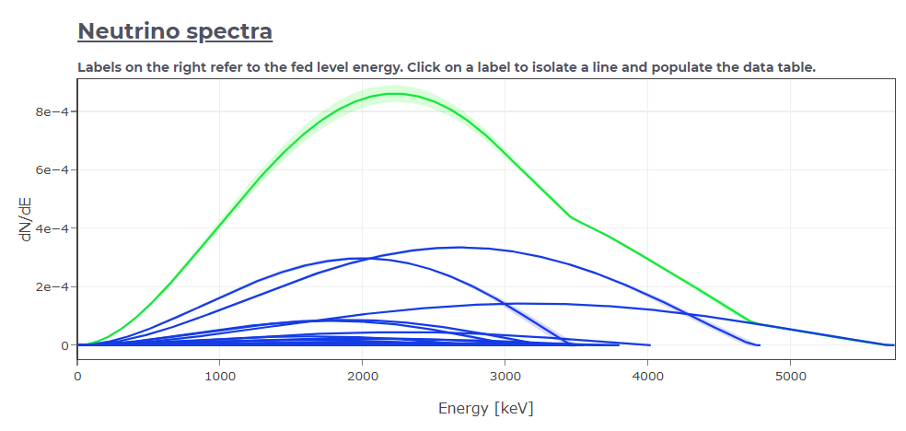
Plots are interactive, with data tables
The use of Betashape allows a better calculation of the energy balance

Slide 5
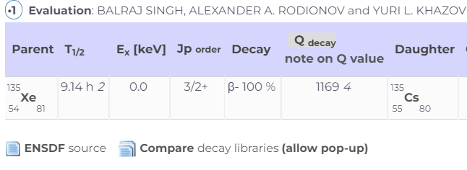
Comparison of decay libraries
From the Decay Radiation tab, direct access to Viktor’s comparison engine

Slide 6
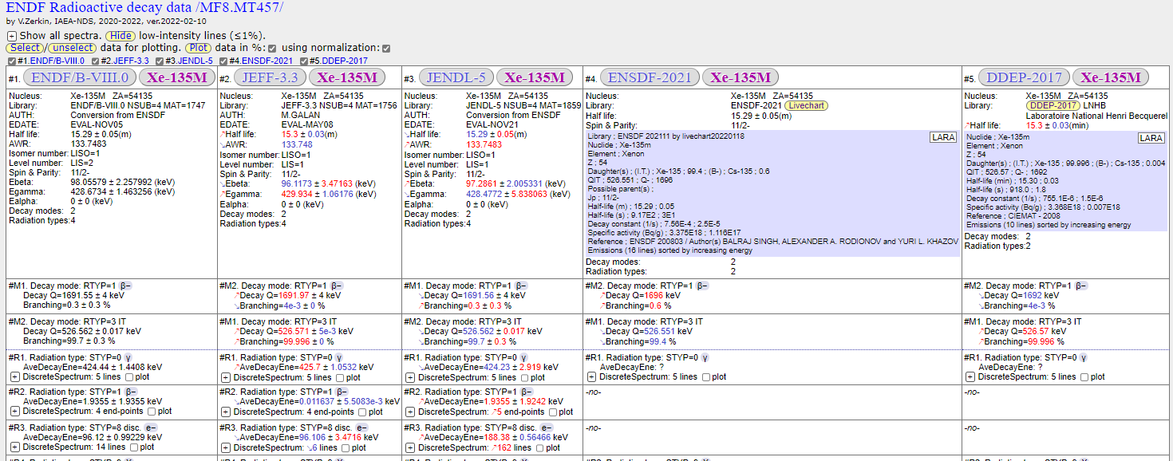
Further development: a dedicated page with chart of nuclides

Slide 7
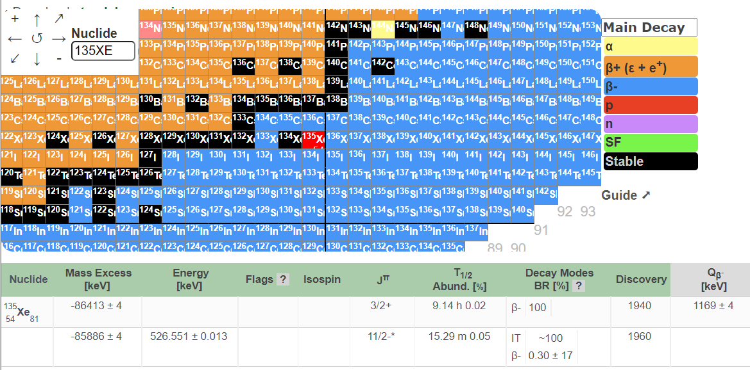
Nubase interactive chart

Slide 8
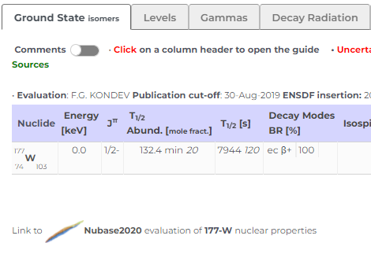
Accessible from the AME site and Livechart
Can be downloaded as standalone application

Slide 9
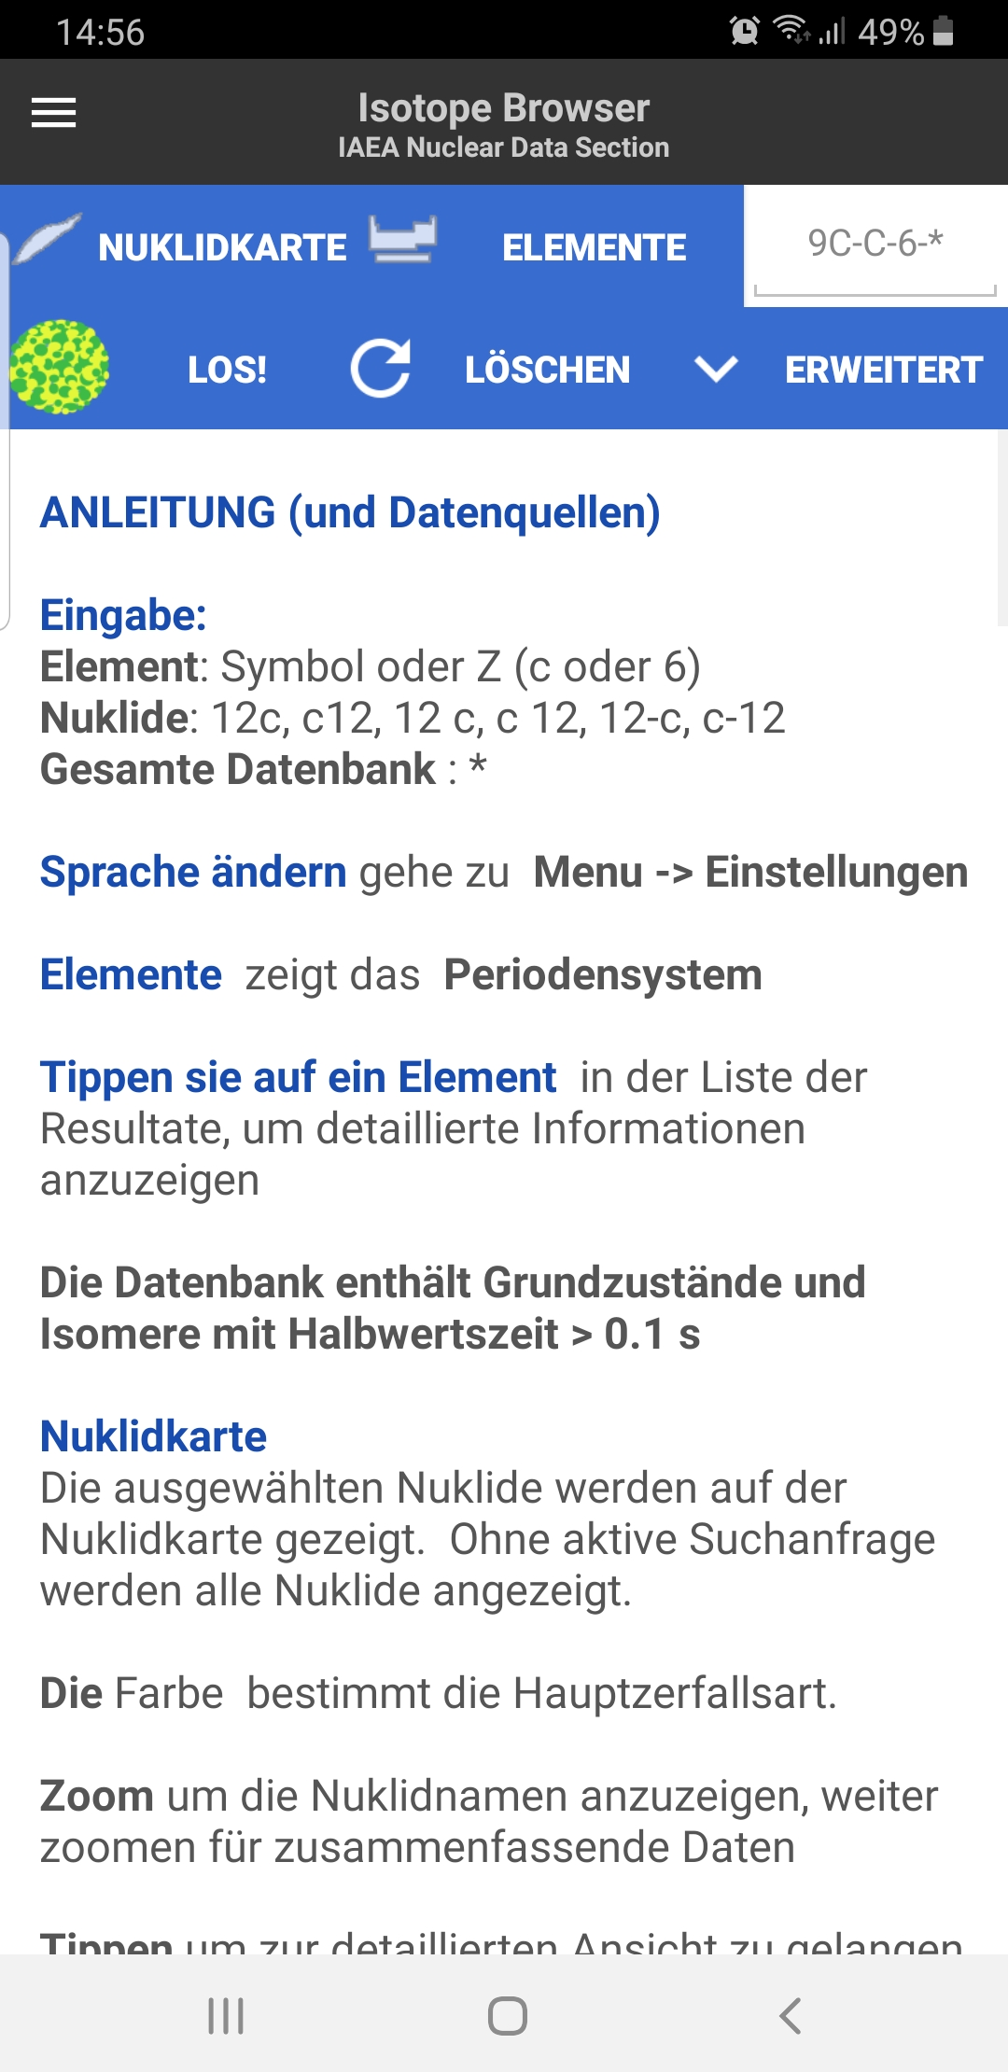
Isotope browser in German
Requested by users and INDC
The app generates lot of feedback,
~10 updates last year

Slide 10
NSDD Codes on GitHub
Easier maintenance
Better version control
Accessible from the NDS web site
(new ENSDF codes page )

Slide 11
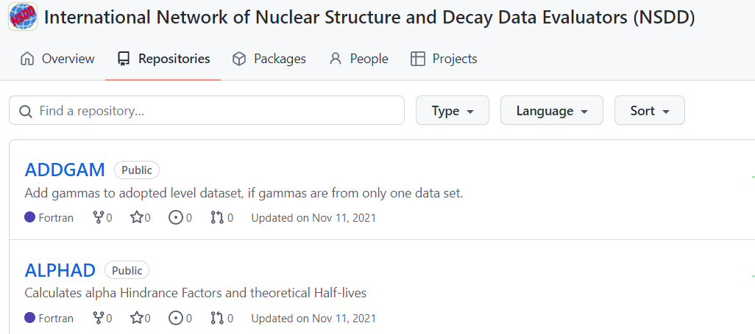

Slide 12
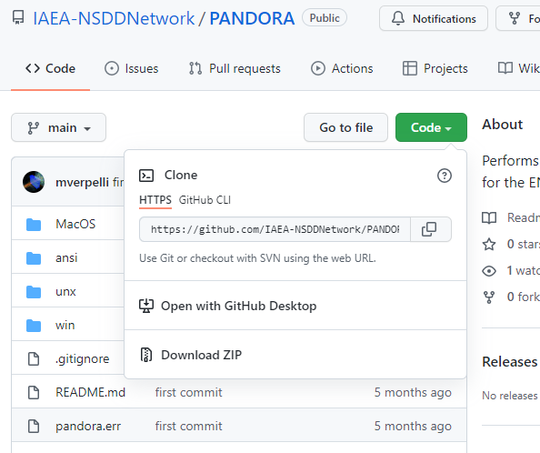
Options to download the entire package
Access to each file: executables, readme, examples …

Slide 13
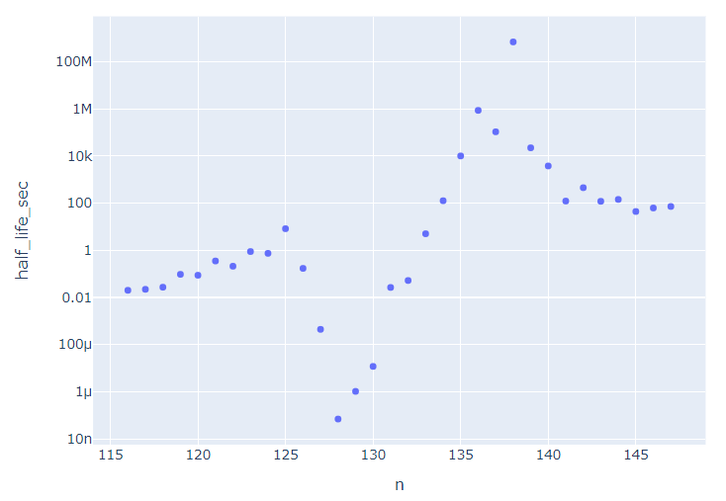
Data API
(Link within Livechart)
Ready to be plugged into:
Python data science packages
Excel
Anything that reads CSV files
Code example
Ac isotopes : Half-life vs N
url=livechart+"fields=ground_states&nuclides=all“
df=lc_read_csv(url)[['symbol','n','half_life_sec']].query('symbol=="Ac"')
px.scatter(df, x="n", y="half_life_sec", log_y=True).show()

Slide 14
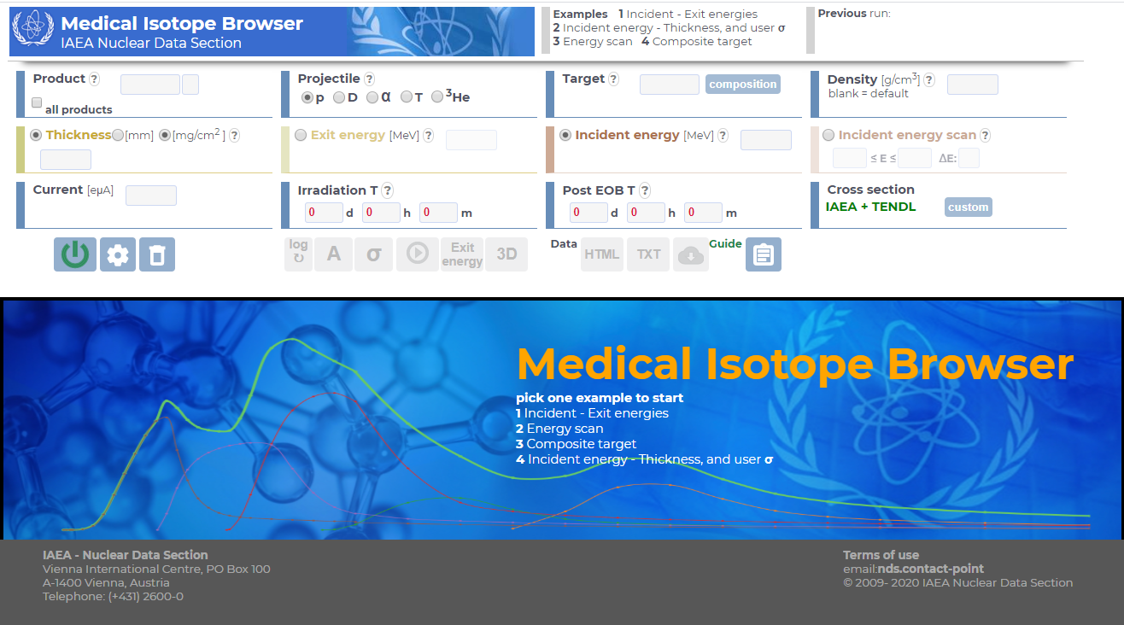
nds.iaea.org/mib

Slide 15
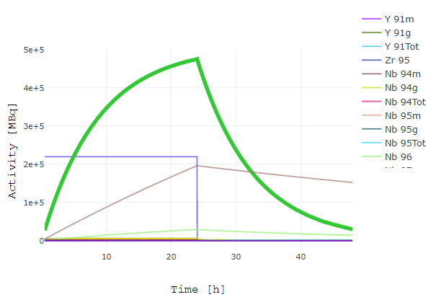
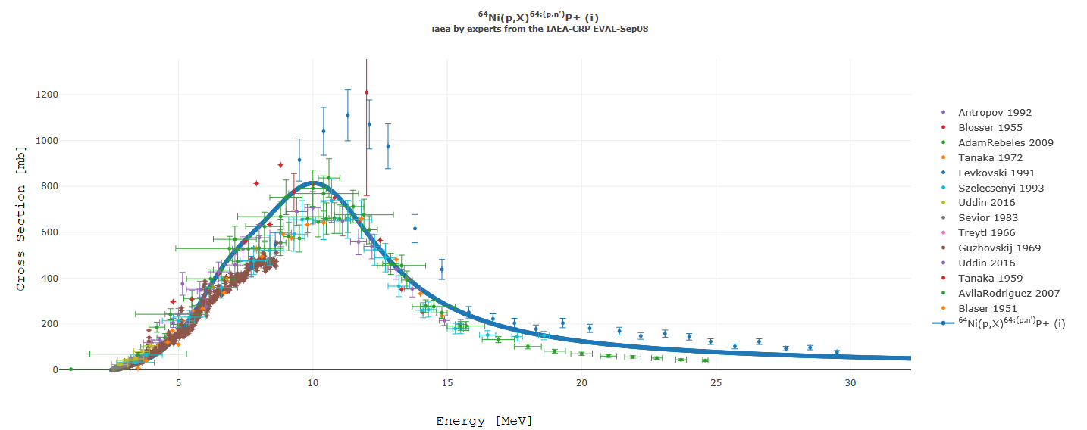
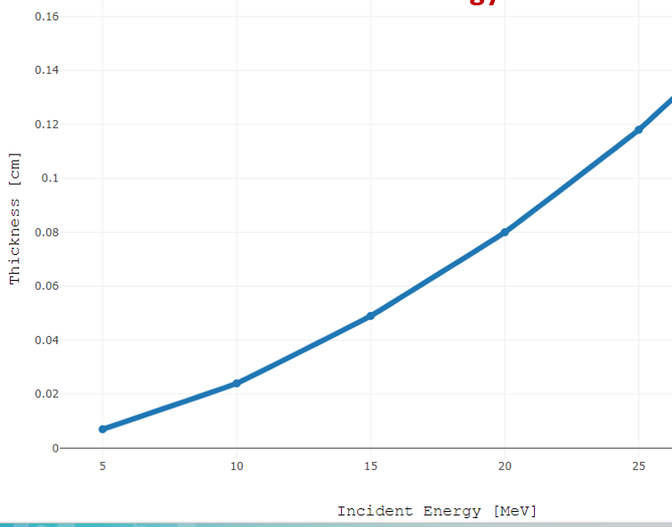
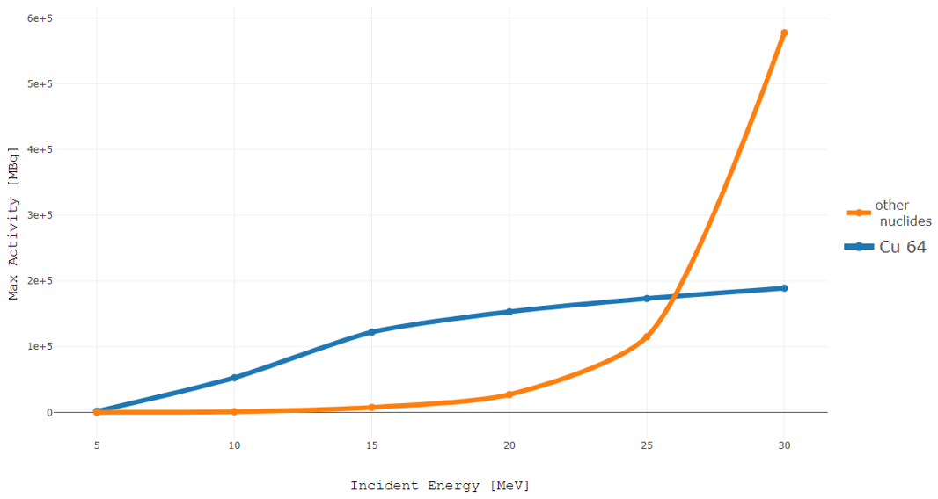

Slide 16
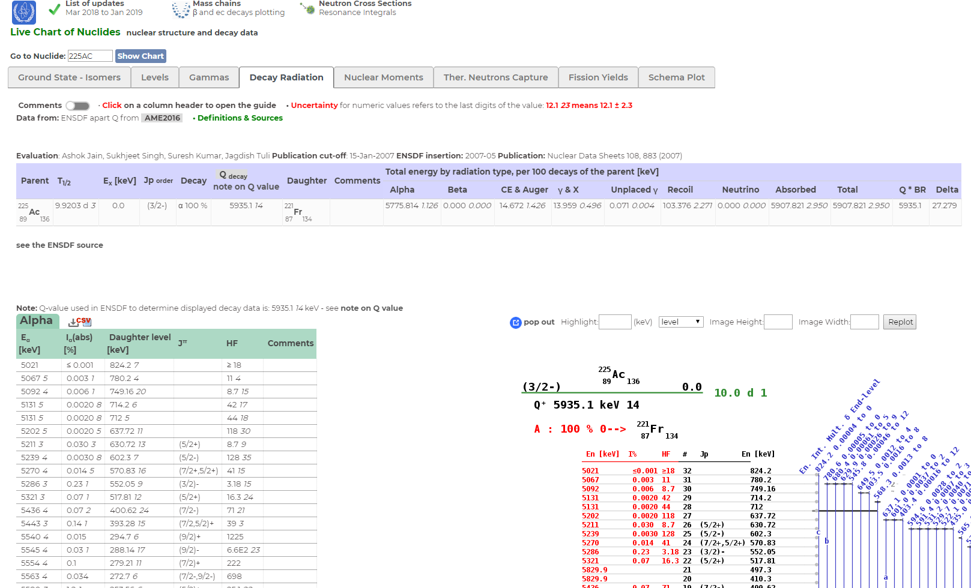

Slide 17
Thank you!
Notes:
Thank you!

