Slide 1


Recommended Values of nuclear moments: the input from improved calculation involving multi-electron configurations.
N.J.Stone, Oxford and Tennessee
ANU Canberra
October 2022

Slide 2
Magnetic dipole moments

Slide 3
Hierarchy of Reference Moments.
Moment values obtained by ratio with ‘fundamental reference’ moment’ which is used to
establish the strength of a magnetic interaction, internal or applied field.
Different element data adopt as their fundamental reference moment :-
the proton moment 12
the deuteron moment 31
11B 1 14N 2
17O 1
19F 1
23Na 6
35,37Cl 2
39K 1
45Sc 1
129Xe 1 137Ba 1
For each element a secondary (stable) reference moment is then chosen: results on isotopes from measured ratio to that chosen.
All these reference isotopes have quoted/author’s moment errors < 2 in 10^6 in 2014 Tabulation
Most precise is the proton: 3 in 10^9

Slide 4
Corrections to raw experimental data.
Focus on the diamagnetic correction which is required when a ‘known’ magnetic field is applied to the material in which the experimental nuclei are situated.
The most accurately measured results [NMR and atomic beam resonance] require this correction.
The correction is also known as the chemical shift particularly in liquid and gaseous samples.

Slide 5
Diamagnetic corrections since the 1940’s
1941 Willis Lamb, Phys Rev 60 817 found 0.0000319Z^4/3 giving 1.2% at Z = 80.
1950 W.C.Dickinson, Phys Rev 80 563 Thomas-Fermi gave 6% at Z = 92.
1969 Feiock and Johnson, Phys Rev 187 39 (1969) made calculation giving
N 1.000332 0.03%
Ba 1.005549 0.5%
Pb 1.017200 1.7%
1976 Gladys Fuller used Dickinson results in her tabulation allowing 10% error.
1989 Pramila Raghavan adopted Feiock and Johnson values,
with no errors, for her ADNDT Moment Table.
2014 NJS in listings to 2014 followed the Raghavan practice.
This treatment resulted in an abundance of disturbing discrepancies in apparently highly accurate measurements by different groups and methods. Recommended values???

Slide 6
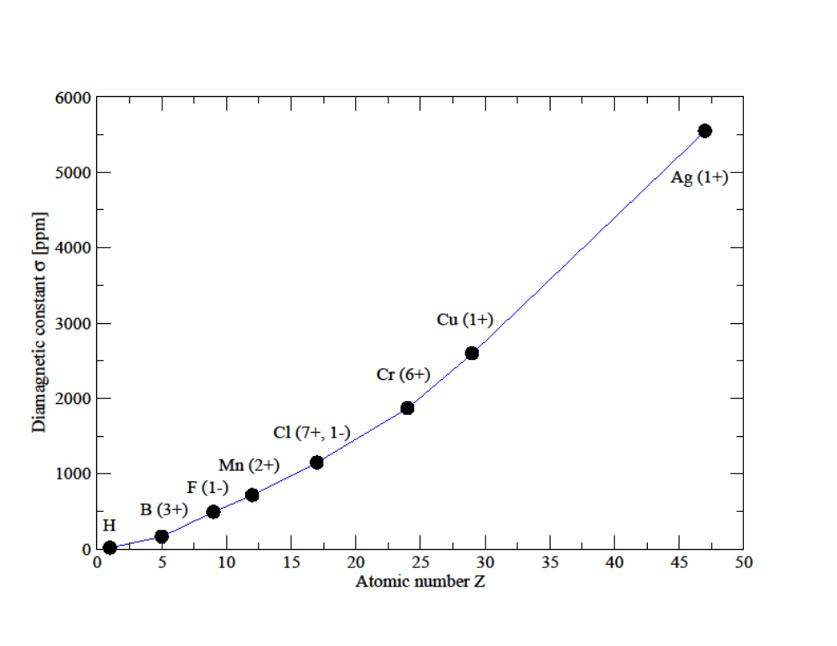
Diamagnetic
factors from Feiock
and Johnson (1969).
-the best available
at the time of many
measurements.
Valid only for closed
sub-shell ions but used
in chemical compounds, liquids, gases …..
Many NMR results claim to give results accurate to a few times 10⁻⁴ or (much) better.
Requiring a diamagnetic correction of 1000 ppm to be accurate to better than 10%.

Slide 7
The diamagnetic correction is a multi-electron computation problem.
Comparable to electric field gradient calculations for electric quadrupole moments. Smaller but no less important for the most accurate results.
Great strides in such calculations have been possible in the last 10-15 years.
Effects are small, precision is difficult even with best methods. Problem is being tackled, easier (lighter) elements first.
32 elements recognised results (2019)
Gurus: Karol Jackowski and his Warsaw group [i.e.Antusek et al Chem Phys Lett 532 1 (2012) and later].

Slide 8
Changes produced by state-of-the-art screening calculations.
Examples in light, medium and heavy nuclei.
Nucleus Correction Moment
F+J 7 N 14 1.000332 +0.40376100(6)
New 1.000224(5) +0.403573(2)
F+J 56 Ba 137 1.007564 +0.937372(2)
New 1.00685(21) +0.9375(2)
F+J 82 Pb 207 1.0172 +0.592583(9)
1.0129(13) +0.5906(4)
Adjustments in 3rd/4th digit compared to precision of expt measurement 10^-8!
Results: Moments are smaller and errors much larger.
Discrepancies shown to be related to differing samples.
Johnson and Feiock corrections generally too large by ¬ 25%.

Slide 9
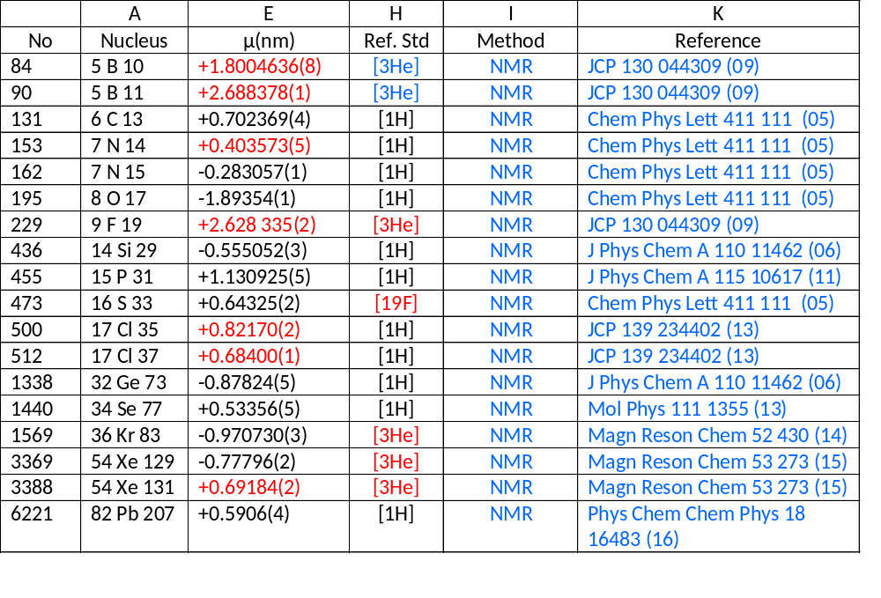
The Reference Moments
Adopted best reference moment values
(Source: K. Jackowski, at IAEA consultant meeting, 2017.) based on fully up-to-date diamagnetic corrections.)

Slide 10
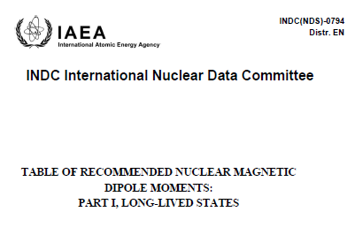
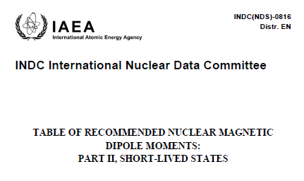
Situation in 2019
Limited number of state-of-the art calculations gave average reduction to 75(10)%
of Feiock and Johnston corrections.
Where no new calculations existed, these reduced F+J corrections were applied, with their errors, in the 2019/20 Recommended Dipole Moment Tables.
INDC(NDS)-0794 NSR 2019STZV [states > 1ms lifetime]
and INDC(NDS)-0816 NSR 2020STZY [states > 1 ms lifetime]
____________________________________________________________________
_____________________________________________________________Nov 2019 ¬2750 entries Sept 2020 ¬1150 entries
End of story?

Slide 11

Diamagnetism experts,
Nuclear Magnetic Moments

Slide 12
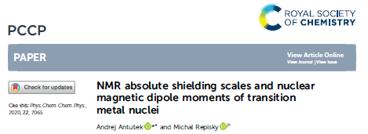
10 days ago discovered:
A. Antusek and M. Repisky Phys Chem Chem Phys 22 7065 (Mar 2020)
Undetected by the NSR system (not surprisingly).
Content: state-of-the-art calculations for 24 transition metal elements with revised ‘reference’ stable dipole moments.

Slide 13
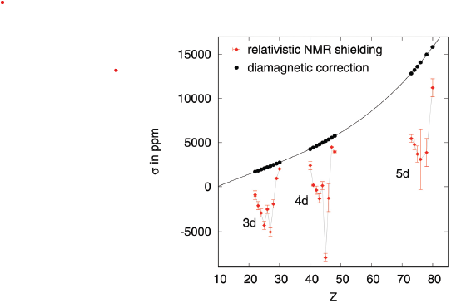
From Antusek 2020
Transition metal element corrections compared to
Feioch and Johnson.
Results show significant paramagnetic effects across
the d-subshells leading
in some to
reversal of sign of correction
and requiring adjustments of
as much as 2% in
reference (stable) moments.
This will lead to the same changes in moments of many other isotopes of these elements.
A major earthquake!
Examples: 61Ni was -0.75002(4) now -0.7473(4)
97Mo was -0.9335(1) now 0.9287(4)
199Hg was +0.5058855(9) now +0.5059(5)

Slide 14
P.S. In addition to the published Reports the NDS On-line Moment Table already includes the Recommended Moments and the measurement listings are being updated.
Consequent upon the 24 element new reference moments many adjustments are necessary.

Slide 15
Nuclear electromagnetic moments
form an active field of research,
having multiple aspects and applications
in nuclear physics and
beyond.
Thank you

