Slide 1
Update on
Comparison of BSK27 interaction with MSC data
A short update on Multi-step cascades (MSC) spektra
Milan Krtička
Charles University, Prague

Slide 2
Comparison of MSC spectra with predictions from BSK27 Skyrme force
Test performed for all nuclei used for check of D1M Gogny interaction - M. Krtička et al., PRC99, 044308 (2019) and PSF review S. Goriely et al., EPJA (2019) 55: 172 - in total 15 nuclei + ¹⁶⁸Er, ¹⁹⁶Pt published later
E1 + “spin” M1 part from microscopic calculations with the BSK27 parametrization of Skyrme interaction
(for details ask Stephane Goriely)
E1 strength:
rather significantly depends on
excitation energy of final state / temperature
Smearing, at least for E1 looks rather different from D1M, where the “(Lorentzian) smearing width” was large (4 MeV)

Slide 3
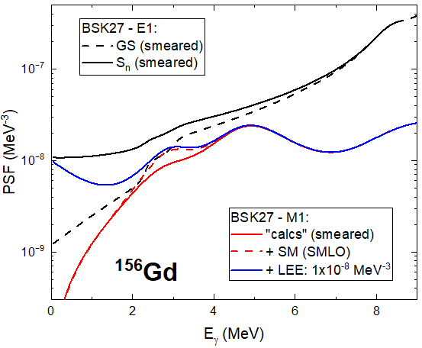
Comparison of MSC spectra with predictions from BSK27 Skyrme force
M1 strength:
No scissors mode (SM) in BSK27 (no deformation included in calculation – only spherical potential considered)
Proposed parametrization of SM from SMLO
Low-energy enhancement considered in M1 PSF in the form
Cx10⁻⁹ exp(-E_{γ}/0.8) [MeV⁻³], with E_{γ} in MeV

Slide 4
MSC spectra
Spectra measured using “highly-segmented” detectors with “relatively good” energy resolution – “large-volume” BaF₂ detectors used
(Almost exclusively) spectra from DANCE detector at Los Alamos
Try-and-error based method

Slide 5
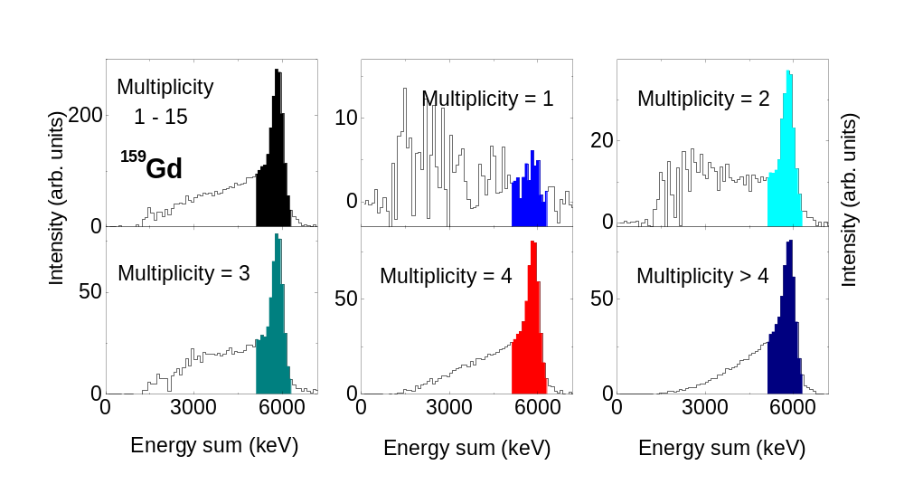
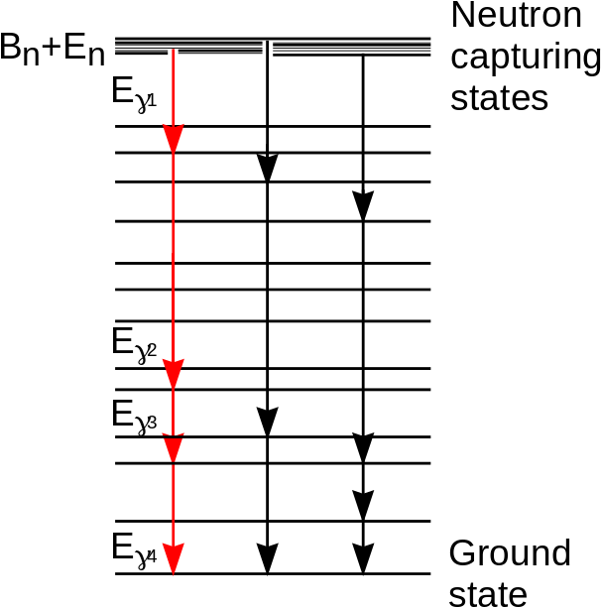
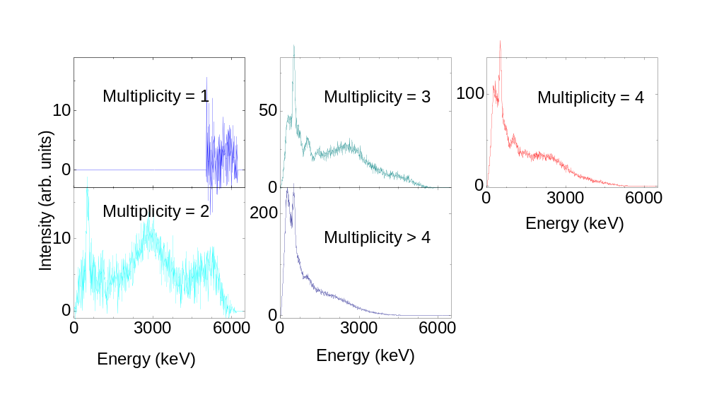
Spectra of our interest
Verification of possible validity of various PSF and NLD models
based on comparison of observables – sum-energy and MSC spectra with predictions of simulations based on statistical model of nucleus
E_{γ1}
E_{γ3}
E_{γ2}
E_{γ4}
Label “Energy” refers to the deposited energy in a crystal

Slide 6
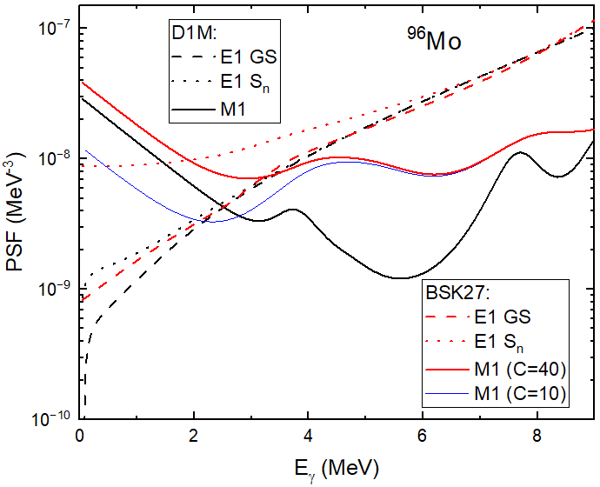
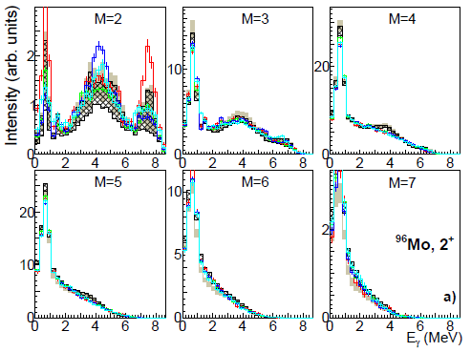
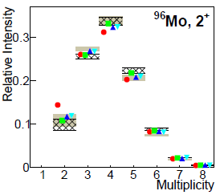
^{96,98}Mo (spherical nuclei):
Reproduction of experimental spectra very reasonable (for appropriately chosen C, which depends on NLD model)
Gray area: C = 20; Black hatched: C = 40; NLD: HFB

Slide 7
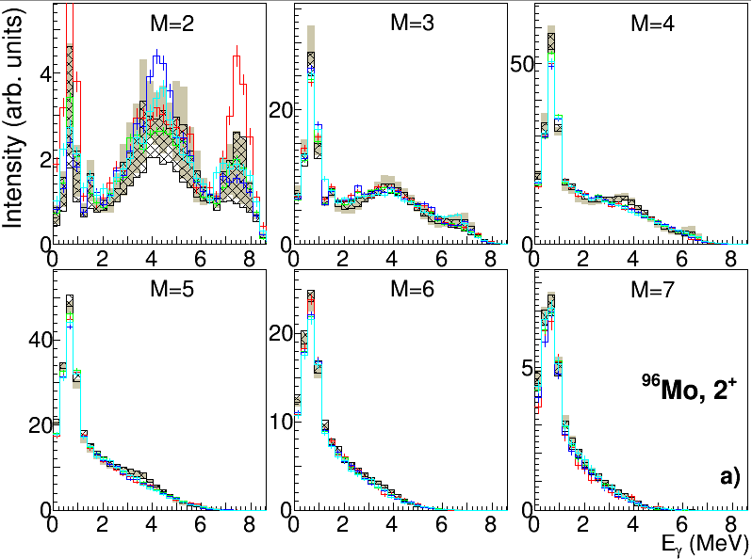
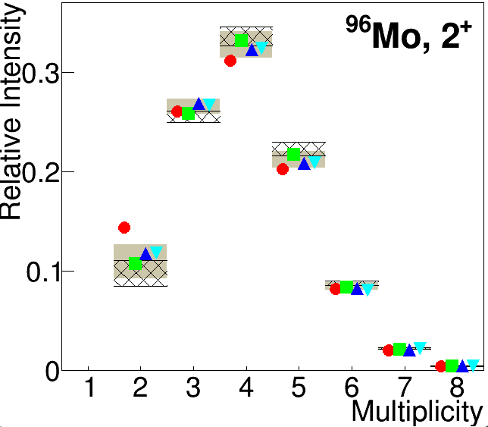
^{96,98}Mo (spherical nuclei):
Similar reproduction of experimental spectra as with D1M Gogny interaction (for appropriately chosen C, which depends E1 – higher E1 in BSK27 requires larger C)
Gray area: D1M C = 30;
Black hatched: BSK27 C = 40; NLD: HFB

Slide 8
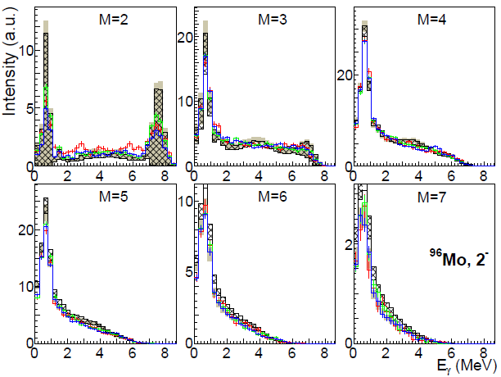
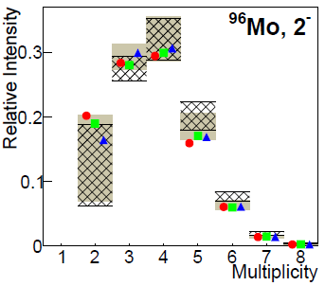
^{96,98}Mo:
Negative-parity resonances
Gray area: C = 20;
Black hatched: C = 40

Slide 9
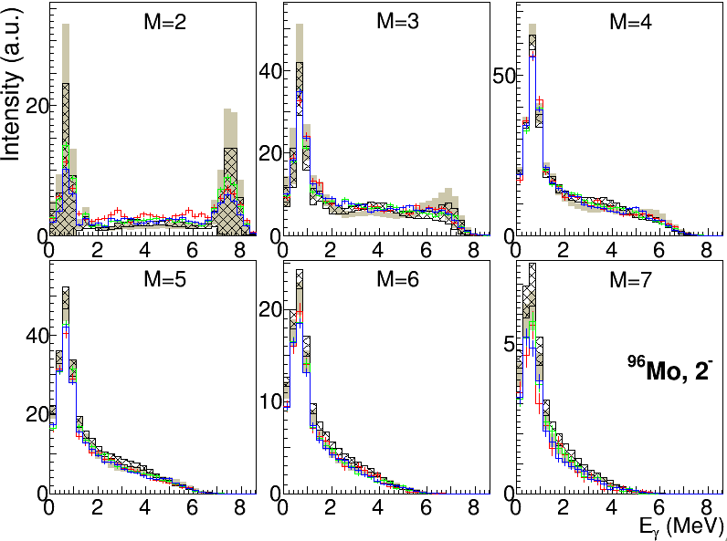
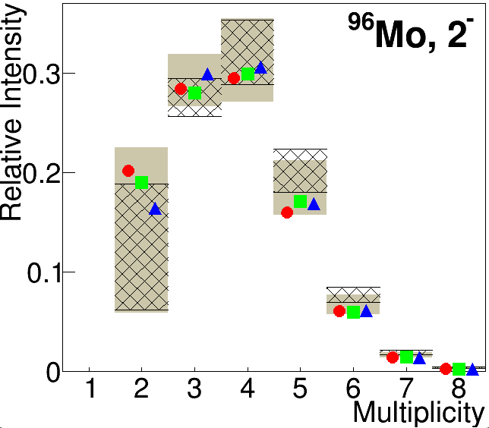
^{96,98}Mo:
Negative-parity resonances
Gray area: D1M C = 30;
Black hatched: BSK27 C = 40;
NLD: HFB

Slide 10
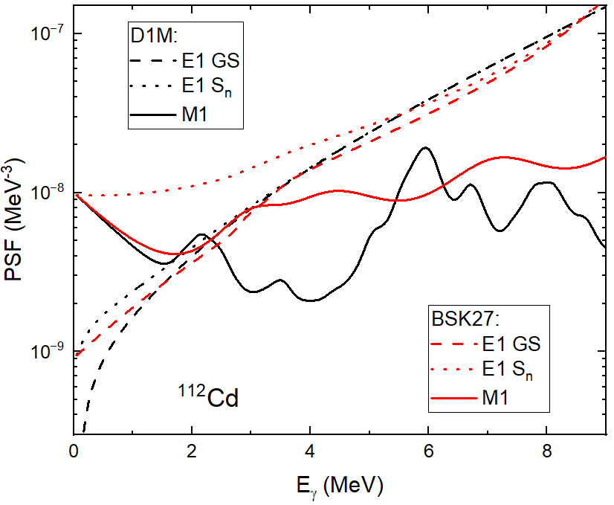
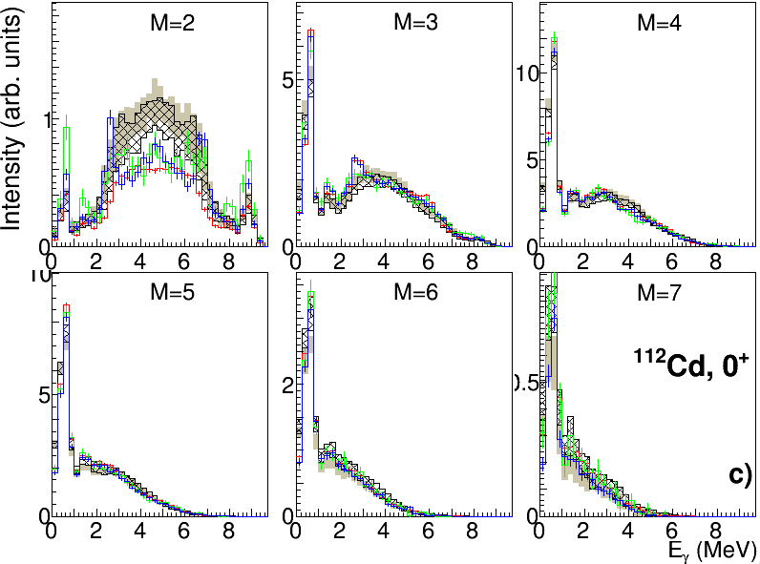
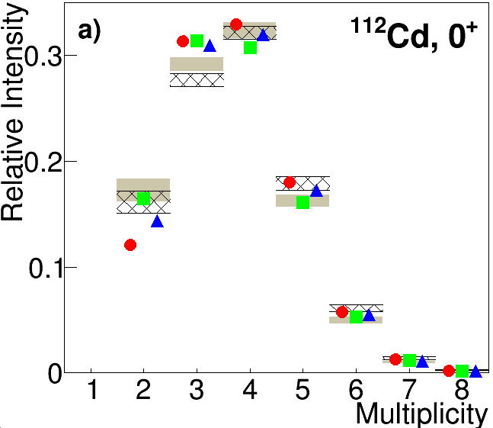
^{112,114}Cd (almost spherical):
MSC spectra are not perfect, but likely “acceptable” in majority of cases
Often a problem with reproduction of
M = 2 and to a lower degree M = 3 (for ¹¹⁴Cd also M = 4) spectra
Gray area C = 0;
Black hatched C = 10;
NLD: HFB

Slide 11
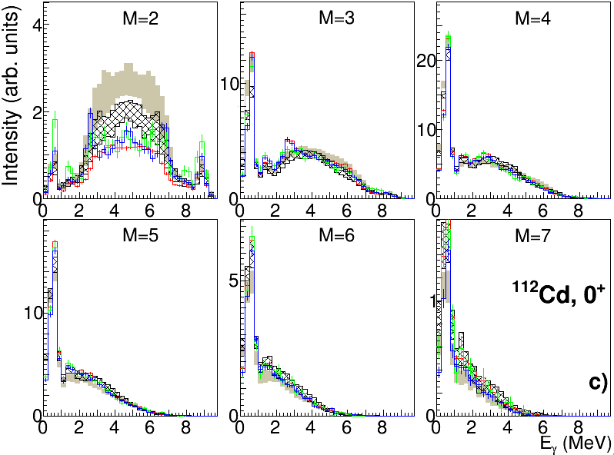
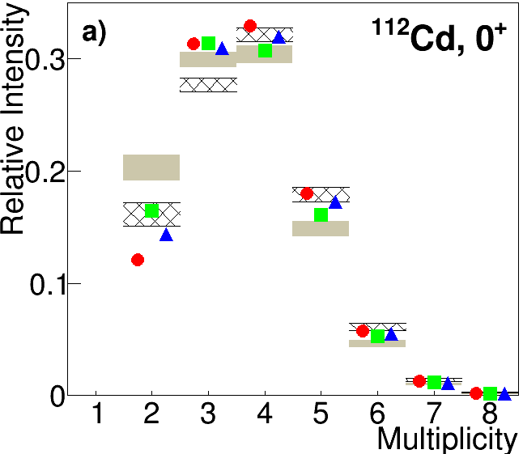
Gray area: D1M C = 10;
Black hatched: BSK27 C = 10;
NLD: HFB

Slide 12
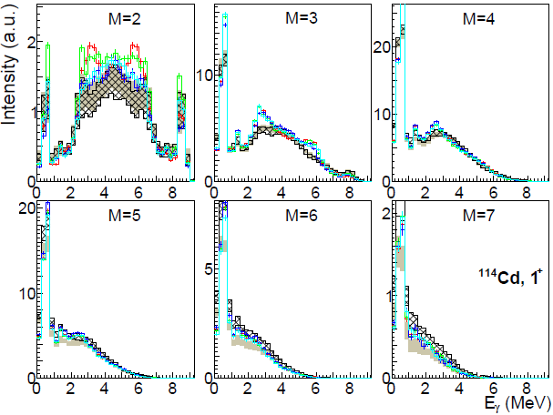
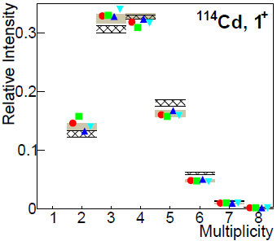
^{112,114}Cd (almost spherical):
Gray area C = 0;
Black hatched C = 10;
NLD: HFB

Slide 13
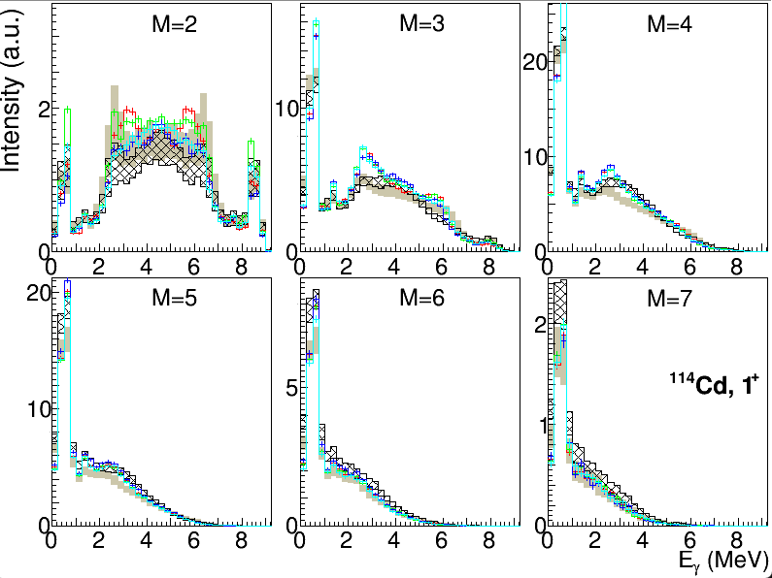
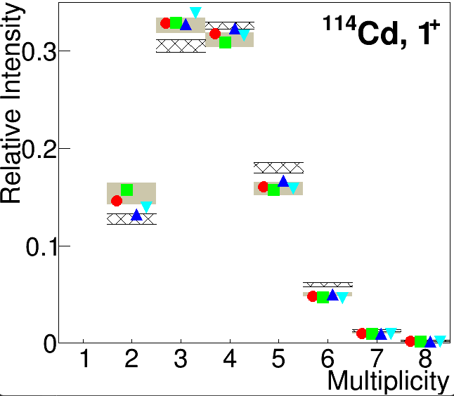
Gray area: D1M C = 10;
Black hatched: BSK27 C = 10;
NLD: HFB

Slide 14
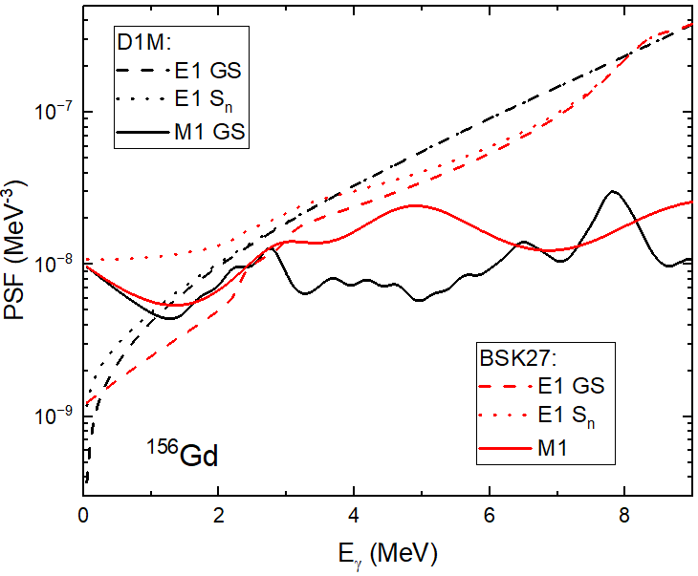
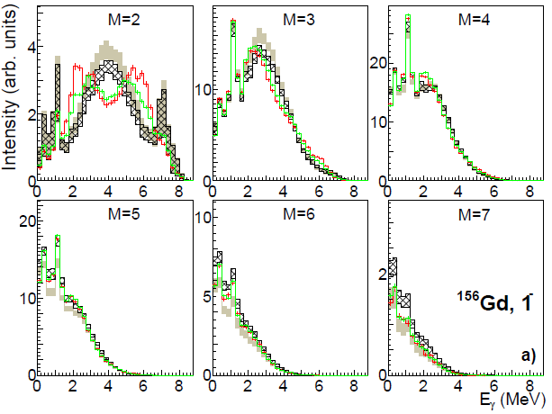
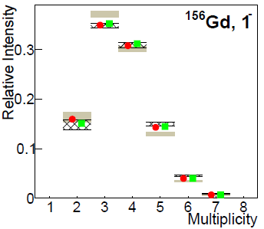
^{156,158}Gd:
Parameters of SM not fully correct - too high predicted intensity in M = 2 (+ an absence of the strength at 2 − 3 MeV in M = 4) spectra indicates assumed SM too weak (and/or wrong position).
Gray area C = 0;
Black hatched C = 10; NLD: HFB

Slide 15
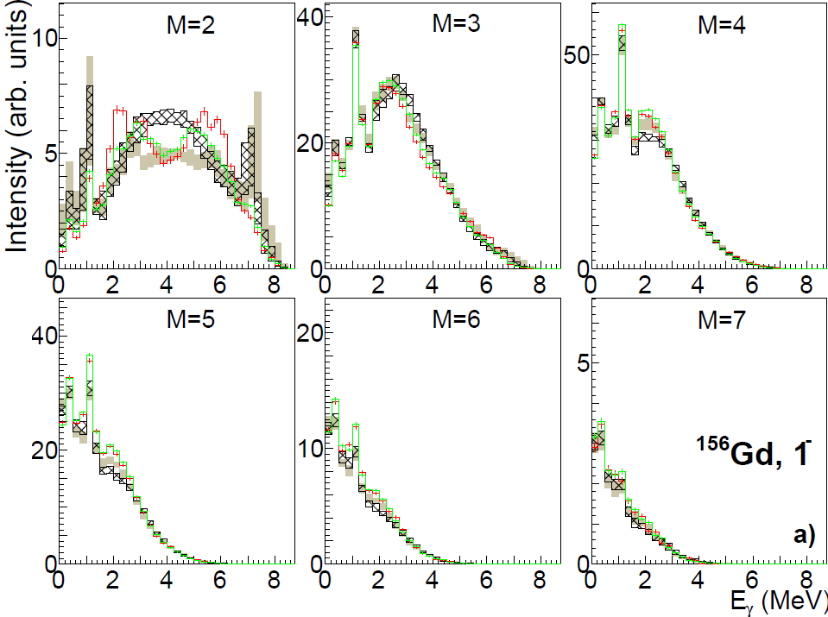
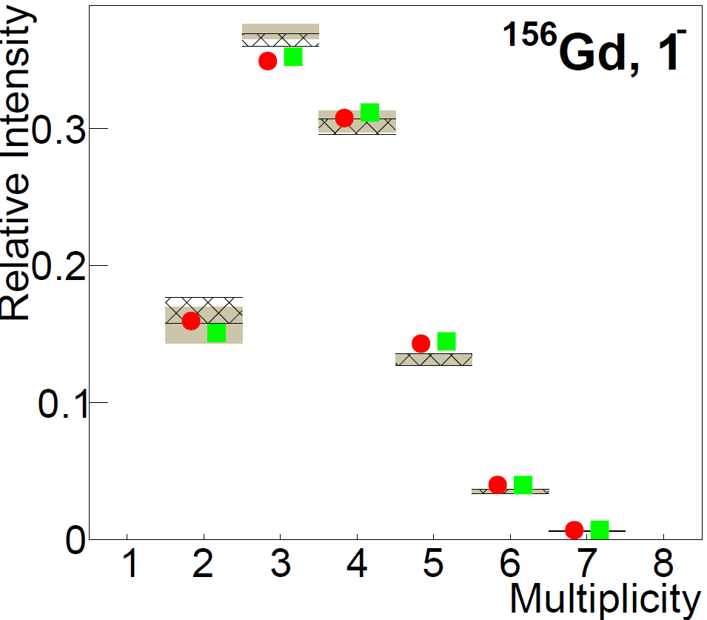
^{156,158}Gd:
Gray area: D1M, C=10;
Black hatched BSK27, C = 10; NLD: HFB

Slide 16
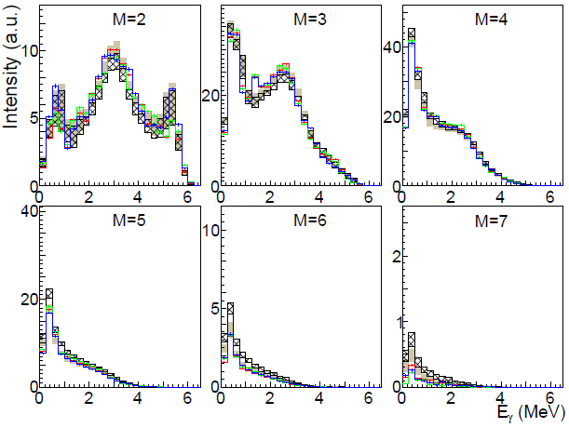
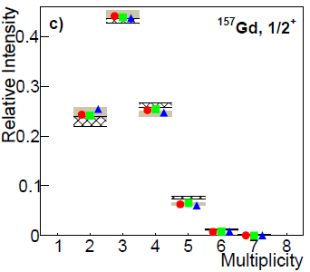
Odd Gd:
Spectra are acceptably (for a global model) reproduced with C≈5 in combination with HFB NLD.
Some imperfections likely arise again from too weak SM
Spectra likely not very sensitive to SM properties
Gray area C = 0;
black hatched C = 5; NLD: HFB
¹⁵⁷Gd, 1/2⁺

Slide 17
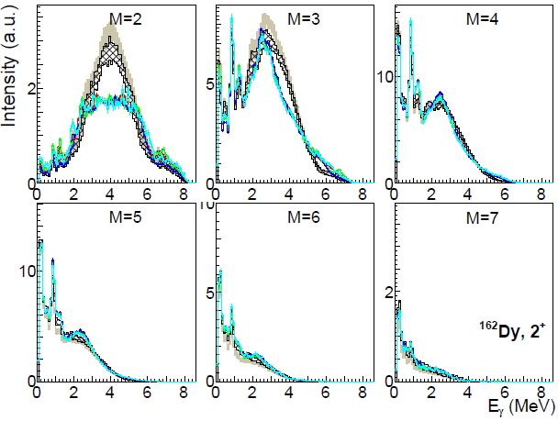
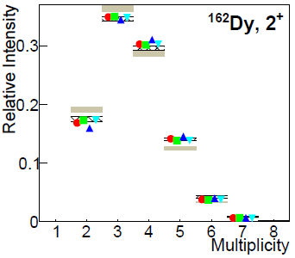
^{162,164}Dy:
Analogous to even Gd isotopes
(problem with the SM strength/position)
Gray area C = 0;
Black hatched C = 10;
NLD: HFB

Slide 18
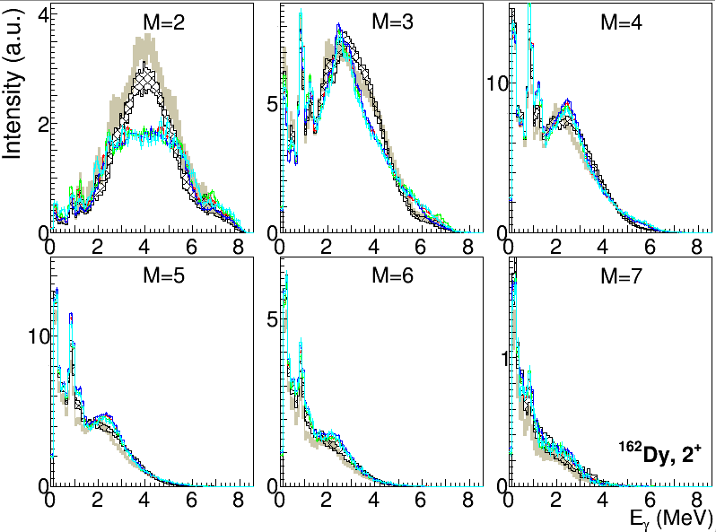
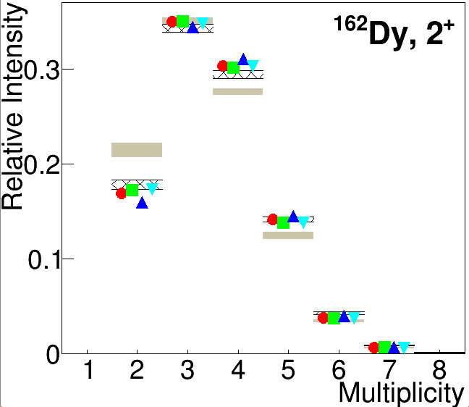
Gray area: D1M, C=10;
Black hatched BSK27, C = 10; NLD: HFB

Slide 19
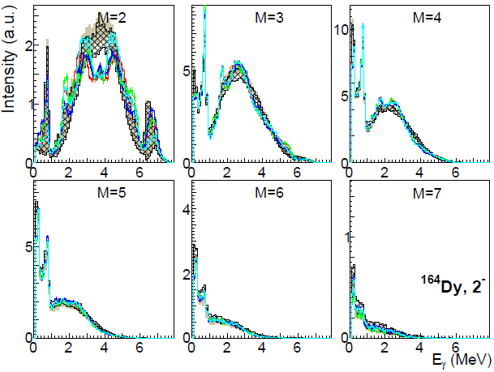
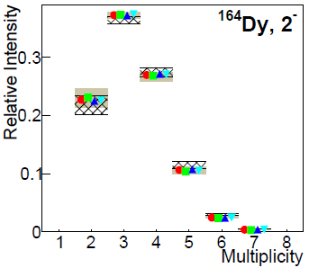
^{162,164}Dy:
Gray area C = 0;
Black hatched C = 5;
NLD: HFB

Slide 20
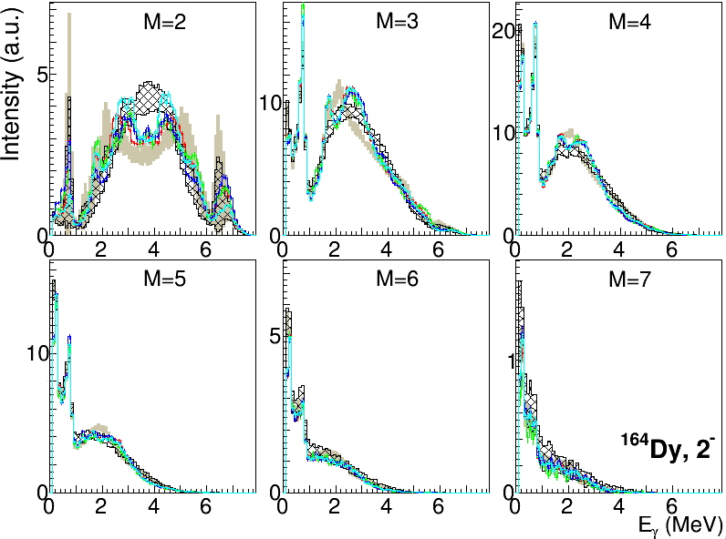
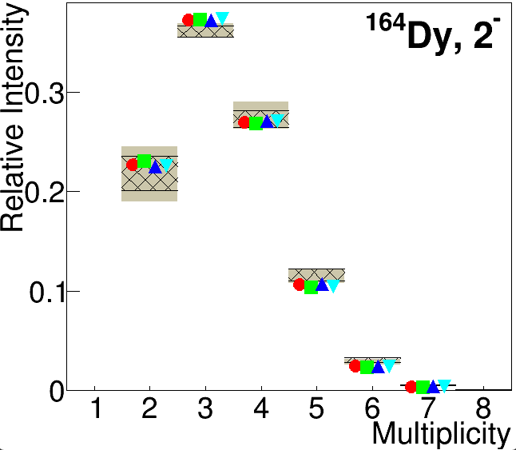
Gray area: D1M, C=10;
Black hatched BSK27, C = 5; NLD: HFB

Slide 21
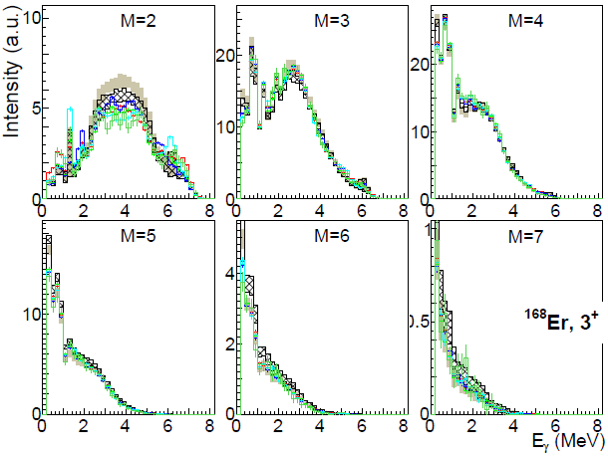
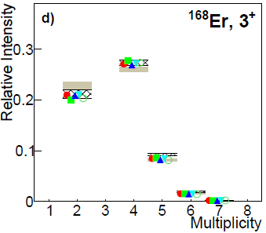
168Er:
Much better reproduction than for e-e Gd and Dy isotopes (by chance?).
The nucleus seems to be not very sensitive to the checked SM parameters.
4⁺ resonances reproduced even better
Gray area C = 0;
Black hatched C = 10;
NLD: HFB

Slide 22
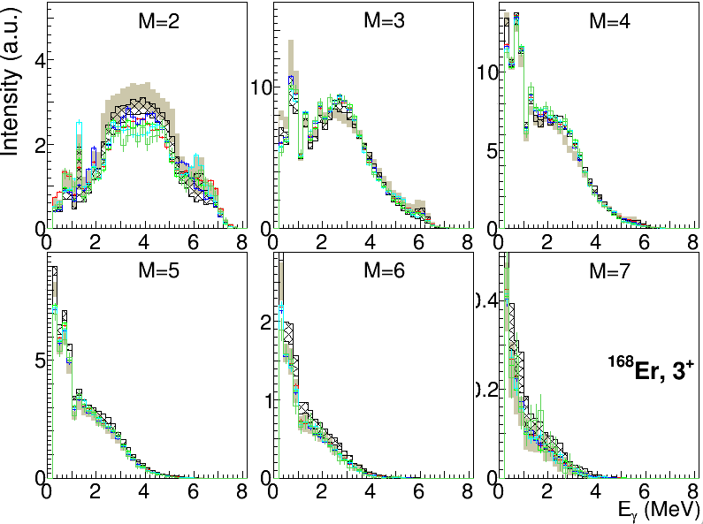
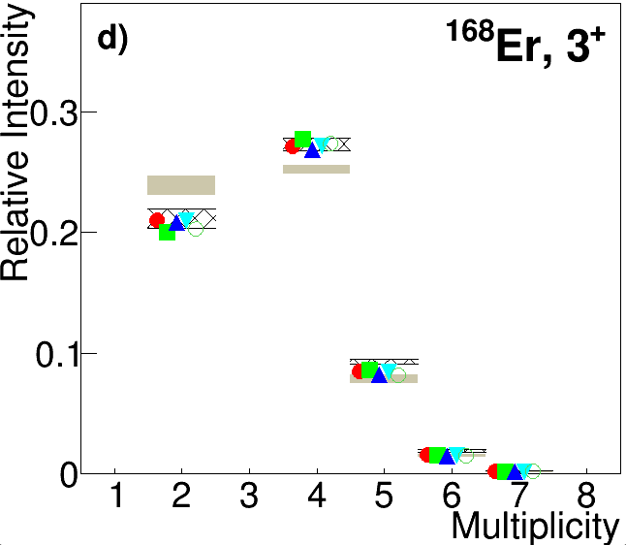
168Er:
Gray area: D1M, C=10;
Black hatched BSK27, C = 10; NLD: HFB

Slide 23
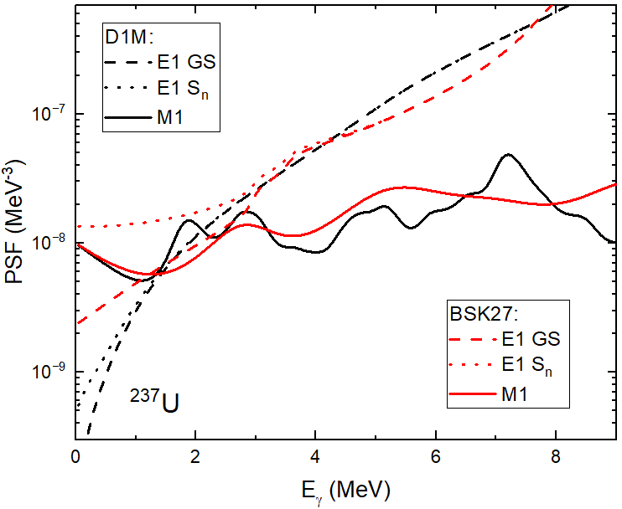
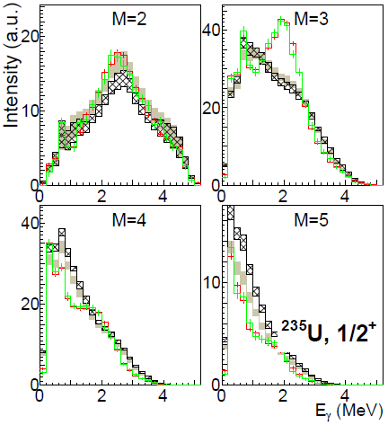
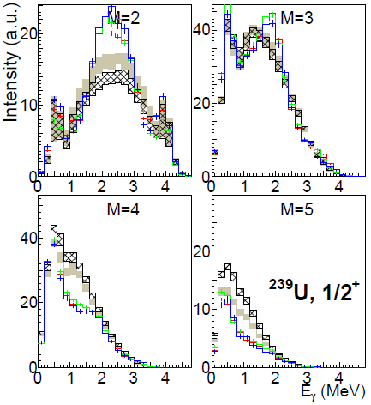
Odd U (^{235,237,239}U):
Similar to e-e Gd isotopes – problem with SM position/strength
+ more complex SM structure
Problem typically visible more in M = 3 spectra (while M = 2 spectra look sometimes OK).
Gray area C = 0; black hatched C = 10; NLD: HFB

Slide 24
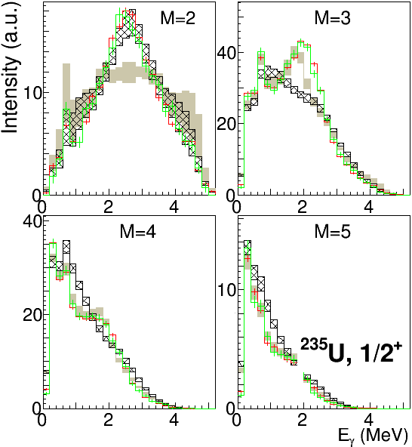
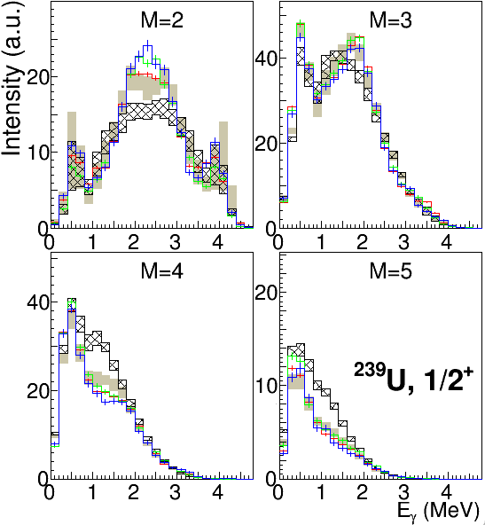
Odd U (^{235,237,239}U):
Gray area D1M C = 10;
Black hatched BSK27 C = 0;
NLD: HFB

Slide 25
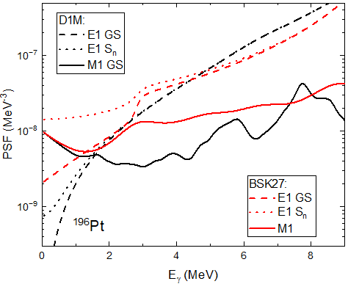
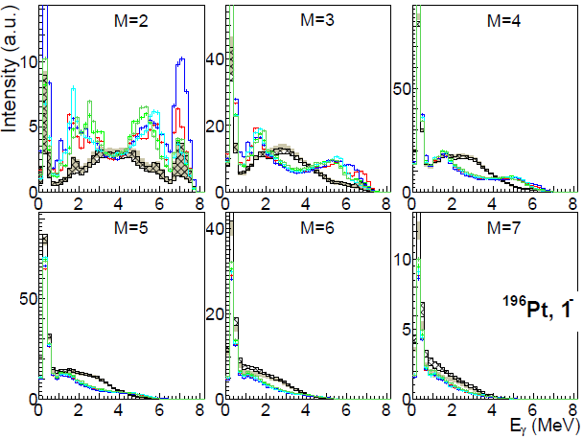
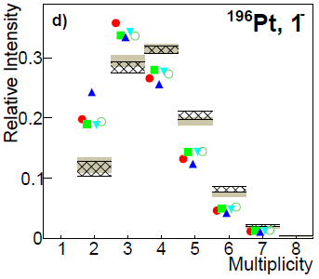
¹⁹⁶Pt:
Evidently problem with the “pygmy resonance” (a structure at about 5 MeV), which significantly affects the decay.
(Not very surprisingly) no chance to reproduce spectra.
Gray area C = 0;
Black hatched C = 10;
NLD: HFB

Slide 26
Some additional checks with the SM strength and position made (motivated by problems visible for some nuclei – even-even Gd and Dy, U)
maximum cross section 3x larger
  gives usually worse description
maximum cross section 2x larger, energy shifted down by 400 keV
  improvement in description is “scatter” – achieved for some nuclei but not for others (sometimes probably worse) than with SMLO parametrization

