Slide 1
Milan Krtička
Resonance data and other related issues

Slide 2
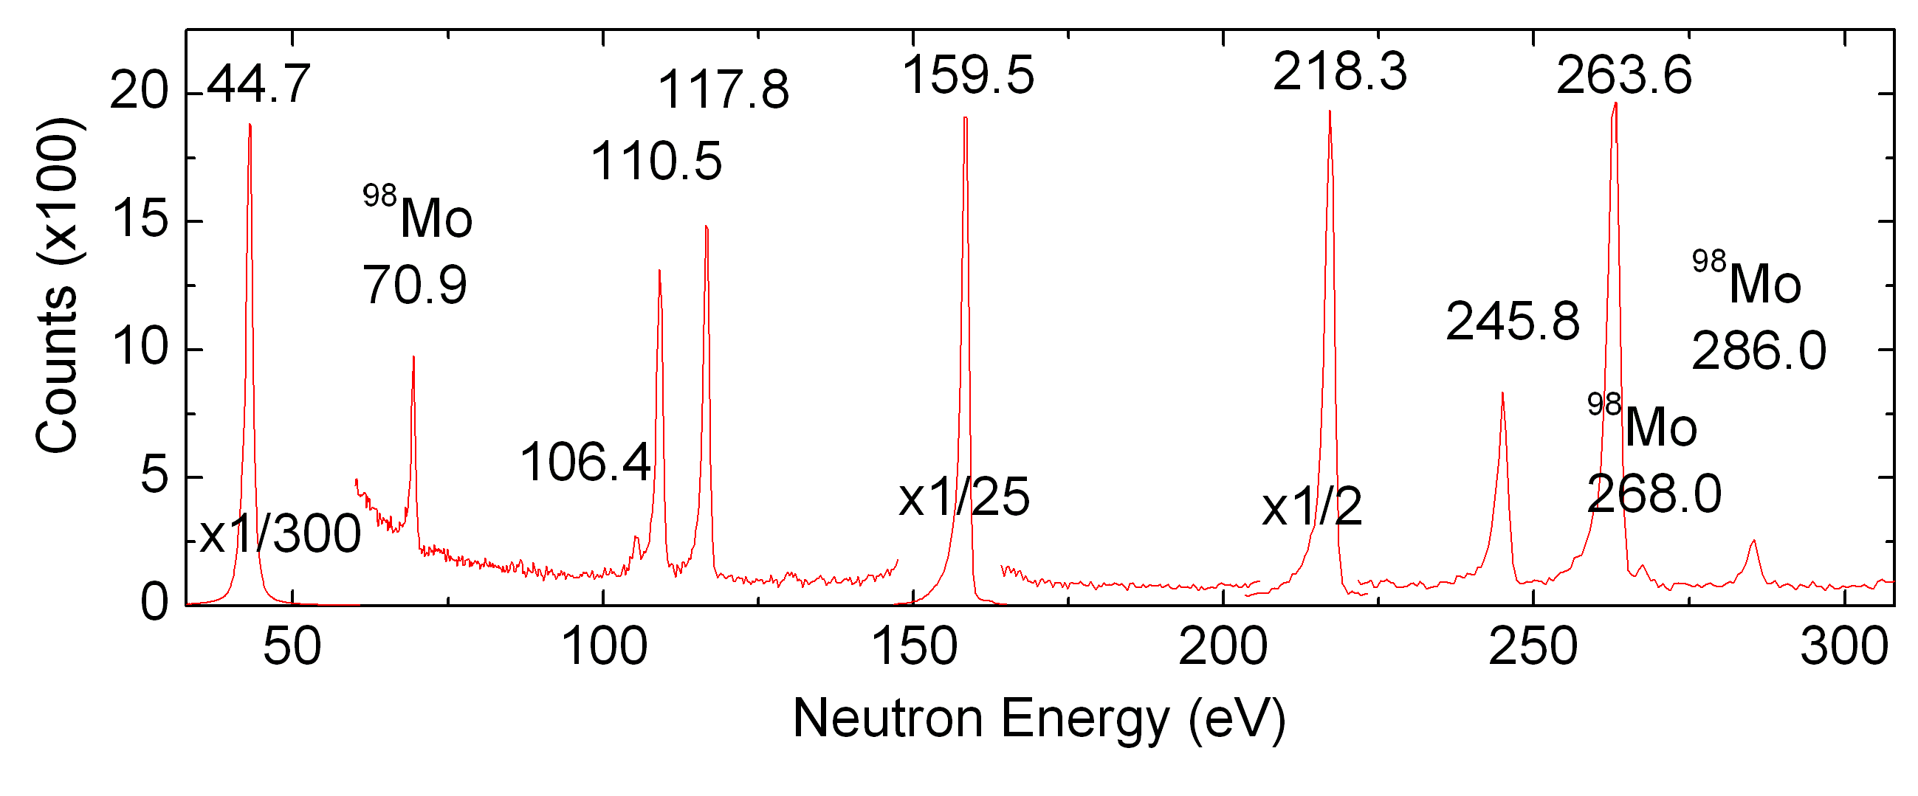
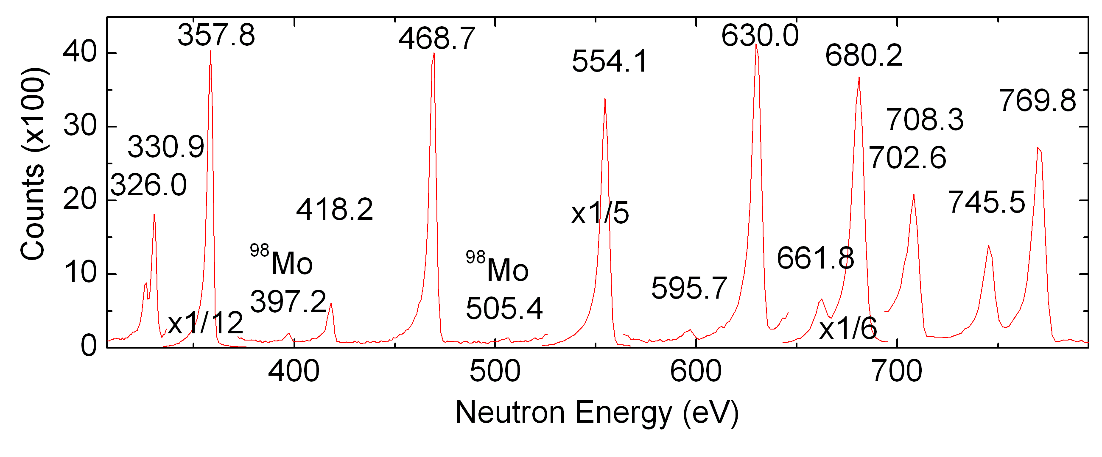
Capture TOF spectrum
3⁺
2⁻
3⁺
2⁻
2⁺
Resonances allow “direct observation” of levels in the region of “high(er) NLD”
Only restricted spin/parity range (due to the penetrability of neutrons with different orbital momentum l)
Resonance spacing usually not determined by simple counting or resonances
1⁻
3⁻
3⁺
2⁺
2⁻
3⁺
2⁺
3⁺ (PK)
3⁻ (SS)
Capture, i.e. (n,γ), yield for ⁹⁵Mo (target) from TOF facility
LANSCE/FP14, DANCE detector

Slide 3
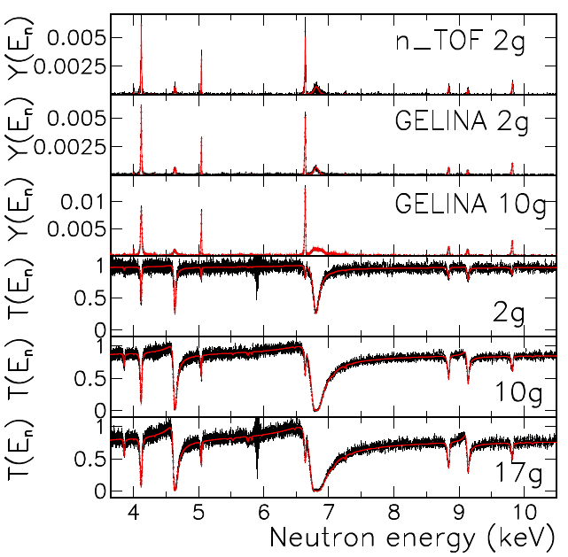
TOF spectra (capture and transmission)
We see resonances, but
how well do we know at least some quantum numbers (l (π), J)?
Analysis typically made using codes that employ some (very reasonable) simplifications of (R-matrix) reaction theory
These codes allow to treat Doppler broadening of resonances, multiple interactions (multiple scattering) and facility resolution function (neutron energy distribution at given time at sample position)
Strictly speaking, only π (and not J) needed for determination of D₀
G. Tagliente et al. (n_TOF coll.), PRC 105, 025805 (2022)

Slide 4
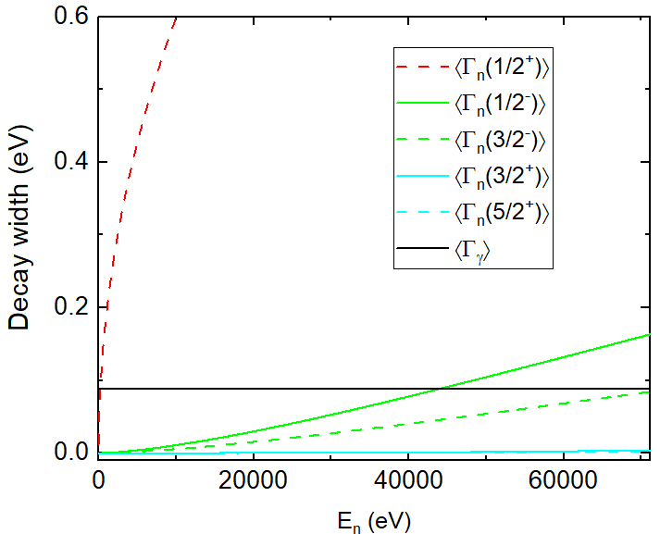
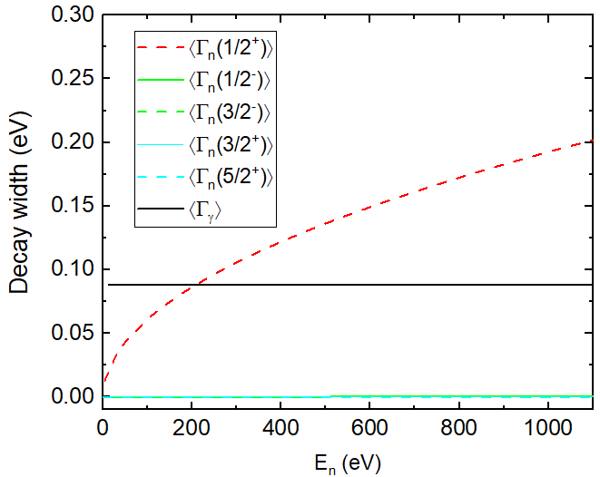
Resonances
Probably not fully general review, but should more-or-less cover situation for non fissile nuclei
Different problems in nuclei with different “resonance density” (approximately)
Consequence of the fact that
Γ_{γ} does not significantly change (except lightest nuclei and perhaps a few nuclei near magic shells)
  Average: a few tens up to a few hundreds meV
  Distribution: typically “close to a Normal one”
Γ_{n} significantly changes
reduced widths Γ_{n}^{(l)} /E^{1/2}/P_{l} given by Γ_{n}^{(l)}=S_{l}.D_{Jπ}
  S_{l} confined within about an order of magnitude.
  On the other hand, D_{Jπ} can be from eV up to tens of keV
Γ_{n} expected to strongly fluctuate
  Γ_{n}^{(l)} should follow PT fluctuations for one “spin” channel
¹⁵⁶Gd

Slide 5
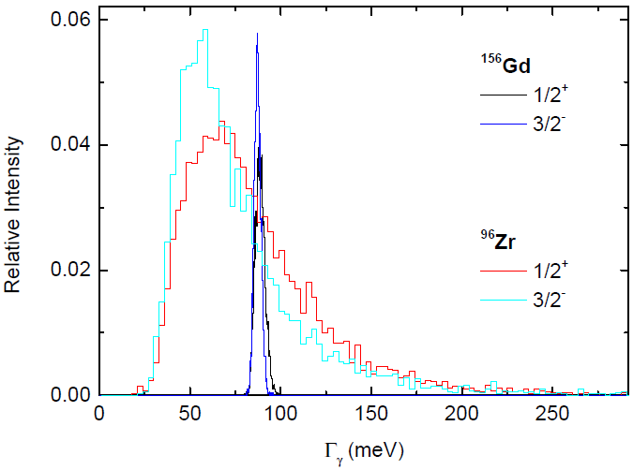
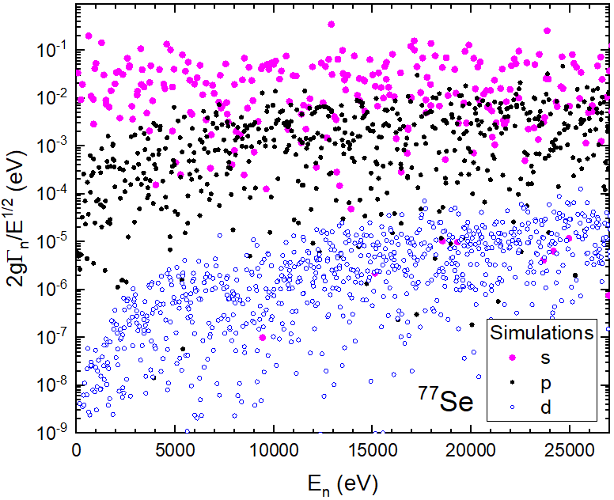
Expected distributions
Expected Γ_{γ} distributions from DICEBOX simulations
Illustration for one model of PSFs and NLD
Width of distribution depends on NLD
One simulated random sequence of Γ_{n}^{(l)} /E^{1/2}
Illustration for ⁷⁷Se

Slide 6
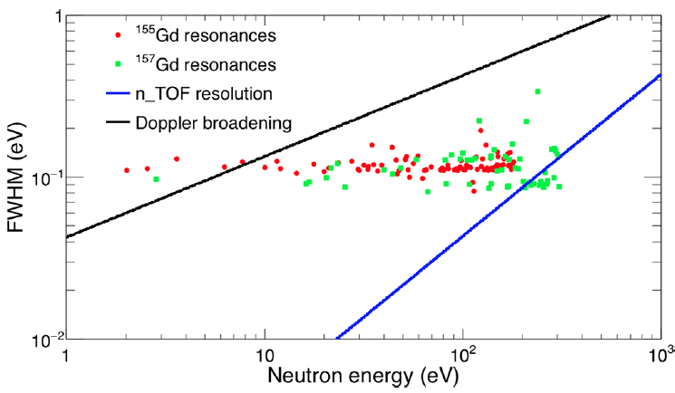
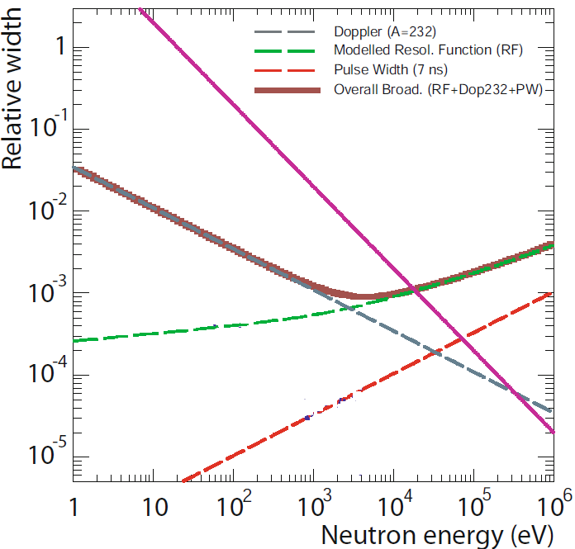
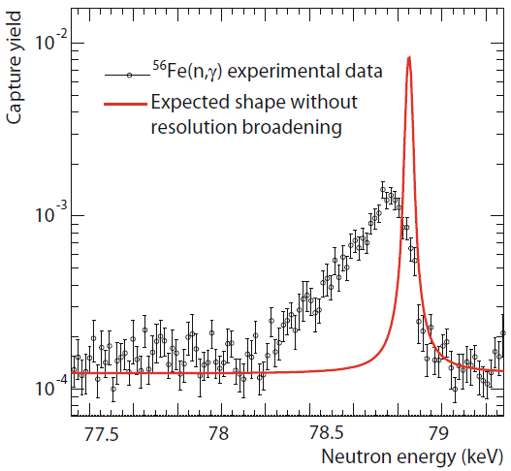
Observed data - Resolution function
In addition:
Each facility has its own “resolution function” (RF) + impact of Doppler broadening
+ usually exponentially decreasing flux
n_TOF RF (EAR1, Phase 2)
M. Mastromarco et al.,Eur. Phys. J. A (2019) 55: 9
C. Guerrero et al., EPJ A (2013) 49: 27
Measured yield compared to the Doppler broadened resonance shape. RF changes the resonance shape leaving its integral unchanged
(if multiple interactions neglected).

Slide 7
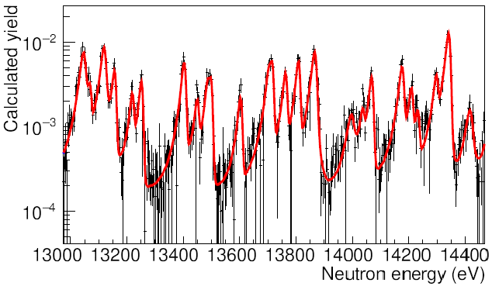
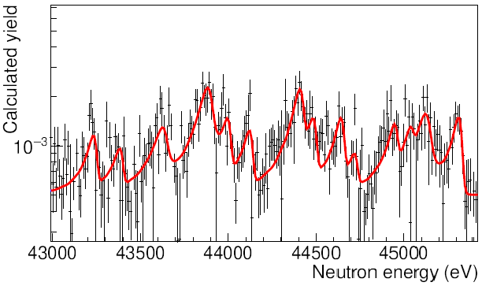
⁷⁷Se
n_TOF experimental data (together with SAMMY fit) from capture experiment on ⁷⁷Se
One can see structures but
how many resonances do we miss?
from capture measurement we have very limited info on J,π

Slide 8


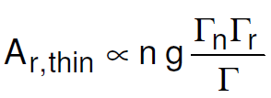








In limiting cases:
The analysis codes can usually produce reliable information on the “resonance area” A
Capture kernels k=gΓ_{n}Γ_{γ} /Γ , Γ =Γ_{n} +Γ_{γ}
(from capture data)
k dominated by smaller of the widths
“Neutron strengths” gΓ_{n}
(from transmission data)
In favorable cases also additional information (on g)
Areas A are given by:
Reaction (capture “r=γ”):
Transmission:
Deducible parameters:
& Γ if larger than Δ_{R} and Δ_{D}

Slide 10
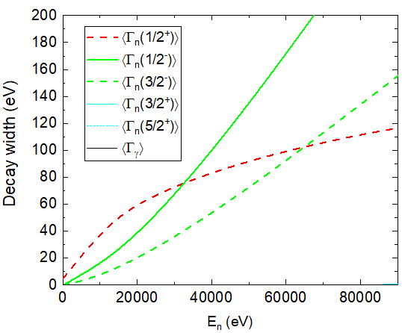
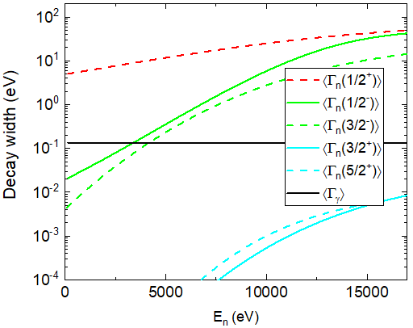
Resonances
It would be ideal to have
resonance sequences with given π (for determination of D₀, D₁,…) and J
Each sequence should be
complete (on the one hand) – problem everywhere but especially for D₀ in eV range
pure of any contamination (on the other hand) – problem for D₀ in keV range
For nuclei with D₀~eV region, we can hardly see resonances with l>0
D₀ ~ keV
⁹⁶Zr
D₀ ~ eV
¹⁵⁶Gd

Slide 11
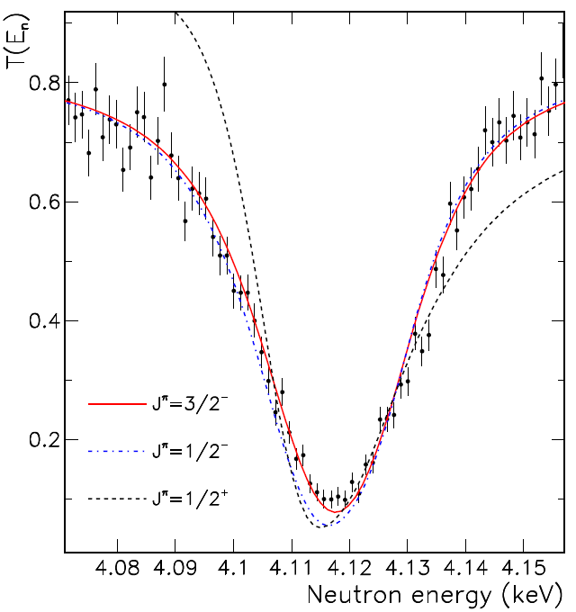
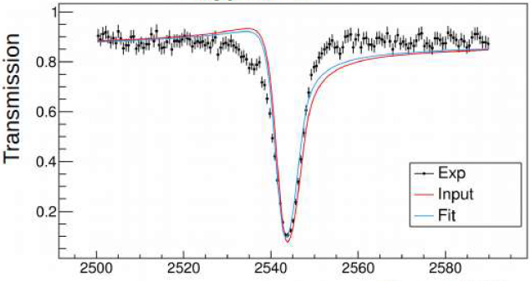
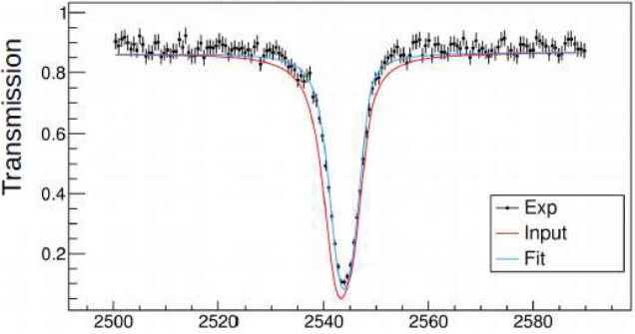
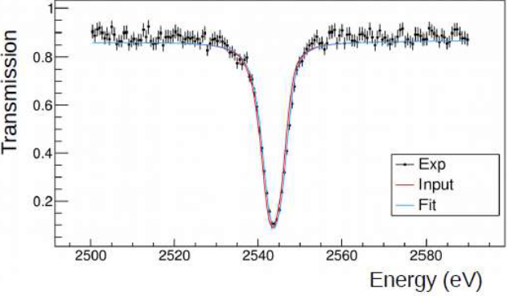
Determination of l=0/l>0 – transmission for strong resonances
If Γ_{n} large enough, π can be identified from transmission shape:
the broadest s-waves - asymmetric
the broadest p-waves - symmetric
1/2+
For smaller Γ_{n}, π assignment difficult – the asymmetry not clearly visible
If gΓ_{n} is not too small, sometimes possible to assign π using both transmission and capture data – difficult to use simultaneous agreement between the fitted and data peak positions for “wrong assumed parity”
practical applicability could be limited (MK) (probably strongly depends on “resolution function”)
3/2-
Transmission through the 17g ⁹²Zr sample, GELINA. Experiment compared with REFIT code fit for J^{π} = 1/2+, 1/2-, and 3/2-.
1/2-
G. Tagliente et al. (n_TOF coll.), PRC 105, 025805 (2022)
¹⁴⁰Ce transmission data
(n_TOF, not published yet)

Slide 12

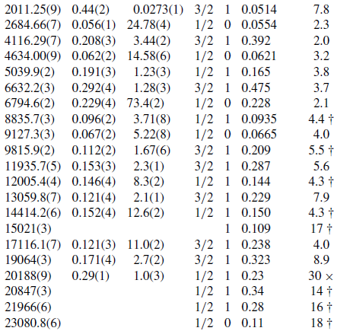
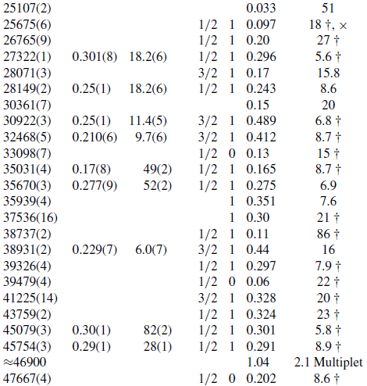
Illustration of analysis results (GELINA + n_TOF, ⁹²Zr)
Definite spin and parity can often be determined only for rather limited number of resonances
Is the spin and parity reliably determined in measurements from 70’s/80’s?
Surely in many cases …
G. Tagliente et al. (n_TOF coll.), PRC 105, 025805 (2022)

Slide 13
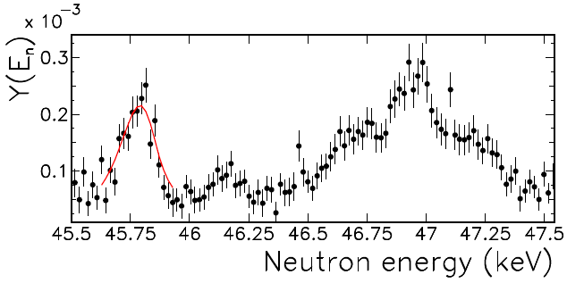
Example of a resonance
G. Tagliente et al. (n_TOF coll.), PRC 105, 025805 (2022)
Many nuclei measured in 70’s (and 80’s)
“relatively routine measurements”
Not always surely correct … but hopefully not many mistakes (in parity assignment)
Experimental capture yield for the 10 g ⁹²Zr sample measured at GELINA. Single resonance reported between 46.5 and 47.5 keV by Boldemann (ORELA). At least triplet visible from GELINA data.

Slide 15
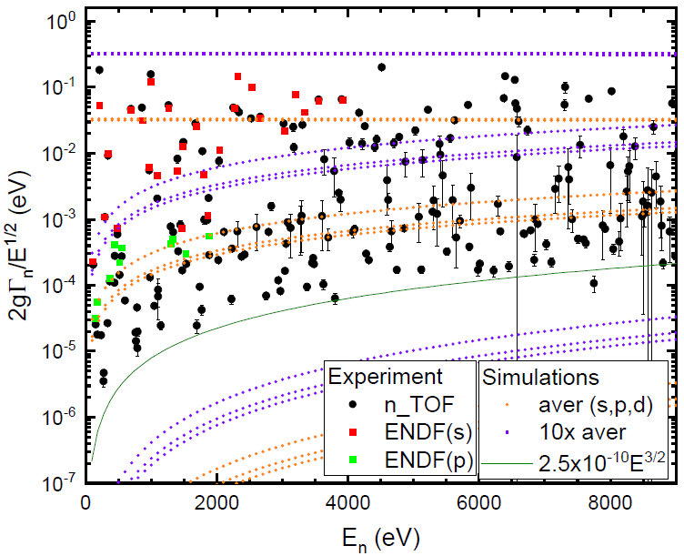
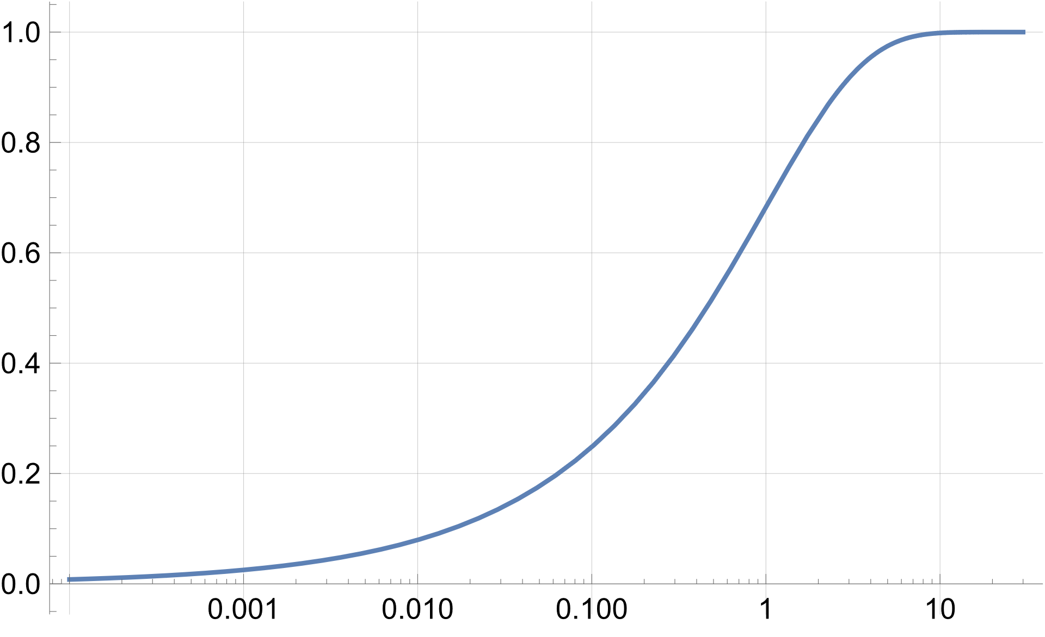
Typical determination of D₀
Parity for strong resonances can often be assigned using “statistical” model predictions
Using different penetrability ⇒ separation of s- (l=0) and p-wave resonances in Γ_{n} (Γ_{n}⁰) at low E_{n}
Resonances above the “middle magenta lines” are (almost surely) s-wave ones
If average resonance parameters close to reality, probability of a p-wave resonance above these magenta lines is about 0.2%.
⁷⁷Se
Cumulative χ² distribution
Figure is only an illustration, the reliability of Γ_{n} in some regions of their values is not very high if only capture data available, only kernels typically published in these cases
N. Sosnin et al. (n_TOF coll.), Paper on ⁷⁷Se accepted for publication in PRC

Slide 16
Typical determination of D₀
If data on Γ_{n} (Γ_{n}⁰) reliable, one usually tries to apply a threshold in this quantity and estimate the number of subthreshold resonances assuming Porter-Thomas distribution assumed/expected for (Γ_{n}⁰)
Estimate of S_{l} must be made (given by a sum of gΓ_{n}^{l} within an interval – OK, but significant fluctuations if not many resonances!)
Applied threshold is usually energy dependent
This procedure is traditionally applied, surely also for RIPL-3 evaluation (MK does not know all the details about procedure used in this case)
Can be applied analytically or Monte Carlo
At n_TOF we use Monte-Carlo approach – random sequences of resonances generated for each tested D₀ and probability that observed number of resonances corresponds to the experiment is checked – uncertainty can be obtained
⁷⁷Se
⁷⁷Se

Slide 17
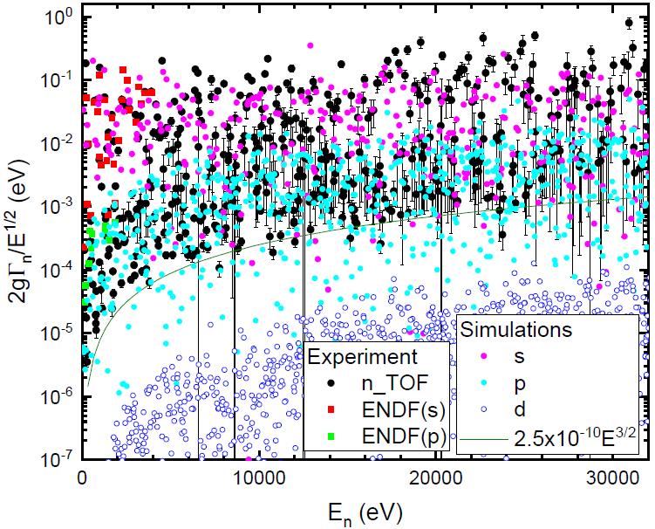
⁷⁷Se
Any threshold can be used
Lower threshold means more resonances and leads to smaller error in D₀ determination but for many nuclei contribution of resonances with l>0 is significant
If some p-wave resonances are above the threshold, an assumption on spin- (and parity-) dependence of level density has to be applied.
Several different thresholds and/or maximum neutron energies can be checked.

Slide 18
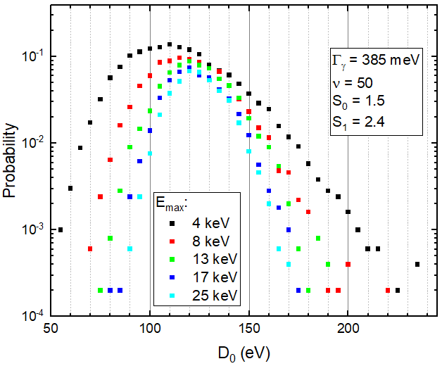
Illustration of MC analysis
Probability that for assumed D₀ the number of above-threshold resonances is the same in simulations and experiment

Slide 19
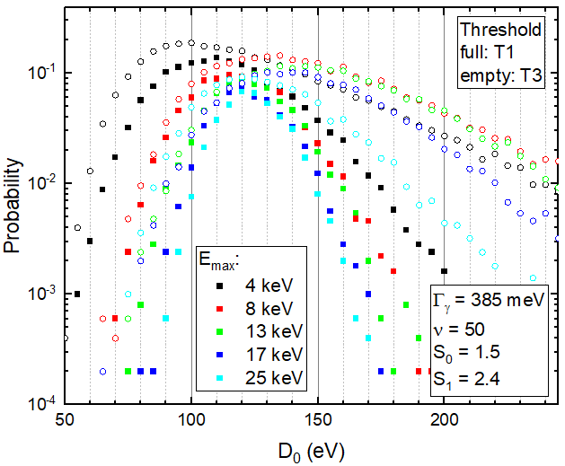
Probability that for assumed D₀ the number of above-threshold resonances is the same in simulations and experiment

Slide 20
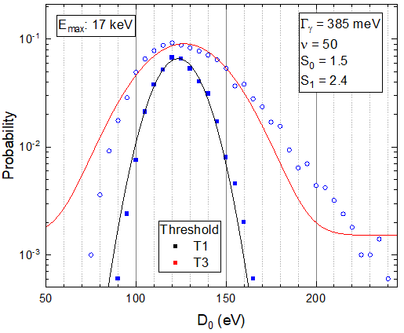
D₀ can be deduced from the distribution
68% central values
Fit of a gaussian (+ small const) – typically used
A combination of more thresholds, …
Probability that for assumed D₀ the number of above-threshold resonances is the same in simulations and experiment

Slide 21
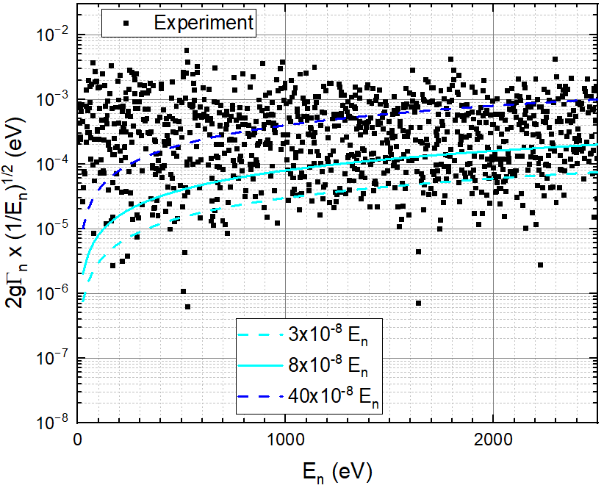
Nuclei with D₀ ~ eV
²³⁹Pu target
(ENDF data – resonances listed up to 2.5 keV)

Slide 22
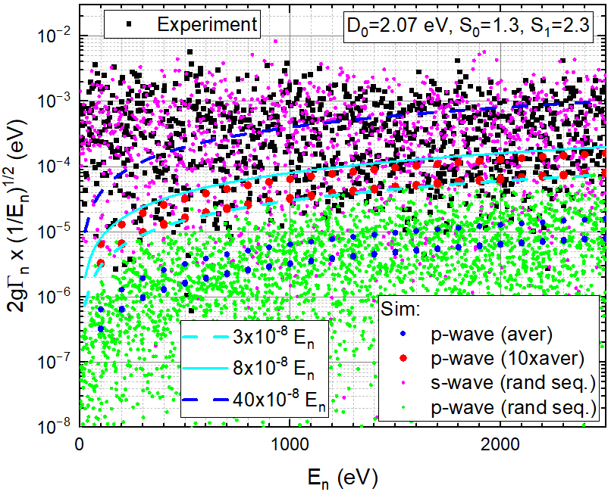
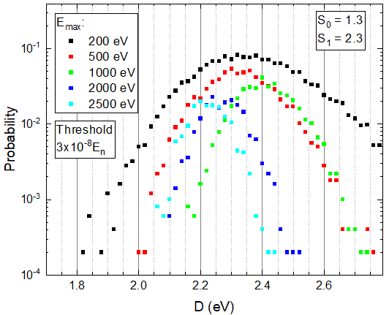
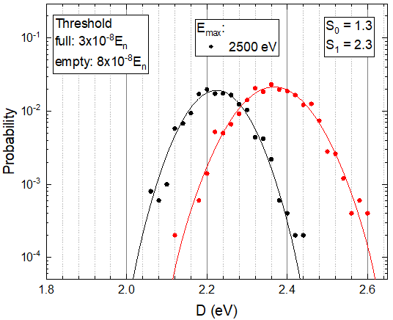
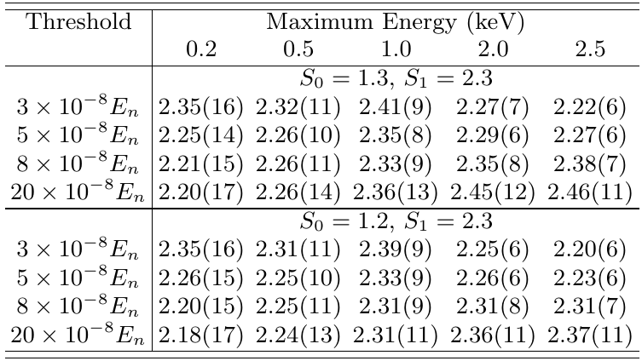
239Pu (ENDF data)
RIPL-3: D₀=2.20(9) eV, S₀=1.2(1)
Mughabghab Atlas: D₀=2.07(7) eV, S₀=1.3(1)
MK approach: D₀~2.30(7)

Slide 23
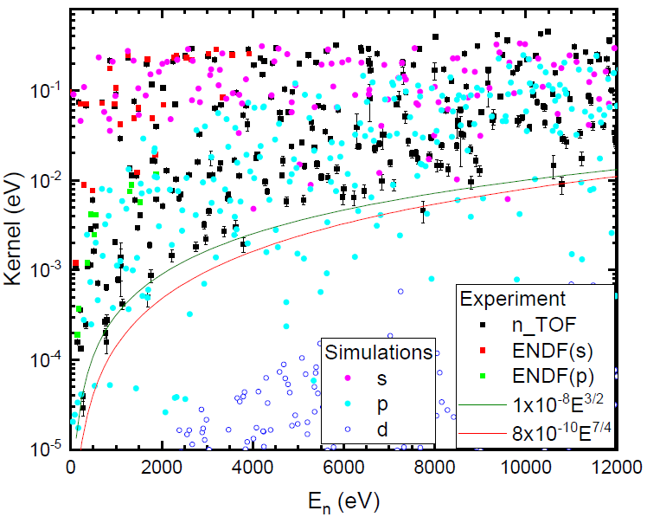
Similar analysis using capture kernels
Good quality data on Γ_{n}⁰ (from transmission) not always available (only a few resonances known in some cases, typically not available at all for radioactive targets as we do not have sufficient amount of material for transmission)
Similar kind of analysis as for Γ_{n}⁰ (comparison of number of observed above-threshold resonances to simulations) can be made also to other quantities
If capture data available, the quantity is capture kernel k=gΓ_{n}Γ_{γ} /Γ (or resonance integral)
There is no simple theory/prediction describing number of sub-threshold resonances, but MC approach can be applied
Knowledge of properties of Γ_{γ} distribution is needed (can be somehow extracted from experimental data + combined with simulations)

Slide 24
⁷⁷Se

Slide 25
Exactly the same procedure as for gΓ_{n} can be applied
Knowledge of properties of Γ_{γ} distribution required
Probability that for assumed D₀ the number of above-threshold resonances is the same in simulations and experiment

Slide 27
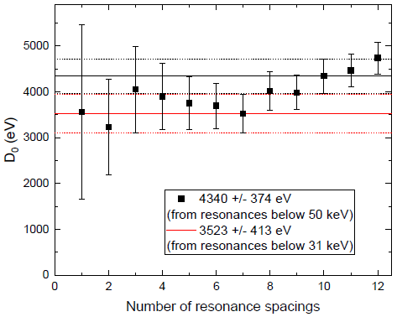
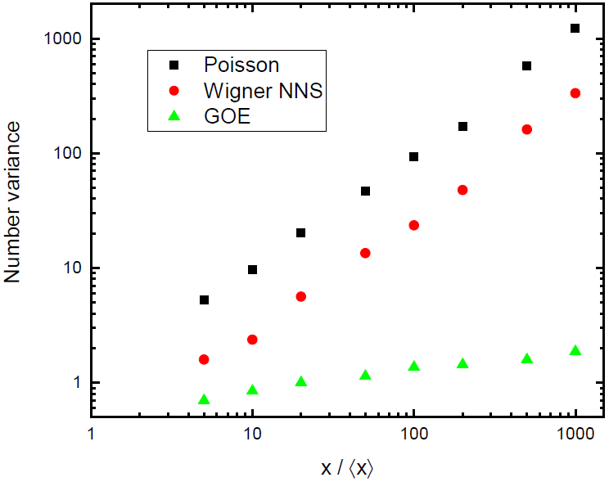
Can we exploit GOE predictions for determination of D₀?
If the resonance positions follow the predictions of GOE (long-range correlations) – spacing “can” be determined more precisely
if the sequence is complete (and pure)
Illustration via “number variance” - describes the (square of) fluctuations of number of levels within an interval.
Alternatively, we can check the position of n^{th} resonance with respect to the first (observed) one
Illustration for ¹⁴⁰Ce target (1/2⁺ res), uncertainties indicate standard deviation from GOE predictions

Slide 28
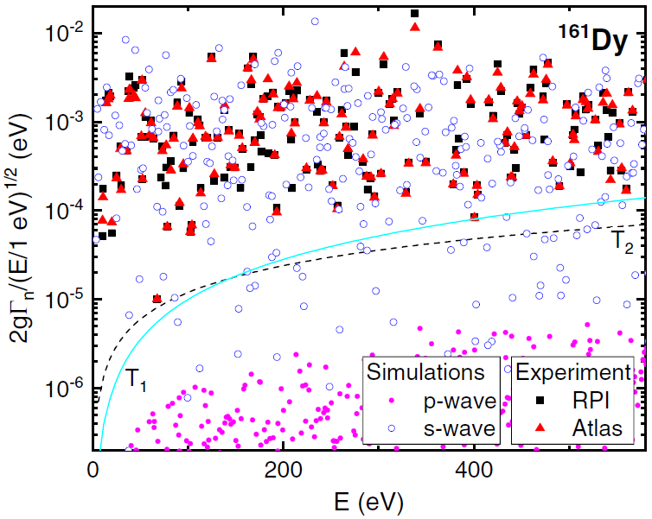
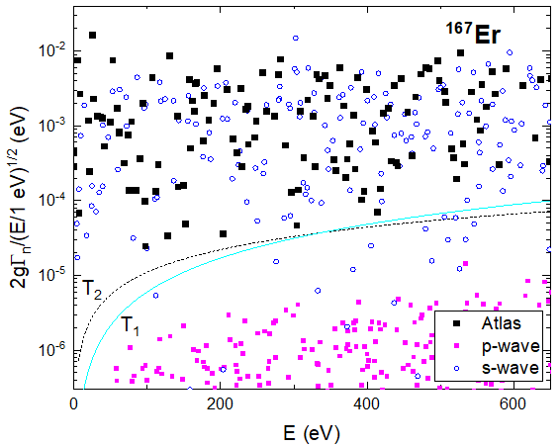
Completeness of sequences
Problem with sequence completeness (for all D₀) and purity (for larger D₀ nuclei)
Experimental data from Mughabghab’s Atlas (and RPI)
One random simulated sequence of resonances.
For Dy: D0 = 2.15 eV, S₀ = 2.0×10⁻⁴, D₁ = 1.16 eV, S₁ = 1.3×10⁻⁴

Slide 29
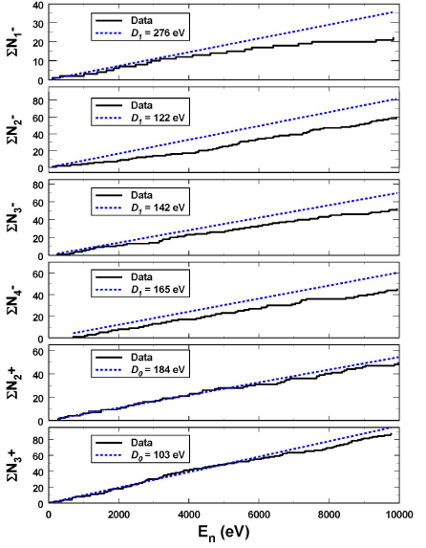
How to check completeness?
The maximum energy where the sequence can be complete might be roughly estimated from a cumulative plot of resonances
Only an estimate and we might miss resonances from very low energies
⁹⁵Mo
P. Koehler, PRC 105, 054306 (2022)

Slide 30
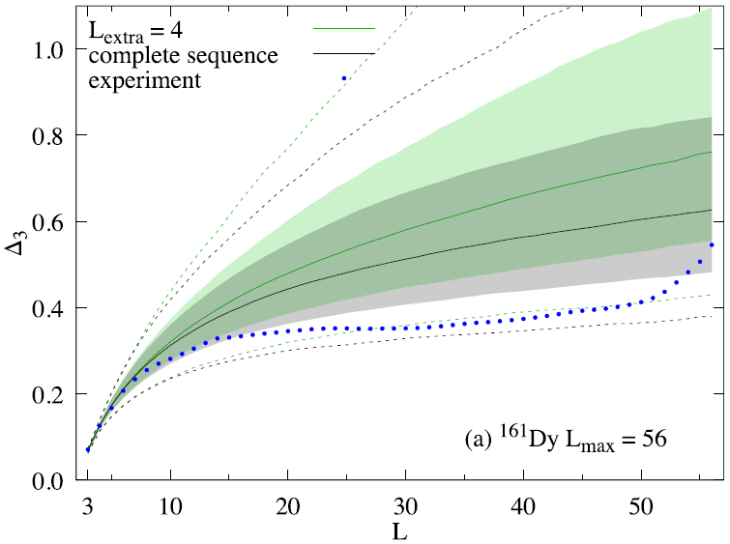
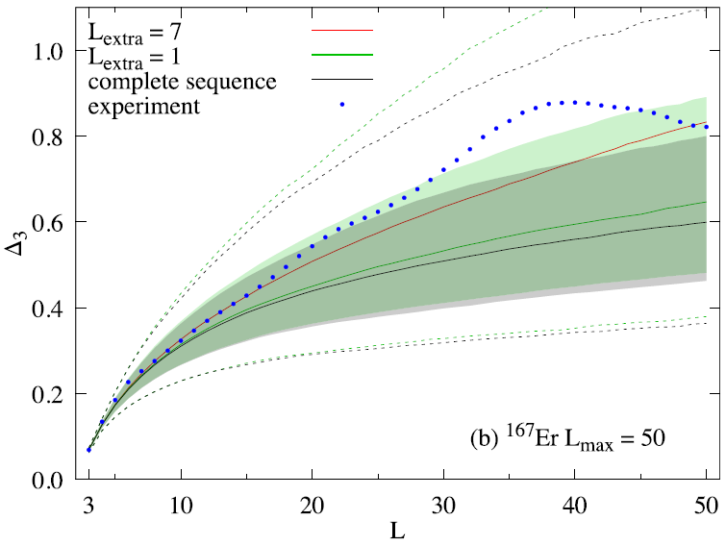
How to check completeness? Tests based on GOE predictions
Δ₃ statistic often used – a measure of fluctuation of positions around the “picket fence” (linear) dependence
It shows up that not very sensitive for sequences of “realistic” length (typically at most a few tens)
Δ₃(L) for experimental mixed-spin sequences compared to their simulated counterparts
Full lines – mean values (from simulations)
Corridors form 68.27% central interval (~1σ), dashed lines 95.45% central interval (~2σ)
L_{extra} … number of “missing resonances”
I. Knapova et al., PRC 106, 034607 (2022)

Slide 31
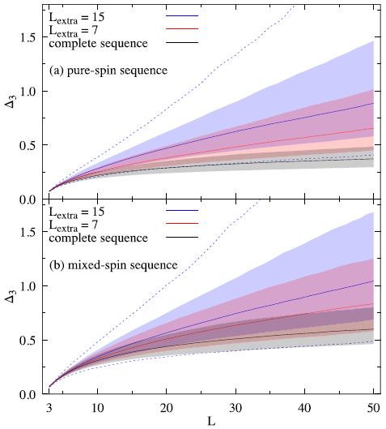
Illustration of limited sensitivity
The simulated Δ₃(L) for sequences with L_{max} = 50 and L_{extra} = 0, 7, and 15.
The shaded corridors correspond to 68.27% central interval and the dashed lines for L_{extra} = 15 show 95.45% central interval.
I. Knapova et al., PRC 106, 034607 (2022)

Slide 32
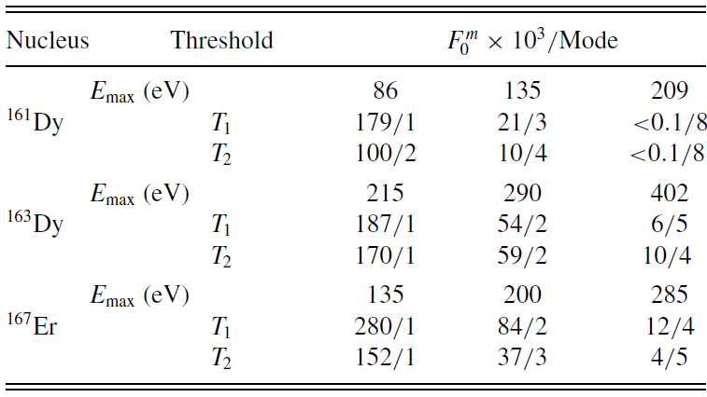
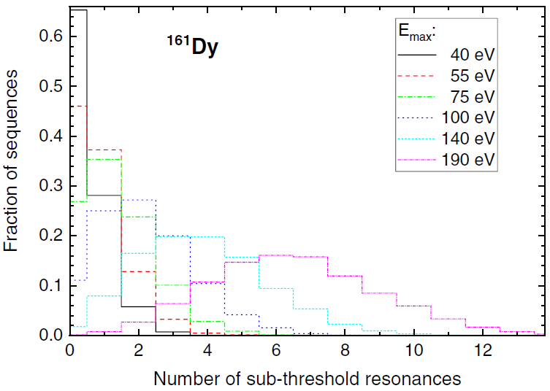
Possible approach for some nuclei
If average resonance parameters are known, estimate of sub-threshold resonances can be made
Fraction of complete (mixed-spin) sequences F₀^{m} and the mode of distribution for different E_{max} and both thresholds on the previous slide.
Simple relation to individual spin sequences found.
Distribution of number of sub-threshold s-wave resonances for a few max E_{n} in ¹⁶¹Dy and T₁
threshold. (D₀ = 2.15 eV and S₀ = 2.0 × 10⁻⁴ used)
I. Knapova et al., PRC 106, 034607 (2022)

Slide 33
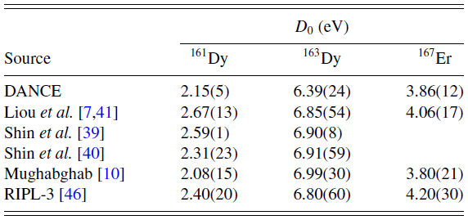
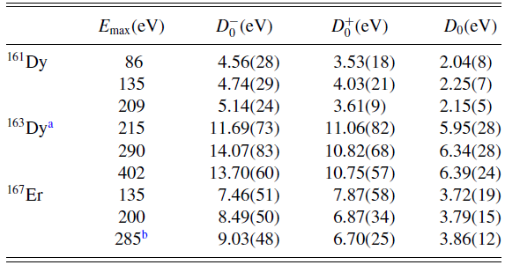

Possible approach for some nuclei
Deduced average resonance spacing from analysis of DANCE data using GOE assumptions and missing resonances (see above)
Comparison of D₀ deduced from DANCE analysis (with highest E_{max}) with literature data
Small uncertainty comes from the fact that the number of sub-threshold resonances is likely rather small. If larger – the uncertainty increases.
I. Knapova et al., PRC 106, 034607 (2022)

Slide 34
Are GOE predictions justified?
Not 100% clear – some deviations reported (mainly works by P.E. Koehler in last about 15 years)
MK involved in some of them. For instance,
Experimental data on reduced neutron widths showed a very low probability that they could be consistent with Porter-Thomas fluctuations; P.E. Koehler at al., PRL 105, 072502 (2010)
If correct, would have a significant impact on actual NLD (D0)
MK is not sure if he believes in this effect but if experimental data correct, the effect is there
There are also some problems with long-range correlations in “Nuclear Data Ensamble” (NDE) P.E. Koehler at al., Fortschritte der Physik-Progress of Physics 61 (2-3) , pp.80-94
P.E. Koehler reported a few more cases …
In general problem with experimental data – spin/parity of resonances in NDE were likely assigned assuming the validity of GOE by experimentalists … (above-discussed problems)

Slide 36
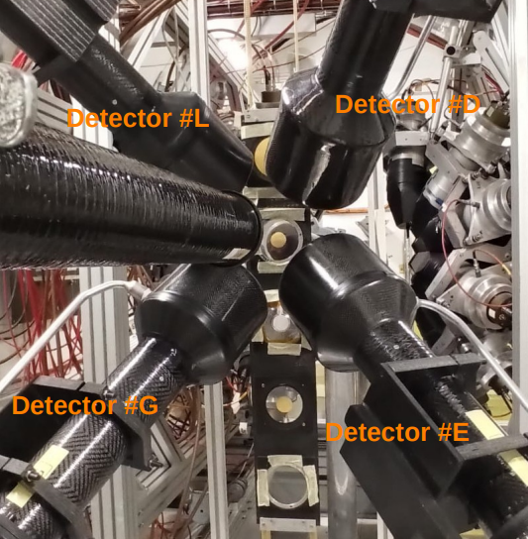
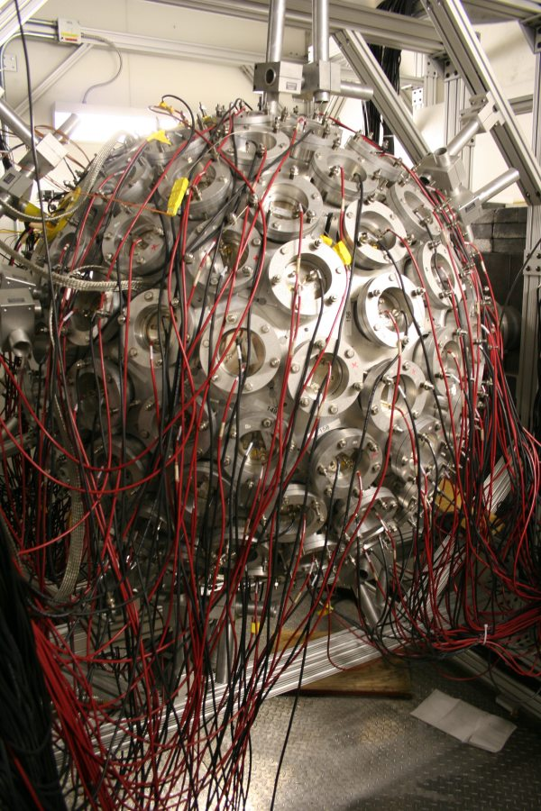
Spin of neutron resonances
Can be determined by several methods (very crude division)
analysis of transmission, scattering, or capture cross-section measurements (above)
measurement of transmission using polarized neutrons and samples
detection of differences in γ-ray spectra from resonances with different spins
ratio of singles to coincidence from two scintillation detectors
intensities of γ rays from low-lying levels measured with Ge detectors,
the singles/singles, and coincidences/coincidences ratios for different pulse-height regions with C₆D₆ detectors,
cascade characteristics measured with 4π segmented detector arrays, e.g., DANCE or TAC at n_TOF
…
Mughabghab Atlas lists 9 methods, but those can be combined into these groups

Slide 37
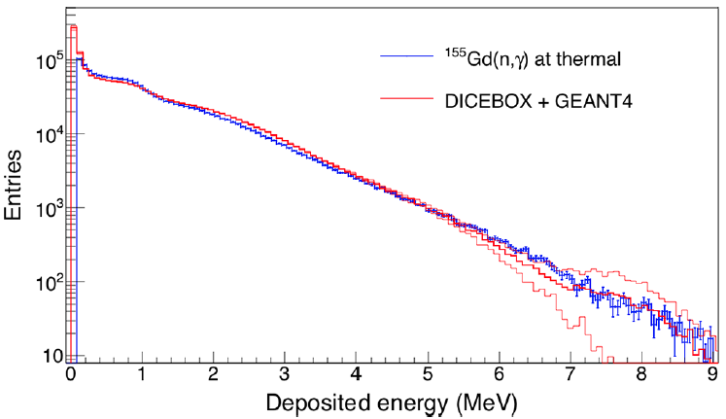
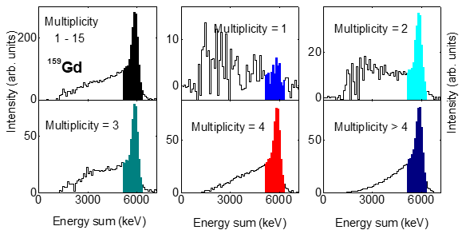
Detection systems
Traditional detection systems:
Low-efficiency detectors (usually C₆D₆) in combinations with “Total-energy deposition + Pulse-Hight Weighting Techniques” – at maximum one photon from a cascade is detected
High-efficiency detectors (BaF₂ spheres)
Other detection systems under development
(@ n_TOF – sTED, iTED)
4 C₆D₆ @ n_TOF
DANCE @ LANSCE

Slide 38
Principle of the multiplicity method
J_{capt} = 4
J_{capt} = 3
J_{capt} = 2
assuming only dipole transitions ⇒ different average multiplicity (and average energy) is expected for different ΔJ
E1 and M1 transitions have different probabilities ⇒ different average multiplicity might be expected for different parity of capturing state
If detector allows to measure multiplicity distribution (or at least average multiplicity), data could be used
⇒ high-efficiency detector needed (BaF₂ balls)
J_{GS} = 0
Example that corresponds to ⁹⁵Mo
with ground state of 5/2+

Slide 39



Principle of multiplicity method
“Prototypical” multiplicity distributions (DANCE)
¹⁴⁷Sm(n,γ)
J=3: 58.09 eV
J=4: 49.36 eV
Decomposition of yield (exp y) into two (or more) “prototypes” μ_{m} (with contributions/yields q) using a χ²-based minimization
more m than number of prototypes needed
F. Becvar et al., NIMA 647 (2011) 73–85

Slide 40

Example
F. Becvar et al., NIMA 647 (2011) 73–85

Slide 41


Examples
The decompositions were performed using m = 2–6
Previously unreported doublets near 101 eV in ¹⁶¹Dy and 53.5 eV in ¹⁶⁷Er clearly seen
In ¹⁶⁷Er a clear indication of a doublet presence comes already from the observed resonance shape
The decomposed shapes nicely agree with the shapes of the neighbor resonances
(resonance shape can be checked)
I. Knapova et al., PRC 106, 034607 (2022)

Slide 42

Examples – “imperfections”
Fluctuations lead to imperfections – presence of ghost resonances (other spin)
The standard deviation of “ratio of the area of the ghost to the total area” R
~0.12 in 167Er
~0.09 in 161Dy
In ¹⁶³Dy a couple of resonances with similar decomposed contributions for both J, and the standard deviation of R was found to be at least 0.15, but still allows spin determination for vast majority of resonances
Counts
J = 2
J = 3
doublet
doublet
E_{n} (eV)
“ghost”
Check of “ghost” sizes from simulations of γ decay (DICEBOX):
~ 0.12(2) for ¹⁶⁷Er, 0.09(2) for ¹⁶¹Dy, and 0.25(6) for ¹⁶³Dy
(agrees with experiment)

Slide 43

Example – comparison with simulations
Comparison of average experimental and simulated multiplicity distribution of ¹⁶¹Dy resonances.
Only events with sum energy between 7.6 and 8.4 MeV used to construct the individual resonance spectra, which are then normalized to their integral for m>2.
The mean and standard deviation of distributions are calculated using the maximum likelihood fit.
The larger spread of simulated values is due to the random nature of “nuclear supra-realizations”.
I. Knapova et al., PRC 106, 034607 (2022)

Slide 44

Comparison with spin dependence of “available” NLD models
Determination of resonance spins allows comparison of experimental data to predictions of spin dependence from different available NLD models
Blue corridor depicts uncertainty of the experimental ratio.
Comparison with NLD models from
TALYS1.8,
CT05 and BSFG05 is von Egidy and Bucurescu PRC72, 044311 (2005),
LD09 is von Egidy and Bucurescu PRC80, 054310 (2009).

Slide 45

Problems with the method
Unfortunately, does not work for all nuclei
the spin difference between resonances and GS small (197Au)
fluctuations in multiplicity distribution is large within the same spin in comparison to the difference within the two spins.
(q_{i}/y) or R
A check for each isotope needed – applicability is nucleus sensitive.
Such a check requires knowledge of a realistic description of γ decay.
Illustration for Au
Simulated decay of resonances using DICEBOX
The same analysis as above applied to data

Slide 46


“Modification of the method” (P.E. Koehler, PRC 105, 054306 (2022))
Even low-efficiency (C₆D₆) detectors can be used for γ multiplicity method (from capture exp.) despite their low-E_{γ} resolution if more detectors used and sufficient number of coincidences detected
Different multiplicity distribution must impact
the number of coincidence with respect to non-coincidence events,
the energy distribution of emitted photons (low-deposited energy vs high-deposited energy events)
Different ratios of these quantities can be made (optimized) – these ratios are normalized to form “indexes” (“spin indexes”, “parity indexes”)

Slide 47


“Modification of the method” (P.E. Koehler, PRC 105, 054306 (2022))
Weighted averages of the three J indexes vs weighted averages of the three π indexes for all spin J=2 and J=3 resonances with assigned firm parity.
A linear transformation was applied to the spin index so that the groups are centered at 2 and 3. Similarly, a linear transformation was applied to the parity index so that the groups were centered at -1 and 1.
Firm spin reported for many (vast majority of observed) resonances
Data from ORELA … difficult to say if one can apply this for any other existing measurement

Slide 49
(Additional) Indirect methods sensitive to NLD
Analysis of Multistep-step (or Two-step) gamma ray spectra from neutron capture (sensitive to NLD energy dependence below neutron separation energy)
Fluctuation Properties of Γ_{γ} from resonances with different spin might perhaps be used to say something about spin dependence of NLD below neutron separation energy
P.E. Koehler at al., EPJ A (2022) 58:195

