Slide 1
Linking optical potentials to resonances at lower energies
Checking the accuracy of common approximations
Ian Thompson
INDEN meeting. June 20, 2022

Slide 2
Summary
Neutrons + ¹⁴N reactions as a test case
Known levels and level densities
Going from R-matrix theory to Hauser-Feshbach models
How to check the approximation used
Try making R-matrix parameters to reproduce optical results,
at least in middle range when resonances overlap more.

Slide 3
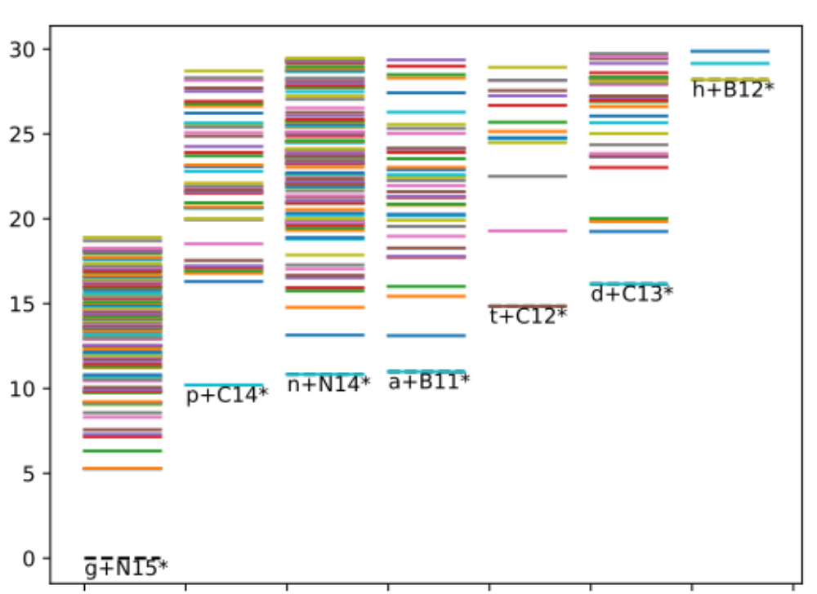
Known levels in n+N14 = N15* reactions
Known levels from RIPL3:
¹⁵N* levels for incident neutrons
n, p and α channels near.
Many gamma decays from excited states.
Needs a new
evaluation!

Slide 4
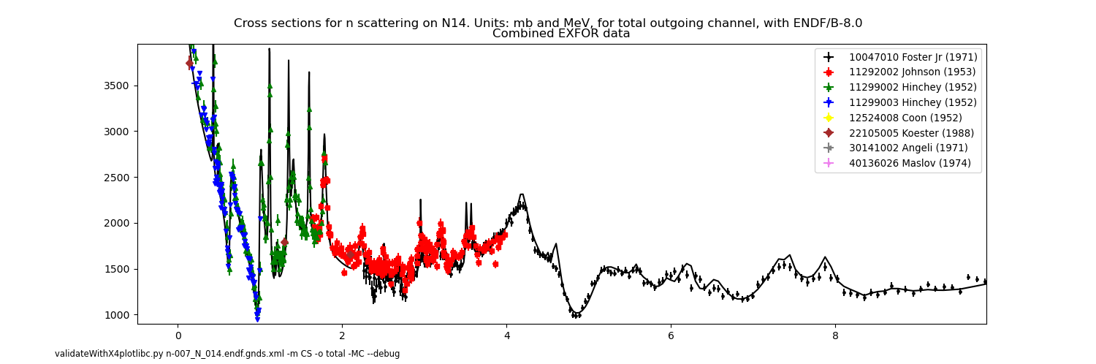
Neutron ‘total cross-section’ data from EXFOR
Line from ENDF/B-VIII.0
Pronounced resonances < 4 MeV.
Smoother > 4 MeV: unresolved resonances with higher densities
Cannot search to fit individual resonances to this data > 4 MeV.

Slide 5
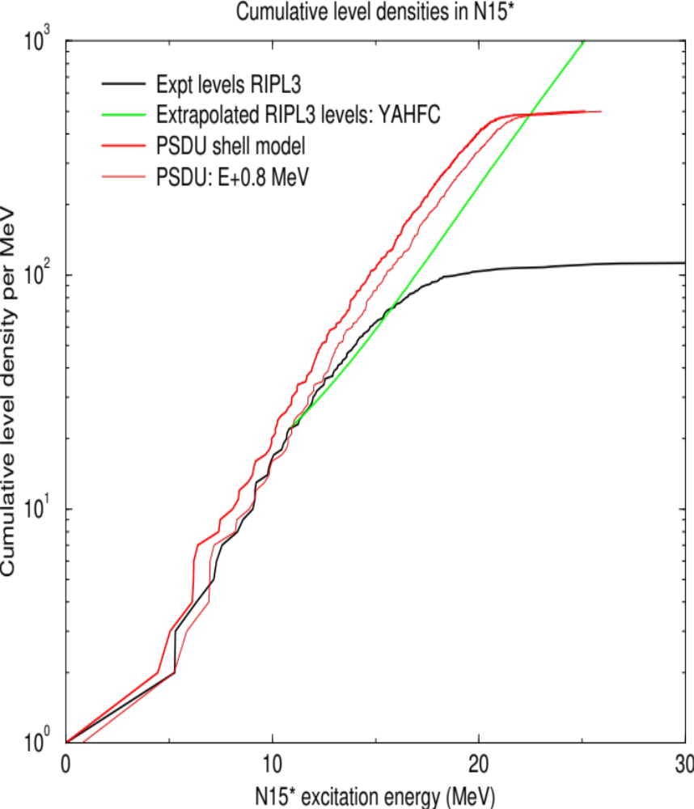
Level Densities: levels per MeV
RIPL3 levels
for N15* as on
level diagram.

Slide 6
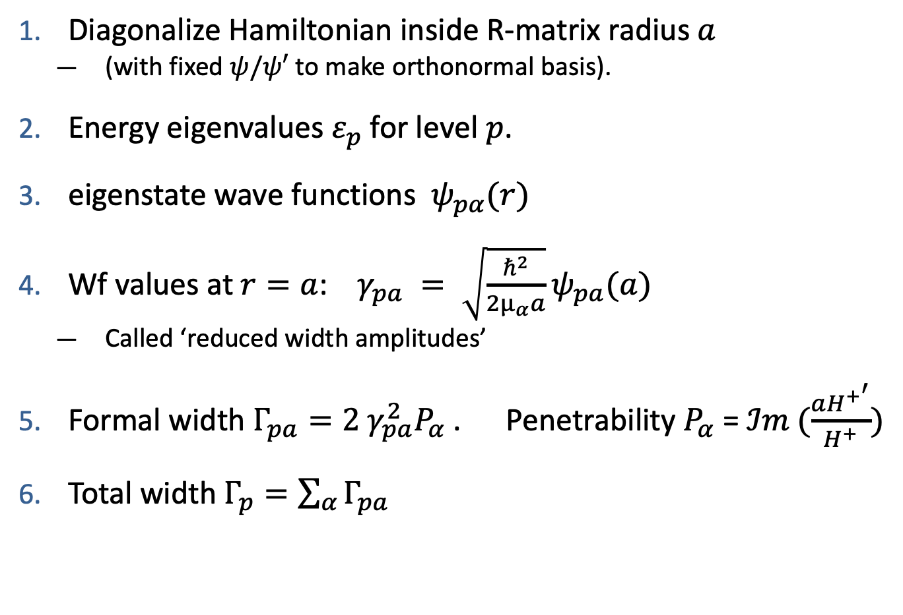
R-matrix parameters
Diagonalize Hamiltonian inside R-matrix radius $a$
  (with fixed $ψ/ψ′$ to make orthonormal basis).
Energy eigenvalues $ε_{p}$ for level $p$.
eigenstate wave functions $ψ_{pα}(r)$
Wf values at $r=a$: $γ_{pa} = \sqrt{\frac{ℏ^{2}}{2μ_{α}a}}ψ_{pa}(a)$
  Called ‘reduced width amplitudes’
Formal width $Γ_{pa}=2 γ_{pa}^{2}P_{α}$. Penetrability $P_{α}$ = $ℐm (\frac{aH^{+^{′}}}{H^{+}})$
Total width $Γ_{p}=\sum_{α}{Γ_{pa}}$

Slide 7
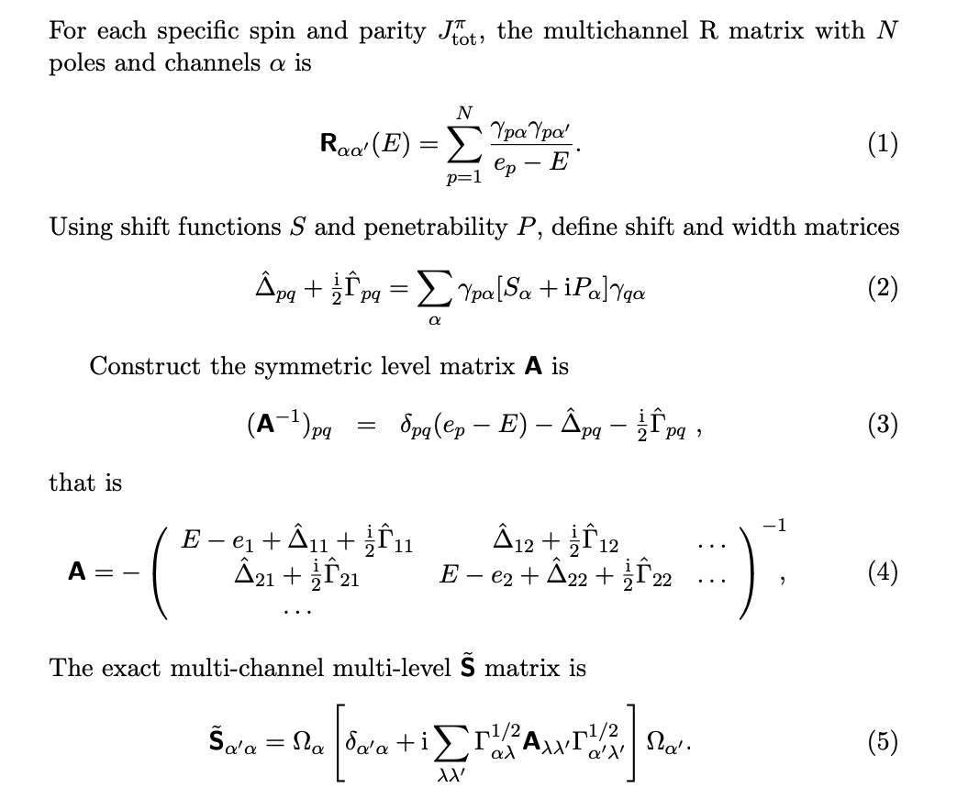
Exact R-matrix theory

Slide 8
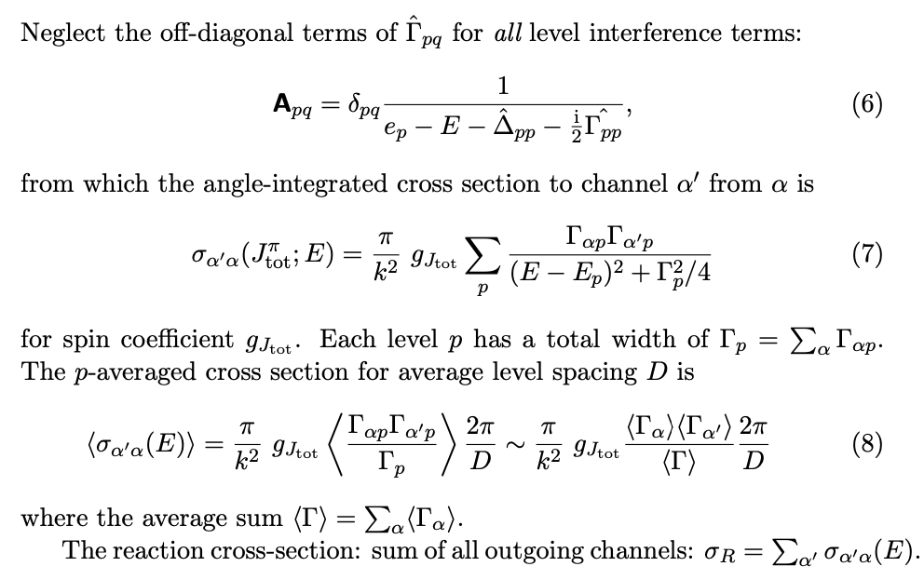
Single-level Breit-Wigner approximation (SLBW)

Slide 9
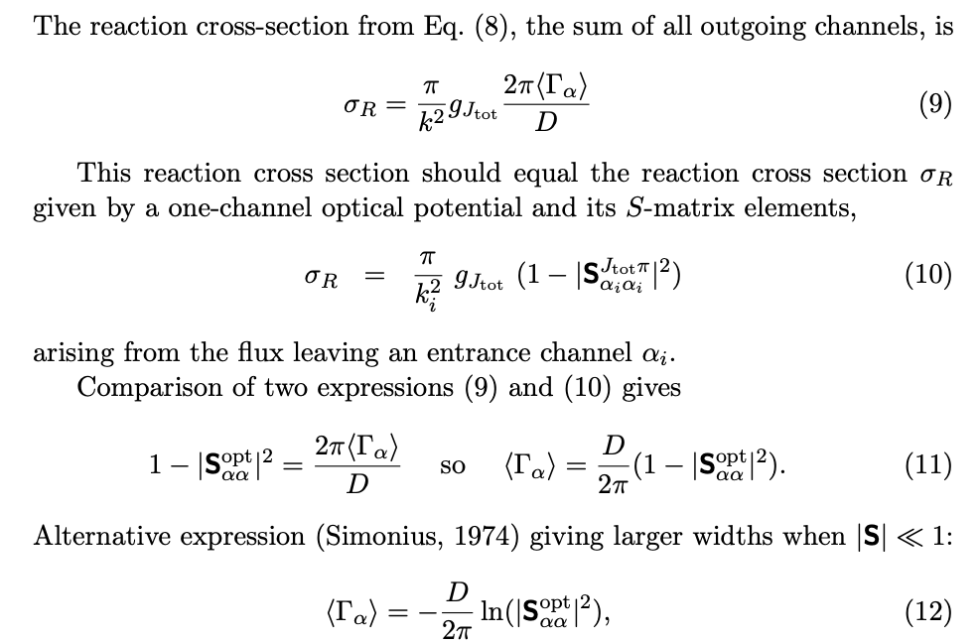
Connecting widths with optical potentials

Slide 10
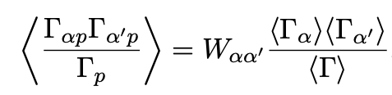
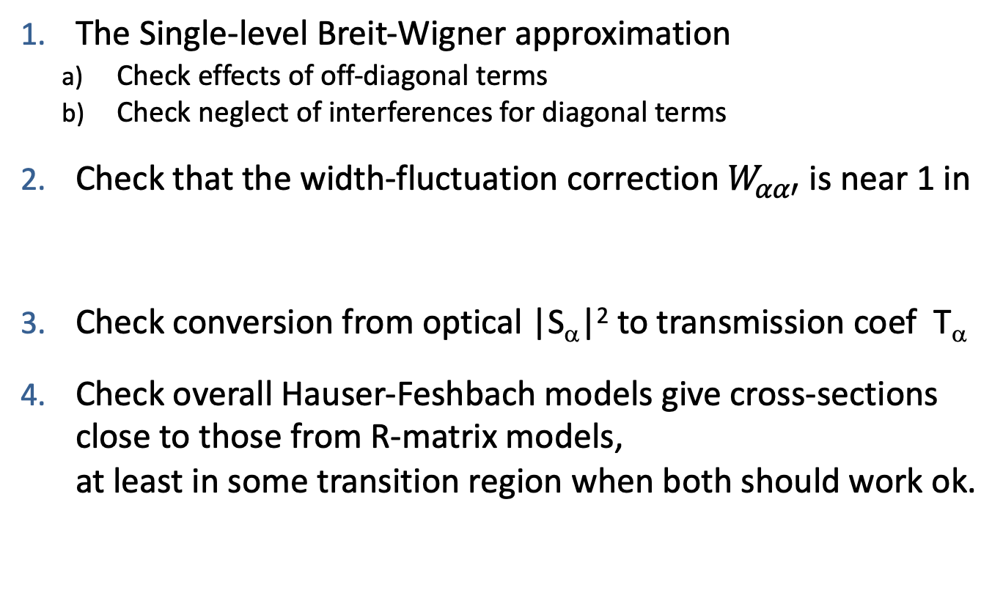
Checking the approximation used
The Single-level Breit-Wigner approximation
  Check effects of off-diagonal terms
  Check neglect of interferences for diagonal terms
Check that the width-fluctuation correction $W_{αα′}$ is near 1 in
Check conversion from optical |S_{α}|² to transmission coef T_{α}
Check overall Hauser-Feshbach models give cross-sections close to those from R-matrix models,
at least in some transition region when both should work ok.

Slide 11
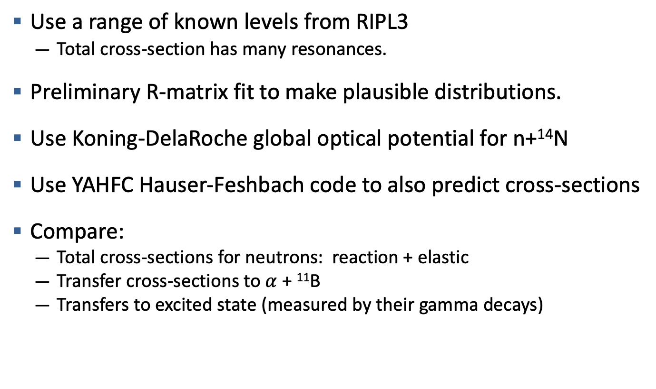
First: Compare R-matrix with HF cross-sections
Use a range of known levels from RIPL3
  Total cross-section has many resonances.
Preliminary R-matrix fit to make plausible distributions.
Use Koning-DelaRoche global optical potential for n+¹⁴N
Use YAHFC Hauser-Feshbach code to also predict cross-sections
Compare:
  Total cross-sections for neutrons: reaction + elastic
  Transfer cross-sections to $α$ + ¹¹B
  Transfers to excited state (measured by their gamma decays)

Slide 12
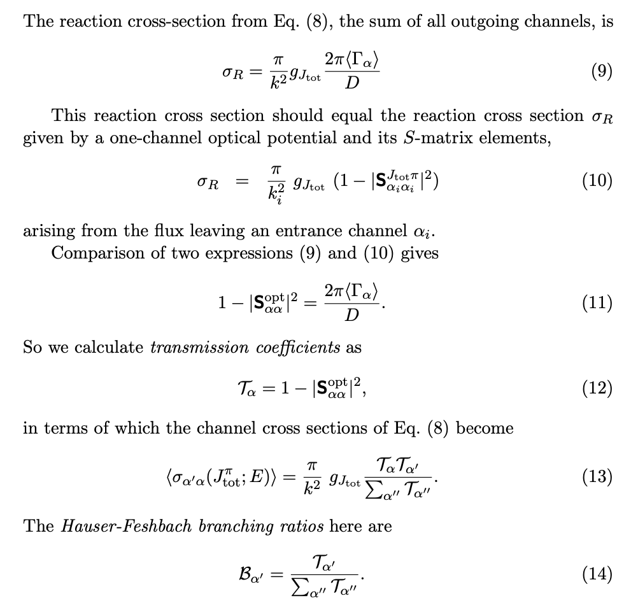
Hauser-Feshbach models

Slide 13
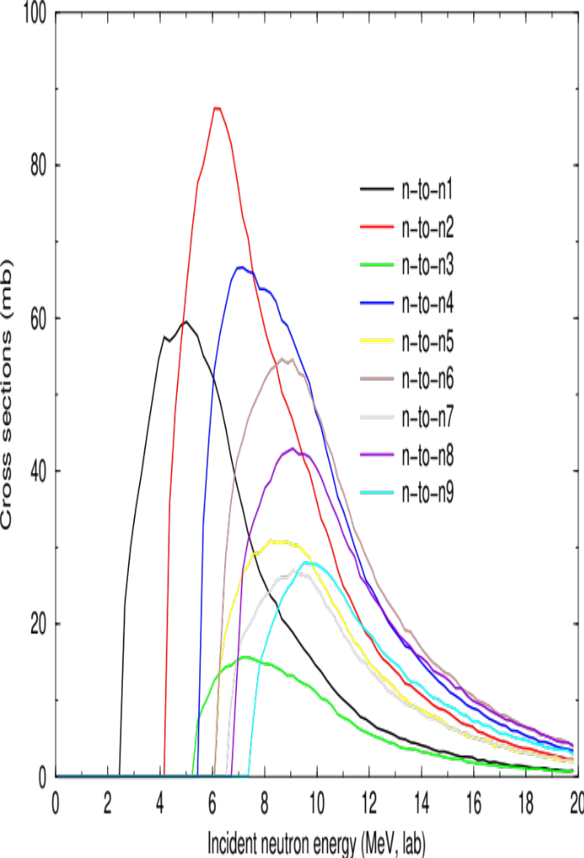
Hauser-Feshbach cross-sections (smooth!)
Inelastic (n,n’)
At higher energies even more inelastic channels.
Fusion neutrons
at 14 MeV will
require all these
inelastic channels
and more !

Slide 14
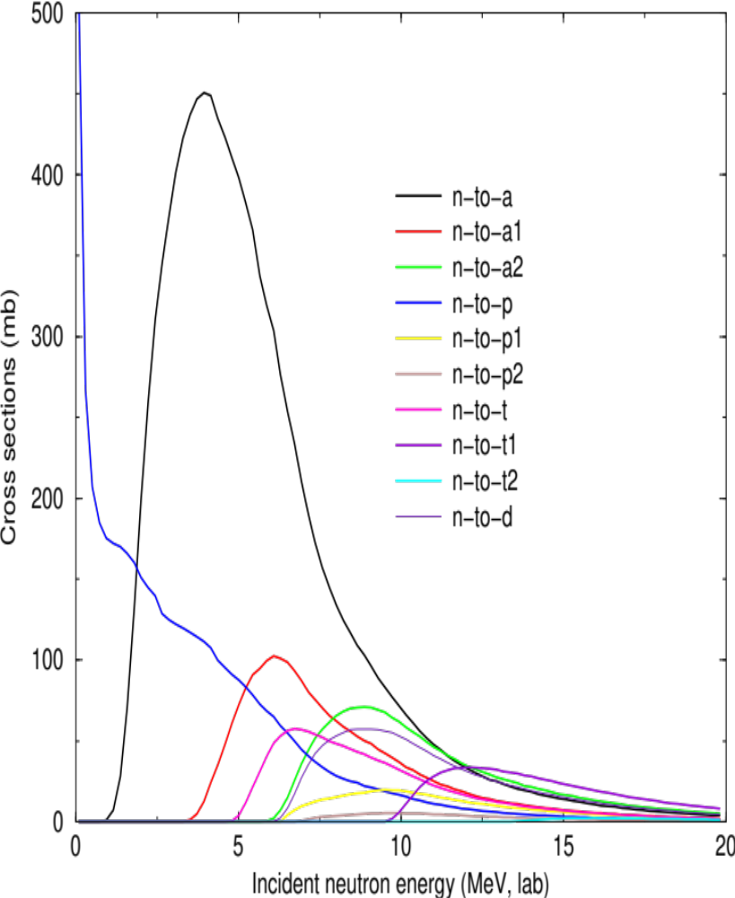
Hauser-Feshbach transfer cross-sections
Transfers
(n,a), (n,p), (n,t), (n,d)
Many larger than
(n,n’)
Fusion neutrons
at 14 MeV will
require all these
transfer channels
and more !

Slide 15
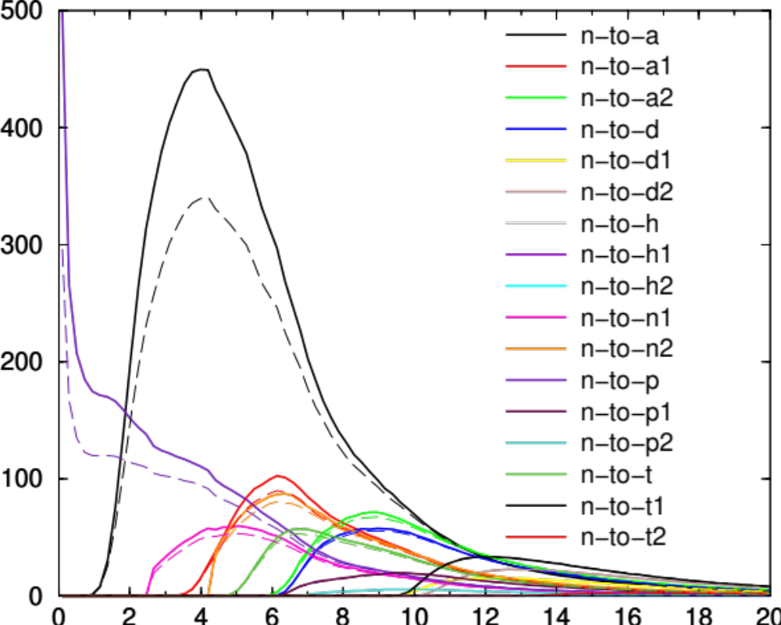
Hauser-Feshbach width-fluctuation corrections
Dashed lines use WFC from Moldauer PRC (1976), NPA (1980).
For neutrons, usually supposed to be small above 1 MeV, but here we see effects up to 9 MeV.
Use WFC calculated factor in YAHFC

Slide 16


Generate R-matrix poles from optical potential and level densities
Start from optical potential for projectiles n, p, α (etc)
Choose which nuclear excited states to include (x1, x4, … , x12)
Use a level-density to generate spacings D up to 12 MeV.
Find partial widths by A:
Or by method B::
Or Ap, Bp: reduced width amplitudes have gaussian fluctuations
Generate discrete levels with above statistics (like Dicebox)
Find exact cross-sections from R-matrix theory
Compare with HF results after smoothing (e.g. 1 MeV Gaussian)

Slide 17
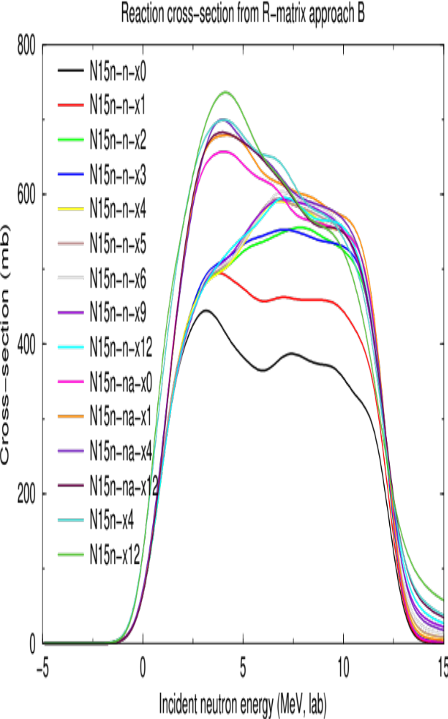
Reaction cross-sections from R-matrix method B
N15n-x is
n + α + p + d + t
Curves larger
as more excited
levels included.
Seems to converge
R-matrix poles
only to 12 MeV

Slide 18
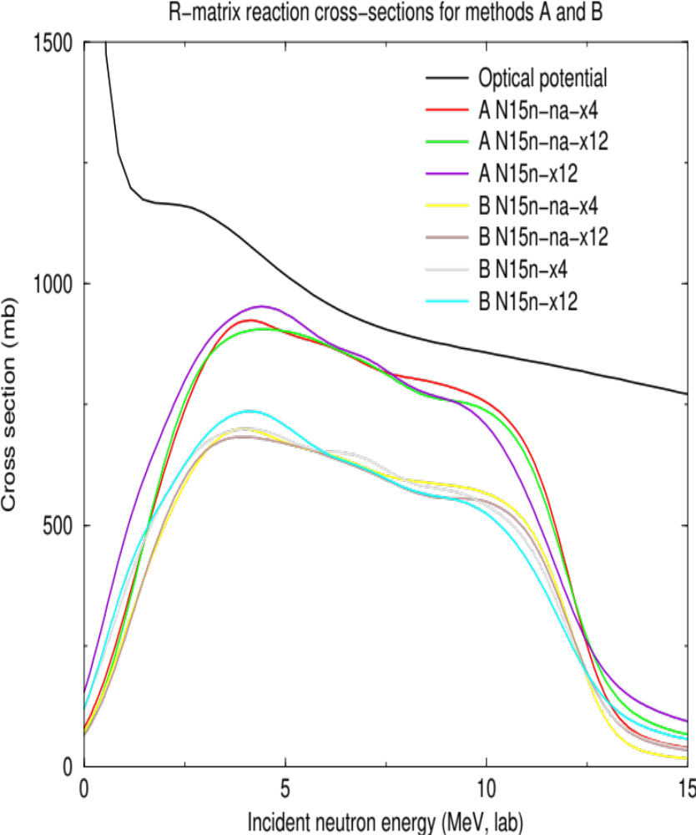
Comparing width methods A and B
R-matrix A method: γ magnitude normal N(0,mean): Porter-T.
R-matrix B method: γ magnitude fixed to mean,
sign random
Method A gives reaction cross section nearest to that of
the optical potential.
But strange short-coming
at low energies.
May be compound-elastic.
R-matrix poles only to 12 MeV

Slide 19
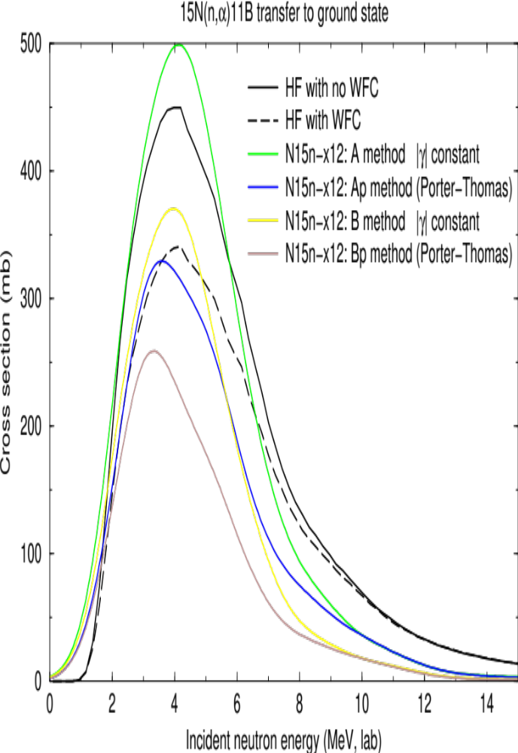
Channel Comparisons: HF and full R-matrix (A,B)
- (n,α) channel
Most accurate
are expected to be
HF+WFC and
Ap methods.
These two (blue and
black-dashed) agree
the best, at least
up to ~ 5 MeV.
R-matrix A method:
γ magnitude normal
N(0,mean): Porter-T.
R-matrix B method:
γ magnitude fixed
to mean, sign random

Slide 20
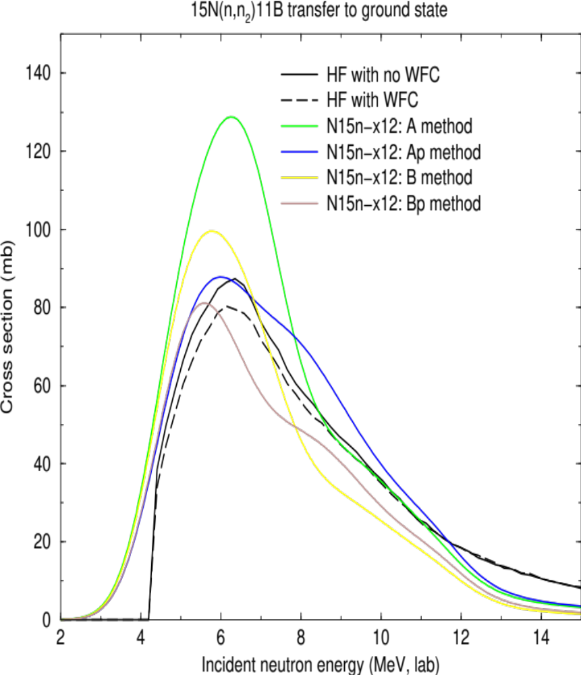
Channel Comparisons: HF and full R-matrix (A,B)
- (n,n₂) channel
Most accurate
are expected to be
HF+WFC and
Ap methods.
HF and Ap methods
(blue and black) agree the best, at least up to ~ 7 MeV.
WFC does not have
large effects here.

Slide 21
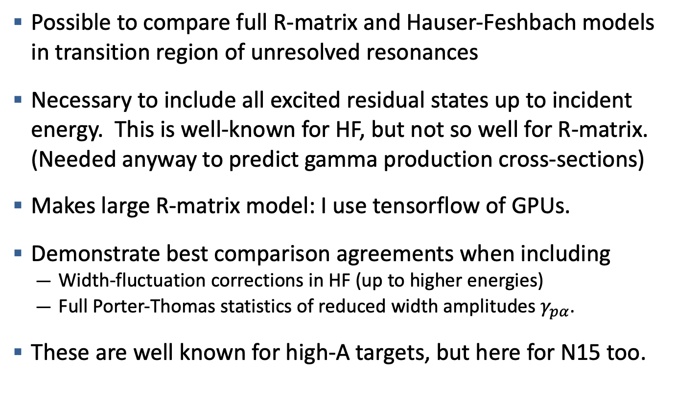
Summary
Possible to compare full R-matrix and Hauser-Feshbach models in transition region of unresolved resonances
Necessary to include all excited residual states up to incident energy. This is well-known for HF, but not so well for R-matrix. (Needed anyway to predict gamma production cross-sections)
Makes large R-matrix model: I use tensorflow of GPUs.
Demonstrate best comparison agreements when including
  Width-fluctuation corrections in HF (up to higher energies)
  Full Porter-Thomas statistics of reduced width amplitudes $γ_{pα}$.
These are well known for high-A targets, but here for N15 too.

Slide 22
Disclaimer
This document was prepared as an account of work sponsored by an agency of the United States government. Neither the United States government nor Lawrence Livermore National Security, LLC, nor any of their employees makes any warranty, expressed or implied, or assumes any legal liability or responsibility for the accuracy, completeness, or usefulness of any information, apparatus, product, or process disclosed, or represents that its use would not infringe privately owned rights. Reference herein to any specific commercial product, process, or service by trade name, trademark, manufacturer, or otherwise does not necessarily constitute or imply its endorsement, recommendation, or favoring by the United States government or Lawrence Livermore National Security, LLC. The views and opinions of authors expressed herein do not necessarily state or reflect those of the United States government or Lawrence Livermore National Security, LLC, and shall not be used for advertising or product endorsement purposes.

