Slide 1
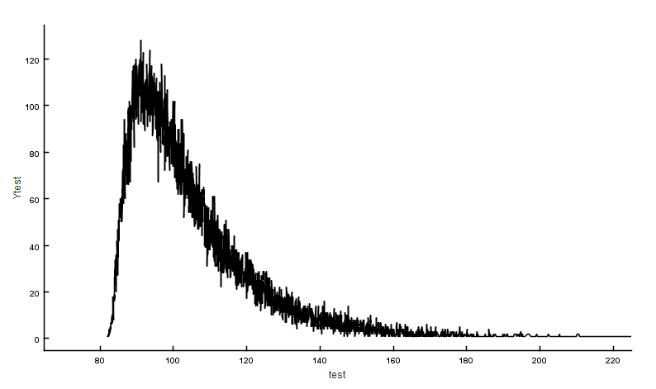
Calculation of Transition Strength: decision needed what is the final VALUE of B(XL)?
Java-RULER has been compared with UncTools by Tibor and tested by Filip for the Monte-Carlo approach for error-propagation; two codes give consistent results but decision is needed on the final value to be adopted: Centroid or Median of the probability distribution function (PDF) of B(XL)
Centroid: directly computed from centroid values of input parameters
Median: value at 50% of the cumulative distribution function (CDF) of B(XL)
Centroid and Median of the final PDF are nearly identical when uncertainties of input parameters are small and symmetric, but could be different otherwise.
Other options: mean value, average value of all trials
mode value, determined at the peak of the PDF
Centroid
Median

Slide 2
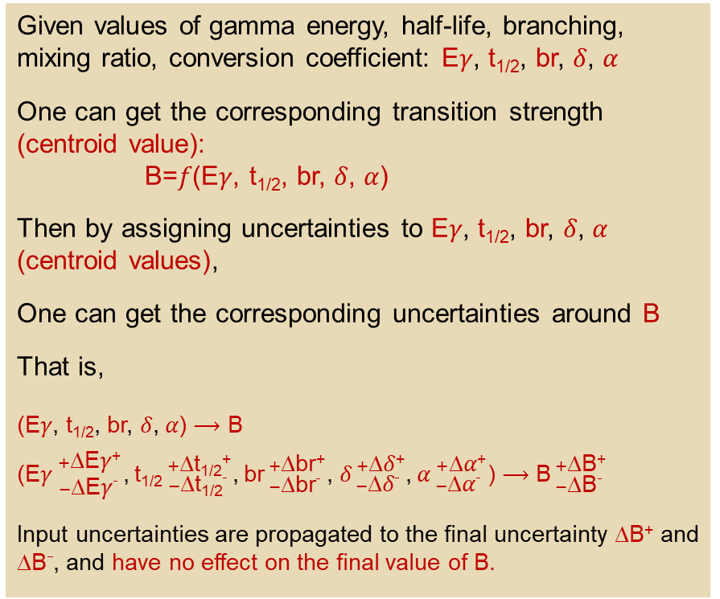
Calculation of Transition Strength: decision needed what is the final VALUE of B(XL)?
Centroid value point of view
Median value point of view
Given values of gamma energy, half-life, branching, mixing ratio, conversion coefficient: E𝛾, t_{1/2}, br, 𝛿, 𝛼
One can get the corresponding transition strength (centroid value):
B=𝑓(E𝛾, t_{1/2}, br, 𝛿, 𝛼)
Then by assigning uncertainties to E𝛾, t_{1/2}, br, 𝛿, 𝛼 (centroid values),
One can get the corresponding uncertainties around B
That is,
(E𝛾, t_{1/2}, br, 𝛿, 𝛼) ⟶ B
(${\text{E}\text{γ}}_{ −\text{∆}\text{E}\text{γ}_}^{ +\text{∆}\text{E}\text{γ}\text{+}}$,${\text{t}\text{1/2}}_{ −\text{∆}\text{t}\text{1/2}_}^{ +\text{∆}\text{t}\text{1/2}\text{+}}$,${ \text{br}}_{ −\text{∆}\text{br}_}^{ +\text{∆}\text{br}\text{+}}$, ${\text{δ}}_{ −\text{∆}\text{δ}_}^{ +\text{∆}\text{δ}\text{+}}$,${ \text{α}}_{ −\text{∆}\text{α}_}^{ +\text{∆}\text{α}\text{+}}$) ⟶ ${\text{B}}_{ −\text{∆}\text{B}_}^{ +\text{∆}\text{B}\text{+}}$
Input uncertainties are propagated to the final uncertainty ∆B⁺ and $\text{∆}\text{B}_$, and have no effect on the final value of B.
Given probability density functions (PDF) of gamma energy, half-life, branching, mixing ratio, conversion coefficient: f(E𝛾), f(t_{1/2}), f(br), f(𝛿), f(𝛼)
One can get the corresponding PDF of transition strength f(B) using Monte-Carlo sampling.
The final value of B is the median determined at 50% of the cumulative distribution function (CDF).
In most cases, f(B) is asymmetric due to asymmetric input PDFs or large input uncertainties, meaning median value could be different from centoid value, that is,
median B ≠ 𝑓(E𝛾, t_{1/2}, br, 𝛿, 𝛼)=centroid B
PDF
Uncertainty is determined as the difference between the choice of the “VALUE” and each bound (lower at 16% and upper at 84%) of the CDF
Other options: mean value, average value of all trials
mode value, determined at the peak of the PDF

