Slide 1
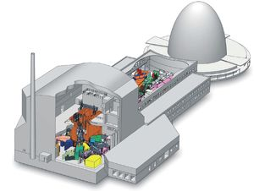
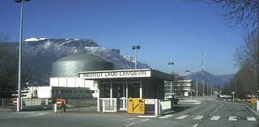
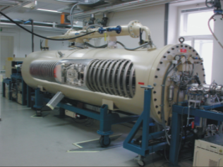
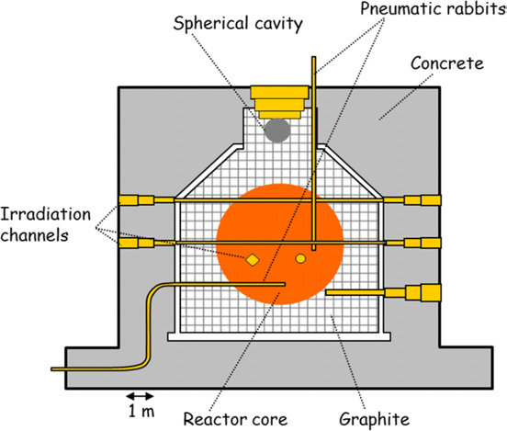
U-235, U-238 neutron capture at thermal and sub-thermal neutron energies
Anton Wallner
The Australian National University (ANU)
Helmholtz Center Dresden-Rossendorf
(HZDR)
in collaboration with:
VERA (Vienna): P. Steier, A. Priller, K. Hain
HZDR (Dresden): S. Fichter
ANU (Canberra): M. Froehlich
IRMM JRC / Geel: P. Schillebeeckx, S. Pomme, A. Plompen et al.
IAEA / Vienna: R. Capote , A. Trkov
BR-1, Mol, Belgium: J. Wagemans et al.
ILL, Grenoble, France: U. Koester, T. Soeldner, T. Jenke, S. Roccia
FRM-2, Munich, Germany: Z. Revay, Ch. Stieghorst

Slide 2
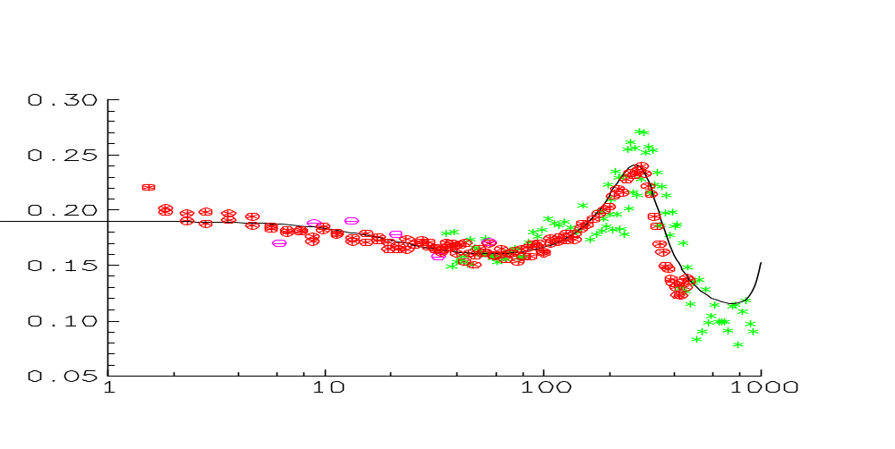
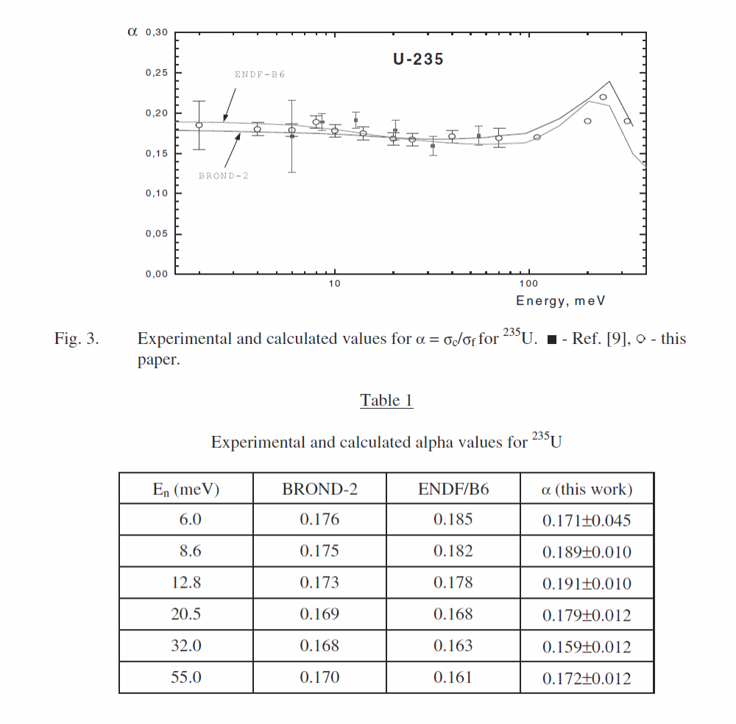
α–ratio = ratio capture to fission for ²³⁵U
Weigmann
Brooks
Gregoriev
ENDF
α (σ_{c}/σ_{f})
neutron energy (meV)
Grigoriev et al. 2000
Weigmann et al. 1990

Slide 3
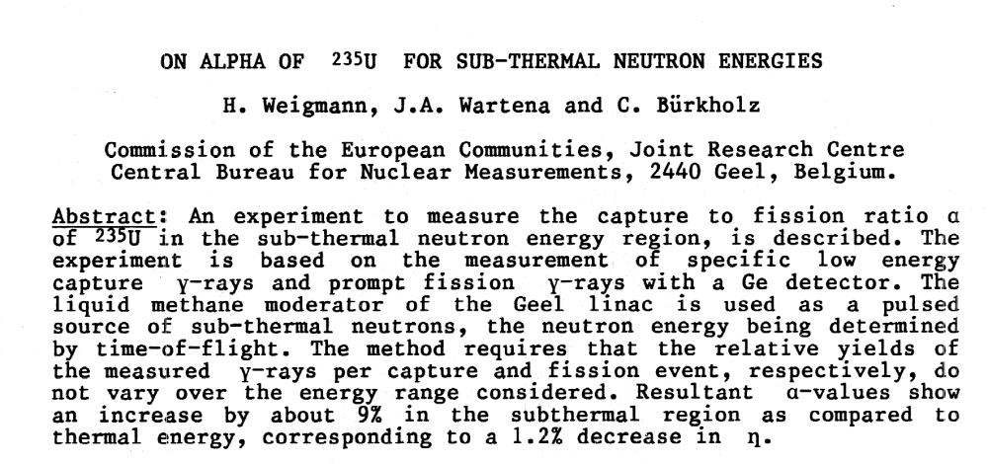
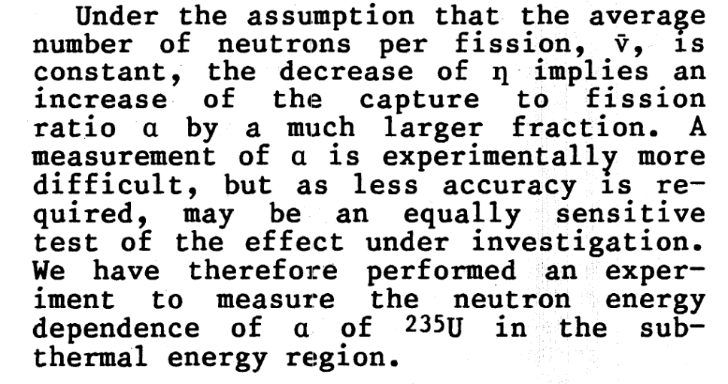
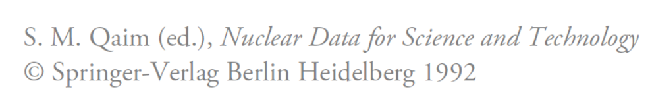

Slide 4
Energy-dependence in the sub-eV range
thermal
1/v dependence → linear function vs logE_{n}

Slide 5
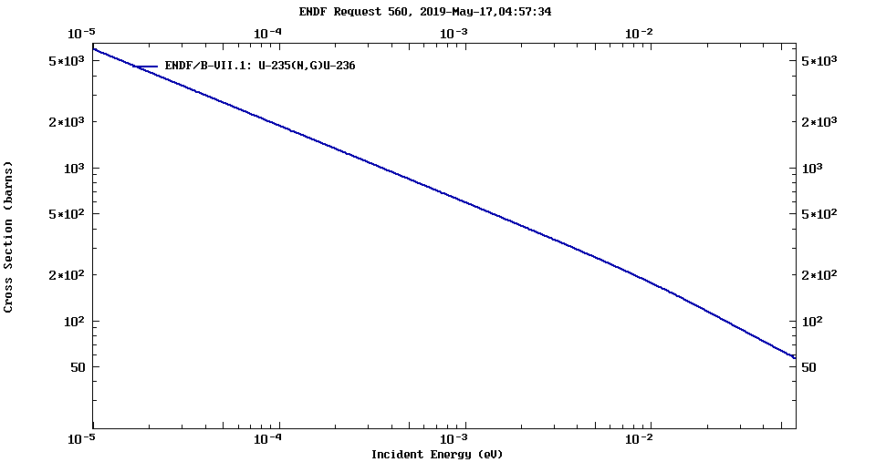
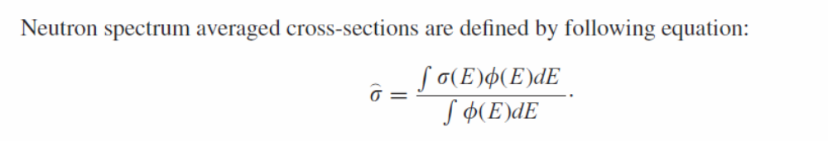
New activations for ²³⁵U(n,γ)
cold
2.5 Å – ILL
13 meV
thermal
very cold
10 Å – ILL
0.82 meV
40 Å – ILL
0.05 meV
6.7 Å – FRM-2
1.83 meV
4 Å – BNC
5 meV
1.8 Å – BR-1
25 meV

Slide 6
New activations for ²³⁵U(n,γ)
Weigmann
Brooks
Gregoriev
ENDF
α (σ_{c}/σ_{f})
cold
2.5 Å – ILL
13 meV
thermal
very cold
10 Å – ILL
0.82 meV
40 Å – ILL
0.05 meV
6.7 Å – FRM-2
1.83 meV
4 Å – BNC
5 meV
1.8 Å – BR-1
25 meV

Slide 7
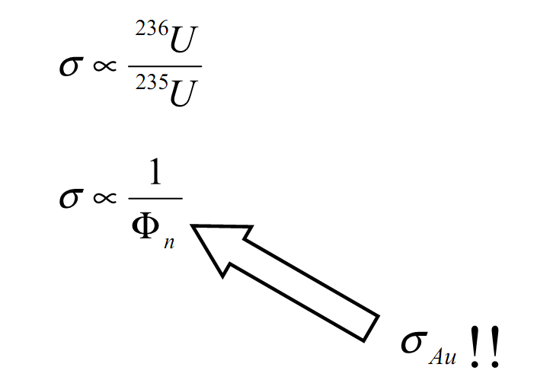
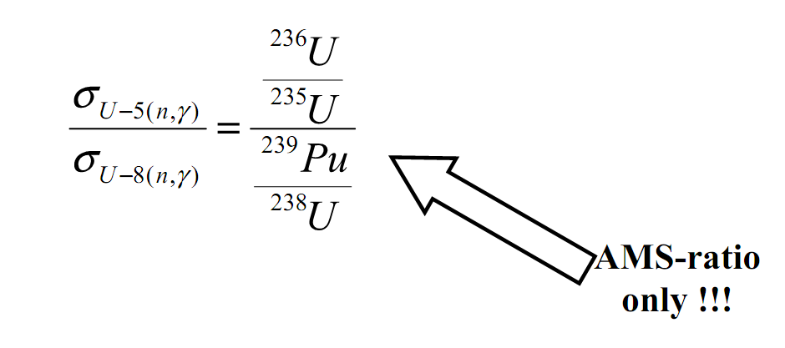
²³⁵U(n,γ)

Slide 8
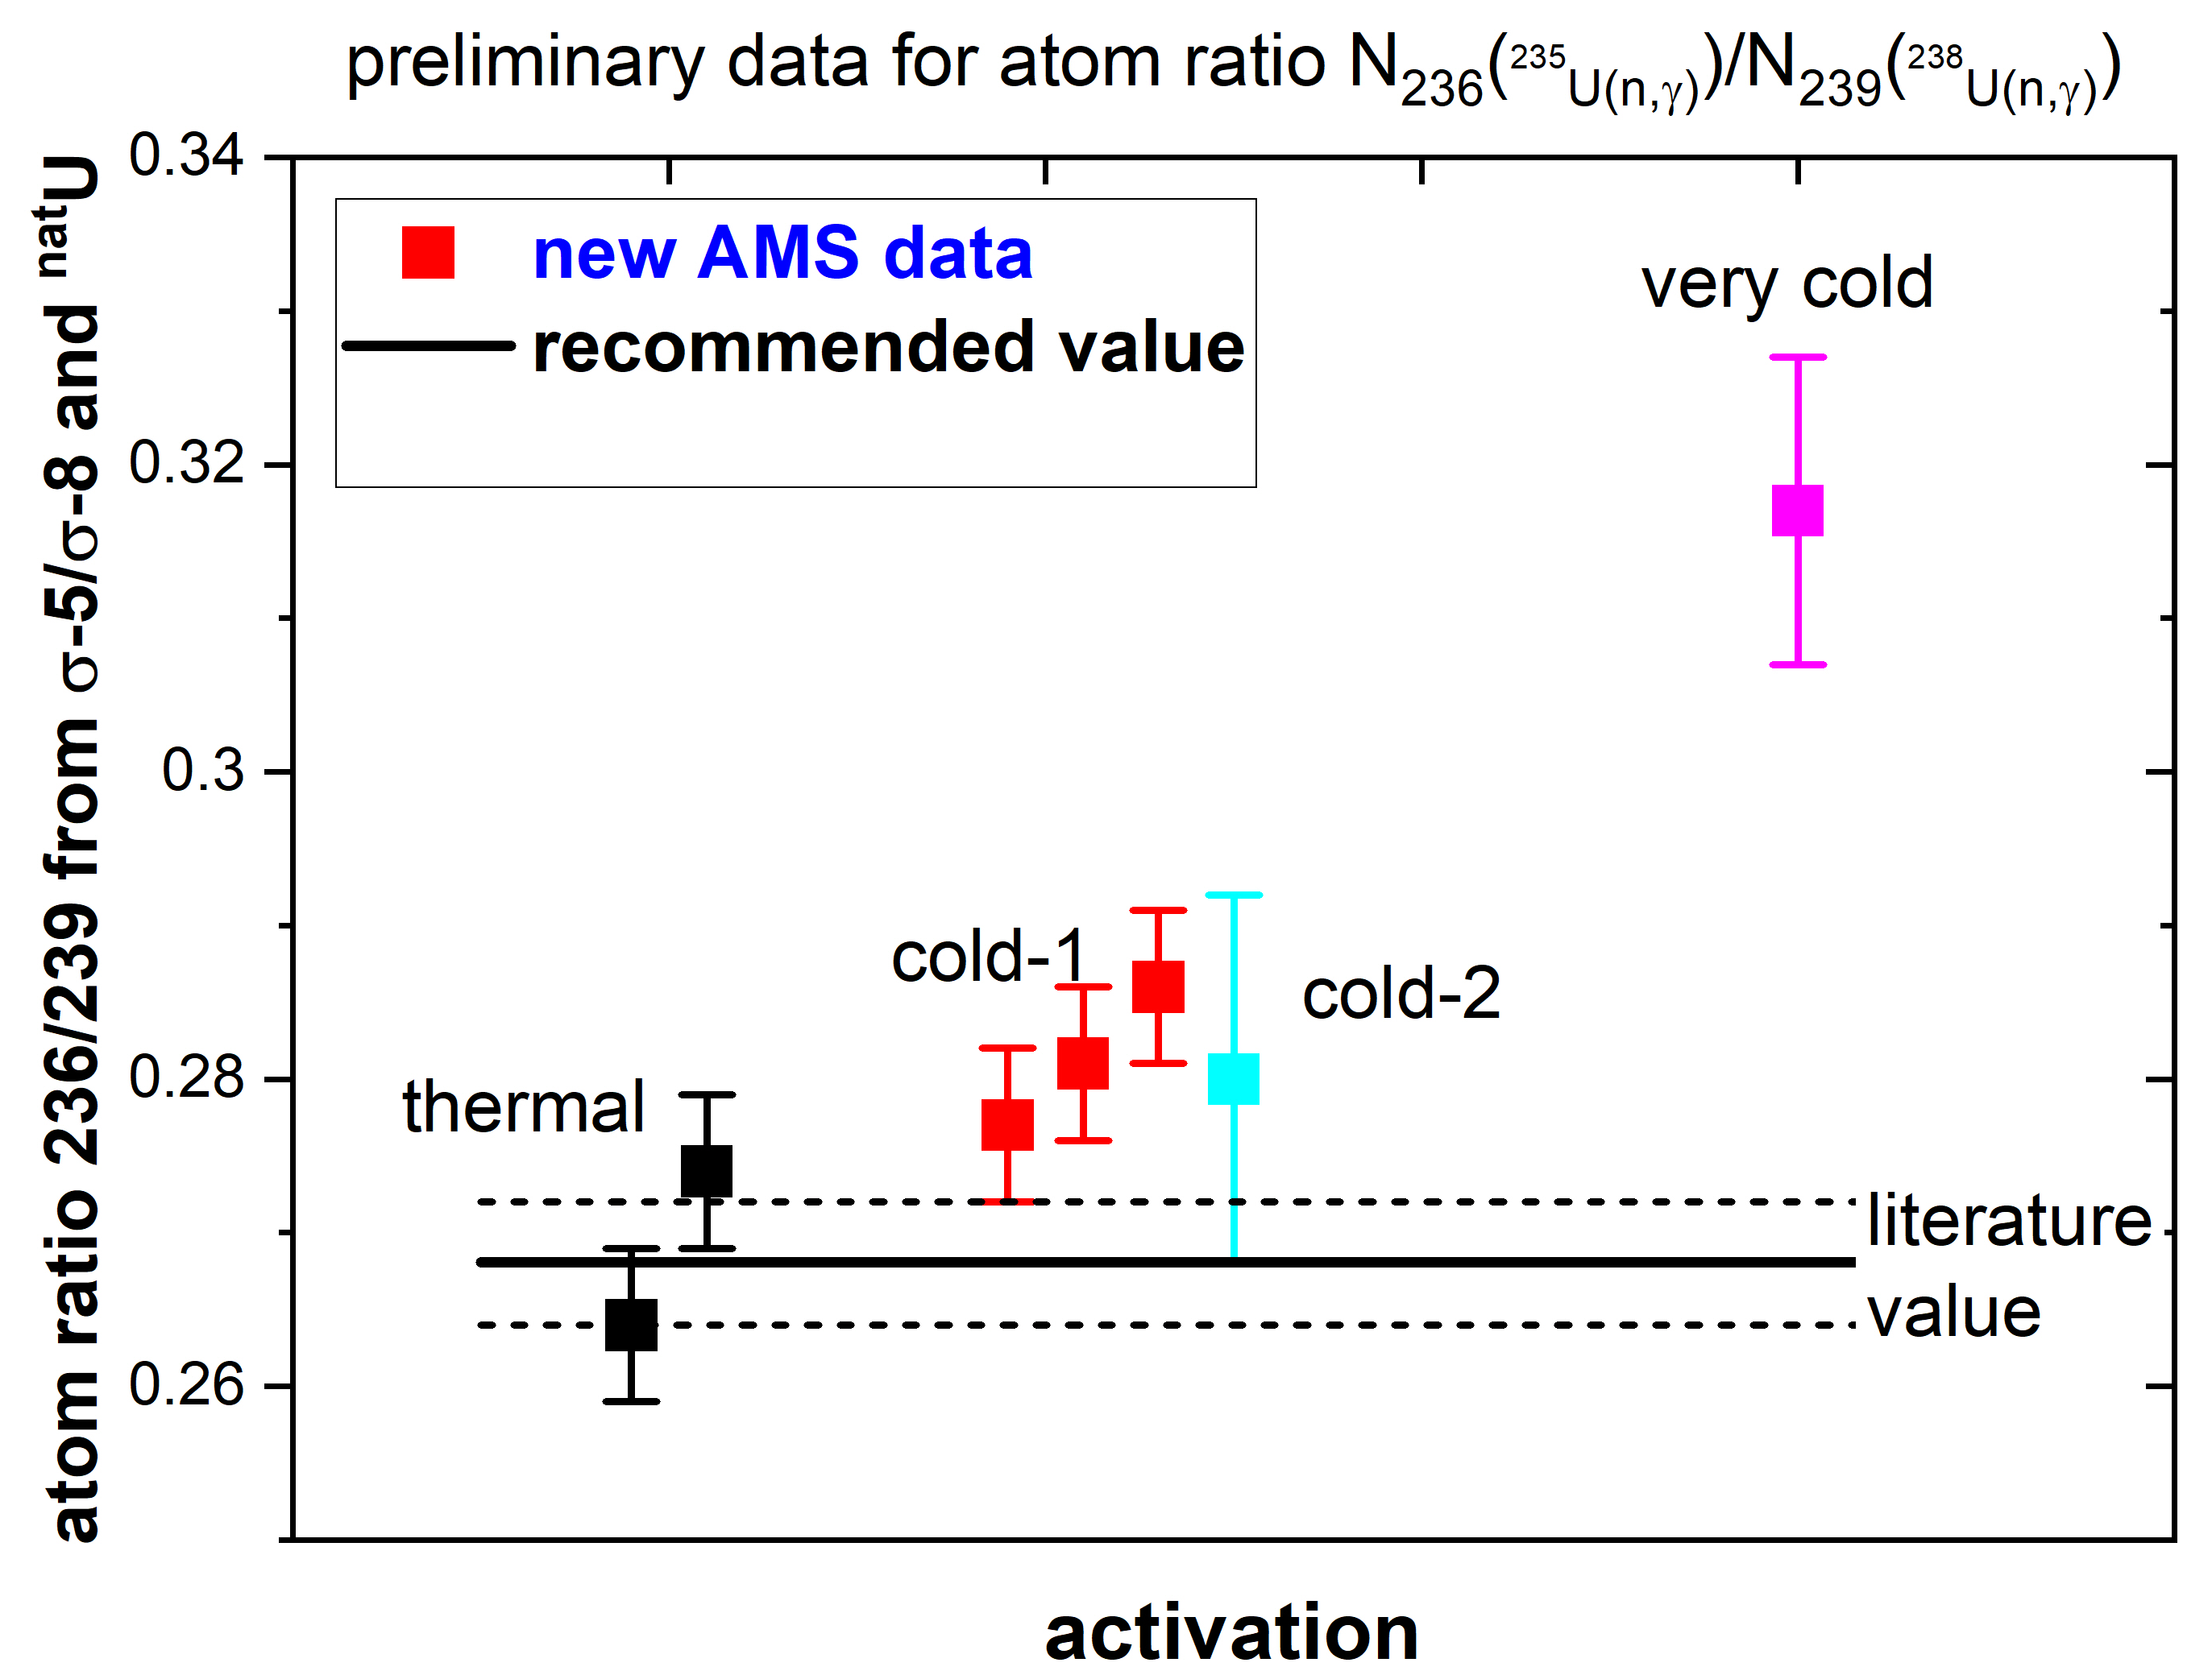
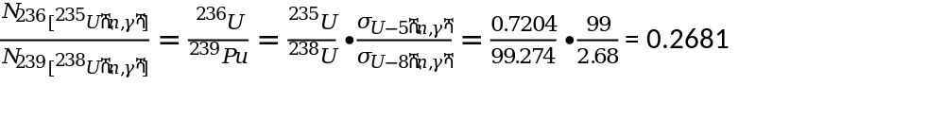
²³⁶U/ ²³⁹Pu atom ratios - preliminary
preliminary – BR-1 = thermal:
²³⁵U(n,γ): 97.4 ± ~2 barn – rel. to Au
²³⁵U(n,γ): 99.8 ± ~2 barn – rel. to ²³⁸U(n,γ)

Slide 9
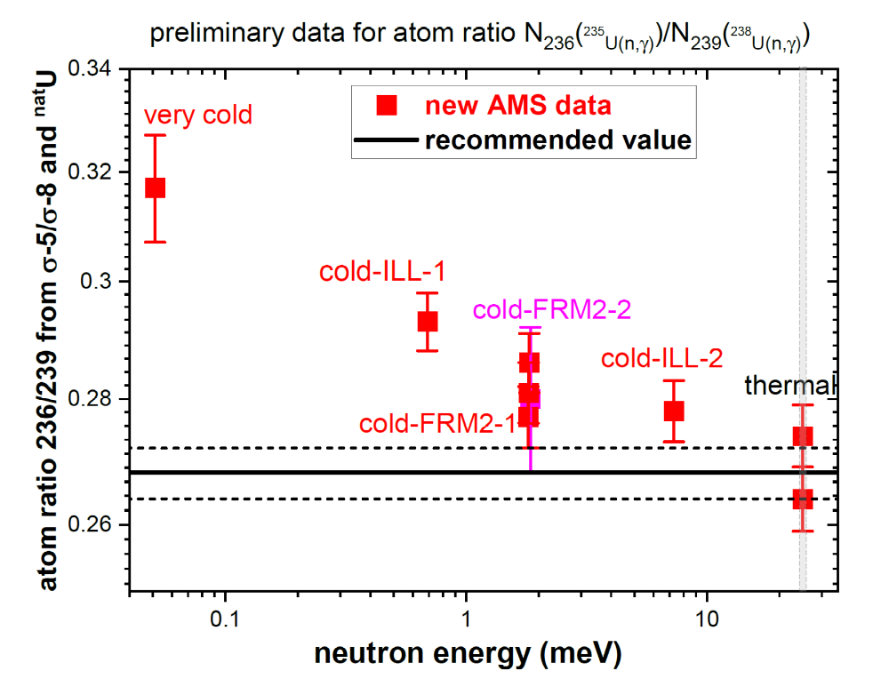
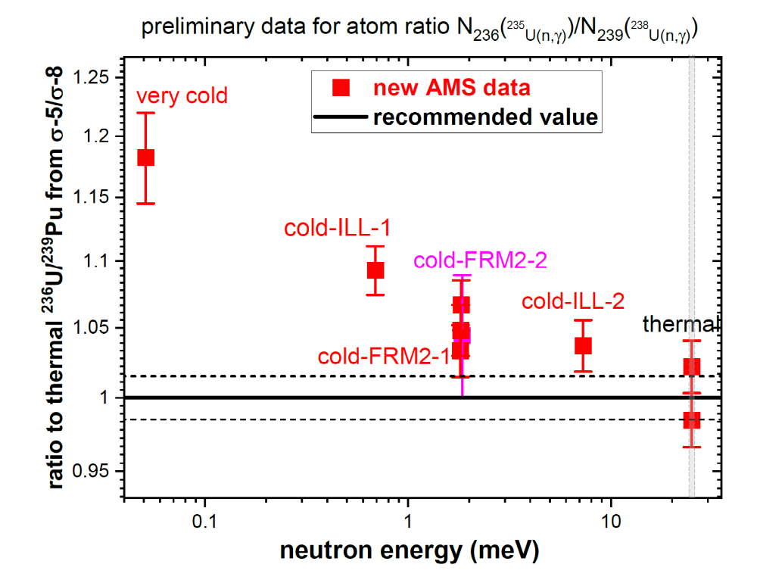
²³⁶U/ ²³⁹Pu atom ratios - preliminary
α-ratio (capture / Fission):
²³⁵U(n,γ)/ ²³⁵U(n,f): 99.8 / 587.3 barn = 0.1699 (± ~2%)

Slide 10
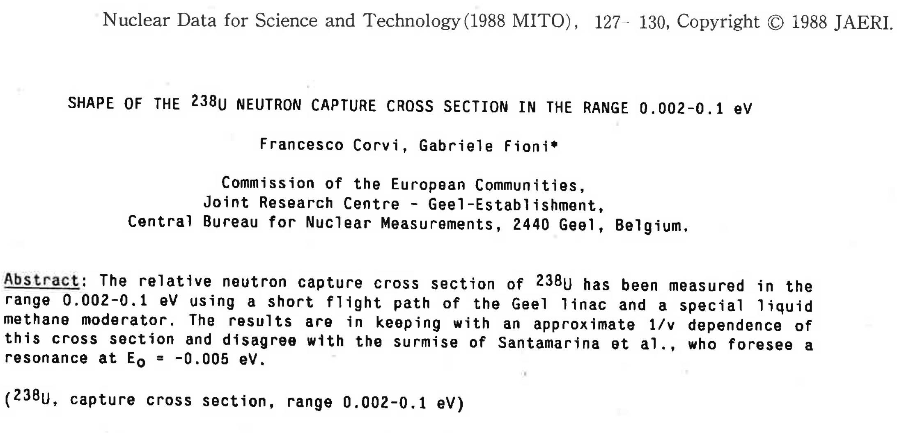
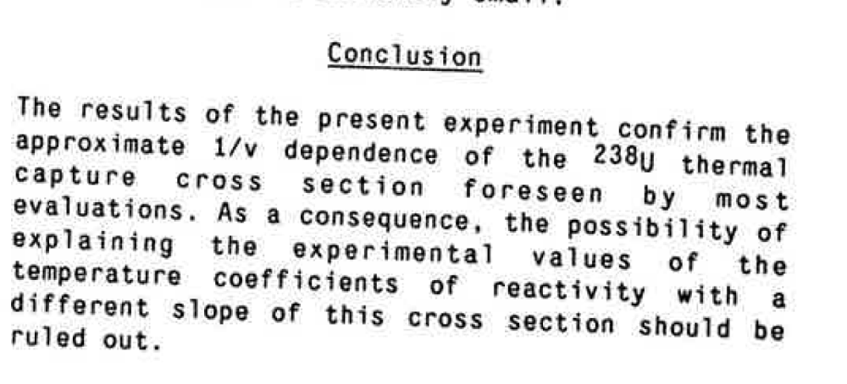

Slide 11
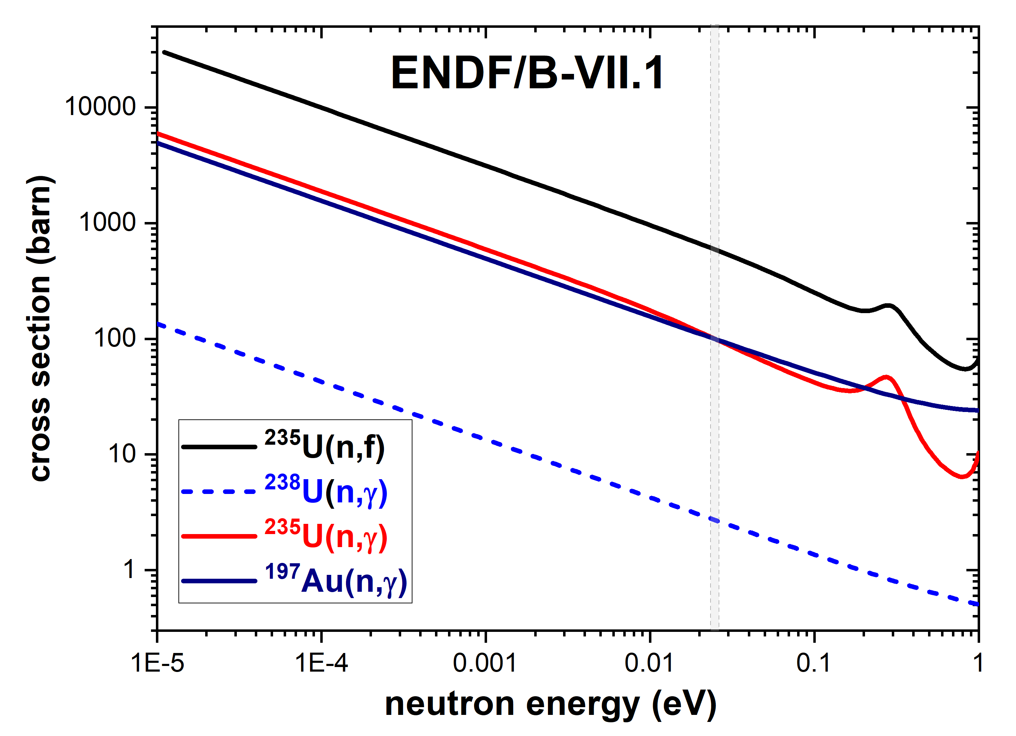
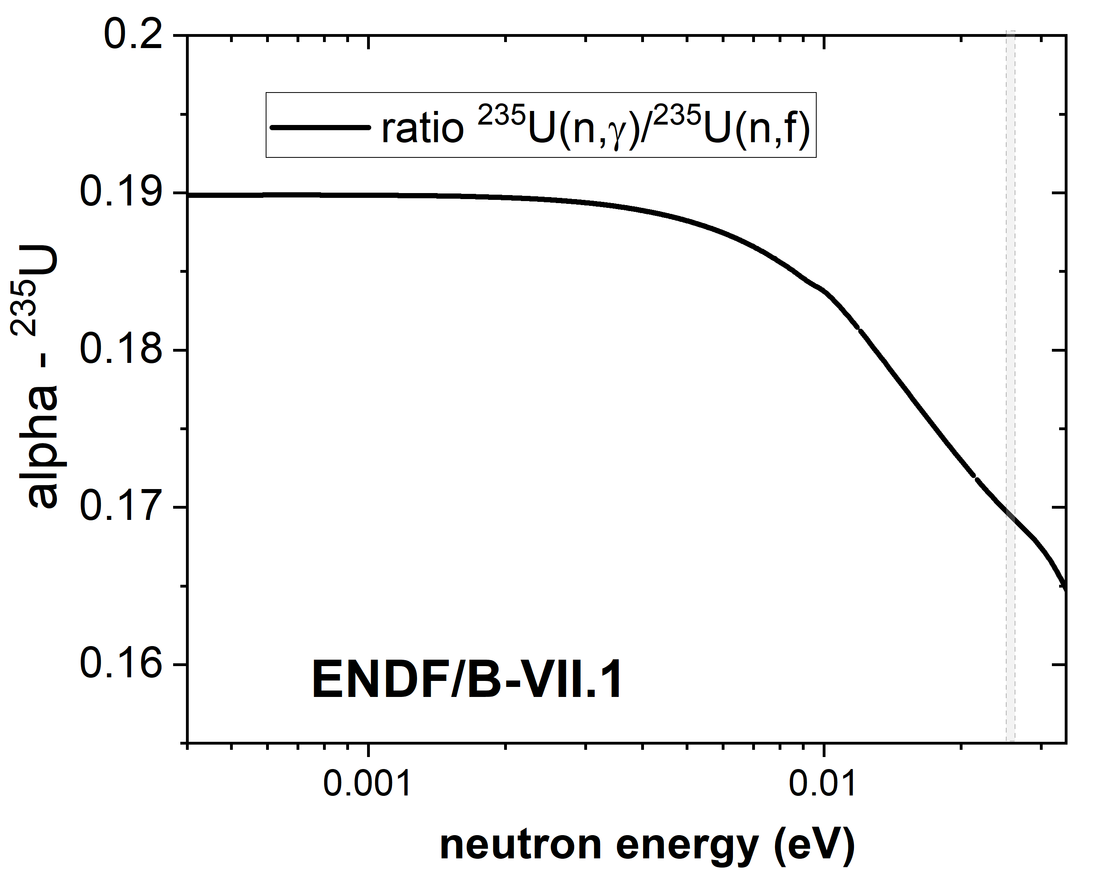
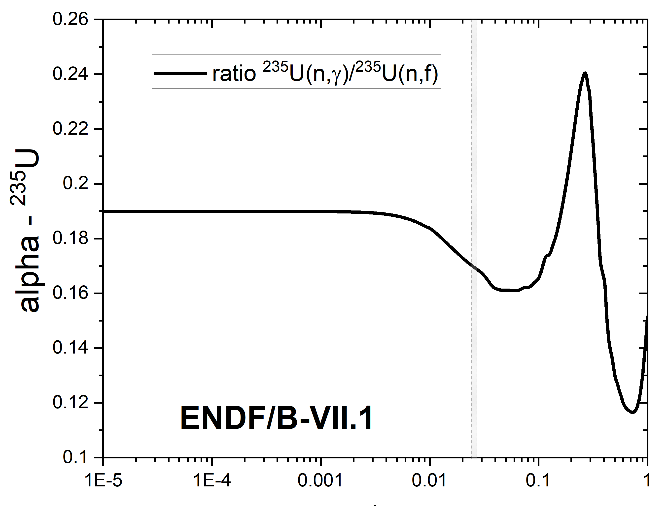
Libraries: ENDF/B-VII.1 as example

Slide 12
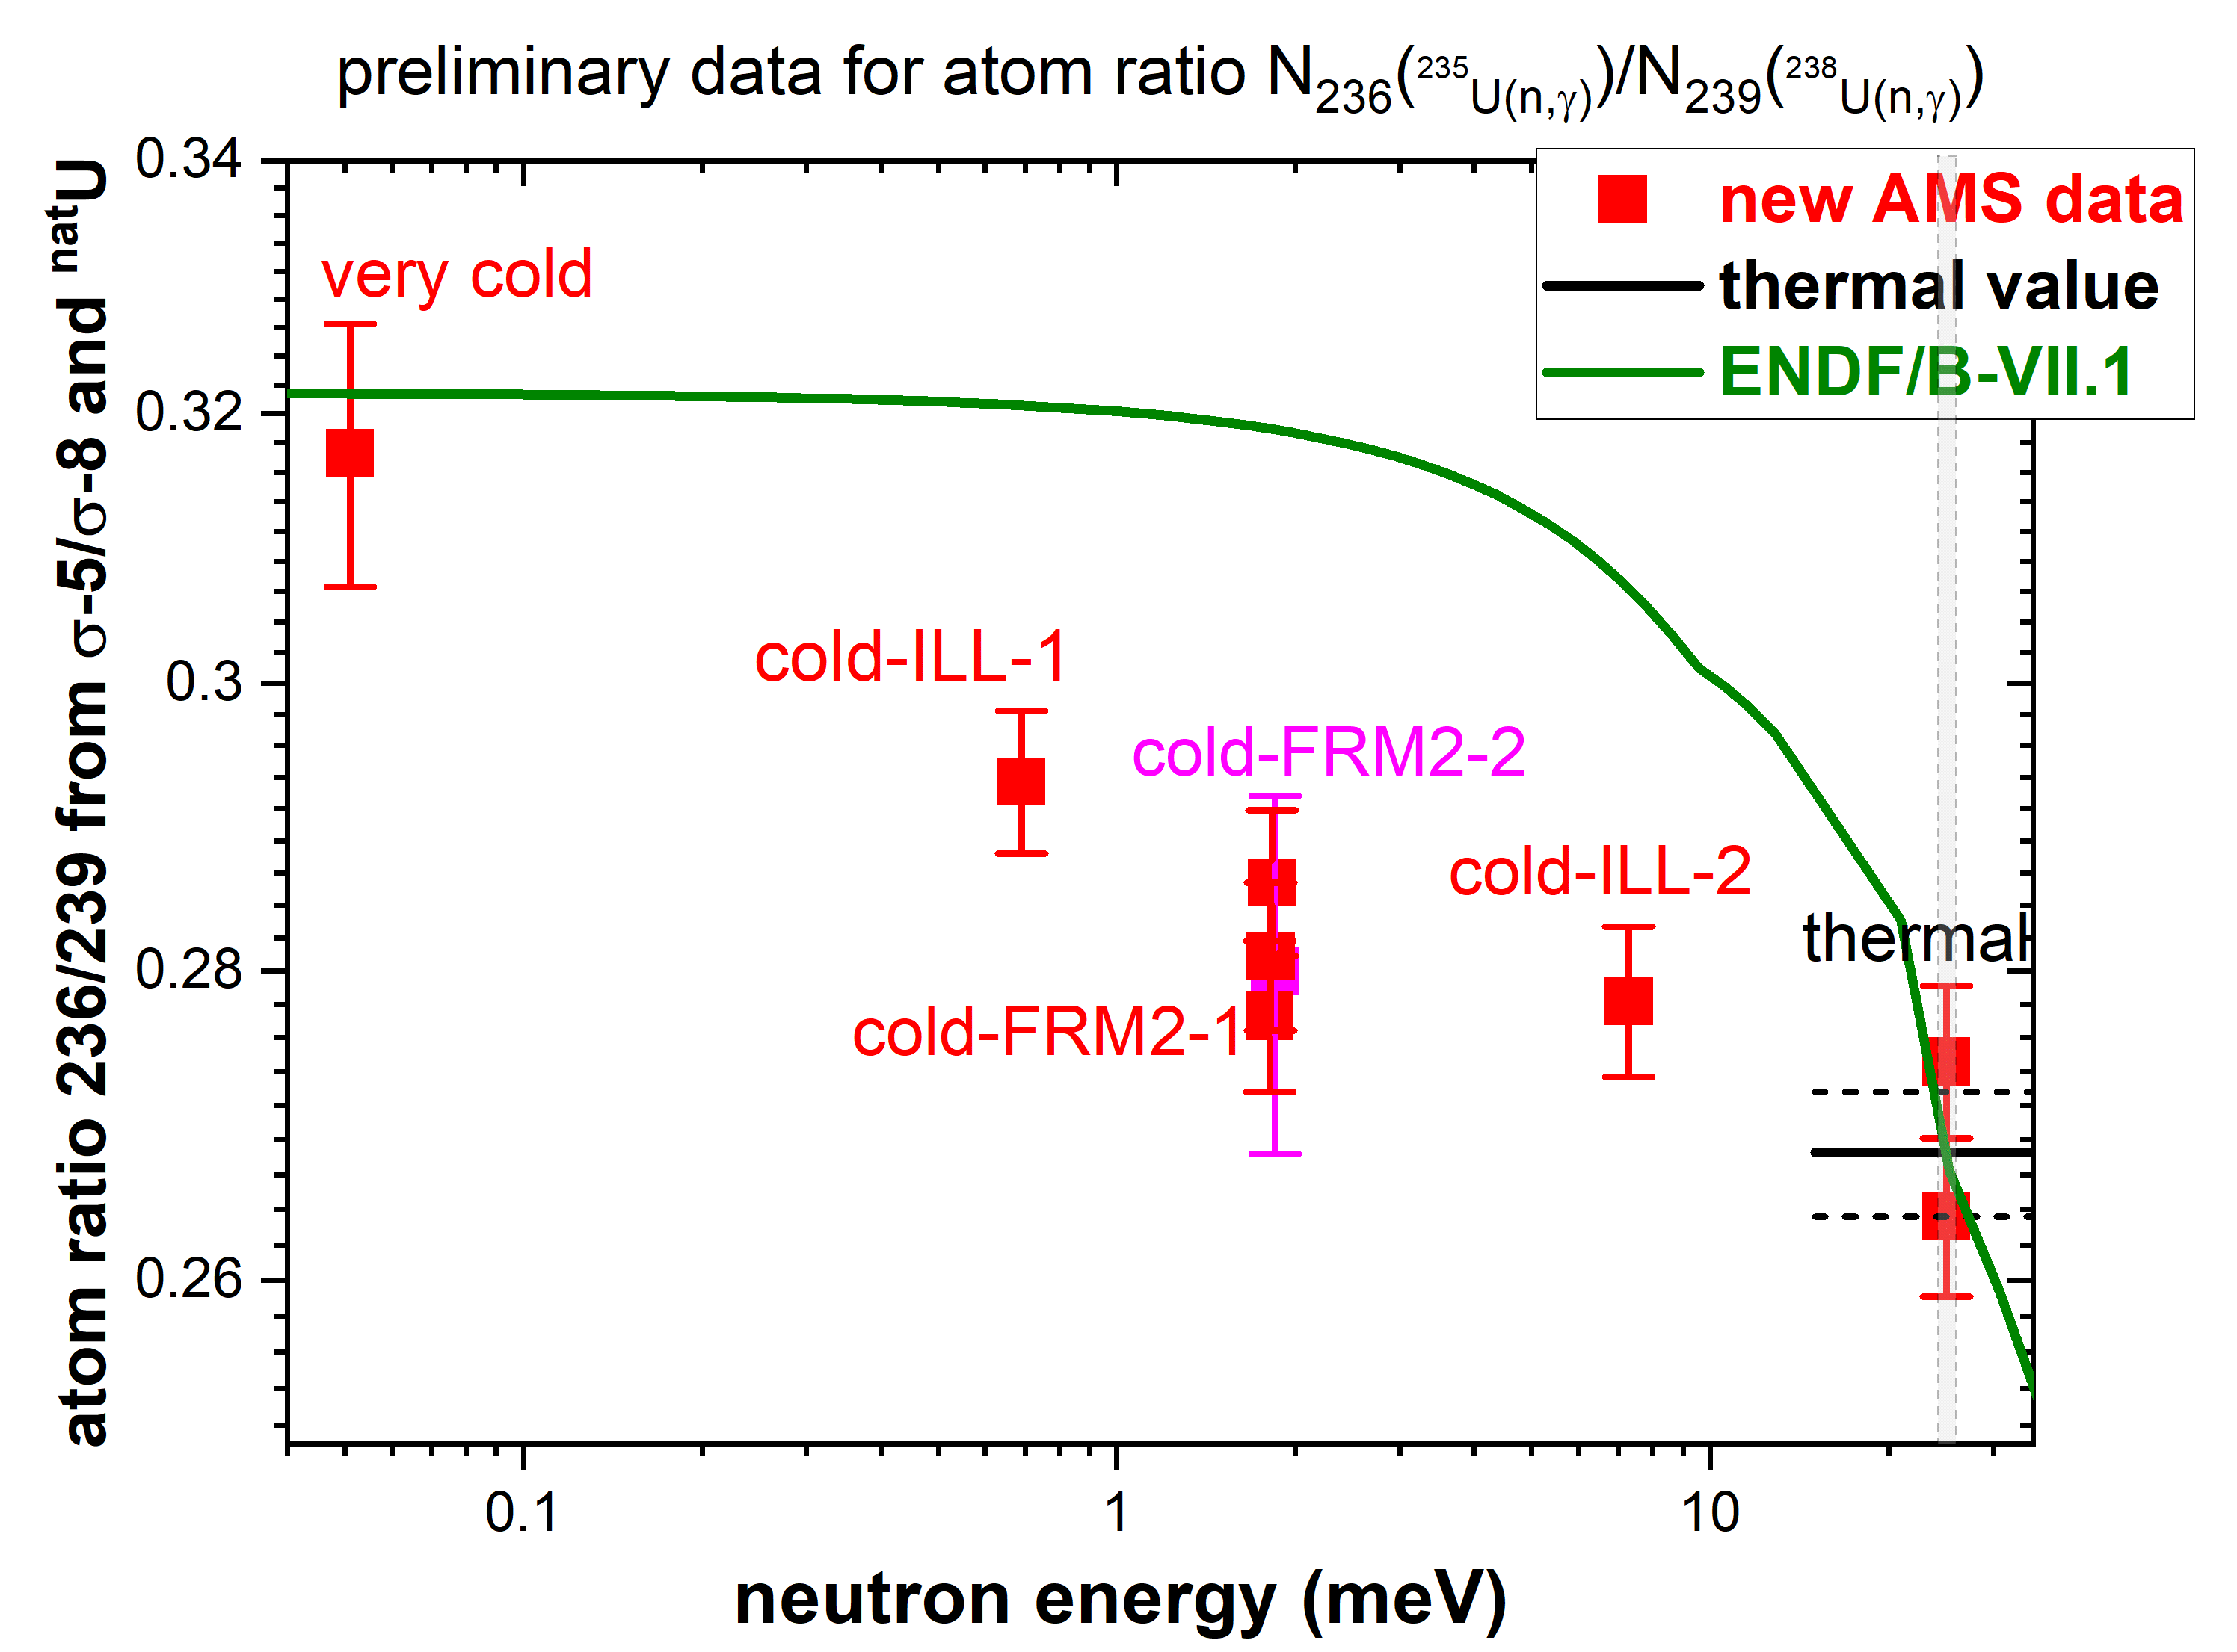
²³⁶U/ ²³⁹Pu atom ratios - preliminary

Slide 13
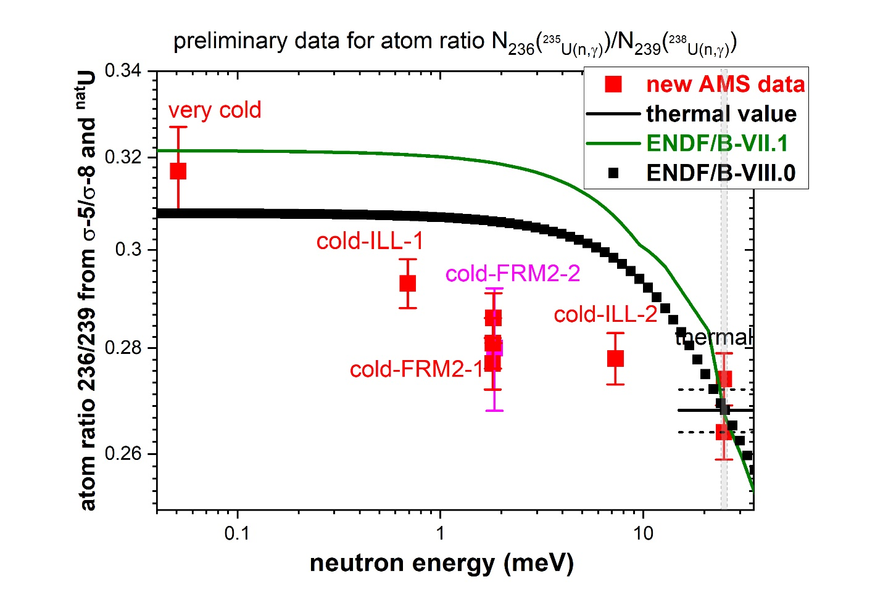

Slide 14
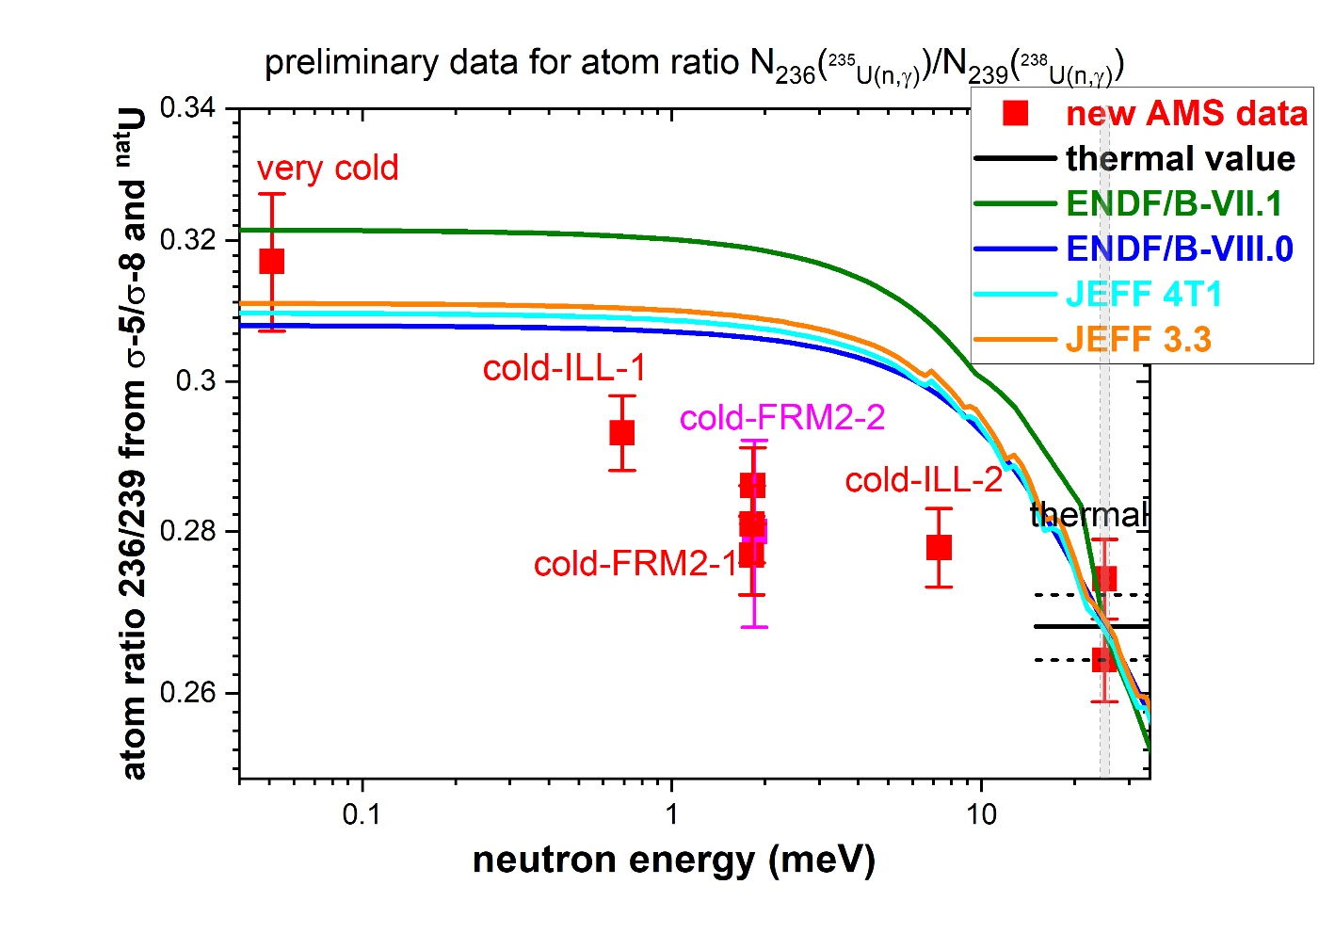

Slide 15
α–ratio = ratio capture to fission for ²³⁵U
AMS
Weigmann
Brooks
Gregoriev
ENDF
α (σ_{c}/σ_{f})
neutron energy (meV)
Grigoriev et al. 2000
Weigmann et al. 1990

Slide 16
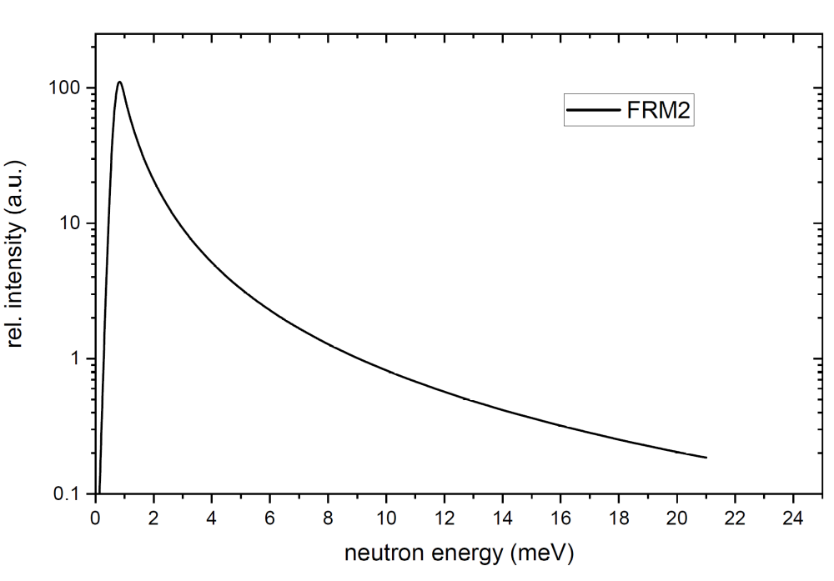
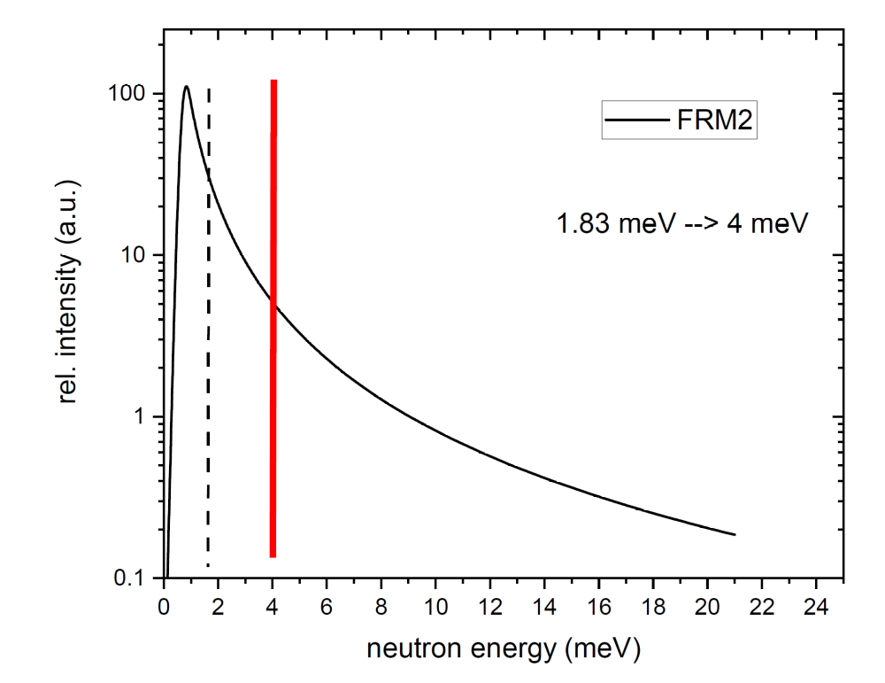
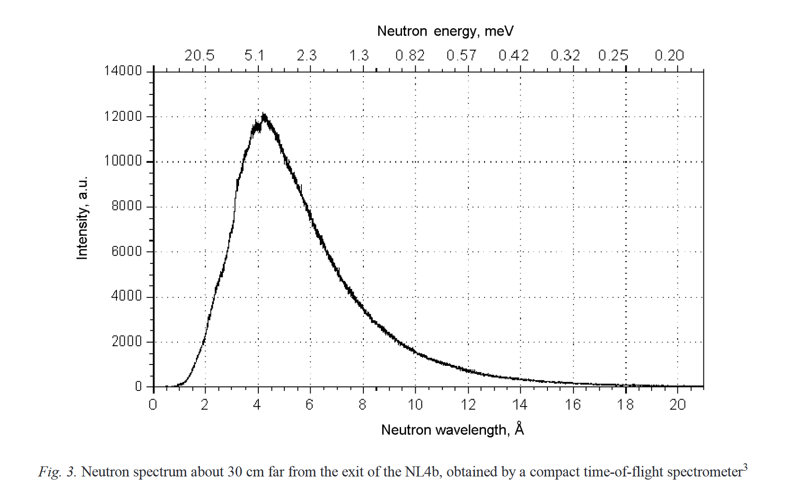
FRM 2

Slide 18
