Slide 1
Overview of data missing in ENSDF for ⁷Li, ⁷Be, ¹⁰Be, ¹⁵N, ¹⁶N, ¹⁷O
J.H. Kelley – North Carolina State University and
    Triangle Universities Nuclear Lab
This material is based upon work supported by the U.S. Department of Energy, Office of Science, Office of Nuclear Physics.

Slide 2
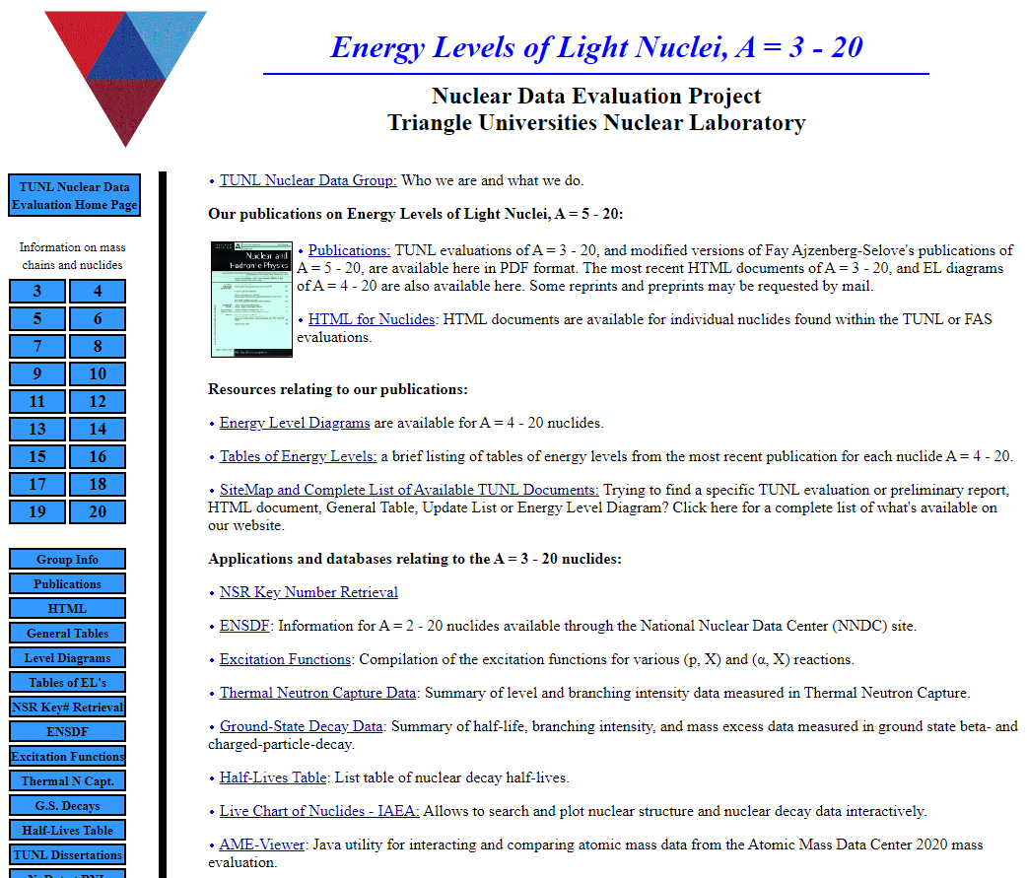

Slide 3
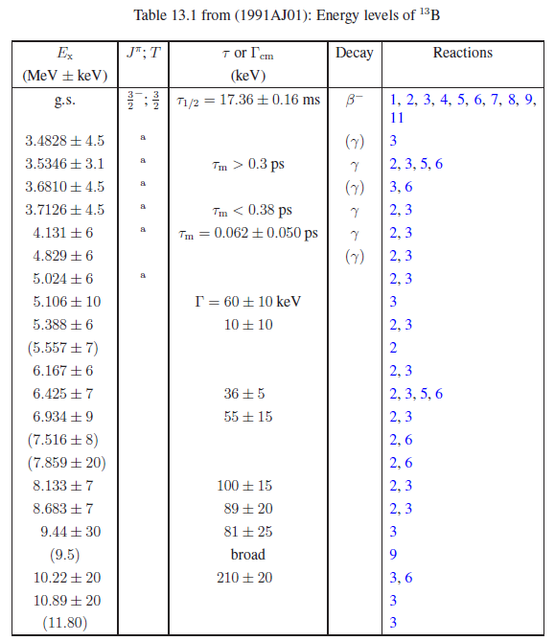
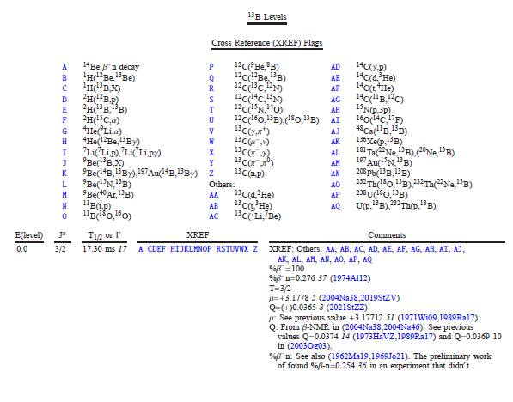
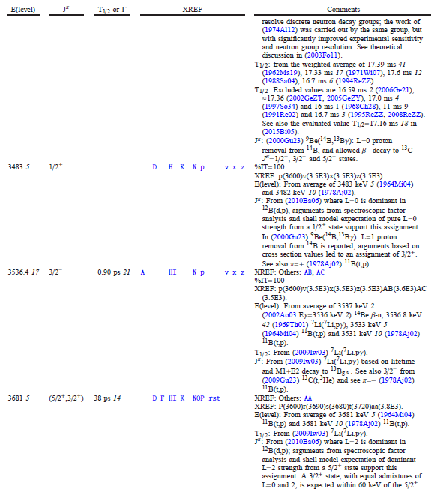
Fay Ajzenberg-Selove vs present analyses

Slide 4
General approach here
Identify and compile literature that hasn’t been considered in ENSDF
Focused on unbound resonances
Focused on new level parameters (E,Γ,Jπ)
Did not focus on high-lying states (above astrophysics interest)
Did not include Firestone (n,γ) or other thermal capture
Did not focus on THM results
Did not focus on angular distribution, spectroscopic factor determinations.
Mainly consulted XUNDL with a literature survey in the gap years.

Slide 5
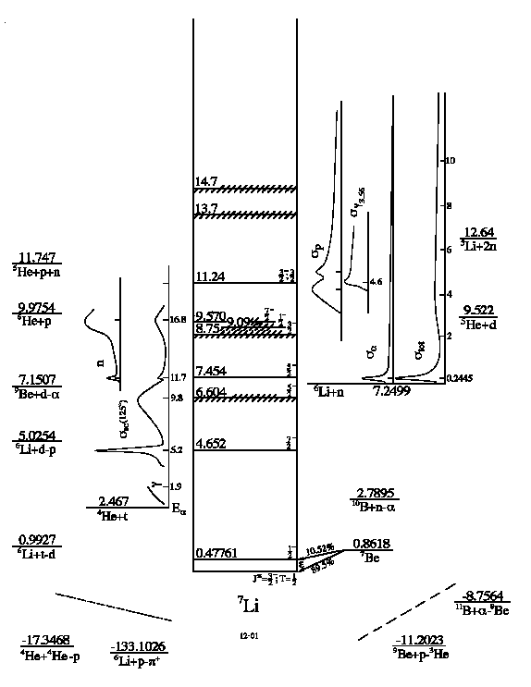
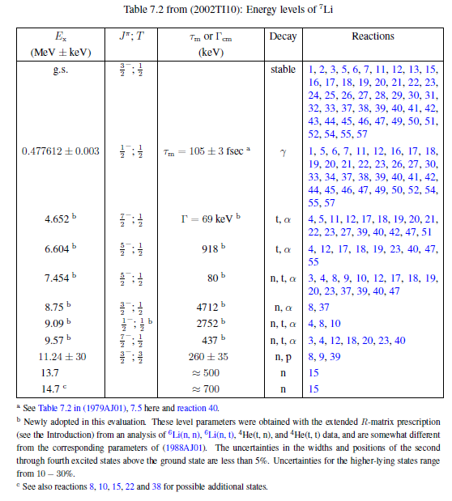
⁷Li

Slide 6
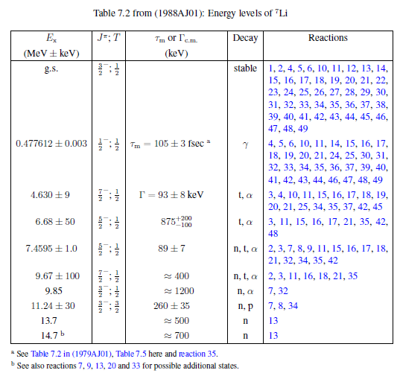
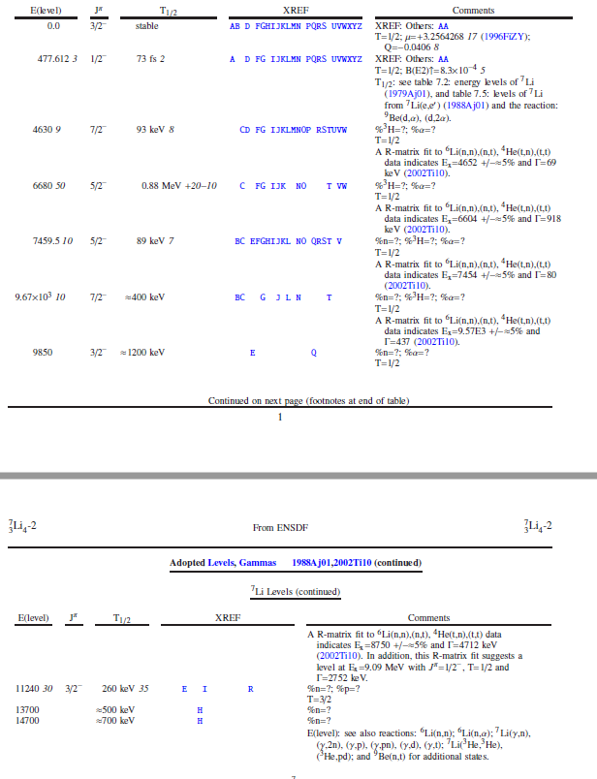
⁷Li

Slide 7
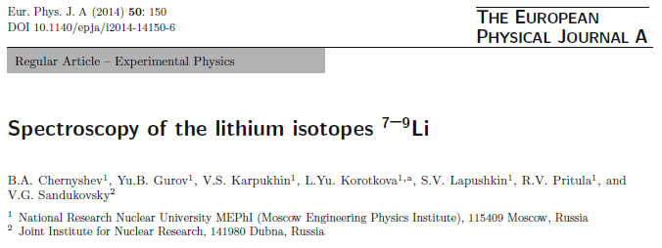
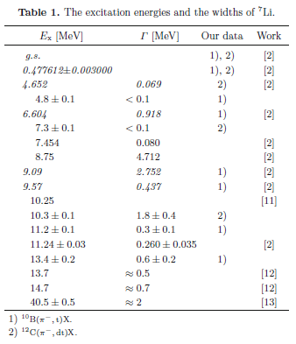
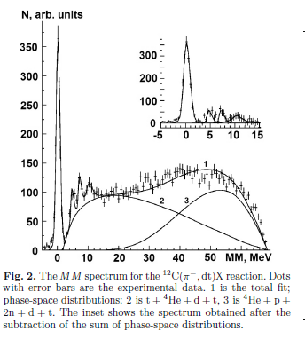
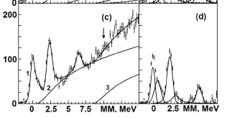
⁷Li – what’s new

Slide 8
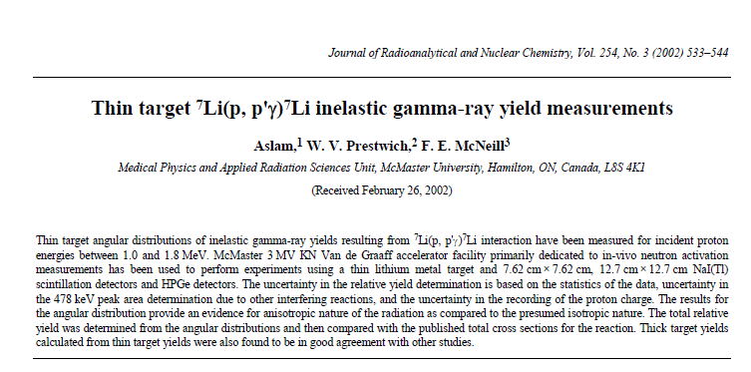
⁷Li – 2002As07 ?

Slide 9
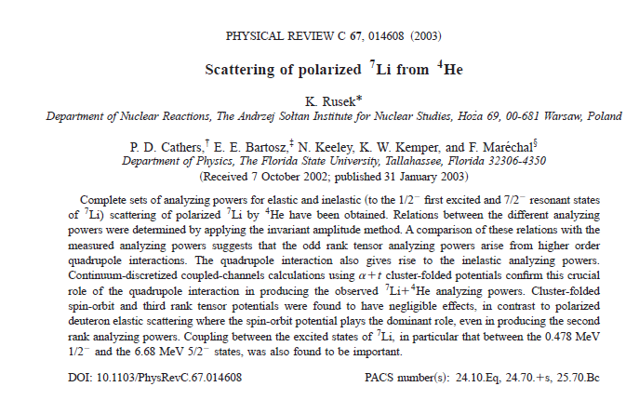
⁷Li 2003Ru01

Slide 10
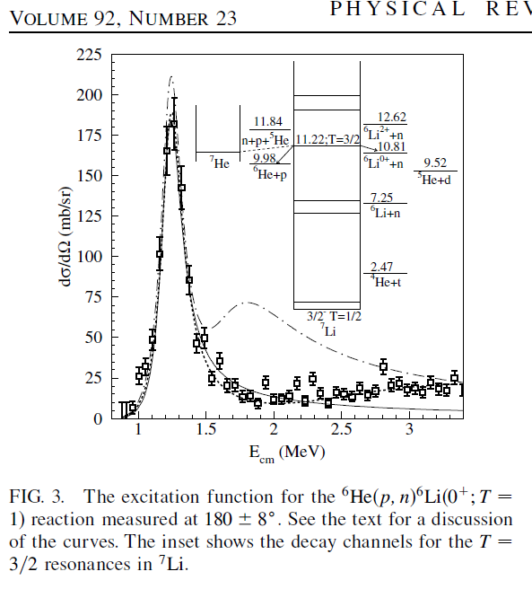
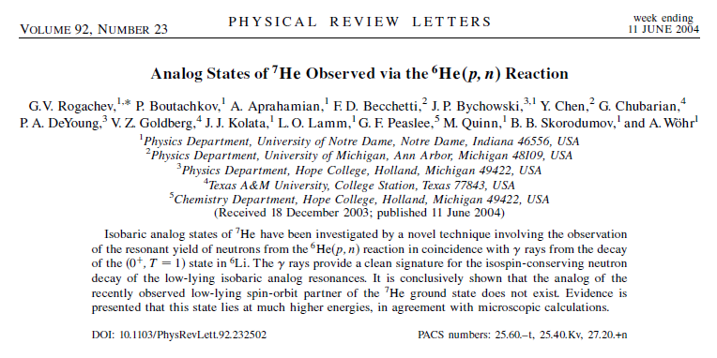
⁷Li 2004Ro20

Slide 11
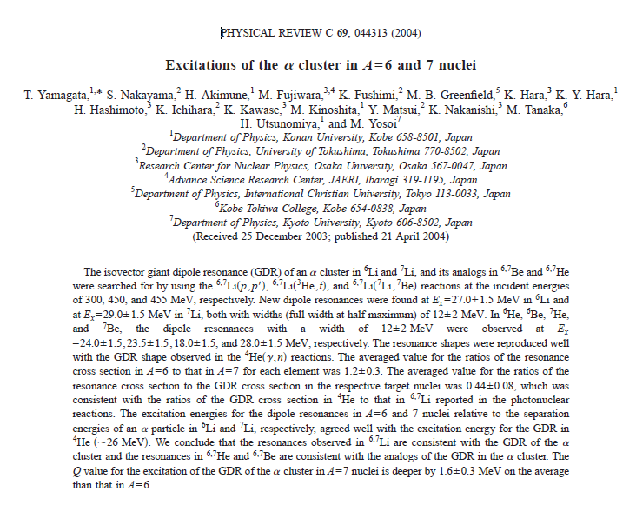
⁷Li 2004Ya12/ 2004Ya21

Slide 12
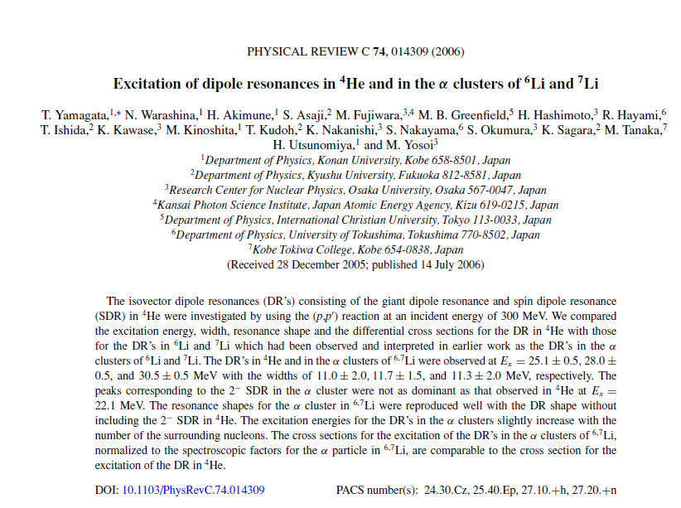
⁷Li 2006Ya06

Slide 13
⁷Li – what’s new
2010Gu17: Study of the ⁶Li(n, α)³H reaction via the ²H quasi-free break-up M Gulino^{1,2},
7454 4 5/2− 96 keV 8 E(level): from Eres=204 keV 4.
2018CH23: Role of cluster structure in the breakup of 7Li Chattopadhyay
E(level)† J Gamma
4.70×103 7/2 ~ 200 keV
6.75×103 5/2 ~ 1.2 MeV
2020Mu07: Measurement of the 7Li(𝛾,𝑡) ground-state cross section between 𝐸𝛾=4.4 and 10 MeV
M. Munch,
E(level)†‡ J Gamma L Gamma_gamma(eV)
0 3/2− 1
4652 7/2− 0.069# MeV 3 0.09
6604 5/2− 0.918# MeV 3 0.27
7454 5/2− 0.17 MeV 3 0.29
9.09×103 1/2− 0.91 MeV 1 2.5

Slide 14
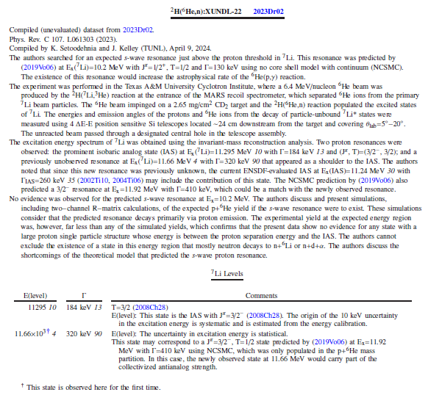
⁷Li 2023Dr02

Slide 15
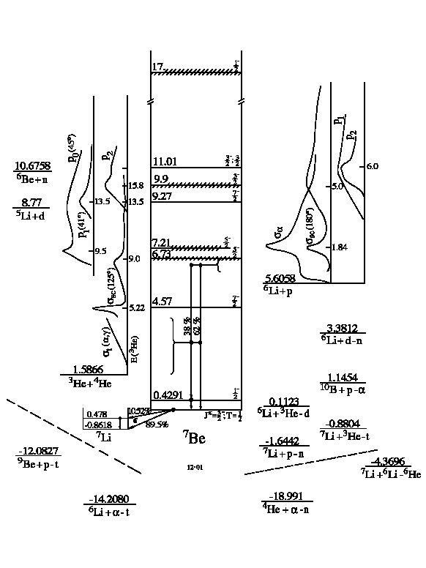
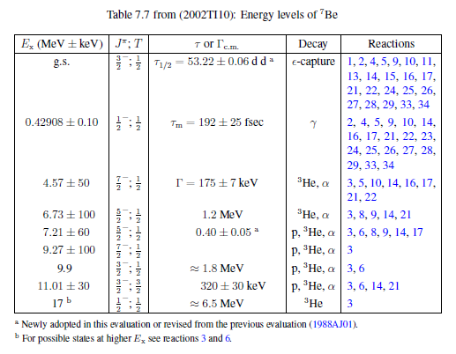
⁷Be

Slide 16
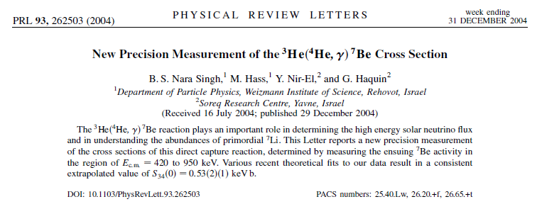
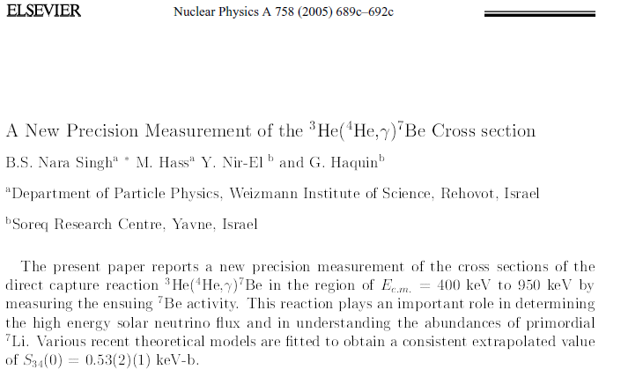
⁷Be – 2004Na42/2005Na32

Slide 17
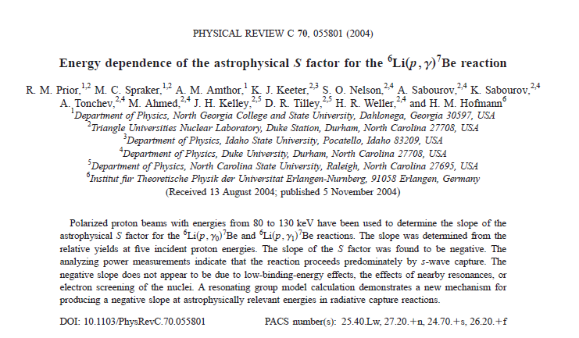
⁷Be 2004Pr09

Slide 18
⁷Be – 2004Ya12/2004Ya21

Slide 19
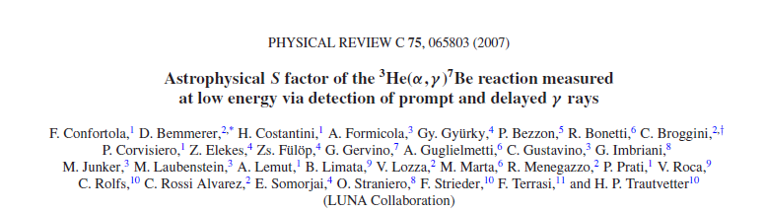
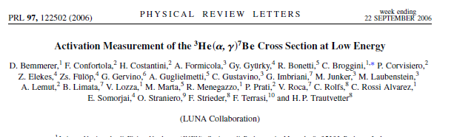
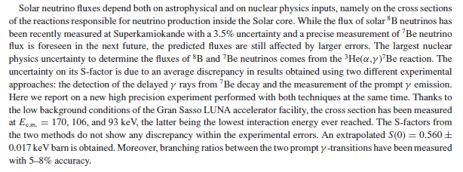
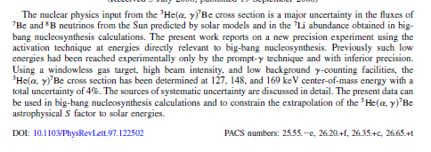
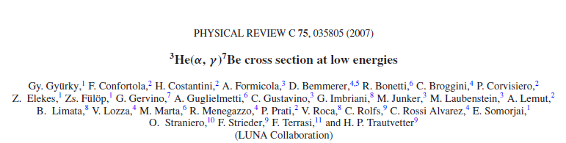
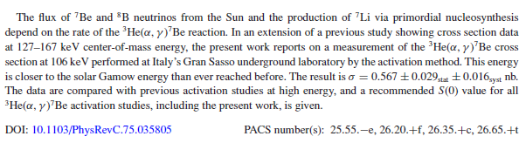
⁷Be - 2006Be41 / 2007Co17/2008Co12/2007Gy01

Slide 20
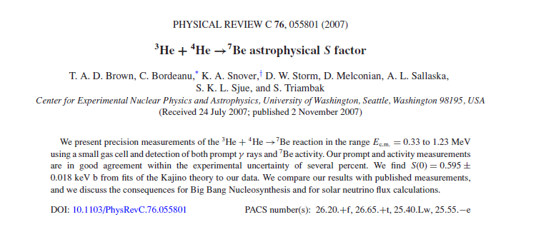
⁷Be 2007Br32

Slide 21
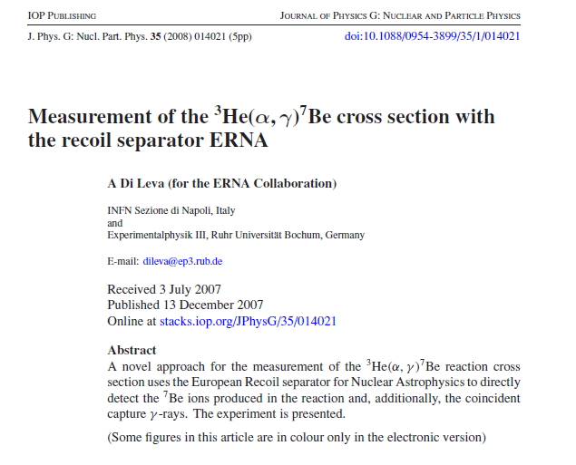
⁷Be-2008Di03

Slide 22
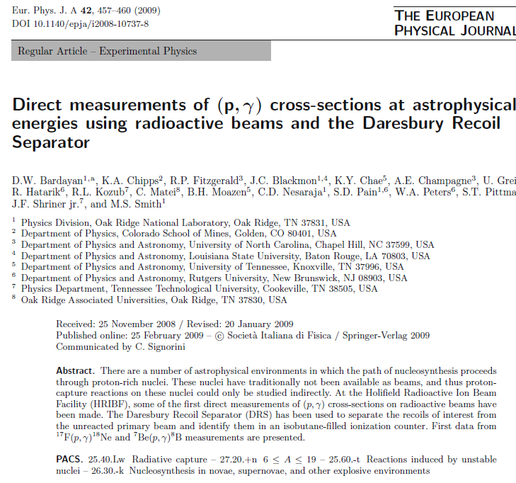
⁷Be – 2009Ba59

Slide 23
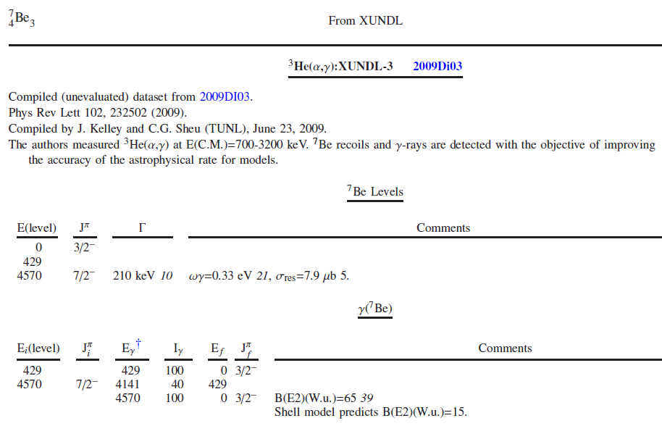
⁷Be – 2009Di03

Slide 24
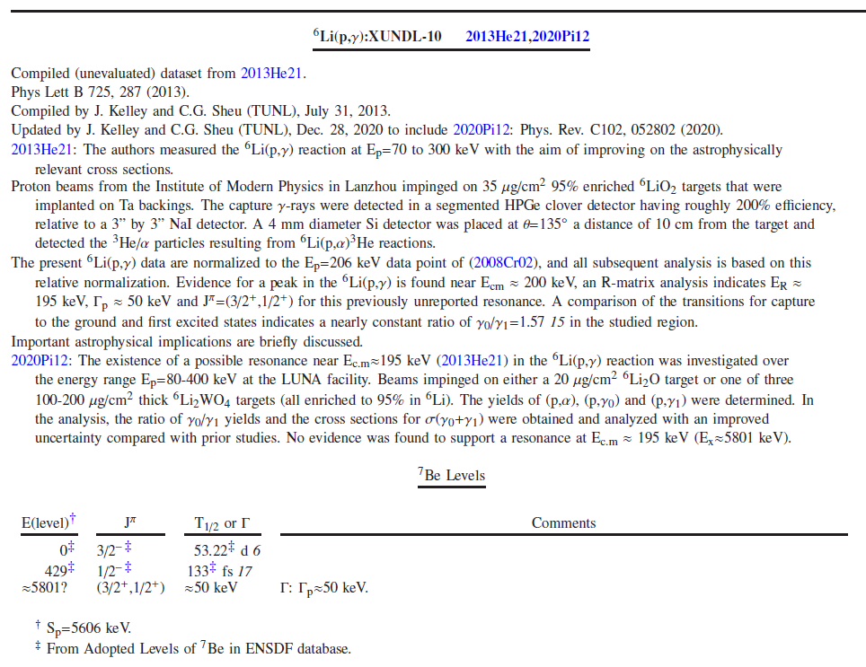
⁷Be – 2020Pi12

Slide 25
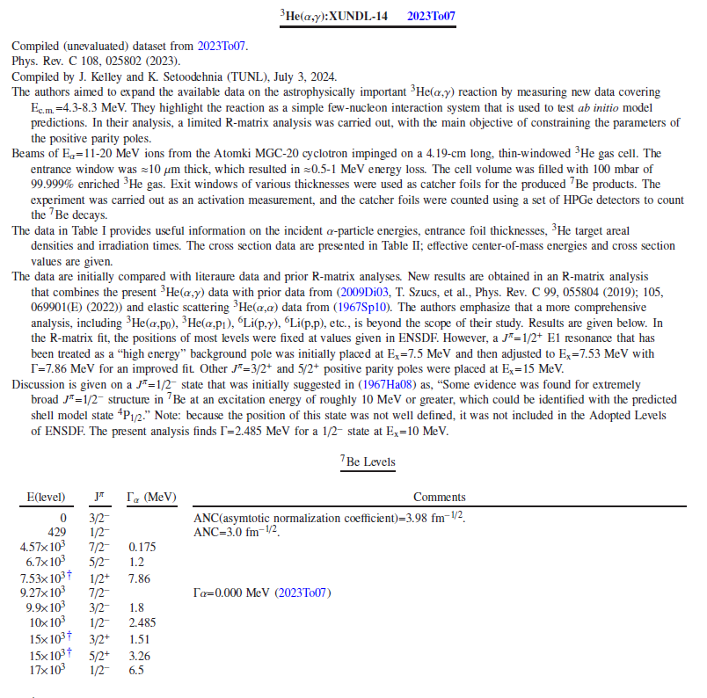
⁷Be 2023To07

Slide 26
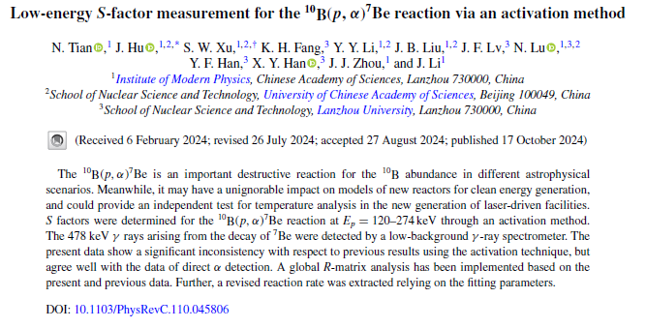
⁷Be – 2024Ti##

Slide 27
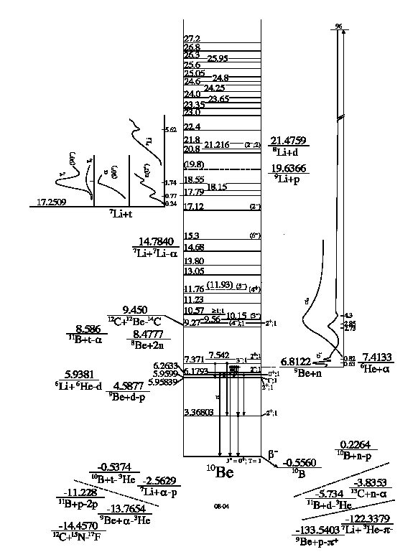
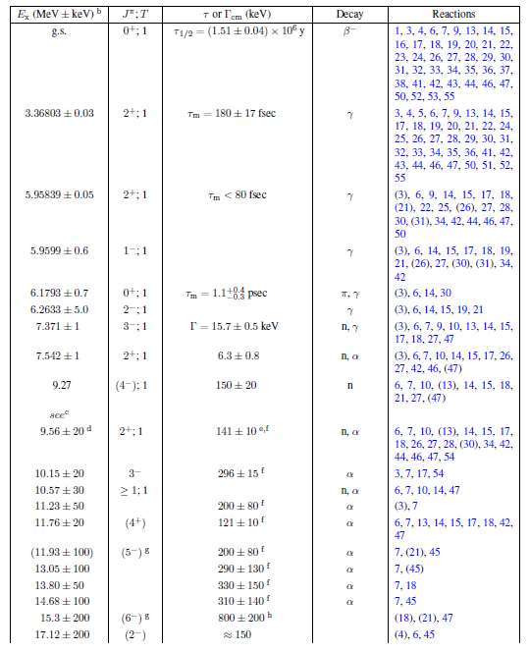
¹⁰Be

Slide 28
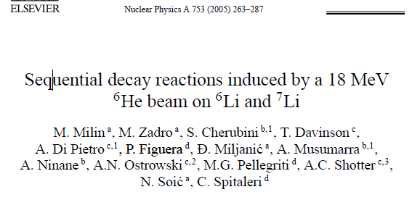
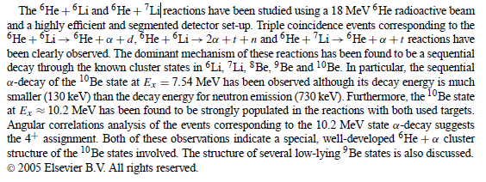
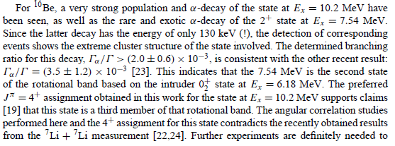
¹⁰Be what’s new: 2005Mi13

Slide 29
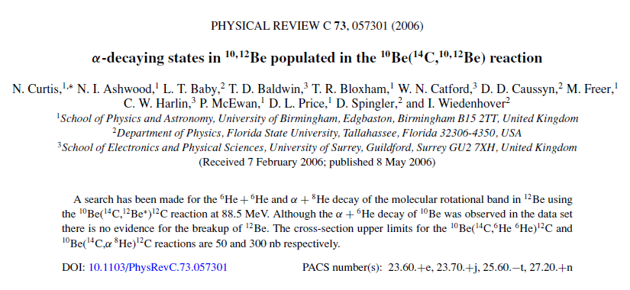
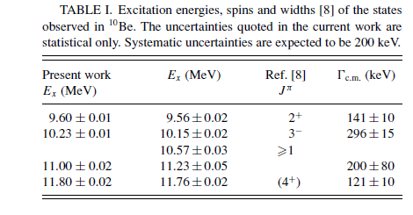
¹⁰Be – 2006Cu01

Slide 30
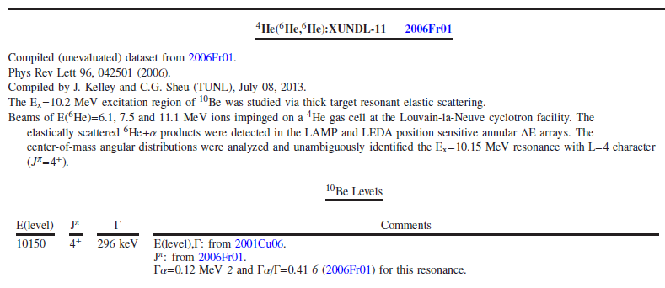
¹⁰Be 2006Fr01

Slide 31
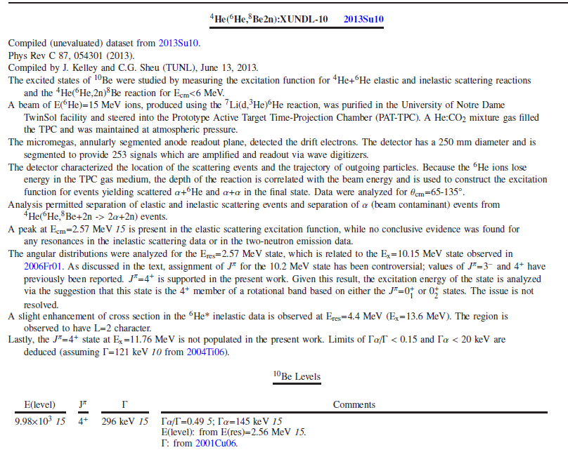
¹⁰Be 2013Su10

Slide 32
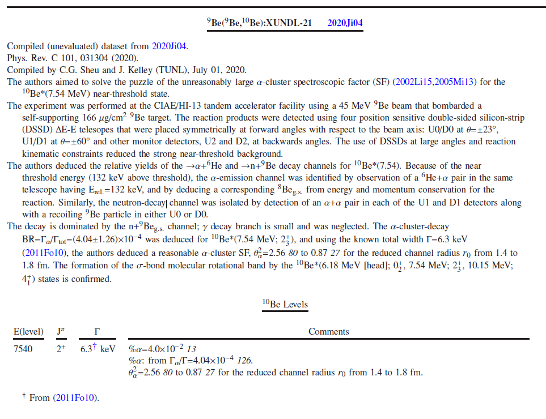
¹⁰Be 2020Ji04

Slide 33
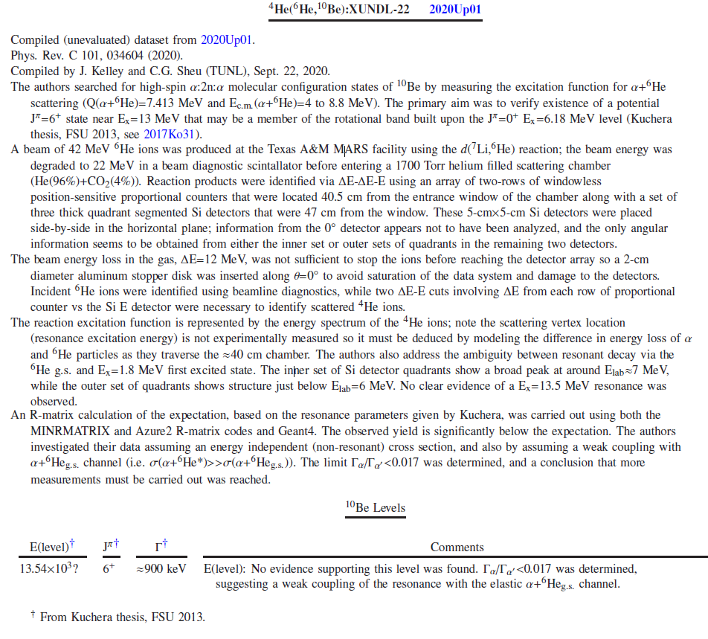
¹⁰Be 2020Up01

Slide 34
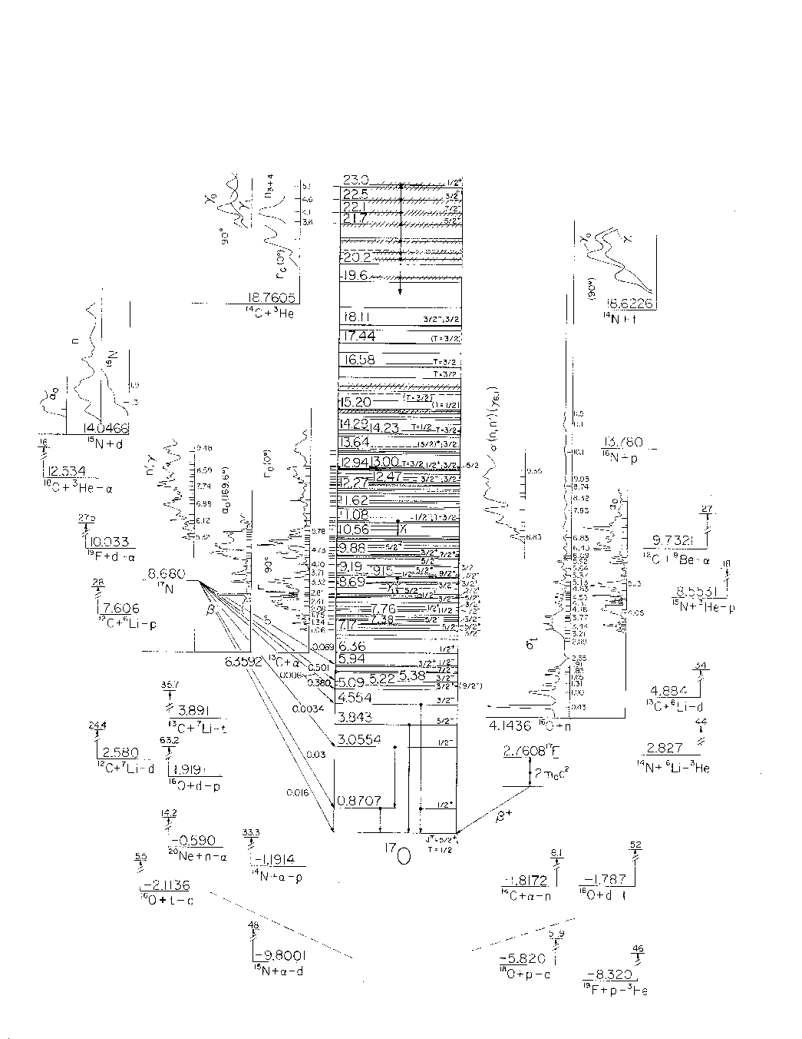
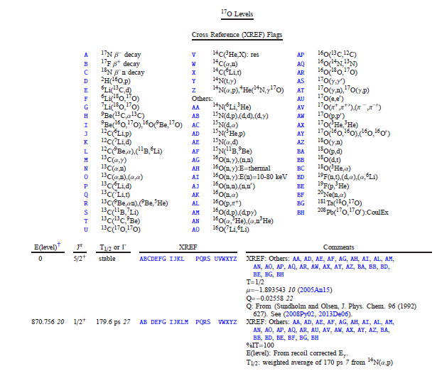
¹⁷O 4/25/2021
Resonance energies are not computed relativistically from resonance energies

Slide 35

¹⁷O 2023Ru05

Slide 36




¹⁵N

Slide 37



¹⁵N – 1993Li02/1994Li32

Slide 38


¹⁵N 1995Li02

Slide 39

¹⁵N 1994Ra17

Slide 40




¹⁵N 1998Le17/1999Le32

Slide 41

¹⁵N 2007Ro17

Slide 42

¹⁵N

Slide 43

¹⁵N 1994Ke02

Slide 44

¹⁵N what’s new

Slide 45

¹⁵N what’s new

Slide 46

¹⁵N what’s new

Slide 47

¹⁵N what’s new

Slide 48



¹⁶N

Slide 49

¹⁵N 1996Me03

Slide 50

¹⁵N 2001Gr06

Slide 51

¹⁵N 2006IsZZ / 2006ISZW

