Slide 1
Don’t Forget What We Already Know
Dr. A. C. (Skip) Kahler
Kahler Nuclear Data Services, LLc
presented at the
IAEA Nuclear Data Section’s Technical Meeting on
Compilation of Nuclear Data Experiments for Radiation Characterization
October 10 – 14, 2022

Slide 2
Don’t Forget What We Already Know
Among the more commonly known modern benchmark compilations are …
  ICSBEP, the International Criticality Safety Benchmark Evaluation Project
  IRPhEP, the International Reactor Physics Evaluation Project
  SINBAD, the Shielding Integral Benchmark Archive Database
  SFCOMPO, Spent Fuel Isotopic Composition Database
In the cross section evaluation world we talk about the “Big 3” nuclides; namely ^{235,238}U and ²³⁹Pu
By the same token, the ICSBEP, IRPhEP and SINBAD benchmark compilations might be referred to as the “Big 3” of benchmarks, with SFCOMPO not far behind
… but just as there are other cross section evaluations there are other legacy benchmark compilations ... including, but not limited to …

Slide 3
Don’t Forget What We Already Know
CSEWG Benchmark Book
  See links to ENDF-202, and more, at https://www.nndc.bnl.gov/endfdocs/.
    First published in the early 1970s, with updates in the late 1970s, 1980s and early 1990s.
  Includes categories for …
    FAST Reactor Benchmarks
    THERMAL Reactor Benchmarks
    SHIELDING Benchmarks
      Some overlap with SINBAD
    DOSIMETRY Benchmark
      Coupled Fast Reactor Measurements Facility (CFRMF)
        CFRMF was part of the Inter-Laboratory Reaction Rate (ILRR) Program
and while many FAST and THERMAL CSEWG Benchmarks are part of the ICSBEP …
  Other information such as actinide reaction rates, activation rates, Rossi-α, reactivity worth, and leakage spectra data may be included in the CSEWG description but are not part of the ICSBEP evaluation.
Many of these are in the ICSBEP & IRPhEP Handbooks

Slide 4
Don’t Forget What We Already Know
CSEWG Shielding Benchmarks …
  Initially (1974), a suite of 12 Shielding Data Test (SDT) experiments were identified …
    Philosophy was not to define benchmark specifications, but to just cite the original Laboratory report
      SDT1 = Iron Broomstick Experiment (ORNL-3867, revised; ENDF-166 … 1974 book incorrectly says ORNL-3876).
      SDT2,3,4,5 = Oxygen, Nitrogen, Sodium, SS Broomsticks (ORNL-3868, 3869, 3870, 3871; ENDF-167, 168, 169, 170)
      SDT6, SDT7 … replaced by SB2, SB3 (see below)
      SDT8 = Zero Power Plutonium Reactor (ZPPR)/Fast Test Reactor Shield (LA-5288; ENDF-193?) … original document lost?
      SDT9 = Fast Flux Test Reactor (FFTF) Radial Shield (AI-AEC-13048; ENDF-181)
      SDT10 = LLL Pulsed Spheres (UCID-16372)
      SDT11 = Neutron Transport through Iron and Stainless Steel (ORNL-TM-4222; ENDF-188)
      SDT12 = Neutron Transport through Sodium (ORNL-TM-4223; ENDF-189)
  Later was augmented with the SB (Shielding Benchmark) Series
    Self-contained benchmark specifications are provided
      SB2, SB3 = Secondary Gamma Production from Thermal and Fast Capture (ORNL-TM-5203, 5204; ENDF-227, 228)
      SB4 = CRBR Upper Axial Shield (ORNL-5259, ENDF-258)
      SB5 = Fusion Shielding Benchmark; Attenuation Experiments and Analysis (ENDF-202, Volume II (1983))
      SB6 = Fusion Shielding Benchmark II; Duct Streaming Experiment and Analysis (ENDF-202, Volume II Supplement (1986))

Slide 5
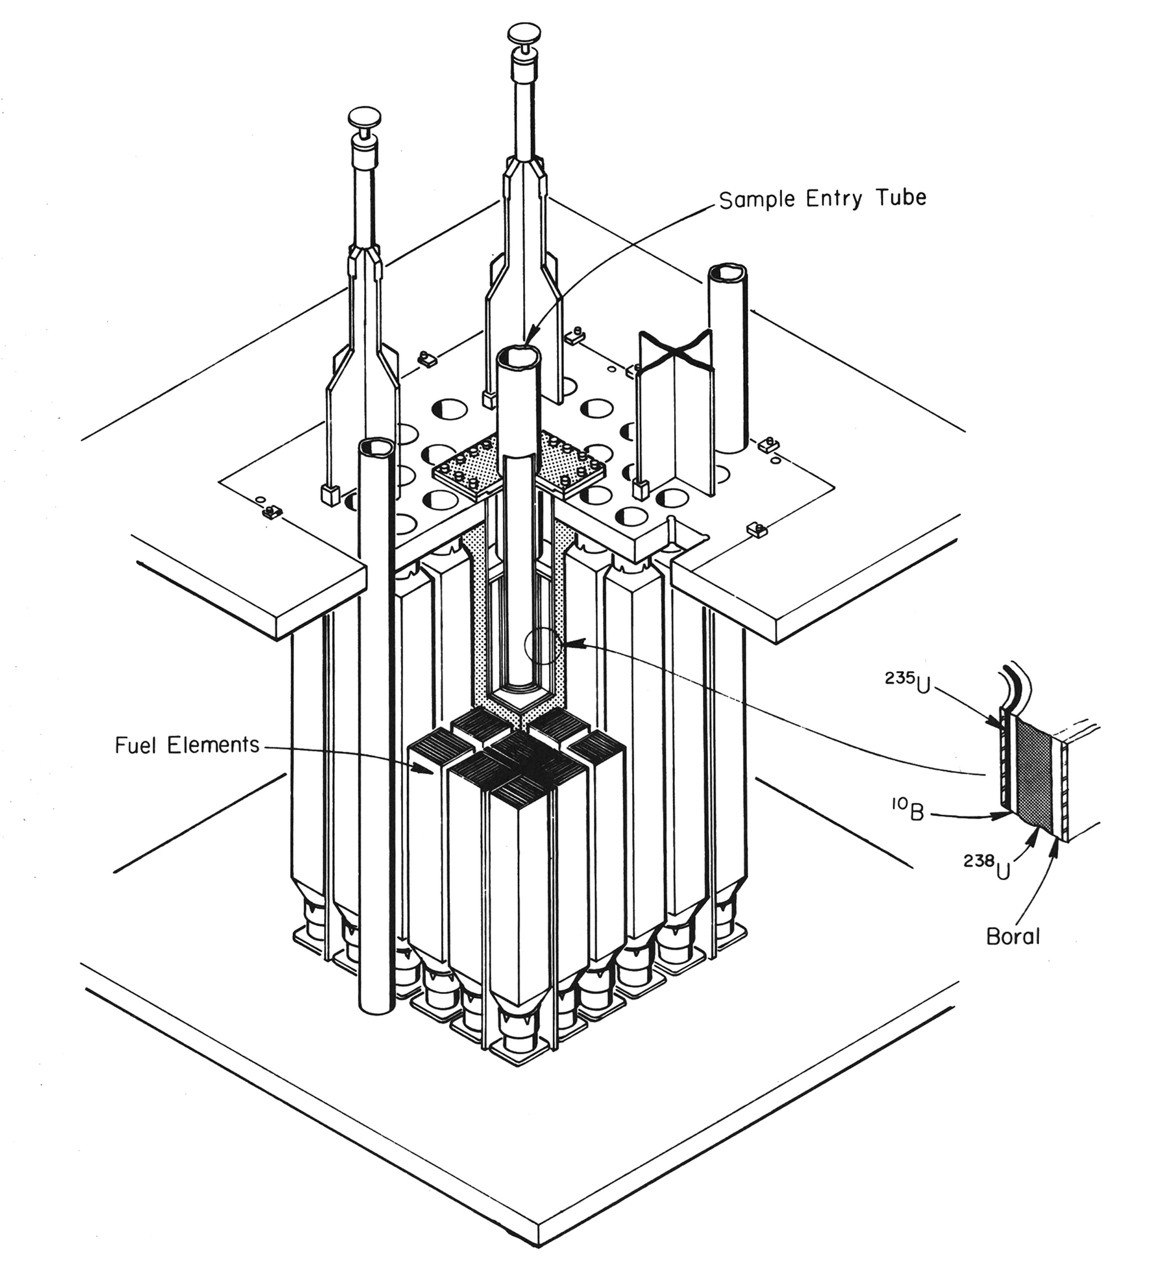
Don’t Forget What We Already Know
CSEWG Dosimetry Benchmark (1982) … Coupled Fast Reactor Measurements Facility (CFRMF)
  A 1D cylindrical model with detailed center region and homogenized outer regions.
  See J.W.Rogers, D.A.Millsap & Y.D.Harker (1975), “CFRMF Neutron Field Flux Spectral Characterization,” Nuclear Technology, 25:2, 330-348, DOI: 10.13182/NT75-A24372
… an R-Z model (detailed center region with axial and radial homogenized regions) is defined in
  J.W.Rogers, Y.D.Harker and D.A.Millsap, “The Coupled Fast Reactivity Measurements Facility (CFRMF),” in Neutron Cross Sections for Reactor Dosimetry, IAEA-208, Vol. 2, pg 117-176 (1978).
    See https://www-nds.iaea.org/publications/group_list.php?group=IAEA

Slide 6
Don’t Forget What We Already Know
ATI (Austria, 2020);
ETRR-2 (Egypt, 2015 and 2020);
IEA-R1 (Brazil, 2015);
INR-1 (Romania, 2020);
IPEN-MB-01 (Brazil, 2020);
IRR-1 (Israel, 2020);
JSI-1 (Slovenia, 2020);
McMaster (Canada, 2015);
MINERVE (France, 2015);
SRR-1/MNSR (Syrian Arab Republic, 2015);
OPAL (Australia, 2015 and 2020);
RSG-GAS (Indonesia, 2015);
SAFARI-1 (South Africa, 2020);
SPERT III (United States of America, 2015);
SPERT IV (Canada, 2015);
TRR-1-M1 (Thailand, 2020).
IAEA Technical Report Series #480: Research Reactor Database: Facility Specification and Experimental Data
  The outgrowth of IAEA CRPs on
    “Innovative Methods in Research Reactor Analysis: Benchmark against Experimental Data on Neutronics and Thermalhydraulic Computational Methods and Tools for Operation and Safety Analysis of Research Reactors”, and
    “Benchmarks of Computational Tools against Experimental Data on Fuel Burnup and Material Activation for Utilization, Operation and Safety Analysis of Research Reactors”
  TRS-480 was initially published in 2015 (first CRP), with a second edition in 2020 (containing additional information generated during the second CRP)
    Research reactors from 16 countries are represented …
    The US contribution is identified as “SPERT III”, but is very different from the ICSBEP’s HEU-COMP-THERM-022 “SPERT III” evaluation (LEU UO₂ fuel pins versus HEU fuel plates)
    Slovenia/Josef Stefan Institute TRIGA (ICSBEP IEU-COMP-THERM-003)

Slide 7
Don’t Forget What We Already Know
Miscellaneous sources (for the adventurous …)
  From https://www.osti.gov/biblio/6489025-nuclear-criticality-safety-experiments-calculations-analyses-volume-summaries-complilation-papers-from-transactions-american-nuclear-society
    “This compilation contains 688 complete summaries of papers on nuclear criticality safety as presented at meetings of the American Nuclear Society (ANS) … reproduced here by permission of the American Nuclear Society from their Transactions, volumes 1-41.”
  Seventy-Five Years of Nuclear Criticality Safety Documents – A Bibliography (LLNL-TR-760080)
    From https://www.osti.gov/biblio/1479075-seventy-five-years-nuclear-criticality-safety-documents-bibliography … a mere 23,208 page pdf.
  Also … Nuclear Criticality Experiments from 1943 to 1978: An Annotated Bibliography (UCRL-52769-Volumes 1, 2 & 3)
    https://www.osti.gov/biblio/6392867-nuclear-criticality-safety-experiments-calculations-analyses-volume-lookup-tables
    https://www.osti.gov/biblio/5948995-nuclear-criticality-experiments-from-annotated-bibliography-volume-lookup-tables
    https://www.osti.gov/biblio/5887072-nuclear-criticality-experiments-from-annotated-bibliography-volume-subject-index

Slide 8
Don’t Forget What We Already Know
Documentation supporting the release of recent ENDF/B-x neutron and thermal scattering data files …
  ENDF/B-VIII.0 “Big Paper”, and more, at https://www.nndc.bnl.gov/endf/b8.0/index.html
  ENDF/B-VII.1 “Big Paper”, and more, at https://www.nndc.bnl.gov/endf/b7.1/index.html
  ENDF/B-VII.0 “Big Paper”, and more, at https://www.nndc.bnl.gov/endf/b7.0/index.html
Some updated LANL Legacy reaction rate data published in the Appendix of the ND2013 “CIELO” paper by Chadwick et al, at https://www.oecd-nea.org/jcms/pl_23285/wpec-subgroup-40-sg40-collaborative-international-evaluated-library-organisation-cielo-pilot-project

Slide 9
Don’t Forget What We Already Know
Legacy ENDF benchmark reports … https://www.nndc.bnl.gov/endfdocs/
  ENDF-230 (BNL-NCS-21118, Vol I & II), Benchmark Testing of ENDF/B-IV (1976).
  ENDF-234 (ORNL-5262), Compilation of Sensitivity Profiles for Several CSEWG Fast Benchmarks (1977).
  ENDF-253 (ORNL-5336), A Compendium of Energy-Dependent Sensitivity Profiles for TRX-2 Thermal Lattice (1978).
  ENDF-265 (BNL-NCS-24853), Sensitivity Coefficient Compilation for CSEWG Data Testing Benchmarks (1978).
    No electronic copy available … anyone?
  ENDF-311 (BNL-NCS-31531), Benchmark Data Testing of ENDF/B-V (1982).
    No electronic copy available … anyone?
  ENDF-313 (BNL-NCS-29891), Benchmark Testing of ENDF/B Data for Thermal Reactors (1981).
    No electronic copy available … anyone?
  ENDF-314 (LA-8950-MS), ENDF/B-V, LIB-V, CSEWG Benchmarks (1981).
  ENDF-318 (LA-9037-MS), Los Alamos Benchmarks: Calculations Based on ENDF/B-V Data (1981).
  ENDF-340 (LA-10230-MS), Analysis of Central Worths and Other Integral Data from the Los Alamos Benchmark Assemblies (1984).

Slide 10
Don’t Forget What We Already Know
ICSBEP Identifiers for CSEWG Fast-Reactor Benchmarks |  |  | ICSBEP Identifiers for CSEWG Thermal-Reactor Benchmarks
Name | Benchmark Identifier |  | Name | Benchmark Identifier
 | CSEWG | ICSBEP or IRPhEP |  | CSEWG | ICSBEP or IRPhEP
Jezebel VERA-11A ZPR-3-48 ZEBRA-3 Godiva VERA-1B ZPR-3-6F … SNEAK-7A, -7B … Jezebel-233 Big-10 Jezebel-240 Flattop-25 Flattop-Pu Flattop-23 THOR | Fast Reactor #1 Fast Reactor #2 Fast Reactor #3 Fast Reactor #4 Fast Reactor #5 Fast Reactor #6 Fast Reactor #7 … Fast Reactor #16, #17 … Fast Reactor #19 Fast Reactor #20 Fast Reactor #21 Fast Reactor #22 Fast Reactor #23 Fast Reactor #24 Fast Reactor #25 | Pu-MET-FAST-001 … MIX-COMP-FAST-003 … HEU-MET-FAST-001 … IEU-MET-FAST-015 … SNEAK-LFMR-EXP-001 … U233-MET-FAST-001 IEU-MET-FAST-007 Pu-MET-FAST-002 HEU-MET-FAST-028 Pu-MET-FAST-006 U233-MET-FAST-006 Pu-MET-FAST-008 | ORNL-1 to ORNL-4 ORNL-10 TRX-1 to TRX-4 MIT-1, -2, -3 PNL-1, -2 PNL-3, -4, -5 BAPL-UO₂-1, -2, -3 BNL-ThO₂-1, -2, -3 PNL-6 to PNL-12 PNL-30 to PNL-35 L7 L8, L9 L10 L11 HISS/HUG HISS/HPG | Thermal Reactor #1-#4 Thermal Reactor #5 Thermal Reactor #6-#9 Thermal Reactor #10-#12 Thermal Reactor #13-#14 Thermal Reactor #15-#17 Thermal Reactor #18-#20 Thermal Reactor #21-#23 Thermal Reactor #24-#30 Thermal Reactor #31-#36 Thermal Reactor #37 Thermal Reactor #38-#39 Thermal Reactor #40 Thermal Reactor #41 Thermal Reactor #42 Thermal Reactor #43 | HEU-SOL-THERM-013.x HEU-SOL-THERM-032 … … Pu-SOL-THERM-021.x Pu-SOL-THERM-011.x … … Various Pu-SOL-THERM MIX-COMP-THERM-002 HEU-SOL-THERM-009.3 HEU-SOL-THERM-043.x HEU-SOL-THERM-009.4 HEU-SOL-THERM-012 HEU-COMP-INTER-004 Pu-COMP-INTER-003
Only a partial list is given

Slide 11
Don’t Forget What We Already Know
HEU-MET-FAST-001 (Godiva)
CSEWG Fast Benchmark #5 (Godiva)
Sphere, r=8.7407 cm
HEU
  ²³⁴U = 4.9184e-4
  ²³⁵U = 4.4994e-2
  ²³⁸U =2.4984e-3
k(benchmark) = 1.000 ± 0.001
  k(calc, e80) = 1.00004 ± 0.00002
  Central Region Flux = 0.005080 ± 0.05%
  ²³⁵U(n,f) = 0.006317 ± 0.05%
  ²³⁸U(n,f) = 0.001004 ± 0.08%
  ²³⁸U(n,γ) = 0.0004697 ± 0.08%
  ²³⁸U(n,2n) = 0.0000497 ± 0.5%
Sphere, r=8.741 cm
HEU
  ²³⁴U = 4.92e-4
  ²³⁵U = 4.500e-2
  ²³⁸U =2.498e-3
k(benchmark) = 1.000 ± 0.001
  k(calc, e80) = 1.00021 ± 0.00002
  Central Region Flux = 0.005079 ± 0.05%
  ²³⁵U(n,f) = 0.006316 ± 0.05%
  ²³⁸U(n,f) = 0.001000 ± 0.08%
  ²³⁸U(n,γ) = 0.0004697 ± 0.08%
  ²³⁸U(n,2n) = 0.0000502 ± 0.5%
MCNP6.2, ENDF/B-VIII.0 xs, 1B histories

Slide 12
Don’t Forget What We Already Know
Closing Comments - I
  Thoughts and observations based upon the author’s personal experience …
    Many input decks are created from a prior, often somewhat similar, input …
    Many input decks are passed on from one researcher to another …
    … and so modeling approximations embedded in “dusty decks” and deemed acceptable in the past are easily passed on without further review.
  My experience begins with MC jobs of 100K histories … but now can encompass MC jobs of many billion histories
    For criticality this means the k_{calc} stochastic uncertainty has decreased from hundreds of pcm to a few pcm.
    Past approximations to re-visit might include
      Presence or absence of thermal scattering kernels (h-h₂o is present, but what else was judged to be unimportant?)
        U-UO₂ (which ^{iso}U?); O-UO₂; hydrides; new fuels (UC, UN, … ); …?
      Isotopes … ¹H or ^{1,2}H; ^{nat}C or ^{12,13}C; ¹⁶O or ^{16,17,(18)}O … ²³⁹Pu or ^{iso}Pu and ²⁴¹Am … or maybe a given isotope wasn’t defined in the user’s xs library when the original model was developed, and so is omitted from the material definition.
      Alloys … stainless steel is more than ^{nat}Fe, ^{nat}Cr and ^{nat}Ni; AL6061 is more than ²⁷Al; how handle a range specification?
      Void regions …or air … and if air is it dry air or humid (and if so, how humid (fully saturated is ~ 10g h₂o/m³)) air?
        Probably not a concern for fully covered fuel rods, but what about open pool assemblies with water height reactivity control?

Slide 13
Don’t Forget What We Already Know
Closing Comments - II
  Processing approximations when going from a “raw” ENDF to an application file, e.g. MCNP ACE.
    (NJOY/RECONR) reconstruction tolerance for resolved resonance reconstruction;
    (NJOY/RECONR & BROADR) linearization criteria (before and after Doppler broadening);
    (NJOY/PURR) Unresolved resonance ladder parameters;
    (NJOY/THERMR) tsl inelastic scattering energy mesh.
  Computational resources have never been greater …
  Theoretical and Experimental capabilities have never been greater …
  Accessibility to, and Sharing of, Data has never been greater …
  National and International (IAEA, NEA, and more) collaboration opportunities abound …
  … but as we continue to march forward … Don’t Forget What We Already Know!

Slide 14
Don’t Forget What We Already Know
Backup/Extra Slides

Slide 15
Don’t Forget What We Already Know
Among the more commonly known benchmark compilations are …
  ICSBEP, the International Criticality Safety Benchmark Evaluation Project
    https://www.oecd-nea.org/jcms/pl_24498/international-criticality-safety-benchmark-evaluation-project-icsbep
  IRPhEP, the International Reactor Physics Evaluation Project
    See https://www.oecd-nea.org/science/wprs/irphe/, or
    https://www.oecd-nea.org/tools/abstract/detail/nea-1765
  SINBAD, the Shielding Integral Benchmark Archive Database
    See https://www.oecd-nea.org/science/wprs/shielding/, or
      https://www.oecd-nea.org/tools/abstract/detail/nea-1517 (reactors)
      https://www.oecd-nea.org/tools/abstract/detail/nea-1552 (accelerator shielding)
      https://www.oecd-nea.org/tools/abstract/detail/nea-1553 (fusion neutronics)
    Also https://www.oecd-nea.org/jcms/pl_23391/wpec-subgroup-47-sg47-use-of-shielding-integral-benchmark-archive-and-database-for-nuclear-data-validation.
    https://www.oecd-nea.org/science/wprs/shielding/sinbad/sinbadis.htm
    https://rsicc.ornl.gov/codes/dlc/dlc2/dlc-237.html
  SFCOMPO, Spend Fuel Isotopic Composition Database
    https://www.oecd-nea.org/jcms/pl_21515/sfcompo-2-0-spent-fuel-isotopic-composition

Slide 16
Don’t Forget What We Already Know

