Slide 1
Texas A&M University
US Nuclear Data Program
TAMU NSDD CENTER
Evaluation Issues
N. Nica

Slide 2
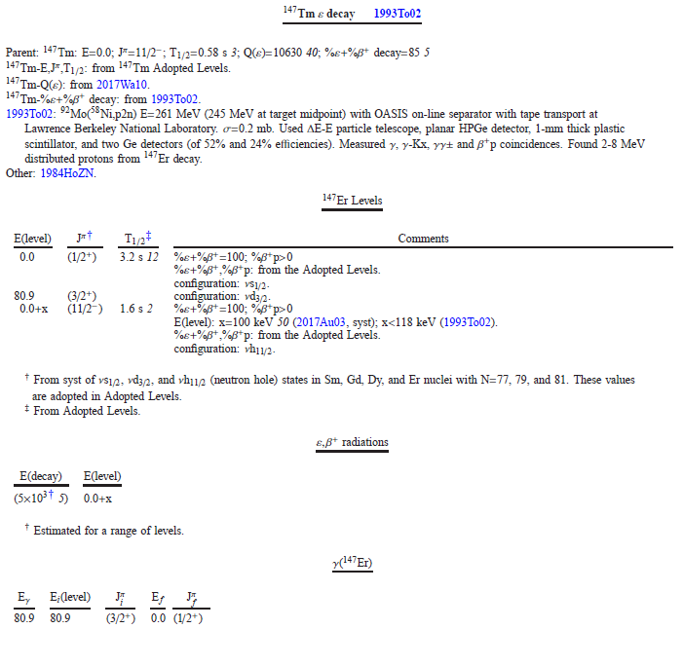

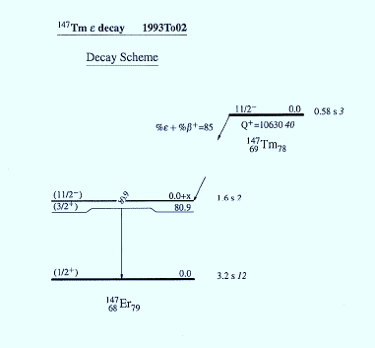
1. Case study for typical EC decay cases
Typical case of a beta decay to an isomer of unknown energy
  Favored 11/2- to 11/2- ε+β⁺ decay, Q(ε)=10630 keV
  Other two lower levels known, of which one is the g.s., unfavored for the ε+β⁺ decay
  The decay energy is 5000 ± 5000 keV
  The decay drawing is not drawing the range, so it is confusing!
Remedies ???

Slide 3
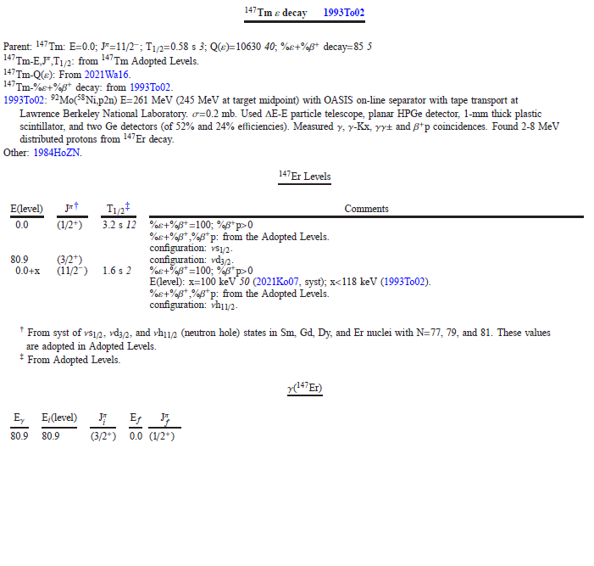
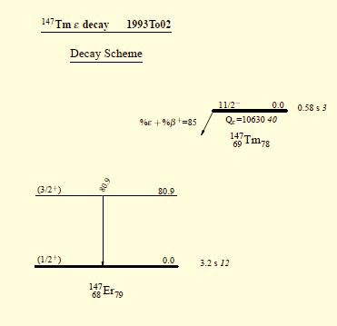
1. Case study for typical EC decay cases
Typical case of a beta decay to an isomer of unknown energy
  Favored 11/2- to 11/2- ε+β⁺ decay, Q(ε)=10630 keV
  Other two lower levels known, of which one is the g.s., unfavored for the ε+β⁺ decay
  The decay energy is 5000 ± 5000 keV
  The decay drawing is not drawing the range, so it is confusing!
Remedy 1: Remove the ε,β⁺ table
    The ε+β⁺ decay does exist and so the 11/2- level, even if its energy is not known
    Not shown the level it would be more confusing, even wrong

Slide 4
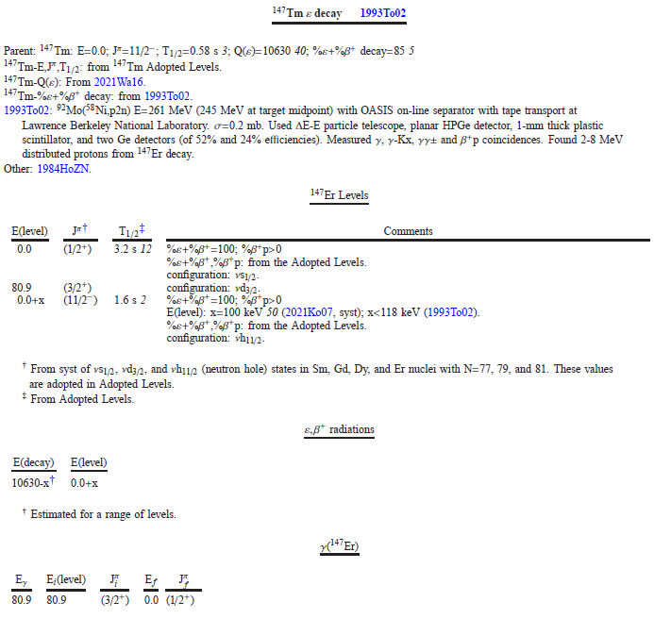
1. Case study for typical EC decay cases
Typical case of a beta decay to an isomer of unknown energy
  Favored 11/2- to 11/-2 ε decay fot Q(ε)=10630 keV
  Other two lower levels known, of which one is the g.s. unfavored for the ε decay
  The decay goes to a level 5000 ± 5000 keV
  The decay drawing is not drawing the range, so it is confusing!
Remedy 2: Redesignate (5×10³ 5) E(decay) value
    Maintain the ε+β⁺ table
    Rename the E(decay) value as:
    147ER E 10630-X
    That would restore the correctness and good sense
However, it should be checked:
  Whether it can be implemented in JAVA-NDS (also fmtchk should be modified to accept the change)
  Whether other unwanted effects are propagated on other codes

Slide 5
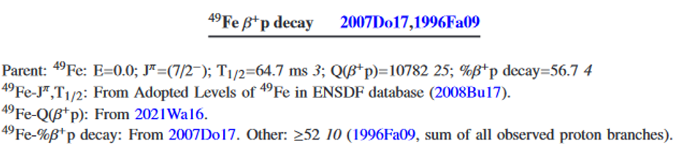
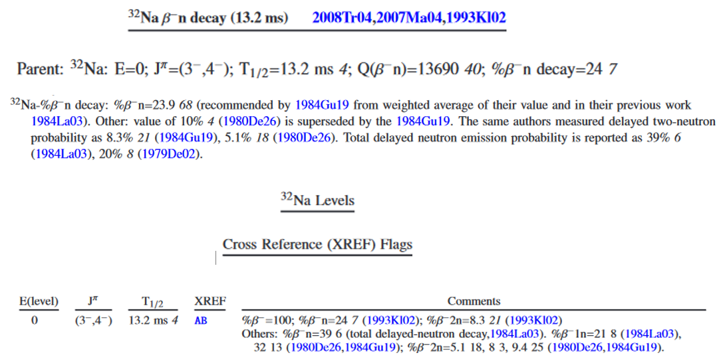
2. A beta-delayed particle decay ambiguity
Remedy 1
Following publications notations P_{1n}, P_{2n}
%β ⁻1n, %β ⁻2n
can be acceptable form for the respective probabilities (as for evaluator in example 2)
This in turn would make available the notation
%β ⁻n
to be used for indicating the “total delayed-neutron decay”.
However, that would consequently demand the systematic replacement of all %β ⁻n of with %β ⁻1n.
That would be a greater problem than the one here scrutinized
Remedy 2
Fortunately, there is a simple solution for the ambiguity:
Keep %β ⁻n, %β ⁻2n unchanged for beta-delayed –one and –two neutrom decays
For the “total delayed-neutron decay” use instead the new notation:
%β ⁻Σn
that would need to replace only the fewer cases of such occurrences
For the beta-delayed proton emission use the corresponding notations
%β ⁺p, %β ⁺2p, %β ⁺Σp
Example 1
%β ⁺1p
%β ⁺p
Example 2
%β ⁻1n
%β ⁻n
%β ⁻1n

Slide 6
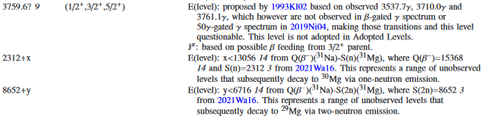
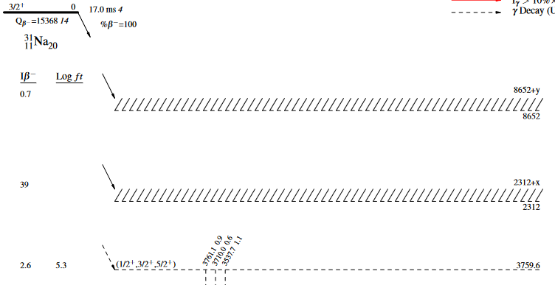
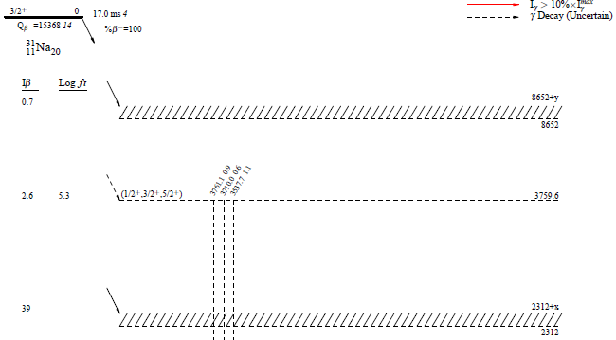
3. The S(n)+x, S(2n)+y range situation
L 3759.6 9 (1/2+,3/2+,5/2+) ?
L 2312+X R
L 8652+Y R
2n
1n

Slide 7
4. Extend the capability of JAVA_RULER
RULER can be used to discriminate between different gamma-ray multipolarities when T_{1/2} is known as value or limit
However, RULER is able to output the “Recommended Upper Limits (RUL) comparisons with calculated B(XL)(W.u.)” only if all needed parameters are known (T_{1/2} , A, Eγ, BR, α, δ).
Tom Burrows recommended to rerun RULER for a given transition by varying the different Eλ’s / Mλ’s
However, changing parameters and rerunning the code especially when looking to test for multiple γ’s is tedious and time consuming
PROPOSAL, based on JAVA-RULER’s the key feature “calculate ICC by BrIcc”
Design a new button (unless is already done but I ignored its existence) to analyze each γ transition with incomplete information and get the RUL comparisons for these situations:
  If γ rays are assigned D, or Q, or higher multipoles, JAVA-RULER can run the possible case scenarios, e.g., E2 vs. M2, E1 vs. M1, etc., combining δ’s if known
  If no δ is assigned, JAVA-RULER can calculate RUL comparisons for δ=0
  If no multipoles are assigned, JAVA-RULER can calculate all combinations for ΔJ=1 to 4.
  If BR is not known, JAVA-RULER can calculate RUL comparisons for BR=1
  The corresponding JAVA-RULER output will contain only the γ transition with incomplete information.

