Slide 1

Measurements of Cross Sections of the ¹⁴N and ¹⁶O(n, α) Reactions
Yiwei Hu¹, Cong Xia¹ , Jie Liu¹, Zepeng Wu¹, Haofan Bai¹, Wenkai Ren¹
Zhenpeng Chen², Tieshuan Fan¹, Jinxiang Chen¹, Guohui Zhang^{1,*}
Peking University¹
Tsinghua University²
Notes:
Good afternoon, everyone. My name is Cong Xia, I’m a PHD student of Peking university. The title of my presentation is ‘measurements of cross sections of the Nitrogen-forteen and oxygen-sixteen (n, α) reactions

Slide 2
Contents
Introduction
Experiments
Data analysis
Results
Conclusions
Notes:
The contents of my presentation include five sections.

Slide 3
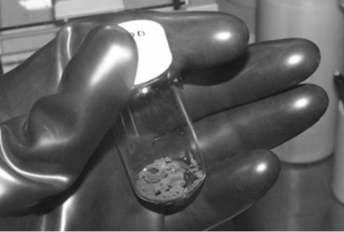
1. Introduction
Nitrogen: one of the most widespread elements in nature and organism.
Nitride fuel is widely used in Gen IV nuclear power systems.
A kind of PuN powder[1]
[1] Y. Arai, T. Iwai, M. Akabori, et al., Nuclear Technology, 162, 244-249(2008).
Notes:
At first I’d like to introduce the significance to measure this two reactions. For Nitrogen, the Nitrogen is one of the most widespread elements in nature and organism, and Nitride fuel is widely used in Gennration IV nuclear power systems. The picture shows a kind of Plutonium nitride powder.

Slide 4
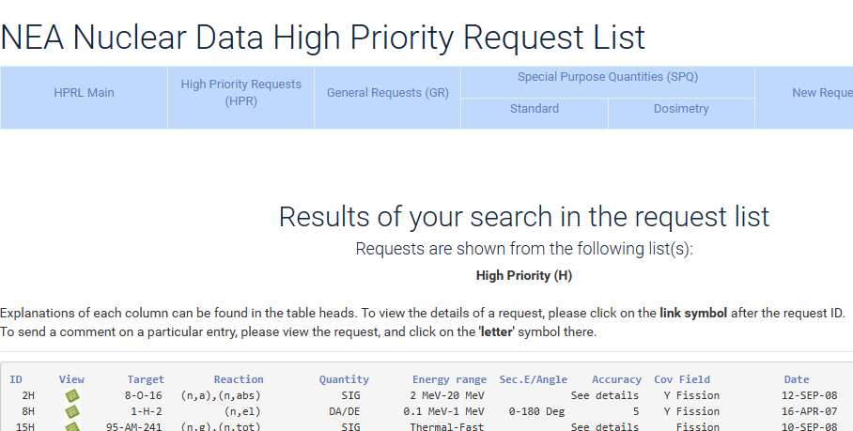
1. Introduction
¹⁶O(n, α)¹³C: important in reactor design and application
Reactor physics design
Helium from (n, α) reaction
The reaction ranked first in NEA Nuclear Data High Priority Request List[2]
[2] NEA Nuclear Data High Priority Request List, https://www.oecd-nea.org/dbdata/hprl/
Notes:
For oxygen, oxygen-sixteen (n, α) Carbon-thirteen is of great significance in reactor design and application. Cause oxygen exist in reactor widely, accrete cross section of the reaction will help to do Reactor physics design and evaluate the impact of helium on the reactor. So the reaction ranked first in NEA Nuclear Data High Priority Request List

Slide 5
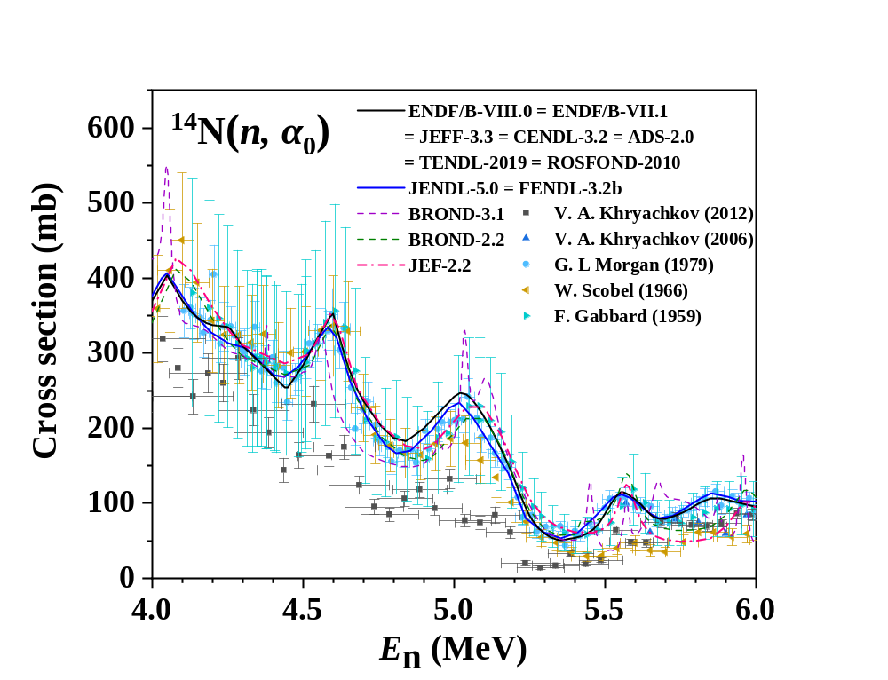
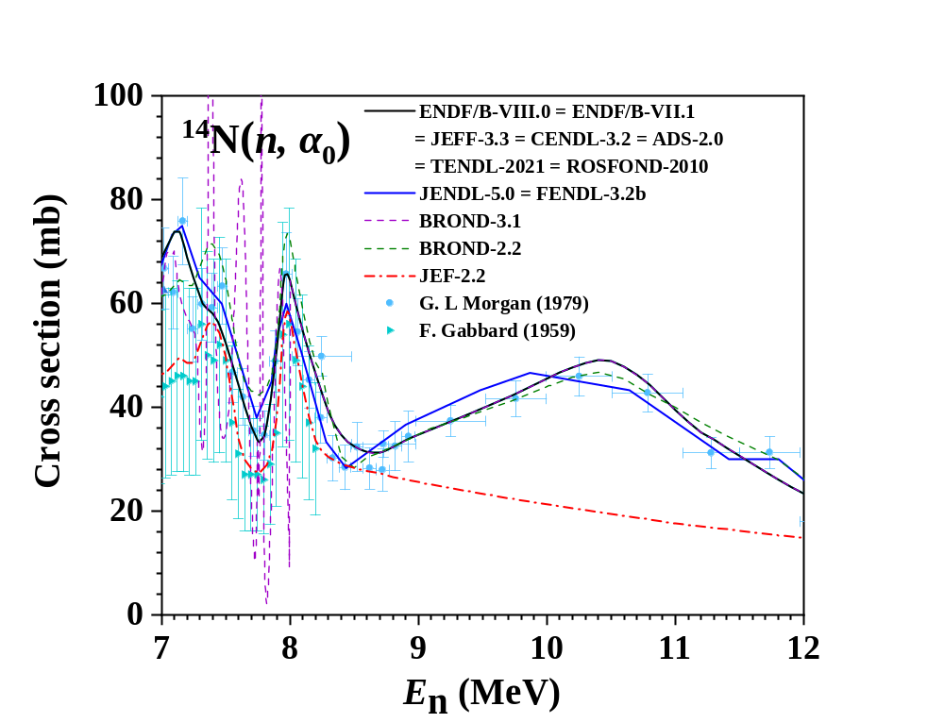
1. Introduction
research status of ¹⁴N(n, α₀)¹¹B
  F. Gabbard‘s (1959, cyan right triangle dots) measurement data had an error of up to 40%
  the latest measurement data of V. A. Khryachkov (2012, black square dots) represented only one-third the values of others.
The experimental data and evaluated data of ¹⁴N(n, α₀)¹¹B reaction in 4.0 – 12 MeV
Notes:
But for Nitrogen-forteen (n, alpha zero) boron eleven, Existing experimental data on the reactions suffer from significant errors and disagreements:
F. Gabbard's measurement data had an error of up to 40%
while the latest measurement data of V. A. Khryachkov represented only one-third the values of others.
Both of them only use gas sample and still produce significant disagreement.

Slide 6
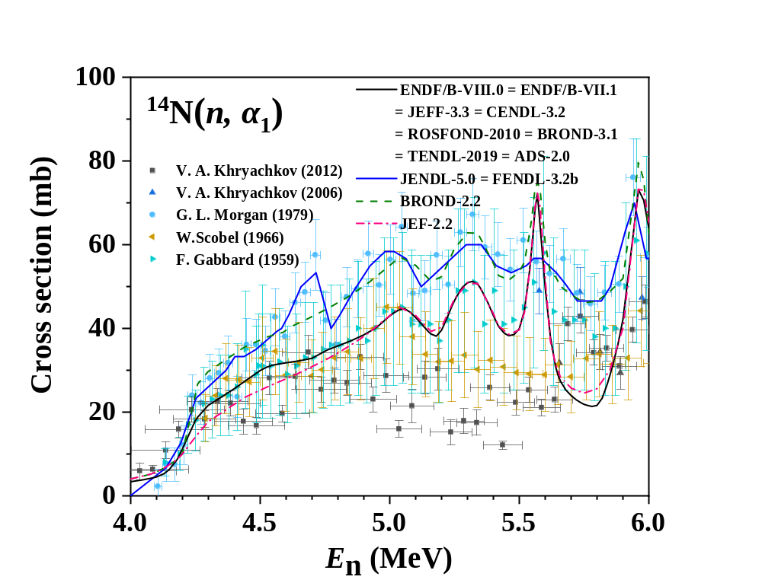
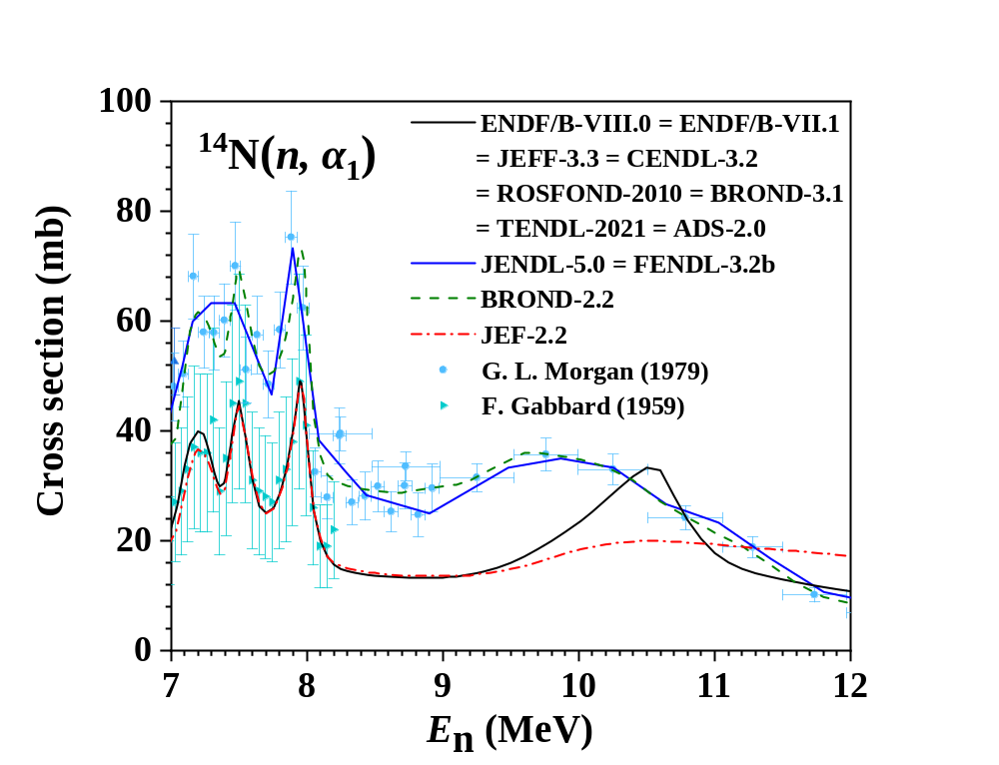
1. Introduction
research status of ¹⁴N(n, α₁)¹¹B
  same problem of F. Gabbard‘s and V. A. Khryachkov’s measurement
  great differences between different evaluated data
The experimental data and evaluated data of ¹⁴N(n, α₁)¹¹B reaction in 4.0 – 12 MeV
Notes:
But for Nitrogen-forteen (n, alpha one) reaction, except the same problem of Gabbard and Khryachkov, the evaluated data also disagree.

Slide 7
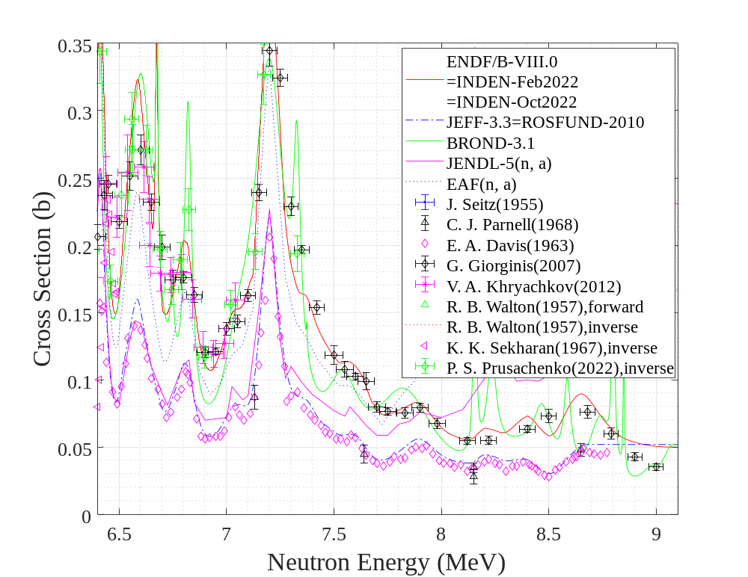
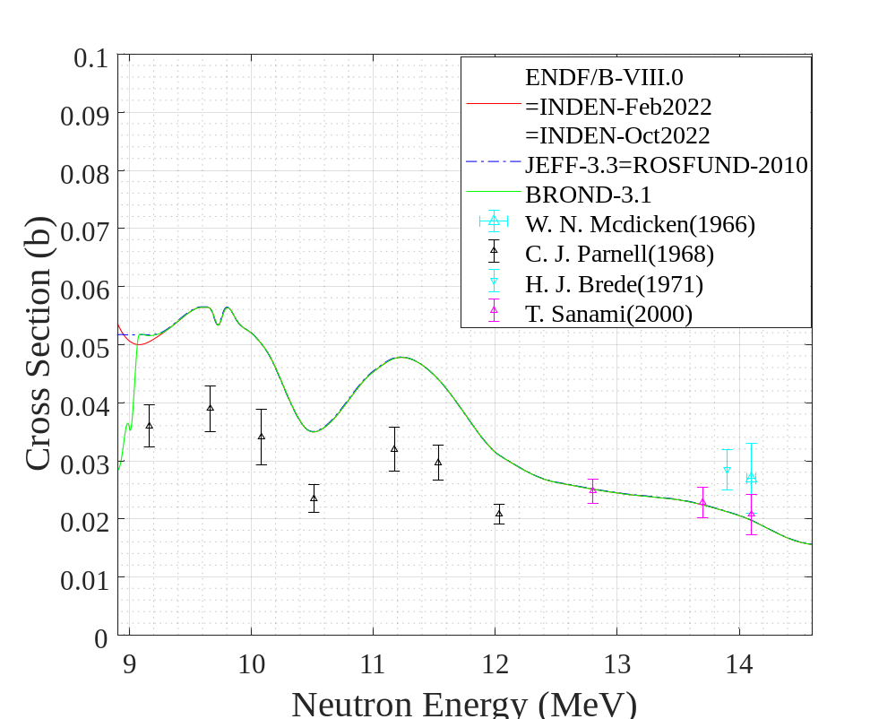
1. Introduction
research status of ¹⁶O (n, α₀)¹³C
Obvious discrepancies exist between different evaluated data and experimental data in the 5 – 9 MeV.
Above 9 MeV, the experimental data are rather rare.
The experimental data and evaluated data of ¹⁶O (n, α₀)¹³C reaction in 6.5 – 14.5 MeV
Notes:
For , oxygen-sixteen (n, α) Carbon-thirteen , obvious discrepancy existed between different evaluated data and experimental data in the 5 – 9 MeV neutron energy range, above 9 MeV, the experimental data were rather rare.

Slide 8
2. Experiments
Recently, ¹⁴N(n, α_{0,1})¹¹B and ¹⁶O(n, α₀)¹³C reactions were measured.
¹⁴N(n, α_{0,1})¹¹B: 4.53 - 5.51 MeV and 7.09 - 11.48 MeV
¹⁶O(n, α₀)¹³C : 6.89 - 11.67 MeV
The above measurements all used gas samples. For ¹⁴N(n, α₀)¹¹B reaction, solid melamine (C₃H₆N₆) samples were used at 4.59, 4.89 and 5.06 MeV neutron energy points.
Notes:
Recently, ¹⁴N(n, α_{0,1})¹¹B and ¹⁶O(n, α₀)¹³C reactions measurements were carried out . the information of them is shown here. For ¹⁴N(n, α₀)¹¹B, solid melamine (C₃H₆N₆) samples were used at three energy points.

Slide 9
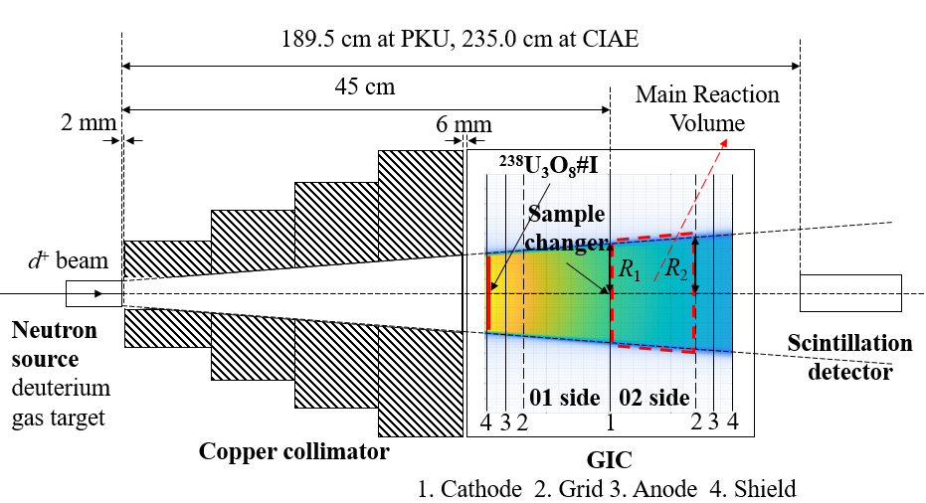
2. Experiments
2.1 Experimental setup with gas sample
D-d neutron source
Deuterium gas target
Copper collimator
Gridded ionization chamber
²³⁸U₃O₈ sample at shield of 01 side
Scintillation detector(EJ-309)
PKU: 4.5 – 5.5 MeV
CIAE: 7-12 MeV
The experimental setup with gas sample
Notes:
For experiments, the picture is the experimental setup of gas sample. The neutron source is d-d neutron source, then the neutron was collimated by Copper Collimator. The charged particle detector is Gridded ionization chamber, The sample was contained by working gas. The main reaction volume is shown in the fig. To determine of the cross section, all the variable is for main reaction volume. U target at shield of 01 side was used to get neutron fluences and Liquid Scintillation detector (EJ-309) was used to get neutron spectra. There a slightly difenerce of the loction of it between PKU and CIAE.

Slide 10
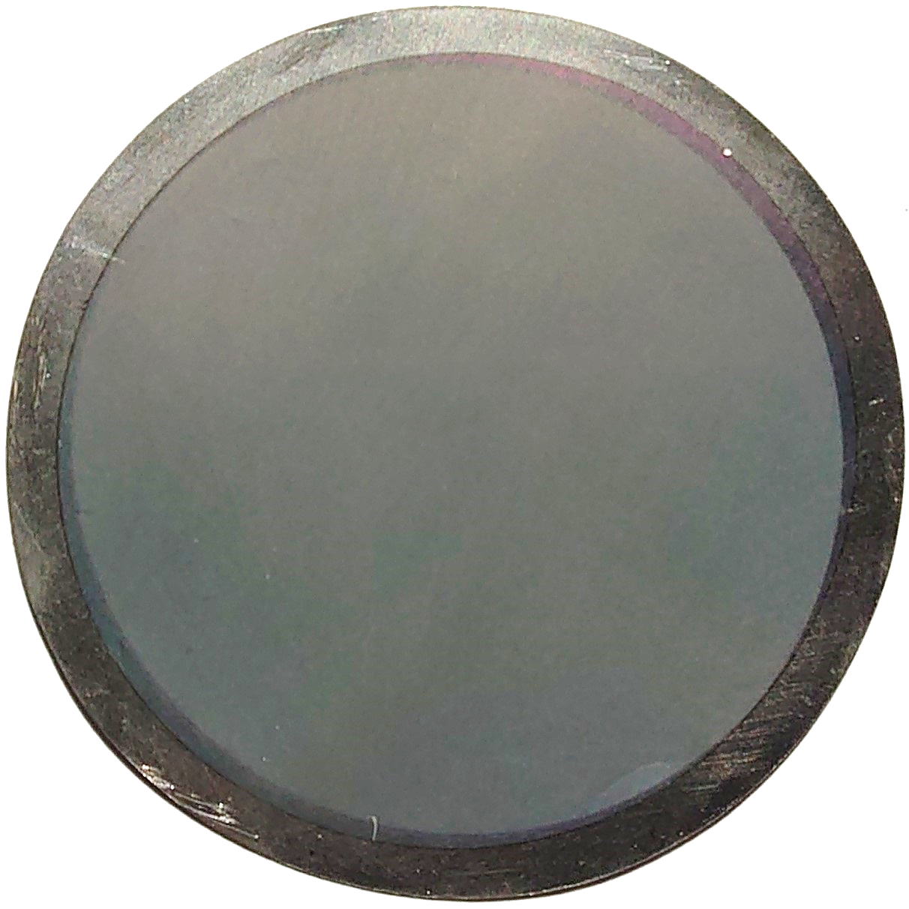
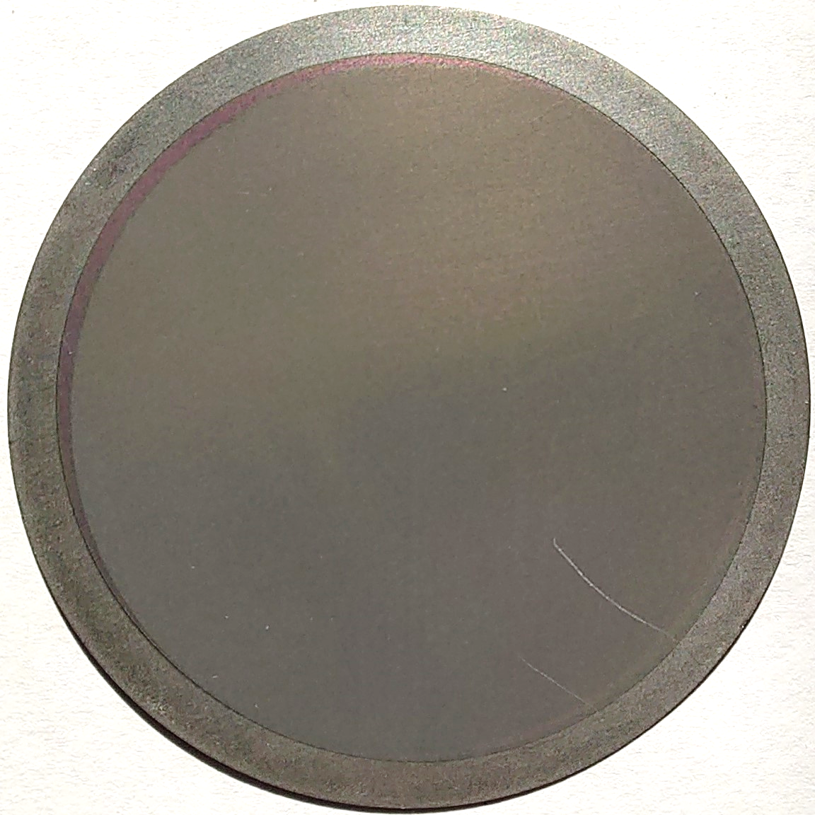
2. Experiments
structure of sample changer
2.2 Experimental setup with solid sample
1
α-sources
For ¹⁴N(n, α₀)¹¹B, solid samples were also used for validation.
α-sources
15.4 cm
Ta1
²³⁸U #2
2
5
²³⁸U₃O₈#I
Ta2
01 side
Ta5
C₃H₆N₆#I
C₃H₆N₆ #II
back-to-back samples
02 side
d⁺ beam
C₃H₆N₆#I
Ta3
C₃H₆N₆ #II
Ta4
Neutron source
deuterium gas target
1 bar
Scintillation detector
4
3
01 side
02 side
solid melamine samples
4
3
2
1
2
3
4
GIC
1. Cathode 2. Grid 3. Anode 4. Shield
The experimental setup with solid sample
C₃H₆N₆#I
C₃H₆N₆#II
Notes:
To developed the experimental method using gas samples, solid sample experiments were also carried out for (n, alpha zero) reaction of nitration.. The experimental setup is shown here and will not be repeated.
mechanical structure

Slide 11
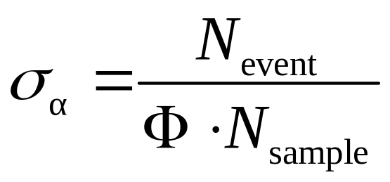
3. Data analysis
3.1 determination of the cross section
N_{event} is the number of (n, α) events
Φ is the average neutron fluence
N_{sample} is the atom number of ¹⁴N or ¹⁶O in the samples
Notes:
The cross sections were calculated with the formula. Where sigma alpha is cross section, Nevent is the number of (n, α) events, Φ is the averaged neutron fluence and N_{sample} is the atom number of ¹⁴N or ¹⁶O in the samples.

Slide 12
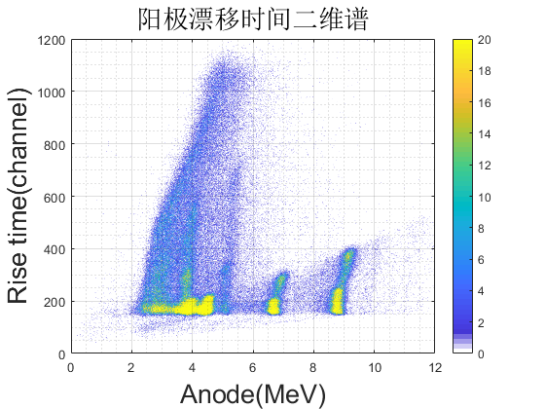
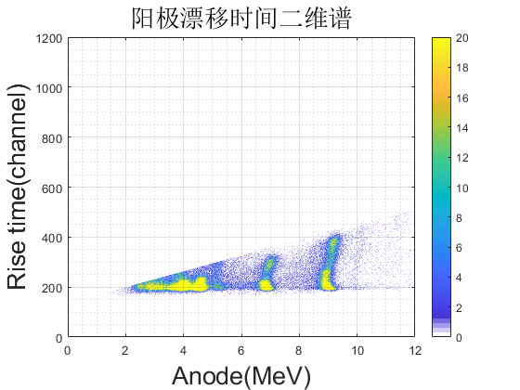
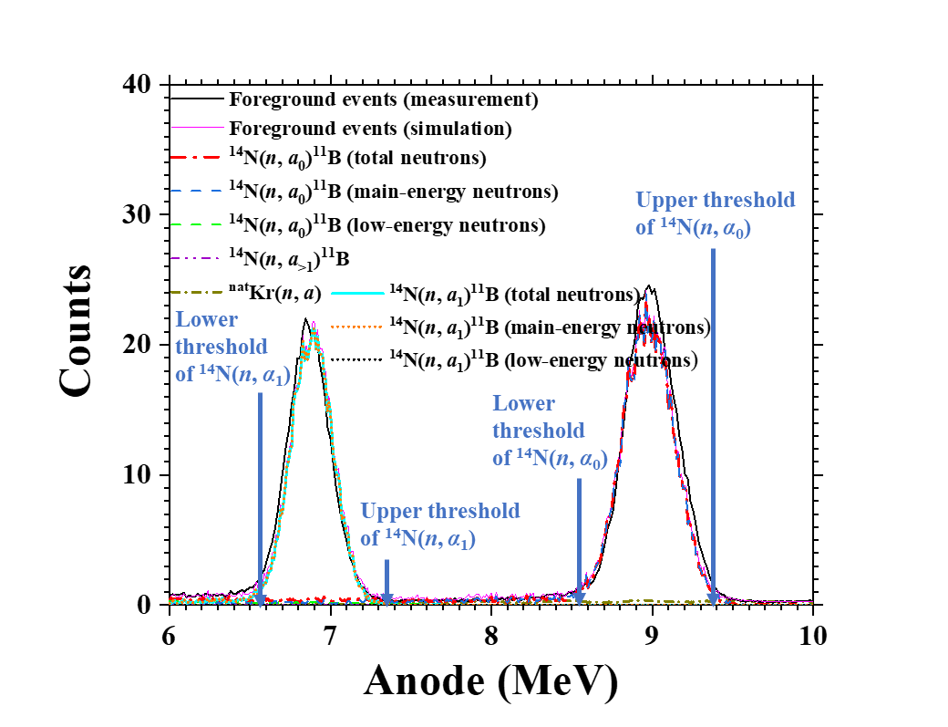
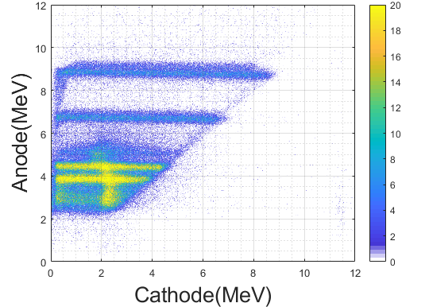
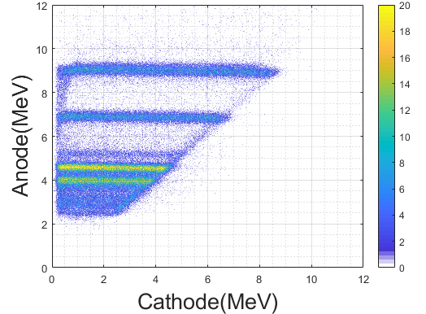
3. Data analysis
3.2 gas sample
determination of N_{event}
Use anode rise time to cut the proton background[3]
Events not within the threshold were modified by simulation
Influences of low-energy neutron and other reactions were also corrected
anode-rise time two-dimensional spectrum
anode spectrum
cathode-anode time two-dimensional spectrum
[3] V. A. Khryachkov, I. P. Bondarenko, B. D. Kuzminov, et al., Physics of Atomic Nuclei, 75, 404–410(2012).
Notes:
Then I will introduce how to get the three variable for gas sample.
To determine the N_{event,} the proton background can be cut by using anode rise time. We also used Verified simulation method to modify the Events not within the threshold and the Influences of low-energy neutron and other reactions.
This page shows some details of data processing. By data processing, We can Distinguish particles with different ionization densities by extract the rise time of anode signal, particles with low ionization densities like proton tend to have long rise time of anode signal. This can help us Distinguish alpha events from proton elastic scattering. Then the distance from grid to the position of the particle track closest to the grid as this picture shows can be extracted. Combined with measurement and simulation, The events occurred too close to grid or cathode that may cannot generate correct anode signal amplitude is able to be modified. The interference from other reactions or low energy neutrons can also be thought about.
This page describes how to select the event, which is very clearly. And the page also shows the neutron spectra, it can be seen that low energy neutron is existing. The low energy neutron will influence both alpha events an fission events.

Slide 13
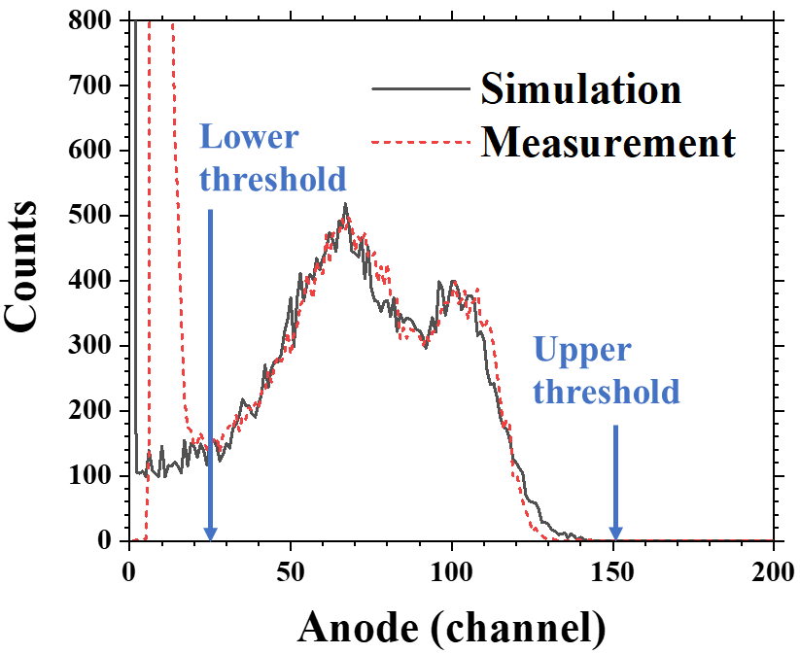
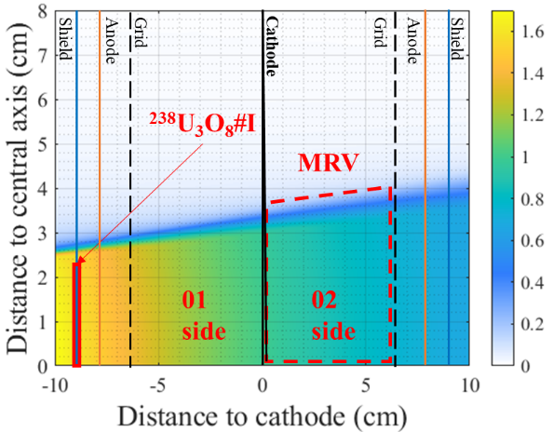
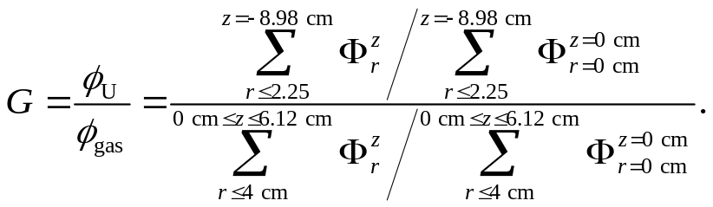
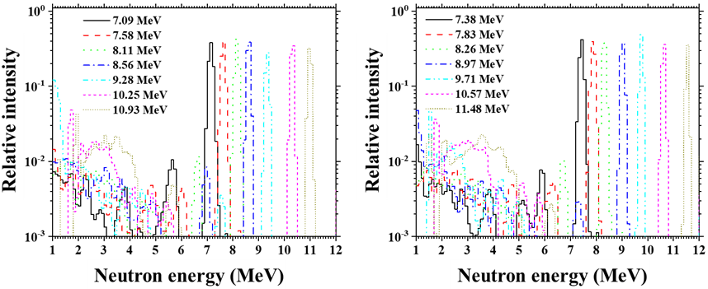
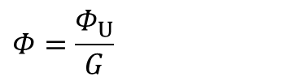
3. Data analysis
determination of Φ
$$Φ=\frac{Φ_{U}}{G}$$
Φ_{U}: the average neutron fluences of the ²³⁸U₃O₈ (determined by fission events)
anode spectrum of fission
Simulation of neutron fluences
G: the ratio of the average neutron fluences in the MRV area to that of the ²³⁸U₃O₈ sample(determined by simulation)
Influences of low-energy neutron were corrected
neutron energy spectra
Notes:
Φ can be calculated by $Φ_{U}$ and G. Φ_{U}: the average neutron fluences of the ²³⁸U₃O₈ (determined by fission events) G: the ratio of the average neutron fluences in the MRV area to that of the ²³⁸U₃O₈ sample(determined by simulation). The MRV is main reaction volume.
Influences of low-energy neutron were corrected. This page shows the neutron energy spectra measured by Scintillation detector of some energy points, and low-energy neutrons can be found here.
This page shows some details of data processing. By data processing, We can Distinguish particles with different ionization densities by extract the rise time of anode signal, particles with low ionization densities like proton tend to have long rise time of anode signal. This can help us Distinguish alpha events from proton elastic scattering. Then the distance from grid to the position of the particle track closest to the grid as this picture shows can be extracted. Combined with measurement and simulation, The events occurred too close to grid or cathode that may cannot generate correct anode signal amplitude is able to be modified. The interference from other reactions or low energy neutrons can also be thought about.
This page describes how to select the event, which is very clearly. And the page also shows the neutron spectra, it can be seen that low energy neutron is existing. The low energy neutron will influence both alpha events an fission events.

Slide 14
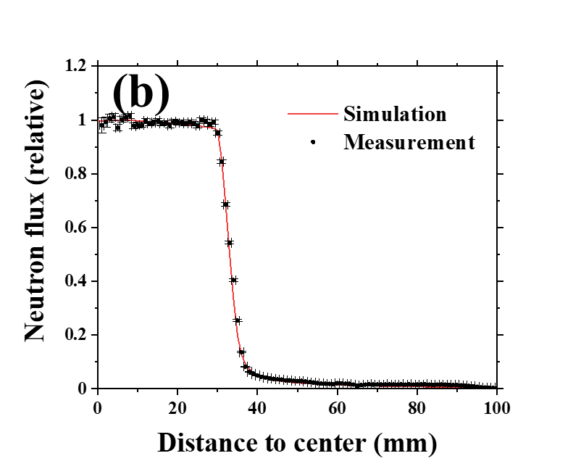
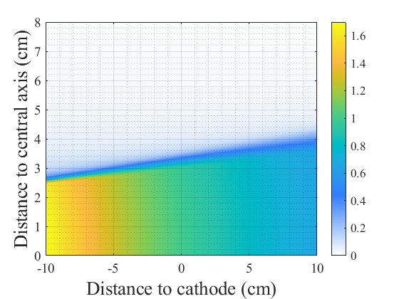
3. Data analysis
determination of N_{sample}
Because the shielding of the collimator is incomplete, reaction could occur out of MRV, N_{sample} was modified by simulation.
the atom number of ¹⁴N or ¹⁶O in MRV
4
3
2
1
2
3
4
GIC
1. Cathode 2. Grid 3. Anode 4. Shield
The simulation and measurement neutron fluences of location of cathode
To determine the N_{sample}
Notes:
The N_{sample} is the atom number of ¹⁴N or ¹⁶O in MRV. But Because the shielding of the collimator is incomplete, reaction could occur out of MRV, N_{sample} was modified by simulation. The left picture shows The simulation and measurement neutron fluences of location of cathode, The simulation and experimental results showed a good agreement.
Fast neutron radiography with imaging plates, MCNP

Slide 15
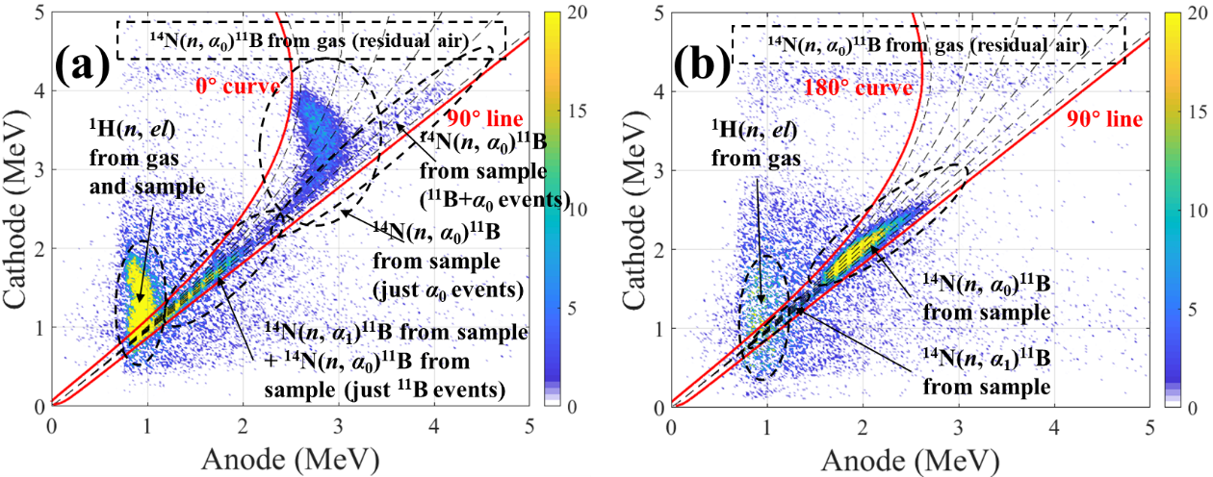
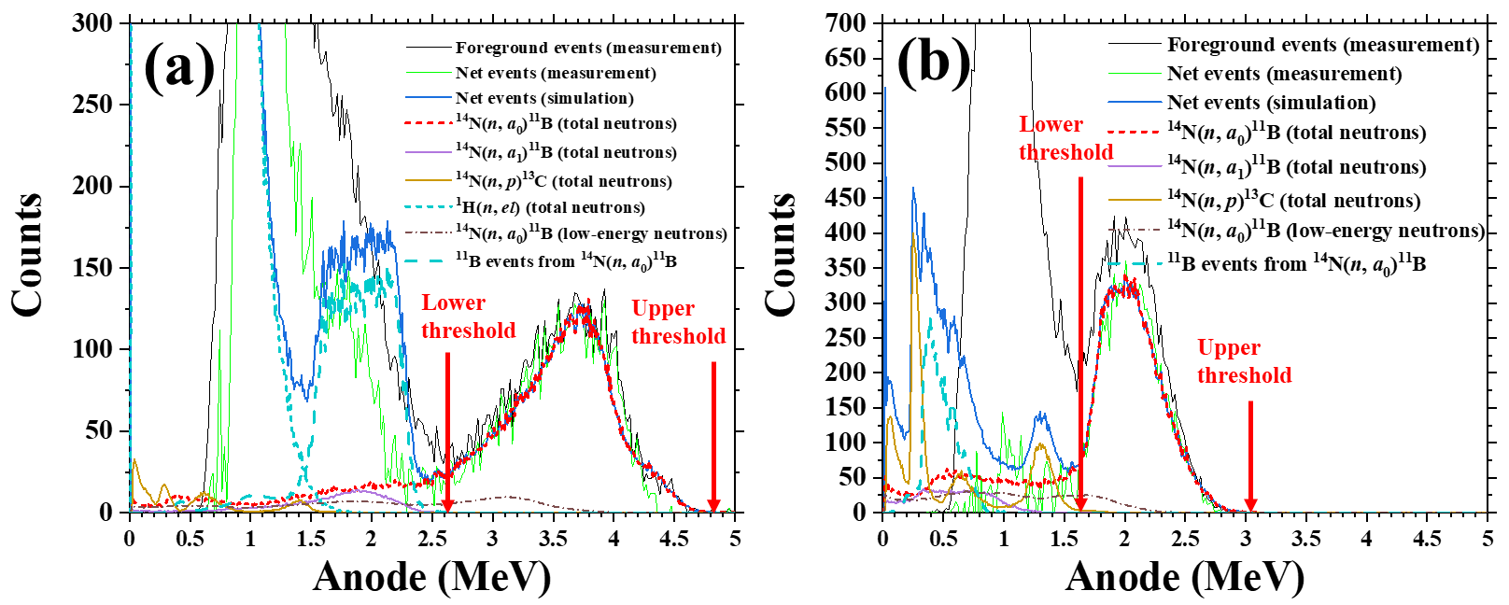
3. Data analysis
3.3 solid sample
determination of N_{event}
Events not within the threshold were modified by simulation
Influences of low-energy neutron and other reactions were also corrected
The determination method of Φ and N_{sample} can be found Ref. 4.
The cathode-anode two-dimensional spectrum and anode spectrum after background subtraction in the (a) forward direction (02 side, 0° - 90°) and (b) backward direction (01 side, 90° - 180°) at E_{n} = 4.59 MeV
[4] H. Y. Jiang, Z. Q. Cui, Y. W. Hu, et al., Chinese Physics C, 44, 114102(2020).
Notes:
This page shows how to determine the N_{event}, The event area is clearly visible both on forward direction and backward direction. in the same way, Events not within the threshold and Influences of low-energy neutron and other reactions were modified. For The determination method of Φ and N_{sample} ,the Ref. 4. has a detailed explanation, so I will not repeated here.
This page shows the event area of Nitrogen-forteen (n, alpha zero and one) boron reactions at cathode-anode two-dimensional spectra. The event area is clearly visible both on forward direction and backward direction.

Slide 16
4. Results
4.1 Cross sections of ¹⁴N(n, α_{0,1})¹¹B in the 4.53 – 5.51 MeV range[5]
The ¹⁴N(n, α₀)¹¹B reaction data measured using the two methods of gas and solid samples are consistent within the error ranges.
The cross sections of ¹⁴N(n, α₀) ¹¹B and ¹⁴N(n, α₁) ¹¹B in the 4.53 – 5.51 MeV with gas sample
The cross sections of ¹⁴N(n, α₀) ¹¹B in the 4.59 – 5.06 MeV with solid sample
E_{n} (MeV) | σ_{α0} (mb) | σ_{α1} (mb)
4.53 ± 0.05 | 309.9 ± 18.6 | 32.4 ± 3.9
4.59 ± 0.05 | 323.7 ± 24.2 | 34.0 ± 4.3
4.66 ± 0.05 | 267.6 ± 15.7 | 36.4 ± 4.4
4.78 ± 0.04 | 205.6 ± 16.5 | 40.3 ± 5.1
4.88 ± 0.04 | 184.6 ± 13.6 | 43.5 ± 5.4
4.96 ± 0.03 | 199.4 ± 14.8 | 43.9 ± 5.4
5.06 ± 0.03 | 242.9 ± 18.3 | 51.4 ± 6.3
5.15 ± 0.04 | 213.3 ± 14.2 | 51.5 ± 6.2
5.31 ± 0.03 | 111.9 ± 8.6 | 56.5 ± 6.9
5.51 ± 0.03 | 66.5 ± 7.8 | 54.5 ± 6.9
E_{n}(MeV) | σ_{α0} (mb)
4.59 ± 0.09 | 308.3 ± 17.8
4.89 ± 0.07 | 178.5 ± 9.7
5.06 ± 0.07 | 230.3 ± 10.2
[5] Y. W. Hu, Y. M. Gledenov, Z. Q. Cui, et al., to be submitted.
Notes:
Then, I’ll show our results. This page shows the results of ¹⁴N(n, α_{0,1})¹¹B reaction in the 4.53 – 5.51 MeV, in addition, The cross sections of ¹⁴N(n, α₀) ¹¹B with solid sample are also showed here.
This page shows Cross sections of Nitrogen-fourteen (n, alpha zero and alpha one ) boron eleven in the 4.53 – 5.51 MeV. In this neutron range, (n, alpha zero) reaction was measured using the two methods. The results of gas and solid samples are consistent within the error ranges.
The data from 01 side were also analyzed, and the results are close.
For (n, alpha zero), In general, our results are in good agreement with the evaluated data from JEF-2.2. However, our results are 2.33 times larger than the latest results measured by V. A. Khryachkov.
For (n, alpha one), our results are not clearly agreement with any evaluated data. Below 5 MeV, our results tend to be in agreement with the evaluated data from ENDFB eight point zero, and above 5 MeV, our results become higher and tend to be in agreement with the evaluated data from JENDL and FENDL.

Slide 17
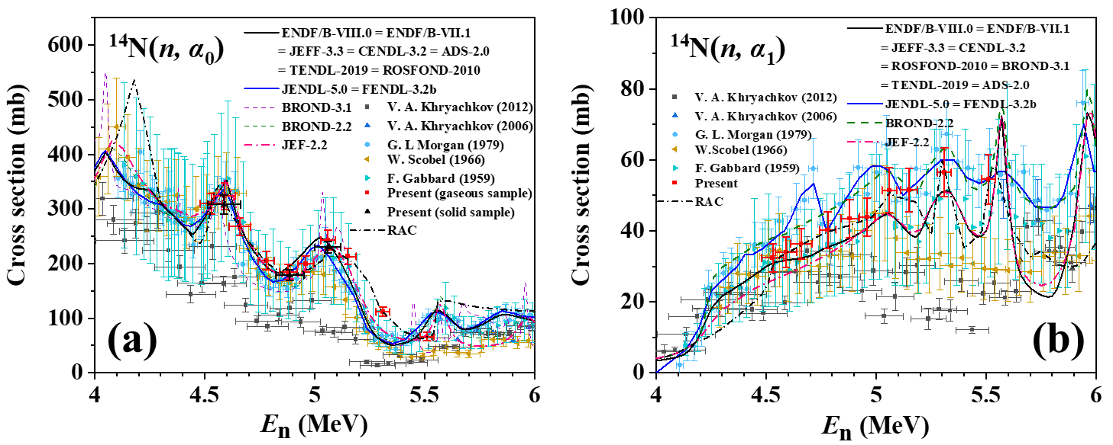
4. Results
gas sample: red square dots; solid sample: black triangle dots
The RAC analysis was also carried out by prof. Chen shown in the picture(black dash-dotted line).
The cross section of (a) ¹⁴N(n, α₀) ¹¹B and (b) ¹⁴N(n, α₁) ¹¹B in the 4.53 – 5.51 MeV
[4] Y. W. Hu, Y. M. Gledenov, Z. Q. Cui, et al., to be submitted.
Notes:
This page shows The present experimental data compared with existing measurements and evaluations
For (n, alpha zero), In general, our results are in good agreement with the evaluated data from JEF-2.2. However, our results are 2.33 times larger than the latest results measured by V. A. Khryachkov.
For (n, alpha one), our results are not clearly agreement with any evaluated data. Below 5 MeV, our results tend to be in agreement with the evaluated data from ENDFB eight point zero, and above 5 MeV, our results become higher and tend to be in agreement with the evaluated data from JENDL and FENDL.

Slide 18
4. Results
4.2 Cross sections of ¹⁴N(n, α_{0,1})¹¹B in the 7.09 – 11.48 MeV range[6]
The cross section of ¹⁴N(n, α₀) ¹¹B and ¹⁴N(n, α₁) ¹¹B in the 7.09 – 11.48 MeV
E_{n} (MeV) | σ_{α0} (mb) | σ_{α1} (mb)
7.09 ± 0.09 | 62.6 ± 4.1 | 34.5 ± 4.2
7.38 ± 0.08 | 66.9 ± 5.6 | 49.7 ± 4.1
7.58 ± 0.08 | 50.8 ± 4.6 | 48.1 ± 3.3
7.83 ± 0.08 | 42.6 ± 4.0 | 46.7 ± 2.9
8.11 ± 0.07 | 55.9 ± 5.7 | 30.3 ± 3.7
8.26 ± 0.08 | 43.3 ± 3.9 | 23.5 ± 3.3
8.56 ± 0.07 | 33.1 ± 4.0 | 21.5 ± 2.8
8.97 ± 0.08 | 31.5 ± 3.0 | 21.4 ± 2.2
9.28 ± 0.07 | 33.7 ± 3.8 | 22.3 ± 2.6
9.71 ± 0.06 | 36.1 ± 4.5 | 26.7 ± 2.7
10.25 ± 0.07 | 44.6 ± 5.5 | 27.3 ± 2.6
10.57 ± 0.06 | 32.9 ± 4.3 | 20.6 ± 1.8
10.93 ± 0.07 | 44.3 ± 5.9 | 22.8 ± 2.5
11.48 ± 0.05 | 28.0 ± 4.6 | 15.2 ± 2.5
[6] Y. W. Hu, Y. M. Gledenov, J. Liu, et al., to be submitted.
Notes:
This page shows the results of ¹⁴N(n, α_{0,1})¹¹B reaction in the 7.09 – 11.48 MeV.
This pages shows Cross sections of Nitrogen-fourteen (n, alpha zero and alpha one ) boron eleven in the 7.09 – 11.48 MeV.
For (n, alpha zero), in general our results are in agreements with evaluated data from JENDL and ENDF,
For (n, alpha one), our results are between evaluated data form ENDF and JENDL.////. 78.28% of evaluated data from JENDL are shown in fig(b) and our results show a good agreement.
It is important to note that our results of both (n, alpha zero) and (n, alpha one) have a decrease near 10.5 MeV. All the evaluated data and previous experimental data do not found the phenomenon. But The same structure also exists in neutron total cross section and elastic scattering cross section. This is a support for our discovery.

Slide 19
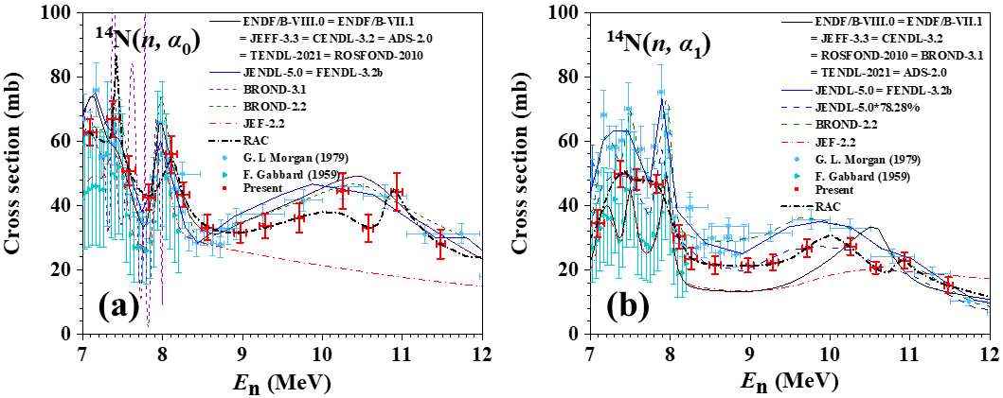
4. Results
Our results: red square dots
The RAC analysis was also carried out by prof. Chen shown in the picture(black dash-dotted line).
The cross section of (a) ¹⁴N(n, α₀) ¹¹B and (b) ¹⁴N(n, α₁) ¹¹B in the 7.09 – 11.48 MeV
[5] Y. W. Hu, Y. M. Gledenov, J. Liu, et al., to be submitted.
Notes:
For (n, alpha zero), in general our results are in agreements with evaluated data from JENDL and ENDF,
For (n, alpha one), our results are between evaluated data form ENDF and JENDL.
It is important to note that our results of both (n, alpha zero) and (n, alpha one) have a decrease near 10.5 MeV. All the evaluated data and previous experimental data do not found the phenomenon. But The same structure also exists in neutron total cross section and elastic scattering cross section. This is a support for our discovery.

Slide 20
4. Results
4.3 Cross sections of ¹⁶O(n, α₀)¹³C in the 6.89 – 11.67 MeV range[6]
The cross section of ¹⁶O(n, α₀) ¹³C in the 6.89 – 11.67 MeV*
E_{n} (MeV) | σ_{α0} (mb)
6.89 ± 0.10 | 146.1
7.33 ± 0.09 | 207.4
7.93 ± 0.08 | 72.1
8.42 ± 0.07 | 59.1
8.48 ± 0.06 | 62.0
8.85 ± 0.08 | 74.4
9.28 ± 0.07 | 47.1
9.63 ± 0.07 | 63.8
9.87 ± 0.06 | 41.5
10.45 ± 0.08 | 71.7
10.80 ± 0.05 | 61.3
11.15 ± 0.07 | 62.1
10.67 ± 0.07 | 59.0
* Preliminary results. The uncertainty was estimated to be approximately 8% -12% which needs further analysis.
[6] Y. W. Hu, Y. M. Gledenov, J. Liu, et al., to be submitted.
Notes:
This page shows the results of ¹⁶O(n, α₀)¹³C reaction in the 6.89 – 11.67 MeV. The results are preliminary. The uncertainty was estimated to be approximately 8% -12% which needs further analysis.
This pages shows Cross sections of Nitrogen-fourteen (n, alpha zero and alpha one ) boron eleven in the 7.09 – 11.48 MeV.
For (n, alpha zero), in general our results are in agreements with evaluated data from JENDL and ENDF,
For (n, alpha one), our results are between evaluated data form ENDF and JENDL.////. 78.28% of evaluated data from JENDL are shown in fig(b) and our results show a good agreement.
It is important to note that our results of both (n, alpha zero) and (n, alpha one) have a decrease near 10.5 MeV. All the evaluated data and previous experimental data do not found the phenomenon. But The same structure also exists in neutron total cross section and elastic scattering cross section. This is a support for our discovery.

Slide 21
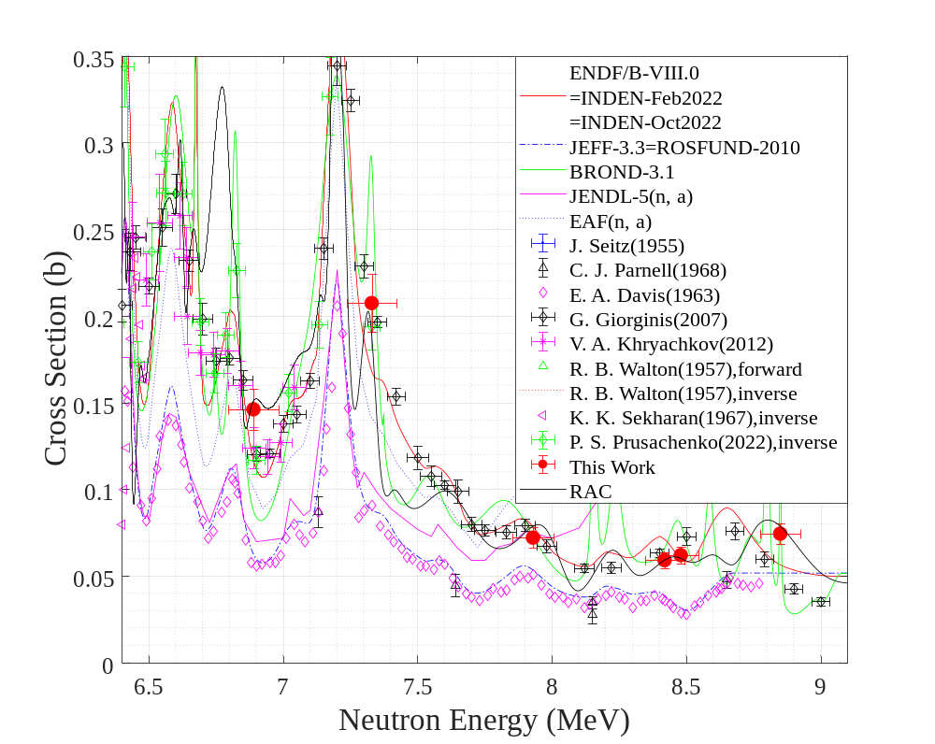
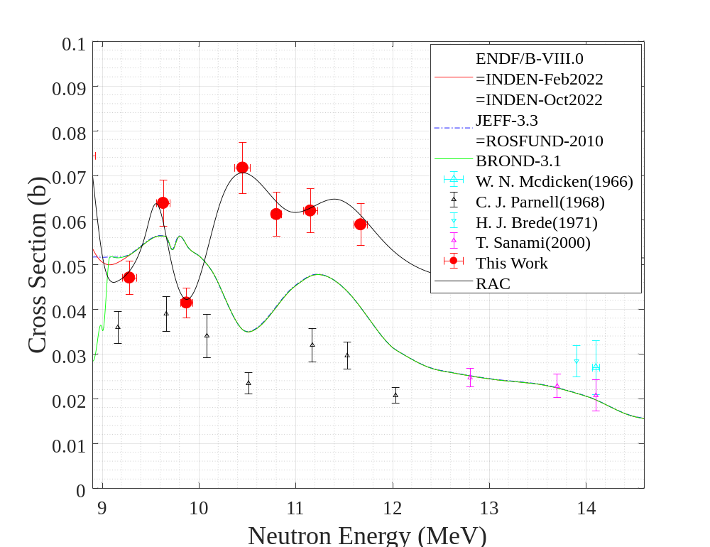
4. Results
Our results: red round dots
The RAC analysis was also carried out by prof. Chen shown in the picture(black dash-dotted line).
The ¹⁶O(n, α₀) ¹³C cross section in the (a) 6.4 – 9.1 MeV and (b) 8.9 – 14.6 MeV
Notes:
This page shows The present experimental data compared with existing measurements and evaluations
For ¹⁶O(n, α₀)¹³C reactions, Below 9 MeV, our results are in agreements with evaluated data from ENDF and closed to Recent measurements of gioginis, above 9 MeV, our results are not in agreements with any evaluated data or previous experimental data.

Slide 22
4. Results
4.3 Uncertainty analysis for ¹⁴N(n, α_{0,1})¹¹B
In 4.53 - 5.51 MeV
ρ^{low} of ¹⁴N(n, α₀)¹¹B: low-energy neutron’s interference
k of ¹⁴N(n, α₁)¹¹B: interference of ¹⁴N(n, α₀)¹¹B
In 7.09 - 11.48 MeV
ε^{amp} _{α} of ¹⁴N(n, α₀)¹¹B and ¹⁴N(n, α₁)¹¹B: wall effect
k of ¹⁴N(n, α₀)¹¹B and ¹⁴N(n, α₁)¹¹B: reaction of krypton
Sources of the uncertainty and their magnitudes for the gas sample in 4.53-5.51 MeV
Sources of the uncertainty and their magnitudes for the gas sample in 7.09 - 11.48 MeV
Source | Magnitude | Source | Magnitude
 | ¹⁴N(n, α_{0,1})¹¹B |  | ¹⁴N(n, α₀)¹¹B | ¹⁴N(n, α₁)¹¹B
σ_{f} | 0.7 ~ 0.8 | ε^{amp} _{α} | 1.2 ~ 2.1 | 0.9 ~ 2.6
G | 1.0 | ε^{dis} _{α} | 0.5 ~ 1.7 | 0.2 ~ 1.3
N_{U} | 1.0 | W | 0.1 ~ 2.1 | 0.1 ~ 2.1
N^{MRV} _{t} | 1.2 | N_{α} | 1.0 ~ 1.4 | 1.7 ~ 2.2
N_{f} | 2.4 ~ 3.2 | ρ^{low} | 1.9 ~ 10.1 | 1.1 ~ 3.2
ε_{f} | 1.7 | k | 0.0 | 10.4 ~ 10.7
Source | Magnitude | Source | Magnitude
 | ¹⁴N(n, α_{0,1})¹¹B |  | ¹⁴N(n, α₀)¹¹B | ¹⁴N(n, α₁)¹¹B
σ_{f} | 0.8 ~ 1.1 | ε^{amp} _{α} | 4.8 ~ 15.5 | 2.2 ~ 10.1
G | 1.0 | ε^{dis} _{α} | 0.1 ~ 1.4 | 0.1 ~ 1.5
N_{U} | 1.0 | W | 0.1 ~ 1.6 | 0.4 ~ 3.6
N^{MRV} _{t} | 1.0 | N_{α} | 0.3 ~ 1.2 | 0.4 ~ 1.1
N_{f} | 0.1 ~ 0.7 | ρ^{low} | 0.7 ~ 3.2 | 0.7 ~ 3.2
ε_{f} | 1.7 ~ 2.6 | k | 0.6 ~ 7.1 | 1.9 ~ 13.0
Notes:
This page shows the Uncertainty analysis for the reaction of 14N. These quantities are mostly correction coefficients. Ρ^{low} is to modify the low-energy neutron’s interference, k is to modify the other reaction’s interference. So In 4.53 - 5.51 MeV, for ¹⁴N(n, α₀)¹¹B,
The Uncertainty of ρ^{low} is a major role because of Resonance of Excitation Function. for ¹⁴N(n, α₁)¹¹B, The Uncertainty of ρ^{low} is a major role because, Because the Q-value of (n, alpha one) reaction is very low, so it easy to be covered by ¹⁴N(n, α₀)¹¹B.
In 7.09 - 11.48 MeV, the ε^{amp} _{α} and k are the major Uncertainty source, the former is because the serious wall effect, and the latter is because the reaction of krypton.
there are some certain neutron energies existing, Near these neutron energies, the cross section of the reaction may very high, so these events may cause significant interference. For coefficient k, Because the Q-value of (n, alpha one) reaction is very low, so it easy to be covered by other reactions

Slide 23
5. Conclusion
A measurement method has been established for gas samples.
Cross sections of the ¹⁴N(n, α_{0,1})¹¹B reactions in the 4.53 - 5.51 MeV and 7.09 - 11.48 MeV energy range were obtained.
Cross sections of the ¹⁶O(n, α₀)¹³C reactions in the 6.89 - 11.67 MeV energy range were obtained.
Notes:
The conclusions are shown here.
We established A measurement method for gas samples and The method has been validated.
for Nitrogen-fourteen (n, alpha zero and alpha one ) boron eleven, the Cross sections in the 4.53 - 5.51 MeV and 7.09 - 11.48 MeV energy range were obtained.
For oxygen sixteen (n, alpha zero) carbon thirteen , Cross sections of this reactions in the 6.89 – 11.67 MeV energy range were obtained.

Slide 24
Future Plan
Measurement of ¹⁹F(n, α)¹⁶N and ²⁰Ne(n, α)¹⁷F reactions
Measurement of ¹⁶O(n, α_{1,2,3})¹³C reactions
Theoretical analysis of neutron induced light nuclear reactions
Thank you!
Notes:
in the future, We will measure fluorine nineteen (n, α) Nitrogen-sixteen and neon twenty (n, α) fluorine seventeen reactions
We will also measure oxygen sixteen (n, alpha one two and three) carbon thirteen reactions
based on the results, we will try to carry out Theoretical analysis.

