Slide 1
Status Report of MSU Data Center for the period of May 2021 – Oct 2022
Jun Chen
2022 NSDD meeting, ANU
October 24-28, 2022

Slide 2
Overview
Grant status (funded by US DOE since 2017):
Current budget cycle: 15 December to 14 December
Renewal is under review
Current personnel (since 2017, 1FTE)
Hiro Iwasaki (line-manager)
Jun Chen (PI, 1 FTE)
Responsibilities:
ENSDF evaluation (A=31-44 and 60-73 except 62,67-70)
XUNDL compilation including data check for PRC and EPJA manuscripts
Development and modernization of ENSDF codes
Data support to FRIB users via the FRIENDS project

Slide 3
ENSDF evaluation at MSU
Current mass region:
A=31 to 44, 60 to 73 except 62,67-70
All are in the region of FRIB research interest
Task for FY22:
other: review of 2 mass chains (done)
Plan for FY23
A=33, 80 and 151 with B. Singh
Review of 1 mass-chain
A | # nuclides | # datasets | # lines | #Adopted Levels | #Adopted Gammas | Evaluators | status
A=32 | 9 | 102 | 17,252 | 787 | 1032 | J. Chen | in review
A=44 | 12 | 115 | 13,312 | 798 | 723 | J. Chen, B. Singh | in review
A=165 | 18 | 86 | ~21,011 | ~1325 | ~2322 | B. Singh, J. Chen | to be submitted by Oct31

Slide 4
XUNDL compilation at MSU
All compilations since 2014:
  913 data sets/457 papers for 667 nuclides
Compilations in FY22:
95 datasets from 40 papers, including 36 datasets/20 papers for PRC data checking
Plan for FY23:
continue prior-publication data checking
continue to recruit top MSU undergraduates to strengthen the involvements of MSU students in the nuclear data program

Slide 5
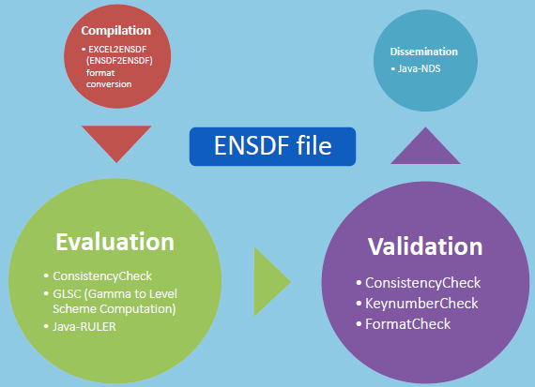


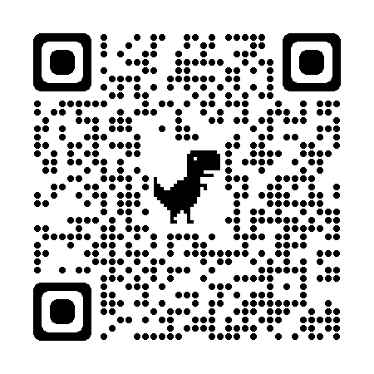
Java codes for ENSDF evaluation
To streamline and automate evaluation process, ensure evaluation quality and improve evaluation efficiency
  McMaster-MSU Java-NDS
  ConsistencyCheck
  KeynumberCheck
  Java-RULER
  Excel2ENSDF
  AME-NUBASE viewer
  GLSC(Gamma to Level Scheme Computation: GTOL+GABS*)
  RadiationReport (LOGFT+RADLIST*)
  AlphaHF (ALPHAD+RadD*)
All codes are available at IAEA NSDD GitHub: https://github.com/IAEA-NSDDNetwork

Slide 6

The FRIENDS project at FRIB
FRIB Integral Experimental Nuclear Data Services
aiming to provide seamless support for data needs to FRIB experimenters throughout all stages of an experimental work
as an integral part of the FRIB experimental support
Proposal Preparation
Up-to-date datasets
Data Taking
Fully customized data search
Data Analysis
Help on use of data tools
Publication Preparation
Prior publication data check
Consultation and discussion
researchers
data evaluators
FRIENDS

Slide 7

Current cycle of experimental nuclear structure & decay data
:
experimental nuclear databases & services:
XUNDL
ENSDF
NUDAT
Nuclear Data Sheets
use
database
build
database
researchers
data evaluators
contribute
new data
Base of all:
Published Data
compile &
evaluate data

Slide 8
Better cycle of experimental nuclear structure & decay data
experimental nuclear databases & services
researchers
data evaluators
FRIENDS
Base of all:
Published Data

Slide 9

The FRIENDS project at FRIB
FRIB Integral Experimental Nuclear Data Services
Proposal Preparation
Proposal Preparation
Data Taking
Data Analysis
Publication Preparation
provides users with up-to-date data sets and references for nuclides of interest:
• all evaluated (ENSDF) and unevaluated (XUNDL) data up to date, covering most recent published data compiled but not included in the databases yet.
• data copies from references not available online (old journal papers, proceedings, lab reports, theses).
provides users with consultation and discussion on issues and gaps in existing data and on other data needs, such as survey of experimental methods, uncertainty budgets.

Slide 10
The FRIENDS project at FRIB
FRIB Integral Experimental Nuclear Data Services
Data Taking
Proposal Preparation
Data Taking
Data Analysis
Publication Preparation
provides users with customized search for any existing structure and decay data in ENSDF and XUNDL, like,
• spectroscopic properties (level, gamma and decay properties, such as T1/2, Mult.)
• experimental methods (for lifetimes, B(E2), spin-parity assignments)
• experiment facilities and reaction types
This service will be available once the experimental schedule is published on the FRIB webpage and the spokespeople will be contacted for their needs by the data scientist at FRIB.

Slide 11
The FRIENDS project at FRIB
FRIB Integral Experimental Nuclear Data Services
Data Analysis
Proposal Preparation
Data Taking
Data Analysis
Publication Preparation
provides help on use of data tools useful for data analysis
• GLSC (Gamma to Level Scheme Computation code)
• RULER (gamma-transition strength calculator)
• LOGFT (beta decay and electron capture log ft and decay energy calculator)
• ALPHAD_RAD (alpha decay hindrance-factor and charge radius calculator)
• AME_NUBASE (Atomic Mass Evaluation and NuBASE retrieval tool)
• other tools: see all ENSDF analysis and utility tools hosted at the IAEA Nuclear Data Services webpage: https://wwwnds.iaea.org/public/ensdf_pgm/

Slide 12
The FRIENDS project at FRIB
FRIB Integral Experimental Nuclear Data Services
Publication Preparation
Proposal Preparation
Data Taking
Data Analysis
Publication Preparation
provides users with prior-publication check on data to be published for consistency, correctness, validity, currency, format and presentation, in comparisons with existing data in ENSDF and XUNDL databases.
provides users with explanations on rules, policies and procedures for evaluated and recommended data, such as, rules and arguments (strong and weak) for spin-parity assignments, gamma-ray multipolarity assignments, averaging methods, uncertainty propagation approaches.
FRIENDS has also served to review experimental structure and decay data in proposals submitted to FRIB PAC1

